Slide 1
Draw a penny in the top right of your paper.
Do you think you will be able to remember this set of numbers by the end of this class?
7 4 8 2 9 9 6 3 1 5

Slide 2
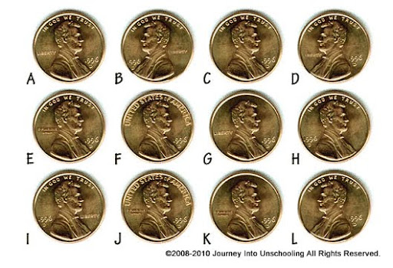
Which penny does yours look like?

Slide 3
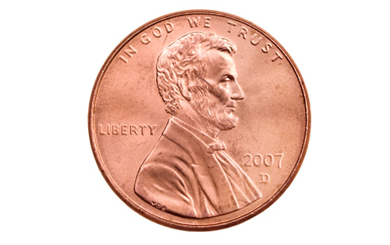
It was A

Slide 4
Cognition
Taken from all different places on the internet and mashed up together.
We are now hitting the cognition section of the book to include: memory, thinking and language.
Cognition: all the mental activities associated with thinking, knowing, and remembering information.

Slide 5
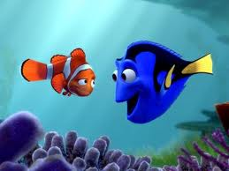
Ch. 10
Memory: is your capacity to register, store, and recover information over time, or more simply, the persistence of learning over time.

Slide 6
How does memory work
We use different “models” to explain memory.
Information Processing Model:
Three Stage Model

Slide 7
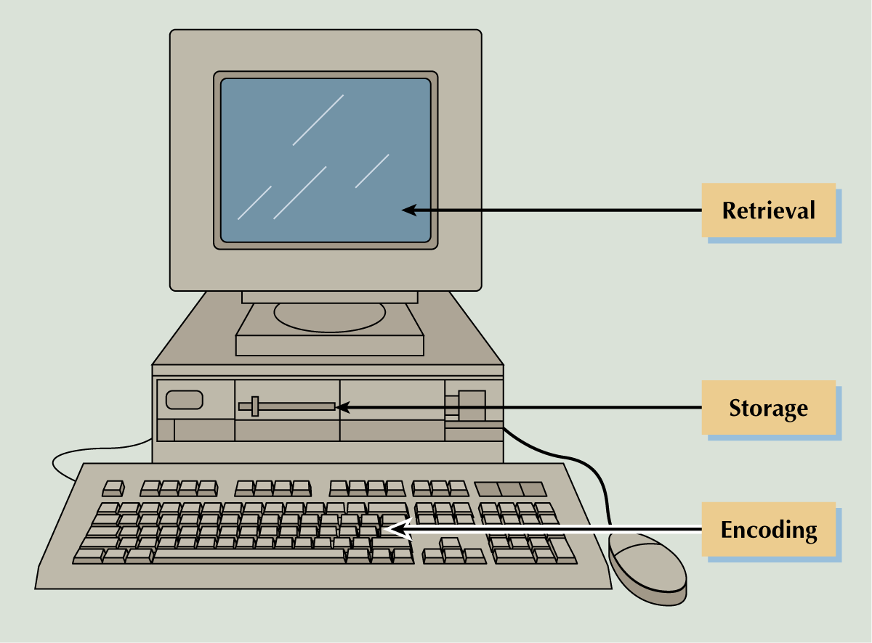
Information Processing Model: compares our memory to a computer
3 Step Process in how Memory Works
Three step process….
Encoding: The processing of information into the memory system.
Storage: The retention of encoded material over time.
Retrieval: The process of getting the information out of memory storage.

Slide 8
Encoding
Spacing Effect
http://www.psychbytes.com/Flash/Encoding/Encoding.htm
We encode better when we study or practice over time.
DO NOT CRAM!!!!!
The ways we encode:
Visual Encoding: the encoding of picture images.
Acoustic Encoding: the encoding of sound, especially the sounds of words.
Semantic Encoding: the encoding of meaning.

Slide 9
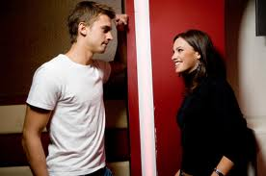
Encoding
The processing of information into the memory system. (what you do to learn something)
Typing info into a computer
Getting a girls name at a party

Slide 10
Storage
The retention of encoded material over time.
Pressing Ctrl S and saving the info.
Trying to remember her name when you leave the party.

Slide 11
Retrieval
The process of getting the information out of memory storage.
Seeing her the next day and calling her the wrong name (retrieval failure).
Finding your document and opening it up.

Slide 12
Three Stages of Memory
Three Stage Model
Atikinson-Shiffrin three-stage model of memory, describes 3 different memory systems characterized by time frames:
Stage 1 - Sensory Memory is a brief representation of a stimulus while being processed in the sensory system
Stage 2 - Short-Term Memory (STM) is working memory
  Limited capacity (7 items)
  Duration is about 30 seconds
Stage 3 - Long-Term Memory (LTM) is large capacity and long duration

Slide 13

Iconic Memory
Three Stage Model
Sensory Memory
momentary sensory memory of visual stimuli, a photograph like quality lasting only about a second.
Echoic Memory
We also have an echoic memory for auditory stimuli. If you are not paying attention to someone, you can still recall the last few words said in the past three or four seconds.
http://www.garyfisk.com/anim/iconic.swf

Slide 14
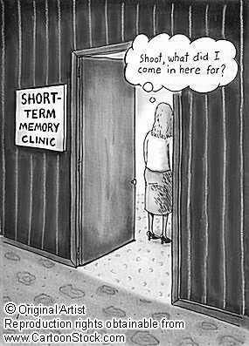
Short Term Memory
Three Stage Model
http://www.garyfisk.com/anim/lecture_stm.swf
The stuff we encode from the sensory goes to STM.
Holds about 7 (plus or minus 2) items for about 20 seconds.
We recall digits better than letters.
Short Term Memory Activity

Slide 15
Short Term Memory
Three Stage Model
Chunking:
Organizing items into familiar, manageable units.
For Example:
DVD, ESPN,
867-5309
Social Security Numbers,
CNN
Short Term Memory Activity
Notes:
Give students a list of numbers for them to write after you finish saying the number: 9754, 6419, 68259, 37148, 913825, 648327, 5963827, 86951372, 51739826, 719384273, 163862
Read numbers but not in chunking: 17761812149219411973 then chunk the numbers together as years

Slide 16
Short Term Memory
Three Stage Model
Maintance Rehearsal:
Repeating the information
Short Term Memory Activity

Slide 17
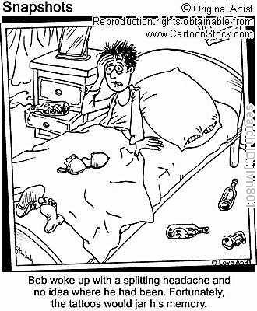
Long Term Memory
Three Stage Model
Unlimited storehouse of information.
Explicit ( or declarative) memories: our LTM of facts and experiences we consciously know and can verbalize. EG. Sematic (facts and general knowledge)and episodic (birthdays)
Implicit ( or non-declarative) memories: our long term memory for skills and procedures to do things by previous experience without that experience being consciously recalled. (Eg. Swimming.)
Short Term Memory Activity

Slide 18
Organization of memories
How information in long-term memory organized?
1. Hierarchies-systems in which concepts are arranged from more general to more specific.
2. Semantic Networks-more irregular and distorted systems with multiple links from one concept to another. EG. Bird linked to flying..feathers..wings
3. Schemas- are preexisting mental frameworks
4. Connectionist networks- memory is stored throughout the brain through neurons.

Slide 19
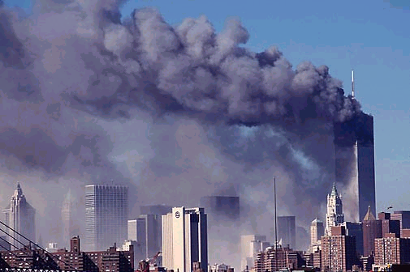
Flashbulb Memory
Biology of Long Term Memory
A clear moment of an emotionally significant moment or event.
Where were you when?
1. You heard about 9/11
2. You heard about the death of a family member
3. During the OJ chase

Slide 20


Recall Versus Recognition
Retrieving Memories
Retrieval is the process of getting information out of memory storage.
Recall
Recognition
you must retrieve the information from your memory
fill-in-the blank or essay tests
you must identify the target from possible targets
multiple-choice tests

Slide 21
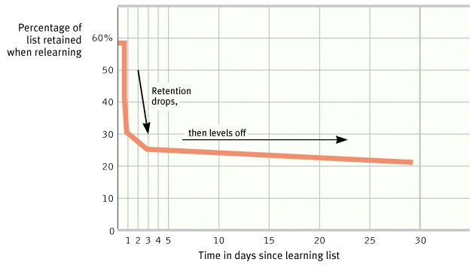
Spacing Effect
DO NOT CRAM!!!!!!!!!!!!
Ebbinghaus’s Forgetting Curve

Slide 22

Clive Wearing the Man with no short term memory.

Slide 23
Serial Position Effect get out a sheet of paper…
Name all of the presidents
Primacy effect – remembering stuff at beginning of list better than middle
Recency Effect – remembering stuff at the end of list better than middle

Slide 24
PRIMING EFFECT (don’t need)
Priming effect occurs when people respond faster or better to an item if a similar item preceded it.
For the most part, the priming effect is considered involuntary and is most likely an unconscious phenomenon. The priming effect basically consists of repetition priming and semantic priming.

Slide 25

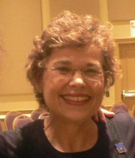
Semantic Priming (don’t need)
2. Semantic priming refers to the fact that it is easier (quicker) to recognize someone or word if you have just seen someone or a word closely associated.

Slide 26
Memory Test
http://www.exploratorium.edu/memory/dont_forget/index.html
Try at home

Slide 27
Mnemonics
A trigger to aid memory, involving prompts such as visual imagery or sounds.
Since imagery is at the heart of memory. Mnemonic techniques use vivid imagery in aiding memory.
Method of Loci
Link Method
Context Effects

Slide 28
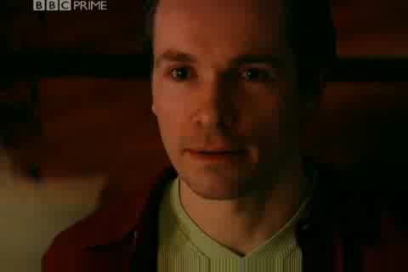
Method of Loci Get out paper

Slide 29
Context Effects
It helps to put yourself back in the same context you experienced (encoded) something.
If you study on your favorite chair at home, you will probably score higher if you also took the test on the chair.

Slide 30
If you have a strong emotional reaction to a remembered event, does that mean your memory is accurate?

Slide 31

Mood-Congruent Memory
The tendency to recall experiences that are consistent with one's current good or bad mood.
If you are depressed, you will more likely recall sad memories from you past.
Moods also effect that way you interpret other peoples behavior
My boyfriend just broke up with me and my mother told Me I couldn’t go to the party, she always tells me no.

Slide 32
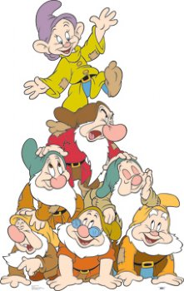
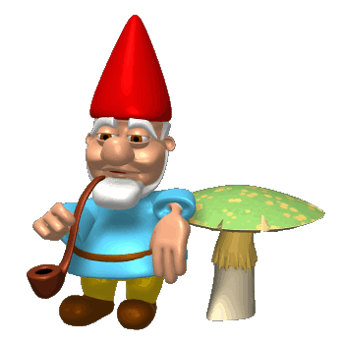
Take out a piece of paper…..
Name the seven dwarves…..
Now name them…..

Slide 33
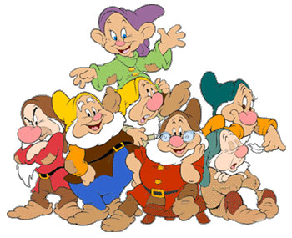
Was it easy or hard?
It depends on several things….
If you like Disney movies?
When was the last time you have seen the movie?
Are people around you being loud pain in the butts so you cannot concentrate?

Slide 34
Now pick pick out the seven dwarves.
Turn your paper over.
Grouchy Gabby Fearful Sleepy Smiley Jumpy Hopeful Shy Droopy Dopey Sniffy Wishful Puffy Dumpy Sneezy Pop Grumpy Bashful Cheerful Teach Snorty Nifty Happy Doc Wheezy Stubby Poopy

Slide 35
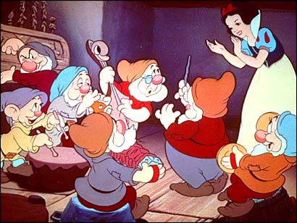
Seven Dwarves
Sleepy, Dopey, Grumpy, Sneezy, Happy, Doc and Bashful

Slide 36
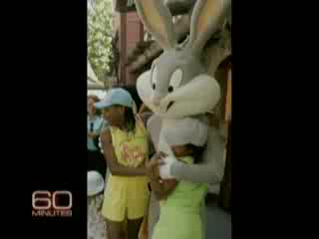
False Memories
Exclusive: The Bunny Effect
http://www.youtube.com/watch?v=eZlPzSeUDDw&feature=relmfu

Slide 37

Forgetting

Slide 38
Theories of Forgetting
Proactive interference: old information interferes with recall of new information
Retroactive interference: new information interferes with recall of old information
Decay theory: memory trace fades with time
Motivated forgetting: involves the loss of painful memories (protective memory loss)
Retrieval failure: the information is still within LTM, but cannot be recalled because the retrieval cue is absent

Slide 39
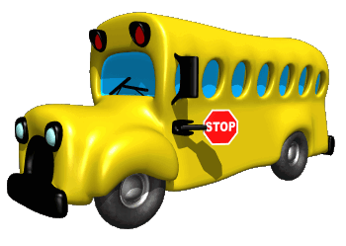
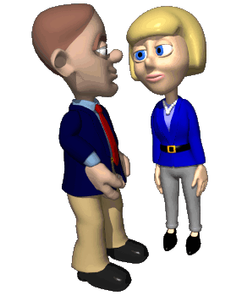
Forgetting
Getting a new bus number and forgetting old bus number.
Retroactive Interference: new information blocks out old information.
Proactive Interference: old information blocks out new information.
Calling your new girlfriend by old girlfriends name.

Slide 40

Storage Decay
Even if we encode something well, we can forget it.
Without rehearsal, we forget thing over time.
Ebbinghaus’s forgetting curve.

Slide 41
Do you remember the 10 numbers? Write them down then scroll back up to check if you were right. If you were correct then congratulations!

Slide 42
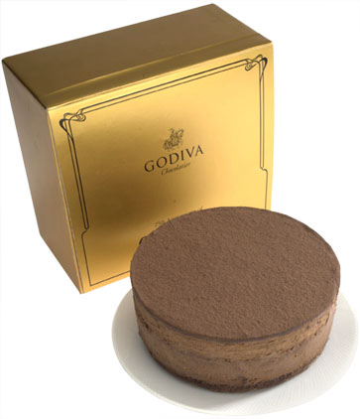
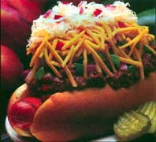
Motivated Forgetting
We sometimes revise our own histories.
Honey, I did stick to my diet today!!!!!!

Slide 43
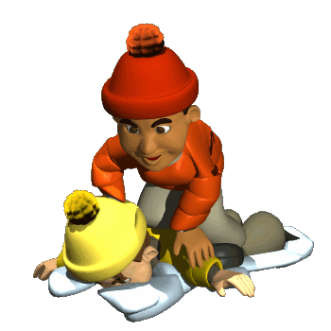
Motivated Forgetting
Why does is exist?
One explanation is REPRESSION:
in psychoanalytic theory, the basic defense mechanism that banishes anxiety-arousing thoughts, feelings and memories from consciousness.

Slide 44

My Trip To Cheesecake Factory
You go to the Cheesecake Factory for dinner. You are seated at a table with a white tablecloth. You study the menu. You tell the female server you want Avocado Egg Rolls, extra sauce, Roadslide Sliders, Thai Lettuce Wraps, and Chino-Latino Steak (medium). You also order a Cherry Coke from the beverage list. A few minutes later the server returns with your Avocado Egg Rolls. Later the rest of the meal arrives. You enjoy it all, except the Chino-Latino Steak is a bit overdone.

Slide 45
Cheesecake factory
How did you order the steak?
Was the red tablecloth checkered?
What did you order to drink?
Did a male server give you a menu?

Slide 46
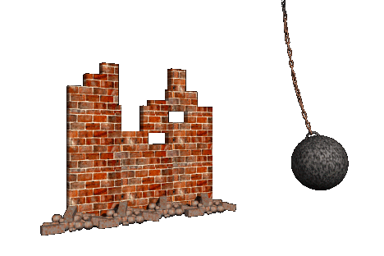
Memory Construction
We sometimes alter our memories as we encode or retrieve them.
Your expectations, schemas, environment may alter your memories.

Slide 47
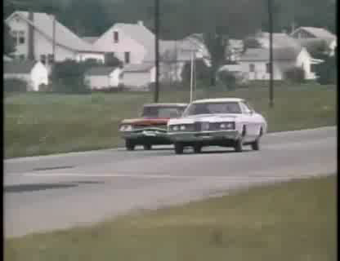
False Memories

Slide 48
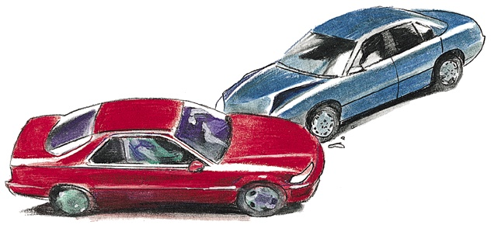
Misinformation Effect
Depiction of Accident

Slide 49
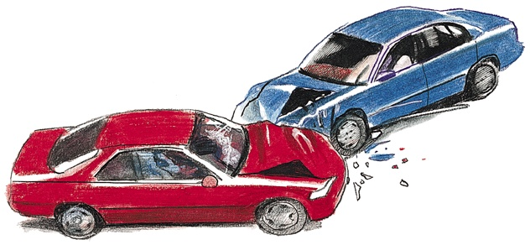
Misinformation Effect
Leading Question: About how fats were the cars going when they smashed into each other?

Slide 50
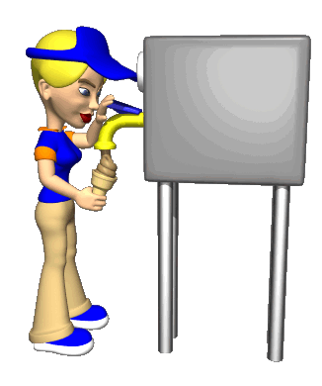
Source Amnesia
(Source Attribution)
Attributing to the wrong source an event we have experienced, heard about, read about or imagined.

Slide 51
Special Topics in Memory
Autobiographical memory
  Recollection of events in our life
  More recent events are easier to recall
Childhood Amnesia (Infantile Amnesia)
  Generally poor memory for events prior to age 2-3
  May occur because brain is not fully developed at birth
    Hippocampus not fully formed until age 2
  May be due to a lack of a clear sense-of-self in young children
  May be the absence of language

Slide 52
Special Topics in Memory
Extraordinary memory
  Includes eidetic imagery (photographic memory)
  Usually due to well developed memory techniques
Flashbulb memories
  Vivid memories of dramatic event
  May occur because of strong emotional content

Slide 53
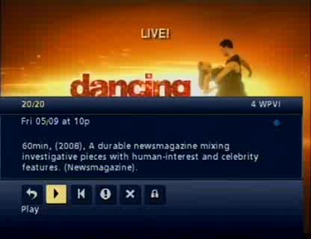
Eidetic Memory
The Woman Who Could Not Forget
http://www.youtube.com/watch?v=SoxsMMV538U&feature=related

Slide 54
Endless Memory, Part 1
http://www.youtube.com/watch?v=oHeEQ85m79I&feature=relmfu

Slide 55
Endless Memories pt. 2
http://www.youtube.com/watch?v=1th1fVIc8Vo&feature=related

Slide 56
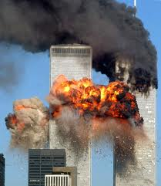
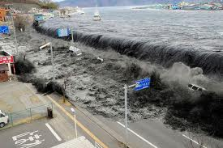
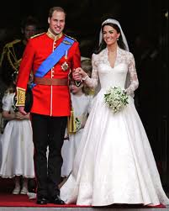
Flashbulb Memory
  Vivid memories of dramatic event
  May occur because of strong emotional content

Slide 57

Eidetic Memory: photographic memory

Slide 58
Special Topics in Memory
Eyewitness testimony
  Shown to be unreliable
  People’s recall for events may be influenced by what they heard or constructed after the incident
  Memory is reconstructed
  Memories are not stored like snapshots, but are instead like sketches that are altered and added to every time they are called up

Slide 59
Special Topics in Memory
Eyewitness testimony cont’d
  Elizabeth Loftus has shown subjects who are given false information about an event or scene tend to incorporate it into their memories, and "recall" the false information as a part of their original memory even two weeks later.
  Loftus gives the example of the sniper attacks in the fall of 2002. "Everybody was looking for a white van even though the bad guys ended up having a dark Chevy Caprice." That's because some people reported seeing a white van at the scene of the crime. "Witnesses overhear each other," says Loftus, and police may also unintentionally influence people's memories when they talk about a crime.
  http://cnettv.cnet.com/manufacturing-memories/9742-1_53-50069462.html
Notes:
1956 Air Show Disaster in England 1-10 Fighter Jet Broke apart in Mid-Air killing 12. Witnessed by 100,000 avid fans watching the event. They had the wreckage and photos and asked the people to write in. Got a few 1000 people to respond. Fewer than 6 gave info that was consistent with the evidence they had
We can plant false memories (Elizabeth Loftus) Did an experiment with on of her graduate student’s 14 yr old younger brother. Said here are four stories from your past (only three actually happened – one of them, being lost in the mall – was planted) Over the next two weeks whenever you remember something about one of these, write it down. Chris rate each of the 4 for clarity, he gave the false on 8 of 11. He picked a real memory as being fake.

