Slide 1
Unit 6 Cognitive Learning
Thought Process:
Watson and Skinner thought learning was from environment. Cognitive theorist interpreted learning as a thinking process.

Slide 2
Objectives
By the end of this lesson, I will be able to:
1. Describe the essential characteristics of insight learning, The Contingency Model, latent learning, and social learning

Slide 3
The Contingency Model
Cognitivists interpret classical and operant conditioning differently. Beyond making associations between stimuli and learning from rewards and punishment, cognitive theorists believe that humans and other animals are capable of forming expectations and consciously being motivated by rewards. Pavlov's view of classical conditioning is called the contiguity model. He believed that the close time between the CS and the US was most important for making the connection between the two stimuli and that the CS eventually substituted for the US. Cognitivist Robert Rescorla challenged this viewpoint, suggesting a contingency model of classical conditioning that the CS tells the organism that the US will follow. Although the close pairing in time between the two stimuli is important, the key is how well the CS predicts the appearance of the UCS.
http://www.youtube.com/watch?v=QB9vxiMighM

Slide 4
The Contigency Model
Another challenge to Pavlov's model is what Leon Kamin calls the blocking effect. Kamin paired a light (NS) with a tone (CS) that had already been classically conditioned with shock (UCS) to produce fear (CR). He found that he was unable to produce conditioned fear to the light alone. He argued that the rat had already learned to associate the signal for shock with the tone so that the light offered no new information. The conditioning effect of the light was blocked.
Blocking: if learner is already making an association between two things, a second neutral stimulus will be blocked from creating a reaction.

Slide 5
The Contingency Model
Contingency theorists argue that types of learning exist that are not explained by operant and classical conditioning. Contingency theory proposes that for learning to take place, a stimulus must provide the subject information about the likelihood that certain events will occur. Robert Rescorla demonstrated that the pairing of a conditioned stimulus (CS) and unconditioned stimulus (UCS) does not always produce learning and contended that it is necessary for the CS to signify a contingency.
This is one of the reasons some people can not lose weight or quit smoking.

Slide 6
Latent Learning:
Latent learning – learning in the absence of rewards
Humans and animals will work in the absence of rewards
If one group is given rewards and the other is not, the rewarded group will work harder
But…if the non rewarded group is eventually rewarded at a later time, they will work hard because the think a reward might come at a later time.
Edward Tolman – Rats and maze example (rats created a cognitive map)
http://www.youtube.com/watch?v=a9UDvHAsddE

Slide 7
Latent Learning:

Slide 8
Insight Learning: the sudden appearance of an answer or solution to a problem.
Wolfgang Kohler: exposed chimpanzees to new learning tasks and concluded the learn by insight.
http://www.youtube.com/watch?v=fPz6uvIbWZE

Slide 9
Insight learning
Neo did not know kung fu until he needed to use it.
http://www.youtube.com/watch?v=j82GKTgVDkw

Slide 10
Latent Learning
Edward Tolman – Rats and maze example (rats created a cognitive map)
Cognitive Map: mental picture
http://www.youtube.com/watch?v=SBTP7W5c3c8&feature=related

Slide 11
Social or Observational Learning
Modeling by watching the behavior of a model. For example; if you want to learn a new dance step you watch someone else do it.
Albert Bandura and his BoBo Doll
We learn through modeling behavior from others.
Observational learning + Operant Conditioning
Click pic to see some observational learning.

Slide 12
Children See, Children Do
http://www.youtube.com/watch?v=KHi2dxSf9hw

Slide 13
Further Research: Observational Learning
Viewing violence can increase the likelihood of aggressive behavior. (300)
Viewing violence reduces our sensitivity to violence. (videogames)
Viewing violence decreases our concern about the suffering of victims
Feeling pride or shame here impacts our further reaction(s) to violence
Click the PIC!

Slide 14
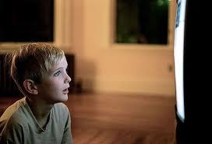
At what age do you think that media violence impacts people the most?
Elementary school
Middle school
High school
College
Adult

Slide 15
Do you think that it is important to have ratings on media?
Yes
Maybe
No
Not sure

Slide 16
Which of the following forms of media impact children most when it comes to violence?
Video Games
Movies
Music
Television
Internet

Slide 17
Before We Start:
Recap from yesterday:
1. Insight learning - Kohler
2. Latent learning - Tolman
3. Social Learning - Bandura

Slide 18
Biological Factors in Learning:
Historically speaking, humans have avoided foods that are sour/bitter from a survival standpoint.
Taste Aversions – an intense dislike or avoidance of food because of its association with an unpleasant or painful stimulus through backward conditioning.

Slide 19
Biological Factors in Learning:
Mirror Neurons: Provide basis for observational learning. The neurons are activated not only when you perform an action, but also when you observe someone else perform the action. Empathy.
http://www.ted.com/talks/vs_ramachandran_the_neurons_that_shaped_civilization.html

Slide 20
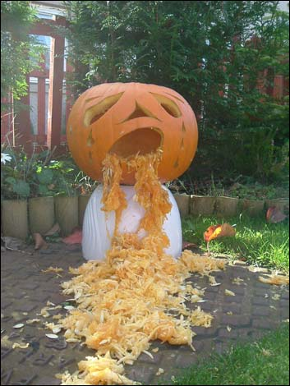
Taste Aversion Scenario:
You have the stomach flu
You eat popcorn and throw up 2 hours later (the delay portion of this is important)
Stomach Virus is the UCS
Vomiting is the UCR
Now you don’t want to eat popcorn
NOTE: Behavioral psychologists have a tough time explaining this because of the length of time in between eating something and getting sick.
How do we choose what to blame the sickness on?

Slide 21
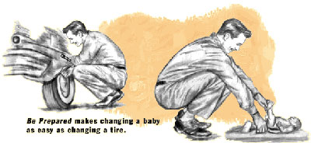
Preparedness
Preparedness – Through evolution, animals are biologically pre-disposed or prepared to associate illness with bitter or sour foods.
Other behaviors are learned slowly or not at all.
Example: People are more likely to be afraid of snakes and spiders than flowers or happy faces.

Slide 22
Last Few Terms:
Counter conditioning – reward behavior when improvement is made
Mere exposure effect – the more you see something, the more likely you are to buy it or do it.
Superstitions – happen just like any other association – something positive happened so they want to do it again

Slide 23
Behavioral Modification:
Systematic Desensitization – Provide the person with a very minor version of the phobia and work them up to handling the phobia comfortably.
Example: Fear of snakes:
1. Have them watch a short movie about snakes
2. Have them hold a stuffed animal snake
3. Have them hold a plastic snake
4. Have them hold a glass container with a snake inside
5. Have them touch a small harmless snake
6. Gradually work to holding a regular size snake

Slide 24
Power point was adapted from :
http://www.appsychology.com/appsychPP/appsychology/APpresentationshome.htm
http://www.actfl.org/images/April08TLEMarkParisiCartoonOffTheMark.jpg
http://www.sangrea.net/free-cartoons/phil_joy-of-learning.jpg
http://hollywoodhatesme.files.wordpress.com/2009/10/jason.jpg
http://blogs.smh.com.au/sit/broccoli2.jpg
http://www.blog.joelx.com/de-motivational-posters/730/

