Slide 1
Grammar
Grammar is the system of rules in a language that enable us to communicate with and understand others.
Grammar
Semantics
Syntax

Slide 2
Semantics
Semantics is the set of rules by which we derive meaning from morphemes, words, and sentences. For example:
Semantic rule tells us that adding –ed to the word laugh means that it happened in the past.

Slide 3
Syntax
Syntax consists of the rules for combining words into grammatically sensible sentences. For example:
In English, syntactical rule says that adjectives come before nouns; white house. In Spanish, it is reversed; casa blanca.

Slide 4
Language Development
Children learn their native languages much before learning to add 2+2.
We learn, on average (after age 1), 3,500 words a year, amassing 60,000 words by the time we graduate from high school.
Time Life Pictures/ Getty Images

Slide 5
When do we learn language?
Babbling Stage: Beginning at 4 months, the infant spontaneously utters various sounds, like ah-goo. Babbling is not imitation of adult speech.
Notes:
OBJECTIVE 12| Trace the course of language acquisition from the babbling stage through two-word stage.

Slide 6
When do we learn language?
One-Word Stage: Beginning at or around his first birthday, a child starts to speak one word at a time and is able to make family members understand him. The word doggy may mean look at the dog out there.

Slide 7
When do we learn language?
Two-Word Stage: Before the 2nd year a child starts to speak in two-word sentences. This form of speech is called telegraphic speech because the child speaks like a telegram: “Go car,” means I would like to go for a ride in the car.

Slide 8
When do we learn language?
Longer phrases: After telegraphic speech, children begin uttering longer phrases (Mommy get ball) with syntactical sense, and by early elementary school they are employing humor.
You never starve in the desert because of all the sand-which-is there.

Slide 9
When do we learn language?

Slide 10
Explaining Language Development
Operant Learning: Skinner (1957, 1985) believed that language development may be explained on the basis of learning principles such as association, imitation, and reinforcement.
Notes:
OBJECTIVE 13| Discuss Skinner’s and Chomsky’s contributions to the nature-nurture debate over how children acquire language, and explain why statistical learning and critical periods are important concepts in children’s language learning.

Slide 11
Explaining Language Development
2. Inborn Universal Grammar: Chomsky (1959, 1987) opposed Skinner’s ideas and suggested that the rate of language acquisition is so fast that it cannot be explained through learning principles, and thus most of it is inborn.

Slide 12
Explaining Language Development
3. Statistical Learning and Critical Periods: Well before our first birthday, our brains are discerning word breaks by statistically analyzing which syllables in hap-py-ba-by go together. These statistical analyses are learned during critical periods of child development.

Slide 13
Genes, Brain, & Language
Genes design the mechanisms for a language, and experience modifies the brain.
Michael Newman/ Photo Edit, Inc.
David Hume Kennerly/ Getty Images
Eye of Science/ Photo Researchers, Inc.

Slide 14
Language & Age
Learning new languages gets harder with age.

Slide 15
Language & Thinking
Language and thinking intricately intertwine.
Rubber Ball/ Almay

Slide 16
Language Influences Thinking
Linguistic Determinism: Whorf (1956) suggested that language determines the way we think. For example, he noted that the Hopi people do not have the past tense for verbs. Therefore, the Hopi cannot think readily about the past.
Notes:
OBJECTIVE 14| Summarize Whorf’s linguistic determinism hypothesis, and comment on its standing in contemporary psychology.

Slide 17
Language Influences Thinking
When a language provides words for objects or events, we can think about these objects more clearly and remember them. It is easier to think about two colors with two different names (A) than colors with the same name (B) (Özgen, 2004).

Slide 18
Word Power
Increasing word power pays its dividends. It pays for speakers and deaf individuals who learn sign language.

Slide 19
Linguistic Determinism Questioned
Although people from Papua New Guinea do not use our words for colors and shapes, they still perceive them as we do (Rosch, 1974).

Slide 20
Thinking in Images
To a large extent thinking is language-based. When alone, we may talk to ourselves. However, we also think in images.
We don’t think in words, when:
1. When we open the hot water tap.
2. When we are riding our bicycle.
Notes:
OBJECTIVE 15| Discuss the value of thinking in images.

Slide 21
Images and Brain
Imagining a physical activity activates the same brain regions as when actually performing the activity.
Jean Duffy Decety, September 2003

Slide 22
Language and Thinking
Traffic runs both ways between language and thinking.

Slide 23
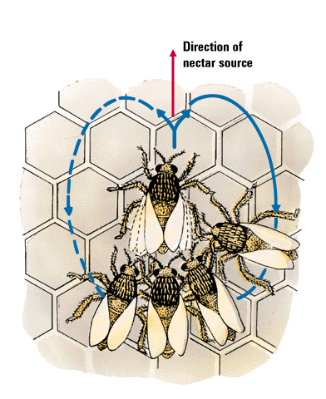
Animals & Language
Do animals have a language?
Honey bees communicate by dancing. The dance
moves clearly indicate the direction of the nectar.

Slide 24
Do Animals Think?
Common cognitive skills in humans and apes include the following:
Concept formation.
Insight
Problem Solving
Culture
Mind?
William Munoz
African grey parrot assorts red
blocks from green balls.
Notes:
OBJECTIVE 16| List five cognitive skills shared by the great apes and humans.

Slide 25
Insight
Chimpanzees show insightful behavior when solving problems.
Sultan uses sticks to get food.

Slide 26
Problem Solving
Apes are famous, much like us, for solving problems.
Courtesy of Jennifer Byrne, c/o Richard Byrne,
Department of Psychology, University of St. Andrews, Scotland
Chimpanzee fishing for ants.

Slide 27
Animal Culture
Animals display customs and culture that are learned and transmitted over generations.
Michael Nichols/ National Geographic Society
Copyright Amanda K Coakes
Dolphins using sponges as
forging tools.
Chimpanzee mother using and
teaching a young how to use
a stone hammer.

Slide 28
Mental States
Can animals infer mental states in themselves and others?
To some extent. Chimps and orangutans (and dolphins) used mirrors to inspect themselves when a researcher put paint spots on their faces or bodies.

Slide 29
Do Animals Exhibit Language?
There is no doubt that animals communicate.
Vervet monkeys, whales and even honey bees communicate with members of their species and other species.
Copyright Baus/ Kreslowski
Rico (collie) has a
200-word vocabulary
Notes:
OBJECTIVE 17| Outline the arguments for and against the idea that animals and humans share the capacity for language.

Slide 30
The Case of Apes
Chimps do not have a vocal apparatus for human-like speech (Hayes & Hayes,1951). Therefore, Gardner and Gardner (1969) used American Sign Language (ASL) to train Washoe, a chimp, who learned 182 signs by the age of 32.

Slide 31
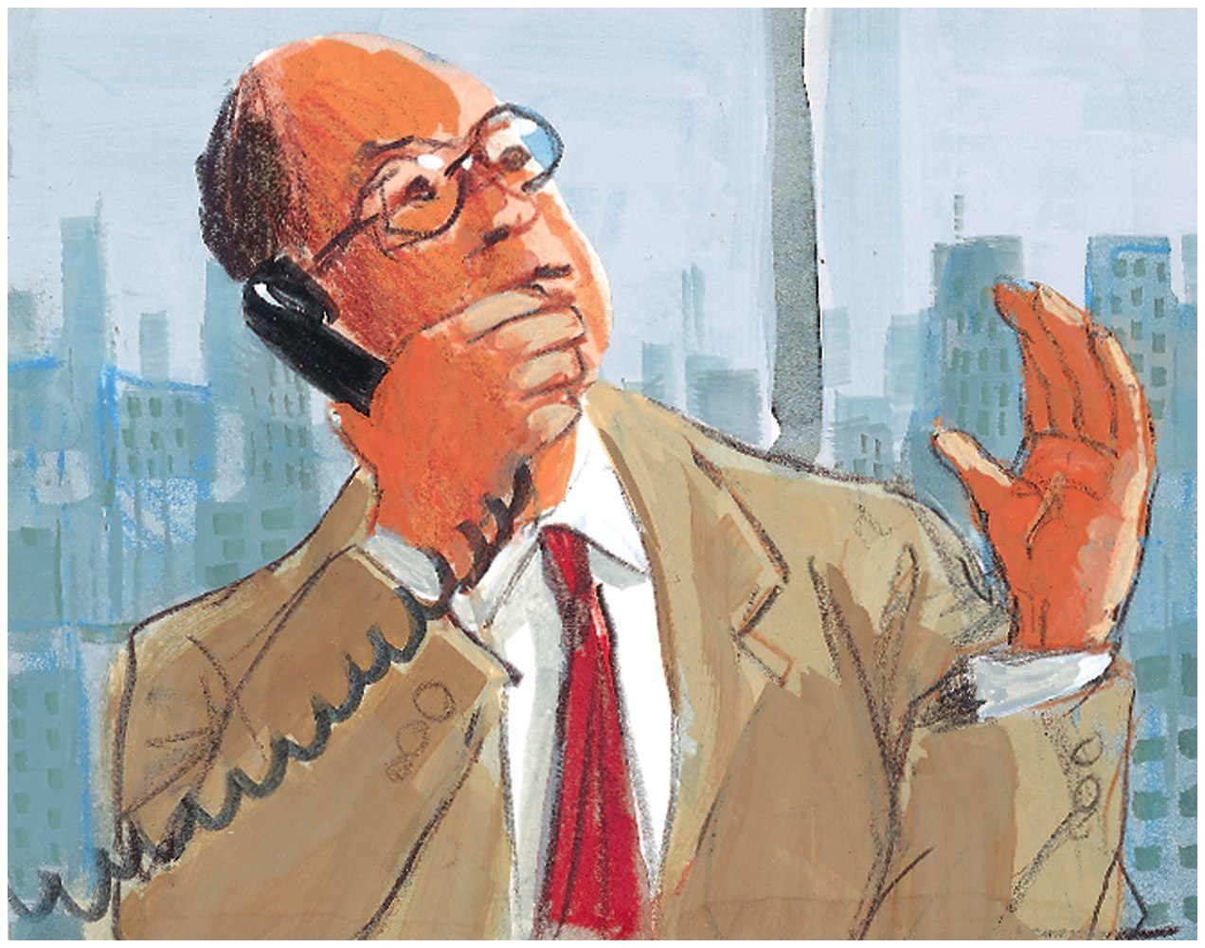
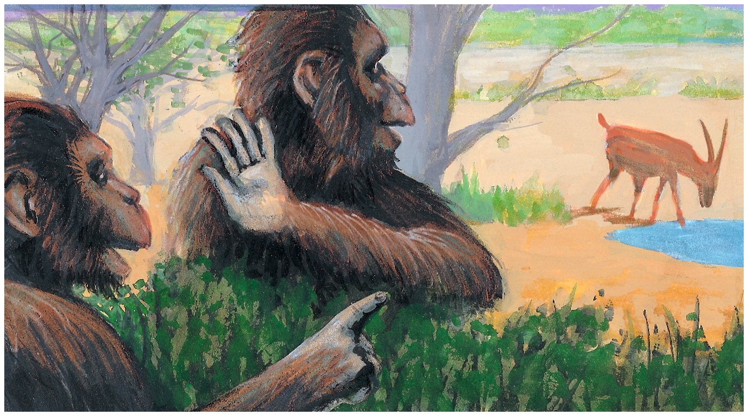
Gestured Communication
Animals, like humans, exhibit communication through gestures. It is possible that vocal speech developed from gestures during the course of evolution.

Slide 32
Sign Language
American Sign Language (ASL) is instrumental in teaching chimpanzees a form of communication.
Paul Fusco/ Magnum Photos
When asked, this chimpanzee uses
a sign to say it is a baby.

Slide 33
Computer Assisted Language
Others have shown that bonobo pygmy chimpanzees can develop even greater vocabularies and perhaps semantic nuances in learning a language (Savage-Rumbaugh, 1991). Kanzi and Panbanish developed vocabulary for hundreds of words and phrases.
Copyright of Great Ape Trust of Iowa

Slide 34
Criticism
Apes acquire their limited vocabularies with a great deal of difficulty, unlike children who develop vocabularies at amazing rates.
Chimpanzees can make signs to receive a reward, just as a pigeon who pecks at the key receives a reward. However, pigeons have not learned a language.
Chimpanzees use signs meaningfully but lack syntax.
Presented with ambiguous information, people tend to see what they want to see.

Slide 35
Conclusions
If we say that animals can use meaningful sequences of signs to communicate a capability for language, our understanding would be naive… Steven Pinker (1995) concludes, “chimps do not develop language.”

