Slide 1
Thinking & Language

Slide 2
Thinking and Language
Thinking
Concepts
Solving Problems
Making Decisions and Forming Judgments
Belief Bias

Slide 3
Thinking and Language
Language
Language Structure
Language Development
Thinking & Language
Language Influences Thinking
Thinking in Images

Slide 4
Thinking and Language
Animal Thinking and Language
Do Animals Think?
Do Animals Exhibit Language?
The Case of the Apes

Slide 5
Thinking
Thinking, or cognition, refers to a process that involves knowing, understanding, remembering, and communicating.
Notes:
OBJECTIVE 1| Define cognition.

Slide 6
Cognitive Psychologists
Thinking involves a number of mental activities, which are listed below. Cognitive psychologists study these in great detail.
Concepts
Problem solving
Decision making
Judgment formation

Slide 7
Concept
The mental grouping of similar objects, events, ideas, or people. There are a variety of chairs but their common features define the concept of a chair.
Notes:
OBJECTIVE 2| Describe the roles of categories, hierarchies, definitions, and prototypes in concept formation.

Slide 8
Category Hierarchies
We organize concepts into category hierarchies.
Courtesy of Christine Brune

Slide 9
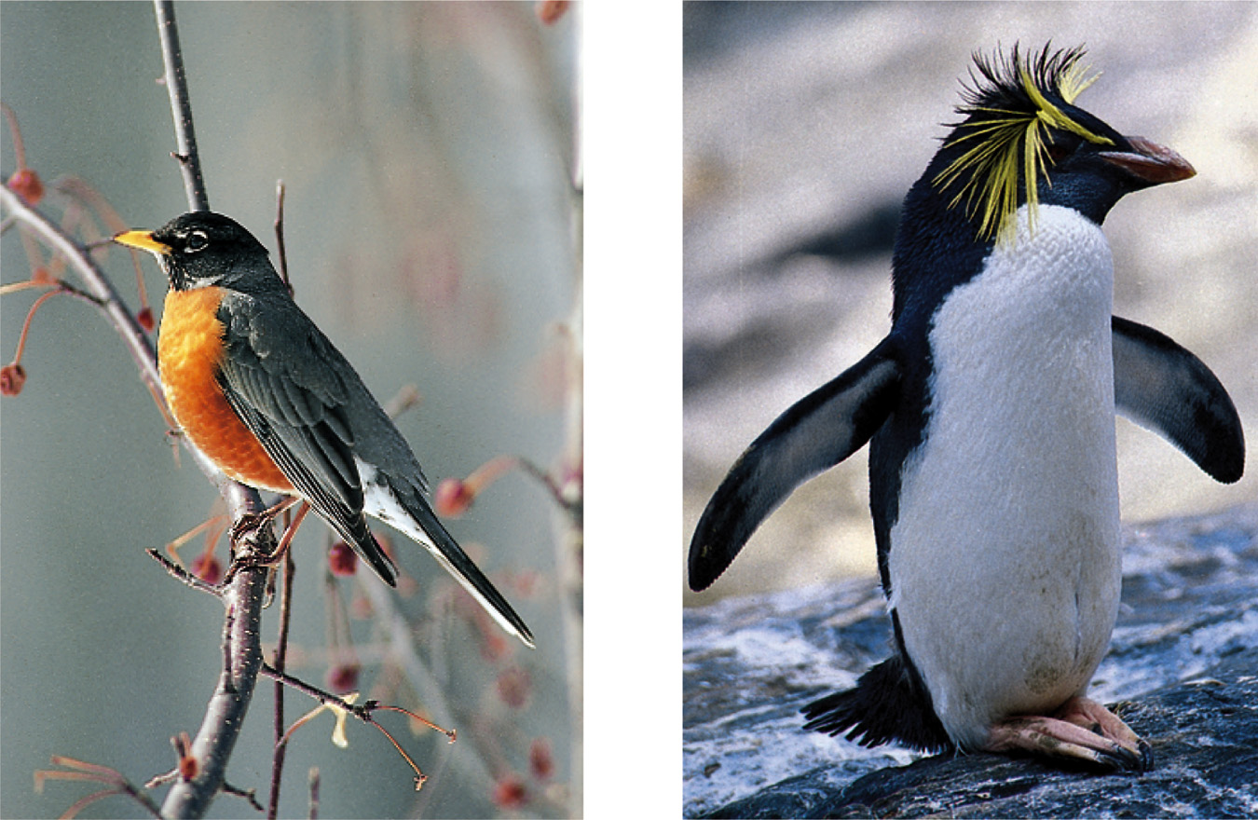
Development of Concepts
We form some concepts with definitions. For example, a triangle has three sides. Mostly, we form concepts with mental images or typical examples (prototypes). For example, a robin is a prototype of a bird, but a penguin is not.
J. Messerschmidt/ The Picture Cube
Daniel J. Cox/ Getty Images
Triangle (definition)
Bird (mental image)

Slide 10
Categories
Once we place an item in a category, our memory shifts toward the category prototype.
Courtesy of Oliver Corneille
A computer generated face that was 70 percent
Caucasian led people to classify it as Caucasian.

Slide 11
Problem Solving
There are two ways to solve problems:
Algorithms: Methodical, logical rules or procedures that guarantee solving a particular problem.
Notes:
OBJECTIVE 3| Compare algorithms and heuristics as problem-solving strategies, and explain how insight differs from both of them.

Slide 12
Algorithms
Algorithms, which are very time consuming, exhaust all possibilities before arriving at a solution. Computers use algorithms.
S P L O Y O C H Y G
If we were to unscramble these letters to form a word
using an algorithmic approach, we would face
907,208 possibilities.

Slide 13
Heuristics
Heuristics are simple, thinking strategies that allow us to make judgments and solve problems efficiently. Heuristics are less time consuming, but more error-prone than algorithms.
B2M Productions/Digital Version/Getty Images

Slide 14
Heuristics
Heuristics make it easier for us to use simple principles to arrive at solutions to problems.
S P L O Y O C H Y G
S P L O Y O C H G Y
P S L O Y O C H G Y
P S Y C H O L O G Y
Put a Y at the end, and see if the word
begins to make sense.

Slide 15
Insight
Insight involves a sudden novel realization of a solution to a problem. Humans and animals have insight.
Grande using boxes to
obtain food

Slide 16
Insight
Brain imaging and EEG studies suggest that when an insight strikes (the “Aha” experience), it activates the right temporal cortex (Jung-Beeman, 2004). The time between not knowing the solution and realizing it is 0.3 seconds.
From Mark Jung-Beekman, Northwestern
University and John Kounios, Drexel University

Slide 17
Obstacles in Solving Problems
Confirmation Bias: A tendency to search for information that confirms a personal bias.
2 – 4 – 6
Rule: Any ascending series of numbers. 1 – 2 – 3 would comply. Ss had difficulty figuring out the rule due to a confirmation bias (Wason, 1960).
Notes:
OBJECTIVE 4| Contrast confirmation bias and fixation, and explain how they can interfere with effective problem solving.

Slide 18
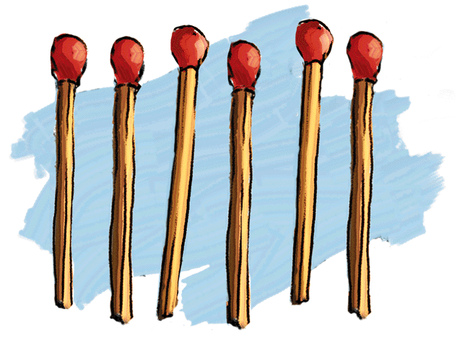
Fixation
Fixation: An inability to see a problem from a fresh perspective. This impedes problem solving. Two examples of fixation are mental set and functional fixedness.
The Matchstick Problem: How would you arrange six matches to form four equilateral triangles?
From “Problem Solving” by M. Scheerer. Copyright © 1963 by
Scientific American, Inc. All Rights Reserved.

Slide 19
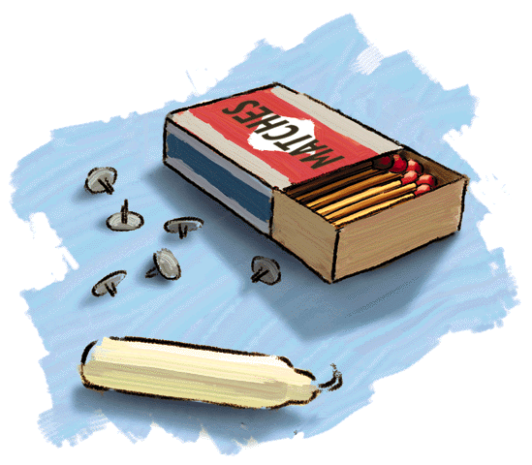
Candle-Mounting Problem
Using these materials, how would you mount the candle on a bulletin board?
From “Problem Solving” by M. Scheerer. Copyright © 1963 by
Scientific American, Inc. All Rights Reserved.

Slide 20
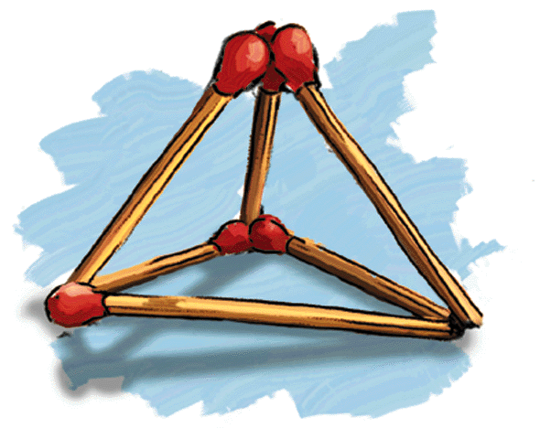
The Matchstick Problem: Solution
From “Problem Solving” by M. Scheerer. Copyright © 1963 by
Scientific American, Inc. All Rights Reserved.

Slide 21
Candle-Mounting Problem: Solution

Slide 22
Mental Set
A tendency to approach a problem in a particular way, especially if that way was successful in the past.

Slide 23
Functional Fixedness
A tendency to think only of the familiar functions of an object.
?
Problem: Tie the two ropes together.
Use a screw driver, cotton balls and a matchbox.

Slide 24
Functional Fixedness
Use the screwdriver as a weight, and tie it to the end of one rope. Swing it toward the other rope to tie the knot.
?
The inability to think of the screwdriver as a weight is
functional fixedness.

Slide 25
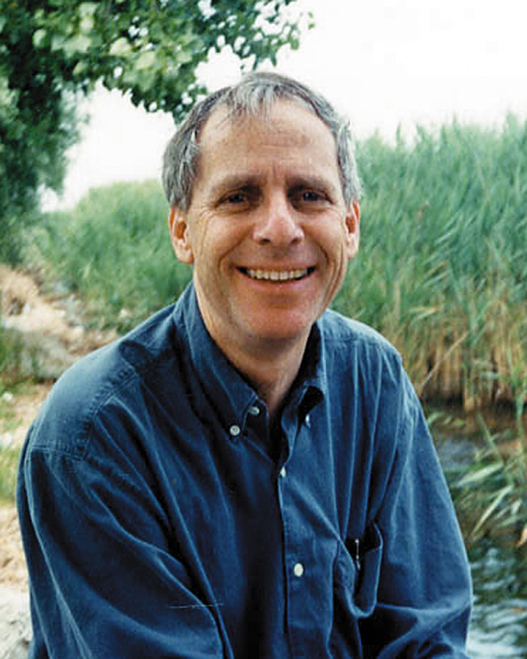
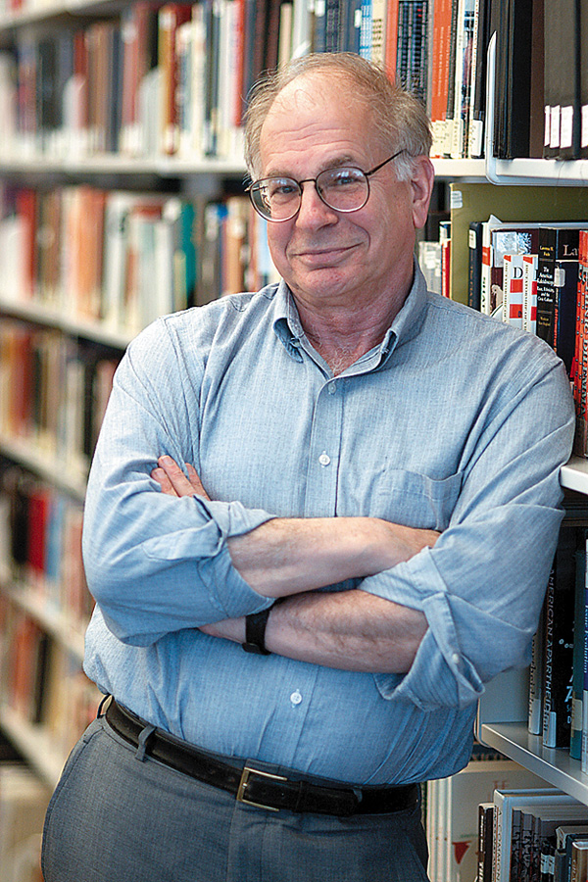
Using and Misusing Heuristics
Two kinds of heuristics, representative heuristics and availability heuristics, have been identified by cognitive psychologists.
Courtesy of Greymeyer Award, University
of Louisville and the Tversky family
Courtesy of Greymeyer Award, University
of Louisville and Daniel Kahneman
Amos Tversky
Daniel Kahneman
Notes:
OBJECTIVE 5| Contrast the representative and availability heuristics, and explain how they can cause us to underestimate or ignore important information.

Slide 26
Representativeness Heuristic
Judging the likelihood of things or objects in terms of how well they seem to represent, or match, a particular prototype.
If you meet a slim, short, man who wears glasses and likes poetry, what do you think his profession would be?
An Ivy league professor or a truck driver?
Probability that that person is a truck driver is far greater than an ivy league professor just because there are more truck drivers than such professors.

Slide 27
Availability Heuristic
Why does our availability heuristic lead us astray?
Whatever increases the ease of retrieving information increases its perceived availability.
How is retrieval facilitated?
How recently we have heard about the event.
How distinct it is.
How correct it is.

Slide 28
Making Decision & Forming Judgments
Each day we make hundreds of judgments and decisions based on our intuition, seldom using systematic reasoning.

Slide 29
Overconfidence
Intuitive heuristics, confirmation of beliefs, and the inclination to explain failures increase our overconfidence. Overconfidence is a tendency to overestimate the accuracy of our beliefs and judgments.
At a stock market, both the seller and the buyer may be confident about their decisions on a stock.
Notes:
OBJECTIVE 6| Describe the drawbacks and advantages of overconfidence in decision making.

Slide 30
Exaggerated Fear
The opposite of having overconfidence is having an exaggerated fear about what may happen. Such fears may be unfounded.
The 9/11 attacks led to a decline in air travel due to fear.
AP/ Wide World Photos

Slide 31
Framing Decisions
Decisions and judgments may be significantly affected depending upon how an issue is framed.
Example: What is the best way to market ground beef — as 25% fat or 75% lean?
Notes:
OBJECTIVE 7| Describe how others can use framing to elicit from us the answers they want.

Slide 32
Belief Bias
The tendency of one’s preexisting beliefs to distort logical reasoning by making invalid conclusions.
God is love.
Love is blind
Ray Charles is blind.
Ray Charles is God.
Anonymous graffiti
Notes:
OBJECTIVE 8| Explain how our preexisting beliefs can distort our logic.

Slide 33
Belief Perseverance
Belief perseverance is the tendency to cling to our beliefs in the face of contrary evidence.
If you see that a country is hostile, you are likely to interpret their ambiguous actions as a sign of hostility (Jervis, 1985).
Notes:
OBJECTIVE 9| Describe the remedy for belief perseverance phenomenon.

Slide 34
Perils & Powers of Intuition
Intuition may be perilous if unchecked, but may also be extremely efficient and adaptive.
Notes:
OBJECTIVE 10| Describe the smart thinker’s reaction to using intuition.

Slide 35
Perils & Powers of Intuition

Slide 36
Language
Language, our spoken, written, or gestured work, is the way we communicate meaning to ourselves and others.
M. & E. Bernheim/ Woodfin Camp & Associates
Language transmits culture.

Slide 37
Language Structure
Phonemes: The smallest distinct sound unit in a spoken language. For example:
bat, has three phonemes b · a · t
chat, has three phonemes ch · a · t
Notes:
OBJECTIVE 11| Describe the basic structural units of language.

Slide 38
Language Structure
Morpheme: The smallest unit that carries a meaning. It may be a word or part of a word. For example:
Milk = milk
Pumpkin = pump . kin
Unforgettable = un · for · get · table

Slide 39
Structuring Language
Phonemes
Basic sounds (about 40) … ea, sh.
Morphemes
Smallest meaningful units (100,000) … un, for.
Words
Meaningful units (290,500) … meat, pumpkin.
Phrase
Composed of two or more words (326,000) … meat eater.
Sentence
Composed of many words (infinite) … She opened the jewelry box.

