Slide 1
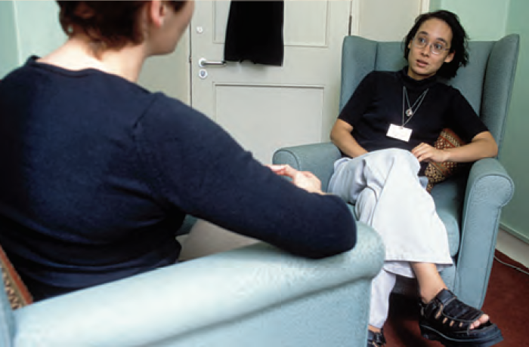
Overview
Therapy refers to how mental disorders are treated, with the help of the knowledge base of psychology.
Major types of psychotherapy include psychoanalytic, humanistic, behavior, cognitive, and individual, group, and family psychotherapy.
Issues in psychotherapy include culture, gender, values, effective factors and types, and the evaluation of psychotherapy effectiveness.
We’ll also look at biomedical therapies such as drugs, brain stimulation, surgery, and lifestyle change.
Finally, we’ll briefly consider the prevention of psychological disorders.
Notes:
Click to reveal all bullets.
Instructor: Chazz can introduce this slide by saying, “let’s get a realistic view of the therapeutic challenges ahead of us.”

Slide 2
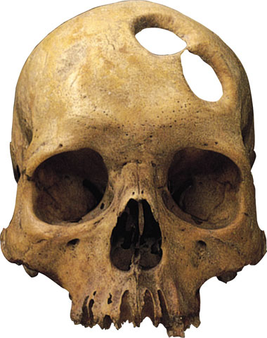
History of Mental Health Treatment
When people have displayed unusual behaviors rooted in the mind, these people have often been locked away or “treated” using old ideas of mental illness.
Old ways of getting rid of “the evil spirits” include:
beating them out of people.
bleeding them out.
letting the spirits out through holes drilled in the skull.
Notes:
Click to reveal text.

Slide 3
Reforms in Treatment
Other Reforms in Treatment
Seeing the “insane” as ill instead of “possessed”
Treating them with tenderness, not harshness
Housing them in hospitals rather than locking them up in asylums
Developing psychotherapeutic treatments, medications, and community supports to allow life outside hospitals
This chair was designed to be an improvement in medical treatment. It was meant to have a calming effect on people with mania.
This is working remarkably well.
Notes:
Click to reveal sidebar bullets.
Instructor, you can add that the designer of this chair, Benjamin Rush (1746-1813), was a strong advocate for more humane treatment of the mentally ill. Students may laugh about the supposed humanity of this chair, but compare it to trephination. Actually, some people with autism find firm restraint to be dramatically soothing when they are overwhelmed and stressed.

Slide 4
Current Forms of Therapy
Psychotherapy:
an interactive experience with a trained professional, working on understanding and changing behavior, thinking, relationships, and emotions
Biomedical therapy:
the use of medications and other procedures acting directly on the body to reduce the symptoms of mental disorders
Combining Therapies
There are various forms of psychotherapy.
An eclectic approach uses techniques from various forms of therapy to fit the client’s problems, strengths, and preferences.
Medications and psychotherapy can be used together, and may help the each other achieve better reduction in symptoms.
Notes:
After bubbles appear, click through to reveal remaining text.

Slide 5
Noteworthy Schools of Psychotherapy
Psychoanalysis, psychodynamic therapy
Humanistic, client-centered therapy
Behavior therapy, using conditioning
Cognitive therapy, changing thoughts
Sigmund Freud’s legacy carried on today
Carl Rogers and Abraham Maslow
B.F. Skinner and Ivan Pavlov applied to people
Aaron Beck and Albert Ellis, reducing errors and distress
Notes:
Click to reveal sub-bullets for each type of therapy.

Slide 6
Psychoanalysis: Aims
Since psychological problems originate from childhood repressed impulses and conflicts, the aim of psychoanalysis is to bring repressed feelings into conscious awareness where the patient can deal with them.
When energy devoted to id-ego-superego conflicts is released, the patient’s anxiety lessens.

Slide 7
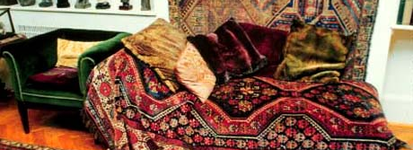
Psychoanalysis
Psychoanalysis refers to a set of techniques for releasing the tension of repression and resolving unconscious inner conflicts.
Sigmund Freud (1856-1939) found that the unusual symptoms of patients sometimes improved when repressed inner conflicts and feelings were brought into conscious awareness.
Techniques:
Free association: the patient speaks freely about memories, dreams, feelings
Interpretation: the therapist suggests unconscious meanings and underlying wishes to help the client gain insight and release tension
Notes:
Click to reveal bullets.
These psychoanalytic conflicts were presumed to exist among the id, ego, and superego. These are parts of the personality, often assumed to be related to sexual desires, that are repressed because they feel inappropriate. You can note, as this picture shows, that Freud sat out of his patients’ view so that they would be more uninhibited in their associations, less likely to be distracted by him, and more likely to transfer onto the therapist the feelings associated with past people.

Slide 8
Interpretation in Psychoanalysis
The therapist may see unconscious meaning in resistance, dreams, and transference.
Resistance:
the therapist notices times when the patient seems blocked in speaking about certain subjects
Dreams:
there may be themes or “latent content” behind the plot of a patient’s dream
Transference:
the patient may have reactions toward the therapist that are actually based on feelings toward someone from the past
Notes:
No animation.

Slide 9
Psychodynamic Therapy
Interpersonal Therapy
Less intensive version of psychoanalysis
Fewer sessions per week and fewer years
Less theory about sex, id, and superego
The focus is on improved self-awareness and insight into unconscious thoughts and feelings which may be rooted in past relationships.
In addition to insight, therapists suggest changes in patterns of thinking and relating to others.
A further extension of psychoanalysis
The goal is less focused on insight, and more on relational behavior change and symptom relief.
The focus is less on the past, and more on current feelings and relationships including the interaction with the therapist.
Notes:
Click to reveal bullets under each heading.

Slide 10
Assessing the Unconscious
Projective Test
a personality test, that provides ambiguous stimuli designed to trigger projection of one’s inner dynamics
TAT
Rorschach

Slide 11
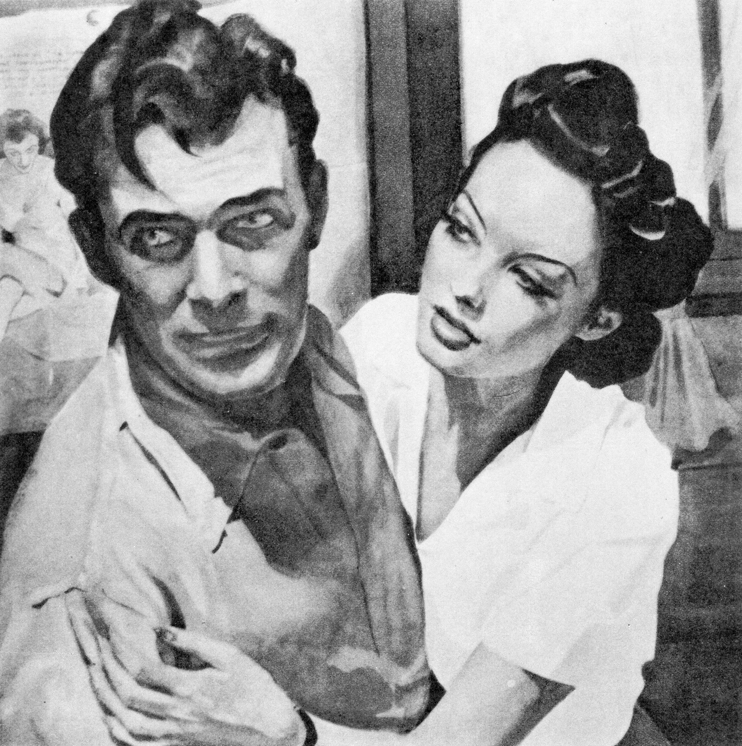
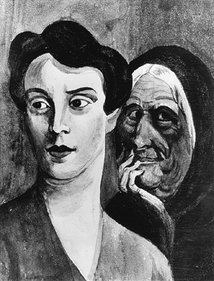
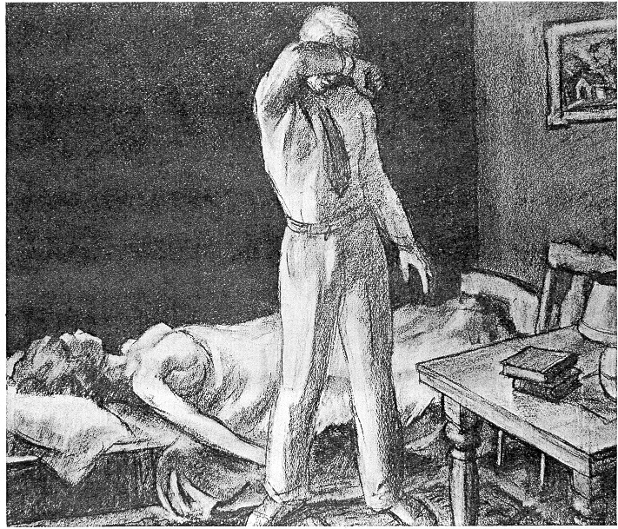
Assessing the Unconscious
Thematic Apperception Test (TAT)
people express their inner feelings and interests through the stories they make up about ambiguous scenes

Slide 12
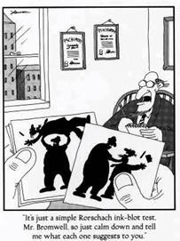
Assessing the Unconscious
Rorschach Inkblot Test
the most widely used projective test
seeks to identify people’s inner feelings by analyzing their interpretations of the blots

Slide 13
Humanistic Therapies
Humanistic therapists aim to boost self-fulfillment by helping people grow in self-awareness and self-acceptance.
Activating the self-actualizing tendency is a primary goal.
Reconciling the Real Self and Ideal Self, thereby reducing incongruence, is also a focus.
Notes:
OBJECTIVE 5| Identify the basic characteristics of the humanistic therapies, and describe the specific goals and techniques of Carl Rogers’ client-centered therapy.

Slide 14
Humanistic Therapies
Humanistic psychology (Abraham Maslow and Carl Rogers) emphasizes the human potential for growth, self-actualization, and personal fulfillment.
Humanistic therapy attempts to support personal growth by helping people gain self-awareness and self-acceptance.
“Client-centered therapy”
is Carl Rogers’s name for his style of humanistic therapy.
Notes:
Click to reveal bubbles.

Slide 15
Style of the Client-Centered Therapist
Showing Empathy Through
Active Listening
Client-centered therapists show that they are tuning in to clients’ feelings and meanings.
Summarize, paraphrase
“So your father wasn’t around much?”
Invite clarification and elaboration
“When you say ‘anxiety,’ what does that feel like to you? What is going on in your body and thoughts?”
Reflect Feelings
“It seems like you are disappointed; am I right?”
Being non-directive
Let insight and goals come from the client, rather than dictating interpretations.
Being genuine
Be yourself and be truthful; don’t put on a therapist façade.
Being accepting and showing unconditional positive regard
Help the client learn to accept themselves despite any weaknesses.
Being empathetic
Demonstrate careful attention to the clients’ feelings, partly by reflecting what you hear the client saying.
Notes:
Click to reveal more about each component.
Click to reveal sidebar.

Slide 16
Humanistic vs. Psychoanalytic Therapy
 | Humanistic psychotherapy | Psychoanalytic psychotherapy
Goal | Promote growth | Cure mental illness
How to improve | Take responsibility for feelings and actions | Bring unconscious conflicts into conscious awareness
Role of therapist | Provide an environment in which growth can occur | Provide interpretations (e.g. of dreams, resistance and transference)
Content of therapy | Conscious feelings, actual self and ideal self | Unconscious conflicts
Time focus | The present and future | The past
Notes:
No animation.

Slide 17
Behavior Therapy
Sometimes, insight is not helpful to recover from some mental health problems. The client might know the right changes to make, but finds that it’s hard to change actual behavior.
Behavior therapy uses the principles of learning, especially classical and operant conditioning, to help reduce unwanted responses. These might include behaviors such as addictions, or emotions such as panic.
Notes:
Click to reveal bullets.
A critique of this approach reverses the first bullet point; for many problems, simply shaping a behavior or response is not enough without the insight about the origin or function of the behavior.

Slide 18
Classical Conditioning Techniques
Counterconditioning refers to linking new, positive responses to previously aversive stimuli.
If you have been conditioned to fear stores because you have had panic attacks there, you could be led into a store and then helped with relaxation exercises. The goal is to associate stores with relaxation, a state incompatible with fear.
Notes:
Click to reveal example.

Slide 19
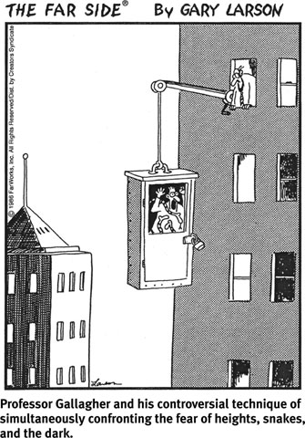
Exposure Therapy
A conditioned fear can worsen when avoidance of the feared situation gets reinforced by a quick reduction in anxiety.
Guided exposure to the feared situation can reverse this reinforcement by waiting for anxiety to subside during the exposure.
The person can habituate to (get used to) the anxiety itself, and then the feared situation.
What mistake is Professor Gallagher making here?
Hint: systematic desensitization might have been more effective, though less dramatic
Notes:
Click to reveal bullets, then the cartoon. Another click brings up the question and hint.

Slide 20
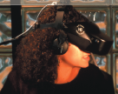
Versions of Exposure Therapy
Sometimes, exposure to the feared situation is too anxiety-provoking or impractical. In those cases, you can use:
systematic desensitization. Beginning with a tiny reminder of the feared situation, keep increasing the exposure intensity as the person learns to tolerate the previous level.
virtual reality therapy. This involves exposure to simulations, such as flying (below) or snakes.
Notes:
Click to reveal bullets.
The image on the right is the client’s view through the virtual reality glasses. You could ask students, “would this be effective if she knew it was a simulation?” If they are quick to answer no, prompt them to consider the comparison between a 3D cartoonish but immersive scene, compared to just imagining she’s in a plane, or compared to actually going on a plane despite her phobia. This cartoonish reality might be just the right step up in exposure intensity from a picture or mental image, but not as panic-provoking as an actual flight, which she may not be ready for… yet.

Slide 21
Systematic Desensitization
A type of therapy that associates a pleasant, relaxed state with gradually increasing anxiety-triggering stimuli commonly used to treat phobias.

Slide 22
The Bed-Wetting Alarm Example
Isn’t a bed-wetting alarm a form of operant conditioning? Doesn’t the child get a punishment for wetting the bed?
Assuming the child is not wetting on purpose:
the bed wetting is not an operant behavior, and the child cannot choose to avoid the alarm.
The association that is made is between a biological state (a full and relaxing bladder), and sudden alarming wakefulness. This resembles classical conditioning.
Notes:
Click to reveal bullets.
This example, like many, does not neatly fit into categories but is presented in the text as classical conditioning, which it fits more closely.

Slide 23
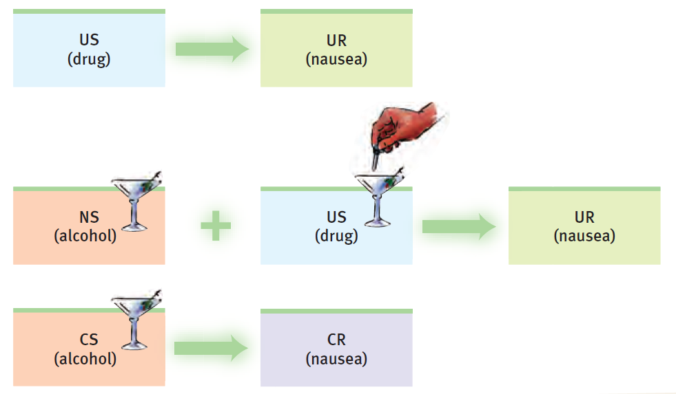
Aversive Conditioning
When a person has been conditioned to have a positive association with a drug...
Aversive conditioning can associate the drug with a negative response.
Notes:
No animation.
Instructor: you might want to ask students to narrate, one line per student, what is represented in this graphic. Then, a fourth student could summarize how this aversive conditioning might help with a drug use habit.
The problem with aversive conditioning is that the conditioning is not always generalized to a situation outside of the treatment situation.

Slide 24
Operant Conditioning Therapy
Operant conditioning refers to the shaping of chosen behavior in response to the consequences of the behavior.
Behavior modification refers to shaping a client’s chosen behavior to look more like a desired behavior, by making sure that desired behaviors are rewarded and problematic behaviors are unrewarded or punished.
Applications of Operant Conditioning
Applied behavioral analysis/application is used with nonverbal children with autism. It rewards behaviors such as sitting with someone or making eye contact, and sometimes punishes self-harming behaviors.
A token economy uses coins, stars, or other indirect rewards as “tokens” that can be collected and traded later for real rewards.
Notes:
Click to reveal bullets on the right.

Slide 25
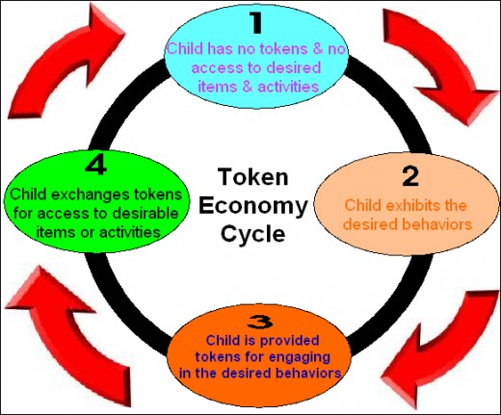
Token Economy
In institutional settings therapists may create a token economy in which patients exchange a token of some sort, earned for exhibiting the desired behavior, for various privileges or treats.

Slide 26
Critiques of Behavior Therapy
Does it work?
Is it ethical?
And when it does, do the changes stick, without insights and other changes to hold the new behavior in place?
Since conditioning operates below conscious awareness, couldn’t people’s choices and reactions be manipulated without their consent?
It does often work, but extinguished behaviors and reactions do spontaneously reappear.
To ensure maintenance of changes, a transition is needed from artificial rewards to awareness of natural, environmental consequences.
To minimize ethical problems:
acquire consent, at least of guardians.
develop goals for treatment that are more humane than the alternative. For example, shaping autistic behavior is seemingly better than institutionalization.
Notes:
Click to reveal bullets.

Slide 27
Cognitive Therapies: Theory
Being depressed and/or anxious involves negative thoughts and interpretations.
In the cognitive perspective, the cause of depression are not bad events, but our thoughts about those events.
Notes:
No animation.
The chart on this slide assumes the direction of causation is to the right. In reality, pessimistic cognition can be a function of the depression. However, even if the depression came first, these negative thoughts and interpretations can make depression worse.
The chart also skips the fact that repeated stress can lead to depression, not just through thinking, but through a biological reaction to chronically high cortisol levels.

Slide 28
Cognitive Therapies: Practice
Cognitive therapy helps people alter the negative thinking that worsens depression and anxiety.
Therapists might suggest other thoughts that the clients could have about their lives, or at least point out when clients jump to conclusions that make them feel worse.
Schools of Cognitive Therapy
Albert Ellis’s rational-emotive behavior therapy
challenging irrational beliefs and assumptions
Aaron Beck’s cognitive therapy for depression
correcting cognitive distortions
Donald Meichenbaum’s stress inoculation training
practicing healthier thinking before facing a stressor, disappointment, or frustration
Notes:
Click to reveal text boxes and “Schools of Cognitive Therapy,” then click to reveal bullets under each school.
The third style of therapy is very much less important than the other two styles of therapy mentioned, which is why it doesn’t have its own section in the book or its own slide.

Slide 29
Rational-Emotive Behavior Therapy
Albert Ellis showed how depression is worsened by irrational beliefs. These include depressing assumptions about the world such as “everyone should like me” or “I should never do anything wrong.”
Rational-Emotive Behavior Therapy [REBT] helps people: 1) notice that they are operating on self-defeating assumptions, and 2) reward themselves for replacing these assumptions with realistic beliefs. For example, a more realistic belief might be, “some people won’t like me, many will have no opinion; it doesn’t matter.”
Notes:
Click to reveal bullets.
The text implies that the “behavior” part of this therapy allows the enabling of healthy behaviors. Albert Ellis added the “behavior” part to his “rational therapy” by adding operant conditioning; you can reward yourself sometimes for using the replacement thoughts to help establish the new thinking as a habit.

Slide 30
Aaron Beck’s Therapy for Depression
Aaron Beck helped people see how their depression was worsened by errors in thinking such as catastrophizing, (interpreting current events as signs of the worst possible outcome). For example:
“Now that I’ve made a mistake in my lecture, I’ve failed as a professor. Students can’t take me seriously, and they can’t learn from me.”
Beck’s style of therapy helps clients notice and challenge these errors in thinking.
Notes:
Click to reveal bullets.

Slide 31
Cognitive Therapy for Depression
Rabin et al., (1986) trained depressed patients to record positive events each day, and relate how they contributed to these events. Compared to other depressed patients, trained patients showed lower depression scores.

Slide 32
Cognitive Behavioral Therapy
Cognitive behavioral therapy [CBT] works to change both cognitions and behaviors that are part of a mental health disorder.
Using cognitive behavioral therapy, people with OCD are led to resist the urge to act on their compulsions, as well as to learn to manage obsessional thinking.
Notes:
Click to reveal bullets.
Instructor: CBT is one of the most commonly practiced and thoroughly researched forms of psychotherapy.
For people with OCD struggling to resist giving in to compulsions, such as the “need” to check three times to make sure a door is closed “the right way” (people with OCD use compulsions to reduce anxiety, even if they know that the actions don’t make sense), there is “exposure and response prevention.” This involves being in the situation that would trigger the compulsion, but doing something else instead until the anxiety subsides.

Slide 33
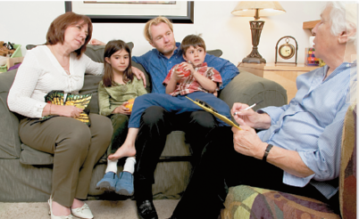
Family Therapy
Group Therapy
Self-Help Groups
Having a session with the whole family, at home or in the office, allows the therapist to work on the family system, that is, the family’s patterns of alliances, authority, and communication.
A related modality is couples/marital therapy.
Group therapy assembles about six to nine people with related needs into a group, facilitated by a therapist, to work on therapeutic goals together. The benefits include:
less cost per person.
more interaction, feedback, and support.
clients realize others share their problems and they are not alone.
Self-help groups are led by group members instead of a therapist.
They can be much larger than group therapy, with less interaction.
The focus is more on support rather than on working on goals during the group session.
Notes:
Click to reveal description of each type of therapy.
Instructor: you might also make the point that sometimes even individual symptoms are a function of problems in the family system. For example, a child may be reinforced for acting out if it brings the disaffected parents together.
A well-known example of a self-help group is a “Twelve Step” group like Alcoholics Anonymous; these groups support members’ work on recommended steps of managing problems with addiction.

Slide 34
Is Psychotherapy Effective?
What Causes Improvement?
Even if clients do improve, is the improvement really caused by therapy? It could be:
→regression to the mean, drifting from initial crisis back to an average state.
→the client’s motivation to appear better in order to please the therapist or to justify the cost of therapy.
There are different measures of the value and effectiveness of psychotherapy:
whether the client is satisfied
whether the client senses improvement
whether the therapist sees improvement
whether there has been an observable, measured change in initial symptoms
Studying Treatment Outcomes
To track the effectiveness of an intervention, use a control group not receiving the intervention, or even a placebo group.
To measure effectiveness, use objective, observable measures of symptoms rather than relying on client or therapist perceptions.
Notes:
Click to reveal bullets on left.
Click to reveal sidebar. The crucial question related to the first bullet point is, “would the client have improved even without therapy?”
Click to reveal bottom bar.
The placebo group might receive a bogus intervention.
See if students can guess the value of a control group: to control for maturation/regression to the mean, getting better with time.
See if students can guess the value of a placebo: to control for client expectations of improvement with intervention.
In this case, “control for” means “make sure improvement is not caused by.”

Slide 35
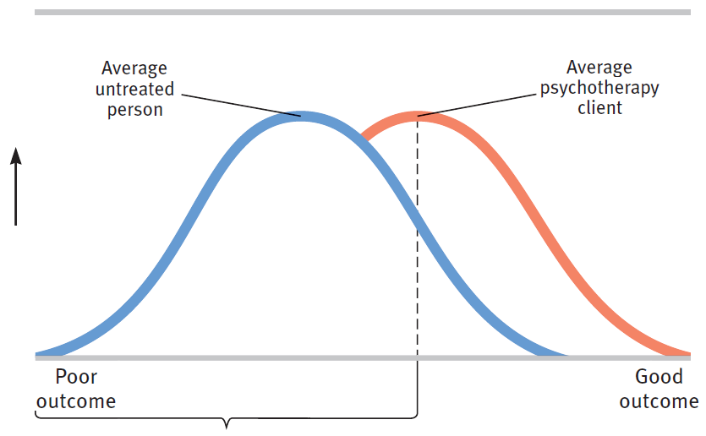
Understanding Outcome Data
If we find that even people in a control group (e.g. on a waiting list) showed improvement, is therapy a waste of time?
Number of persons
People are more likely to improve with treatment.
About 80 percent of untreated people have poorer outcomes than the average treated person.
Notes:
No animation.
Instructor: to see if students understand this information, ask the following question and wait for laughter as well as a response: “What percentage of TREATED people had poorer outcomes than the average treated person? [The answer is just under 50 percent, by definition]? Do you find this surprising? Would you find it surprising if almost 50 percent of your test scores were lower than your average score?
→A statistics-savvy student might speaks up here, using information from the intelligence chapter to ask, “don’t you mean “median” score?” Or s/he might challenge whether it’s really 50 percent depending on skewing of the data. The student is technically correct, but ask her/him to keep focus on the main point.

Slide 36
Results of Outcome Research
Some forms of psychotherapy have been found to be effective for certain problems:
Depression
Anxiety
Phobias
Bedwetting
Cognitive-behavioral
Psychodynamic therapy
Exposure therapy
Behavior conditioning
Notes:
Click to show the most effective therapy for each problem.

Slide 37
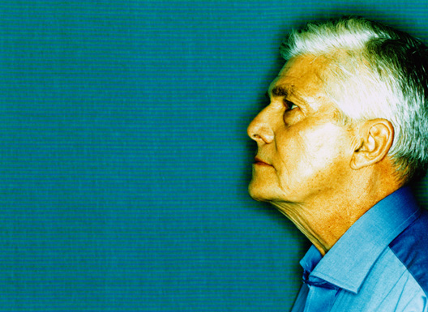
Eye Movement Desensitization and Reprocessing (EMDR)
In EMDR therapy, the therapist attempts to unlock and reprocess previous frozen traumatic memories. The therapist waves a finger or light in front of the eyes of the client, in order to integrate past and present, and left and right hemispheres.
Some studies show EMDR is effective and some do not. Studies which did not show effectiveness were critiqued by the founder as being done without adequate training in EMDR. Is this a valid critique of the research?
Research suggests that the effectiveness of EMDR, even when it does work, may not depend on the eye movement technique.
Notes:
Click to show bottom bar.

Slide 38
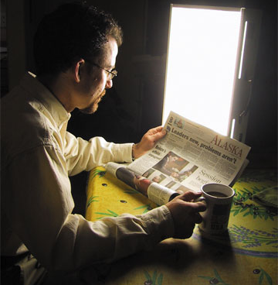
Light Exposure Therapy
Research supports the idea that daily exposure to bright light, especially with a blue tint, is effective in treating the depressive symptoms of seasonal affective disorder [SAD].
Notes:
No animation.

Slide 39
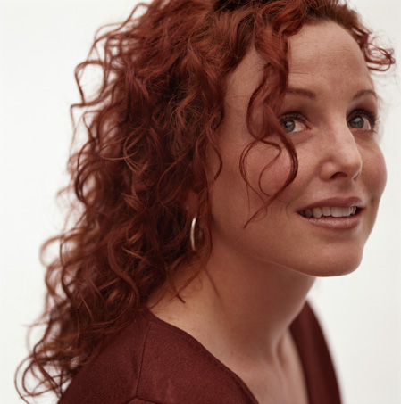
What do effective psychotherapy styles seem to have in common?
Hope: therapists assume the client has resources that can be used for recovery, and that improvement is possible
A new perspective: new interpretations and narratives (from “victim” to “survivor”) can improve mood and motivate change
The relationship: empathy, trust, and caring provide an environment for healthy growth
Notes:
Click to reveal bullets.
The successful working relationship between therapist and client has been called the therapeutic alliance.
Psychotherapy also may offer:
1. a safe place to explore feelings, ideas, self.
2. a source of ideas (not “advice”) and options for behaving and seeing things differently.
3. exercises in behavioral, cognitive, and emotional change.
4. affirmation for who you are, along with support for change.
5. a source of challenge and enrichment to support neural growth and integration.

Slide 40
Client-Therapist Differences
Therapists differ from clients (and from each other) in beliefs, values, cultural background, conversational style, and personality.
Ways to serve diverse clients
Therapists should be receptive, respectful, curious, and seek understanding rather than assuming it.
The therapist and client do NOT have to have similar backgrounds for effective therapy and a good therapeutic relationship. It is more important to have similar ideas about the function and style of therapy.
Notes:
Click to reveal bullets.
Instructor: you might begin introduce this slide by saying, “therapists do not say ‘I understand’ or ‘I know what you mean.’ Everyone’s has different experiences, backgrounds, meanings, and even if you’ve been through a similar event, the client may have experienced it differently.” Even if you go to the same denomination of church, your beliefs may serve a different function in your life.
Research shows that therapists who are curious and open are more effective at working with clients from different backgrounds than therapists who study a great deal of diversity material.

Slide 41
Selecting a Psychotherapist
Therapists and their Training
Psychotherapists ≠ psychologists
Psychologists (PhD, PsyD) do therapy plus intelligence and personality testing.
Psychiatrists (MD, DO) prescribe medicine and sometimes do psychotherapy.
Social workers (MSW) as well as counselors, nurses, and other professionals may be trained and licensed to diagnose and treat mental health disorders.
People with a variety of different graduate degrees are able to provide psychotherapy.
Specific training and experience in the area of your difficulty is worth asking about.
What is most important is whether you and the therapist are able to establish an alliance.
→ Some of this is trial and error. If problems arise, you can try working it out, but switching therapists is okay.
Notes:
Click to reveal bullets.

Slide 42
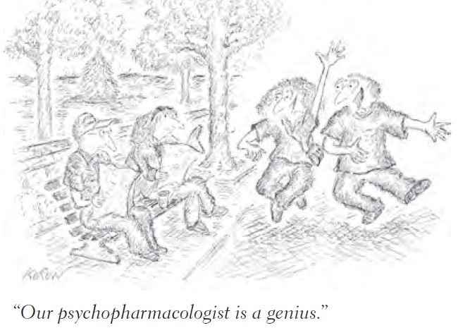
Biomedical Therapies
Interventions in the brain and body can affect mood and behavior.
Biomedical therapies refer to physically changing the brain’s functioning by altering its chemistry with medications, or affecting its circuitry with electrical or magnetic impulses or surgery.
Notes:
No animation.
Remember, although there is still psychosurgery, we are not drilling holes in skulls anymore.

Slide 43
Drug (Medication) Therapies
Psychopharmacology refers to the study of drug effects on behavior, mood, and the mind.
Notes:
No animation.

Slide 44
Drug Therapies
Psychopharmacology is the study of drug effects on mind and behavior.
With the advent of drugs, hospitalization in mental institutions rapidly declined, called deinstitutionalization.
Notes:
OBJECTIVE 18| Define psychopharmacology, and explain how double-blind studies help researchers evaluate a drug’s effectiveness.

Slide 45
Drug Therapies
However, many patients are left homeless on the streets due to their ill-preparedness to cope independently outside in society. Thus, deinstitionalization was an abysmal failure
Notes:
OBJECTIVE 18| Define psychopharmacology, and explain how double-blind studies help researchers evaluate a drug’s effectiveness.

Slide 46
 | Antipsychotic | Antianxiety | Antidepressant
What they do | Reduces the symptoms of schizophrenia, especially “positive” symptoms such as hallucinations and delusions | Temporarily reduces worried thinking and physical agitation; might permanently erase traumatic associations | Improves mood and control over depressing and anxious thoughts
How they work | Blocking dopamine receptors | Slowing nervous system activity in the body and brain | Increasing levels of serotonin (sometimes norepinephrine) at synapses by inhibiting reuptake; possible neurogenesis
Side effects | Obesity, diabetes, and movement problems (sluggishness, twitching, or eventually tardive dyskinesia--odd facial/tongue and body movements) | Slowed thinking, reduced learning, dependence, and withdrawal | Dry mouth, constipation, and reduced sexual desire and/or response
Types of Medication
Notes:
No animation.
Brand names for antipsychotics that students might have heard of: Haldol, Risperdal, Clozaril, Zyprexa, Abilify, Seroquel. I have left Zyprexa on the list because it’s mentioned in the text, even though it’s rarely used because of the increased risk of diabetes.
“Tardive dykenesia” literally means “late bad movements”; it shows up later than other side effects, and only after chronic use.
Antianxiety medicine includes alprazolam (Xanax), lorazepam (Ativan), and buspirone (Buspar).
A student might say, “I take Paxil (or Effexor or Prozac) for anxiety.” Yes, many medications for depression also have benefits for anxiety disorders. This is especially true for OCD more for the “worrying” than for the physical agitation parts of anxiety.
In case someone asks, “slowing nervous system activity” (under “Antianxiety”) is mostly about increasing synaptic levels of the inhibitory neurotransmitter GABA.
Antidepressant medication includes fluoxetine (Prozac), citalopram (Celexa), paroxetine (Paxil), and sertraline (Zoloft).

Slide 47
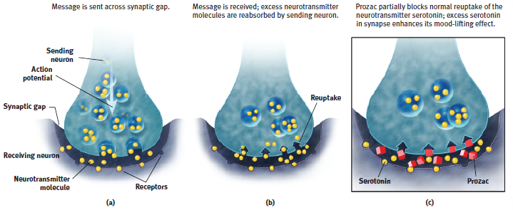
Inhibiting Reuptake
Many medications increase synaptic neurotransmitter levels; they stop the sending neuron from taking back its chemical messages.
Notes:
No animation.

Slide 48
Schizophrenia Symptoms
Inappropriate symptoms present (positive symptoms) | Appropriate symptoms absent (negative symptoms)
Hallucinations, disorganized thinking, deluded ways. | Apathy, expressionless faces, rigid bodies.

Slide 49
Antipsychotic Drugs
Classical antipsychotics [Chlorpromazine (Thorazine)]: Remove a number of positive symptoms associated with schizophrenia such as agitation, delusions, and hallucinations by blocking dopamine receptor sites.
Atypical antipsychotics [Clozapine (Clozaril)]: Remove negative symptoms associated with schizophrenia such as apathy, jumbled thoughts, concentration difficulties, and difficulties in interacting with others.
Notes:
OBJECTIVE 19| Describe the characteristics of antipsychotic drugs, and discuss their use in treating specific disorders.

Slide 50
Atypical Antipsychotic
Clozapine (Clozaril) blocks receptors for dopamine and serotonin to remove the negative symptoms of schizophrenia.

Slide 51
Antianxiety Drugs
Antianxiety drugs (Xanax, Valium, and Ativan) depress the central nervous system and reduce anxiety and tension by elevating the levels of the Gamma-aminobutyric acid (GABA) neurotransmitter.
Notes:
OBJECTIVE 20| Describe the characteristics of antianxiety drugs, and discuss their use in treating specific disorders.

Slide 52
Antidepressant Drugs
Antidepressant drugs like Prozac, Zoloft, and Paxil are Selective Serotonin Reuptake Inhibitors (SSRIs) that improve the mood by elevating levels of serotonin by inhibiting reuptake.
Notes:
OBJECTIVE 21| Describe the characteristics of antidepressant drugs, and discuss their use in treating specific disorders.

Slide 53
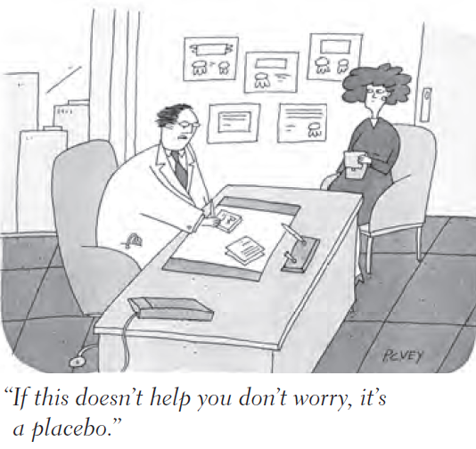
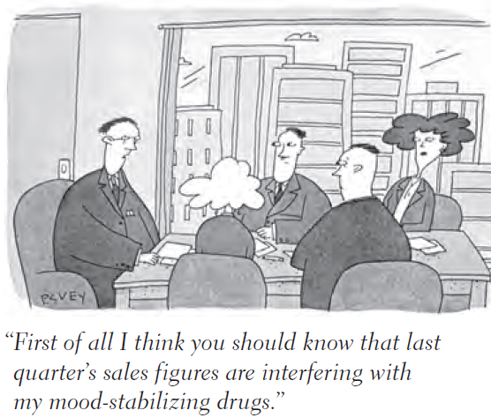
 | Mood Stabilizers | ADHD “Stimulants”
What they do | Reduce the “highs” of mania as well as reduce the depressive “lows” | Help control impulses, and reduce distractibility and the need for stimulation including fidgeting
How they work | Under investigation | Blocking reuptake of dopamine from synapses
Side effects | Various; blood levels must be monitored | Decreased appetite
Types of Medication
Notes:
No animation.
Mood stabilizers include lithium, and anti-seizure medications such as Depakote, Tegretol, and Lamictal.
ADHD stimulants include methlyphenidate (Ritalin, Concerta) and amphetamine salts (Adderal).

Slide 54
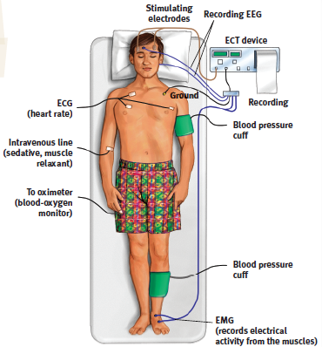
Electroconvulsive Therapy (ECT)
Electroconvulsive therapy [ECT] induces a mild seizure that disrupts severe depression for some people.
This might allow neural re-wiring, and might boost neurogenesis.
Notes:
No animation.

Slide 55
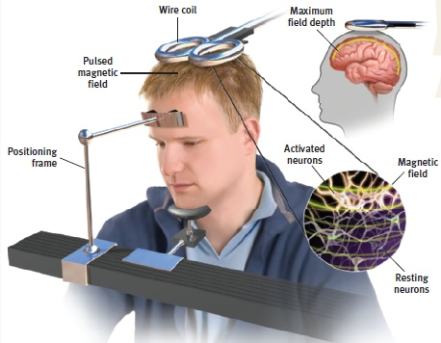
Repeated Transcranial Magnetic Stimulation
Another option is repeated deep-brain stimulation using implanted electrodes.
Like ECT, these techniques may disrupt depressive electrochemical brain patterns.
Notes:
No animation.

Slide 56
Psychosurgery
A lobotomy
destroys the connections between the frontal lobes and the rest of the brain. This decreases depression, but also destroys initiative, judgment, and cognition.
Microsurgery
might work by disrupting problematic neural networks involved with aggression or obsessive-compulsive disorder.
Notes:
Automatic animation.

Slide 57
Psychosurgery
Psychosurgery was popular even in Neolithic times. Although used sparingly today, about 200 such operations do take place in the US alone.
Notes:
OBJECTIVE 24| Summarize the history of the psychosurgical procedure known as lobotomy, and discuss the use of psychosurgery today.

Slide 58
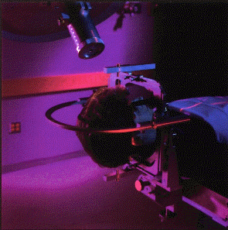
Psychosurgery
Modern methods use stereotactic neurosurgery and radiosurgery (Laksell, 1951) that refine older methods of psychosurgery.

Slide 59
Psychological Disorders are Biopsychosocial in Nature

Slide 60
Therapeutic Lifestyle Change
We can indirectly affect the biological components of mental health problems.
Exercise can boost serotonin levels and reduce stress.
Changing negative thoughts can improve mood and even rewire the brain.
Mental health problems also can be reduced by meeting our basic needs for sleep, nutrition, light, meaningful activity, and social connection.
Notes:
Click to reveal bullets.

Slide 61
Preventing Psychological Disorders
In addition to treating mental health disorders, some mental health professionals, especially social workers, also work to reduce the risk of mental health disorders. Such prevention efforts include:
support programs for stressed families.
community programs to provide healthy activities and hope for children.
relationship-building communication skills training.
working to reduce poverty and discrimination.
Notes:
No animation.

