Slide 1
Modifying Illness-Related Behaviors
The elimination of smoking would increase life expectancy more than any other preventive measure.
Notes:
OBJECTIVE 19| Explain why people smoke.

Slide 2
Why Do People Smoke?
People smoke because it is socially rewarding.
Smoking is also a result of genetic factors.
Russel Einhorn/ The Gamma Liason Network

Slide 3
Why Do People Smoke?
Nicotine takes away unpleasant cravings (negative reinforcement) by triggering epinephrine, norepinephrine, dopamine, and endorphins.
Nicotine itself is rewarding (positive reinforcement).

Slide 4
Biopsychosocial Factors: Smoking

Slide 5
Helping Smokers Quit
Smoking decreased in Western countries, especially in higher socioeconomic groups and more educated groups.
Notes:
OBJECTIVE 20| Discuss ways of helping smokers to quit smoking – or preventing young people from ever starting.

Slide 6
Ways to Quit Smoking
Here are a few pointers on how to quit smoking:
Set a quit date.
Inform family and friends.
Throw away all cigarettes.
Review successful strategies.
Use a nicotine patch or gum.
Abstain from alcohol.
Exercise.

Slide 7
Smoking Abstinence Programs
Smoking abstinence programs for teens provide:
Information about the effects of smoking
Information about peer, parent & media influence
Ways to refuse cigarettes

Slide 8
Do Programs Work?
Prevention programs do have an effect on smoking.
Paul J. Milette/ Palm Beach Post

Slide 9
Obesity and Weight Control
Fat is an ideal form of stored energy and is readily available. In times of famine, an overweight body was a sign of affluence.
Notes:
OBJECTIVE 21| Discuss the adaptive advantage of a body that stores fat.

Slide 10
Body Mass Index (BMI)
Obesity in children increases their risk of diabetes, high blood pressure, heart disease, gallstones, arthritis, and certain types of cancer, thus shortening their life-expectancy.

Slide 11
Obesity and Mortality
The death rate is high among very overweight men.

Slide 12
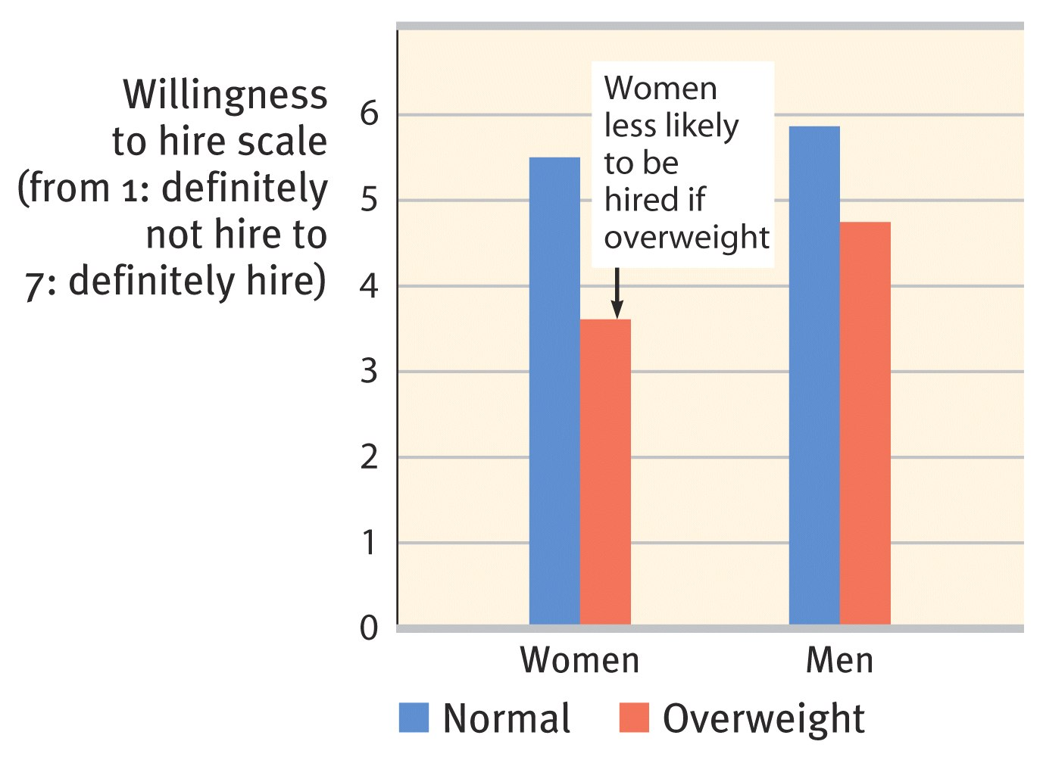
Social Effects of Obesity
When women applicants were made to look overweight, subjects were less willing to hire them.
Notes:
OBJECTIVE 22| Describe some of the social effects of obesity.

Slide 13
Physiology of Obesity
Fat Cells: There are 30-40 million fat cells in the body. These cells can increase in size or increase in number (75 million) in an obese individual (Sjöstrum, 1980).
Notes:
OBJECTIVE 23| Give arguments for and against the idea that genes determine body weight.

Slide 14
Set Points and Metabolism
When reduced from 3,500 calories to 450 calories, weight loss was a minimal 6% and the metabolic rate a mere 15%.
The obese defend their weight by conserving energy.

Slide 15
The Genetic Factor
Identical twin studies reveal that body weight has a genetic basis.
Courtesy of John Soltis, The Rockefeller University, New York, NY
The obese mouse on the left has a defective gene for the hormone leptin. The mouse on the right sheds 40% of its weight when injected with leptin.

Slide 16
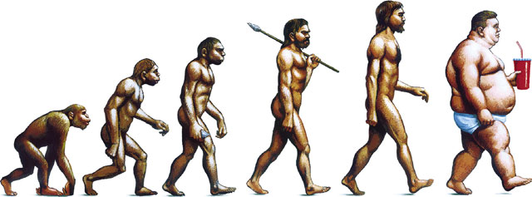
Activity
Lack of exercise is a major contributor to obesity. Just watching TV for two hours resulted in a 23% increase of weight when other factors were controlled (Hu et al., 2003).

Slide 17
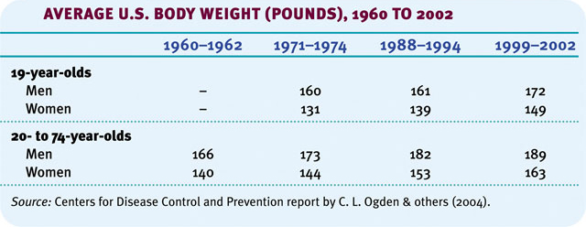
Food Consumption
Over the past 40 years average weight gain has increased. Health professionals are pleading with US citizens to limit their food intake.

Slide 18
Trading Risks
Although cigarette smoking has declined over the years in the Americas, obesity is on the rise.

Slide 19
Losing Weight
In the US, two-thirds of the women and half of the men say that they want to lose weight. The majority of them lose money on diet programs.
Notes:
OBJECTIVE 24| Discuss the chances of success for an overweight person to lose weight.

Slide 20
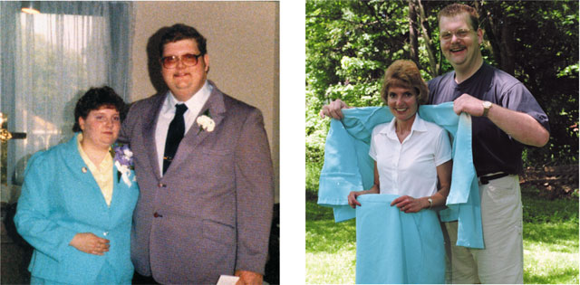
Plan to Lose Weight
When you are motivated to lose weight, begin a weight-loss program, minimize your exposure to tempting foods, exercise, and forgive yourself for lapses.
Joe R. Liuzzo

Slide 21
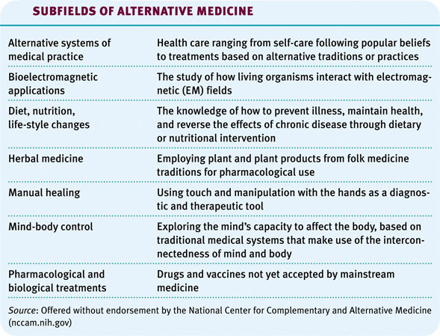
Alternative Medicine
Other medicinal ways of achieving health

