Slide 1
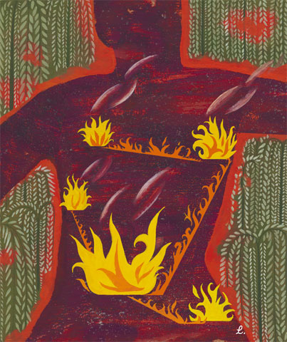
Stress and Health

Slide 2
Stress and Health
Stress and Illness
Stress and Stressors
Stress and the Heart
Stress and the Susceptibility to Disease
Promoting Health
Coping with Stress

Slide 3
Stress and Health
Promoting Health
Managing Stress
Modifying Illness-Related Behaviors
Thinking Critically About: Alternative Medicine – New Ways to Health, or Cold Snake Oil

Slide 4
Stress
Psychological states cause physical illness. Stress is any circumstance (real or perceived) that threatens a person’s well-being.
Lee Stone/ Corbis
When we feel severe stress, our ability to cope with it is impaired.
Notes:
OBJECTIVE 1| List four leading causes of death and describe health psychology’s contribution to the field of behavioral medicine.

Slide 5
Stress and Causes of Death
Prolonged stress combined with unhealthy behaviors may increase our risk for one of today's four leading diseases.

Slide 6
Behavioral Medicine
Centers for Disease Control (CDC) claim that half of the deaths in the US are due to people’s behaviors (smoking, alcoholism, unprotected sex, insufficient exercise, drugs, and poor nutrition).
Psychologists and physicians have thus developed an interdisciplinary field of behavioral medicine that integrates behavioral knowledge with medical knowledge.

Slide 7
Health Psychology
Health psychology is a field of psychology that contributes to behavioral medicine. The field studies stress-related aspects of disease and asks the following questions:
How do emotions and personality factors influence the risk of disease?
What attitudes and behaviors prevent illness and promote health and well-being?
How do our perceptions determine stress?
How can we reduce or control stress?

Slide 8
Stress and Illness
Stress can be adaptive. In a fearful or stress- causing situation, we can run away and save our lives. Stress can be maladaptive. If it is prolonged (chronic stress), it increases our risk of illness and health problems.

Slide 9
Stress and Stressors
Stress is a slippery concept. At times it is the stimulus (missing an appointment) and at other times it is a response (sweating while taking a test).
Notes:
OBJECTIVE 2| Discus the importance of appraisal in the way we respond to stressful events.

Slide 10
Stress and Stressors
Stress is not merely a stimulus or a response. It is a process by which we appraise and cope with environmental threats and challenges.
Bob Daemmrich/ The Image Works
When short-lived or taken as a challenge, stressors may have positive effects. However, if stress is threatening or prolonged, it can be harmful.

Slide 11
The Stress Response System
Canon proposed that the stress response (fast) was a fight-or-flight response marked by the outpouring of epinephrine and norepinephrine from the inner adrenal glands, increasing heart and respiration rates, mobilizing sugar and fat, and dulling pain.
Notes:
OBJECTIVE 3| Identify and describe the dual-track system by which our body responds to stress, and give the three phases of the general adaptation syndrome.

Slide 12
The Stress Response System
The hypothalamus and the pituitary gland also respond to stress (slow) by triggering the outer adrenal glands to secrete glucocorticoids (cortisol).

Slide 13
General Adaptation Syndrome
According to Selye, a stress response to any kind of
stimulation is similar. The stressed individual goes
through three phases.
EPA/ Yuri Kochetkov/ Landov

Slide 14
Stressful Life Events
Catastrophic Events: Catastrophic events like earthquakes, combat stress, and floods lead individuals to become depressed, sleepless, and anxious.
Notes:
OBJECTIVE 4| Discuss the health consequences of catastrophes, significant lie changes, and daily hassles.

Slide 15
Significant Life Changes
The death of a loved one, a divorce, a loss of job, or a promotion may leave individuals vulnerable to disease.

Slide 16
Daily Hassles
Rush hour traffic, long lines, job stress, and becoming burnt-out are the most significant sources of stress and can damage health

Slide 17
Stress and the Heart
Stress that leads to elevated blood pressure may result in Coronary Heart Disease, a clogging of the vessels that nourish the heart muscle.
Plaque in
coronary artery
Artery
clogged
Notes:
OBJECTIVE 5| Discuss the role of stress in causing coronary heart disease, and contrast Type A and Type B personalities.

Slide 18
Personality Types
Type A is a term used for competitive, hard-driving, impatient, verbally aggressive, and anger-prone people. Type B refers to easygoing, relaxed people (Friedman and Rosenman, 1974).
Type A personalities are more likely to develop
coronary heart disease.

Slide 19
Pessimism and Heart Disease
Pessimistic adult men are twice as likely to develop heart disease over a 10-year period (Kubzansky et al., 2001).

Slide 20
Stress & Susceptibility to Disease
A psychophysical illness is any stress-related physical illness such as hypertension or headaches. Hypochondriasis is a misinterpretation of normal physical sensations as symptoms of disease.
Notes:
OBJECTIVE 6| Distinguish between a psychophysical illness and hypochondriasis.

Slide 21
Stress and the Immune System
B lymphocytes fight bacterial infections, T lymphocytes attack cancer cells and viruses, and microphages ingest foreign substances. During stress, energy is mobilized away from the immune system making it vulnerable.
Lennart Nilsson/ Boehringer Ingelhein International GmbH
Notes:
OBJECTIVE 7| Describe the effect of stress on immune system functioning.

Slide 22
Stress and Colds
People with the highest life stress scores were also the most vulnerable when exposed to an experimental cold virus.

Slide 23
Stress and AIDS
Stress and negative emotions may accelerate the progression from human immunodeficiency virus (HIV) to acquired immune deficiency syndrome (AIDS).
UNAIDS/ G. Pirozzi
Notes:
OBJECTIVE 8| Discuss the findings on the link between stress and AIDS.

Slide 24
Stress and Cancer
Stress does not create cancer cells. Researchers disagree on whether stress influences the progression of cancer. However, they do agree that avoiding stress and having a hopeful attitude cannot reverse advanced cancer.
Notes:
OBJECTIVE 9| Discuss the findings on the link between stress and cancer.

Slide 25
Stress and Immune Conditioning
If the immune system can be suppressed through conditioning, researchers believe that immune- enhancing responses can be inculcated to combat viral diseases.
Notes:
OBJECTIVE 10| Describe the impact of learning on immune system functioning.

Slide 26
Health-Related Consequences
Stress can have a variety of health-related consequences.
Kathleen Finlay/ Masterfile

Slide 27
Promoting Health
Promoting health is generally defined as the absence of disease. We only think of health when we are diseased. However, health psychologists say that promoting health begins by preventing illness and enhancing well-being, which is a constant endeavor.

Slide 28
Coping with Stress
Reducing stress by changing events that cause stress or by changing how we react to stress is called problem-focused coping.
Emotion-focused coping is when we cannot change a stressful situation, and we respond by attending to our own emotional needs.
Notes:
OBJECTIVE 11| Explain what it means to cope with stress, and contrast problem-focused coping and emotion-focused coping.

Slide 29
Perceived Control
Research with rats and humans indicates that the absence of control over stressors is a predictor of health problems.
Notes:
OBJECTIVE 12| Describe how a perceived lack of control can affect health.

Slide 30
Explanatory Style
People with an optimistic (instead of pessimistic) explanatory style tend to have more control over stressors, cope better with stressful events, have better moods, and have a stronger immune system.
Notes:
OBJECTIVE 13| Discuss the links among explanatory style, stress and health.

Slide 31
Social Support
Supportive family members, marriage partners, and close friends help people cope with stress. Their immune functioning calms the cardiovascular system and lowers blood pressure.
Bob Daemmrich/ Stock, Boston
Notes:
OBJECTIVE 14| Describe some of the ways that social support acts as a stress buffer.

Slide 32
Managing Stress
Having a sense of control, an optimistic explanatory style, and social support can reduce stress and improve health.
Notes:
OBJECTIVE 15| Explain the difference between coping with stress and managing stress.

Slide 33
Aerobic Exercise
Can aerobic exercise boost spirits? Many studies suggest that aerobic exercise can elevate mood and well-being because aerobic exercise raises energy, increases self-confidence, and lowers tension, depression, and anxiety.
Notes:
OBJECTIVE 16| Discuss the advantages of aerobic exercise as a technique for managing stress and fostering well-being.

Slide 34
Biofeedback, Relaxation, and Meditation
Biofeedback systems use electronic devices to inform people about their physiological responses and gives them the chance to bring their response to a healthier range. Relaxation and meditation have similar effects in reducing tension and anxiety.
Notes:
OBJECTIVE 17| Compare the benefits of biofeedback and relaxation training as stress-management techniques, and discuss meditation as a relaxation technique.

Slide 35
Life-Style
Modifying a Type-A lifestyle may reduce the recurrence of heart attacks.
Ghislain and Marie David De Lossy/ Getty Images

Slide 36
Spirituality & Faith Communities
Regular religious attendance has been a reliable predictor of a longer life span with a reduced risk of dying.
Notes:
OBJECTIVE 18| Discuss the correlation between religiosity and longevity, and offer some possible explanations for this link.

Slide 37
Intervening Factors
Investigators suggest there are three factors that connect religious involvement and better health.

Slide 38
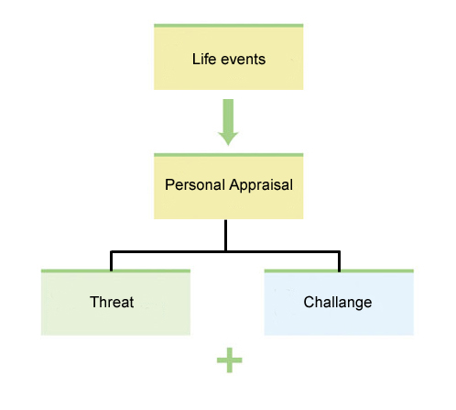
Managing Stress: Summary
How can stress be managed?

