Slide 1
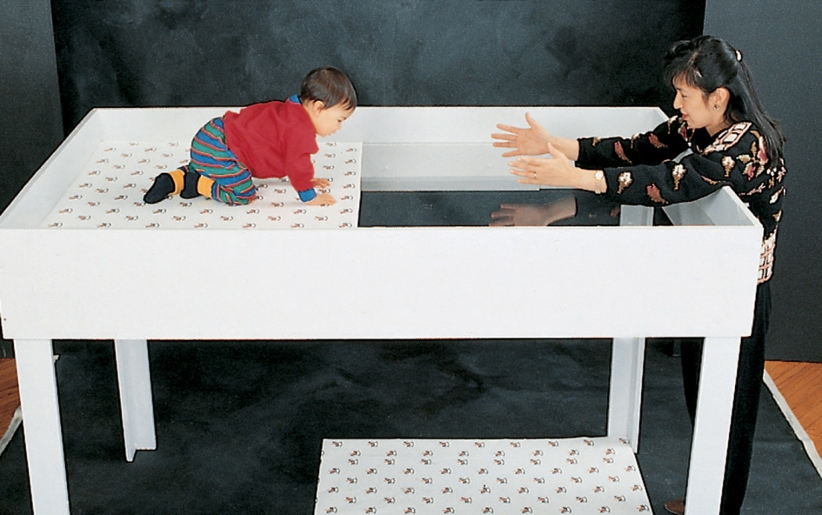
Visual Cliff: A Test of Depth Perception
Babies seem to develop this ability at crawling age.
Even newborn animals fear the perceived cliff.
Notes:
No animation.
Instructor: as a preview of figuring out how we perceive depth, note that the pattern on the floor looks more condensed (and thus farther away) to the infant than the identical pattern on the table. The infant can perceive this difference as depth/height and see a danger of falling.
Note that the ability to perceive glass as solid does not appear to be as innate as the fear of the cliff.

Slide 2

Perceiving Depth From a 2D Image: Binocular Methods
Binocular (using both eyes) cues exist because humans have two eyes in the front of our head. This gives us retinal disparity; the two eyes have slightly different views, and the more different the views are, the closer the object must be. In an extreme example, your nose is so close that each eye sees a completely opposite half-view of it.
How do we perceive depth from a 2D image?...
by using monocular (needing only one eye) cues
Notes:
Click to reveal second text box.

Slide 3
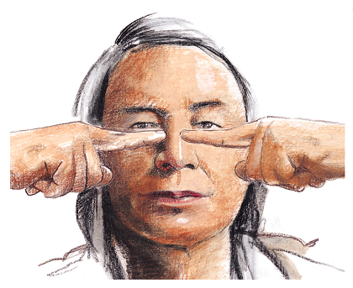
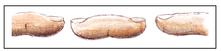
Binocular Cues
Retinal disparity: Images from the two eyes differ. Try looking at your two index fingers when pointing them towards each other half an inch apart and about 5 inches directly in front of your eyes. You will see a “finger sausage” as shown in the inset.

Slide 4
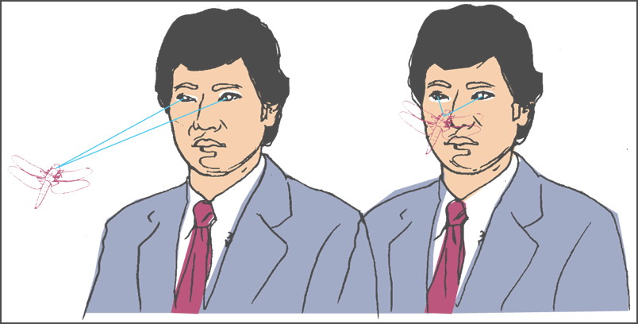
Binocular Cues
Convergence: Neuromuscular cues. When two eyes move inward (towards the nose) to see near objects and outward (away from the nose) to see faraway objects.
Notes:
OBJECTIVE 6| Describe two binocular cues for perceiving depth, and explain how they help the brain to compute distance.

Slide 5

Monocular Cue: Interposition
Interposition:
When one object appears to block the view of another, we assume that the blocking object is in a position between our eyes and the blocked object.
Notes:
No animation.

Slide 6

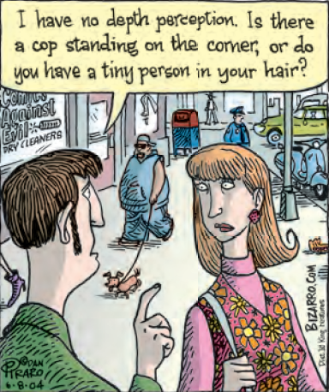
Monocular Cue: Relative Size
We intuitively know to interpret familiar objects (of known size) as farther away when they appear smaller.
Notes:
No animation.

Slide 7

Monocular Cues:
Linear Perspective and Interposition
The flowers in the distance seem farther away because the rows converge. Our brain reads this as a sign of distance.
Notes:
No animation.
Instructor: see if students can notice one other monocular cue for depth perception evident in this picture...interposition. The flowers in the very front (bottom of the frame) partially block the view of other flowers, and the whole hill of flowers appears to block the view of the hill in the background.

Slide 8

Tricks Using Linear Perspective
These two red lines meet the retina as being the same size
However, our perception of distance affects our perception of length.
Notes:
Click to bring bottom line up.
The way our brain changes the perception of length in this case is called the Ponzo illusion, first demonstrated by Italian psychologist Mario Ponzo in 1913.
The two [rods/bars/logs] are the same size on screen, but our eyes tend to see one as larger because linear perspective makes its location on the train tracks seem farther away.

Slide 9


Monocular Cues: Shading Effects
Shading helps our perception of depth.
Does the middle circle bulge out or curve inward?
How about now?
Notes:
Click to invert the image and show the hollow as a hill.

Slide 10

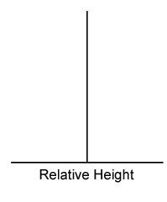
Monocular Cues
Relative Height: We perceive objects that are higher in our field of vision to be farther away than those that are lower.

Slide 11
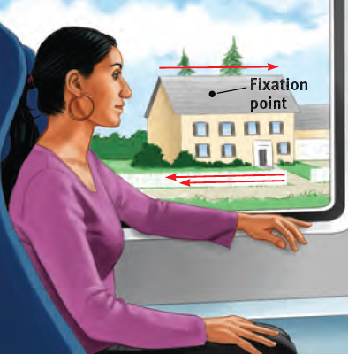
Monocular Cues: Relative Motion
When we are moving, we can tell which objects are farther away because it takes longer to pass them.
A picture of a moon on a sign would zip behind us, but the actual moon is too far for us to pass.
Notes:
No animation.
A great animated example can be found at http://psych.hanover.edu/krantz/motionparallax/motionparallax.html.
This depth perception cue is often referred to as motion parallax. It is used by many animals that don’t have the benefit of binocular cues because their eyes are on the sides of their heads. It is called “relative motion”; when we are moving, the objects we pass can appear to be moving in the opposite direction, and the farther objects don’t move as fast.

Slide 12
Motion Perception
Motion Perception: Objects traveling towards us grow in size and those moving away shrink in size. The same is true when the observer moves to or from an object.
Notes:
OBJECTIVE 8| State the basic assumption we make in our perceptions of motion, and explain how these perceptions can be deceiving.

Slide 13
Apparent Motion
Phi Phenomenon: When lights flash at a certain speed they tend to present illusions of motion. Neon signs use this principle to create motion perception.
Two lights flashing one after the other.
One light jumping from one point to another: Illusion of motion.

Slide 14
Perceptual Constancy
Our ability to see objects as appearing the same even under different lighting conditions, at different distances and angles, is called perceptual constancy. Perceptual constancy is a top-down process.
Examples:
color and brightness constancy
shape and size constancy
Notes:
No animation.
Instructor: you can use this narrative to tie things together after the definition--“Because this means perceiving sameness even when receiving different sensory information, this means that we use this top-down process to change what colors, shapes, sizes and objects we think we see, depending on the context.”

Slide 15
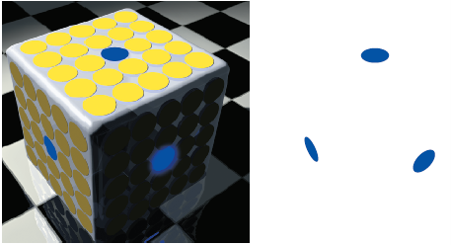
Color Constancy
This ability to see a consistent color in changing illumination helps us see the three sides as all being yellow, because our brain compensates for shading.
As a result, we interpret three same-color blue dots, with shades that are not adjusted for shading, as being of three different colors.
Notes:
Click to reveal bullets and animate example.

Slide 16
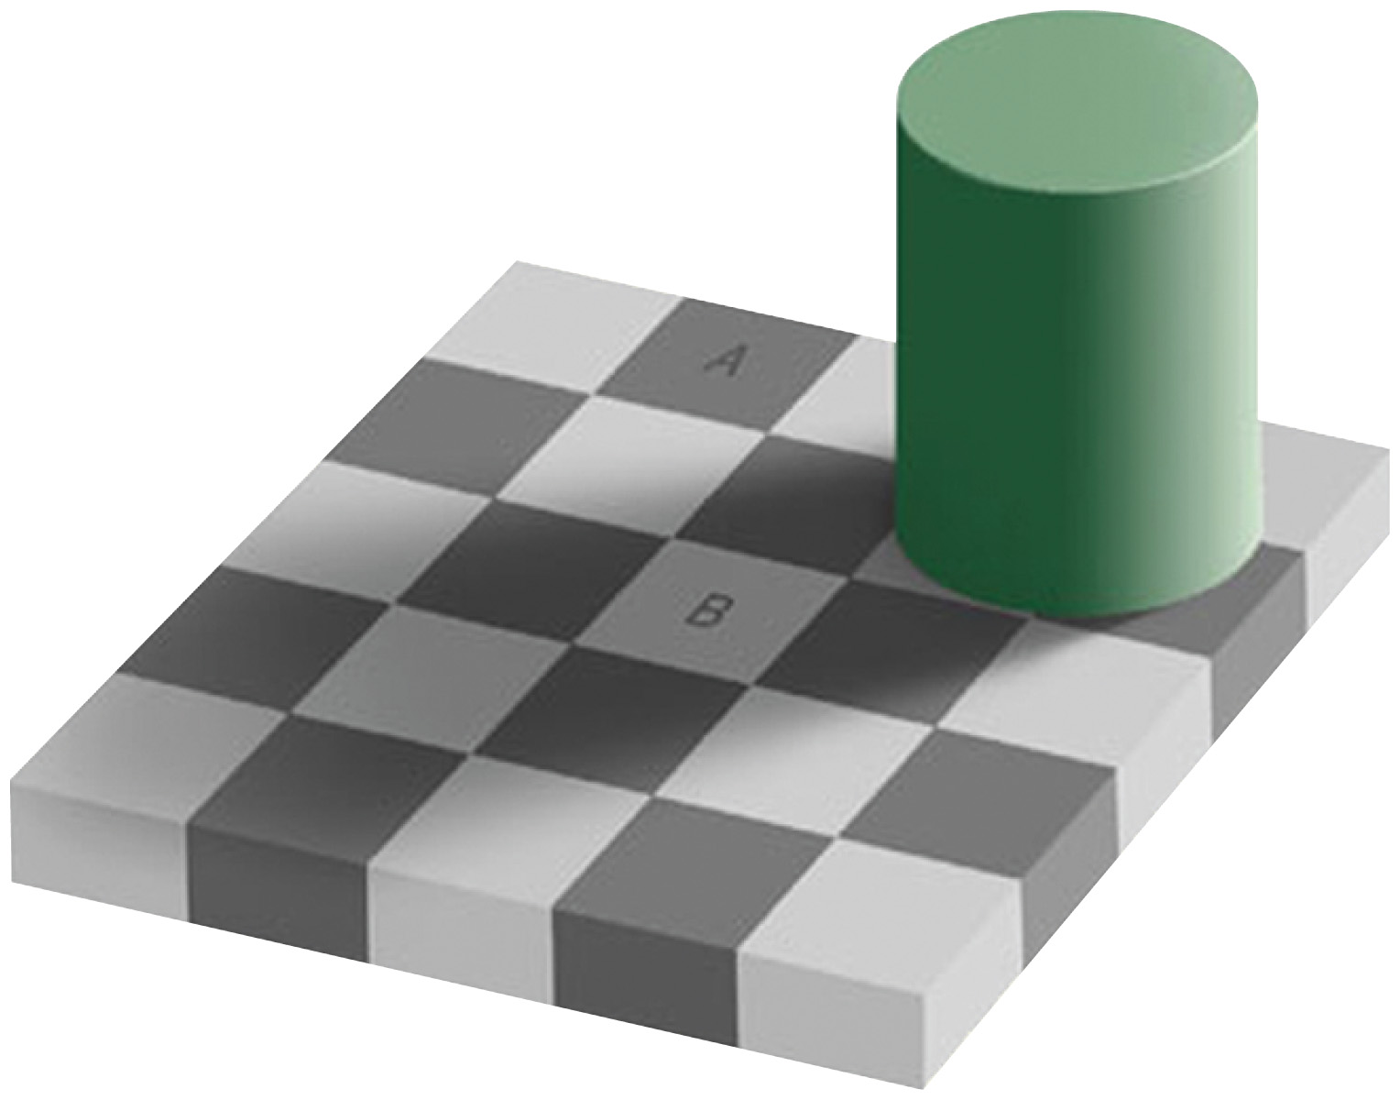
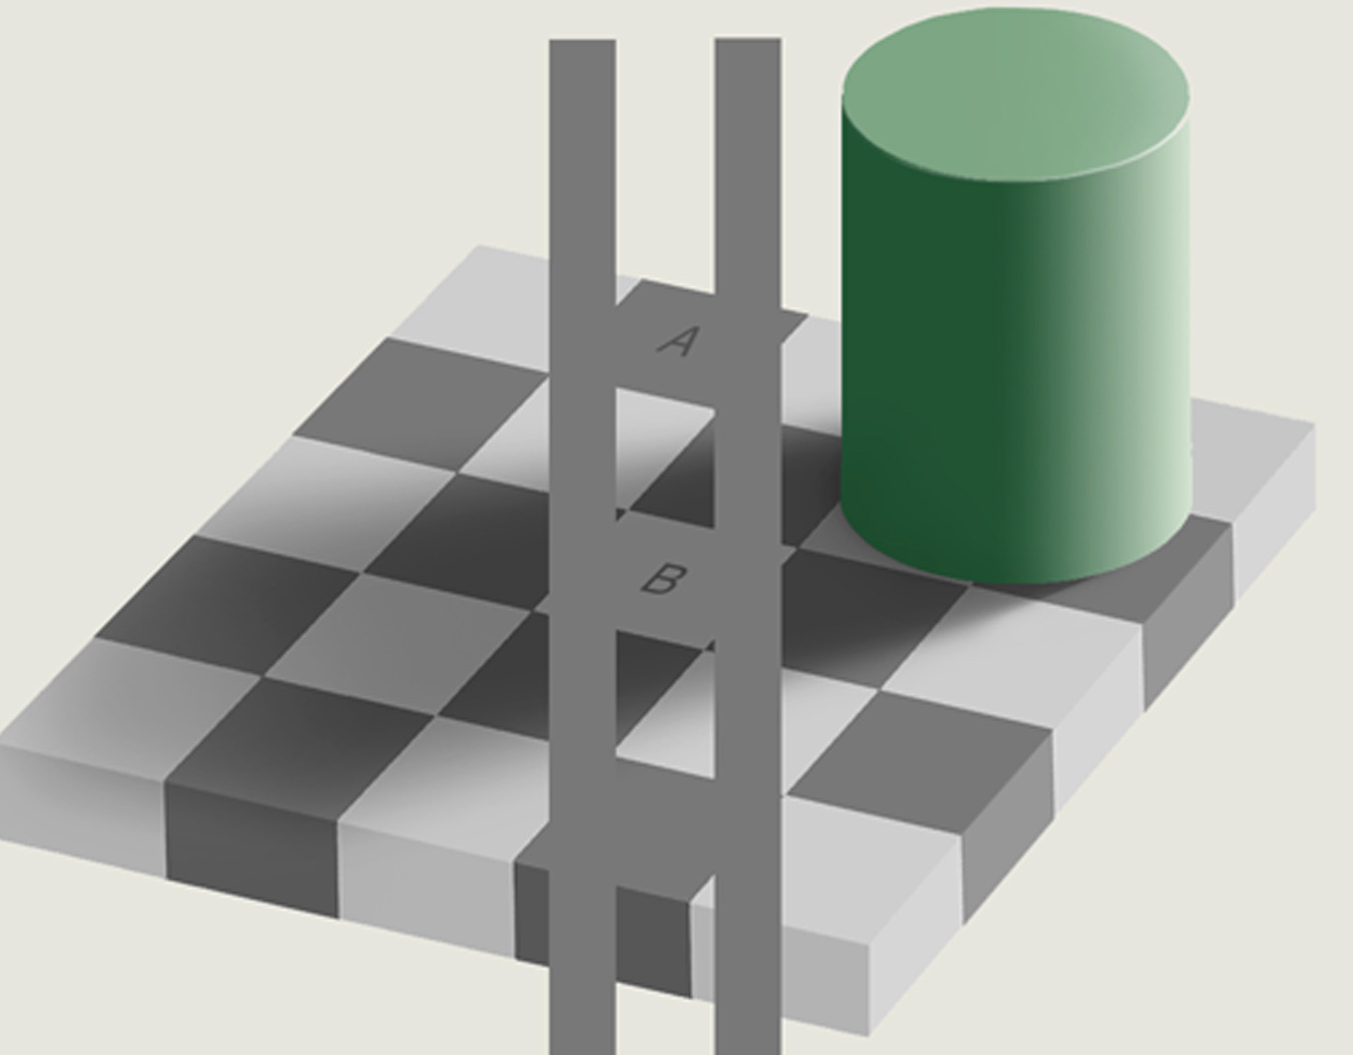
Brightness Constancy
On this screen, squares A and B are exactly the same shade of gray.
You can see this when you connect them.
So why does B look lighter?
Notes:
Click to show image with gray bars to demonstrate.
Click to show image with gray bars connecting the A and B squares.
Hopefully, your students can explain that our brains compensate for shadows and other context by perceiving a constant color shade/brightness even when things are in shadow. This means mentally erasing the shadow to see objects in a lighter shade. This process, plus the checkerboard context, makes B seem lighter to our brain than the images sensed by our eyes.

Slide 17
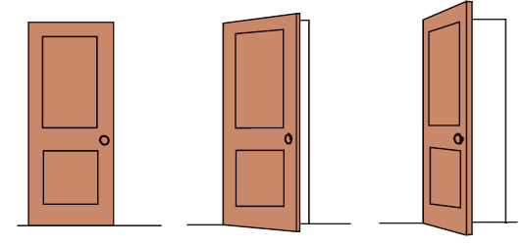
Shape Constancy
Shape constancy refers to the ability to perceive objects as having a constant shape despite receiving different sensory images. This helps us see the door as a rectangle as it opens. Because of this, we may think the red shapes on screen are also rectangles.
Notes:
No animation.
Instructor: you could ask students an intentionally ambiguous question...“What shapes do you see outlined in red?” If they say “rectangle,” ask again, no longer referring to the doors. “Tell us the names of the red shapes.” Then click to fade the doors and reveal that the second and third red shapes are trapezoids.

Slide 18

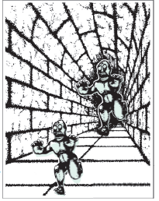
The Moon Illusion
The moon appears larger on the horizon than overhead.
Why do we perceive the moon as a different size depending on its location?
One possible theory is that our ancestors assumed overhead objects were closer than objects on the horizon.
The moon, like one of these monsters, seems larger because we see it as farther away.
Notes:
Click to reveal bullets.
Note that there are several other theories about the moon illusion. One has to do with horizon reference objects; maybe on the horizon we compare the moon to a smaller section of sky than when it’s overhead (try looking at a moonset picture that is NOT zoomed in).

Slide 19
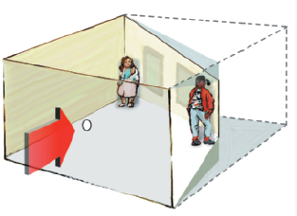
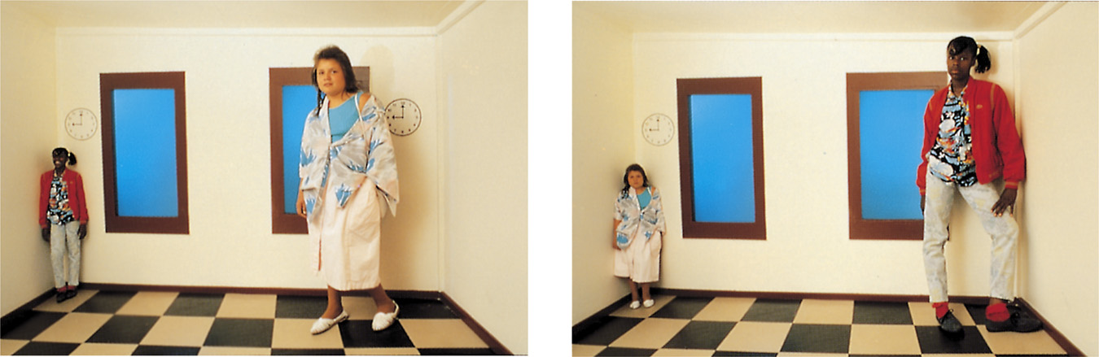
Size Constancy
We have an ability to use distance-related context cues to help us see objects as the same size even if the image on the retina becomes smaller.
The Ames room was invented by American ophthalmologist Adelbert Ames, Jr. in 1934.
The Ames room was designed to manipulate distance cues to make two same-sized girls appear very different in size.
Notes:
Click to reveal bullets and to show explanation.

Slide 20
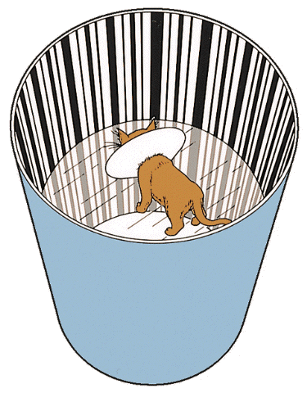
Sensory Deprivation
Kittens raised without exposure to horizontal lines later had difficulty perceiving horizontal bars.
Blakemore & Cooper (1970)

Slide 21
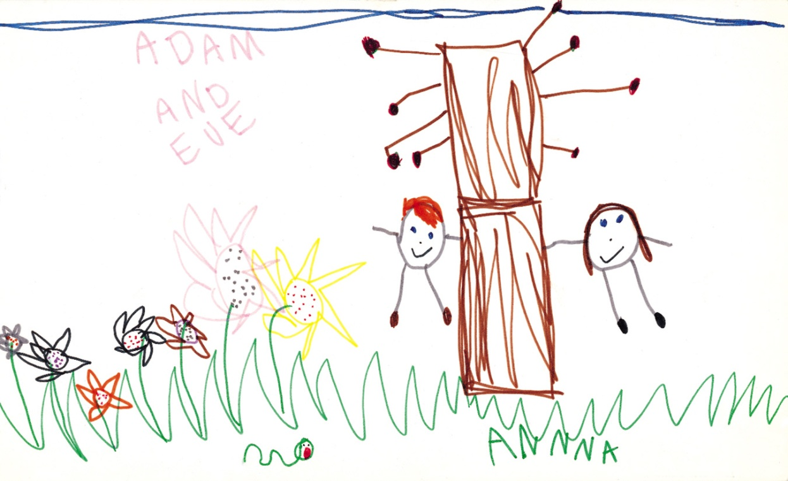
Schemas
Schemas are concepts that organize and interpret unfamiliar information.
Children's schemas represent reality as well as their abilities to represent what they see.
Notes:
All what we perceive not only comes from the environment but also from our minds. Schemas or concepts develop through experience.

Slide 22
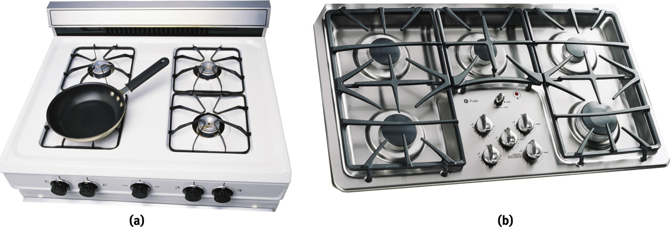
Perception & Human Factors
Human Factor Psychologists design machines that assist our natural perceptions.
Photodisc/ Punchstock
Courtesy of General Electric
The knobs for the stove burners on the right are easier to understand than those on the left.
Notes:
OBJECTIVE 16| Describe the role human factors psychologists play in creating user-friendly machines and work settings.

Slide 23

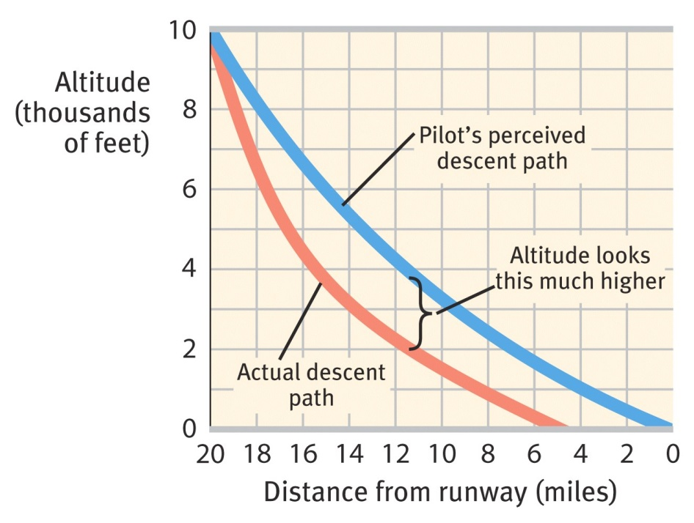
Human Factors & Misperceptions
Understanding human factors enables us to design equipment to prevent disasters.
Two-thirds of airline crashes caused by human error are largely due to errors of perception.

Slide 24
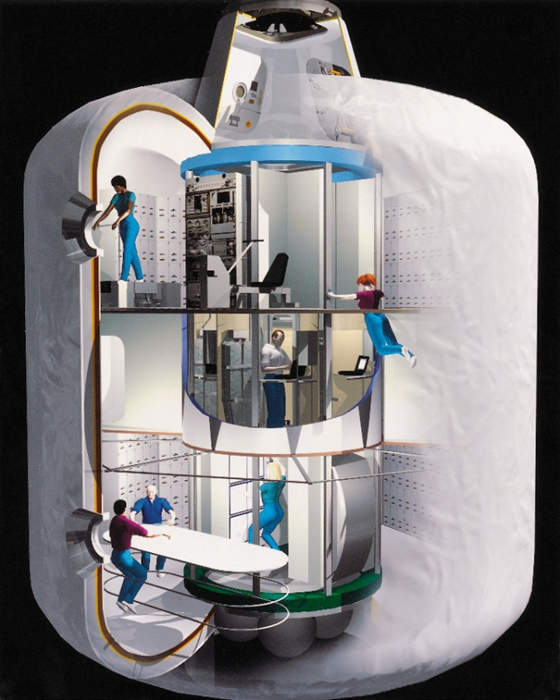
Human Factors in Space
To combat conditions of monotony, stress, and weightlessness when traveling to Mars, NASA engages Human Factor Psychologists.
Transit Habituation (Transhab), NASA

Slide 25
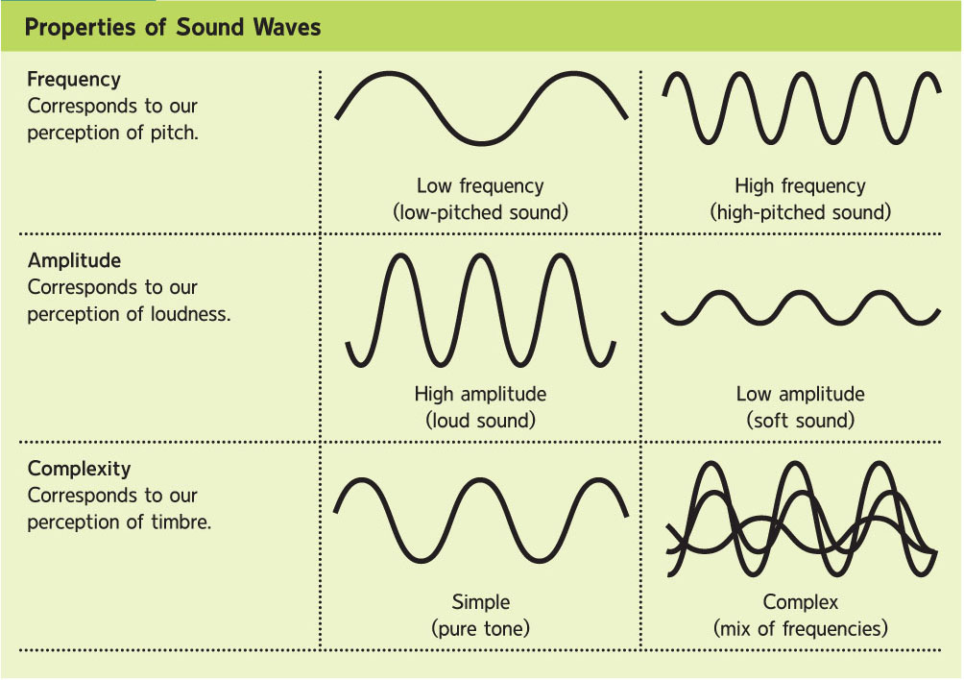
Hearing/Audition: Starting with Sound
  Length of the sound wave; perceived as high and low sounds (pitch)
  Height or intensity of sound wave; perceived as loud and soft (volume)
  Perceived as sound quality or resonance
Notes:
Click for Frequency sequence; click for Amplitude sequence.
Amplitude, or loudness, is measured relative to the threshold for human hearing (set at zero decibels). The rustling of leaves you heard measures at about 20 decibels, my voice (and most conversation) measures at about 40 to 60 decibels. You’ll find out more about the decibels of common sounds a little later in this presentation, but here’s an important decibel tip: enough exposure to a sound above 85 decibels can cause hearing damage.
Click for Complexity sequence.
We distinguish the same note played by a piano and any other instrument due to the complexity of the sound wave and our perception of timbre. Each human voice has its own complexity; for instance, can you describe what it is about the voice of a friend that allows you to recognize that person on the phone?
Of these properties, frequency provides most of the information we need to identify sounds. It is measured in cycles per second, or hertz (Hz), and perceived by humans as pitch (high and low sound). Both amplitude and frequency will be demonstrated further in the next slide.

Slide 26
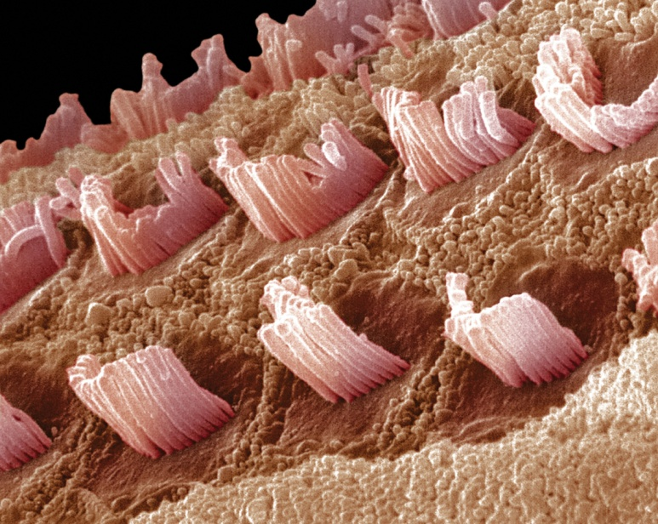
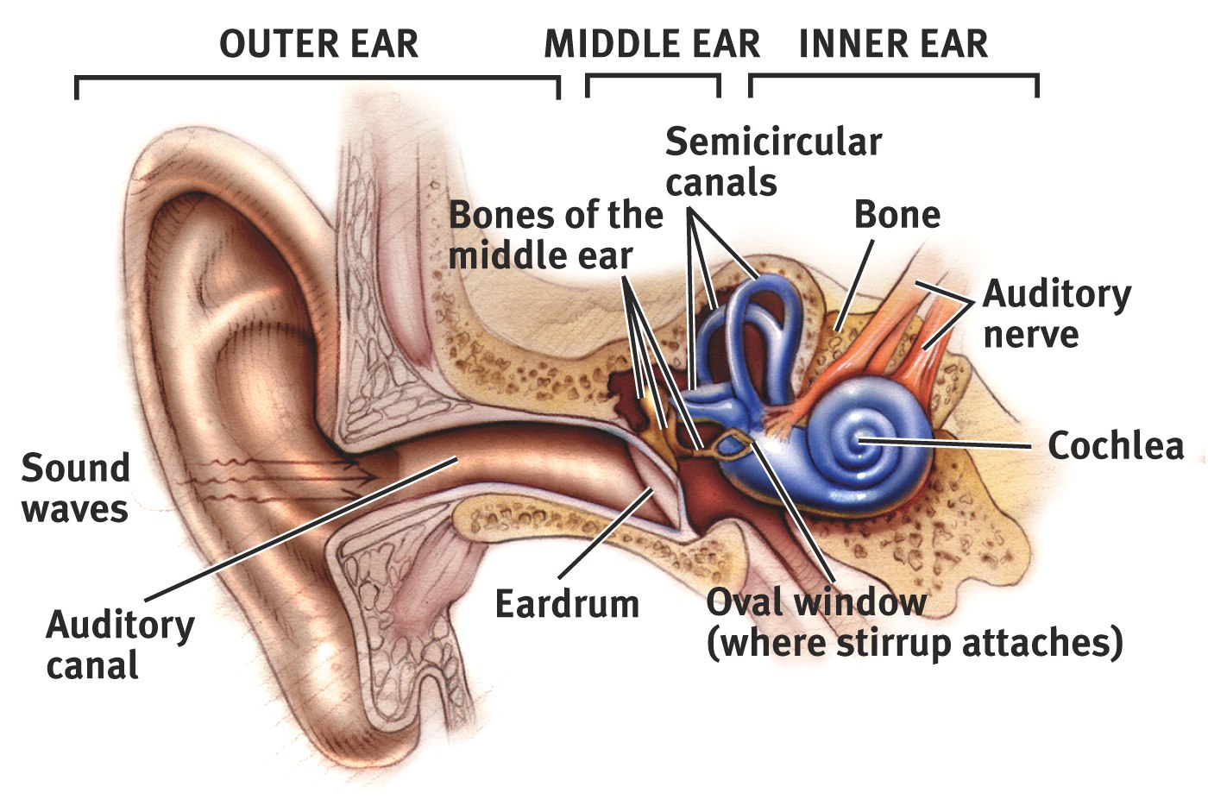
The Ear
Notes:
OBJECTIVE 12| Describe the three regions of the ear, and outline the series of events that triggers the electrical impulses sent to the brain.

Slide 27
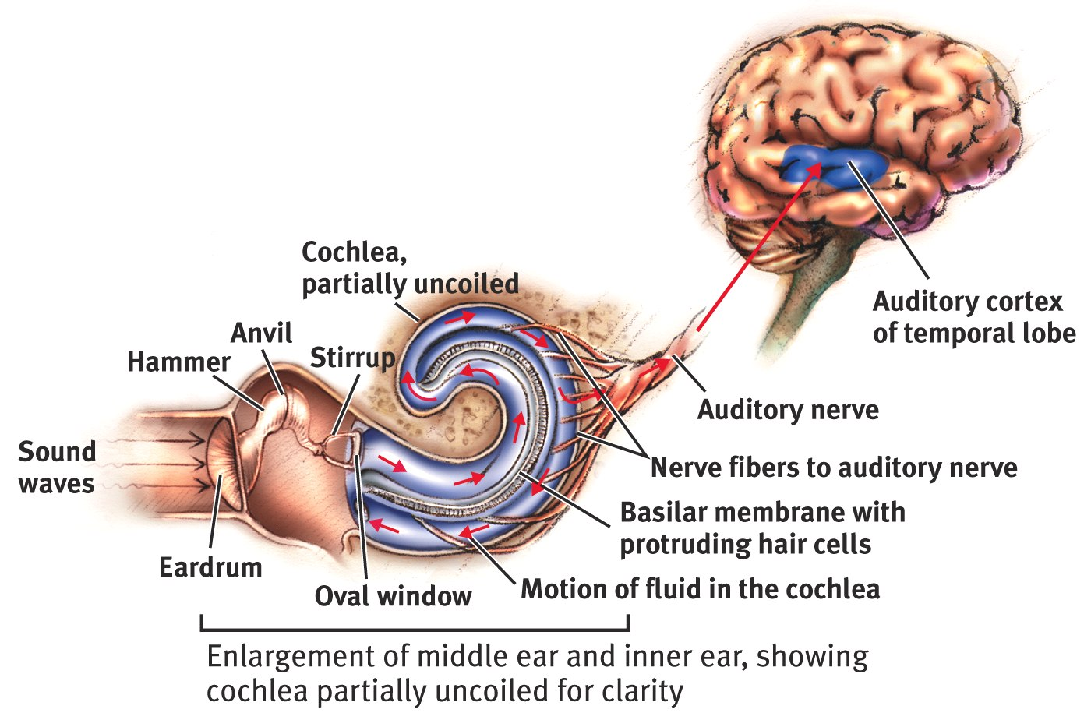
Cochlea
Cochlea: Coiled, bony, fluid-filled tube in the inner ear that transforms sound vibrations to auditory signals.

Slide 28
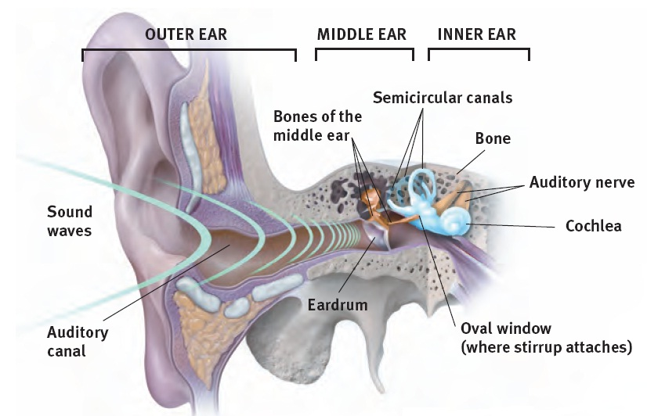
Sound Waves Reach The Ear
The outer ear collects sound and funnels it to the eardrum.
In the middle ear, the sound waves hit the eardrum and move the hammer, anvil, and stirrup in ways that amplify the vibrations. The stirrup then sends these vibrations to the oval window of the cochlea.
In the inner ear, waves of fluid move from the oval window over the cochlea’s “hair” receptor cells. These cells send signals through the auditory nerves to the temporal lobe of the brain.
Notes:
Click to show details about outer, middle, and inner ear.

Slide 29
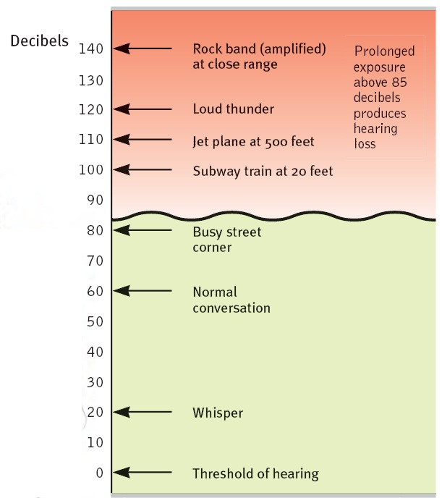
Preventing Hearing Loss
Exposure to sounds that are too loud to talk over can cause damage to the inner ear, especially the hair cells.
Structures of the middle and inner ear can also be damaged by disease.
Prevention methods include limiting exposure to noises over 85 decibels and treating ear infections.
Notes:
People with conduction hearing loss may be helped by hearing aids. These aids amplify sounds striking the eardrum, ideally amplifying only softer sounds or higher frequencies.
People with sensorineural hearing loss can benefit from a cochlear implant. The implant does the work of the hair cells in translating sound waves into electrical signals to be sent to the brain.

Slide 30
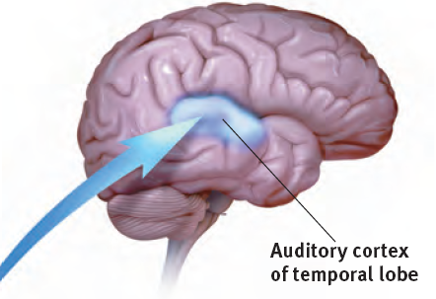
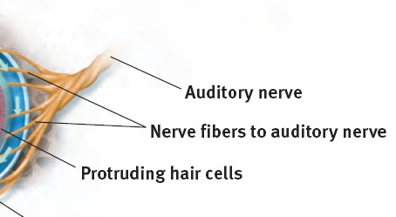
Sound Perception: Loudness
Loudness refers to more intense sound vibrations. This causes a greater number of hair cells to send signals to the brain.
Soft sounds only activate certain hair cells; louder sounds move those hair cells AND their neighbors.
Notes:
Click to reveal bullets.

Slide 31
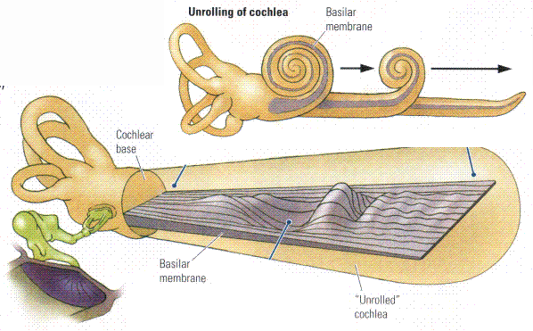
Theories of Audition
Place Theory suggests that sound frequencies stimulate the basilar membrane at specific places resulting in perceived pitch.
http://www.pc.rhul.ac.uk
Notes:
OBJECTIVE 13| Contrast place and frequency theories, and explain how they help us to understand pitch perception.

Slide 32

Theories of Audition
Frequency Theory states that the rate of nerve impulses traveling up the auditory nerve matches the frequency of a tone, thus enabling us to sense its pitch.
Sound
Frequency
Auditory Nerve
Action Potentials
100 Hz
200 Hz

Slide 33
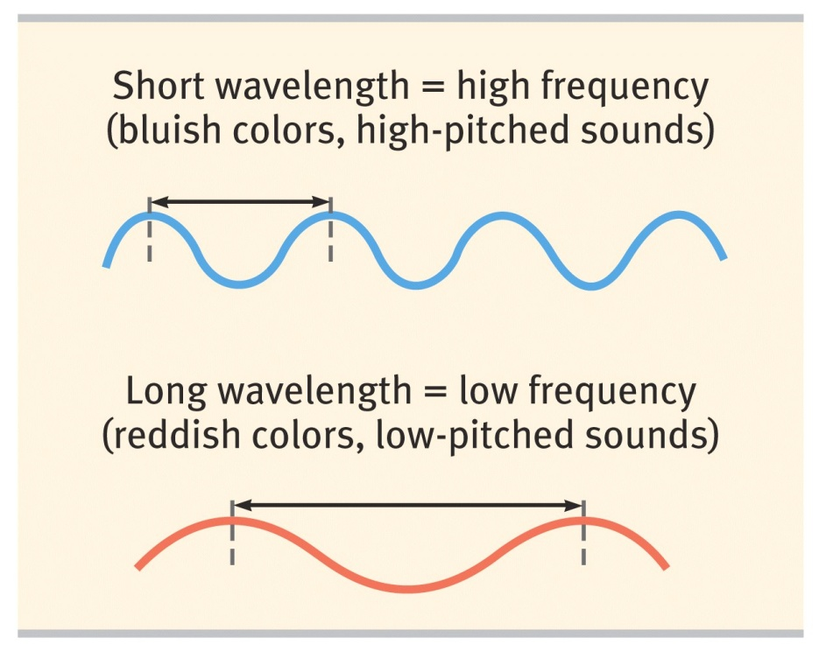
Sound Perception: Pitch
How does the inner ear turn sound frequency into neural frequency?
Frequency theory
At low sound frequencies, hair cells send signals at whatever rate the sound is received.
Place theory
At high sound frequencies, signals are generated at different locations in the cochlea, depending on pitch. The brain reads pitch by reading the location where the signals are coming from.
Volley Principle
At ultra high frequencies, receptor cells fire in succession,
combining signals to reach higher firing rates.
Notes:
Click to reveal three text boxes.

Slide 34
Localization of Sound
1. Intensity differences
2. Time differences
Time differences as small as 1/100,000 of a second can cause us to localize sound. The head acts as a “shadow” or partial sound barrier.

Slide 35
Hearing Loss
Conduction Hearing Loss: Hearing loss caused by damage to the mechanical system that conducts sound waves to the cochlea.
Sensorineural Hearing Loss: Hearing loss caused by damage to the cochlea’s receptor cells or to the auditory nerve, also called nerve deafness.
Notes:
OBJECTIVE 15| Contrast two types of hearing loss, and describe some of their causes.

Slide 36

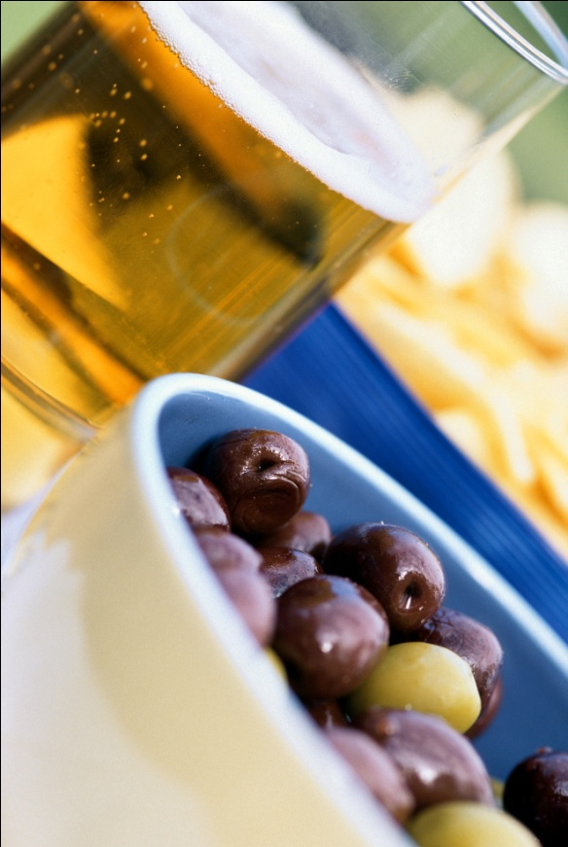



Taste
Our tongues have receptors for five different types of tastes, each of which may have had survival functions.
Bitter:
potential poisons
Sweet:
energy source
Umami: (savoriness)
proteins to grow and repair tissue
Salty: sodium essential to physiological processes
Sour:
potentially toxic acid
Notes:
Click to show labels.
Tastes may exist to attract humans to energy and protein-rich foods that are typically sweet or “umami,” and to avert them from potentially toxic or harmful substances that are often bitter or sour. Umami is a recently identified, savory taste that is associated with monosodium glutamate, meats, mushrooms, seaweed, and aged cheeses (such as Parmesan).
Salty tastes also attract humans to replenish essential salts.

Slide 37
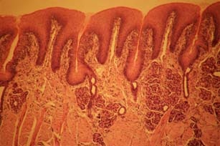
Neurochemistry of Taste
There are no regions of the tongue, just different types of taste receptor cells projecting hairs into each taste bud’s pore.
These cells are easily triggered to send messages to the temporal lobe of the brain.
Burn your tongue? Receptors reproduce every week or two. But with age, taste buds become less numerous and less sensitive.
Top-down processes still can override the neurochemistry; expectations do influence taste.
Notes:
Click to reveal bullets.

Slide 38
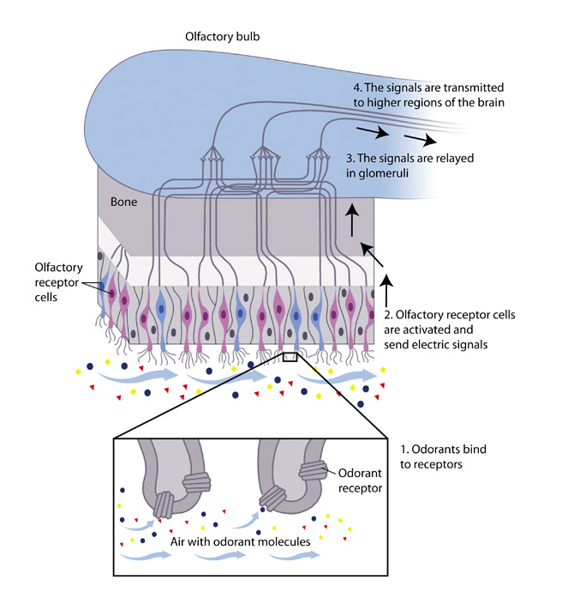
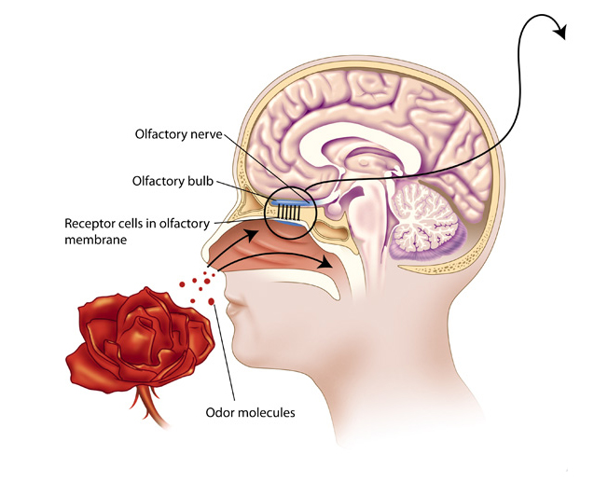
Smell
Like taste, smell is a chemical sense. Odorants enter the nasal cavity to stimulate 5 million receptors to sense smell. Unlike taste, there are many different forms of smell.
Notes:
OBJECTIVE 20| Describe the sense of smell and explain why specific odors so easily trigger memories.

Slide 39
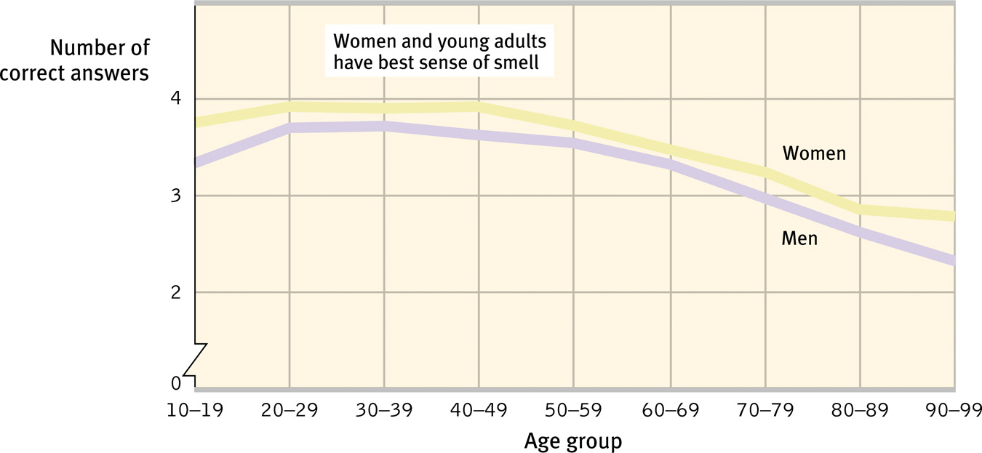
Age, Gender, and Smell
Ability to identify smell peaks during early adulthood, but steadily declines after that. Women are better at detecting odors than men.

Slide 40
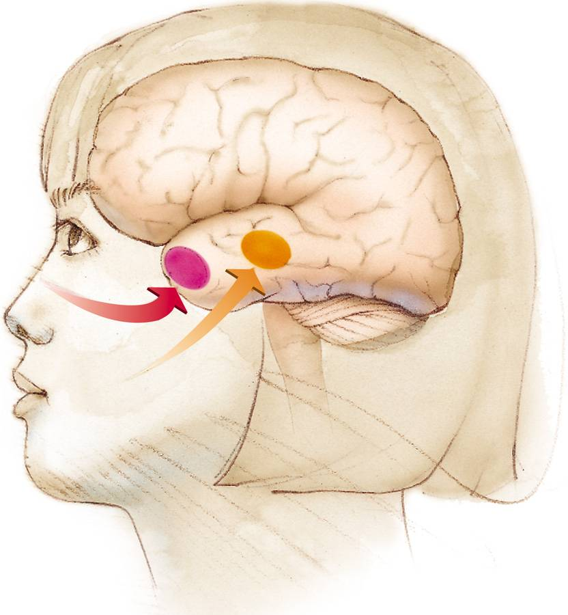
Smell and Memories
The brain region for smell (in red) is closely connected with the brain regions involved with memory (limbic system). That is why strong memories are made through the sense of smell.

Slide 41
Mixing the different senses together
456789
Sensory interaction occurs when different senses influence each other.
For example:
a burst of sound makes a dim light source more visible.
flavor is an experience not only of taste, but also of smell and texture.
seeing text or lip movement, or even feeling the puff of air from consonants, affects what words we hear.
Synaesthesia is a condition when perception in one sense is triggered by a sensation in a DIFFERENT sense.
Some people experience synaesthesia all the time, reporting that, “the number 7 gives me a salty taste” or “rock music seems purple.”
Notes:
Click to reveal bullets.

Slide 42

Touch
The sense of touch is a mix of four distinct skin senses—pressure, warmth, cold, and pain.
Notes:
OBJECTIVE 17| Describe the sense of touch. “Touch is both the alpha and omega of affection” (James, 1890).

Slide 43
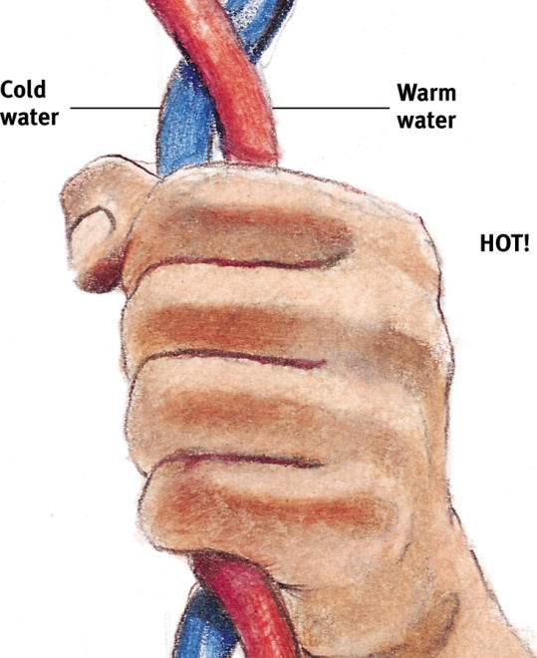
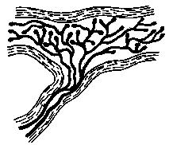
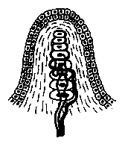

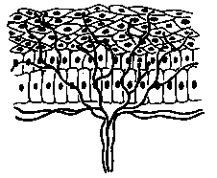
Skin Senses
Only pressure has identifiable receptors. All other skin sensations are variations of pressure, warmth, cold and pain.
Pressure
Vibration
Vibration
Burning hot
Cold, warmth and pain

Slide 44
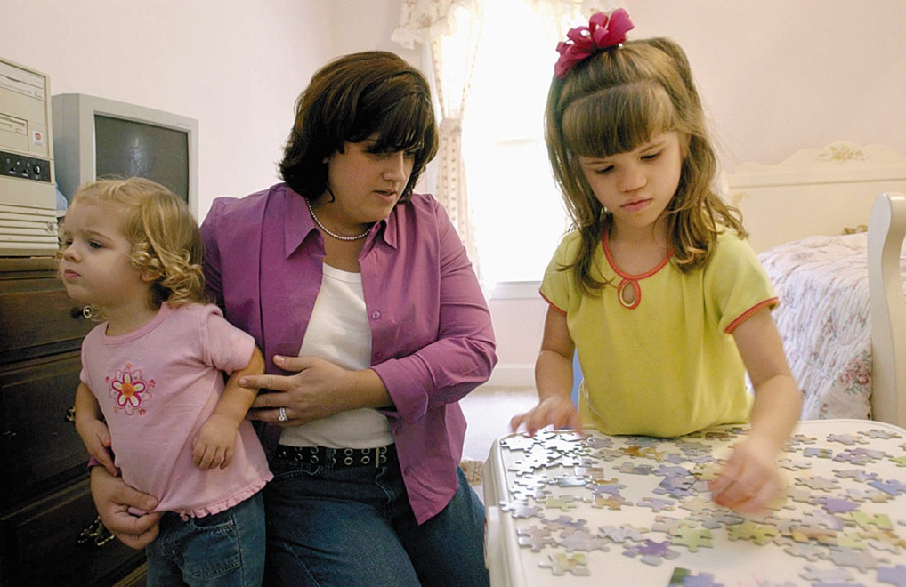
Pain
Pain tells the body that something has gone wrong. Usually pain results from damage to the skin and other tissues. A rare disease exists in which the afflicted person feels no pain.
AP Photo/ Stephen Morton
Ashley Blocker (right) feels neither pain
nor extreme hot or cold.
Notes:
OBJECTIVE 18| State the purpose of pain, and describe the biopsychosocial perspective on pain.

Slide 45
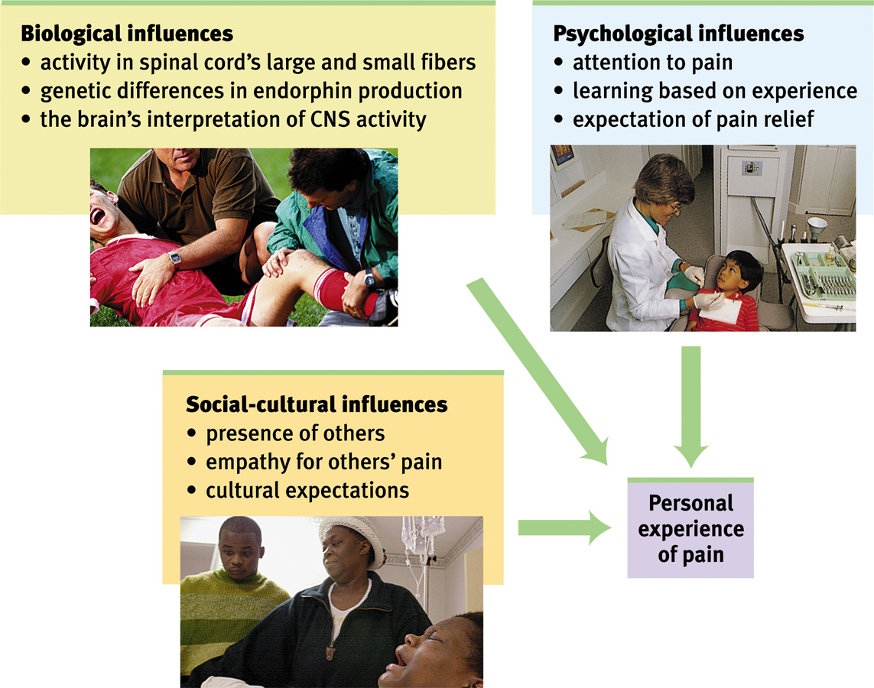
Biopsychosocial Influences

Slide 46

Gate-Control Theory
Melzak and Wall (1965, 1983) proposed that our spinal cord contains neurological “gates” that either block pain or allow it to be sensed.
Gary Comer/ PhototakeUSA.com
Notes:
One way to treat chronic pain is to stimulate it through massage by electrical stimulation or acupuncture. Rubbing causes competitive stimulation to pain thus reduces its effect.

Slide 47
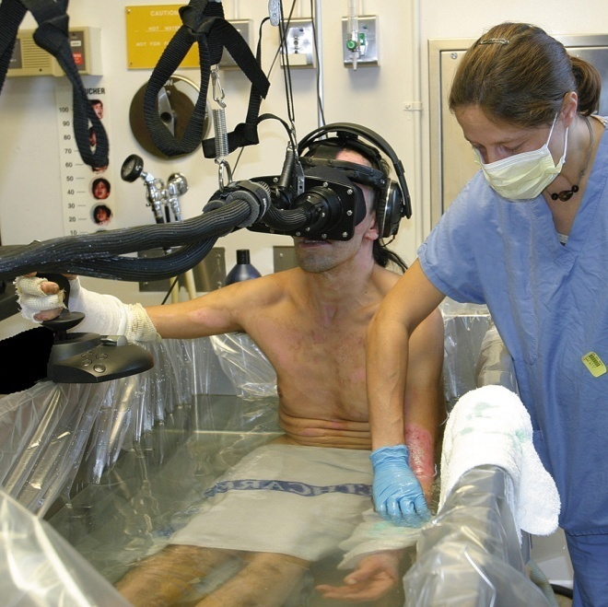
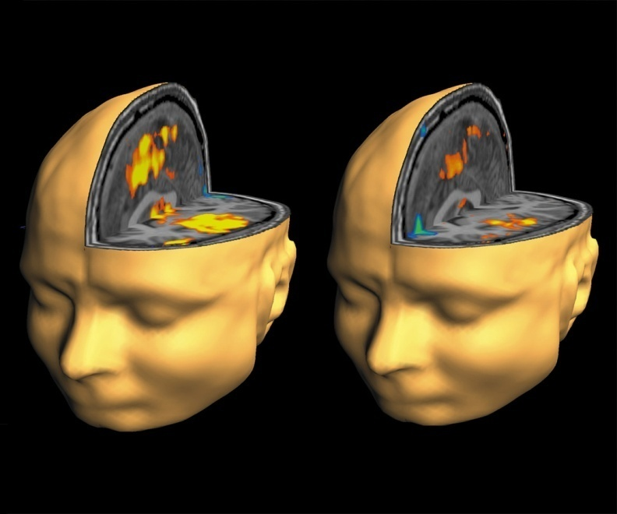
Pain Control
Pain can be controlled by a number of therapies including, drugs, surgery, acupuncture, exercise, hypnosis, and even thought distraction.
Todd Richards and Aric Vills, U.W.
©Hunter Hoffman, www.vrpain.com
Notes:
Burn victims can be distracted by allowing them to engage in illusory virtual reality. Their brain scans show differences in pain perceptions.

Slide 48

Sensing Body Position and Movement
Kinesthesis (“movement feeling”) refers to sensing the movement and position of individual body parts relative to each other.
How it works: sensors in the joints and muscles send signals that coordinate with signals from the skin, eyes, and ears
Without kinesthesis, we would need to watch our limbs constantly to coordinate movement.
Notes:
Click to reveal bullets.

Slide 49
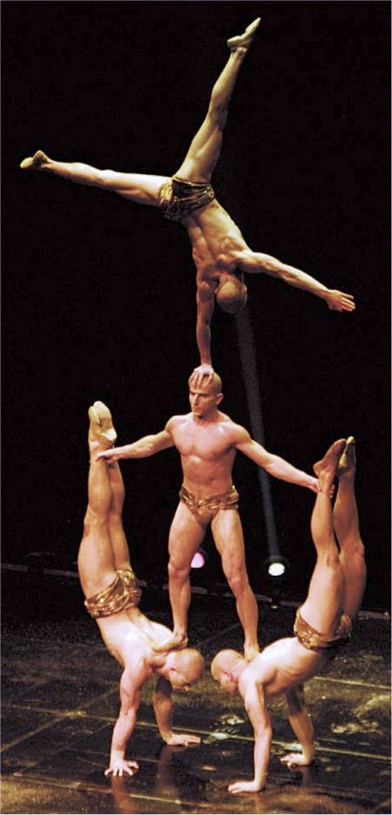
Sensing Body Position and Movement
Vestibular sense refers to the ability to sense the position of the head and body relative to gravity, including the sense of balance.
How it works: fluid-filled chambers in the inner ear (vestibular sacs and semicircular canals) have hairlike receptors that send messages about the head’s position to the cerebellum
Vestibular sense serves as the human gyroscope, helping us to balance and stay upright.
Notes:
Click to reveal bullets.

