Slide 1
Sensation vs. Perception
Sensation
Perception
“The process by which our sensory receptors and nervous system receive and represent stimulus energies from our environment.”
“The process of organizing and interpreting sensory information, enabling us to recognize meaningful objects and events.”
The brain receives input from the sensory organs.
The brain makes sense out of the input from sensory organs.
Transduction: the transformation of stimulus energy into neural impulses.
Notes:
Sense:
especially vision and hearing
smell, taste, touch, pain, and awareness of body position
How do the sense organs and nervous system handle incoming sensory information?
How does the brain turn sensory information into perceptions?
Why is our style of creating perceptions better at perceiving the real world than at decoding tricky optical illusions?

Slide 2
Bottom-up Processing
Analysis of the stimulus begins with the sense receptors and works up to the level of the brain and mind.
Letter “A” is really a black blotch broken down into features by the brain that we perceive as an “A.”

Slide 3
Top-Down Processing
Information processing guided by higher-level mental processes as we construct perceptions, drawing on our experience and expectations.
THE CHT

Slide 4
Making sense of the world
Top-down processing:
using models, ideas, and expectations to interpret sensory information
What am I seeing?
Bottom-up processing:
taking sensory information and then assembling and integrating it
Is that something I’ve seen before?
Notes:
Click to reveal definitions for bottom-up and top-down processing.

Slide 5
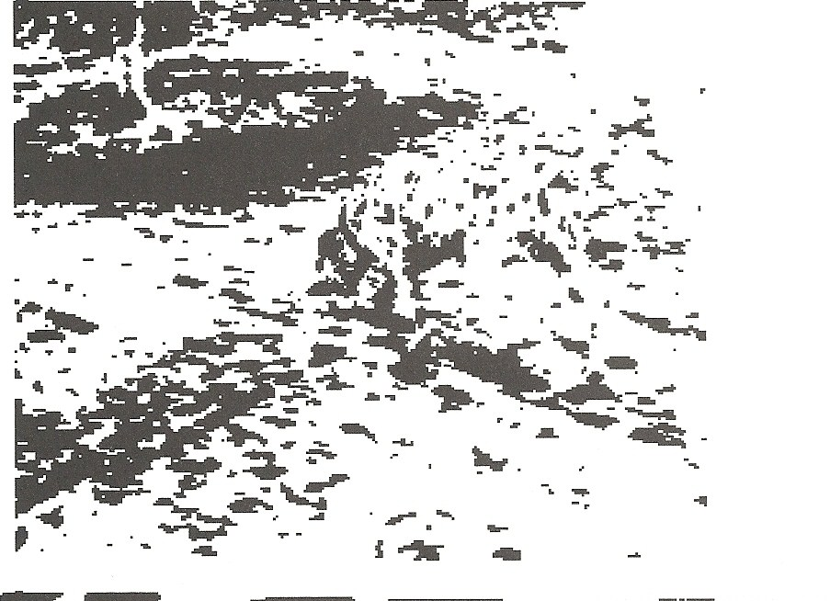
Top-down Processing
You may start to see something in this picture if we give your brain some concepts to apply:
“tree”
“sidewalk”
“dog”
“Dalmatian”
Notes:
Click to reveal sidebar and hints one by one.

Slide 6
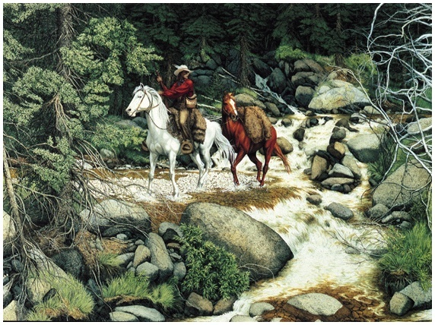
Making Sense of Complexity
Our sensory and perceptual processes work together to help us sort out complex images.
“The Forest Has Eyes,” Bev Doolittle

Slide 7
Do you see a painting or a 3D bottle? What’s on the bottle?
Why do you think kids see something different than adults?
Notes:
Click to reveal answer and to circle the dolphins.
Answer to the question: Top-down processing by children uses different experiences and different models; they are likely to have seen more images of dolphins than images of a nude embrace.
Adults also do more top-down processing, and are more likely to “see” objects that aren’t fully there.
This shows that “seeing” involves the process of perception, not just the process of our eyes taking in information.

Slide 8
From Sensory Organs to the Brain
The process of sensation can be seen as three steps:
Reception--
the stimulation of sensory receptor cells by energy (sound, light, heat, etc)
Transduction-- transforming this cell stimulation into neural impulses
Transmission--delivering this neural information to the brain to be processed
Notes:
Automatic animation.
Psychophysics refers to the study of the psychological effects of the forms of energy (heat, light, sound) that we can detect.

Slide 9
Thresholds
The absolute threshold refers to the minimum level of stimulus intensity needed to detect a stimulus half the time.
Anything below this threshold is considered “subliminal.”
Notes:
No animation.
Instructor: You could first present this question using a specific sense, such as “How loud does a sound have to be before you can detect it?”

Slide 10
How far away can you see a candle flame at night?
30 miles away
-How far away can you hear a tick of a watch under quiet conditions
20 ft.
How much water can you still taste one teaspoon of sugar
2 gal. of water
How much perfume has be diffused into the entire volume of air in a six-room apartment
One drop

Slide 11
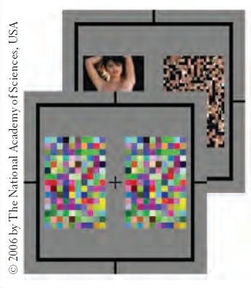
Subliminal Detection
Subliminal:
below our threshold for being able to consciously detect a stimulus
Although we cannot learn complex knowledge from subliminal stimuli, we can be primed, and this will affect our subsequent choices.
We may look longer at the side of the paper which had just showed a nude image for an instant.
Notes:
Click to reveal bullets and example.
Research seems to show that:
1) we can sense something without being aware of it.
2) we can be briefly primed, but not enduringly influenced, by subliminal stimuli.

Slide 12
Difference Threshold
Difference Threshold: Minimum difference between two stimuli required for detection 50% of the time, also called just noticeable difference (JND).
Difference
Threshold
No
No
Yes
Observer’s Response
Tell when you (observer) detect a difference in the light.

Slide 13
Weber’s Law
Two stimuli must differ by a constant minimum percentage (rather than a constant amount), to be perceived as different. Weber fraction: k = δI/I.
Stimulus | Constant (k)
Light | 8%
Weight | 2%
Tone | 3%

Slide 14
When Absolute Thresholds are not Absolute
Signal detection theory refers to whether or not we detect a stimulus, especially amidst background noise.
This depends not just on intensity of the stimulus but on psychological factors such as the person’s experience, expectations, motivations, and alertness.
Notes:
No animation.
For example, parents of newborns can detect a faint baby’s cry that for others would not stand out from background noise.

Slide 15
SDT Matrix
The observer decides whether she hears the tone or not, based on the signal being present or not. This translates into four outcomes.
 |  | Decision
 |  | Yes | No
Signal | Present | Hit | Miss
 | Absent | False Alarm | Correct Rejection

Slide 16
Sensory Adaptation
To detect novelty in our surroundings, our senses tune out a constant stimulus.
The rock in your shoe or the ticking of a clock are more difficult to sense after a while.
We don’t notice this visually because normally our eyes are constantly moving.
However, if you concentrate on keeping your eyes in one spot, you’ll see the effects, as your eyes adjust to stimuli in the following slides.
Notes:
Click to reveal bullets.
To prepare for this slide, at the beginning of class you could ask students to tuck a pen behind one ear, and by the time they get to this slide, ask if they feel it.
Or ask whether they feel the cell phone in their pockets, and then ask them to switch to the opposite pocket and see if they notice it more.

Slide 17
Notes:
Automatic animation.
Instructor: you can tell students, “This will push your motion sensors into sensory adaptation.
For this to work, you must stare at the white dot in the center and never move your gaze.
When the motion stops, quickly stare at a nearby doorway, window, or a face next to you. Decide now what you will look at.”
Explanation: The nerve cells for counter-clockwise rotation become fatigue and start firing slow – we have tired them out by staring. There are still a few cells that might fire off randomly in the clockwise signal. When you look at an unmoving object, the end result is your brain sees the spiral going in opposite direction, and aftereffect of sensory adaptation.

Slide 18
Perceptual Set
Perceptual set is what we expect to see, which influences what we do see. Perceptual set is an example of top-down processing .
Loch Ness monster
or a tree branch?
Flying saucers
or clouds?
Notes:
Click to reveal second picture.

Slide 19
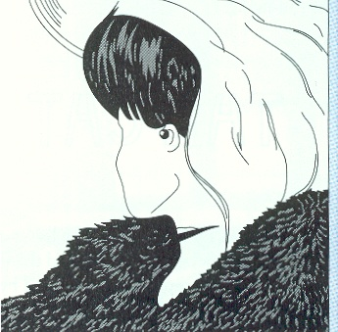
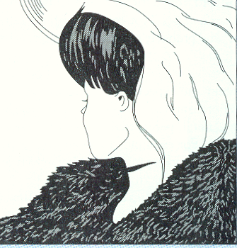
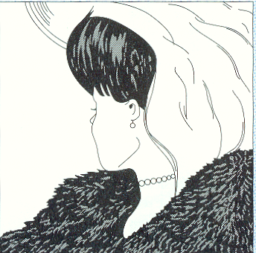
Perceptual set can be “primed.”
Ambiguous
Old woman
Young woman
Notes:
Click to reveal second picture.
Instructor: if you used this extra example, you can ask one half the class to focus on the image on the left, the other to look right. Then click and the ambiguous image appears, and the class can raise hands about which of the two images they see, to see if priming influenced their perception.

Slide 20
Context Effect on Perception
In which picture does the center dot look larger?
Perception of size depends on context.
Spelling test answers:
double pear
apple payor
payee pair
Did context affect which word you wrote?
Notes:
The text at the bottom of the screen will appear on click, and is mean to appear only AFTER you do the “spelling” test below.
Instructor: The point of the test is to demonstrate how context, affected/primed by the previous word you stated, can affect which word they perceived.
You can state to students, “Six word spelling test! You cannot ask questions; just take a guess and listen for the next word. Write these words down:
Double. Pear. (Students may, if “double” gives them context, write “pair.”)
Apple. Payor. (Students may, when primed by “apple”, write “pear.”)
Payee. Pair. (Here, students might be confused, or some may write “payor.”)

Slide 21
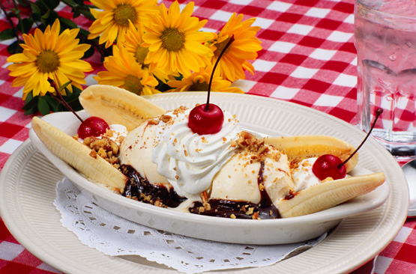
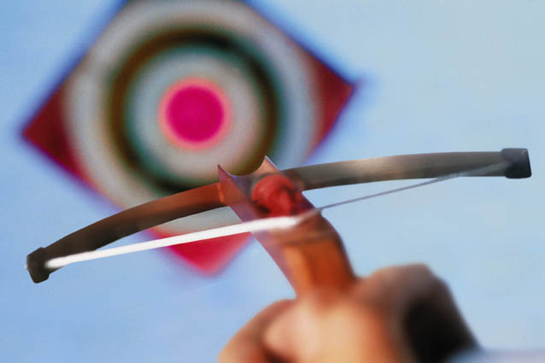
Effect of Emotion, Physical State, and Motivation on Perception
Experiments show that:
destinations seem farther when you’re tired.
a target looks farther when your crossbow is heavier.
a hill looks steeper with a heavy backpack, or after sad music, or when walking alone.
something you desire looks closer.
Notes:
Click to reveal bullets. After reading the last bullet, click again to zoom the banana split.

Slide 22
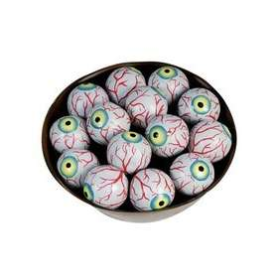
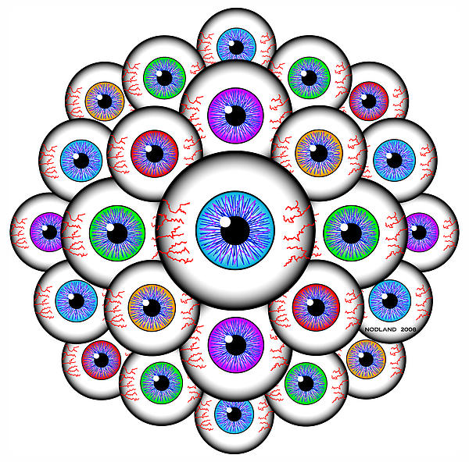
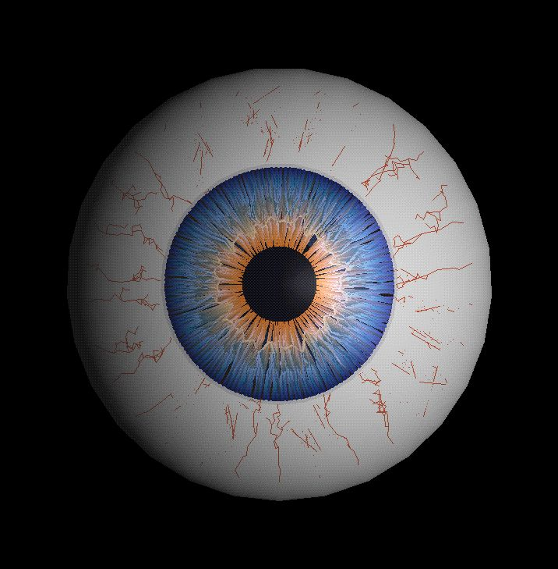
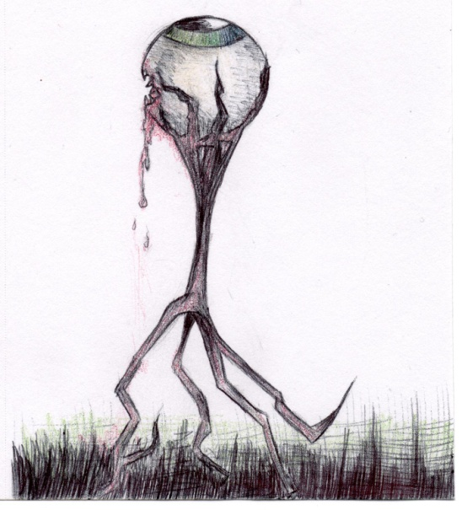
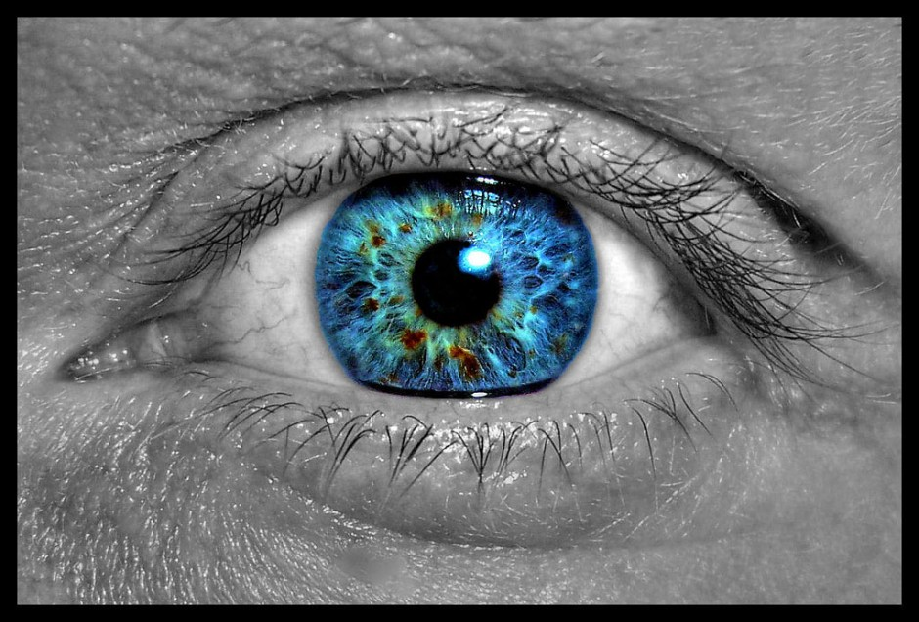
Vision

Slide 23
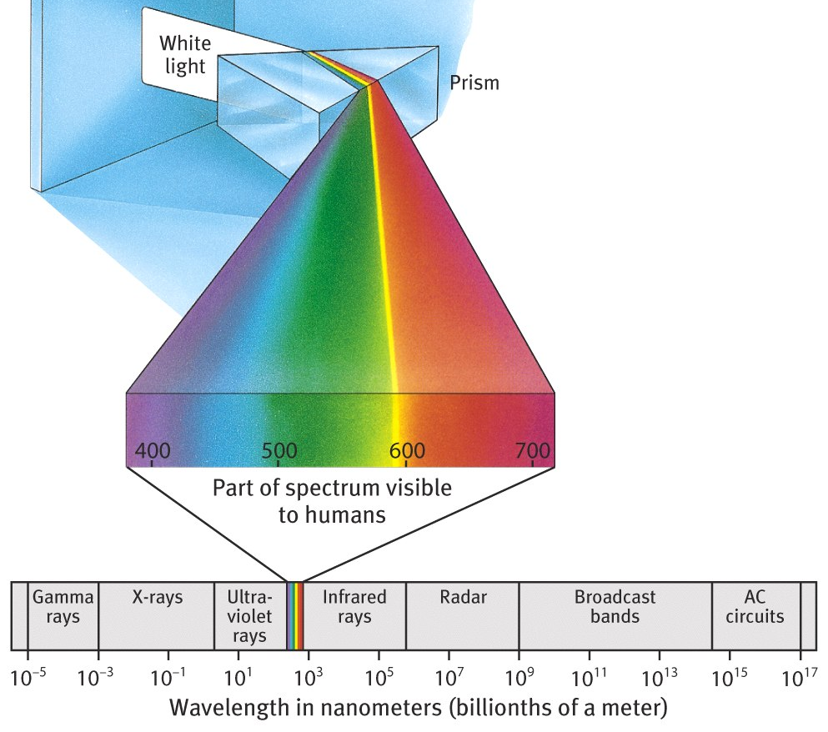
Vision: Energy, Sensation, and Perception
The Visible Spectrum
We encounter waves of electromagnetic radiation.
Our eyes respond to some of these waves.
Our brain turns these energy wave sensations into colors.
Notes:
No animation.

Slide 24
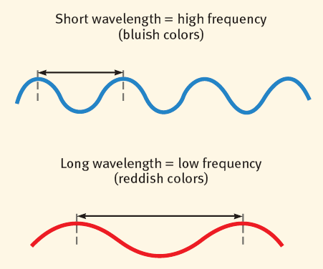
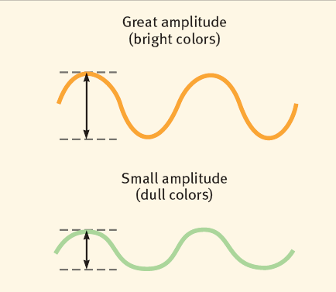
Color/Hue and Brightness
We perceive the wavelength/frequency of the electromagnetic waves as color, or hue.
We perceive the height/amplitude of these waves as intensity, or brightness.
Notes:
Click to reveal two illustrations.

Slide 25
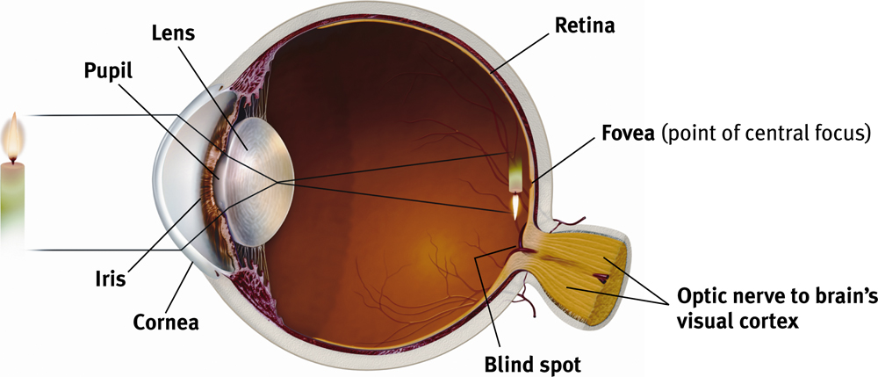
The Eye
Light from the candle passes through the cornea and the pupil, and gets focused and inverted by the lens. The light then lands on the retina, where it begins the process of transduction into neural impulses to be sent out through the optic nerve.
The lens is not rigid; it can perform accommodation by changing shape to focus on near or far objects.
Notes:
Click to reveal bullets.

Slide 26
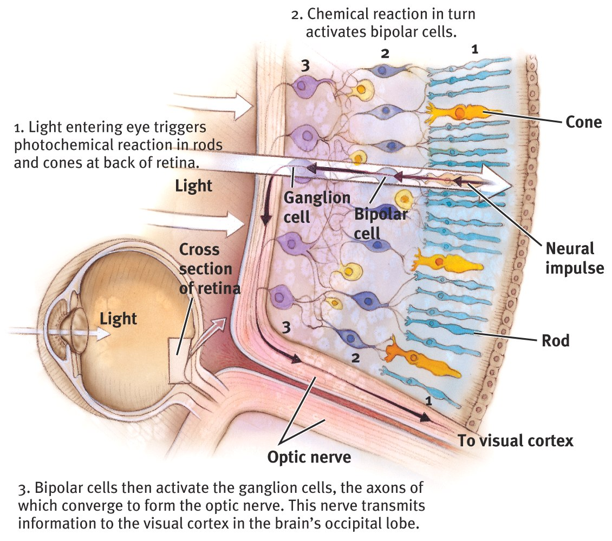
Retina
Retina: The light-sensitive inner surface of the eye, containing receptor rods and cones in addition to layers of other neurons (bipolar, ganglion cells) that process visual information.
Notes:
OBJECTIVE 6| Contrast the two types of receptor cells in the retina, and describe the retina’s reaction to light.

Slide 27
Optic Nerve, Blind Spot & Fovea
Optic nerve: Carries neural impulses from the eye to the brain. Blind Spot: Point where the optic nerve leaves the eye because there are no receptor cells located there. This creates a blind spot. Fovea: Central point in the retina around which the eye’s cones cluster.
http://www.bergen.org

Slide 28
Photoreceptors
E.R. Lewis, Y.Y. Zeevi, F.S Werblin, 1969

Slide 29
Visual Information Processing
Optic nerves connect to the thalamus in the middle of the brain, and the thalamus connects to the visual cortex.
Notes:
OBJECTIVE 7| Discuss the different levels of processing that occur as information travels from the retina to the brain’s cortex.

Slide 30
Feature Detection
Nerve cells in the visual cortex respond to specific features, such as edges, angles, and movement.
Ross Kinnaird/ Allsport/ Getty Images

Slide 31
Perception in Brain
Our perceptions are a combination of sensory (bottom-up) and cognitive (top-down) processes.

Slide 32
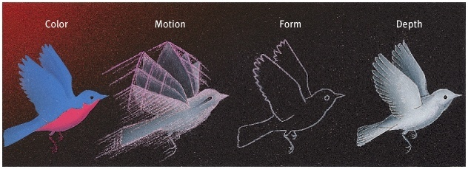
Visual Information Processing
Processing of several aspects of the stimulus simultaneously is called parallel processing. The brain divides a visual scene into subdivisions such as color, depth, form and movement etc.
Notes:
OBJECTIVE 8| Discuss parallel processing and discuss its role in visual processing.

Slide 33
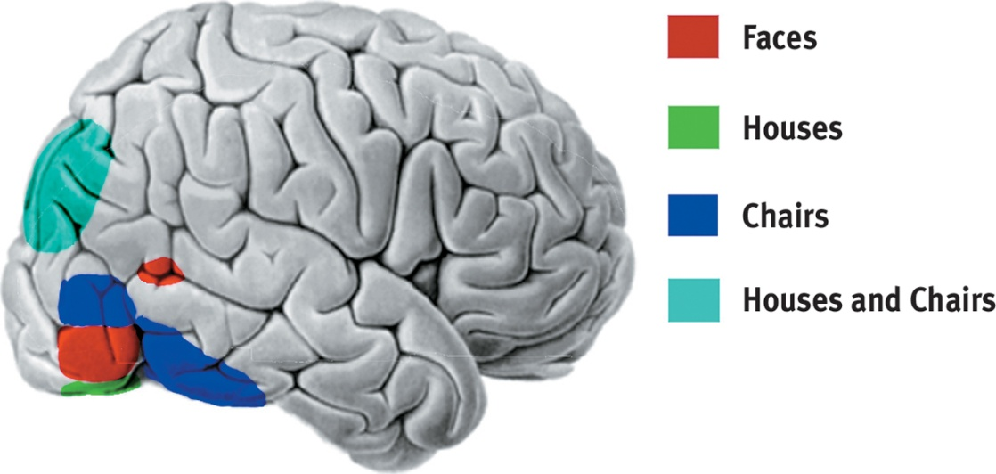
Turning Neural Signals into Images
Some ganglion cells in the eye send signals directly to the visual cortex in response to certain features such as visual patterns, certain edges, lines, or movements.
In and around the visual cortex of the occipital lobe, supercells integrate these feature signals to recognize more complex forms such as faces.
Faces
Houses
Chairs
Houses and Chairs
SUPERCELLS
Notes:
Click to reveal bullets and example.
Instructor: damage to these areas of the brain appears to make it difficult to see certain kinds of objects; most striking is those who have face blindness. Those with these conditions can often see the features, but not integrate them into a whole.

Slide 34
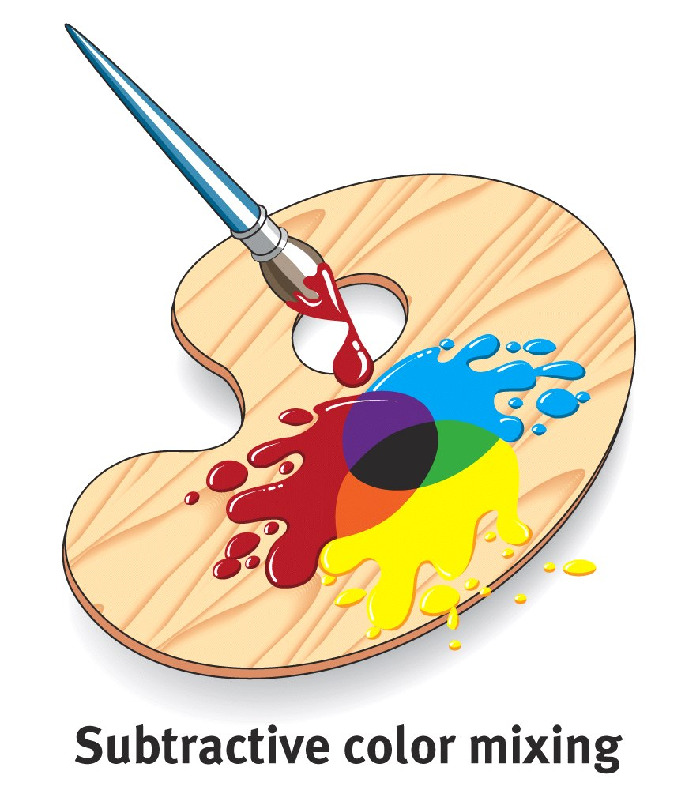
Subtraction of Colors
If three primary colors (pigments) are mixed, subtraction of all wavelengths occurs and the color black is the result.

Slide 35
Addition of Colors
If three primary colors (lights) are mixed, the wavelengths are added and the color white is the result.

Slide 36
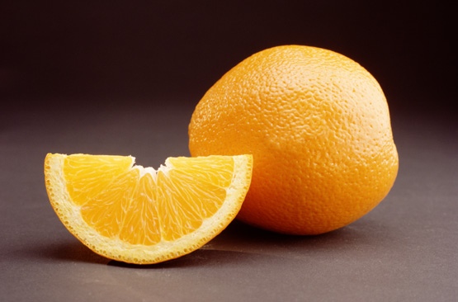
Color Vision
Young-Helmholtz Trichromatic (Three-Color) Theory
According to this theory, there are three types of color receptor cones--red, green, and blue. All the colors we perceive are created by light waves stimulating combinations of these cones.
Notes:
No animation.
Instructor: you could start by saying that we see the color of an orange because it absorbs all light except the wavelengths that our brain interprets as orange.
You could note that the red, green and blue don’t actually refer to the appearance of the cones; they are the colors to which these three cones react.

Slide 37
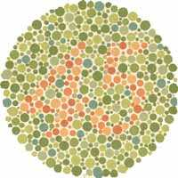
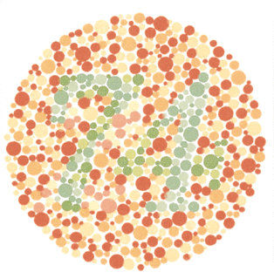
Color Blindness
People missing red cones or green cones have trouble differentiating red from green, and thus have trouble reading the numbers to the right.
Opponent-process theory refers to the neural process of perceiving white as the opposite of perceiving black; similarly, yellow vs. blue, and red vs. green are opponent processes.
Notes:
Click to reveal text boxes.
Instructor: you could add, “Some people say that dogs have “black and white” vision. In fact, they are lacking red receptors, so their vision has simpler color perception, dichromatic, not monochromatic.”
Feeling superior to animals? Note that many birds and insects can sense ultraviolet and infrared that you can’t see.

Slide 38
Opponent-Process Theory Test
The dot, the dot, keep staring at the dot in the center…
Notes:
Instructor: Tell the students: “Stare at the center dot for 30 seconds; if you’re doing it well, the flag will start to disappear. If it does, keep staring at the dot.”
Further narration as they stare at the dot: “If opponent-process theory is correct, then fatiguing our perception of one will make a blank slide look like the opposite color… and the opponent processes are white vs. black, red vs. green, and yellow vs. blue.”
Click to make flag disappear.
What do you see?
Question for students: “Besides opponent-process theory, what else are we demonstrating here?”...(sensory adaptation).
After our color receptors for green become fatigued, an empty white background will briefly seem red, just as plain water might taste salty or strange after eating a lot of intensely sweet candy to the point of fatiguing our tongue.
There have been versions of this circulating online in which our receptors get fatigued just by some dots near the center dot, and a B&W picture turns to full color when we look at a blank space.

Slide 39
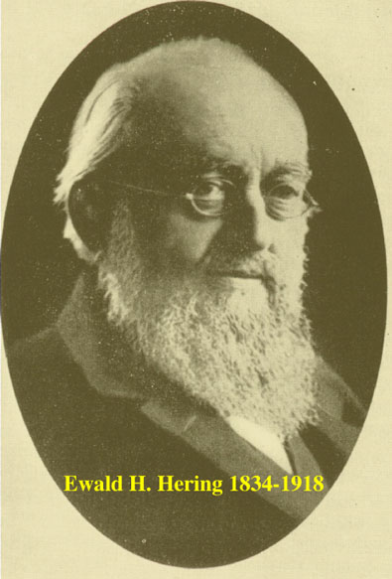
Opponent Process Theory
Hering proposed that we process four primary colors combined in pairs of red-green, blue-yellow, and black-white.
Cones
Retinal
Ganglion
Cells

Slide 40
Turning light waves into mental images/movies... Perceptual Organization
We have perceptual processes for enabling us to organize perceived colors and lines into objects:
grouping incomplete parts into gestalt wholes
seeing figures standing out against background
perceiving form, motion, and depth
keeping a sense of shape and color constancy despite changes in visual information
using experience to guide visual interpretation
Notes:
Click to reveal bullets.
This is a summary slide for this upcoming section, listing the major concepts and not the section headings.

Slide 41
Selective Attention
Perceptions about objects change from moment to moment. We can perceive different forms of the Necker cube; however, we can only pay attention to one aspect of the object at a time.
Necker Cube
Notes:
OBJECTIVE 1| Describe the interplay between attention and perception.

Slide 42
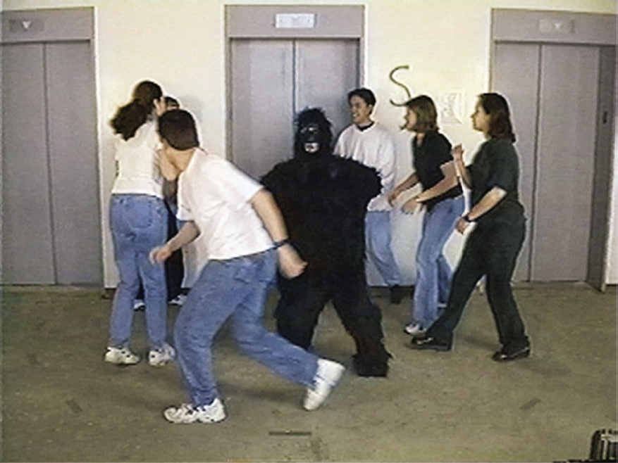
Inattentional Blindness
Inattentional blindness refers to the inability to see an object or a person in our midst. Simmons & Chabris (1999) showed that half of the observers failed to see the gorilla-suited assistant in a ball passing game.

Slide 43
Change Blindness
Change blindness is a form of inattentional blindness in which two-thirds of individuals giving directions failed to notice a change in the individual asking for directions.

Slide 44
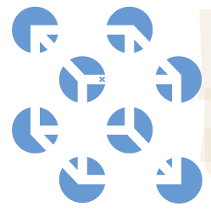
The Role of Perception
Our senses take in the blue information on the right. However, our perceptual processes turn this into:
a white paper with blue circle dots, with a cube floating in front.
a white paper with blue circle holes, through which you can see a cube.
a cube sticking out to the top left, or bottom right.
blue dots (what cube?) with angled lines inside.
Notes:
Click to reveal bullets, BUT before any bullets appear, see how many different visual perceptions students can come up with.
To nudge the discussion, note the little ‘x’ near the center of the picture; ask if it looks like it’s inside a blue hole, or at the back and bottom of a cube that opens up and to the left…

Slide 45
Figure-Ground Perception
In most visual scenes, we pick out objects and figures, standing out against a background.
Some art muddles this ability by giving us two equal choices about what is figure and what is “ground”:
Goblet or two faces?
Stepping man, or arrows?
Notes:
Click to reveal bullets and two examples.

Slide 46
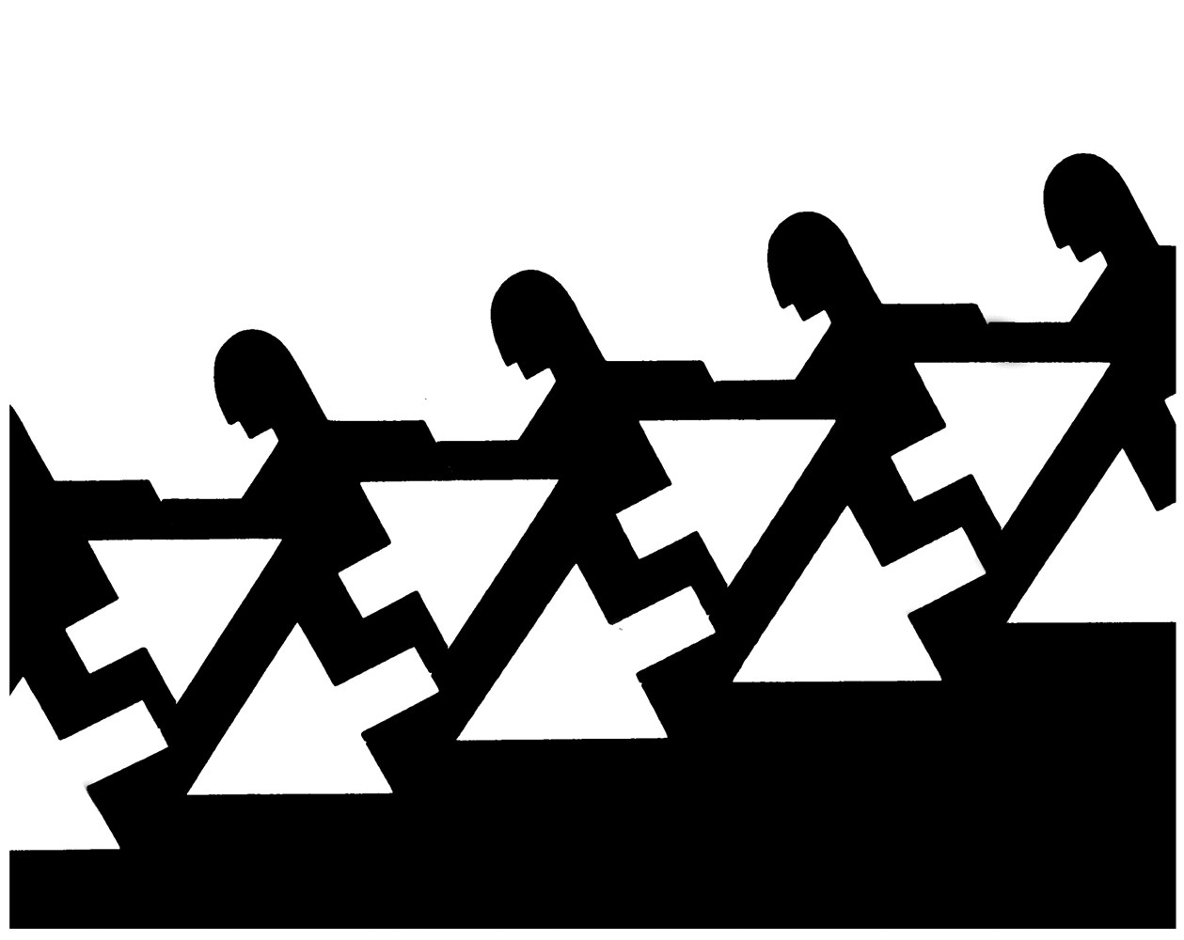
Form Perception – Figure-ground
Organization of the visual field into objects (figures) that stand out from their surroundings (ground).
Notes:
OBJECTIVE 4| Explain the figure-ground relationship and identify principles of perceptual grouping in form perception.

Slide 47
Gestalt and attention…
Aoccdrnig to a rscheearch at Cmabrigde Uinervtisy, it deosn’t mttaer in what oredr the ltteers in a word are, the olny iprmoetnt tihng is that the frist and lsat ltteer be at the rghit pclae. The rset can be a total mses and you can still raed it wouthit porbelm. This is bcuseae the huamn mnid deos not raed ervey lteter by istlef, but the word as a wlohe.

Slide 48
Grouping: How We Make Gestalts
“Gestalt” refers to a meaningful pattern/configuration, forming a “whole” that is more than the sum of its parts.
Three of the ways we group visual information into “wholes” are proximity, continuity, and closure.
Notes:
Click to show a different perspective on each image.
Instructor: perhaps you can get students to bring out the definitions of the concepts in these pictures (as you click to reveal the animations).
“Proximity” means we tend to see objects that are close together as being part of the same object.

Slide 49
Another name for the Gestalt principle of Simplicity….

