Slide 1
Intro to sociology
1 – The Sociological Perspective

Slide 2
Sociology
Someone who can’t find a job is:
Homelessness is a result of:
Immigrants are here because:

Slide 3
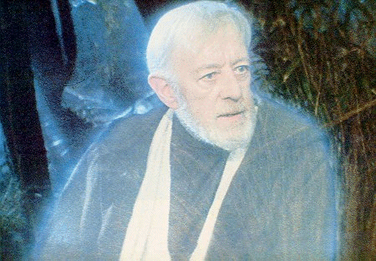
The Nature of Sociology
Perspective –
point-of-view
Sociology –
scientific study of human social behavior
Sociological perspective –
How people act in groups, not as individuals
Notes:
Draw a map from your seat to the Starbucks on Ed Dorado and Custer
Draw an abstract shape on the board. Half sit facing the back. Others explain.

Slide 4
The Importance of Patterns
Social Structure –
patterns of interactions between people in a social environment
What patterns of behavior do teacher’s and students have?

Slide 5
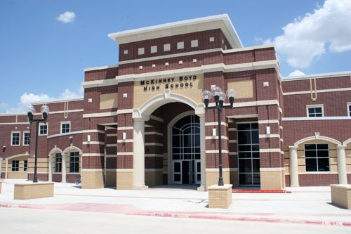
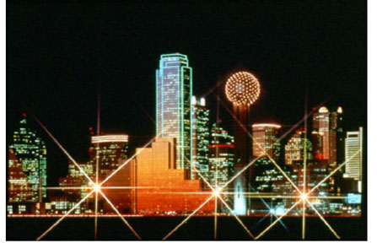
Acquiring the Social Imagination
Sociological Imagination – seeing the link between society and self
Notes:
The problem of the town of truth and the town of lies p.11

Slide 6
Intro to sociology
2 – Origins of Sociology

Slide 7
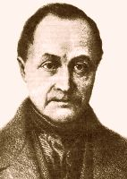
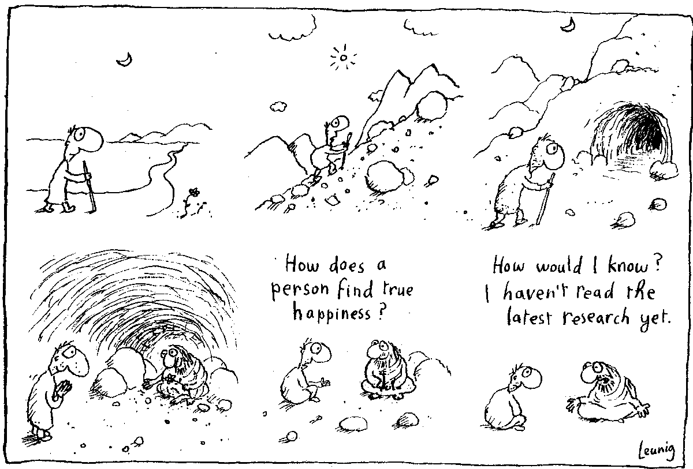
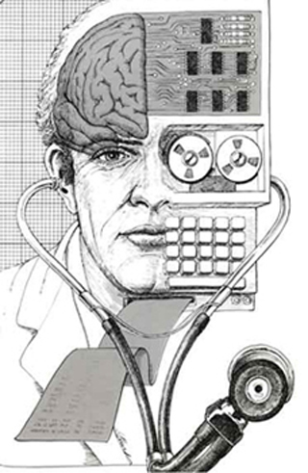
European Origins – Auguste Comte
Positivism –
Science should be the foundation of society

Slide 8
European Origins – Auguste Comte
Social statistics –
Studying social order and stability within societies
Social dynamics –
the study of how societies change

Slide 9
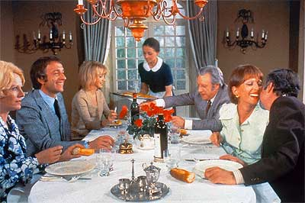
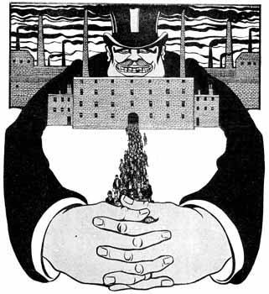
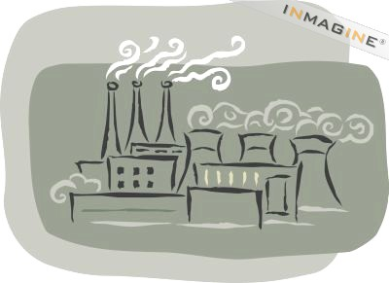
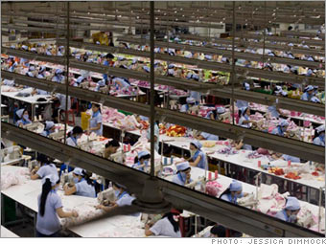
European Origins – Karl Marx
Bourgeoisie –
Class of people that own the means of producing wealth
Capitalists –
Person who is part of the Bourgeoisie.

Slide 10
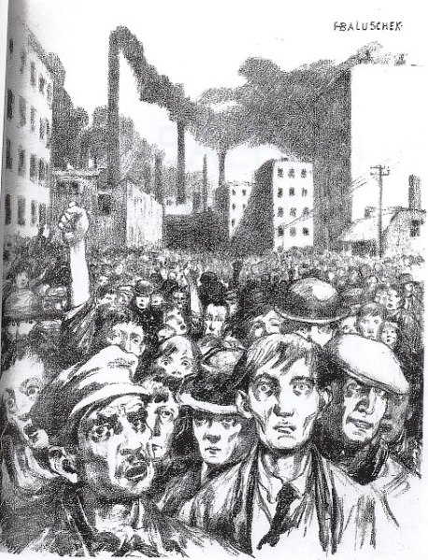
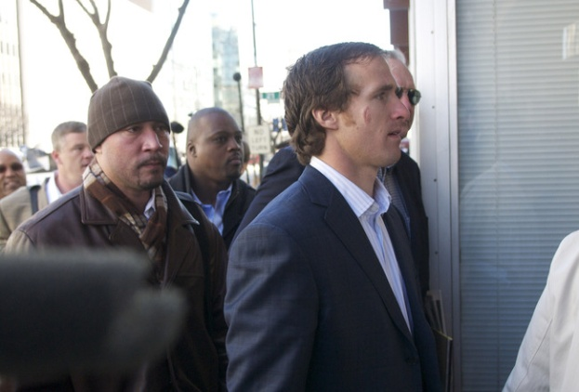
European Origins – Karl Marx
Proletariat –
working class people who produce the wealth for the Bourgeoisie.
Class conflict –
The ongoing conflict between the two classes.

Slide 11
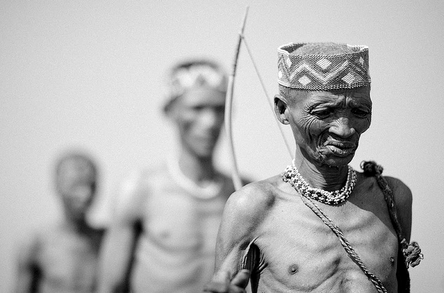
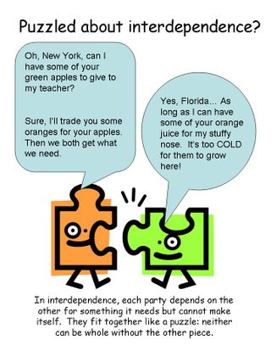
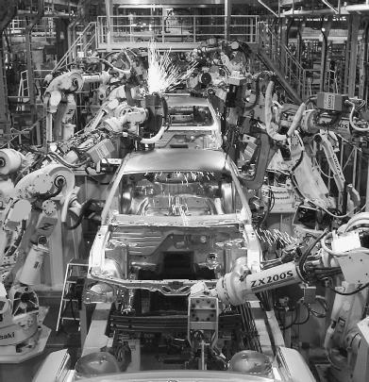
European Origins – Emile Durkheim
Mechanical solidarity –
More traditional societies that stress conformity to values, beliefs, tradition, and family
Organic solidarity –
Industrial societies that are highly specialized and each part is dependant on others

Slide 12
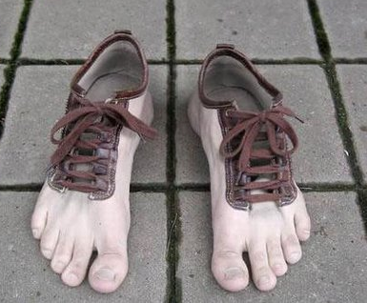
European Origins – Max Weber
Verstehen –
putting yourself in someone else’s shoes.
Rationalization –
Societies based on reason, knowledge, and planning
The Spirit of Capitalism and Religion
Rational, religious belief can bring about social change

Slide 13
Intro to sociology
3 – Theoretical Perspectives

Slide 14
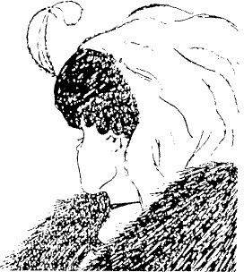
Theoretical Perspectives
Draw a map from your seat to the Starbucks on Ed Dorado and 121

Slide 15
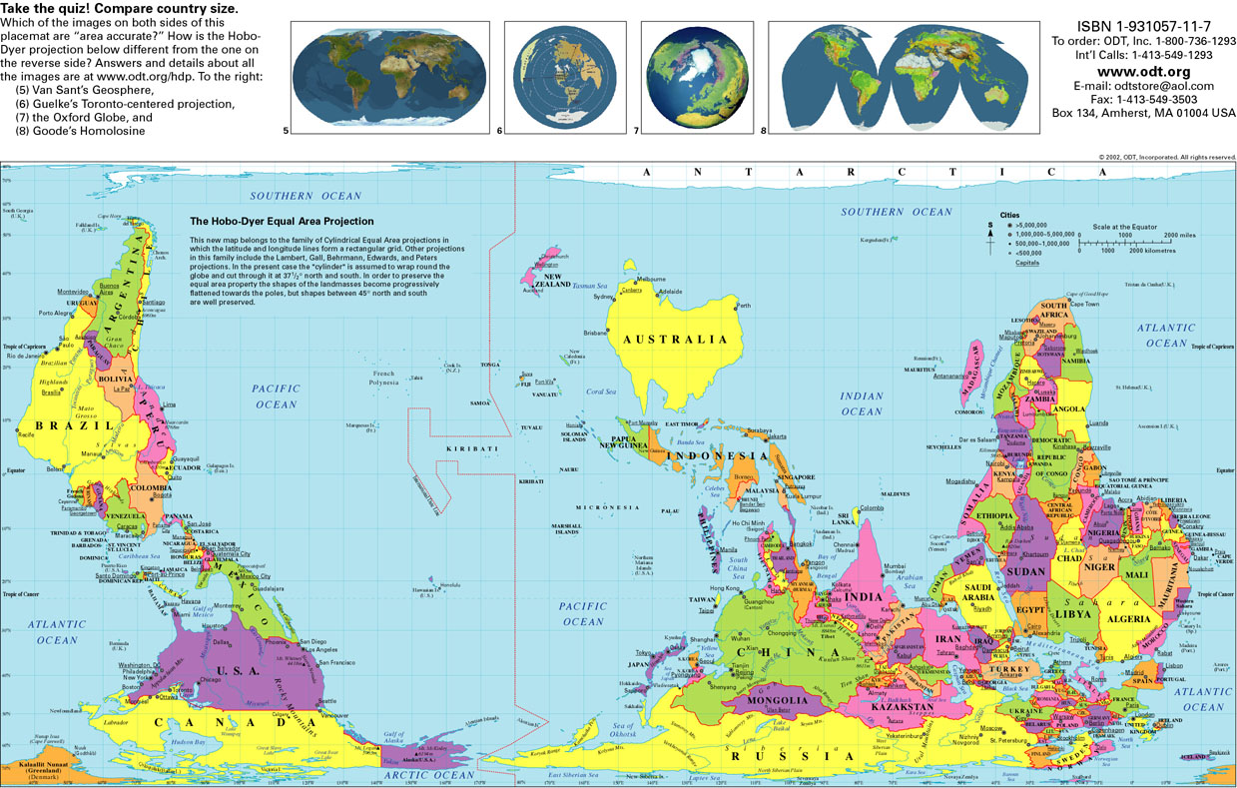

Slide 16
The Role of Theoretical Perspectives
The assumptions you see as being true when we study something.
We have three different ideas on studying groups such as schools

Slide 17
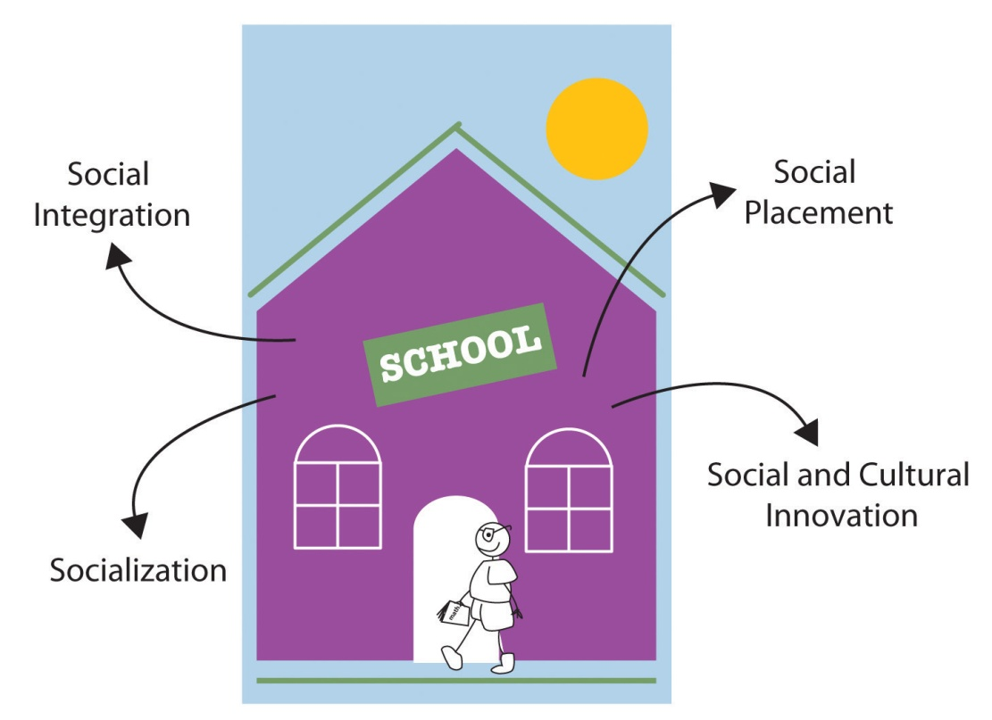
Functionalism
Emphasizes the contributions to society the unit being studies makes
The part it plays in society

Slide 18
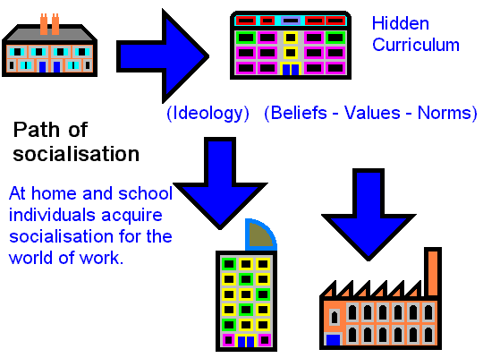
Functionalism – Comte, Durkheim
Manifest Functions –
These are consciously intended.
Latent Functions –
these are unintended consequences
Dysfunction –
elements that have negative effects

Slide 19
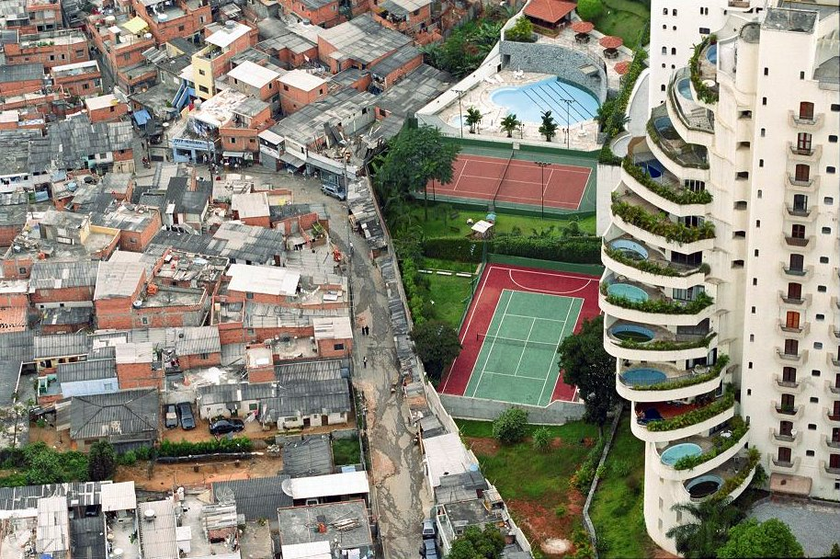
Conflict Theory - Marx
Emphasizes the role that conflict, competition, and constraints play in society

Slide 20
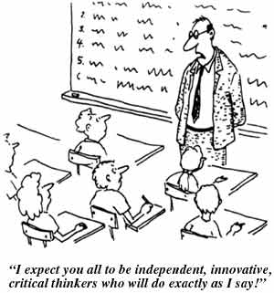
Conflict Theory
Power –
the ability to control the actions of others

Slide 21
Symbolic Interactionism
Looks at the interactions of people based on mutually understood symbols
Everyone needs to know that red means stop

Slide 22
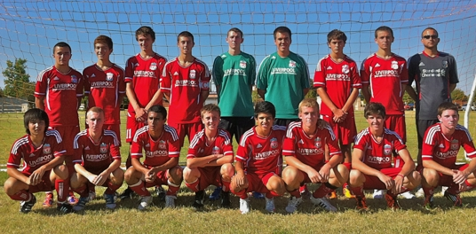
Symbolic Interactionism
Dramaturgy –
in real life you are like an actor/actress in a play.

