Slide 1
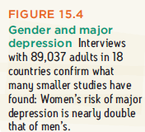
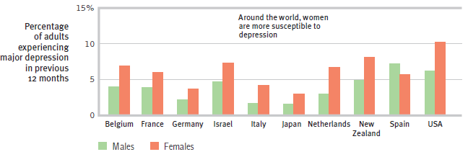
Understanding Mood Disorders
Why are mood disorders so pervasive, and more common among the young, and especially among women?
Notes:
No animation.
You might remind students that the evolutionary perspective has difficulty with mood disorders; it is unlikely that they helped our ancestors survive in any way.
Instructor: warn students that we may not answer this question in this section.

Slide 2
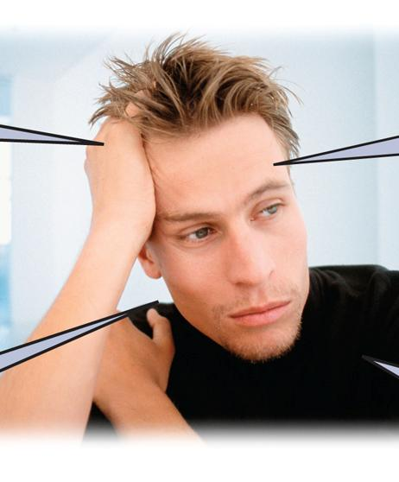
Why Does Depression Have so Many Symptoms?
Notes:
No animation.

Slide 3
Understanding Mood Disorders Can we explain…
why does depression often go away on its own?
the course/development of reactive depression?
Often, time heals a mood disorder, especially when the mood issue is in reaction to a stressful event. However, a significant proportion of people with major depressive disorder do not automatically or easily get better with time.
Notes:
Click to reveal bullets.
Depression in reaction to life events often results in a temporary period of withdrawal, worrying, and feeling down.

Slide 4
Suicide and Self-Injury
Every year, 1 million people commit suicide, giving up on the process of trying to cope and improve their emotional well-being.
This can happen when people feel frustrated, trapped, isolated, ineffective, and see no end to these feelings.
Non-suicidal self-injury has other functions such as sending a message, or self-punishment.
Notes:
Click to reveal bullets.
Beyond the 1 million who succeed, many more attempt suicide or make suicidal gestures, acts that look like suicide attempts, without clear intent to succeed. The numbers get much larger if we consider those who have had thoughts about suicide or wanting to be dead.
Other purposes of NSSI besides the ones above mentioned in the text: distracting from emotional pain, giving themselves an excuse to cry when emotional pain doesn’t feel justified, or eventually to get the endorphin response which can come especially with repeated self-cutting. I mention these because students might speak up to comment that the reasons given in the text are inadequate.

Slide 5
Understanding Mood Disorders
Biological aspects and explanations
Evolutionary
Genetic
Brain /Body
Social-cognitive aspects and explanations
Negative thoughts and negative mood
Explanatory style
The vicious cycle
Notes:
Click to reveal text boxes and examples.

Slide 6
An Evolutionary Perspective on the Biology of Depression
Depression, in its milder, non-disordered form, may have had survival value.
Under stress, depression is social-emotional hibernation. It allows humans to:
conserve energy.
avoid conflicts and other risks.
let go of unattainable goals.
take time to contemplate.
Notes:
Click to reveal bullets.
This information is presented in the book earlier in the chapter, but it also fits here.
However, students might consider that from an evolutionary perspective, it seems just as likely that depression serves no survival purpose, as evidenced by suicide, and is in the process of being eliminated by natural selection.

Slide 7
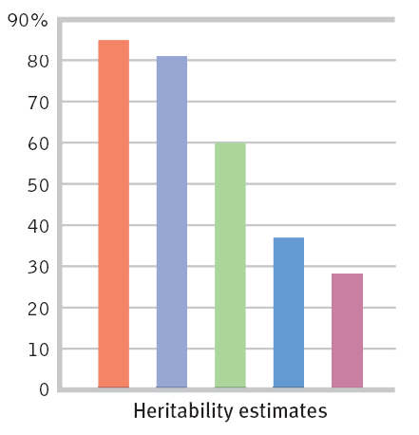
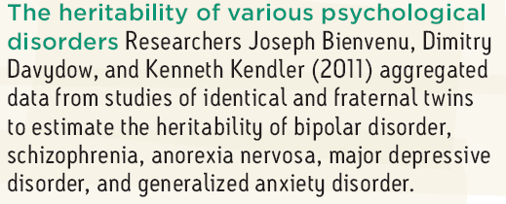
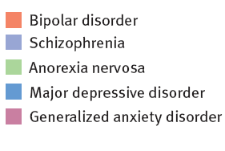
Biology of Depression: Genetics
Evidence of genetic influence on depression:
DNA linkage analysis reveals depressed gene regions
twin/adoption heritability studies
Notes:
No animation.
DNA linkage analysis shows that regions of chromosomes are similar across generations of people in depressed families Another genetic factor to mention here, though it doesn’t come up in the text until the discussion of neurotransmitters (p. 629): people with depression had a variation of a serotonin-controlling gene, although the text notes that this result may not be reliable.
Regarding the chart, see if students can recall the definition of heritability from the chapter on intelligence. Remind them that 80 percent heritability does NOT mean that genes are 80 percent of the cause of schizophrenia, as we shall soon see; it means that 80 percent of the variation among people is caused by genes.

Slide 8
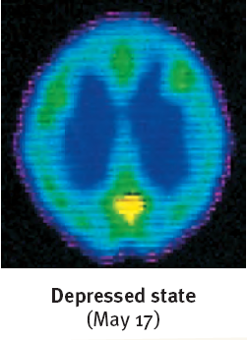
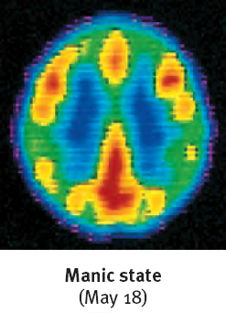
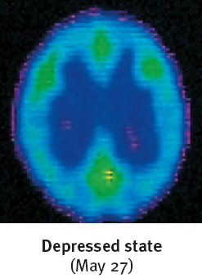
Biology of Depression: The Brain
Brain activity is diminished in depression and increased in mania.
Brain structure: smaller frontal lobes in depression and fewer axons in bipolar disorder
Brain cell communication (neurotransmitters):
more norepinephrine (arousing) in mania, less in depression
reduced serotonin in depression
Notes:
Click to reveal bullets.
Fewer axons, less white matter, and larger ventricles (fluid filled areas in the center of the brain) point to a problem in having different parts of the brain work together smoothly.

Slide 9
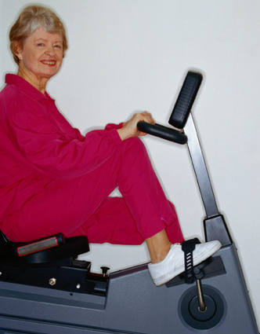
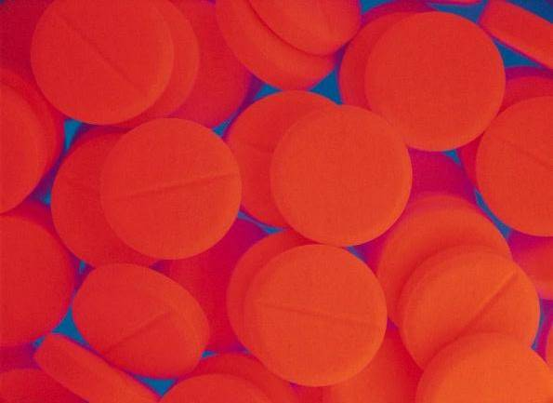
Preventing or Reducing Depression: Using Knowledge of the Biology of Depression
Adjust neurotransmitters with medication.
Increase serotonin levels with exercise.
Reduce brain inflammation with a healthy diet (especially olive and fish oils).
Prevent excessive alcohol use .
Notes:
Click to reveal bullets.
Some medications, such as Wellbutrin try to reduce depression by increasing norepinephrine; other medications, such as Prozac, Zoloft, and Celexa increase the availability of serotonin.
Exercise has other benefits related to depression.
This is the “Mediterranean” diet, although some people try to get the benefits of this diet by taking Omega 3 supplements.
Alcohol abuse its related not only to biological changes but also to problems in behavior and coping skills.

Slide 10
Understanding Mood Disorders: The Social-Cognitive Perspective
Discounting positive information and assuming the worst about self, situation, and the future
Low Self-Esteem
Self-defeating beliefs such as assuming that one (self) is unable to cope, improve, achieve, or be happy
Learned Helplessness
Depression is associated with:
Depressive Explanatory Style
Rumination
Stuck focusing on what’s bad
Notes:
Click to reveal bubbles.
Discounting the positive: “You’re only spending time with me because you feel sorry for me.”
Depression is also associated with cognitive errors, such as assuming one can know the future or the thoughts of others.

Slide 11
Depressive Explanatory Style
How we analyze bad news predicts mood.
Problematic event:
Assumptions about the problem
The problem is:
The problem is:
The problem is:
Mood/result that goes along with these views:
Notes:
Click through to animate the chart.
This chart implies that the negative explanatory style leads to depression. However, as the next chart will show, depression makes it more likely to make cognitive problems such as this negative attributional style.
As Martin Seligman has suggested (quote in the text), depression can be caused by “preexisting pessimism encountering failure.”

Slide 12
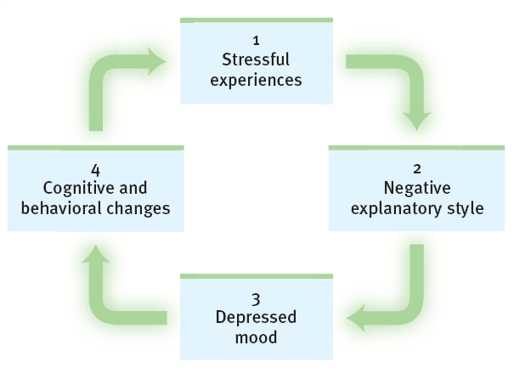
Depression’s Vicious Cycle
A depressed mood may develop when a person with a negative outlook experiences repeated stress.
The depressed mood changes a person’s style of thinking and interacting in a way that makes stressful experience more likely.
Notes:
Click to reveal second text box and chart.

Slide 13
Schizophrenia:
the mind is split from reality, e.g. a split from one’s own thoughts so that they appear as hallucinations.
Psychosis refers to a mental split from reality and rationality.
Schizophrenia symptoms include:
disorganized and/or delusional thinking.
disturbed perceptions.
inappropriate emotions and actions.
Notes:
Click to reveal two more text boxes.
Literally, schizophrenia means “split mind,” but NOT split personality. The person who invented the term, Eugen Bleuler (1857-1939), spoke of a splintering of the functions governing thinking, perception, personality, and memory, although I would add emotion to that list. Most noticeable are the perceptual problems such as a split from REALITY.

Slide 14
Positive and Negative Symptoms of Schizophrenia
Positive + presence of problematic behaviors
Negative - absence of healthy behaviors
Hallucinations (illusory perceptions), especially auditory
Delusions (illusory beliefs), especially persecutory
Disorganized thought and nonsensical speech
Bizarre behaviors
Flat affect (no emotion showing in the face)
Reduced social interaction
Anhedonia (no feeling of enjoyment)
Avolition (less motivation, initiative, focus on tasks)
Alogia (speaking less)
Catatonia (moving less)
Notes:
The column headings appear on click.
You can ask first, “which of these are negative symptoms?” Students have experienced this sense of the words “positive” and “negative” when talking about reinforcement, but it’s a difficult shift in word usage so it’s worth testing them on it here. Some of the symptoms, such as disorganized thought and catatonia, could arguably be placed in either column.

Slide 15
Schizophrenia Symptoms: Problems in Thinking and Speaking
Disorganized speech, including the “word salad” of loosely associated phrases
Delusions (illusory beliefs), often bizarre and not just mistaken; most common are delusions of grandeur and of persecution
Problems with selective attention, difficulty filtering thoughts and choosing which thoughts to believe and to say out loud
? ! ? !
? ! ? !
Notes:
Click to reveal bullets.

Slide 16
Schizophrenia Symptoms: Disturbed Perceptions
You’re evil!
Am I evil?
People with schizophrenia often experience hallucinations, that is, perceptual experiences not shared by others.
The most common form of hallucination is hearing voices that no one else hears, often with upsetting (e.g. shaming) content.
Hallucinations can also be visual, olfactory/smells, tactile/touch, or gustatory/taste.
Notes:
Click to reveal bullets.
There is recent evidence that hallucinations in schizophrenia are caused in part because there is dysfunction in the parts of the brain that identify what is self vs. what is external. Thus, the fleeting ideas in the thought balloon might trigger, not just follow, the “heard” words about being evil.

Slide 17
Schizophrenia Symptoms: Inappropriate Emotions
Odd and socially inappropriate responses such as looking bored or amused while hearing of a death
Flat affect: facial/body expression is “flat” with no visible emotional content
Impaired perception of emotions, including not “reading” others’ intentions and feelings
Notes:
Click to reveal bullets.

Slide 18
Schizophrenia Symptoms: Inappropriate Actions/Behavior
Odd and socially inappropriate behavior can be caused by symptoms such as:
errors in social perception.
disorganized, unfiltered thinking.
delusions and hallucinations.
The schizophrenic body exhibits symptoms such as:
repetitive behaviors such as rocking and rubbing.
catatonia, such as sitting motionless and unresponsive for hours.
Notes:
Click to reveal bullets.
See if students can picture an example of “crazy”/odd behavior; then picture the point of view of this person and try to imagine how the symptoms above could be part of the odd behavior. For example, someone with tactile hallucinations might keep rubbing and swatting a part of the body.
Instructor: you might remind students that the evolutionary perspective has difficulty with schizophrenia; it is unlikely that they helped our ancestors survive in any way."

Slide 19
Onset and Development of Schizophrenia
Course of Schizophrenia
Acute/Reactive Schizophrenia In reaction to stress, some people develop positive symptoms such as hallucinations.
Recovery is likely.
Chronic/Process Schizophrenia develops slowly, with more negative symptoms such as flat affect and social withdrawal.
With treatment and support, there may be periods of a normal life, but not a cure.
Without treatment, this type of schizophrenia often leads to poverty and social problems.
Onset: Typically, schizophrenic symptoms appear at the end of adolescence and in early adulthood, later for women than for men.
Prevalence: Nearly 1 in 100 people develop schizophrenia, slightly more men than women.
Development: The course of schizophrenia can be acute/reactive or chronic.
Notes:
Click to reveal bullets.
“Course” means the development of symptoms over time.
Treatment can include not only medication but psychosocial rehabilitation, exercise, psychotherapy, supervised group homes, case management, daily living skills support, and vocational programs.
Without real treatment, institutionalization was once the norm, then homelessness and incarceration, now outpatient treatment and “partial hospitalization” (day treatment).

Slide 20
Subtypes of Schizophrenia
Paranoid
Disorganized
Catatonic
Undifferentiated
Residual
Plagued by hallucinations, often with negative messages, and delusions, both grandiose and persecutory
Primary symptoms are flat affect, incoherent speech, and random behavior
Rarely initiating or controlling movement; copies others’ speech and actions
Many varied symptoms
Withdrawal continues after positive symptoms have disappeared
Notes:
No animation.
The previous slide showed two types of course: acute/reactive and chronic/process. This slide differentiates types of schizophrenia by the pattern of symptoms.
Paranoid schizophrenia is the most common and the most likely to be known to students. The symptoms go together as the individual experiences brain-generated perceptions that seem as real as sensory experiences. Often the delusions are an attempt to explain these hallucinations; “thoughts are being broadcast into my head so I must have a special power or role in the world.”

Slide 21
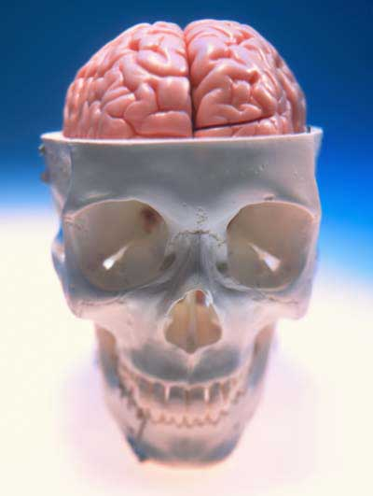
Understanding Schizophrenia
What’s going on in the brain in schizophrenia?
Abnormal brain structure and activity
Too many dopamine/D4 receptors help to explain paranoia and hallucinations; it’s like taking amphetamine overdoses all the time.
Poor coordination of neural firing in the frontal lobes impairs judgment and self-control.
The thalamus fires during hallucinations as if real sensations were being received.
There is general shrinking of many brain areas and connections between them.
Notes:
Click to reveal bullets.
Students may need reminding that the thalamus was referred to earlier in the course as the sensory switchboard.
There is also abnormal amygdala functioning in schizophrenia, which could be a result of schizophrenia or could explain the hyper-sensitivity to threat that could feed into paranoid ideas and aggressive reactive behavior.
In addition to the shrinkage of the brain tissue, enlargement of the ventricles (fluid-filled areas within and between areas of tissue) can be seen.

Slide 22
Understanding Schizophrenia
Schizophrenia is more likely to develop in babies born:
during and after flu epidemics.
in densely populated areas.
a few months after flu season.
after mothers had the flu during the second trimester, or had antibodies showing viral infection.
The lesson is to:
Are there biological risk factors affecting early development?
Biological Risk Factors
Schizophrenia is somewhat more likely to develop when one or more of these factors is present:
low birth weight
maternal diabetes
older paternal age
famine
oxygen deprivation during delivery
maternal virus during mid-pregnancy impairing brain development
get flu shots with early fall pregnancies.
Notes:
Click to reveal bullets.
Lesson: even if we do not know how the virus in the mother derails the fetus’s brain development, the statistical results here are enough of a warning. Get a flu inoculation (in the shot form, if you want to avoid nasal mist exposure to live-deactivated virus) if pregnancy will include flu season.

Slide 23
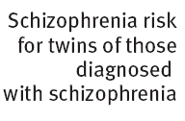
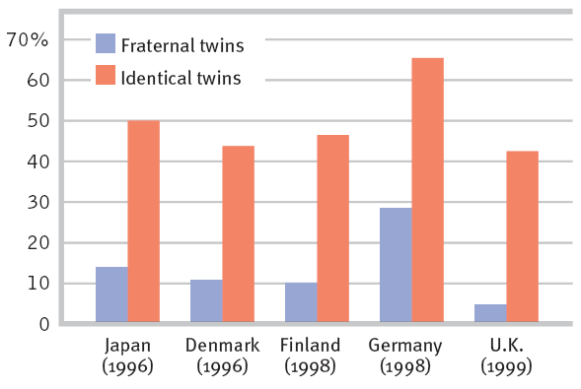
Understanding Schizophrenia
Are there genetic risk factors? If so, we would see more similar schizophrenia risk shared between identical twins than fraternal twins (graph below). Do we?
Genetic Factors
If one twin has schizophrenia, the chance of the other one also having it are much greater if the twins are identical.
Having adoptive siblings (or parents) with schizophrenia does not increase the likelihood of developing schizophrenia.
Notes:
Click to reveal bullets.
Questions to raise here: what does this tell us about the role of genes in schizophrenia? They must play some role, because having more genes in common means more similar likelihood of developing schizophrenia.
Preview of the next slide, or in place of it: why is the risk not identical for identical twins? It could be environmental factors. Or, it could be a difference beginning even sooner (not sharing a placenta).

Slide 24
Abnormal Brain Activity
Brain scans show abnormal activity in the frontal cortex, thalamus, and amygdala of schizophrenic patients. Adolescent schizophrenic patients also have brain lesions.

Slide 25
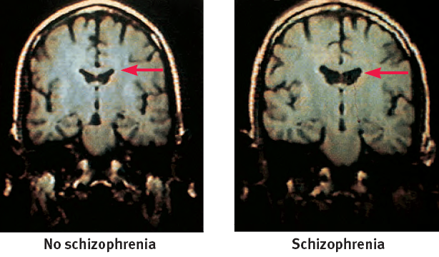
Understanding Schizophrenia
Genetic and Prenatal Causes
Even if maternal flu during the second trimester doubles the risk of schizophrenia, this means only 2 percent of these babies develop the disorder.
Genetics may differentiate these 2 percent.
Research shows many genes linked to schizophrenia, but it may take environmental factors to turn on these genes.
Even in identical twins, genetics do not fully predict schizophrenia.
This could be because of environmental differences.
First difference: twins in separate placentas.
Only one of two twins has the enlarged ventricles seen in schizophrenia.
Notes:
Click to reveal bullets.
Identical twins who developed in separate placentas in the womb, which happens about a third of the time for identical twins, were less similar in their risk of developing schizophrenia than twins who developed in a shared placenta (60 percent chance of also having the diagnosis with shared placenta, 10 percent risk in separate placentas).

Slide 26
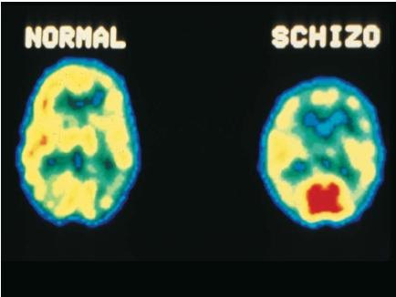
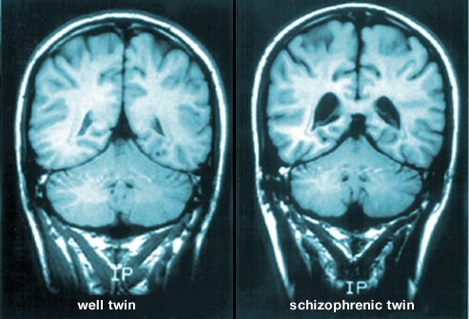

Slide 27
Understanding Schizophrenia
Are there psychological causes?
Social-Psychological Factors
Research does not support the idea that social or psychological factors (such as parenting) alone can cause schizophrenia.
However, there may be factors such as stress that affect the onset of schizophrenia.
Until we find a mechanism of causation, all we may have is a list of factors which correlate with increased risk.
Notes:
Click to reveal bullets.

Slide 28
Predicting Schizophrenia: Early Warning Signs
Social/psychological factors which tend to appear before the onset of schizophrenia:
Biological factors which tend to appear before the onset of schizophrenia:
early separation from parents
short attention span
disruptive OR withdrawn behavior
emotional unpredictability
poor peer relations and/or solitary play
having a mother with severe chronic schizophrenia
birth complications, including oxygen deprivation and low birth weight
poor muscle coordination
Notes:
Click to reveal bullets under each heading.

Slide 29
Other Disorders
Dissociative Disorders
Eating Disorders
Personality Disorders
Notes:
Automatic animation.

Slide 30
Dissociative Disorders
Dissociation refers to a separation of conscious awareness from thoughts, memory, bodily sensations, feelings, or even from identity.
Dissociation can serve as a psychological escape from an overwhelmingly stressful situation.
A dissociative disorder refers to dysfunction and distress caused by chronic and severe dissociation.
Examples:
Dissociative Amnesia:
Loss of memory with no known physical cause; inability to recall selected memories or any memories
Dissociative Fugue
“Running away” state; wandering away from one’s life, memory, and identity, with no memory of these
Dissociative Identity Disorder (D.I.D.)
Development of separate personalities
Notes:
Click to reveal bullets.
Dissociation is related to “spacing out” but well beyond it. During a physical assault, people might try to separate themselves from bodily experience, which is functional at the time but can lead to problems in relating to one’s bodily memory and experience later.
Click to reveal examples.
Question for class: using this definition of dissociation, describe the process of dissociation going on in each of these disorders.
Answer: the person is dissociating 1) from memory, 2) from situation and identity, or 3) having dissociations within identity (or among parts of identity).
Another question you might ask before the next slide: “what is another, former name for Dissociative Identity Disorder?”

Slide 31
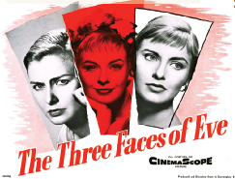
Dissociative Identity Disorder (D.I.D.) formerly “Multiple Personality Disorder”
Alternative Explanations for D.I.D.
Dissociative “identities” might just be an extreme form of playing a role.
D.I.D. in North America might be a recent cultural construction, similar to the idea of being possessed by evil spirits.
Cases of D.I.D. might be created or worsened by therapists encouraging people to think of different parts of themselves.
In the rare actual cases of D.I.D., the personalities:
are distinct, and not present in consciousness at the same time.
may or may not appear to be aware of each other.
Notes:
Click to reveal bullets and sidebar.
“Identity” is another movie to explore on this topic; it portrays schizophrenia from the inside rather than from the outside.
A different way of looking at the cultural issue: could it be that cases of D.I.D. and demonic possession might be two different names for the same phenomenon?

Slide 32
D.I.D., or DID Not? Evidence that D.I.D. is Real
Different personalities have involved:
different brain wave patterns.
different left-right handedness.
different visual acuity and eye muscle balance patterns.
Patients with D.I.D. also show heightened activity in areas of the brain associated with managing and inhibiting traumatic memories.
Explaining fragmentation of personality from different perspectives
Psychoanalytic perspective:
diverting id
Cognitive perspective:
coping with abuse
Learning perspective:
dissociation pays
Social influence:
therapists encourage
Notes:
Click to reveal bullets and sidebar.
In apparently genuine cases of Dissociative Identity Disorder, the different personalities show differences that are hard to fake.
In the sidebar, you can prompt students with the hints to do the work guessing at what different perspectives might say.

Slide 33
Eating Disorders
These may involve:
unrealistic body image and extreme body ideal.
a desire to control food and the body when one’s situation can’t be controlled.
cycles of depression.
health problems.
Anorexia nervosa Bulimia nervosa Binge-eating disorder
 | Definition | Prevalence
Anorexia Nervosa | Compulsion to lose weight, coupled with certainty about being fat despite being 15 percent or more underweight | 0.6 percent meet criteria at some time during lifetime
Bulimia Nervosa | Compulsion to binge, eating large amounts fast, then purge by losing the food through vomiting, laxatives, and extreme exercise | 1.0 percent
Binge-Eating Disorder | Compulsion to binge, followed by guilt and depression | 2.8 percent
Notes:
Click to reveal bullets, then table.
Health problems include malnutrition, shutdown of bodily functions and structures, and death.
“Nervosa” is a leftover term related to neurosis or what we would now call anxiety.
“Underweight,” like “overweight,” is determined by medical standards, and obviously not by the felt standards of those with anorexia.

Slide 34
Eating Disorders: Associated Factors
Family factors:
having a mother focused on her weight, and on child’s appearance and weight
negative self-evaluation in the family
for bulimia, if childhood obesity runs in the family
for anorexia, if families are competitive, high-achieving, and protective
Cultural factors:
unrealistic ideals of body appearance
Notes:
Click to reveal bullets.

Slide 35
Personality Disorders
Personality disorders are enduring patterns of social and other behavior that impair social functioning.
There are three “clusters”/categories of personality disorders.
Anxious: e.g., Avoidant P.D., ruled by fear of social rejection
Eccentric/Odd: e.g. Schizoid P.D., with flat affect, no social attachments
Dramatic: e.g. Histrionic, attention-seeking; narcissistic, self-centered; antisocial, amoral
Notes:
Click to reveal bullets.
A full list of the disorders in each category of the DSM, although the list is changing with the DSM-V:
Anxious Cluster: Avoidant, Dependent, and Obsessive-Compulsive Personality Disorder
Eccentric/Odd/Detached cluster: Schizoid, Schizotypal, and Paranoid Personality Disorders
Dramatic/Erratic/Impulsive cluster: Histrionic, Narcissistic, Antisocial, and Borderline Personality Disorders

Slide 36
AXIS II – Personality Disorders
Paranoid: suspicious, argumentative, paranoid, continually on the lookout for trickery and abuse, jealous, tendency to blame others, cold and humorless; hold grudges
Schizoid: has few friends other than 1st-degree relatives - a "loner"; indifferent to praise and criticism of others; unable to form close relationships; takes pleasure in few, if any, activities; shows emotional coldness, detachment, or flattened affect
Schizotypal: also aloof and indifferent like the schizoid; magical thinking; superstitious beliefs; uses unusual words and has peculiar ideas; a very mild form of schizophrenia
Antisocial: breaks rules and laws; takes advantage of other people for personal gain; feels little remorse or guilt; appears friendly and charming on the surface; often intelligent
Narcissistic: grandiose; crave admiration of others; extremely self-centered; feel they are privileged and special; expects favors from others; emotions are not erratic
Histrionic: overly dramatic; attention seekers; easily angered; seductive; dependent on others; vain, shallow, and manipulative; displays intense, but often false emotions
Borderline: very unstable relationships; erratic emotions; self- damaging behavior; impulsive; unpredictable aggressive and sexual behavior; monophobia; easily angered
Avoidant: hypersensitvity to rejection/criticism; self-imposed social isolation; extreme shyness; severe low self-esteem; avoids physical contact; self-loathing; mistrust of others
Dependent: see relationships with significant others as necessary for survival; subordinate their needs to those of others; terrified of being alone; relationship-hoppers; lack self-confidence; need approval for everything
Obsessive-Compulsive: perfectionists; preoccupied with details, rules, schedules; rigid and stubborn; more concerned about work than pleasure; serious and formal; cannot express tender feelings

Slide 37
Antisocial Personality Disorder [APD]
Antisocial personality disorder refers to acting impulsively or fearlessly without regard for others’ needs and feelings.
The diagnostic criteria include a pattern of violating the rights of others since age 15, including three of these:
Deceitfulness
Disregard for safety of self or others
Aggressiveness
Failure to conform to social norms
Lack of remorse
Impulsivity and failure to plan ahead
Irritability
Irresponsibility regarding jobs, family, and money
Notes:
Click to reveal all text.

Slide 38
Which Kids May Develop APD as Adults?
Biological APD Risk Factors
Antisocial or unemotional biological relatives increases risk.
Some associated genes have been identified.
Risk factors include body-based fearlessness, lower levels of stress hormones, and low physiological arousal in stressful situations such as awaiting receiving a shock.
Fear conditioning is impaired.
Reduced prefrontal cortex tissue leads to impulsivity.
Substance dependence is more likely.
About half of children with persistent antisocial behavior develop lifelong APD.
Which kids are at risk? Psychological factors:
those who in preschool were impulsive, uninhibited, unconcerned with social rewards, and low in anxiety.
those who endured child abuse, and/or inconsistent, unavailable caretaking.
Notes:
Click to reveal bullets and sidebar.
These attributes and experiences increase risk for developing APD, especially in combination with biological factors, discussed on the next slide.

Slide 39
Antisocial PD ≠ Criminality
Criminals: people who repeatedly commit crimes
People with antisocial personality disorder
Many career criminals do show empathy and selflessness with family and friends.
Many people with A.P.D. do not commit crimes.
Notes:
No animation.
This chart is not based on any statistics but is an illustrative estimate.

Slide 40
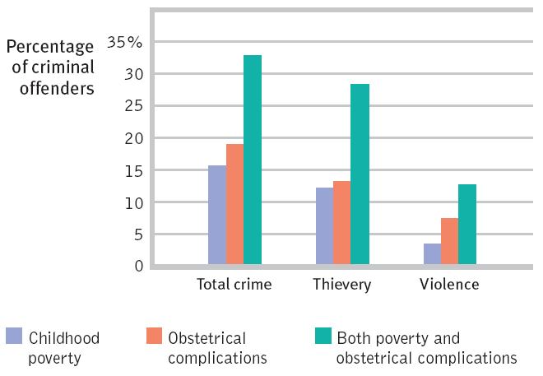
Antisocial Crime
If antisocial personality disorder is not a full picture of most criminal activity, what can we say about people who commit crime, especially violent crime?
Biosocial roots of crime: birth complications and poverty combine to increase risk.
Notes:
No animation.

Slide 41
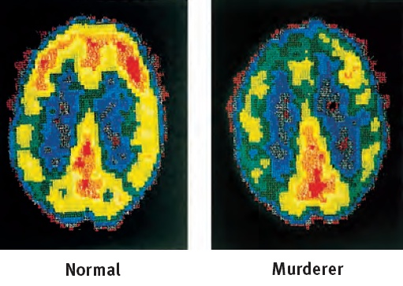
Biosocial Roots of Crime: The Brain
People who commit murder seem to have less tissue and activity in the part of the brain that suppresses impulses.
Other differences include:
less amygdala response when viewing violence.
an overactive dopamine reward-seeking system.
Notes:
No animation.
For a review, you can ask, “what part of the brain are we referring to here?” Hint: These are top-down views of the brain, with people facing up toward the top of the slide.
Review challenge: What type of scan is this? (PET Scan).

Slide 42
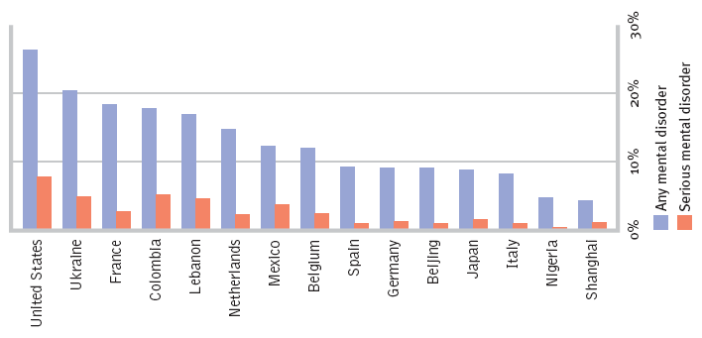
How common are psychological disorders?
Countries vary greatly in the percentage of people reporting mental health issues in the past year.
Notes:
No animation.
Depression and schizophrenia are found all over the world. Bulimia, however appears mostly in the United States and pockets of Americanized culture elsewhere.

Slide 43
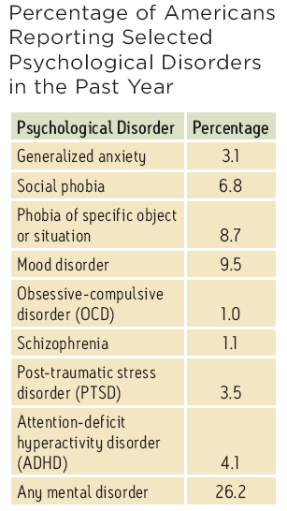
Rates of Psychological Disorders
This list takes a closer look at the past-year prevalence of various mental health diagnoses in the United States.
Notes:
No animation.
“Mood disorder” includes depressive disorders and bipolar disorders.

Slide 44
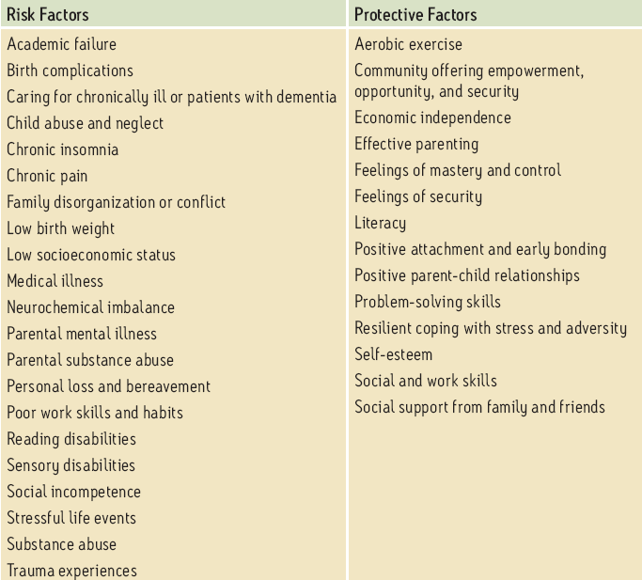
Who is less at risk?
Risks and Protective Factors for Mental Disorders
Who is at risk of mental disorders?
Notes:
No animation.

Slide 45
Outcomes for People with Psychological Disorders
There are risks to be watchful of, obstacles to be overcome, and improvements to be made, often with the help of with treatment.
Some people with psychological disorders do not recover.
Some achieve greatness, even with a psychological disorder.
Notes:
Click to reveal bullets.

