Slide 1

What we’ll seek to understand...
What does it mean to have a mental disorder?
Defining and classifying disorders
Anxiety disorders, including OCD and PTSD
Mood disorders, including depression and bipolar disorder
Schizophrenia
Sample of other disorders:
    Dissociative disorders
    Eating disorders
    Personality disorders
Rates, vulnerability, and protective factors
Notes:
Click to reveal all bullets.

Slide 2

Why Learn about Psychological Disorders?
Reasons for curiosity:
personal familiarity with psychological symptoms
knowing someone else with the disorder
hearing about how prevalent and socially devastating some disorders have become in society
wanting to learn more about mental health and human nature
Notes:
Click to reveal bullets.
Instructor: you might add to the last point, “Just as our understanding of the brain has been increased by studies of damage to the brain, our understanding of the mind may be improved by studying problems in psychological functioning. As William James said, ‘To study the abnormal is the best way of understanding the normal.’”

Slide 3
Perspectives on Psychological Disorders
Defining psychological disorders
Understanding psychological disorders
Classifying psychological disorders
Labeling psychological disorders
Insanity and responsibility
Questions to Keep in Mind
How do we decide when a set of symptoms are severe enough to be called a disorder that needs treatment?
Can we define specific disorders clearly enough so that we can know that we’re all referring to the same behavior/mental state?
Can we use our diagnostic labels to guide treatment rather than to stigmatize people?
Notes:
Click to reveal bullets and questions.

Slide 4

Psychological disorders are:
patterns of thoughts, feelings, or actions that are deviant, distressful, and dysfunctional.
Terms from the Definition
Disorder refers to a state of mental/behavioral ill health.
Patterns refers to finding a collection of symptoms that tend to go together, and not just seeing a single symptom.
For there to be distress and dysfunction, symptoms must be sufficiently severe to interfere with one’s daily life and well being.
Deviant means differing from the norm.
Notes:
Click to reveal bullets.
The term “disorder” is used instead of “disease” because the latter term typically implies a known cause of the symptoms. In naming a disorder, you’re not naming a cause such as a virus. Instead, you are naming the collection of symptoms that tend to go together.
More on the issue of pattern vs. single symptom: one of the symptoms of brain cancer is a headache. If you have a headache, though, it would be a mistake to assume that you have brain cancer. Similarly, one of the symptoms of major depression may be that you feel sad. If you feel sad, though, this is not enough to qualify for diagnosis of major depressive disorder. Keep this in mind when we discuss ADHD.
More about deviance coming up. Another common term is “ abnormal,” which more literally means varying from the norm. Both of these terms have acquired an unnecessarily negative connotation outside the field of psychology.
Image from the text.

Slide 5
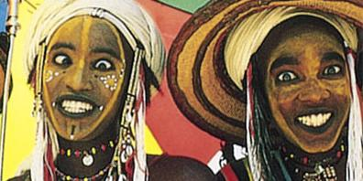

“Deviant”?
Defining Deviance:
The Role of Context and Culture
Context: whether a behavior varies from expectation depends on the situation in which the behavior occurs →Yelling for hours is not deviant when it happens at a football game.
Culture: these painted faces might seem deviant when viewed from a different culture
To deviate, in general, means to vary from what typically would happen.
In psychology, a behavior or mental state is considered deviant by a culture when it is different from what would be expected in that culture.
A disorder may also be a deviation from a typical developmental pathway.
Notes:
Click to reveal bullets on left.
Deviation from a developmental pathway includes autism, mental retardation, or extremely disruptive behavior which persists in all situations.
To deviate from the norm is not enough to define a disorder. The genius, a champion athlete, and the nonconformist all deviate from the norm but do not necessarily have a disorder.
Click to reveal sidebar.
Context is crucial. Rolling on the floor and calling out nonsense syllables might seem to be deviant/abnormal but in some churches it’s called glossalalia and is considered to be a sign of divine inspiration.
Although the definition says “distress and dysfunction,” in some disorders only one of these will really stand out. Some personality disorders, as well as substance abuse, involve dysfunction without distress. Some anxiety disorders can involve distress without any dysfunction that others will notice.
Dysfunction refers to the impact of the psychological disorder on a person’s ability to manage day-to-day tasks and relationships. For examples, severe depression or anxiety might prevent you from feeling able to go to work or school. Personality disorders create problems in relationships.
Distress refers to the internal anguish that can lead to desperation and even to suicide.

Slide 6
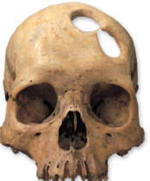
Understanding the Nature of Psychological Disorders
One reason to diagnose a disorder is to make decisions about treating the problem.
To treat a disorder, it helps to understand the nature/cause of the psychological symptoms.
Based on older understanding of psychological disorders, treatments have included: exorcising evil spirits, beatings, caging/restraint, and
Notes:
Click to reveal bullets.
The term for drilling holes in the skull to release evil spirits is “trephination.”
When you click the drill will bounce and to demonstrate the old medical technique, although the equipment may be anachronistic.

Slide 7
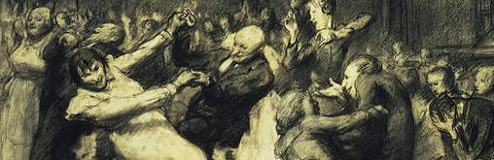
Pinel’s New Approach
From the humane view to the scientific view of the mentally ill:
Pinel’s humane environmental interventions improved lives but often did not effectively treat mental illness
Philippe Pinel (1745-1826) and others sought to reform brutal treatment by promoting a new understanding of the nature of mental disorders.
Pinel proposed that mental disorders were not caused by demonic possession, but by environmental factors such as stress and inhumane conditions.
Pinel’s “moral treatment” involved improving the environment and replacing the asylum beatings with patient dances.
But then…
Notes:
Click to reveal bullets.

Slide 8
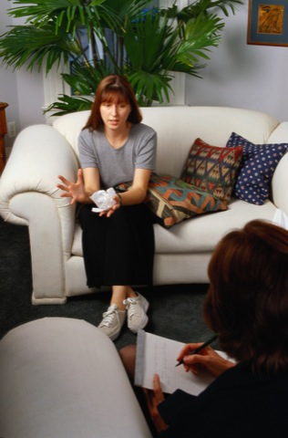
The Medical Model
The discovery that the disease of syphilis causes mental symptoms (by infecting the brain) suggested a medical model for mental illness.
Psychological disorders can be seen as psychopathology, an illness of the mind.
Disorders can be diagnosed, labeled as a collection of symptoms that tend to go together.
People with disorders can be treated, attended to, given therapy, all with a goal of restoring mental health.
Notes:
Click to reveal bullets.
The medical model also implies ideas about etiology, the cause of mental disorders. It is not always possible to determine the cause of a specific mental disorder, but in general, the assumption here is that the cause is physical and mental, and not spiritual.

Slide 9
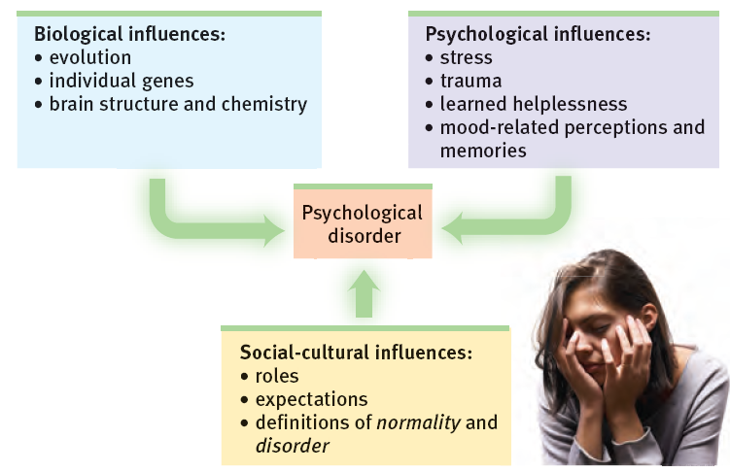
The Biopsychosocial Approach
Mental disorders can arise in the interaction between nature and nurture caused by biology, thoughts, and the sociocultural environment.
Notes:
No animation.

Slide 10
Cultural Influences on Disorders
Culture-bound syndromes are disorders which only seem to exist within certain cultures; they demonstrate how culture can play a role in both causing and defining a disorder.
Examples:
Bulimia Nervosa: binging/purging, in the United States
Running amok: violent outbursts, in Malaysia
Hikikomori: social withdrawal, in Japan
Notes:
Automatic animation.
Some disorders, such as depression and schizophrenia, appear to be found in the same form across all cultures.

Slide 11
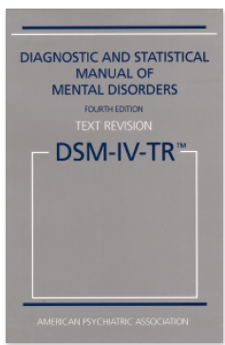
Classifying Psychological Disorders
The Diagnostic and Statistical Manual
It’s easier to count cases of autism if we have a clear definition.
Versions: DSM-IV-TR, DSM-V (May 2013)
The DSM is used to justify payment for treatment.
It’s consistent with diagnoses used by medical doctors worldwide.
Why create classifications of mental illness? What is the value of talking about diagnoses instead of just talking about individuals?
Diagnoses create a verbal shorthand for referring to a list of associated symptoms.
Diagnoses allow us to statistically study many similar cases, learning to predict outcomes.
Diagnoses can guide treatment choices.
Notes:
Click to reveal bullets and sidebar.
In order to make the definitions clear, each diagnosis in the DSM includes lists of symptoms, often in groups. The DSM includes criteria about how many symptoms must be present in each category to justify a label.

Slide 12
The Five “Axes” of Diagnosis
The DSM suggests describing someone not just with a label but with a five-part picture.
Axis I:
Is a clinical syndrome present?
Using specifically defined criteria, clinicians may select none, one, or more syndromes.
Axis II:
Is a personality disorder or mental retardation (intellectual developmental disorder) present?
Clinicians may or may not also select one of these two conditions.
Axis III:
Is a general medical condition, such as diabetes, arthritis, or hypertension also present?
Axis IV:
Are psychosocial or environmental problems, such as school or housing issues, also present?
Axis V:
What is the global assessment of this person’s functioning?
Clinicians assign a code from
0-100.
Notes:
No animation.
Usually Axis V is in two parts: the highest GAF in the past year, and the current GAF.

Slide 13
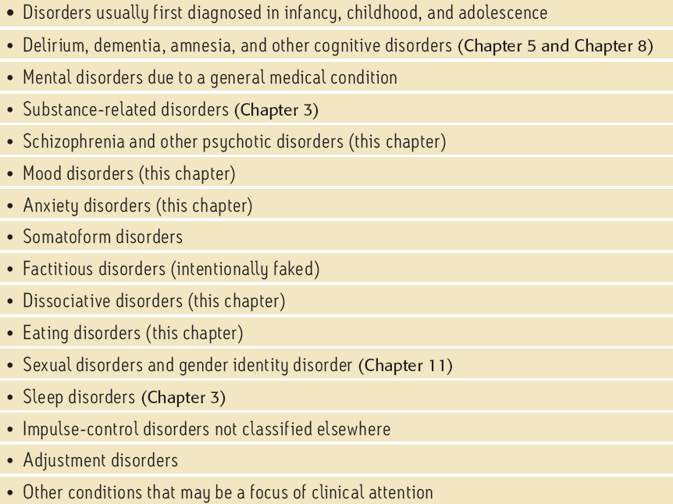
Categories of Diagnoses
Notes:
No animation.
The text describes this table as a list of syndromes. However, this is a table of contents of the DSM, a list of the categories under which other diagnoses fall.

Slide 14
Critiques of Diagnosing with the DSM
1. The DSM calls too many people “disordered.”
The border between diagnoses, or between disorder and normal, seems arbitrary.
Decisions about what is a disorder seem to include value judgments; is depression necessarily deviant?
Diagnostic labels direct how we view and interpret the world, telling us which behavior and mental states to see as disordered.
Notes:
No animation.
More comments about each of these points:
The first critique has been raised about the DSM 5 in particular, including the possibility that some depression that is part of a grieving process may be more likely to be called a disorder (implying that it needs to be treated).
Valid, reliable criteria might address this concern.
In an older DSM, homosexuality was considered a disorder. In the current and future versions, there are more adult labels for symptoms more likely to be evident in females, such as anxiety and depression, and fewer “male” diagnoses (such as diagnoses that relate to the emotion of anger).
See if students can connect the impact of diagnoses to the general impact of having schema, concepts and categories that organize and influence our perceptions.

Slide 15
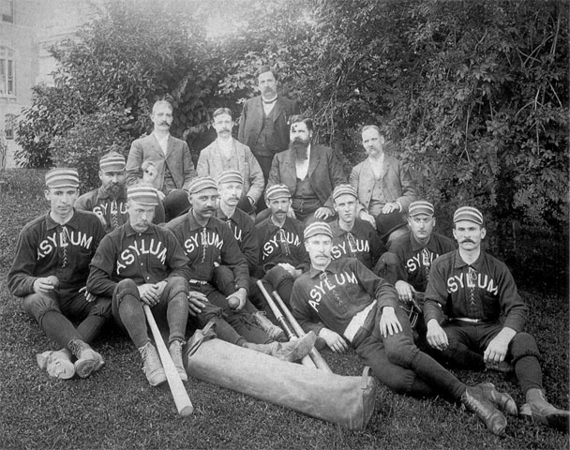
Labeling Psychological Disorders
Critics of the DSM-IV argue that labels may
stigmatize individuals.
Asylum baseball team (labeling)
Notes:
OBJECTIVE 4| Discuss the potential dangers and benefits of using diagnostic labels.

Slide 16


Labeling Psychological Disorders
Labels may be helpful for healthcare professionals when communicating with one another and establishing therapy. However, they can result in a bogus reality such as that created by Rosenhahn (1973).

Slide 17

Stigma and Stereotypes
Many people think a diagnostic label means being seen as tainted, weak, and weird.
Because of this, many psychologists believe we should use extreme caution in diagnosing and labeling.
However:
these negative views/stigma come from popular cultural views of mental illness, and not from the DSM. [Does a diabetes diagnosis create stigma? No. Bipolar diagnosis? Yes.]
the DSM may contain the information to correct inaccurate perceptions of mental illness.
Notes:
Click to reveal bullets.
Some of the stigma of labels is not the DSM’s fault; notice how “deviant” and “retarded” and other once-neutral terms have acquired a negative connotation.
Having schizophrenia is not about having a “split personality” (that’s D.I.D.) and does not mean you are not dangerous or “crazy.” Having mood swings does not mean you have bipolar disorder or a split personality.

Slide 18

Insanity and Responsibility
Jared Loughner shot many people, including a U.S. Representative, in 2011.
Loughner had schizophrenia and substance abuse problems, a combination associated with increased violence.
To what degree, if any, should he be held responsible for his actions?
What is the appropriate consequence?
Notes:
Click to reveal bullets and questions.
Note: schizophrenia alone is not associate with increased risk of violence. However, schizophrenia plus substance abuse increases the risk of violent behavior.
Both people who see him as NOT responsible for his actions and those who see his mental illness as part of who he is, and thus making him responsible, might agree that the appropriate consequence might be confinement with mandatory treatment rather than simply imprisonment.

Slide 19
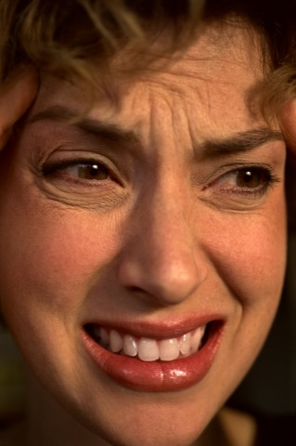
Anxiety Disorders
GAD: Generalized anxiety disorder
Panic disorder
Phobias
OCD: Obsessive-compulsive disorder
PTSD: Post-traumatic stress disorder
Notes:
No animation.

Slide 20

GAD: Generalized Anxiety Disorder
Emotional-cognitive symptoms include worrying, having anxious feelings and thoughts about many subjects, and sometimes “free-floating” anxiety with no attachment to any subject. Anxious anticipation interferes with concentration.
Physical symptoms include autonomic arousal, trembling, sweating, fidgeting, agitation, and sleep disruption.
Notes:
Click to reveal bullets.
GAD tends to occur along with mild but persistent depression.
GAD becomes more rare after age 50. Why might that be? Perhaps experience shows that things usually don’t turn out as badly as those with Generalized Anxiety Disorder think they will.

Slide 21

Panic Disorder: “I’m Dying”
A panic attack is not just an “anxiety attack.” It may include:
many minutes of intense dread or terror.
chest pains, choking, numbness, or other frightening physical sensations. Patients may feel certain that it’s a heart attack.
a feeling of a need to escape.
Panic disorder refers to repeated and unexpected panic attacks, as well as a fear of the next attack, and a change in behavior to avoid panic attacks.
Notes:
Click to reveal bullets.
Panic disorder includes the fight or flight system, and easy triggering of the autonomic nervous system.
In a panic attack, the mind fills in an explanation: “If I’m feeling terror and a physical response to a threat, there must be some danger here.” People sometimes attribute the panic to whatever situation was present when the attack occurred.
Extreme avoidance of possible panic triggers agoraphobia, an anxiety disorder characterized by anxiety in situations where the sufferer perceives the environment to be difficult or embarrassing to escape, such as wide-open spaces.

Slide 22
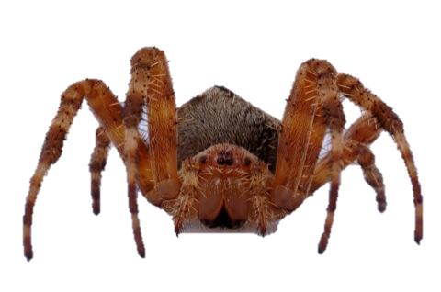
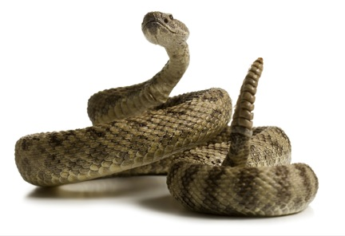
Specific Phobia
A specific phobia is more than just a strong fear or dislike. A specific phobia is diagnosed when there is an uncontrollable, irrational, intense desire to avoid the some object or situation. Even an image of the object can trigger a reaction--“GET IT AWAY FROM ME!!!”--the uncontrollable, irrational, intense desire to avoid the object of the phobia.
Notes:
Automatic animation.
“Irrational” means the fear and the avoidance compulsion are out of proportion to the actual threat (e.g. triggered by even a photograph) and the phobia occurs even when the person knows that the fear doesn’t make sense.
Some phobias may make evolutionary sense. More on this later, but in case you decide to delete the biological perspective slide, there are some fears more likely to form phobias. These seem to be part of our biological heritage to avoid (for example, clowns may trigger a fear of baboons and mandrills bred into our ancestors). People reasonably fear handguns, but are not likely to panic and run away from a mere photograph of a gun unless they had a personal traumatic experience with one. However, people fear heights, snakes and spiders with no previous bad experience with these, because those that didn’t fear these 100,000 years ago might have not lived to reproduce.
I suggest asking students, before viewing the next slide with its list of phobias and fears, about their own fears. You might ask, “is anyone getting an irrational fear reaction triggered by this slide?” and “do any of you have a fear that meets the criteria to be called a phobia?”
This diagnosis is known in the DSM as “specific phobia,” although agoraphobia is in a separate category because it is so closely and frequently associated with panic disorder. Social phobia is also a separate diagnosis.

Slide 23
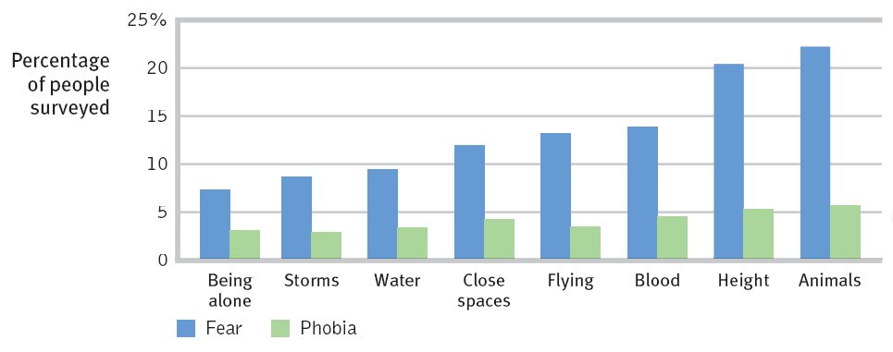
Some Fears and Phobias
What trends are evident here? Which varies more, fear or phobias? What does this imply?
Some Other Phobias
Agoraphobia is the avoidance of situations in which one will fear having a panic attack, especially a situation in which it is difficult to get help, and from which it difficult to escape.
Social phobia refers to an intense fear of being watched and judged by others. It is visible as a fear of public appearances in which embarrassment or humiliation is possible, such as public speaking, eating, or performing.
Notes:
Click to reveal two additional phobias.
The number of people with the specific FEAR varies more widely than the number of people with that specific PHOBIA. This implies that what we are really seeing in the lighter color is the number of people prone to a phobic-level fear. Not clear why clowns were not part of the survey, since this is a phobia mentioned often in the popular culture and by Intro Psych students.

Slide 24
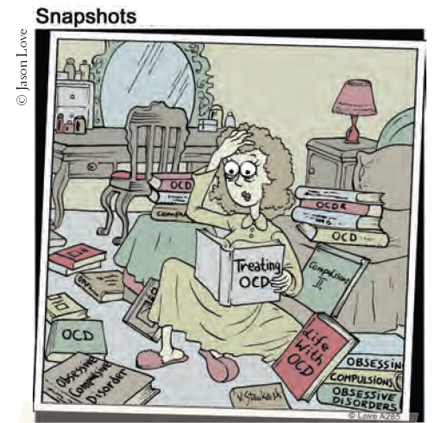
Obsessive-Compulsive Disorder [OCD]
Obsessions are intense, unwanted worries, ideas, and images that repeatedly pop up in the mind.
A compulsion is a repeatedly strong feeling of “needing” to carry out an action, even though it doesn’t feel like it makes sense.
When is it a “disorder”?
  Distress: when you are deeply frustrated with not being able to control the behaviors
  or
  Dysfunction: when the time and mental energy spent on these thoughts and behaviors interfere with everyday life
Notes:
Click to reveal bullets.
Why is OCD considered an anxiety disorder? Because obsessions can be a distraction from underlying anxiety, and compulsions worsen through a cycle of negative reinforcement related to anxiety. The OCD sufferer resists carrying out a compulsion, feels anxious, and ultimately relieves the anxiety by giving in to the compulsion.

Slide 25
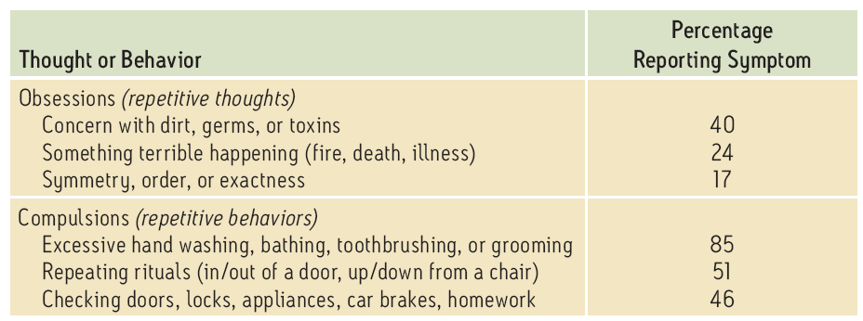
Common OCD Behaviors
Percentage of children and adolescents with OCD reporting these obsessions or compulsions:
Common pattern: RECHECKING Although you know that you’ve already made sure the door is locked, you feel you must check again. And again.
Notes:
Click to show bottom text box and start animation.
Emphasize the concept of “again.” Doing one of these behaviors does not mean that you have OCD. You are more likely to get a higher level of distress or dysfunction when you keep having these thoughts or behaviors, even when it makes no sense to you and you want to stop, but feel too much anxiety when you try to stop the compulsions and feel that the obsessions are outside of your control.

Slide 26
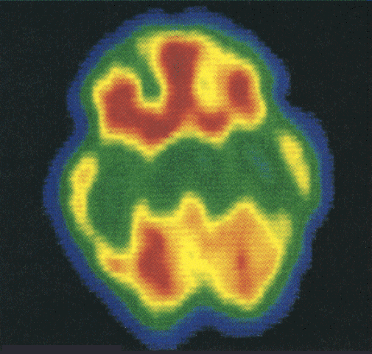
Brain Imaging
A PET scan of the brain of a person with Obsessive-Compulsive Disorder (OCD). High metabolic activity (red) in the frontal lobe areas are involved with directing attention.
Brain image of an OCD

Slide 27

Post-Traumatic Stress Disorder [PTSD]
About 10 to 35 percent of people who experience trauma not only have burned-in memories, but also four weeks to a lifetime of:
repeated intrusive recall of those memories.
nightmares and other re-experiencing.
social withdrawal or phobic avoidance.
jumpy anxiety or hypervigilance.
insomnia or sleep problems.
Notes:
Click to reveal bullets.
Instructor: point out that PTSD is not just an outcome of war experience. Overwhelming trauma happens to people in all walks of life.
Why is PTSD classified as an anxiety disorder? The overall experience may look like spacey withdrawal and occasional jumpiness from the outside. However, inside there is tension, turmoil, worry, fear, dread, angst, stress, and re-living the feelings of the trauma itself, which is likely to be anxiety and related reactions to threat.

Slide 28

Which People get PTSD?
Resilience and Post-Traumatic Growth
Resilience/recovery after trauma may include:
some lingering, but not overwhelming, stress.
finding strengths in yourself.
finding connection with others.
finding hope.
seeing the trauma as a challenge that can be overcome.
seeing yourself as a survivor.
Those with less control in the situation
Those traumatized more frequently
Those with brain differences
Those who have less resiliency
Those who get re-traumatized
Notes:
Click to reveal bullets and sidebar.
Most people experiencing trauma do NOT develop PTSD.
Those with less control: sensing less of a chance to escape or change the situation.
Those traumatized more frequently refers to people with less chance to recover from stress and harm.
Those with brain differences such as a sensitive amygdala, or difficulty controlling attention.
Those who have fewer traits and behaviors of resiliency, such as finding mentors.
Those re-traumatized by intrusive debriefing.
“That which does not kill us makes us stronger.”-- Friedrich Nietzsche (1844-1900), not known popularly as a bright-eyed optimist.

Slide 29
Understanding Anxiety Disorders: Explanations from Different Perspectives
Psychodynamic/
Freudian: repressed impulses
Classical conditioning: overgeneralizing a conditioned response
Operant conditioning: rewarding avoidance
Observational learning: worrying like mom
Cognitive appraisals: uncertainty is danger
Evolutionary: surviving by avoiding danger
Notes:
Click to reveal six explanations.

Slide 30
Understanding Anxiety Disorders: Freudian/Psychodynamic Perspective
Sigmund Freud felt that anxiety stems from repressed childhood impulses, socially inappropriate desires, and emotional conflicts.
We repress/bury these issues in the unconscious mind, but they still come up, as anxiety.
Notes:
With a click, the guy burying his issues rises and fades to reveal some anxiety peeking out, then emerging as something scary.
All three images from PowerPoint clip art.
Full text: Sigmund Freud felt that anxiety stems from hidden feelings, impulses, socially inappropriate desires, and emotional conflicts, and issues from childhood.
Freud felt that we tend to repress these issues, that is, push them out of our awareness so far that we forget about them, but the feelings still come to the surface as anxiety.

Slide 31
Classical Conditioning and Anxiety
Operant Conditioning and Anxiety
In the experiment by John B. Watson and Rosalie Rayner in 1920, Little Albert learned to feel fear around a rabbit because he had been conditioned to associate the bunny with a loud scary noise.
Sometimes, such a conditioned response becomes overgeneralized. We may begin to fear all animals, everything fluffy, and any location where we had seen those, or even fear that those items could appear soon along with the noise.
The result is a phobia or generalized anxiety.
We may feel anxious in a situation and make a decision to leave. This makes us feel better and our anxious avoidance was just reinforced.
If we know we have locked a door but feel anxious and compelled to re-check, rechecking will help us temporarily feel better.
The result is an increase in anxious thoughts and behaviors.
Notes:
Click to show bullets under each heading.
If you want to remind students of operant conditioning ideas, you can point out that the anxious, avoidant behavior was negatively reinforced (rewarded by the removal of aversive feelings).
See if students can connect the second bullet point to OCD. “Compelled” = compulsion; see if they can see pattern of reinforcement (once again, negative).
One more example to insert before the last bullet, though this type of example is not in the text. You can ask, “what happens if we reassure a friend who is worrying?” If we verbalize a worry and a friend reassures us, worrying just got positively reinforced.

Slide 32
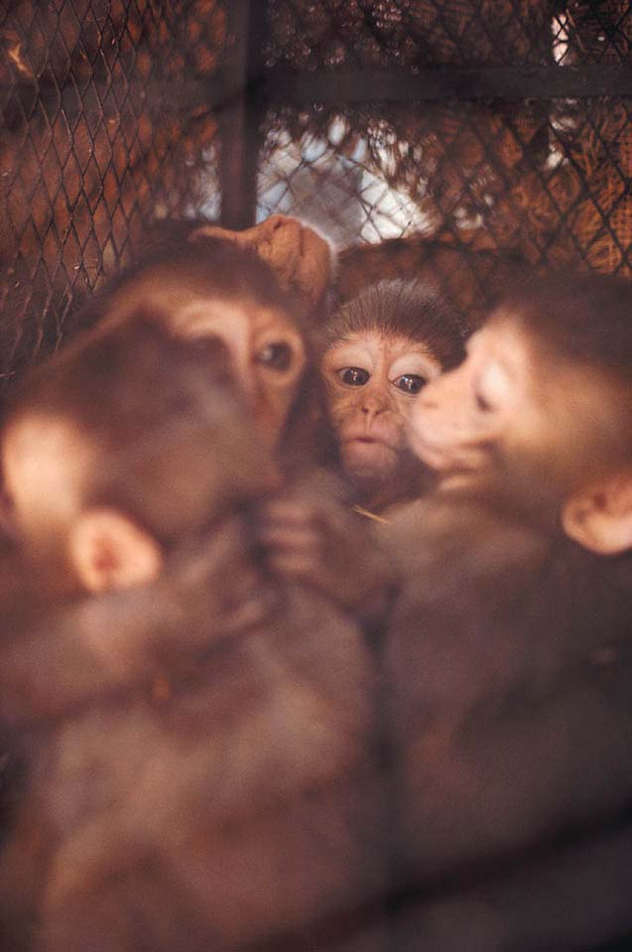
Observational Learning and Anxiety
Experiments with humans and monkeys show that anxiety can be acquired through observational learning. If you see someone else avoiding or fearing some object or creature, you might pick up that fear and adopt it even after the original scared person is not around.
In this way, fears get passed down in families.
Notes:
Click to reveal bullets.
Could this method of developing anxiety help explain the acquisition of prejudices? Subtle behaviors like avoiding certain types of people on a dark street might be acquired through watching the behavior of parents and friends even when we espouse believing in equal treatment and worth of all groups.

Slide 33

Cognition and Anxiety
Cognition includes worried thoughts, as well as interpretations, appraisals, beliefs, predictions, and ruminations.
Cognition includes mental habits such as hypervigilance (persistently watching out for danger). This accompanies anxiety in PTSD.
In anxiety disorders, such cognitions appear repeatedly and make anxiety worse.
Notes:
Click to reveal bullets.

Slide 34
Examples of Cognitions that can Worsen Anxiety:
Cognitive errors, such as believing that we can predict that bad events will happen
Irrational beliefs, such as “bad things don’t happen to good people, so if I was hurt, I must be bad”
Mistaken appraisals, such as seeing aches as diseases, noises as dangers, and strangers as threats
Misinterpretations of facial expressions and actions of others, such as thinking “they’re talking about me”
Notes:
Click to reveal four examples.
Not mentioned in the book:
“what-if” questions/worries such as, “what if a truck crashed into this room?” These questions are not really seeking answers, but statements of worry.
Anxiety might serve a potential cognitive function to get our minds to do some planning to avoid threats. In the same way, cognitive therapy could involve getting anxiety to work that way, doing some planning for whatever threats are most pressing, and correcting the cognitive errors and unhelpful beliefs and anxiety-provoking interpretations and appraisals.

Slide 35
Biology and Anxiety:
An Evolutionary Perspective
1. Human phobic objects:
Snakes
Heights
Closed spaces
Darkness
2. Similar but non-phobic objects:
Fish
Low places
Open spaces
Bright light
3. Dangerous yet non-phobic subjects:
We are likely to become cautious about, but not phobic about:
Guns
Electric wiring
Cars
Evolutionary psychologists believe that ancestors prone to fear the items on list #1 were less likely to die before reproducing.
There has not been time for the innate fear of list #3 (the gun list) to spread in the population.
Notes:
Evolutionary psychology question: why is anxiety part of our biological repertoire?
Perhaps panic, when functioning as fight, flight, or freeze, helped our ancestors stay safe when encountering danger. Perhaps worrying helps us plan how to face future danger.
The book suggests that compulsions are exaggerations of natural survival strategies, e.g. hair pulling stems from grooming, rechecking stems from territory management, compulsive washing stems from a healthy practice.
Click to reveal answer.

Slide 36
Biology and Anxiety: Genes
Genes and Neurotransmitters
Genes regulate levels of neurotransmitters.
People with anxiety have problems with a gene associated with levels of serotonin, a neurotransmitter involved in regulating sleep and mood.
People with anxiety also have a gene that triggers high levels of glutamate, an excitatory neurotransmitter involved in the brain’s alarm centers.
Studies show that identical twins, even raised separately, develop similar phobias (more similar than two unrelated people).
Some people seem to have an inborn high-strung temperament, while others are more easygoing.
Temperament may be encoded in our genes.
Notes:
Click to reveal bullets and sidebar.
Even if natural selection explains some things about humans as a whole, why are some people more prone to anxiety than others? Part of the answer is in a person’s experience, but part is in the genes.
This association with a serotonin-related gene may be why some people with worrying-style anxiety respond to the SSRIs which increase serotonin at the synapse.
A third major type of neurotransmitter involvement related to anxiety is GABA (gamma-aminobutyric acid), the inhibitory and “calming” neurotransmitter. GABA is not mentioned in this section of the text, probably because there is not a related gene that has been identified as being different in people with anxiety.

Slide 37
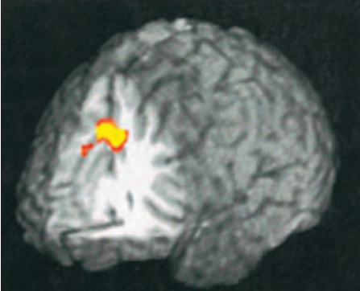
Biology and Anxiety: The Brain
Traumatic experiences can burn fear circuits into the amygdala; these circuits are later triggered and activated.
Anxiety disorders include overarousal of brain areas involved in impulse control and habitual behaviors.
The OCD brain shows extra activity in the ACC, which monitors our actions and checks for errors.
ACC = anterior cingulate gyrus
Notes:
Click to reveal bullets and illustration.

Slide 38
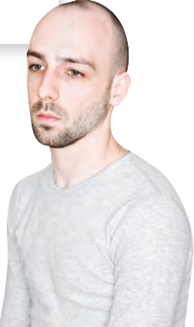

Mood Disorders
Major depressive disorder [MDD] is:
  more than just feeling “down.”
  more than just feeling sad about something.
Bipolar disorder is:
  more than “mood swings.”
  depression plus the problematic overly “up” mood called “mania.”
Notes:
Click to reveal text.

Slide 39

Criteria of Major Depressive Disorders
Major depressive disorder is not just one of these symptoms.
It is one or both of the first two, PLUS three or more of the rest.
Depressed mood most of the day, and/or
Markedly diminished interest or pleasure in activities
Significant increase or decrease in appetite or weight
Insomnia, sleeping too much, or disrupted sleep
Lethargy, or physical agitation
Fatigue or loss of energy nearly every day
Worthlessness, or excessive/inappropriate guilt
Daily problems in thinking, concentrating, and/or making decisions
Recurring thoughts of death and suicide
Notes:
Click to reveal bullets.
Diagnosing major depressive disorder, as with making other diagnoses, requires seeing the whole pattern rather than just one or two symptoms. Depression crosses the line into a disorder when it impairs daily functioning and/or causes significant distress.
With this list, the pattern is one or both of the first two symptoms and three to four of the rest of the symptoms, lasting more than two weeks.
The criteria related to weight loss does not include weight loss caused by deliberate dieting.

Slide 40
Major Depression:
Not Just a Depressive Reaction
Some people make an unfair criticism of themselves or others with major depression: “There is nothing to be depressed about.”
If someone with asthma has an attack, do we say, “what do you have to be gasping about?”
It is bad enough to have MDD that persists even under “good” circumstances. Don’t add criticism by implying the depression is an exaggerated response.
Notes:
Click to reveal bullets. The two related images appear with the middle bullet point.
Answer to the question on the slide: the depression is the illness and it doesn’t need further justification. It is not a problem of being depressed “about” something. The question is harmful because it brings about shame, and in depression, the question is most likely to be asked of oneself, “why am I depressed when other people have much worse problems?” This question misses the fact that depression IS the problem.
(Powerpoint clip art).

Slide 41
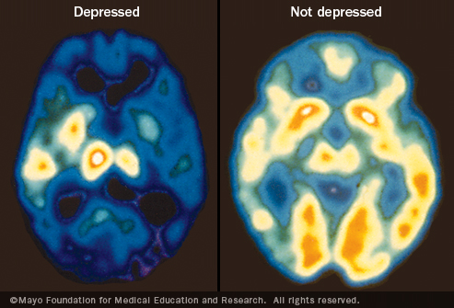

Slide 42
Depression is Everywhere
Depression shows up in people seeking treatment:
Phobias are the most common (frequently experienced) disorder, but depression is the #1 reason people seek mental health services.
Depression appears worldwide:
Per year, depressive episodes happen to about 6 percent of men and about 9 percent of women.
Over the course of a lifetime, 12 percent of Canadians and 17 percent of Americans experience depression.
Depression: The “Common Cold” of Disorders?
Although both are “common” (occurring frequently and pervasively), comparing depression to a cold doesn’t work.
Depression:
is more dangerous because of suicide risk.
has fewer observable symptoms.
is more lasting than a cold, and is less likely to go away just with time.
is much less contagious.
And…depressive pain is beyond sniffles.
Notes:
Click to reveal bullets and sidebar.
Instructor: the information in the sidebar is included for your optional use. Although it is a minor issue in the text, this analogy was a major complaint for a few of my students each semester. They reacted to the connotation of the word “common” as “no big deal,” and did not notice Myers’ sympathetic disclaimer that comparing depression to the common cold “effectively describes its pervasiveness but not its seriousness.” If you do some form of pre-class feedback, hopefully you’ll know in advance if you need this slide.
This analogy will come up again soon when discussing schizophrenia, so we may as well clarify it now.

Slide 43
Dysthymic Disorder
Dysthymic disorder lies between a blue mood and major depressive disorder. It is a disorder characterized by daily depression lasting two years or more.
Blue
Mood
Dysthymic
Disorder
Major Depressive
Disorder

Slide 44

Seasonal Affective Disorder [SAD]
Seasonal affective disorder is more than simply disliking winter.
Seasonal affective disorder involves a recurring seasonal pattern of depression, usually during winter’s short, dark, cold days.
Survey: “Have you cried today”? Result: More people answer “yes” in winter.
 | Percentage who cried
 | Men | Women
August | 4 | 7
December | 8 | 21
Notes:
Click to reveal bullets.

Slide 45
Bipolar Disorder
Bipolar disorder was once called “manic-depressive disorder.”
Bipolar disorder’s two polar opposite moods are depression and mania.
Mania refers to a period of hyper-elevated mood that is euphoric, giddy, easily irritated, hyperactive, impulsive, overly optimistic, and even grandiose.
Contrasting Symptoms
Depressed mood: stuck feeling “down,” with: | Mania: euphoric, giddy, easily irritated, with:
exaggerated pessimism social withdrawal lack of felt pleasure inactivity and no initiative difficulty focusing fatigue and excessive desire to sleep | exaggerated optimism hypersociality and sexuality delight in everything impulsivity and overactivity racing thoughts; the mind won’t settle down little desire for sleep
Notes:
Click to reveal bullets and table of contrasting symptoms.
A typical pattern is three to seven weeks of depression, followed by three to seven DAYS of mania. People enjoying their mania often forget or deny that the manic phase leads back into depression.
Like depression, this euphoria is self-sustaining; in mania, it’s not that you’re happy about something.

Slide 46
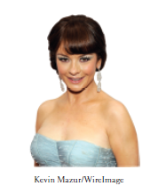
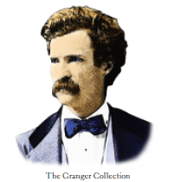
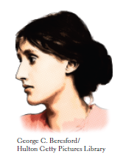

Bipolar Disorder and Creative Success
Many famous and successful people have lived with the ups and downs of bipolar disorder. Some speculate that the depressive periods gave them ideas, and the manic episodes gave them creative energy. Any evidence of mood swings here?
Notes:
Animation: after a click from the instructor, the pictures will move up and down at different rates to simulate up and down swings of mood.

Slide 47
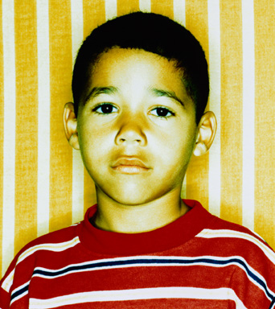
Bipolar Disorder in Children and Adolescents
Does bipolar disorder show up before adulthood, and even before puberty?
Many young people have cycles from depression to extended rage rather than mania.
The DSM-V may have a new diagnosis for these kids: disruptive mood dysregulation disorder.
Notes:
Click to reveal bullets.
Many have questioned whether children and adolescents who have swings in mood have bipolar disorder or something else. The 2013 edition of the diagnostic manual, the DSM-V, may have a new diagnosis which is designed to describe many of these kids: “Disruptive mood dysregulation disorder.” This awkward diagnoses has gone through a few name changes between 2010 and 2012, and in earlier versions including the inclusion of the word “dysphoric” (depressed mood) and “temper” (as in, temper tantrum).

