Slide 1
Chapter 3 - Socialization
1 – The Importance of Socialization

Slide 2
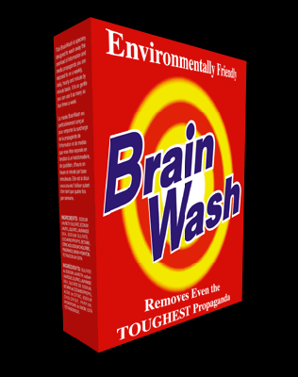
1984, Part 1 Chapter 7 – Does 2 + 2 = 5?
In the end the Party would announce that two and two made five, and you would have to believe it. It was inevitable that they should make that claim sooner or later: the logic of their position demanded it. Not merely the validity of experience, but the very existence of external reality, was tacitly denied by their philosophy. The heresy of heresies was common sense. And what was terrifying was not that they would kill you for thinking otherwise, but that they might be right. For, after all, how do we know that two and two make four? Or that the force of gravity works? Or that the past is unchangeable? If both the past and the external world exist only in the mind, and if the mind itself is controllable—what then?

Slide 3
How do these reflect our norms?
A man should not sit down at the table before the woman is seated.
A man should always pull out a woman’s chair for her and see that she is seated first.
A man should never let a woman carry anything heavy; she should carry only a small package and her coat.
A man should help a woman take off and put on her coat.
A man always leads when dancing.
A man should always open a door for a woman and let her pass first.

Slide 4
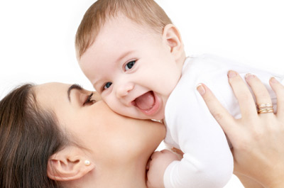
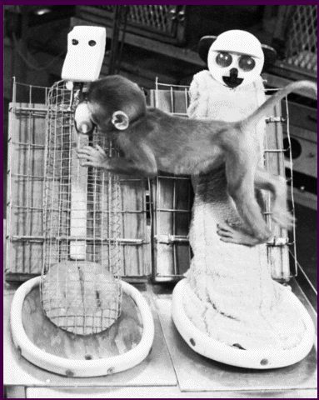
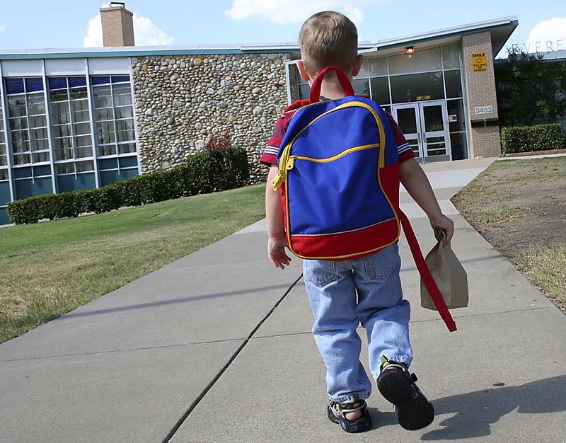
Socialization and Personality
Socialization
learning to participate in group life.
Learning to become “human”
Harry Harlow – Contact Comfort
How important is it?

Slide 5
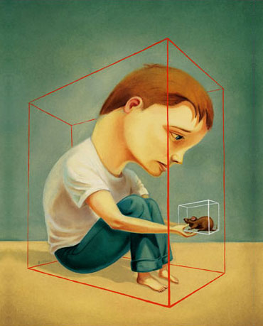
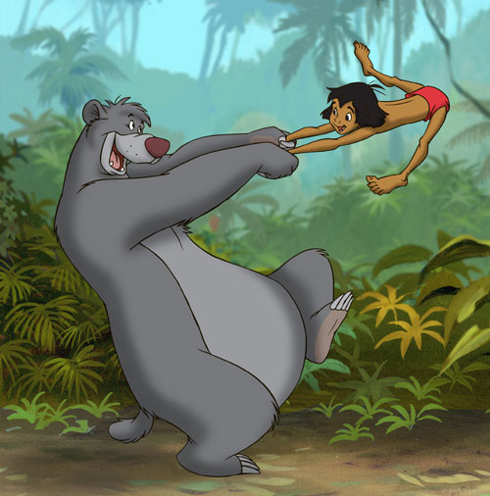
Socialization and Personality
How would being raised in isolation make us different?

Slide 6
Chapter 3 - Socialization
2 – Socialization and the Self

Slide 7
How has my family socialized me?
On a sheet of paper, list the ways in which your family has socialized you.
Socialization must be internalized

Slide 8
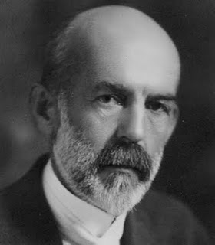
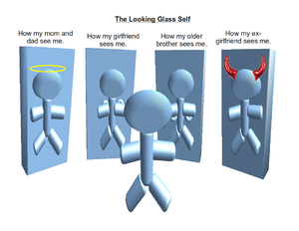
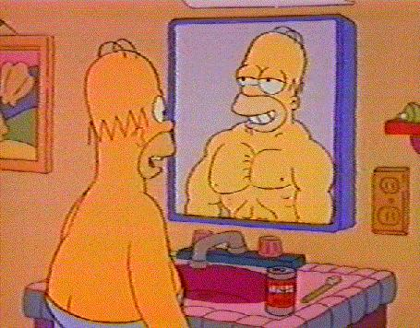
The Self
Self Concept
an image of yourself separate from others.
Looking-Glass Self
Others act as a mirror for developing a sense of self
Charles Horton Cooley
Notes:
When you get dressed in the morning, are you dressing for yourself or for others?

Slide 9
Think about…
When you are getting ready for school everyday, are you dressing for yourself or for how others will see you?
If not for rules and expectations, would you dress differently than you do? How and why?

Slide 10
Can the mirror be distorted?
Anorexic who sees him/herself as overweight while society does not…
Someone embarrassed to dance in public…
A girl afraid to be seen without makeup…
WHY DOES IT MATTER…
Because they are all afraid of how society will “see” them…

Slide 11
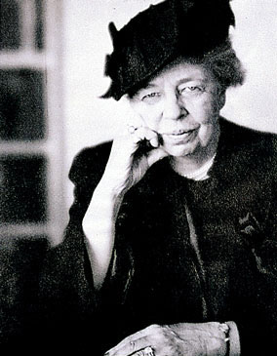
Eleanor Roosevelt
“No one can make you feel inferior without your own consent”
How is this an example of the looking-glass self?

Slide 12
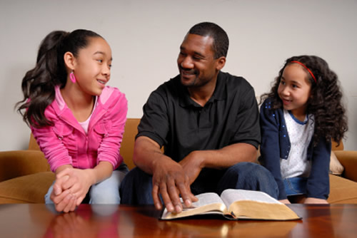
The Self
Significant Others
People whose judgments are most important to us and our self concept.
Role Taking
This is important to seeing others points-of-view.
This can lead to a new self-concept.
George Herbert Mead

Slide 13
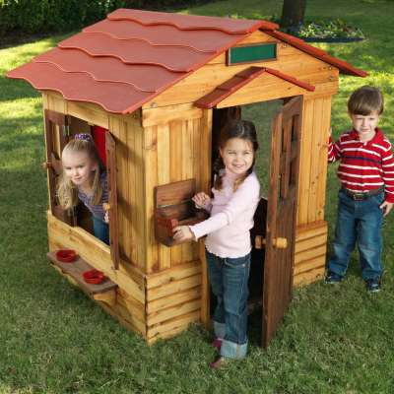
The Self - Mead’s 3 Stages
Imitation stage
1-2 years old, imitation of significant other
Play stage
Child pretends and takes on roles
i.e. playing ‘house’, dressing up as other sex
Game stage
More complex than play stage, more roles and social rules introduced
i.e. sports

Slide 14
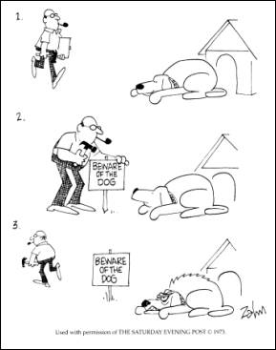
The Self
Generalized other
Taking on norms, values and beliefs from your culture that seems wrong in principal.

Slide 15
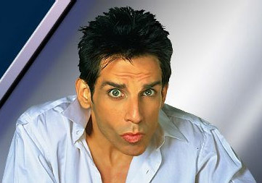
Who am I?
“Me”
Self given through socialization
Myself as others see me
Close to Freud’s ego
“I”
Natural awareness of oneself
Myself as I am.
i.e. temper tantrum reflects the “I”
Close to Freud’s ID

Slide 16
Chapter 3 - Socialization
3 – Agents of Socialization

Slide 17
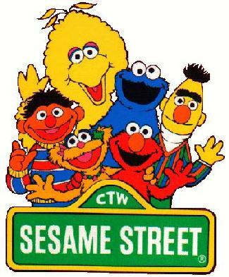
The Family and Socialization
The family is the first agent of socialization.
Get in groups and brainstorm a list of 5 proverbs.
Do these really teach values?
Should they be updated?

Slide 18
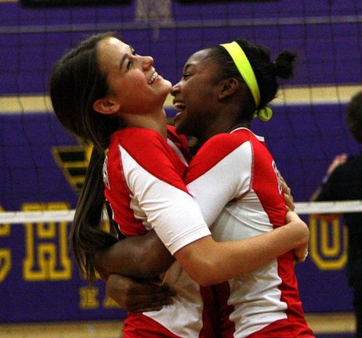
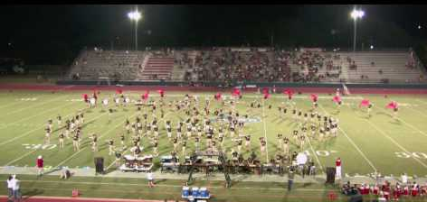
Socialization in Schools
For the first time:
kids have impersonal relationships
Kids are rewarded or punished based on ability rather than affection
Notes:
Have them read p.20 “mcdonaldization of high school”

Slide 19
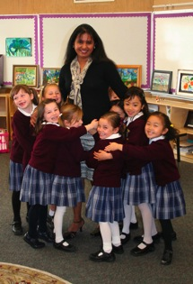
Socialization in Schools
Why do we come to school?
What is the purpose of school?
Hidden curriculum
The goals that underlie the formal goals of schooling
Discipline, obedience, order, cooperation, competition, conformity, etc…
Socializing to business world
Bells, set times, etc…
According to class?
Notes:
Have them read p.20 “mcdonaldization of high school”

Slide 20
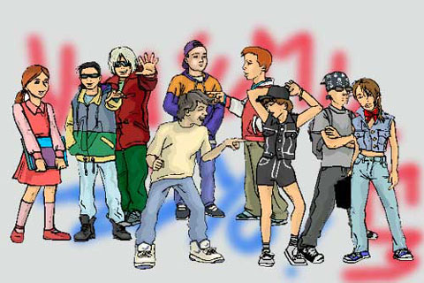
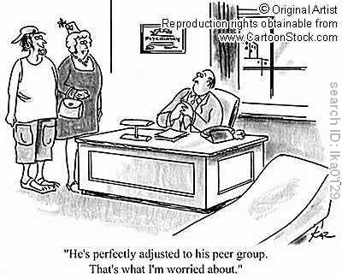
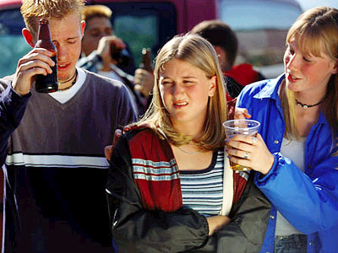
Peer Group Socialization
Peer groups – people around the same age and with the same interests
Notes:
Do peers or family have more influence on soicalization?

Slide 21
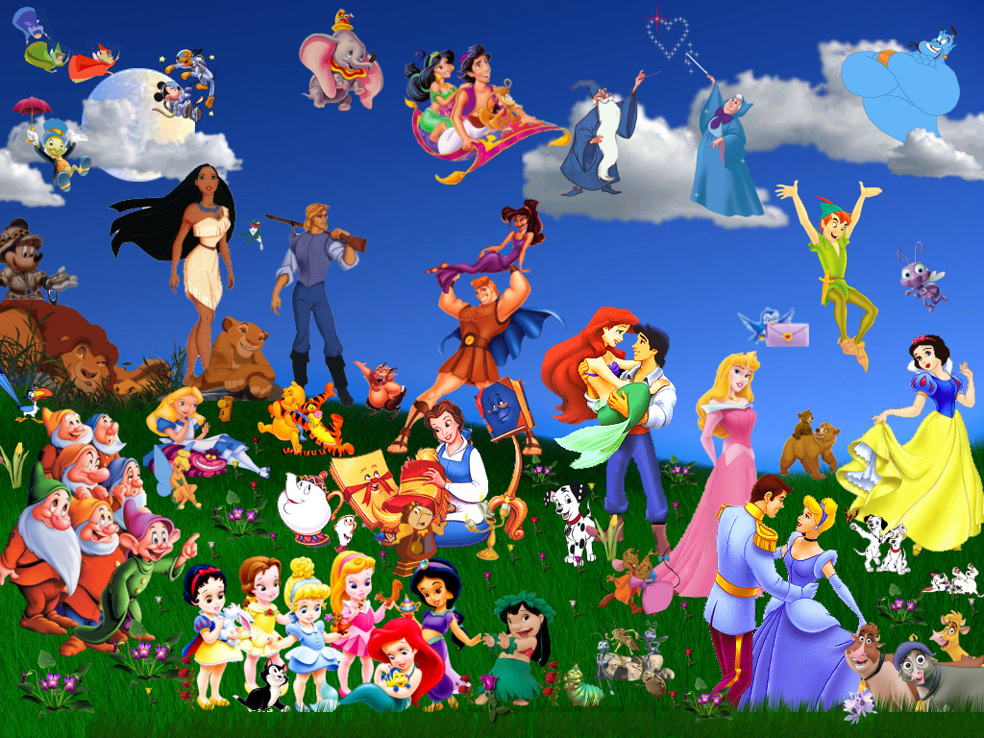
Mass Media and Socialization
Mass media – communication that meant to reach a general population
Notes:
How does disney socialize boys and girls?

Slide 22
Chapter 3 - Socialization
4 – Processes of Socialization

Slide 23
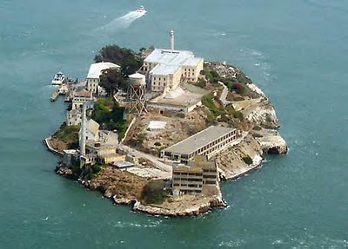
Desocialization and Resocialization
Total Institutions –
places where people are separated from the rest of society
Examples?
What is the point of total institutions?
Controlling and manipulating people to change their behavior.

Slide 24
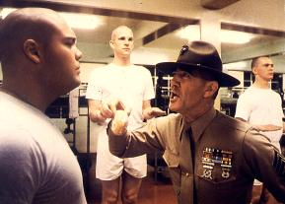
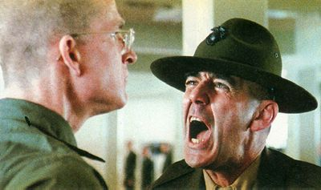
Desocialization and Resocialization
Desocialization
The process of destroying old self-concepts (norms, values, beliefs)
Goal: to lose individuality

Slide 25
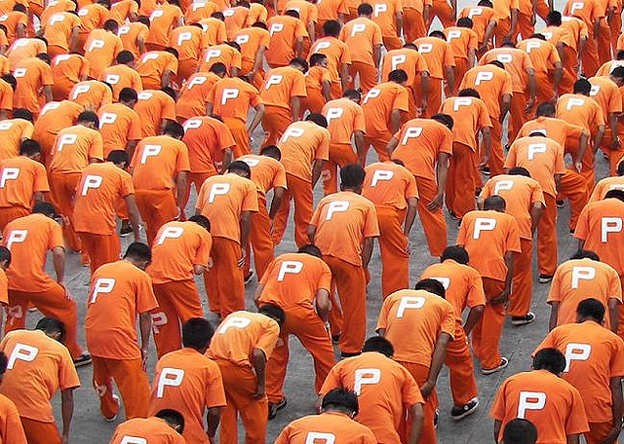
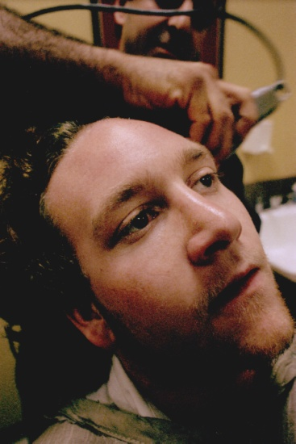
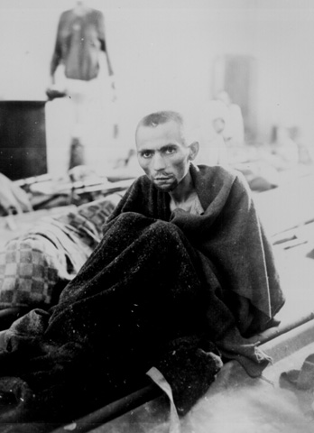
Desocialization and Resocialization
Ways Desocialization is accomplished:
not called by first name
personal belongings taken away
former roles go unrecognized

Slide 26
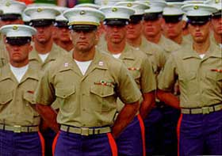
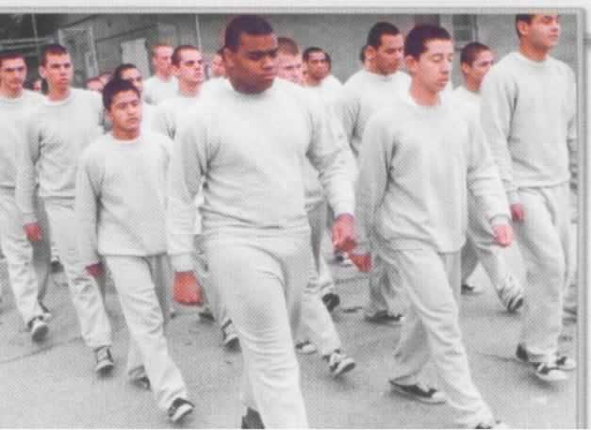
Desocialization and Resocialization
Resocialization
Process of accepting new norms, values, and beliefs once self concept is broken down.
same rules and procedures followed all day, every day
Zimbardo’s Prison Experiment

Slide 27
In your notebook
How does desocialization and resocialization occur as a child becomes a teenager?
As a young adult begins a career?
As an elderly person goes into a retirement home?

Slide 28
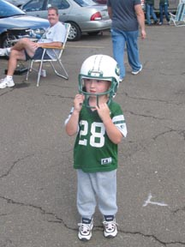
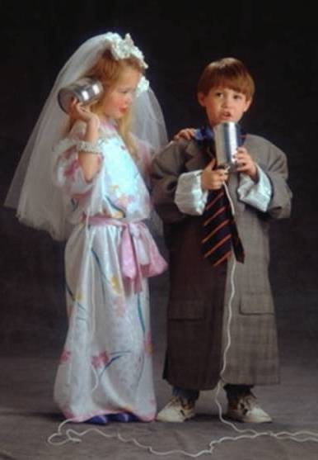
Anticipatory Socialization
Anticipatory socialization
voluntarily preparing to accept new norms, beliefs, and values.
How is dating a form of anticipatory socialization?

Slide 29
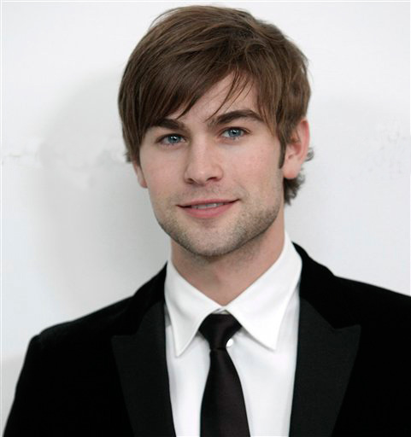
Anticipatory Socialization
Reference group
Group with which one identifies with.
Used to guide norms, values, and beliefs

