Slide 1
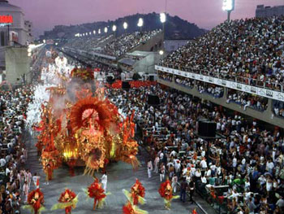
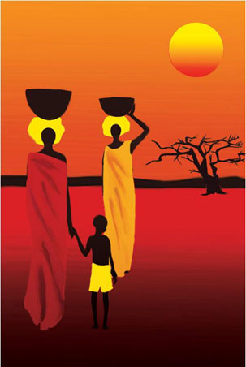
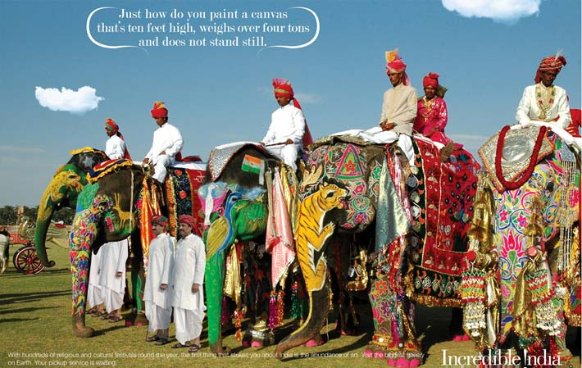
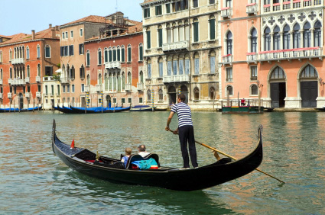
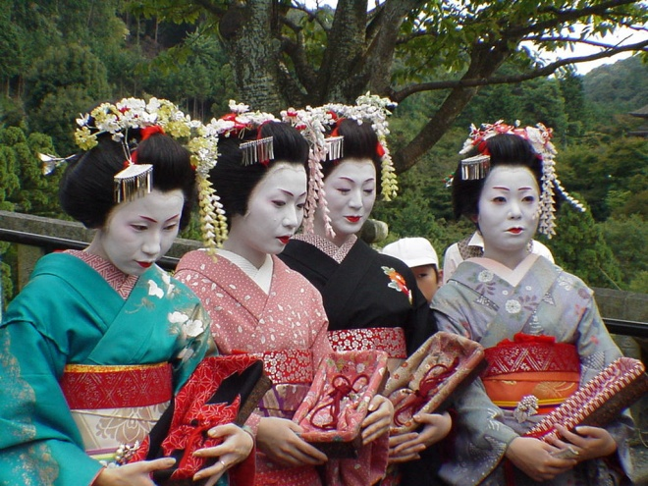
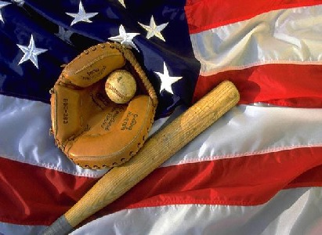
Chapter 2 - Culture
1 – The Basis of Culture
Notes:
http://www.youtube.com/watch?v=mKaaHLjOXPg&feature=related - “Dallas” Intro
The God’s Must Be Crazy?

Slide 2
Ethical Dilemma
A passenger liner is wrecked at sea and these 15 people find themselves together in a lifeboat. The lifeboat however, can only support 9 people. If six are not eliminated everyone will die. If you were in command of the lifeboat, whom would you choose to survive?

Slide 3
A doctor. GP. He is addicted to drugs, and very nervous, aged 60
A black Minister, Protestant, Age 27
A prostitute, no parents. She is an excellent nurse. Has already saved a drowning child. Aged 36
A male criminal. Charged with murder. He is the only one capable of navigating the boat. Aged 37
A man mentally disturbed, who carries important government secrets in his head, aged 41
A salesman. He sells automatic washing machines. Member of the local Rotary Club. Aged 51.
A crippled boy, paralyzed since birth. He cannot use his hands, or do anything for himself, so must be fed by others. Aged 8.
A married couple. He is a construction worker, who drinks a lot. Aged 27.
She is a housewife with two children at home. Aged 23
A Jewish restaurant owner married with three children at home, aged 40.
A teacher considered one of the best in McKinney! Aged 34.
A Catholic Nun. Supervisor of girls’ school, Aged 46.
An unemployed man, formerly a professor of literature. He has a great sense of humor, showed courage in the last war, and was in a concentration camp for three years, aged 53.
A married couple deeply in love, but no children yet. Both Irish. He is studying to be a pharmacist. Aged 24.
She is a housewife, helps with a playgroup. Aged 21.

Slide 4
Write a report (1 page) about this exercise. How did cultural values play a role in your decisions?

Slide 5
Chapter 2 - Culture
1 – The Basis of Culture
Notes:
http://www.youtube.com/watch?v=mKaaHLjOXPg&feature=related - “Dallas” Intro
The God’s Must Be Crazy?

Slide 6
Knowing Your Culture
The pen is mightier than _______.
Better safe than ________.
It’s always darkest before the ________.
Don’t bite the hand that ______.
No news is ______.
If you can’t run with the big dogs ________.
A penny saved is a _______.
Children should be seen and not _______.
Better late than _______.
If I have seen further, it is because I have ________ .
Notes:
What does it mean to “have fun” to you?

Slide 7
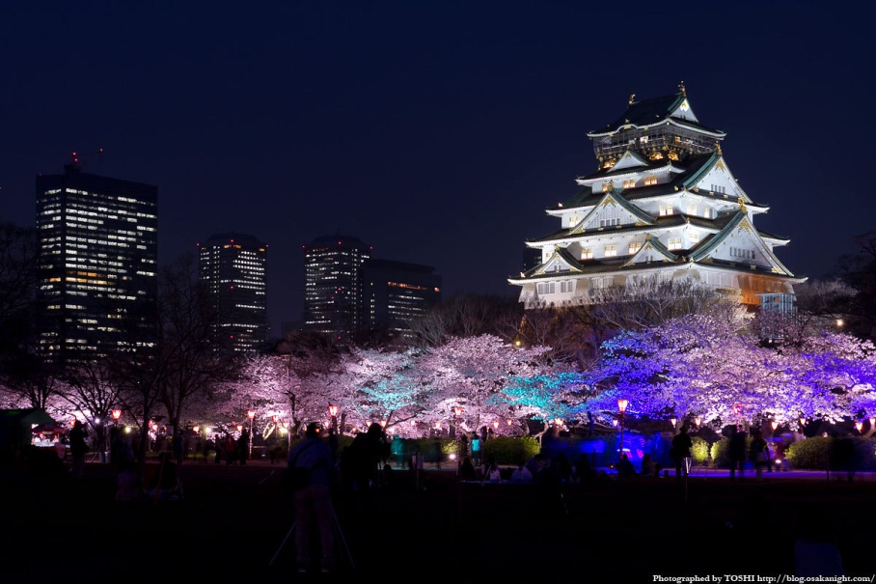
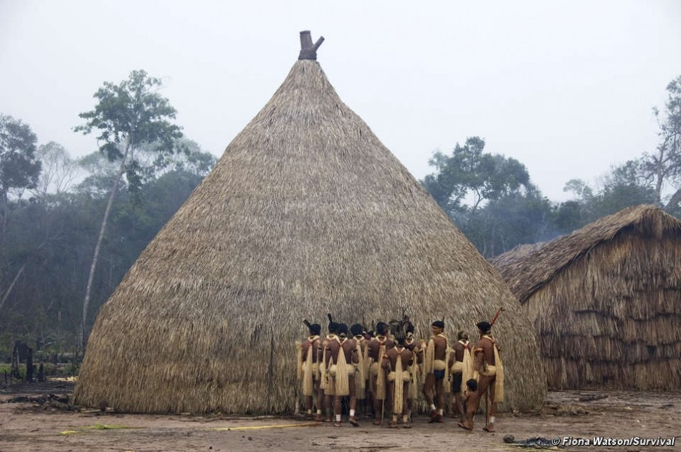
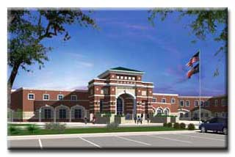
Culture and Society
Society –
  People who share a culture and territory
  Largest and most complex group
  Difference between industrial and information society?
Notes:
Reading “Nacerima”

Slide 8

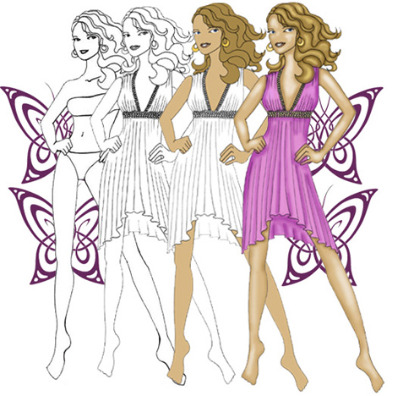
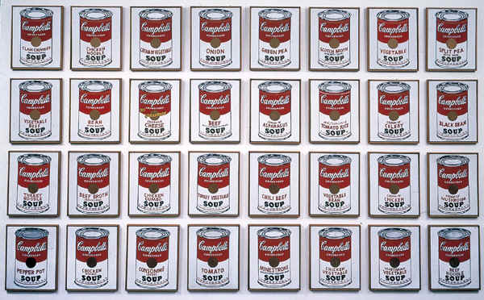
Culture and Society
Culture –
All the language, knowledge, values, customs, and physical objects shared by people in a society

Slide 9
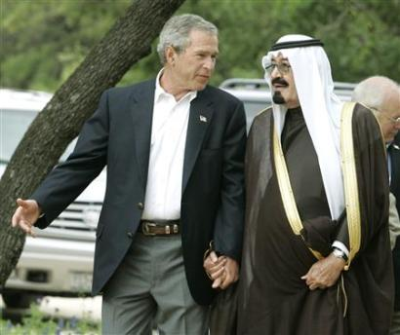
Cultural Relativism
Cultural relativism –
  assumes that no culture is “right” or “wrong”, and that it is impossible to make a value system to fit every culture.
Notes:
Reading on page 80 Section 2 culture
The show was known for its wealth, sex, intrigue, and power struggles. When the series began, the founder of Ewing Oil and patriarch of the Ewing family was Jock (veteran movie actor Jim Davis), a malevolent oil tycoon who had allegedly cheated his one-time partner, Digger Barnes (David Wayne, later replaced by Keenan Wynn) out of his share of the company as well as Digger's only love, Eleanor "Ellie" Southworth (veteran stage/movie actress Barbara Bel Geddes). Later, the offspring of Jock's brother would claim that their father was intregal to the oil boon that created the Ewing dynasty, and unsuccessfully sued the estate.

Slide 10
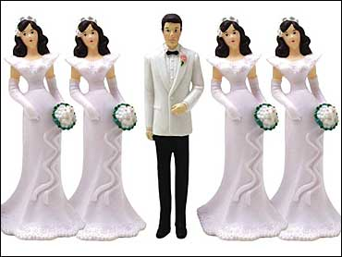
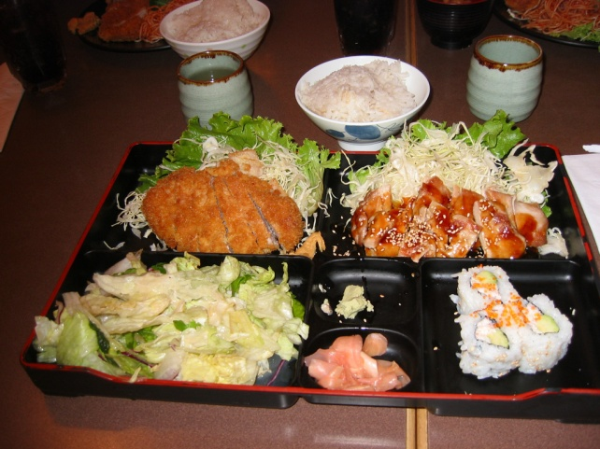
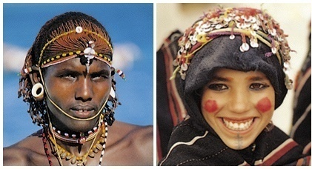
Cultural Diversity
Ethnocentrism
  Judging other’s by your cultural standards
    Are there standards of living you think others should adopt?
    Culture shock, Xenocentrism

Slide 11
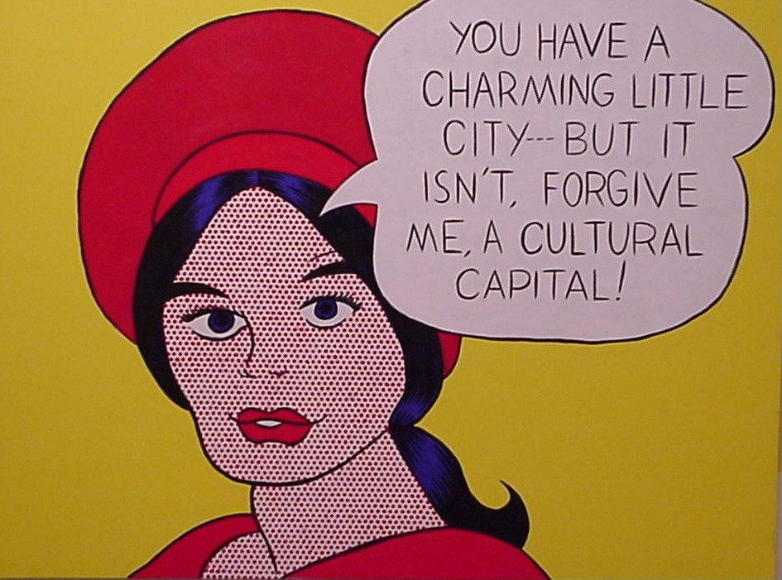
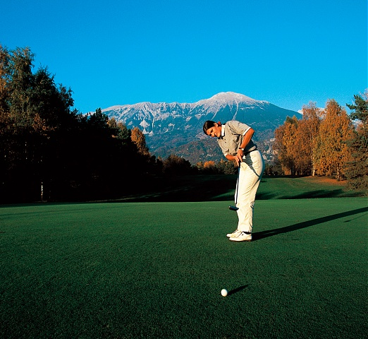
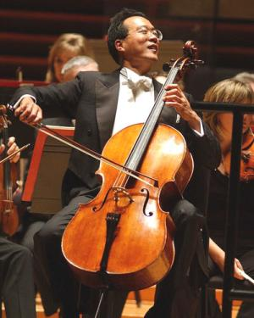
Culture and Society
Cultural Capital –
Amount of culture you need to gain more access to more elite groups
  Examples?

Slide 12
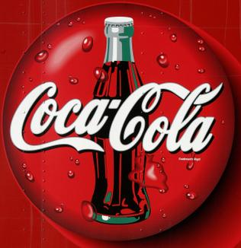

Chapter 2 - Culture
2 – Transmitting Culture

Slide 13
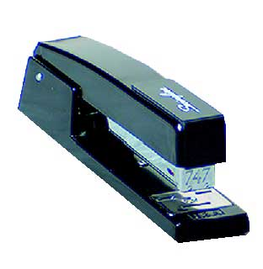
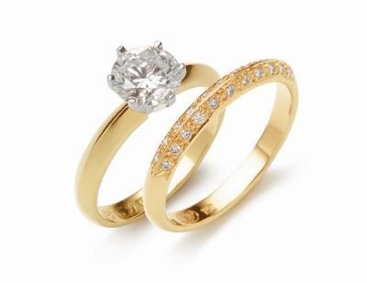
Describe the function of these two.
What social meaning do they have?
Are they the same?

Slide 14
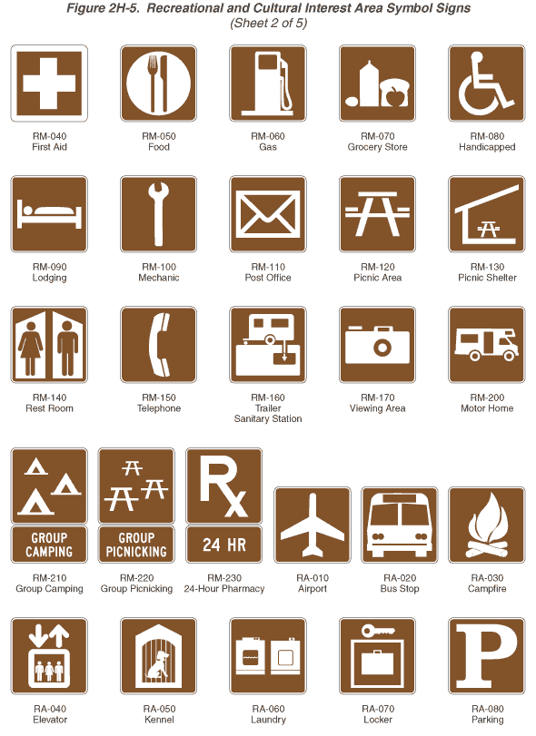

Symbols
Symbols
  Things that stand or represent something else

Slide 15
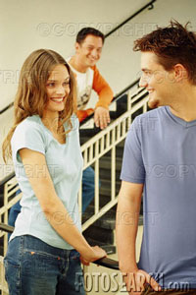
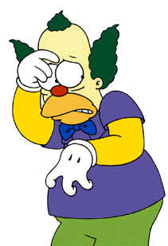
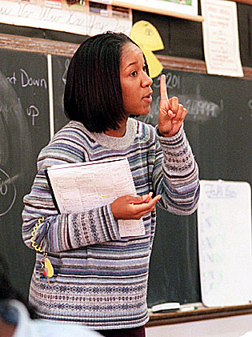
Symbols
Body language
  movement, gestures, facial expressions that convey without words, thoughts, and feelings
    e.g., flirting

Slide 16
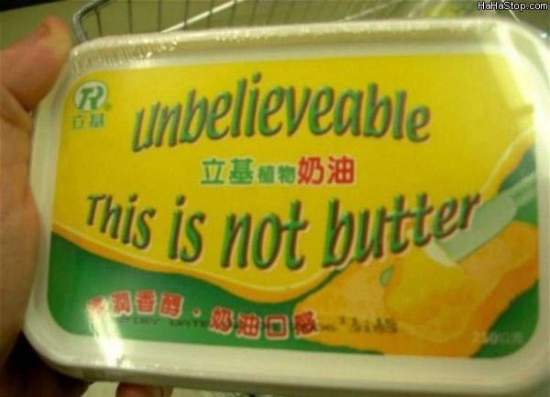

Language
Language
  key to communication of ideas & expression
    use of written symbols
    words have different meanings in different societies
      e.g., football has a different meaning in the U.S. and Great Britain
Notes:
Stand up in the front of room and line up in order of birthday without talking

Slide 17
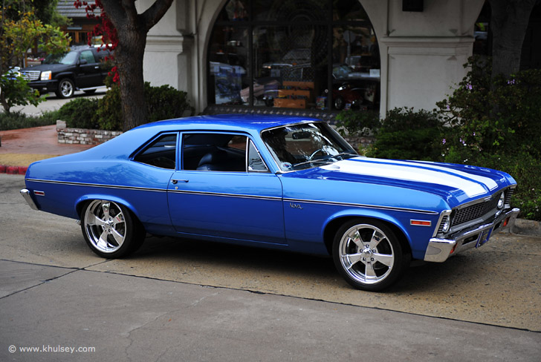
Chevy Nova – Any reasons why this didn’t sell well in Spanish speaking countries?

Slide 18
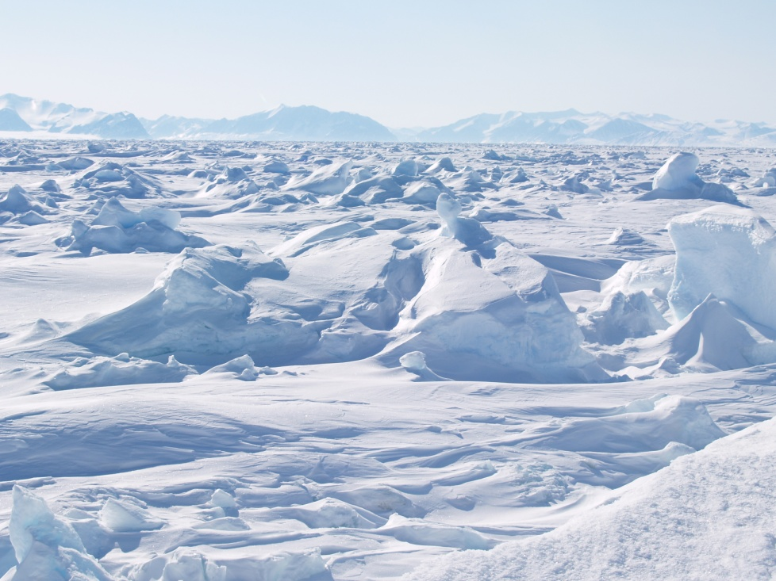
Language
The Sapir-Whorf Hypothesis
  Our perceptions of the world are dependant on the language we have available to us.
  The European Sami (NOT Eskimos) have hundreds of words for “snow”.
Notes:
Stand up in the front of room and line up in order of birthday without talking

Slide 19
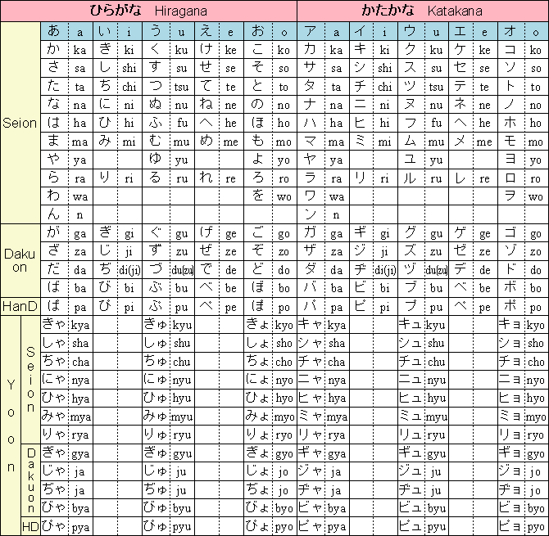
Language
  Chinese language doesn’t have a word for ‘sin’.
    What does this tell you about their culture?
  Japanese language doesn’t have phrase for ‘to take advantage of’.
    What does this tell you about their culture?
  How many words do we have to describe time?
    What does this tell you about the importance we place on time?
Notes:
Stand up in the front of room and line up in order of birthday without talking

Slide 20
Language
  “How could you have a slogan like "freedom is slavery" when the concept of freedom has been abolished? The whole climate of thought will be different. In fact there will be no thought, as we understand it now. Orthodoxy means not thinking—not needing to think. Orthodoxy is unconsciousness.”^{[1]}
  - George Orwell, 1984
Notes:
http://www.businessinsider.com/guide-to-earnings-season-2010#
1. Orwell, George (1949). Nineteen Eighty-Four.

Slide 21
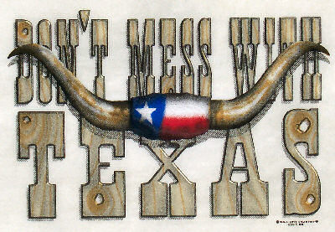
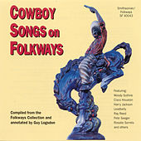
Chapter 2 - culture
3 Norms and Values

Slide 22

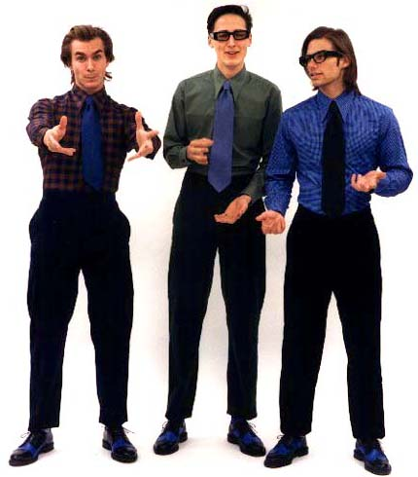
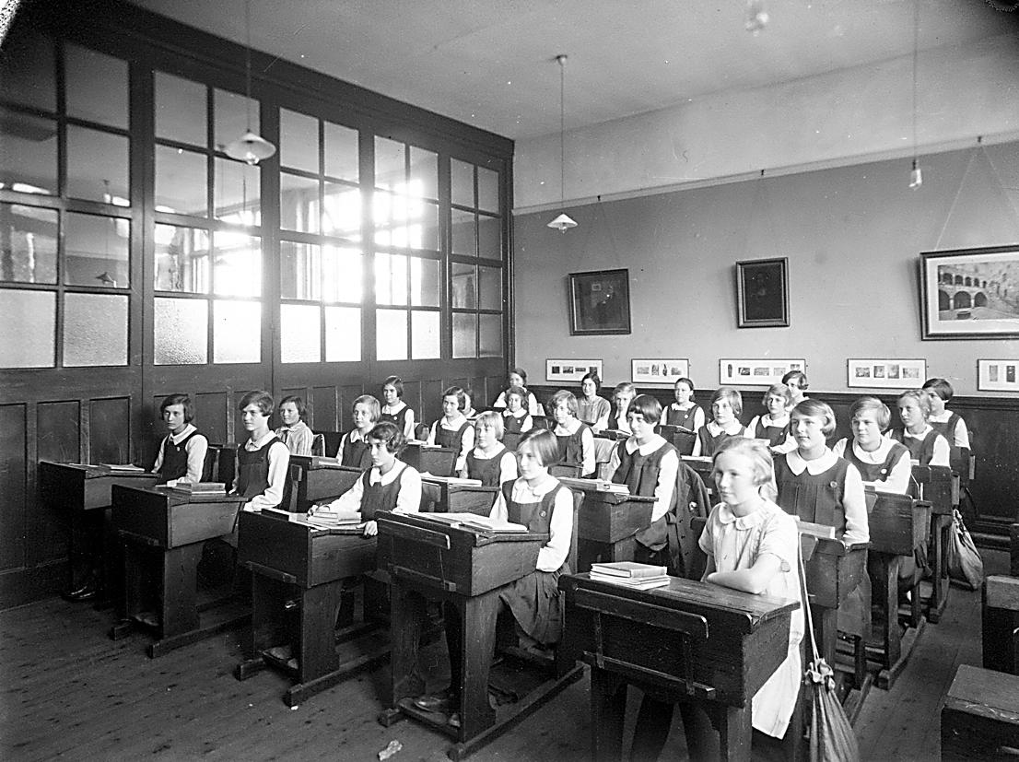
Cultural Norms: The Rules We Live By
Norms –
right and wrong behavior
Notes:
Go over page 82 in book

Slide 23
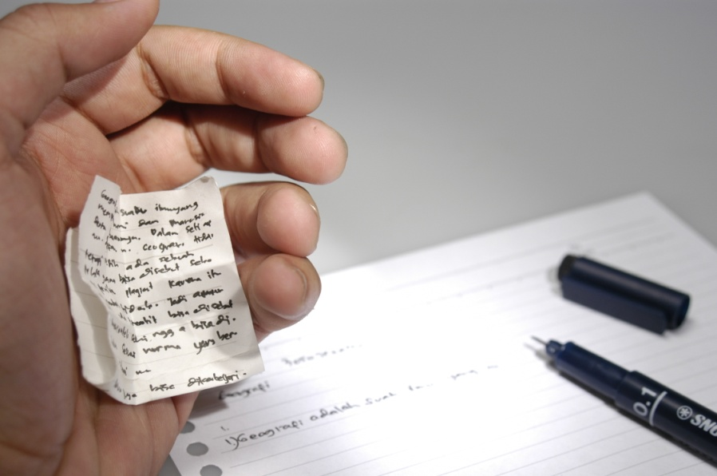
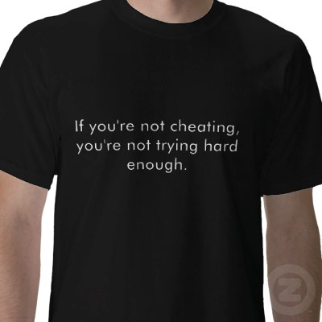
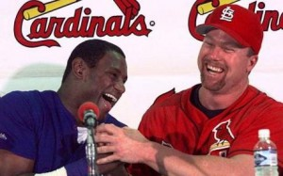
Cultural Norms: The Rules We Live By
Analyze this…
Notes:
Go over page 82 in book

Slide 24
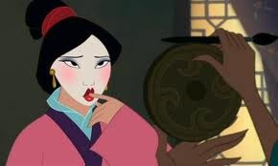
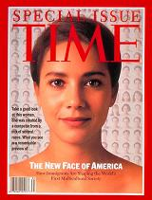
Cultural Norms
Norms can define the way we view beauty.
  What norms shape the American view of beauty?
  Is it advantageous to be beautiful in our culture? How?

Slide 25
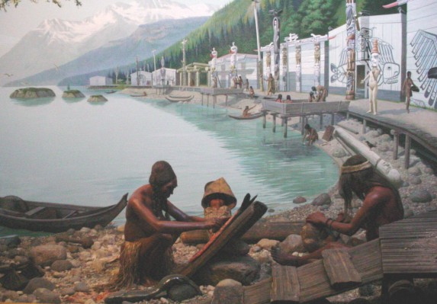
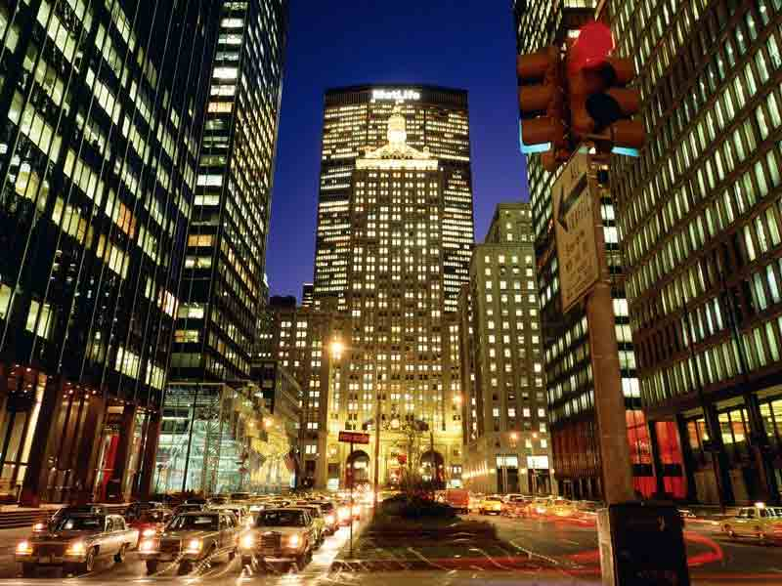
Cultural Norms
Comparing Cultures
Norms in one society are very different from norms in another society
  (Think about our discussion on cultural relativism)
Discuss these American norms:
Tipping
Women and men’s clothing
Chewing food with no sound
Dating
Notes:
Look up culture japan video

Slide 26

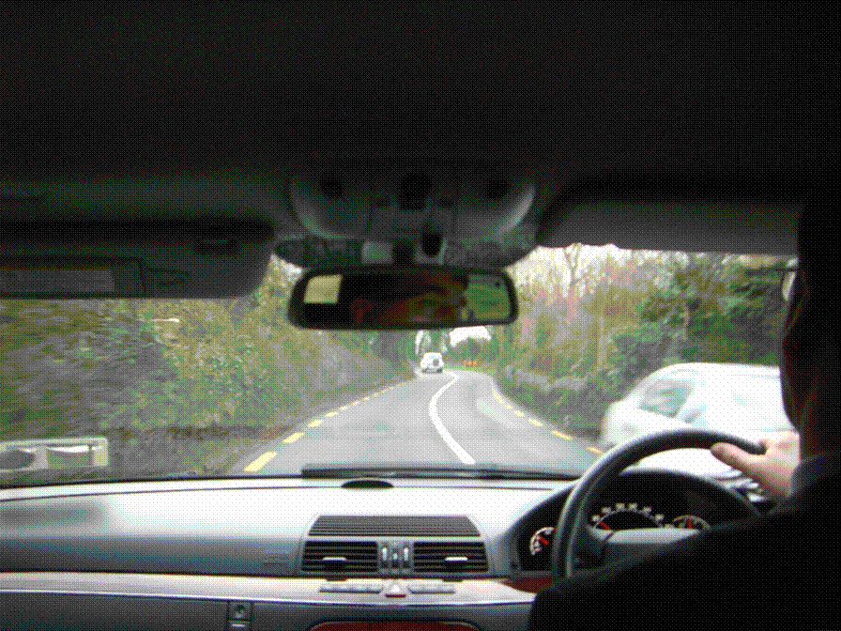
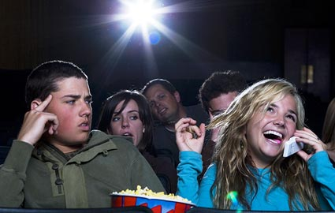
Folkways
Folkways –
norms that lack moral importance.
  i.e. driving on the right side of the road

Slide 27
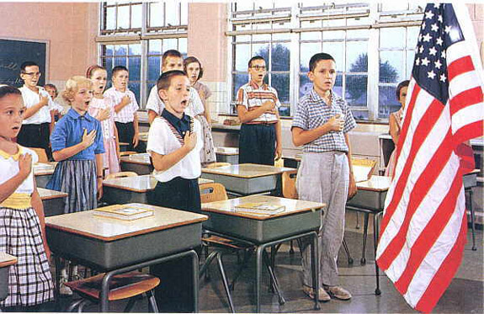
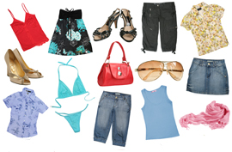
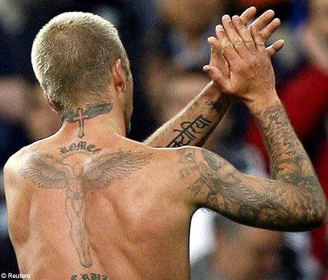
Mores and Taboos
Mores –
norms that do have moral importance for that society.
Taboo –
the most serious violations of mores.
  Ex. Incest, pre-marital sex
What is appropriate to wear to school?
What cultures would this be a taboo in? (Hint: past or present)
Notes:
Is able bodied men that don’t work a mores? Is able bodied women who don’t have kids a mores?

Slide 28
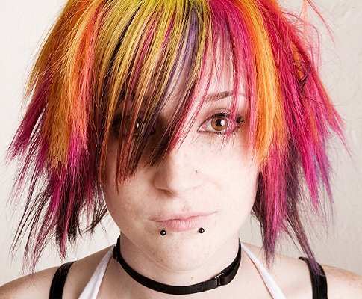
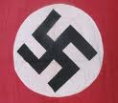
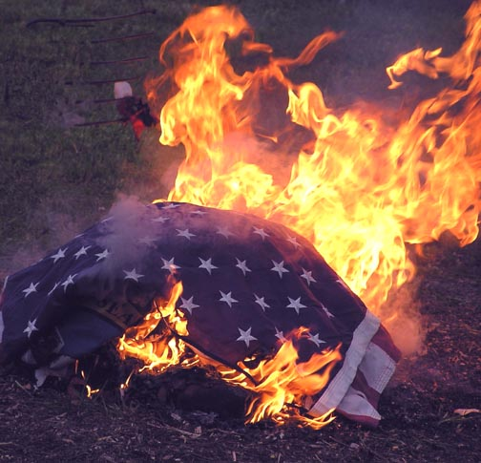
Where do these fit?
Spanking children
Reading the newspaper daily
Sleeping late
Recite “Pledge of Allegiance.”
Buying things/Shopping

Slide 29
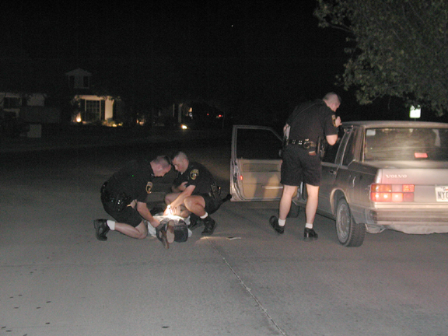
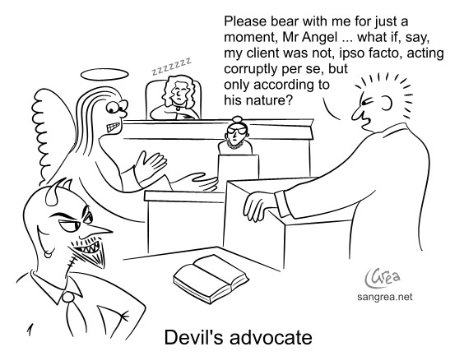
Laws
Laws –
norms that are formally defined and enforced by officials.
  Legislating morality
  Most, if not all, taboos are made into law.
  Not all laws are mores
    Examples?
    Parking tickets
Notes:
Go over table on p.86
http://www.dumblaws.com/laws/united-states/texas
texas dumb laws

Slide 30




Enforcing the Rules
Sanctions –
rewards and punishments to encourage social norms.
  Formal Sanctions – officially enforced sanctions

Slide 31

Enforcing the Rules
Informal Sanctions –
sanctions applied by most members of the group.

Slide 32


Values – The Basis for Norms
Values –
broad ideas about what is good that is shared by people in a society
  What are other values we share at Boyd? We share as Americans?
Do these values still prevail?
  Achievement and Success
  Activity and Work
  Efficiency and practicality
  Equality
  Democracy
  Group Superiority
Notes:
Although we should not be unnecessarily cruel to animals, they were put on earth to serve human being.
The death penalty should be abolished because it is inherently racist in its application.
Men and women are not politically or intellectually equal because they are biologically different
There is too much violence and sex in the media, especially on television
There is too much freedom given to young, unmarried boys and girls today.

Slide 33
On a sheet of paper…
List the 15 most important things in your life.
  Can be material and non-material (i.e. health)
  Please be honest.
Rank your list 1 – 15 (1 being most important)
I’m giving you $1,000 to spend on these. You can put it all on one, or spread it out.

Slide 34
Activity - Values – The Basis for Norms
Who shares your values?
Agree – By big window
Disagree – By door
Somewhat agree – By my desk
Unsure – By lava lamp
Although we should not be unnecessarily cruel to animals, they were put on earth to serve human being.
The death penalty should be abolished
Men and women are not politically or intellectually equal because they are biologically different
There is too much violence and sex in the media, especially on television
There is too much freedom given to young, unmarried boys and girls today.
Notes:
Although we should not be unnecessarily cruel to animals, they were put on earth to serve human being.
The death penalty should be abolished because it is inherently racist in its application.
Men and women are not politically or intellectually equal because they are biologically different
There is too much violence and sex in the media, especially on television
There is too much freedom given to young, unmarried boys and girls today.

Slide 35
Chapter 2 - culture
4 Beliefs and Material Culture

Slide 36
Material Culture
Things created by the members of a society that have meaning
  How has the telephone changed in cultural meaning?
Notes:
have no meaning apart from what we give them: think of a hot dog bun.

Slide 37



Non-Material Culture
Symbols
Gestures
Norms
Values
Beliefs
Notes:
Students in pairs sharing about a hobby. What are the material and non-material aspects of that hobby?

Slide 38




Beliefs
Ideas about the nature of reality
Notes:
Brainstorm what beliefs means

Slide 39

Ideal and Real Culture
Ideal culture –
guidelines that group members claim to accept
Real Culture –
actual behavior of group members
Cheating:
Is this reflected in reality?

Slide 40
Chapter 2 - culture
5 Cultural Diversity and Similarity

Slide 41


Cultural Diversity
Social Categories –
groupings of people that share common social characteristics

Slide 42


Cultural Diversity
Subculture –
Part of the mainstream culture, but different in many important respects
Chinatown in San Francisco

Slide 43




Cultural Diversity
Counterculture –
Deliberately opposed to dominant culture
  Would you avoid any of these people or would you be perfectly comfortable with them?
  Do people who dress this way still have an ability to shock?
Che Guevara
Bob Dylan

Slide 44
Cultural Diversity
Cultural Universals –
Thing that exist in all cultures
Cultural Particulars –
Things unique to one culture in the way they carry out universals

