Slide 1
Deviance and Social Control Ch 7
1 – The nature of deviance

Slide 2
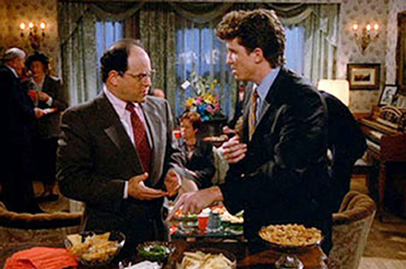
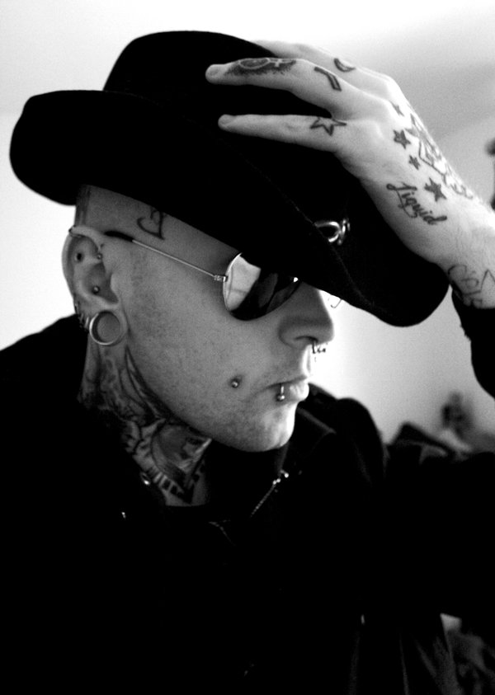
The Nature of Deviance
Deviance – behavior the departs from the social norm.
Deviant – person who significantly departs from the social norm

Slide 3
The Nature of Deviance
What are examples of behavior considered deviant in one group or culture but not another?
What are some examples of deviant behavior that is found in all groups or cultures?
What causes a person to be deviant?

Slide 4
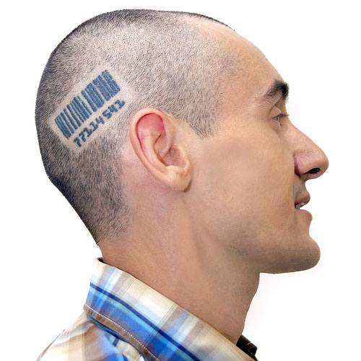
Social Control
Social controls –
ways to encourage or enforce conformity
Social sanctions –
rewards and punishments to encourage conformity

Slide 5
Competing explanations of Deviance
Biological —a physical illness
Psychological — personality disorder
Sociological —socialization into deviance

Slide 6
Negative and Positive Deviance
Negative Deviance
Based on ignoring or rejecting social norms
Extreme cases lead to anarchy
Conformity
-Normally Accepted
Range of Behavior
Positive Deviance - based on unquestioned acceptance of norms
- extreme cases leads to fascism

Slide 7
Functionalism and Deviance
Basic views
Negative effects
Benefits
Strain Theory
Control theory

Slide 8
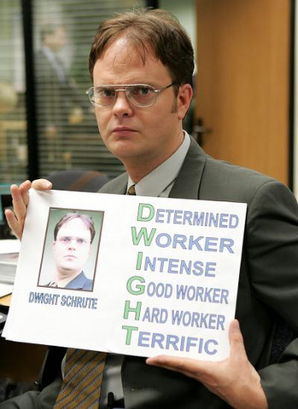
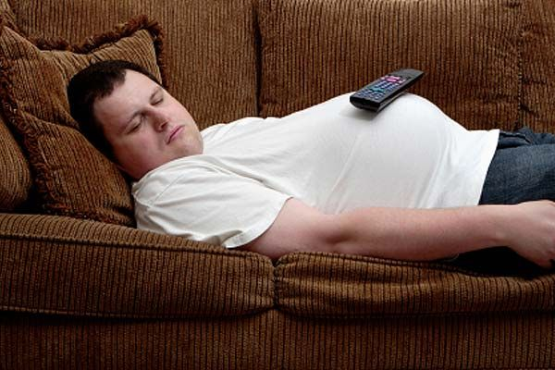
Functionalism and Deviance – Negative Effects
Inconsistency leads to trust issues
Ex. If people randomly decide not to come to work
Can cause more non-conforming behavior in others
Ex. Teachers not coming to work could lead students to not coming to school, which leads to more kids on the street, which leads to more gang activity, etc…
Deviant behavior is expensive
The more deviation there is, the more police is needed, the more jails must be built, etc...

Slide 9
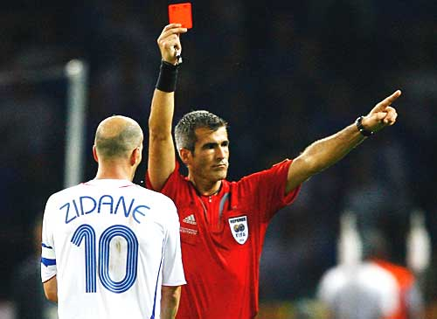
Functionalism and Deviance – Positive Effects
Clarifies existing social norms
If a high school player curses at an official during a game, society will punish that athlete (penalty, suspension, etc…) in order to show to everyone the normative behavior
Relieves pressure to conform
Teenagers have pressure from many authority figures and by listening to “deviant” music or dressing differently can reduce that pressure
Can increase unity in the group
Traitors can inspire feelings of nationalism, patriotism, etc…
Promotes social change
Ending women’s suffrage
Civil Rights Movement

Slide 10
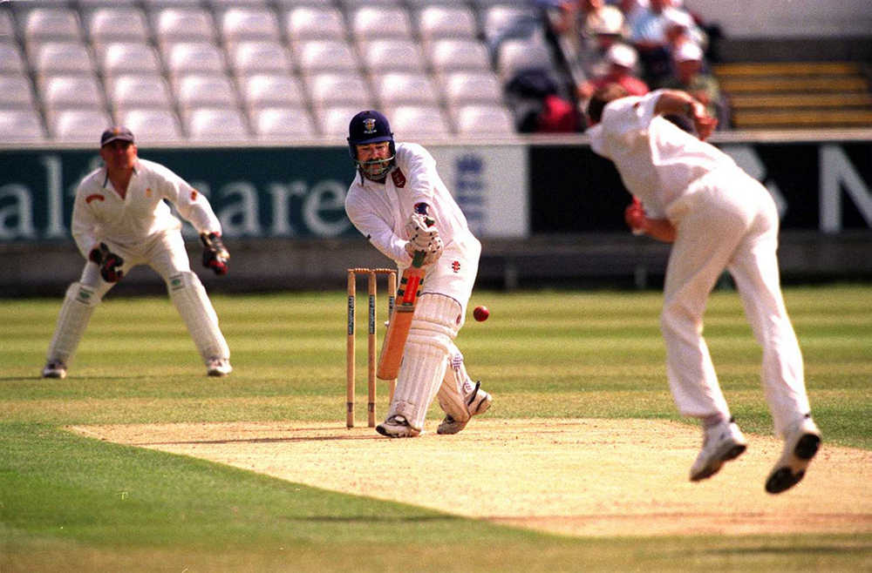
Functionalism and Deviance
Imagine you must move (without researching) to live in Japan…
Would you exhibit deviant behavior? Why or why not?
Anomie – social condition when norms are weak, conflicting, or absent.

Slide 11
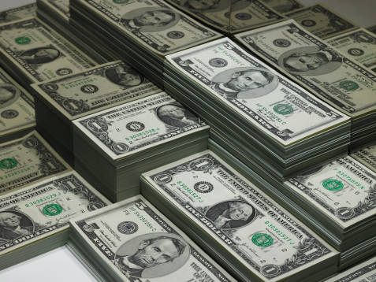
Functionalism and Deviance
Robert Merton’s Strain Theory
Deviance is more likely when there is a gap between cultural goals and the ability to achieve those goals.
Examples of our cultural goals?
What are legitimate means of attaining those goals?
Conformity is when people accept both the means and the end goal.

Slide 12
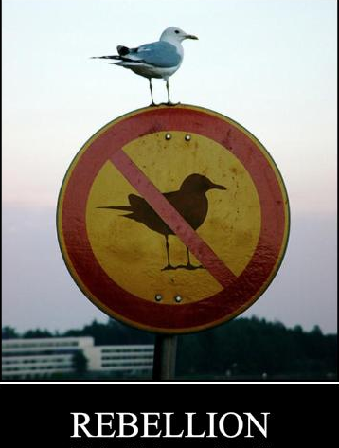
Functionalism and Deviance - Strain Theory
Innovation – accepting the goal, but using illegal means to achieve it.
Ritualism – Rejects the goal, but continues using legitimate means
Retreatism – Rejects both the goal and the means.
Rebellion – rejects both success and the approved means to achieve it. Substitute new goals and means.

Slide 13
Functionalism and Deviance - Strain Theory
Goals
Means
+
Conformity
+
Innovation
-
Ritualism
-
Retreatism
+/-
` Rebellion
+
-
+
-
+/-

Slide 14
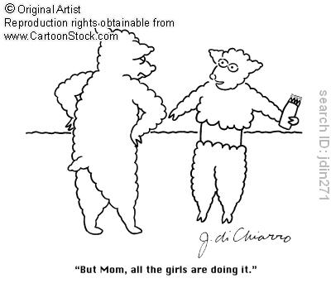
Functionalism and Deviance
Travis Hirschi’s Control Theory
Deviance correlates to the strength of the bond between the individual and society
The stronger the bond is, the more conformity there is
People conform in order to “save face”

Slide 15
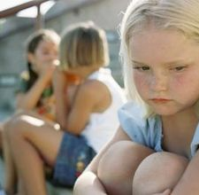
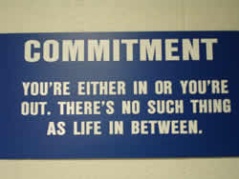
Elements of Social Bonds
Attachment
Conformity strength of ties to things like family, school, friends, churches etc…
How strong are your ties?
Commitment
A stronger commitment to the goal will lead to stronger conformity
Do you believe your hard work will pay off?

Slide 16
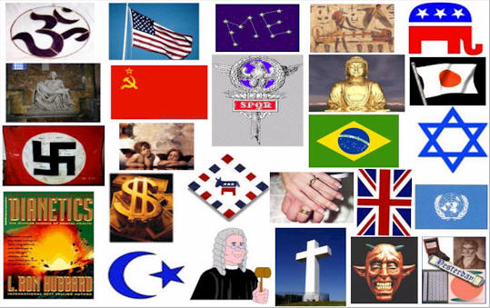
Elements of Social Bonds
Involvement
Participation in approved activities leads to more conformity
Is there a relationship between kids who participate in extra-curricular activities and conformity?
Belief
The stronger the belief in the norms and values of the culture, the stronger the conformity
What incentives to people have to conform if these four elements of social bonds don’t exist?

Slide 17
How does this transaction relate to Control Theory and Anomie?
Notes:
Does he like his job? How can you tell? What would control theory say about this?

Slide 18
Symbolic Interactionism and Deviance
Differential Association Theory
Labeling Theory

Slide 19
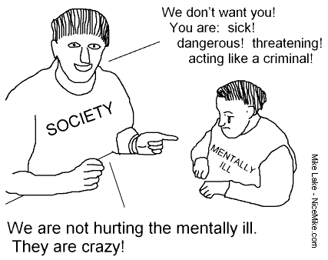
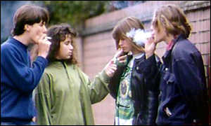
Symbolic Interactionism and Deviance
Differential Association Theory
Focuses on how deviance is learned
Some groups teach members to deviate from social norms while others teach conformity.
Can you think of any such organizations?
Factors:
Ratio of deviant to non-deviant people you are in contact with
Are significant others deviant?
Age of exposure to deviance
Is this deviant behavior?

Slide 20
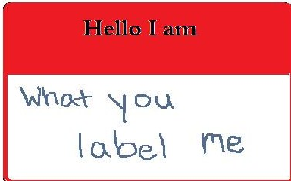
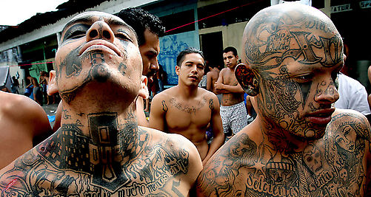
Symbolic Interactionism and Deviance
Labeling Theory
Society creates deviance by calling people ‘deviant’
Which direction would a label of “scholar” or “smart” propel you?
How about the label of “delinquent”?
Labels open and close doors of opportunity
How does this connect to Cooley’s “Looking Glass Self”?

Slide 21
In each of the cases below:
Identify a label, which may be attached to the person as a result of their deviant behaviour.
Outline how a deviant career may develop by describing the possible consequences of the labelling for the person’s future life and relationships.
Suggest ways in which that person might avoid being labelled even after they have committed the deviant act.
A young woman who is caught shoplifting in Wal-Mart.
A teacher who publicly declares himself/herself to be gay.
A person who is temporarily admitted to a mental hospital as a result of a nervous breakdown.
An 18-year-old man who gets arrested during a fight at a football match.

Slide 22
Symbolic Interactionism and Deviance
With an unmarried pregnancy, who is usually labeled the deviant?

Slide 23
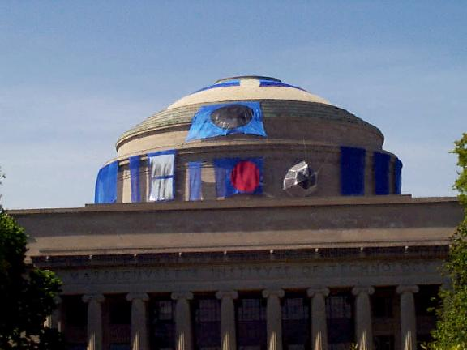
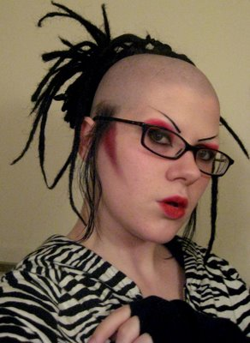
What are the degrees of deviance?
Primary deviance –
deviant behaviors occur, but it does not affect the person’s label for themselves or their lifestyle.
How often do you violate a cultural norm? Do you view yourself as a deviant?
Do prisoners view themselves as deviants?
Secondary Deviance
Deviance as a lifestyle, way of life, or career; people primarily view themselves as deviant
Examples?

Slide 24
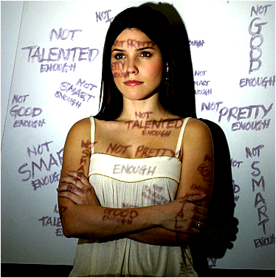
Consequences of Labeling
Social stigma
Undesirable label used by others that deny full social acceptance
How would a person freed from prison have a stigma?
Unemployed?
Handicapped?
Immigrant?

Slide 25
Conflict Theory and Deviance
Victim discounting
White collar crime

Slide 26
Conflict Theory
Conflict theory states that tensions and conflicts arise when resources, status, and power are unevenly distributed between groups in society, and that these conflicts become the engine for social change. In this context, power can be understood as control of material resources and accumulated wealth, control of politics and the institutions that make up society, and one's social status relative to others (determined not just by class but by race, gender, sexuality, culture, and religion, among other things).

Slide 27
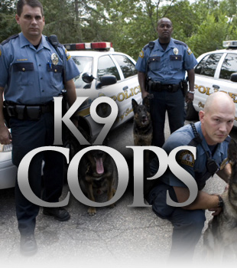
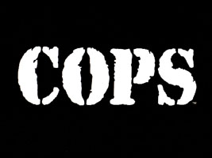
Race, Ethnicity, and Crime
Minorities are given unequal treatment in the justice system.
43% of death row inmates are black.
In interracial murders, Blacks are 13X more likely to be put on death row than white who murder Blacks.
Blacks make up 12% of the total US population
of those arrested:
72% white
25% black
Does this reflect the TV image?
Notes:
Activity p. 218

Slide 28
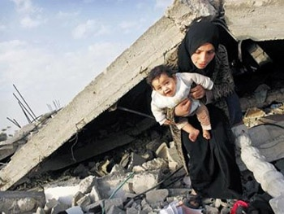
Race, Ethnicity, and Crime
Victim discounting – seeing minority interests are less valuable as the majority (or power) group.
If the victim is less valuable, the crime is less serious, and the punishment is less severe.

Slide 29
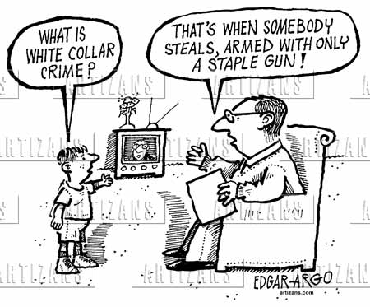
White-Collar Crime
White-collar crime – job related crime committed by high status people.
Enron
Freddie Mac

Slide 30
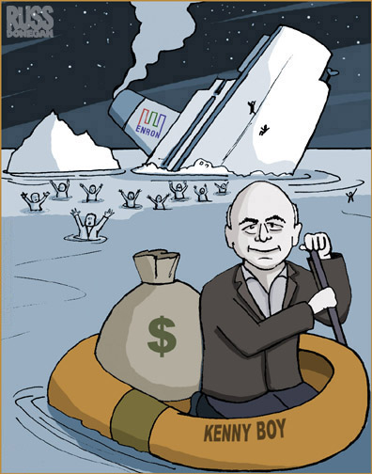
White-Collar Crime
More than $100 million each year is laundered through banks by white-collar criminals.
10X more than robberies, larcenies, burglaries, and auto thefts combined.
For every murder:
2 people die from unsafe working conditions
Notes:
Corporate video

Slide 31
Crime and Punishment
Measurement of crime
Juvenile crime
Approaches to crime control

Slide 32
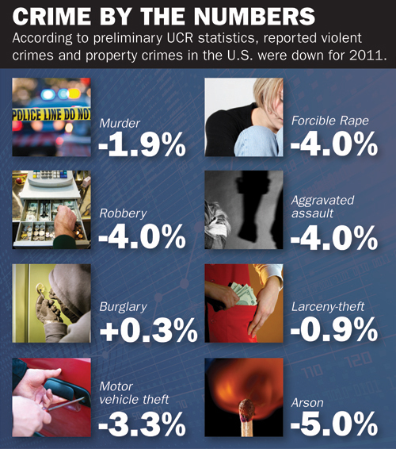
Measurement of Crime
What is crime?
How is crime data collected and measured?
Uniform Crime Reports

Slide 33
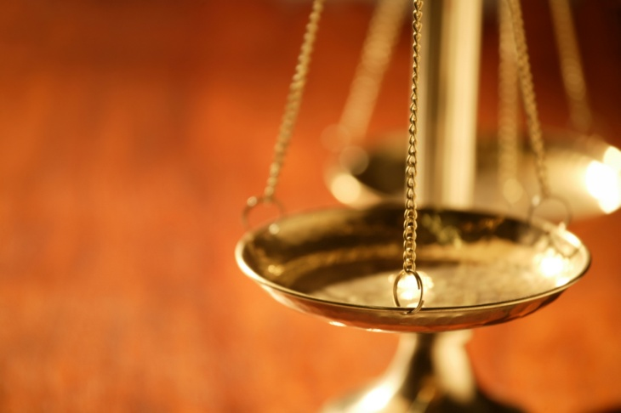
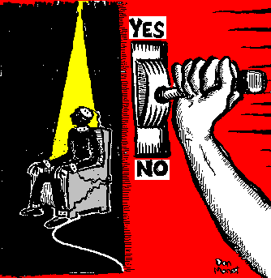
Approaches to Crime Control
Criminal justice system
The institutions responsible for enforcing formal social sanctions for crimes.
Deterrence
Punishing so others will not commit the same crime
i.e. The death penalty

Slide 34
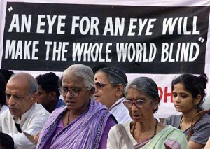
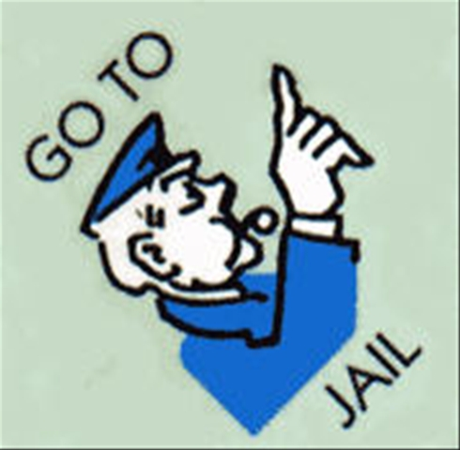
Approaches to Crime Control
Retribution –
criminals pay compensation for their crime
‘eye for eye’ or revenge
Incarceration –
Going to jail

Slide 35
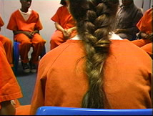
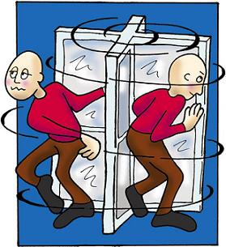
Approaches to Crime Control
Rehabilitation –
Resocializing people who have committed crimes to socially acceptable behavior
Recidivism –
Cycle of repeating criminal behavior
Why?
Stigma, influence of other prisoners, biological influences

Slide 36
An Example of Overconfomity in Sports
The Norms of the Sport Ethic
An athlete makes sacrifices for “the game”
An athlete strives for distinction
An athlete accepts risks and plays through pain
An athlete accepts no limits in the pursuit of possibilities

Slide 37
Why Do Athletes Engage in Deviant Overconformity?
Sports are so exhilarating and thrilling that athletes want to play, and they will do almost anything to continue to do so
Being selected by coaches and managers is more likely when athletes over conform to the sport ethic

Slide 38
Athletes Most Likely to Over-Conform to the Sport Ethic
Those who have low self-esteem or are so eager to be accepted by their peers in sport that they will make whatever sacrifices they think others want them to make
Those who see achievements in sport as their only way to get ahead, make themselves a name, and become important to the world

Slide 39
Social Processes in Elite Power & Performance Sports
Bond athletes in ways that normalize over conformity to the sport ethic
Separate athletes from the rest of the community while inspiring awe and admiration among community members
Lead athletes to develop HUBRIS – that is, a sense of arrogance, separateness, and superiority

Slide 40
