Slide 1
Chapter 14 - Religion
4 Religion in the United States

Slide 2
Intro Activity
Write down your religious affiliation.
Write down five friends and their religious affiliations.
Answer these questions:
Did your friendships develop because of your religious affiliation?
Have your friendships ever been tested because of your religious differences?
How important is religion to you personally and in your friendships?

Slide 3
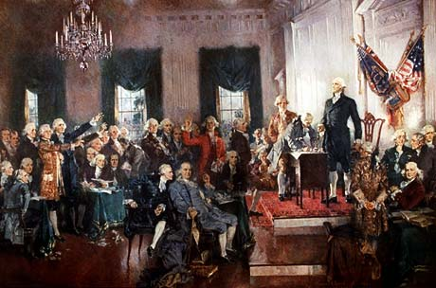
The Development of Religion
The framers of the Constitution were very critical of mixing religion and the state.
Why were they so worried about religion being together with the state?
What are some contemporary issues involving church and state?

Slide 4
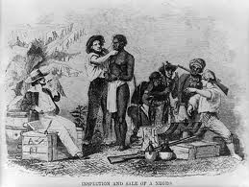
The Development of Religion
Religious Awakenings – periods where religious principles guides the development of culture and society.
i.e. religious movements against slavery and alcohol.

Slide 5
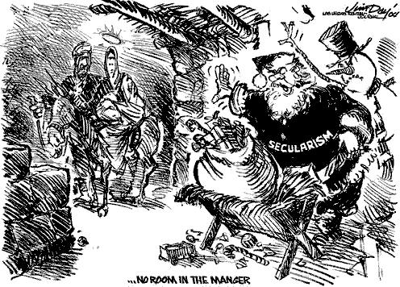
Secularization in the United States
Secularization – the process of the sacred loses influence over society.
i.e. education
Can you think of other examples?
Debate: Is secularization destroying religion in the U.S.?
About 88% of Americans identify themselves with a religion

Slide 6
Secularization in the United States
Look at the table on page 483 and answer the questions above.
How does church attendance relate to the overall importance of being religious?
Why is church attendance not a strong value in the U.S.?

Slide 7
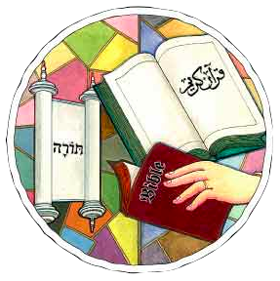
Fundamentalism in America
fundamentalism – the resistance of secularization and a strict adherence traditional religious beliefs, rituals, and doctrines.
Is found in all religions, but we will focus on Protestants

Slide 8
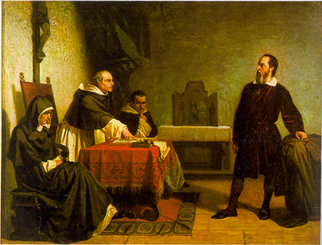
Fundamentalism in America
Fundamentalism developed here mostly in the middle of the 19th century. Why?
Scientific Revolution was a challenge to traditional beliefs, and as became more influential the response was more severe.
Fundamentalism is growing and primarily found among Mormons, the Assemblies of God, the Seventh-Day Adventists, the Baptists, and Jehovah’s Witnesses.

Slide 9
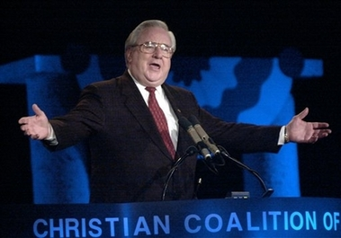
Fundamentalism in America
What is the nature of fundamentalism today?
Literal truth of the Scriptures
Being “born again” through acceptance of Jesus Christ as the Son of God who was sent to redeem mankind through his sacrifice.
Believers are responsible to witness on behalf of God
Satan is an active force of evil for the destruction of the world.
Messiah will come back to destroy Satan and establish His kingdom on earth.

Slide 10
Fundamentalism in America
Why is fundamentalism so strong today?
Americans feel their world is out of control and disconnected.
Fundamentalist churches emphasize warmth and caring rather than mainline churches who emphasize formality and are general more impersonal.
They offer what they consider a more pure and sacred environment, while mainline churches argue that is succumbing to secular society
The electronic church as been key to its growth as well

Slide 11
Group Activity
Get into groups of 4 or 5
Each group takes ONE role for the whole group: teacher, student, parent, principal.
Determine a positive or negative response
Submit your response in writing to be read in class, and make a recommendation.
After all groups’ recommendations are shared, we will come to a conclusion.
We must compromise, negotiate, and come to a consensus.

Slide 12
The Scenerio
Scenario:
Members of the Youth for Christ and the Fellowship of Christian Athletes have requested permission to hold lunch time prayer meetings as well as to continue meeting on Wednesdays at the flagpole before school.
Your head principal has tasked you with serving on a committee of 8 students (2 from each grade 9-12), two teachers, two parents, and two principals.
Your Task:
Your committee has been directed to reach a group consensus: whether to allow religious freedom to these groups or restrict their activities on campus.
You must think about their constitutional rights of free religious expression while also thinking about separation of church and state (“Public schools can neither foster religion nor preclude it”).
The Main Question:
Will you allow religious freedom or restrict their activities? Explain your reasons.

Slide 13
Religion, Science, and Society
How are religion and science the same philosophically?
They both are concerned with what is true.
How are they different?
Science deals with things observable, religion deals with beyond the observable.

Slide 14
Religion, Science, and Society
Name some conflicts between religion and science.
Can these two important pieces of human existence coincide? Explain.

Slide 15
Activity
Get in pairs or groups.
Role-play a scenario:
For religious reasons, the McKinney school board is debating whether to take out of books and tests any questions that:
say the Earth revolves around the sun for religious reasons.
Say anything about evolution
Say anything about the positives of stem cell research
List other controversial scientific discoveries

Slide 16
Activity
How can society learn to deal with constructively with this apparent conflict between science and religion?

