Slide 1
CH. 15 – Sociology of Sport
3 – Social issues in sport

Slide 2
Intro
Do students appreciate athletics more than academics?
Do African Americans jump higher than whites?
If yes, is this biological?
Canadians are superior hockey players because ________ .
The overwhelming majority of golfer are white because ______ .
Is there sexism in sports? Explain.
Is there racism in sports? Explain.
Notes:
Gnida, John. “Teaching Nature vs. Nurture: the Case of African American Athletic Success.”

Slide 3
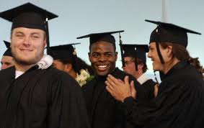
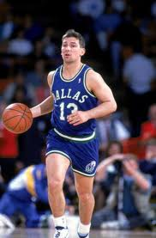
Sport and Social Mobility
Does sport promote social mobility?
Yes – just by going to college athlete often have better jobs and education levels than their parents.
What other skills could help in later life that is obtained through playing sports?
No – The % of athletics who makes it even to college is low, and many who strive to play pro don’t make other career plans.
If they do make it, the average career is about 5 years.
Can you name this player from the early 90’s?
What does he do now?
Notes:
Look up graph: national federation of state high school associations – “high school athletes’ chances of advancing to the pros.”

Slide 4
Sport and Racism
Stacking – players are assigned less central positions based on race or ethnicity
Some football examples?
Some examples in other institutions?

Slide 5
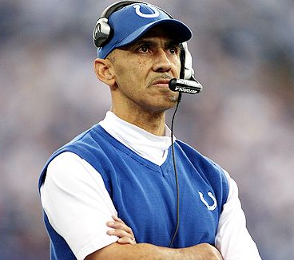
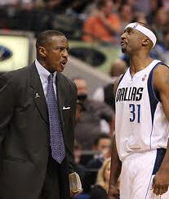
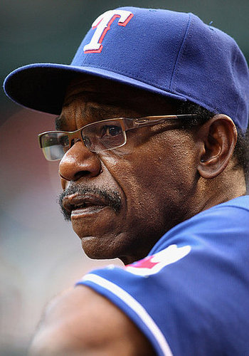
Sport and Racism
Research:
In professional sports, how many African American:
Head coaches are there?
Owners are there?
Does this surprise you? Explain.
What does this reflect about our society?
Do you think this is changing? Explain.
Notes:
Use reading on 519 for bigotry in the use of mascots.

Slide 6
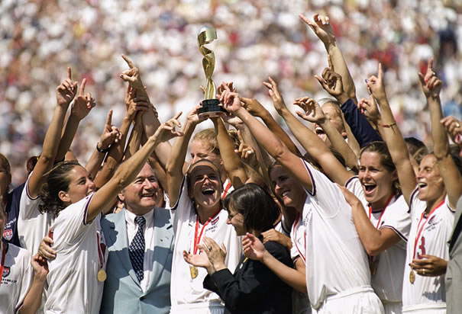
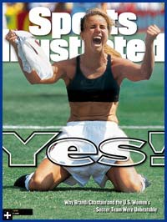
Sexism in Sport
The 1999 Women’s World Cup drew the largest media attention any women’s sport ever has.
Why do you this picture is the one that received most of the media attention and is the one people most remember?
Notes:
Can do a survey on page 516

Slide 7
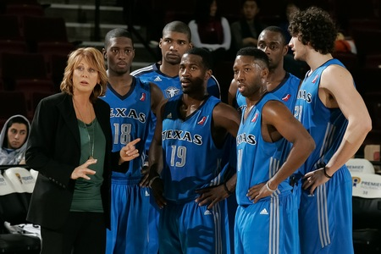
Sexism in Sport
What are some stereotypes that discourage females from participating in sports?
Are women represented level? Explain.
What are some stereotypes about these leagues? Would you watch? Explain.
Nancy Leiberman is the Head Coach of the Dallas Mavs developmental team.
Notes:
Read p.524-525 and answer questions 1-4

Slide 8
Summarize
From what we have learned in this unit, what advice would you give a young boy or girl who wished to become a professional athlete?

