Slide 1
Chapter 14 - Religion
3 Religious Organization and Religiosity

Slide 2
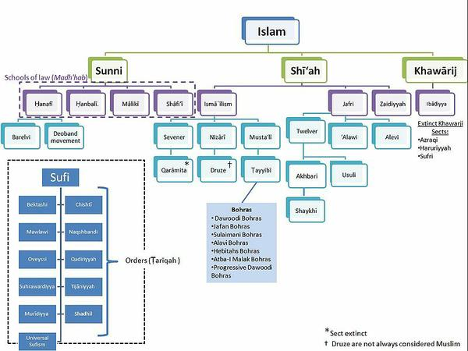
Religious Organization
Church –
all members of a society are also members of the religion
Denomination –
a religious organization that most members of society accept as legitimate
During the Elizabethan Era, if you were an Englishman, you were also automatically part of the Church of England.
As you can see, there are several denominations within Islam – not just one version as we typically think. How many denominations are there in Christianity?

Slide 3
Religious Organization
Why are denominations more likely to thrive in a pluralistic society?
various group will have different beliefs about what is sacred, various groups can lead to more tolerance of more denominations, etc…

Slide 4
Religious Organization
Sect – a religious organization that breaks off of the main organization in an attempt to reform it.
This is a depiction of the pilgrims before leaving England. They left because they wanted to reform the Church of England.
Can you think of other examples of sects?

Slide 5
Religious Organization
Cult – like a sect, but whose roots do not come from any existing social tradition.
The Church of Scientology is more conventional and less extreme than the cults that are usually thought of .
This cult had 39 members commit ritualistic suicide. However, Most cults are not this dangerous.

Slide 6
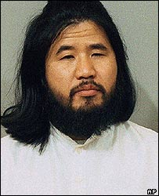
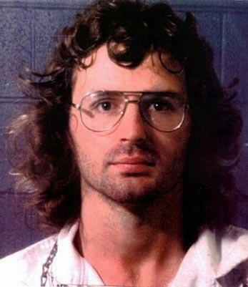
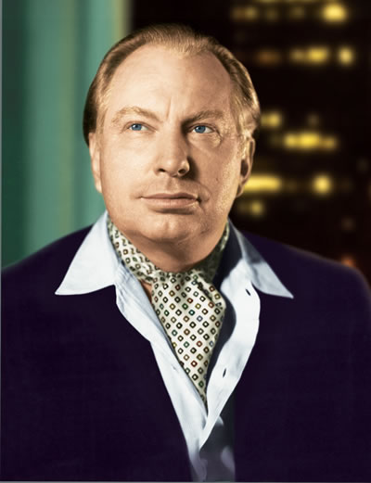
Religious Organization
Shoko Asahara, leader of the AUM cult that put Sarin gas in Tokyo subways
Cults
What kind of personality traits are most common among cult leaders?
What kind of people will be drawn to the leader’s personality?
Understanding the dangers of cults
Read pages 476 – 477 and answer the questions that follow.
David Koresh, leader of the Branch Davidians in Waco, TX
L. Ron Hubbard, a science fiction and fantasy writer who later founded Scientology

Slide 7
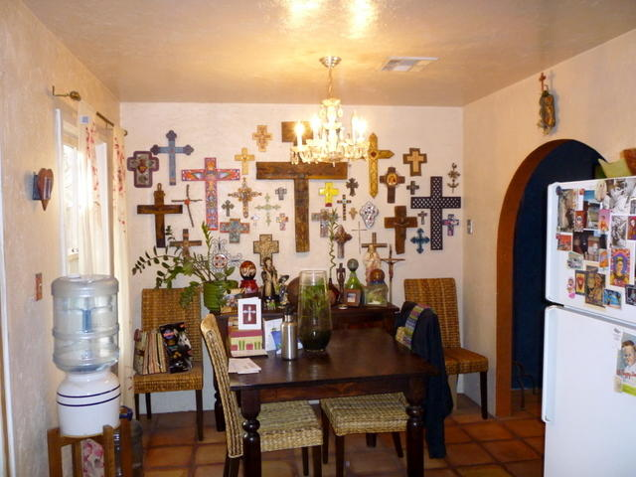
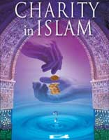
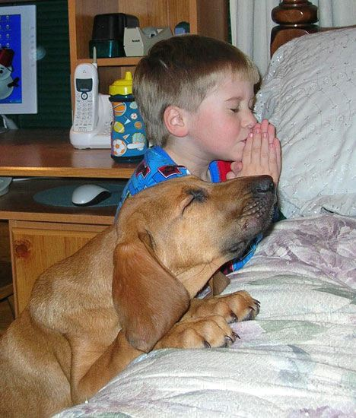
Religiosity
Religiosity – the ways that people express their religious views and convictions.
What are some examples of how people display their religiousness or spirituality?

Slide 8
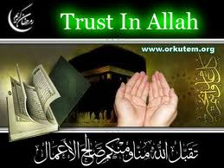
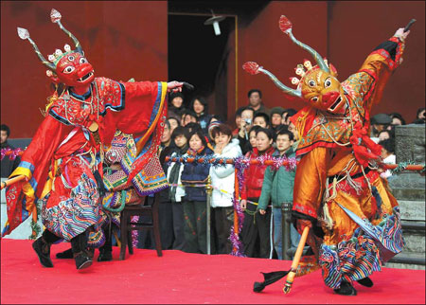
Religiosity
Belief – what people believe is true
Rituals – religious practices that people take part in
“Allah” is the Arabic word for God.
Buddhist New Year’s ritual in China
Notes:
Click on Buddhist picture for video – play 1 – 2 minutes

Slide 9
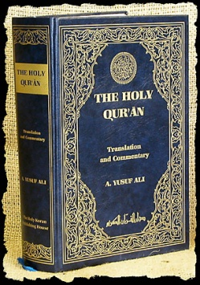
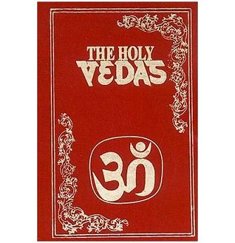
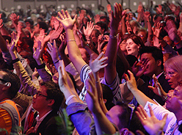
Religiosity
Intellectual dimensions – how much people are supposed to know about the religion
Experience – certain feelings people have that are attached to religious expression
Consequences – the decisions people make as a result of their religiosity
Speaking in tongues is an example
How does your religiosity effect your cursing or lying everyday?
Notes:
Click on speaking in tongues to view a video example of christians dancing, singing, and speaking. Does this compare to other religions

Slide 10
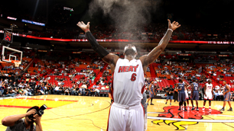
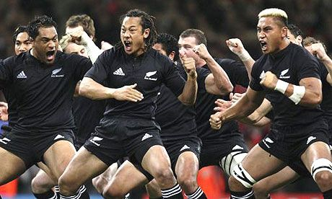
Religiosity - Rituals
Name some rituals that athletes or entertainers do to ensure a positive outcome.
Are these rituals religious? Why or why not?
Brainstorm some rituals that you do outside of your religion.
Preparing for a test, preparing for the day in the morning, before a performance, while you are watching a game, etc…
This is an example.
The New Zealand Rugby team – or the “All-Blacks” as they are commonly know – have a pre-match ritual that comes from the natives. It is a war dance from many years ago.

Slide 11
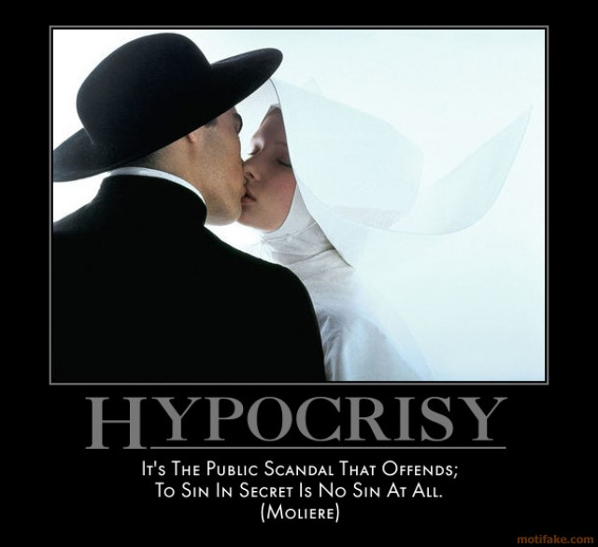
Religiosity vs. Religiousness
Religiosity is only an indicator of how “religious” a person is.
Are people that go to church really religious? Explain.
We can’t study what is really in a person’s heart.
What is the name we give people who display religiosity but are not “religious”?
The gap between religiosity and religiousness is called hypocrisy.
First, identify the hypocrisy. Next discuss whether you agree with Moliere or not.

