Slide 1
3 family and Marriage in the United States
The Family

Slide 2
Short Quiz: The Characteristics of the American Family
Get with a partner and list the characteristics (vocab) of the typical US family .
Review: What do these terms mean?
Nuclear
Bilateral
Democratic
Neolocal
Monogamous

Slide 3
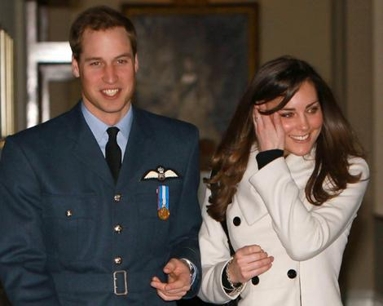
Activity – The Ideal Marriage
What will the ideal marriage be like?
Research shows that:
Students have an idealized views of what marriage will be
People who have been married have a different view of what marriage really is
Prince William and Kate Middleton – Is this going to be an ideal marriage?

Slide 4
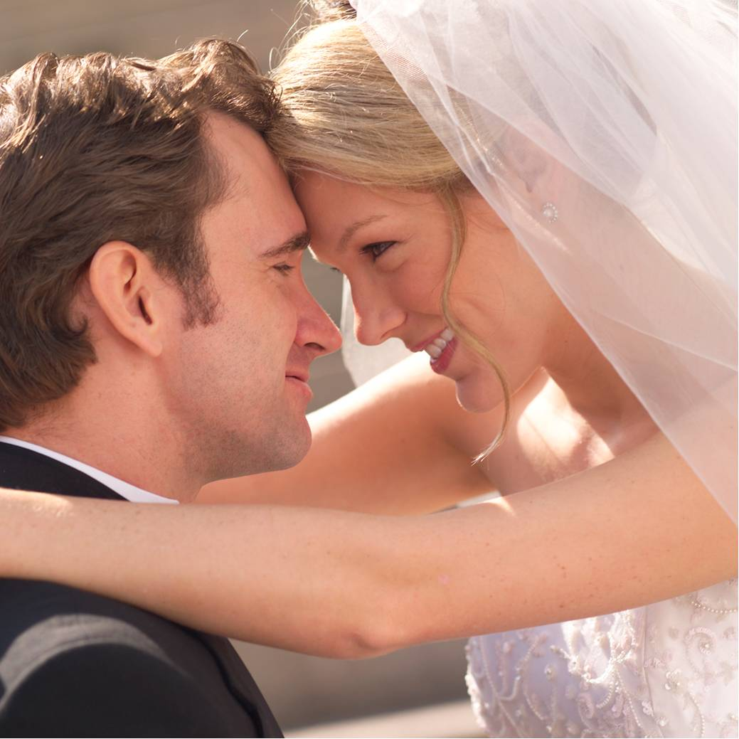
The Ideal Marriage – Comparing Research
Answer these questions:
Why do students have an idealized view of marriage?
What agents of socialization create this perception?
How does this differ from the reality of marriage?
Ask your parents to answer them at home to see if they match the research findings of the previous page.

Slide 5
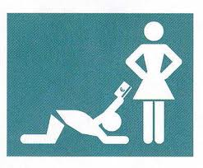
Romantic Love and Marriage
What do you think is the most important reason to marry?
83% of Americans “being in love” as being most vital
What are some pros and cons of this view?
What do you think are other criterion?
Among Hindus in India, parents are expected to find suitable males based on:
caste, wealth, family reputation, appearance and love follows after that.

Slide 6
Activity: Romantic Love and Marriage
Read and fill out the survey on page 362, then answer the questions on that page.

Slide 7
Romantic Love and Marriage
Will a marriage without romantic love last? Why or why not?
Based on the research, a marriage based on only romantic love is sure to fail.
Marriage Rate – number of marriages per year for every 1000 people.

Slide 8
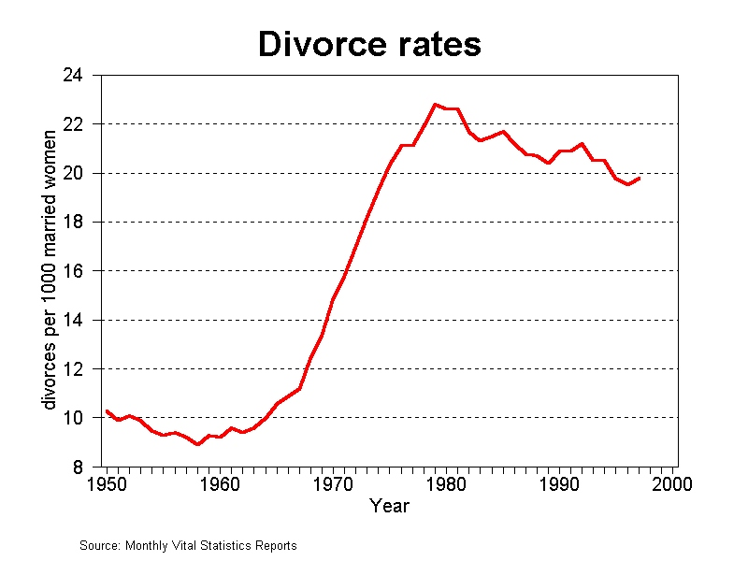
Divorce
Divorce Rate – number of divorces per year for every 1000 people.
It rose quickly during the ‘60s and ‘70s, leveled, and even dropped a little.

Slide 9
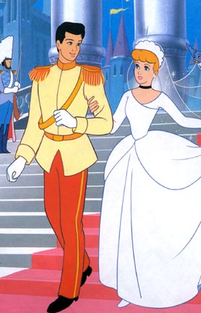
Divorce - Causes
What do you think some causes of divorce are?
At the individual level:
How could age be a factor?
How could time married be a factor?
How could respect and flexibility be a factor?
Movies end with the marriage. Will this marriage last?

Slide 10
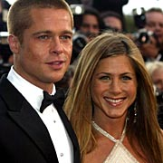
Divorce - Causes
At the societal level (which concerns us more):
How could economic prosperity lead to a higher divorce rate?
The 1960s women’s movements led to their not being a stigma attached to divorce
How could financial independence of women lead to divorce? Could this be a good thing for society if women are able to leave?
American values are changing.
Brad Pitt and Jennifer Aniston

Slide 11
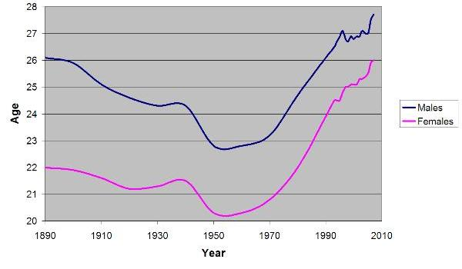
Divorce – What does the Future for Marriage look like?
The average age to marry in the US is increasing. How do you expect that to effect the divorce rate? Why?
Americans couples are having fewer kids. How can that lower the divorce rate?

Slide 12
Family Violence T/F Record your answers and give reasons to support what you put
Wife battering is a predominantly lower class phenomenon.
False – wealthy women tend to hide it more. No social barriers to violence
Wife battering occurs more often in some ethic groups than others.
False – abuse can appear in any ethnic group where there is unequal power between men and women
Alcohol is the main cause of domestic violence.
False – The alcohol is merely a trigger, but not the major cause. For the perpetrator of violence, it becomes a convenient excuse.
Women who are battered must be crazy or neurotic.
False – There is no evidence that abused women are any different psychologically the other women. Often, they are just trying to survive a difficult and possibly life threatening time.
Once a battered woman, always a battered woman.
False – Once a woman successfully escapes a violent relationship, she is more likely to choose more carefully in the next relationship.

Slide 13
Family Violence
¼ of children in the US reported being physically abused as children.
¼ of all girls, and 1/10 of all boys are victims of sexual aggression
At least 4 million women in the US are abused by their husbands annually – 4,000 are beaten to death.
O.J. Simpson was a high profile case that revealed he had abused his wife before he was accused of killing her.

Slide 14
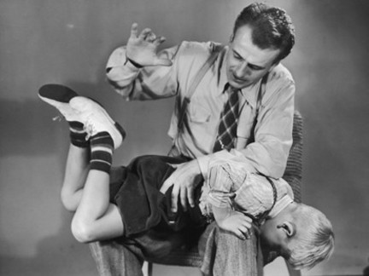
Family Violence
How much physical abuse is too much? Where should parents draw the line?

Slide 15
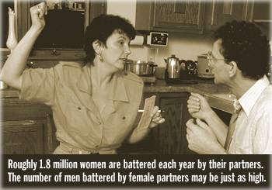
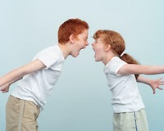
Family Violence
Husbands are abuse also, and at the same rate as women; HOWEVER, violence against men generally involves self-protection or retaliation.
The most frequent violence in the family occurs between…?
siblings

