Slide 1
3 – Theoretical Perspectives
Chapter 10: INEQUALITIES OF GENDER AND AGE

Slide 2
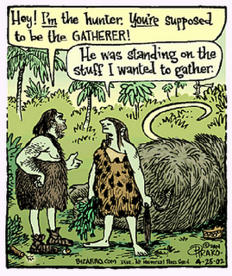
Functionalism and gender
Focus is on the origins of gender differences.
The different responsibilities of men and women made early societies more efficient (hunter/gatherer).

Slide 3
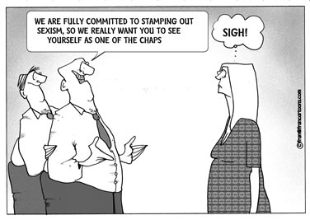
Conflict theory and gender
Looks at the reasons gender differences continue to exist
They see traditional gender roles outdated in industrial societies
What are some traditional gender roles for women?
Why would these be outdated in America today?

Slide 4
Conflict theory and gender
If you come from a two parent home where both parents work
List the work done by the mother and father.
Who does more?

Slide 5
Conflict theory and gender
Women complain about having to work 9-5, then 5-9.
Does this exist in your home? If so, why would conflict theorists say it’s not fair?
If not, why would this be an example of outdated gender role?

Slide 6
Symbolic interactionsim and gender
Complete the BEM study scale

Slide 7
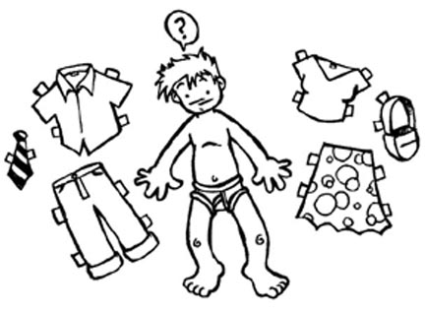
Symbolic interactionism and gender
Focus is on the ways gender is acquired.
GENDER SOCIALIZATION - the process of learning to act like a boy or a girl.

Slide 8
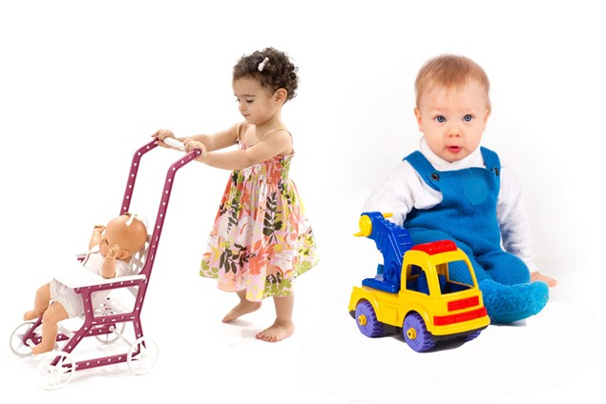
Symbolic interactionism and gender
How do the all-important parents contribute?
What the baby girl’s room color supposed to be?
What are dolls for boys called?
Action figures
What different chores do boys and girls have?
Can you tell which one is the girl and which one is the boy? How?

Slide 9
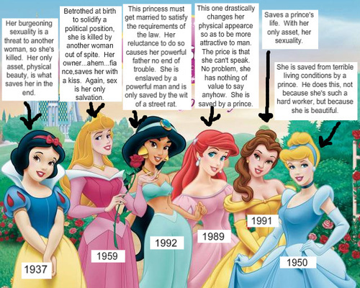
What are the values little girls are learning is important to possess?

Slide 10
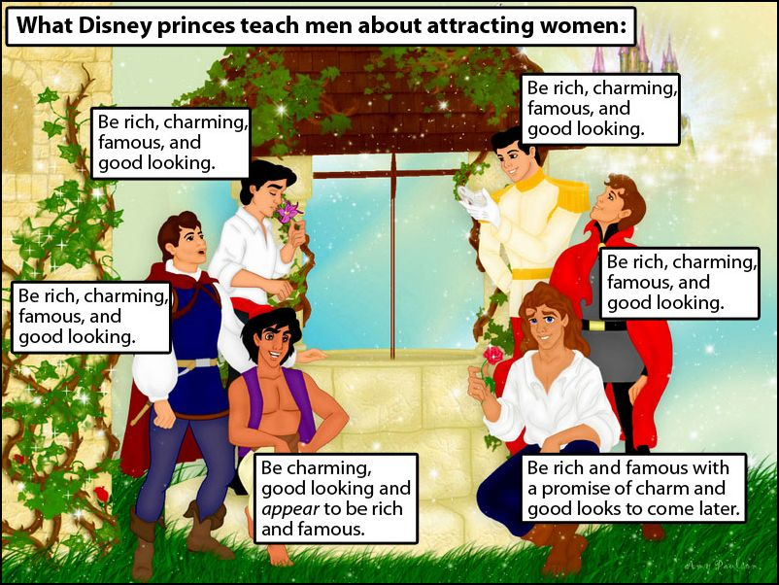
And the values boys are learning?

Slide 11
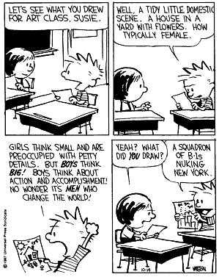
Symbolic interactionism and gender
How do schools reinforce gender socialization?
Are boys or girls more likely to shout out answer?
Which one is more likely to unpunished because it’s expected?
Are girls taught to be more passive in school?
Are “feminine” boys or “masculine” girls given as much respect as the cheerleader girl or football player boy?

