Slide 1
3. Theories of Prejudice and Discrimination
Prejudice, Racism, and Discrimination

Slide 2
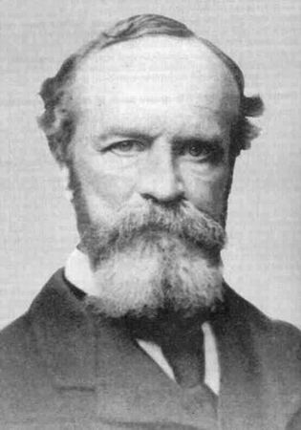
A great many people think they are thinking when they are merely rearranging their prejudices…
William James

Slide 3
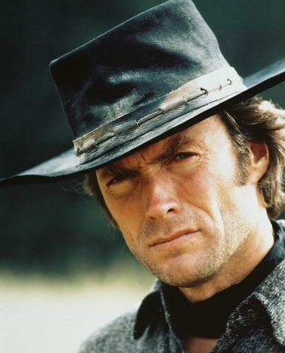
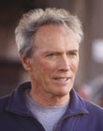
The less secure a man is, the more likely he is to have extreme prejudices…
Clint Eastwood

Slide 4
Have students think of the meanings of the previous quotes

Slide 5
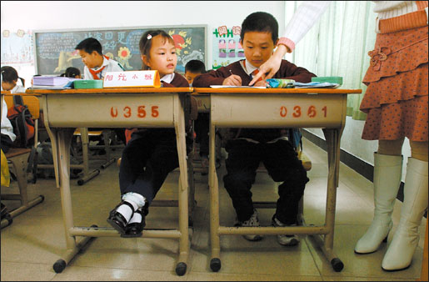
Prejudice
Widely held, generalized views of a group (majority or minority) and its individual members
It is based on insufficient information and on strong emotion, so it can be really difficult to change.
What are some prejudices we might have of the picture above?
What are other examples of prejudices we might have?
Can you think of prejudices that don’t involve race or ethnicity?

Slide 6
Because of these ideas, Asians kids that aren’t good at math are though to be exceptions.

Slide 7
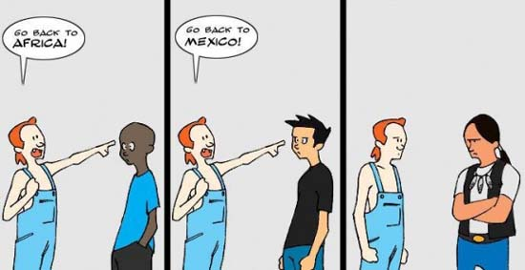
Racism
When prejudice develops into beliefs & feelings of superiority over a particular group

Slide 8
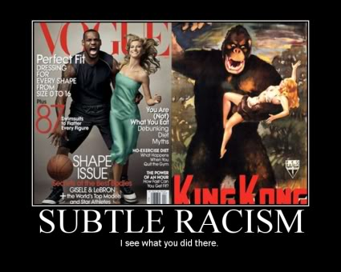
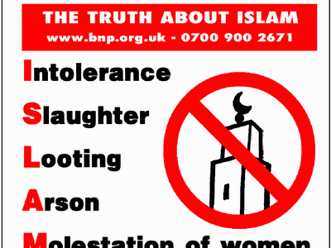
What do you think about these photos? What do images like these lead to?

Slide 9
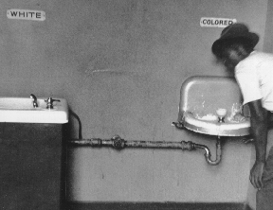
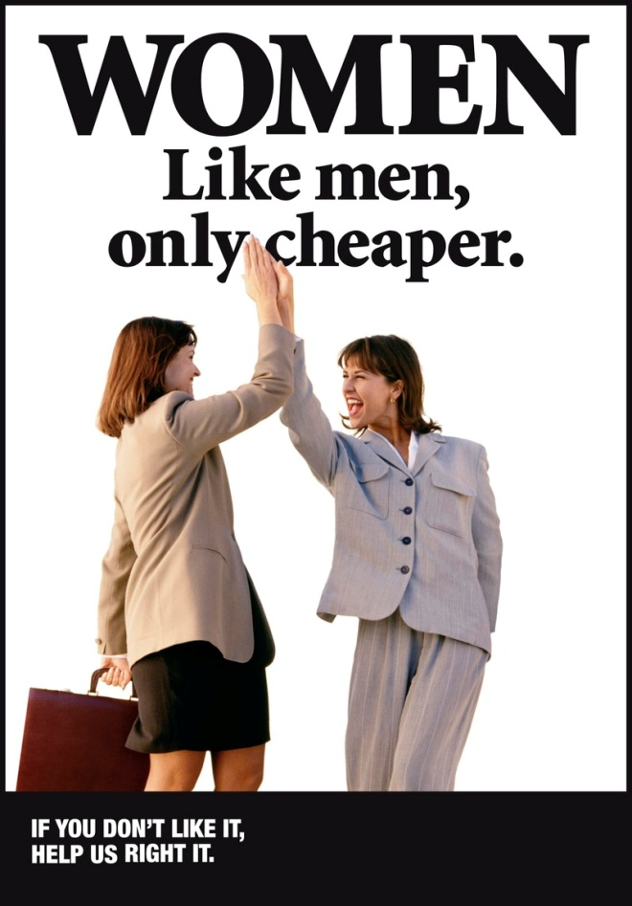
Discrimination
Treating people differently based on race, ethnicity, religion, or culture
Whereas prejudice and racism are about what people believe, discrimination is about action.
What discriminatory acts are these photos referring to?

Slide 10
3. Theories of Prejudice and Discrimination
Hate Crimes

Slide 11
Hate Crime: Mini Quiz (True/False) Write the statements first, then answer.
Most hate crimes are extremely brutal and involve violence done to a person.
The U.S. Constitution has identified English as the official language of the country.
The frequency of hate crimes in the U.S. has begun to decrease.
Most school-related hate crimes involve students who belong to hate groups.
Some types of hatred toward certain groups of people are instinctive and biologically based.

Slide 12
Hate Crime: Answers
True. Research shows that more force than necessary is often used against the victims than to just render them helpless.
False.
False. In 1999, hate crimes were still on the rise.
False. Students arrested for hate crimes are more likely to acting alone or with one or two friends (think Columbine).
False. Racism is a culturally transmitted or learned behavior.

Slide 13
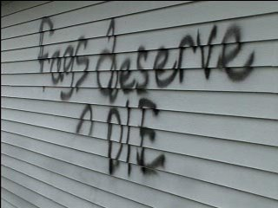
Hate Crime
A criminal act motivated by racism or prejudice.
What is the difference between a hate crime and discrimination?
Click the link below for a hate crime committed close to home.
http://edition.cnn.com/US/9807/06/dragging.death.02/

Slide 14
3. Theories of Prejudice and Discrimination
Stereotypes

Slide 15
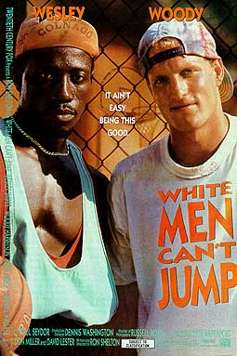
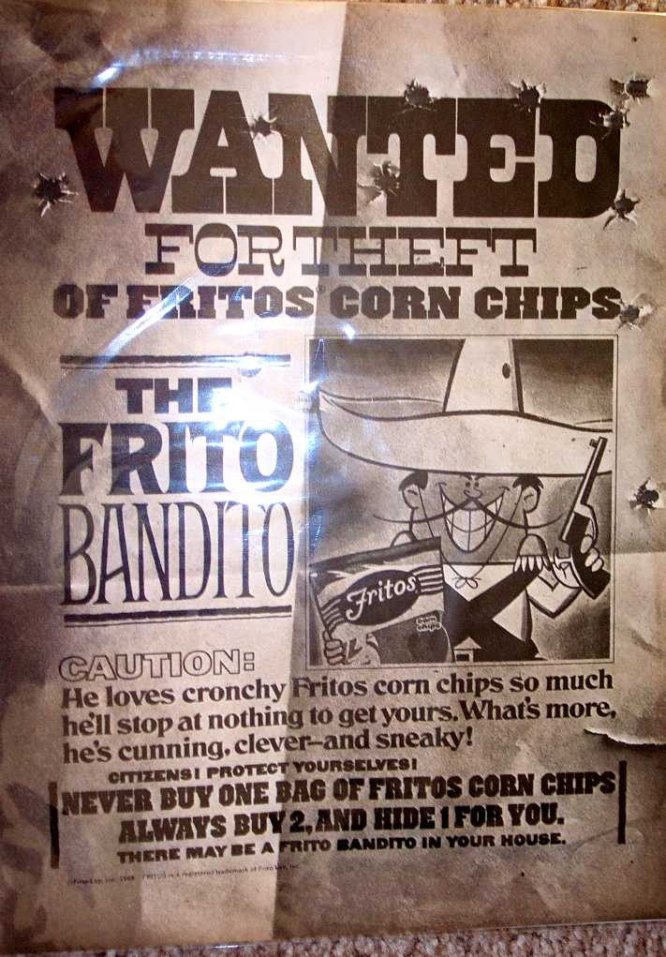
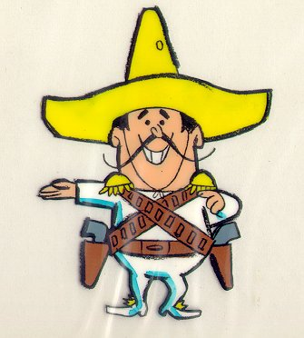
Stereotypes
A distorted, exaggerated, or oversimplified view applied to a category of people.
What different stereotypes can be inferred from the pictures?

Slide 16
3. Theories of Prejudice and Discrimination
Theoretical Perspectives

Slide 17
Theoretical Perspectives
Theoretical Perspective
Concept
Functionalism
Conflict Theory
Symbolic Interactionism
Ethnocentrism
Competition for power
Self-fulfilling prophecy
White colonists used negative stereotypes as a justification for taking Native American land
The NAZI’s saying their race was superior than others, thus they should rule
Members of a minority fail because they have low expectations for themselves.

Slide 18
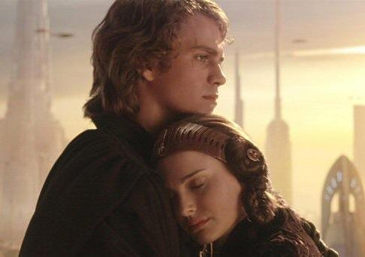
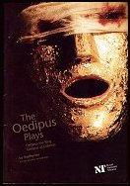
Self-fulfilling prophecy
An expectation that leads to behavior that causes the expectation to become a reality.
In order to prevent the prophecy and his expectation coming true about killing his father and sleeping with his mother, Oedipus Rex does both while trying to avoid it. Once he learns of what he has done, he rips his eyes out and becomes blind.
In order to prevent the prophecy and his expectation coming true of his wife’s death during child birth, Anakin changes his behavior (becoming Darth Vader) and winds up causing her death.

Slide 19
Review Questions
Can you hold a prejudice about a group without discriminating against that group? Why or why not?
Why do you think most stereotypes are negative? What are some positive stereotypes?
What are other examples of the self-fulfilling prophecy?

