Slide 1
CH. 15 – Sociology of Sport
2 – theoretical perspectives and sport

Slide 2
Intro – Thinking Ahead
What do you imagine are the four functions of sport?
What are some ways in which sports can have a positive influence for the elite?
What are some important ways we develop our self-concepts from sports and sports symbols?

Slide 3
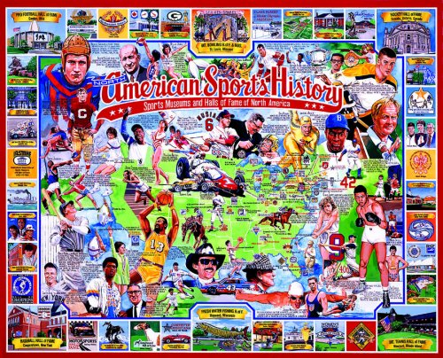
Culture and Sport
Stanley Eitzen wrote:
“American sport embodies American values – striving for excellence, winning, individual and team competition, and materialism. Parents want their children to participate in sport because participation teaches them basic values of American society and builds character.”
Notes:
You can do a survey to validate or just discuss the merit of this quote.

Slide 4
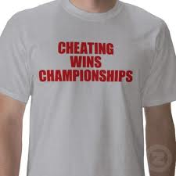
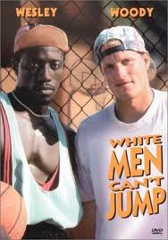
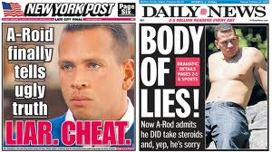
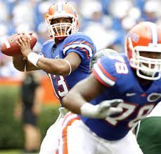
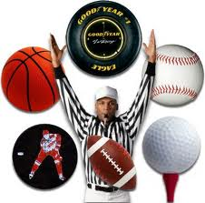
Eitzen’s Sports Paradoxes
Social Integration
Fair Play
Ohio State gave up championship
Physical Fitness
Academics
Cam Newton was on academic suspension at Florida for cheating
Social Mobility
In May 2008, average yearly wages for professional athletes were $79,460
In 2008, about 16,500 held jobs as professional athletes and sports competitors.
That’s .011% of labor market

Slide 5
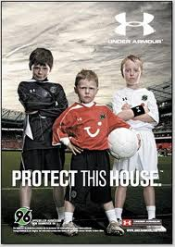
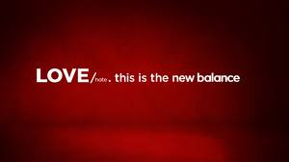
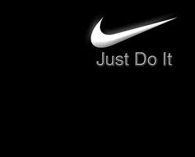
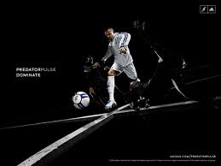
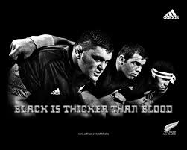
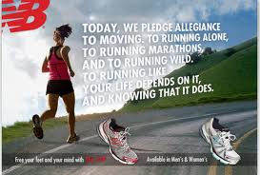
Functionalism
1. Sport teaches basic values, norms, and beliefs
2. Sport promotes a sense of social identification

Slide 6
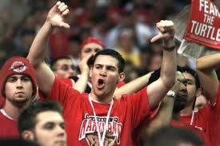
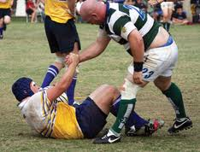
Functionalism
3. Sport offers a safe release of negative aggressive feelings generated by the frustrations, anxieties, and strains of modern life.
4. Sport encourages the development of character.

Slide 7
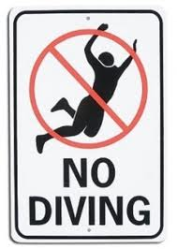
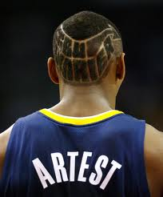
Social Dysfunctions
Promotes cheating to win
promotes violence, “enforcers” used.

Slide 8
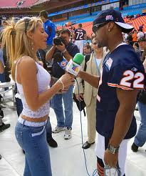
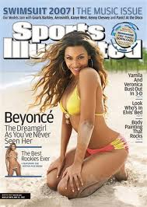
Conflict Theory
Sport does not truly unify people:
“When the game is over, the enthusiasm dies, the solidarity run short, and the disharmony in other relations reasserts itself. Much as one hour a week cannot answer the religious impulse, one game a week cannot answer the solidarity needs of a racist, sexist, or elitist society” (Young, 1986).
Notes:
Watch the 30 for 30 about Andres Escobar.

Slide 9
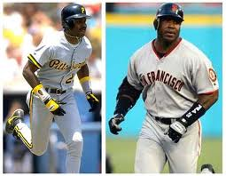
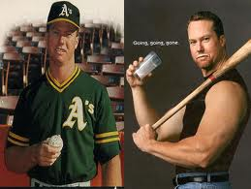
Conflict Theory
Sports building character is a myth
Media creates glorified images of athletes who believe they are above the normal consequences of society.
If their team wins, this further elevates their status.
Notes:
Take about “sportsmanship”. Is that a gender biased term? Ask for a different term. Ask what are ex. Of sportsmanship and unsportsmanlike conduct. Which is easier to find, more fun to watch? Does the behavior carry over to real life?
Have students watch one at least one sporting event and track the number of sportsmanlike instances and non.

Slide 10
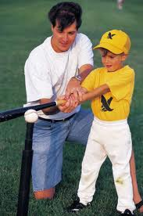
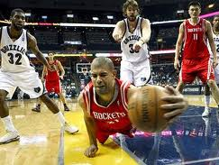
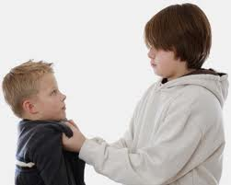
Symbolic Interactionism
Studies showed that kids:
Many times misinterpreted the messages about values into “masculine” values of dominance, “toughness”, and risky behavior
Aggressive, risky behavior was called “hustle”, dedication to competition, and desire to win.
When kids didn’t show this “masculine” behavior, they often scorn their peers and it led to a loss of self-esteem.
Notes:
Kids taking cues from parents at little league games

Slide 11
Symbolic Interactionism
Has your self-concept been affected by sports? Explain the effects from a symbolic interactionist viewpoint.

Slide 12
Summary
Read article on page 510-511 and answer the two questions that follow.

