Slide 1
Chapter 14 - Religion
2 Theoretical Perspectives

Slide 2
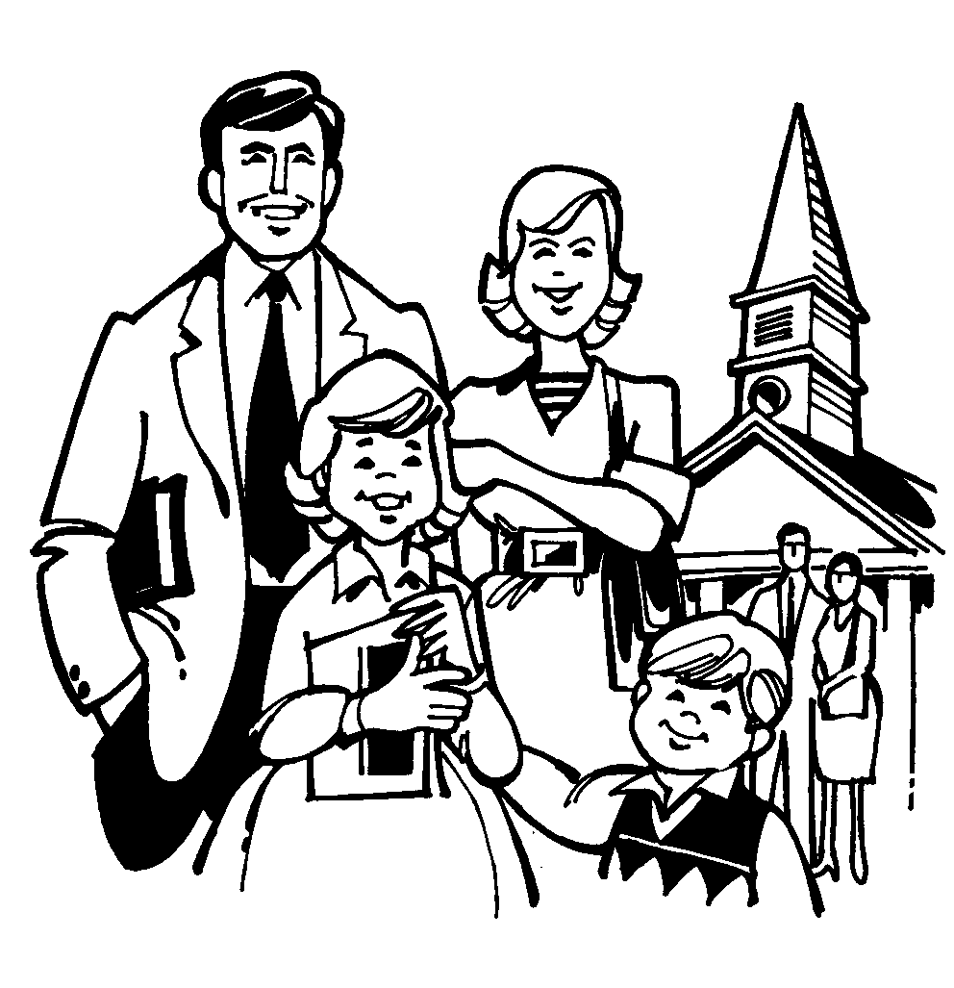
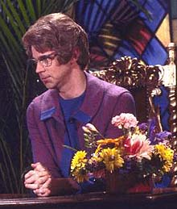
Discuss the Following
Who goes to church?
What groups of people go to church?
A: If you said mostly older people and families, you are correct.
Studies show that there is a strong correlation between people that fit cultural values and attending church.
Who does that leave out?
Teens, divorcees, and gays/lesbians are least likely to attend church
Click on the picture above to see video
Notes:
Discuss, but cut it off when the discussion gets heated

Slide 3
Functionalism and Religion
Before thinking too much about how a religion functions, try to think of ways in which a religion can be dysfunctional for a society.

Slide 4
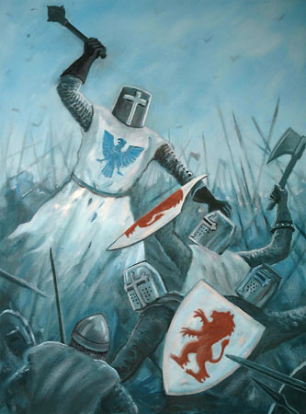
Functionalism and Religion
Dysfunctions:
Prevents progress
Promotes inequality
Stifles new thoughts or ideas
Creates war and other conflicts
Can you think of any real life examples of these?

Slide 5
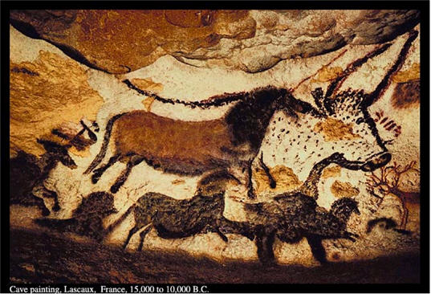
Functionalism and Religion
Religions date back 50,000 years.
Evidence of burying their dead and belief in existence after life.
They were hunter/gatherer groups.
What deities, beliefs and rituals revolve around?
The hunt, animals, weather were often sacred
Notes:
If you haven’t already, watch the first 10 or 15 minutes of “the gods must be crazy” on youtube

Slide 6
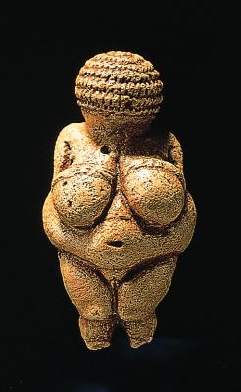
Functionalism and Religion
Durkheim’s main function of religion
to provide a mirror - through sacred symbols – for individuals to view themselves.
What does this sacred symbol tell us about what is important to this society?
A: the mother and childbirth.

Slide 7
Functionalism and Religion
Gives formal approval to existing social condition
What does Christianity say about why some people are rich and others poor? How about Buddhism?
Encourages a sense of unity
It is the fabric that connects people in a society, but it can also fragment a society. Any examples of both?

Slide 8
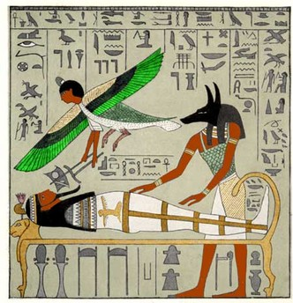
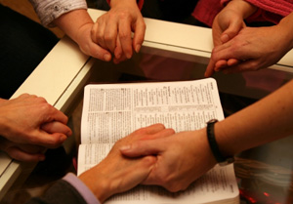
Functionalism and Religion
Provides a sense of understanding
Helps explain things like birth, sexual maturity, marriage, and death.
Gives believers a sense of place, purpose, and eternal importance to uncertain earthly existence.
Promotes sense of belonging
Religion helps support a group identity as opposed to just individual who aren’t connected.
Provides sense of community
Ancient Egyptian death and resurrection

Slide 9
Conflict Theory and Religion
Marx - religion is used by the rulers to justify inequalities.
“opiate” of the masses
Gives people the sense that things are correct the way they are
Is Marx correct?
Think up some examples of religions being used as a tool for the elite.
Karl Marx (Germany)

Slide 10
Conflict Theory and Religion
Weber believed that religion sometimes promotes social change.
Name some of the riches countries and where are they mostly located
Max Weber (Germany)

Slide 11
Conflict Theory and Religion
Weber wondered why these countries developed and the others did not.
Why do think they did? What do most of these countries have in common?
Notes:
A: They are mostly protestant dominated countries. Weber believed that Protestantism developed the spirit of capitalism

Slide 12
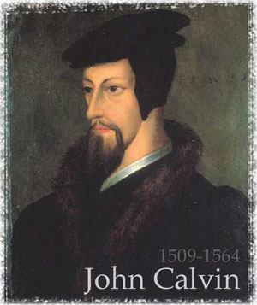
Conflict Theory and Religion
Protestant Ethic
Stresses hard work, thrift, and self-discipline
Calvinism
God rewards people in this world; if your rich, then you’re a chosen one.
Beyond necessity consumption is sinful. So , what do are you supposed do with all of your profits?
Leave inheritance? – wrong. That’s personal, and your kids need to know if they are chosen by God.
Answer: Reinvest!
How can the bullets on the left lead to the spirit of making as much money as you can?

Slide 13
Conflict Theory and Religion
Spirit of Capitalism
Reinvest money rather than spend
The religious values led to economic prosperity which led to power
Ben Franklin’s father was a Calvinist. Recognize these sayings?
A life of leisure and a life of laziness are two things. There will be sleeping enough in the grave.
A penny saved is a penny earned.
Early to bed early to rise makes a man healthy, wealthy, and wise.

Slide 14
Conflict Theory and Religion
Do you think the work ethic in the United States is disappearing or changing?
What are the pros and cons of having a strong Protestant work ethic in a person’s career?

Slide 15
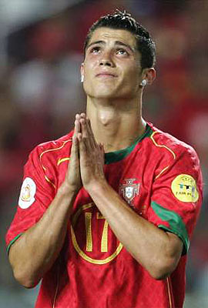
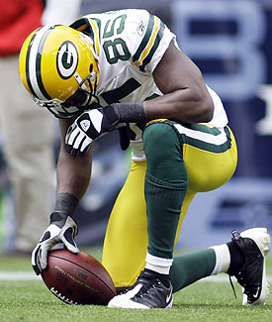
Symbolic Interactionism and Religion
Symbolic meanings are used to guide everyday social interaction.
Beliefs, rituals, and ideals tells people the difference between the sacred and profane
How are these two pictures similar and different? How do you know?

Slide 16
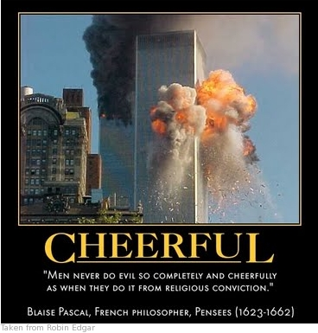
Symbolic Interactionism and Religion
What does the expression “there’s no atheists in foxholes” mean? What does it tell us about religion?
Why do terrorists perform suicide bombings “cheerfully”?

Slide 17
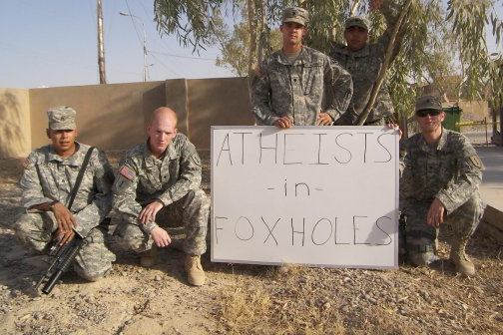
Symbolic Interactionism and Religion
Do you think a “foxhole conversion” is legitimate? Why or why not?
What do you think about sacrificing one’s life for a religious cause?
Why would a society encourage this behavior?
How would society benefit from the loss of one of its members in that way?

Slide 18
Activity/Debate
Read page 474 and answer the question at the bottom of the page.
What does cloning look like?
No mad scientists creating “baby farms”
Involves prodding immature cells to grow into specialized cells (blood, liver, brain, etc…) .
i.e. growing cells to replace damaged heart muscle
Notes:
Make sure the religious and secular viewpoints are equally represented

Slide 19
Activity/Debate
Debate: What is the effect of cloning on society? Is it good or bad? Why?
Notes:
Make sure the religious and secular viewpoints are equally represented

