Slide 1
The Family
2 – Theoretical Perspectives and the Family

Slide 2
Functionalism
How does the family socialize children?
Teaching what the child must know to participate in society
Socioemotional Maintenance – the emotional support kids must have to develop normally.
What could happen to children who did not have unconditional love from their parents?
Low self – esteem, fear rejection, feel insecure, eventually find it difficult to adjust to marriage and express affection to their own children.
Notes:
Activity – look at the chart on page 358 and answer the question below.

Slide 3
Functionalism
The functionalist view states that the family is the most orderly way to have and raise kids. (regulating sexual activity)
Discuss or write down- Is it important to have children? Why or why not?
In many cultures, the failure to reproduce children is grounds for divorce.
In many cultures there are rituals , customs, and traditions associated with pregnancy and birth
Notes:
Another discussion: How many children should a couple have? How many is enough? How many is too many? Should governments dictate policies regarding the number of children a couple should have? What about China?

Slide 4
Functionalism
How are the bounds of sexual activity in the US? In other words, what are the norms of sexual activity?
Some groups in the Trobriand Islands encourage premarital sex.
Others, like in Afghanistan go to great lengths to prevent it.
We are between these two extremes.
Are we getting mixed signals from the culture?

Slide 5
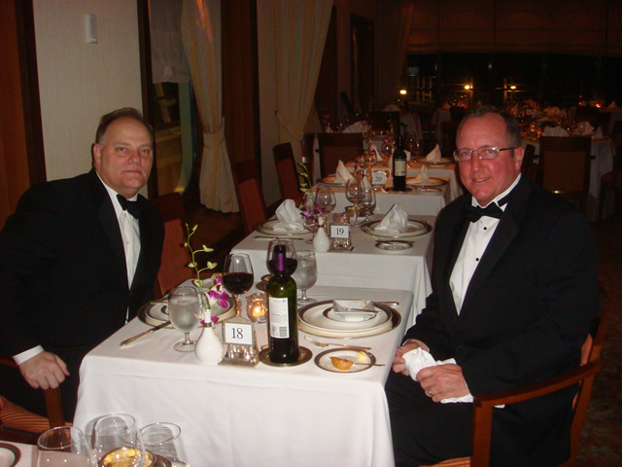
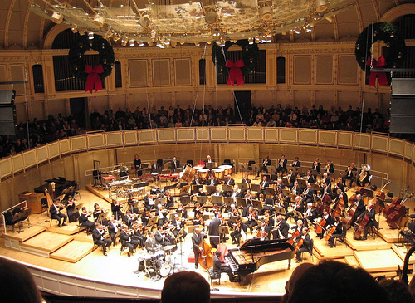
Functionalism
How do families transmit social status?
Children of rich people tend to go to what type of schools?
What eating manners do rich people typically pass on?
What eating manners do poor people typically have?
What culture events do children of rich people have access to that poor people do not?
In these and many other ways, the family effects the placement of their kids

Slide 6
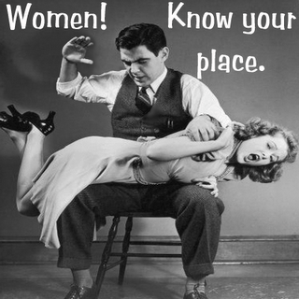
Conflict Theory
Emphasizes the dominant position that males have had over their wife.
Women have historically, in many societies, been the property of men
Control of the family by the dominant male or female has been considered “natural” and “legitimate”.
What is the picture on the left trying to say?

Slide 7
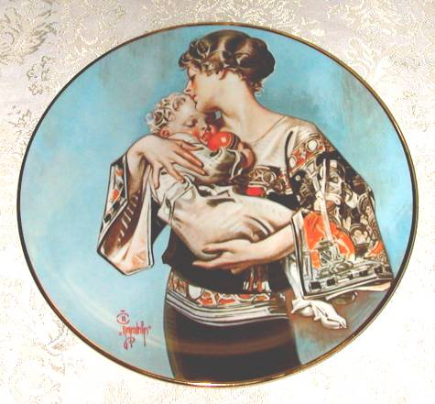
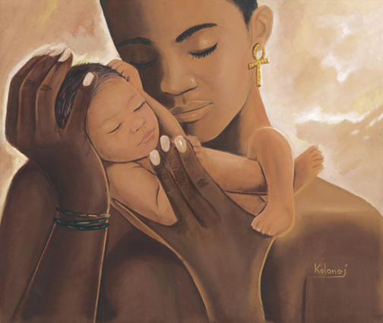
Conflict Theory
Is being a mother necessary in society? Why or why not?
How much do we value mothers?

Slide 8
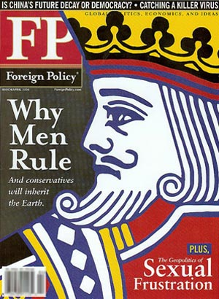
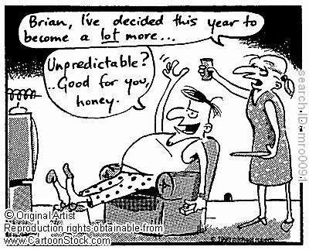
Conflict Theory
Why did they choose a picture of a king of clubs?
How much do we pay mothers?
Women are expected to raise children – possibly the most important job in society – and it is expected. No pay.
A man CEO who cheats on Wall Street, pollutes the environment, lets others raise his kids, and hurts society is valued more. Why?

Slide 9
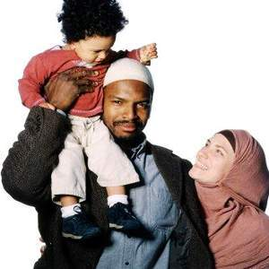
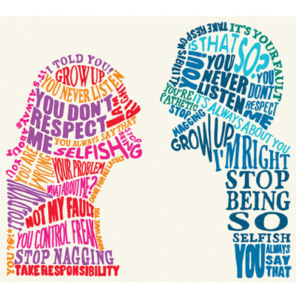
Symbolic Interactionism
What is this child being socialized to become?
Children develop their self-concept as they are socialized by their family.
Relationships are constantly changing and developing.
Examples?
Newlyweds have a feeling out period where their self-concept will change
They struggle as they work out problems of being in a new family with chores and responsibilities, personality clashes, and in-laws.

Slide 10
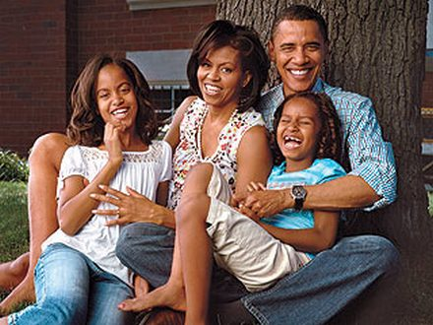
Symbolic Interactionism
The family is at the same time the most private and most public of all social institutions
Are families able to live private lives, unaffected by public opinion; OR
Does society have the right to impose certain standards on family life?
How much involvement should the community have in dealing with child neglect or abuse?

Slide 11
Symbolic Interactionism
Because of its privacy, the family can also be the most violent of institutions.
Some sociologists believe that violence begins at the home, and if homes were less violent, there would be less violence in society as a whole.
What do you think?

Slide 12
Imagine This is Your Situation
Having lived in this city all your life, you know people well and feel they are especially friendly to everyone. Age, race, gender, education, ethnicity, and family status have never mattered. Recently your aunt divorced her husband due to his lengthy sentence given for a crime against humanity. That’s all your parents will tell you about the situation.
Because your aunt is undergoing chemotherapy for an illness no one will discuss, you learn your cousin will be staying with you for at least half of the school year. You and your cousin are one year apart; that’s good because you will be able to introduce him to your friends and maybe even double date together. As you prepare to share your bedroom and tell your friends he’s coming, you hear a ring at the doorbell. You are upstairs, so your mother answers the door. You can hear people taking in hushed tones, and occasionally word such as “AIDS, risky business, welfare, trashy people, divorce, communicable disease, and dirt bags” dart past your ears.
You hear the d0or slam as Mom’s sobs echo through the house. Dad is enraged when he comes home from work and hears what happened.
What will you do to remedy this series of questionable events and save face for your family?
What is your greatest responsibility: to the society at large or to your individual family members?
Notes:
Read on the board or copy – have students discuss in groups

