Slide 1
2 - Gender inequality
Chapter 10: INEQUALITIES OF GENDER AND AGE

Slide 2
Women as a minority group
The most advances women have made have been in the fields of education, healthcare, and human service jobs.
Why haven’t women been successful in fields such as economics, law, or politics?

Slide 3
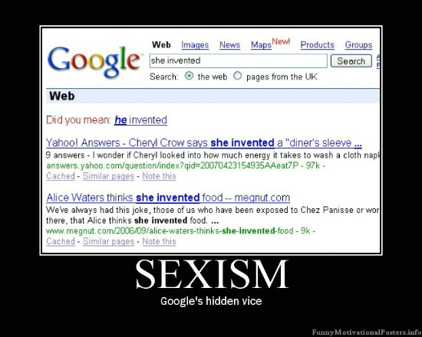
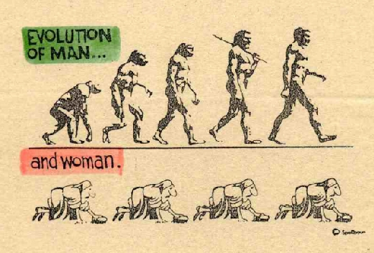
Women as a minority group
SEXISM- beliefs, attitudes, and norms used to justify sexual inequality.

Slide 4
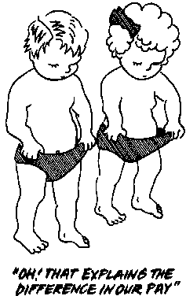
Women as a minority group
OCCUPATIONAL SEX SEGREGATION – concentration of woman in lower status jobs.
11 % of engineers
29% of attorneys
Women make 72% of what men make for doing the same job
Are men smarter or more capable of doing these jobs? Do AP classes reflect these percentages of women?

Slide 5
Occupational and economic inequality
CONTROVERSY:
Women have some conflict between raising a family and having a career. What do you think about the statement:
“Well, it’s no wonder that women don’t earn as much as money. How could they when they are continually taking time off to have kids?”
What is your initial reaction? What is a fair solution?

