Slide 1
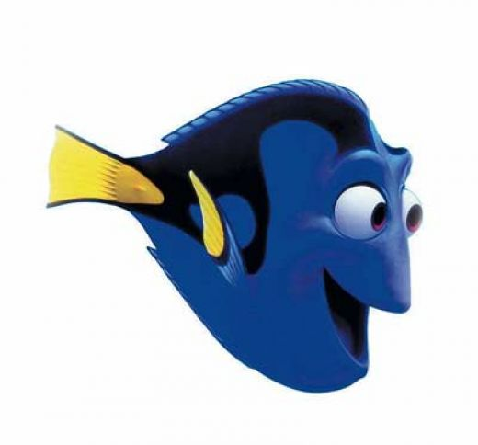
How does psychology define memory?
Memory is any indication that learning has persisted over time. It is our ability to store and retrieve information.
Notes:
Click to reveal bullets.

Slide 2
How Does Memory Work?
An Information-Processing Model
Here is a simplified description of how memory works:
Encoding
Encoding: the information gets into our brains in a way that allows it to be stored
Storage: the information is held in a way that allows it to later be retrieved
Retrieval: reactivating and recalling the information, producing it in a form similar to what was encoded
Storage
Retrieval
Notes:
Click to reveal bullets.

Slide 3
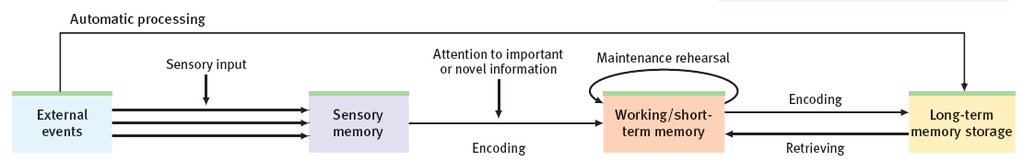
Models of Memory Formation
The Atkinson-Shiffrin Model (1968)
Stimuli are recorded by our senses and held briefly in sensory memory.
Some of this information is processed into short-term memory and encoded through rehearsal .
Information then moves into long-term memory where it can be retrieved later.
Modifying the Model:
More goes on in short-term memory besides rehearsal; this is now called working memory.
Some information seems to go straight from sensory experience into long-term memory; this is automatic processing.
Notes:
Click to reveal bullets and sidebar
Instructor: rehearsal, in relationship to short-term/working memory, means mentally echoing a term so we’ll know it at a later time.
The Atkinson–Shiffrin model was proposed in 1968 by Richard Atkinson and Richard Shiffrin.
From stimuli to short-term memory
Some of the stimuli we encounter are picked up by our senses and processed by the sensory organs. This generates information which enters sensory memory.
Before this information vanishes from sensory memory, we select details to pay attention to, and send this information into working memory for rehearsal and other processing.

Slide 4
Working Memory: Functions
The short-term memory is “working” in many ways.
It holds information not just to rehearse it , but to process it (such as hearing a word problem in math and doing it in your head).
Auditory rehearsal
repeating a password to memorize it
Executive functions
choosing what to attend to, respond to
Visospatial “sketchpad”
rearranging room furniture in your mind
Short-term memory integrates information from long-term memory with new information coming in from sensory memory.
Notes:
Click to reveal all text.

Slide 5
Dual-Track Processing:
Explicit and Implicit Memories
So far, we have been talking about explicit/ “declarative” memories. These are facts and experiences that we can consciously know and recall.
Some memories are formed without going through all the Atkinson-Shiffrin stages. These are implicit memories, the ones we are not fully aware of and thus don’t “declare”/talk about.
Our minds acquire this information through effortful processing. Explicit memories are formed through studying, rehearsing, thinking, processing, and then storing information in long-term memory.
These memories are typically formed through automatic processing. Implicit memories are formed without our awareness that we are building a memory, and without rehearsal or other processing in working memory.
Notes:
Click to reveal two text sequences.
Instructor: you can add that explicit memories are also called “declarative” memories because we can easily state or “declare” that we know the information. On the other hand, knowing every step involved in getting somewhere is a memory we can form and use automatically without deliberately having to process it.

Slide 6
Automatic Processing
Some experiences go directly to long-term implicit memory
Some experiences are processed automatically into implicit memory, without any effortful/working memory processing:
procedural memory, such as knowing how to ride a bike, and well-practiced knowledge such as word meanings
conditioned associations, such as a smell that triggers thoughts of a favorite place
information about space, such as being able to picture where things are after walking through a room
information about time, such as retracing a sequence of events if you lost something
information about frequency, such as thinking, “I just noticed that this is the third texting driver I’ve passed today.”
Notes:
Click to reveal bullets.
Instructor: Here’s another conditioned response that is built on an automatically processed memory. The sound of a mortar launch can trigger a reaction in a child to look up to see fireworks, or trigger a reaction in a soldier that it’s time to duck and cover to avoid an incoming shell.

Slide 7

Implicit Memory
HM is unable to make new memories that are
declarative (explicit), but he can form new
memories that are procedural (implicit).
A
B
C
HM learned the Tower of Hanoi (game) after his surgery. Each time he plays it, he is unable to remember the fact that he has already played the game.

Slide 8

The Encoding and Processing of Memory:
Sensory Memory
Sensory memory refers to the immediate, very brief recording of sensory information before it is processed into short-term, working, or long-term memory.
We very briefly capture a sensory memory, analogous to an echo or an image, of all the sensations we take in.
How brief? Sensory memory consists of about a 3 to 4 second echo, or a 1/20th of a second image.
Evidence of auditory sensory memory, called “echoic” memory, can occur after someone says, “what did I just say?” Even if you weren’t paying attention, you can retrieve about the last eight words from echoic memory.
Notes:
Click to reveal bullets.
Instructor: you might ask, “why do you think sensory memory is more brief for images than for sounds?”
Possible answers include:
images contain much more information than echoes; it would overwhelm us to store all the details our eyes capture. This is also part of the reason why attention selects important details to process.
so these sensory memories don’t interfere with new images coming in. Otherwise, every experience would be like watching a flashbulb, the afterimage would blind you to what comes next. Echoic memory, though, can be held longer because so much of our experience has little competing auditory input.
Additional comments you can make about the last point: this echoic memory phenomenon allows people to pretend or even convince themselves that they were paying attention when they merely had their ears operating.

Slide 9
Evidence of Visual Sensory (Iconic) Memory:
George Sperling’s Experiments
George Sperling (b. 1934) exposed people to a 1/20th of-a-second view of a grid of letters, followed by a tone which told them which row of letters to pull from iconic memory and recall.
Without the tone, people recalled about 50 percent of the letters; with the tone, recall for any of the rows was typically 100 percent.
To simulate Sperling’s experiment, notice the three rows of letters below. Based on the color of the letters, you will know that you must recall one of the following rows:
top, middle or bottom.
J Y Q
P G S
V F M
Notes:
Click to reveal bullets, then click again to start animation.
Instructor: we cannot reproduce the experiment on screen by producing letters for exactly 1/20th of a second with a tone. The animation is intended to simply give a feel of the challenge. This is a longer flash, and a color instead of a tone.

Slide 10
Encoding Memory
Capacity of Short-Term and Working Memory
Working Memory, which uses rehearsal, focus, analysis, linking, and other processing, has greater capacity than short-term memory. The capacity of working memory varies; some people have better concentration.
Test: see how many of these letters and numbers you can recall after they disappear.
No need for a hyphen before the V.
If some information is selected from sensory memory to be sent to short-term memory, how much information can we hold there?
George Miller (b. 1920) proposed that we can hold 7 +/-2 information bits (for example, a string of 5 to 9 letters).
More recent research suggests that the average person, free from distraction, can hold about:
7 digits, 6 letters, or 5 words.
Test:
  V M 3 C A Q 9 L D
Notes:
Click to reveal bullets. Click again to show sidebar. Click to start the test. When you see the word “Test”, the next click starts the letter animation.
Click again to show the letters.
Instructor: observant students might see the list in the third bullet point and notice: 5 words > 7 letters. This means we can recall MORE than 6 letters if we can cluster them into words, which we’ll soon call “semantic processing.” Experiments by Lloyd Peterson, Margaret Peterson, and Hermann Ebbinghaus (which we’ll cover later in the chapter) made this processing difficult by using nonsense syllables instead of words.

Slide 11
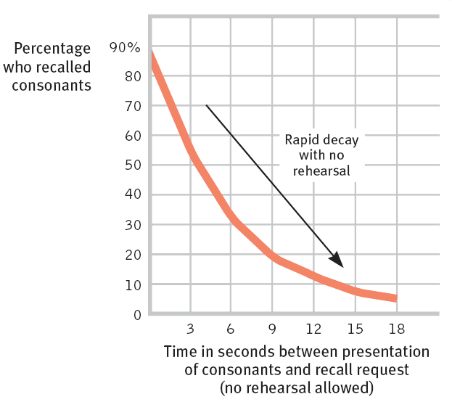
Duration of Short-Term Memory (STM)
Lloyd Peterson and Margaret Peterson wanted to know the duration of short term memory? Their experiment (1959):
People were given triplets of consonants (e.g., “VMF”).
To prevent rehearsing, the subjects had to do a distracting task.
People were then tested at various times for recall.
Result: After 12 seconds, most memory of the consonants had decayed and could not be retrieved.
Notes:
Click to reveal bullets.
Instructor: if you want to test students’ familiarity with the reading, you can ask, “what was the distracting task?”...(counting backward from 100 by 3’s).

Slide 12
Encoding:
Effortful Processing Strategies
If we have short-term recall of only 7 letters, but can remember 5 words, doesn’t that mean we could remember more than 7 letters if we could group them into words?
This is an example of an effortful processing strategy, a way to encode information into memory to keep it from decaying and make it easier to retrieve.
Effortful processing is also known as studying.
Examples:
Chunking (grouping)
Mnemonics: images, maps, and peg-words
Hierarchies/categories
Rehearsal, especially distributed practice
Deep processing
Semantic processing
Making information personally meaningful
→ Can you remember this list?
Notes:
Click to reveal bullets and examples.

Slide 13
Effortful Processing Strategies
Chunking
Why are credit card numbers broken into groups of four digits? Four “chunks” are easier to encode (memorize) and recall than 16 individual digits.
→ Memorize: ACPCVSSUVROFLNBAQ XIDKKFCFBIANA
Chunking: organizing data into manageable units
XID KKF CFB IAN AAC PCV S SU VRO FNB AQ
Chunking works even better if we can assemble information into meaningful groups:
X IDK KFC FBI BA NAACP CVS SUV ROFL NBA Q
X IDK KFC FBI BA NAACP CVS SUV ROFL NBA Q
Notes:
Recommended: Practice this slide!
As you click to reveal the second bullet, ask students to memorize it; it will disappear after 3.5 seconds. Ask them to write down what they can. The same will happen with the next two lines of letters, but they should get more correct (as they will see when you click to make all three lines of letters reappear), thanks to better chunking. They will also be helped by another effect; it’s the same row of letters but with the two halves reversed the first time, so by the third time, there is a small amount of rehearsal and retesting effect helping them out.

Slide 14


Mnemonics
Effortful Processing Strategies
A mnemonic is a memory “trick” that connects information to existing memory strengths such as imagery or structure.
  Read: plane, cigar, due, shall, candy, vague, pizza, seem, fire, pencil
  Which words might be easier to remember?
  Write down the words you can recall.
  Lesson: we encode better with the help of images.
A peg word system refers to the technique of visually associating new words with an existing list that is already memorized along with numbers. For example, “due” can be pictured written on a door, and door = 4.
Notes:
Leave the first bullet visible only as long as it takes to read it; another click will make that bullet disappear as the next bullet appears. After the last bullet, the first bullet reappears along with some images.

Slide 15
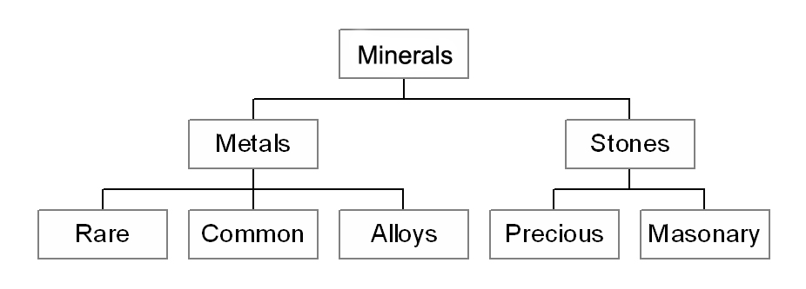
Hierarchy
Complex information broken down into broad concepts and further subdivided into categories and subcategories.

Slide 16
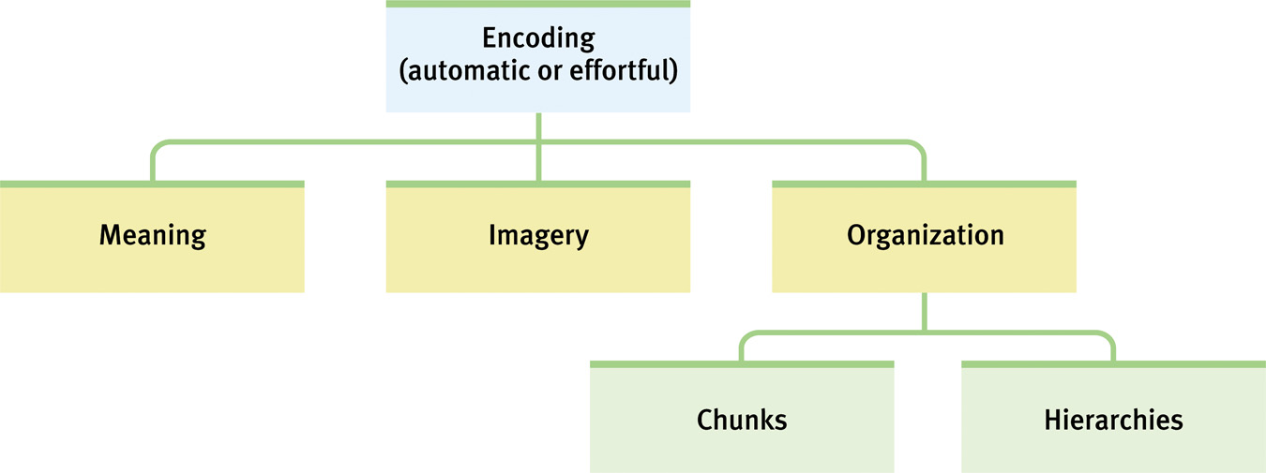
Encoding Summarized in a Hierarchy

Slide 17
Rehearsal and Distributed Practice
Effortful Processing Strategies
Massed Practice refers to cramming information all at once.
It is not time-effective.
The best way to practice? Consider the
testing effect. Henry Roediger (b. 1947) found that if your distributed practice includes testing (having to answer questions about the material), you will learn more and retain more than if you merely reread.
The spacing effect was first noted by Hermann Ebbinghaus in the late 1800s. You will develop better retention and recall, especially in the long run, if you use the same amount of study time spread out over many shorter sessions.
This doesn’t mean you have to study every day. Memory researcher Harry Bahrick noted that the longer the time between study sessions, the better the long-term retention, and the fewer sessions you need.
Notes:
Click to reveal bullets.
Implication of the second bullet on Hermann Ebbinghaus’s result: review all your psychology notes once a week, and you’ll remember it throughout the major.
Implications of Harry Bahrick’s research: the subjects could use half as many study sessions if they started studying four times as early. Starting your exam study early may seem like studying more, but it’s actually a way to study LESS overall to get the same results.
Implication of the testing effect: do as many online quizzes and chapter-end questions as possible. Recent research seems to show that the testing effect works even if you don’t know most of the answers yet; it’s as if the questions create a placeholder in your mind for the information.
Regarding the spacing effect: learning is most effective if you start learning material in sessions closer together, and then further and further apart, NOT closer and closer together as exam time nears. This means reviewing new material a couple of hours after class, then a day, then a week, then a month… then at exam time, you’ll hardly need studying at all.

Slide 18
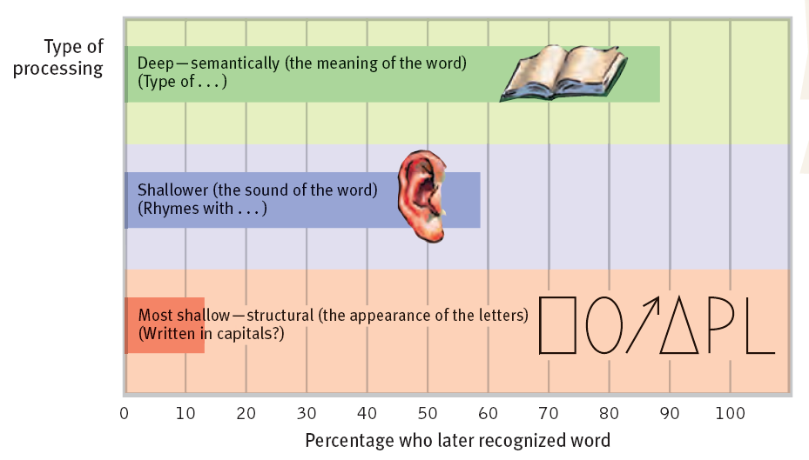
Deep/Semantic Processing
Effortful Processing Strategies
When encoding information, we are more likely to retain it if we deeply process even a simple word list by focusing on the semantics (meaning) of the words.
“Shallow,” unsuccessful processing refers to memorizing the appearance or sound of words.
Notes:
No animation.
Instructor: you can suggest an application of this study result as a study tip. Tell students they will recall more psychology terms by the time of a test if they ask deeper questions about the words rather than just looking over the words or echoing them.

Slide 19
Effortful Processing Strategies
Memorize the following words:
bold truck temper
green run drama
glue chips knob
hard vent rope
Making Information Personally Meaningful
We can memorize a set of instructions more easily if we figure out what they mean rather than seeing them as set of words.
Memorizing meaningful material takes one tenth the effort of memorizing nonsense syllables.
Actors memorize lines (and students memorize poems) more easily by deciding on the feelings and meanings behind the words, so one line flows naturally to the next.
The self-reference effect, relating material to ourselves, aids encoding and retention.
Now try again, but this time, consider how each word relates to you.
Notes:
The very first material to appear on the slide, even before the main title “Making information…” is “Memorize the following words” followed by the 12 words. After the word list appears, you read it slowly, then click to make it disappear. Ask students to write what they can recall.
Then click to reveal bullets.
After the final bullet and the word list appears again, slow down your reading of the words to give students time to come up with a personal story or other connection.
As some student might point out, the memorization results will be more different because of the practice/rehearsal, and even testing effects. However, this may compensate for the results being more similar, because students may have already known they were supposed to make personal connections.

Slide 20
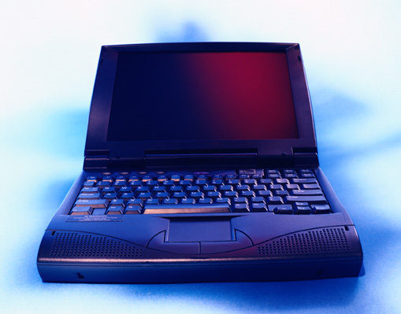
Memory Storage:
Capacity and Location
The brain is NOT like a hard drive. Memories are NOT in isolated files, but are in overlapping neural networks.
The brain’s long-term memory storage does not get full; it gets more elaborately rewired and interconnected.
Parts of each memory can be distributed throughout the brain.
  → Memory of a particular ‘kitchen table’ may be a linkage among networks for ‘kitchen,’ ‘meal,’ ‘wooden,’ ‘home,’ ‘legs,’ and ‘sit.’
Karl Lashley (1890-1958) showed that rats who had learned a maze retained parts of that memory, even when various small parts of their brain were removed.
Notes:
Click to reveal bullets.
Instructor: see if students can recall the study mentioned in the book giving evidence for the distributed nature of memory.

Slide 21
Memory Processing in The Brain
If memory is stored throughout the brain, how does it get in there, and how do we retrieve it and use it?
There are different storage and retrieval/activation systems in the brain for explicit/ declarative memory and for implicit/ procedural memory.
When emotions become involved, yet another part of the brain can mark/flag some memories for quicker retrieval.
The storage occurs by changing how neurons link to each other in order to make some well-used neural networks of neurons easier to activate together.
Notes:
Click to reveal bullets.
Instructor: this slide summarizes the topics of the upcoming several slides, but has no unique content found elsewhere, so it can be deleted if you want to move right to the next topic without an overview.

Slide 22
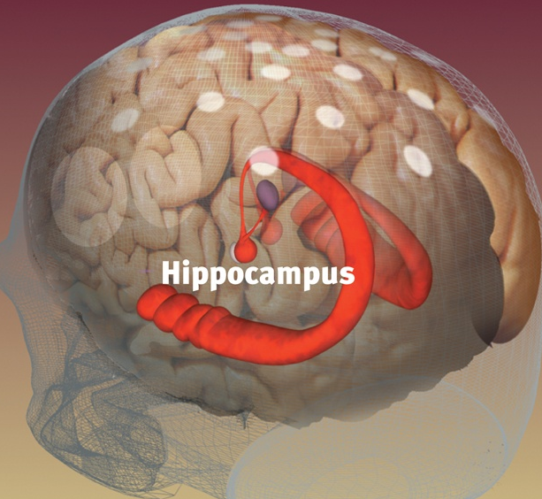
Explicit Memory Processing
Explicit/declarative memories include facts, stories, and meanings of words such as the first time riding a bike, or facts about types of bicycles.
Retrieval and use of explicit memories, which is in part a working memory or executive function, is directed by the frontal lobes.
Encoding and storage of explicit memories is facilitated by the hippocampus. Events and facts are held there for a couple of days before consolidating, moving to other parts of the brain for long-term storage. Much of this consolidation occurs during sleep.
Notes:
Click to reveal bullets.
Instructor: in case the picture of the hippocampus isn’t clear, you could note that the thick ends are behind the eyes and between the tops of the ears, and each hippocampus curves up and toward the center of the brain from there.

Slide 23
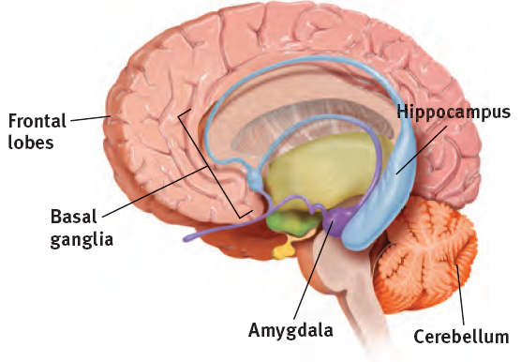
The Brain Stores Reactions and Skills
Implicit Memory Processing
Implicit memories include skills, procedures, and conditioned associations.
The cerebellum (“little brain”) forms and stores our conditioned responses. We can store a phobic response even if we can’t recall how we acquired the fear.
The basal ganglia, next to the thalamus, controls movement, and forms and stores procedural memory and motor skills. We can learn to ride a bicycle even if we can’t recall having the lesson.
Notes:
Click to reveal bullets.

Slide 24

Emotions and Memory
Strong emotions, especially stress, can strengthen memory formation.
Flashbulb memories refer to emotionally intense events that become “burned in” as a vivid-seeming memory.
Note that flashbulb memories are not as accurate as they feel.
Vividly storing information about dangers may have helped our ancestors survive.
Notes:
Click to reveal bullets.
Instructor: why the term “flashbulb” memory? It’s as if a camera’s flashbulb went off when our mental photo was taken of an event, brightening the picture. Maybe this term will need to be updated, since cameras no longer have noticeable bulbs.
Why “vivid-seeming”? These memories may feel vivid as if we were re-experiencing the event, but they are not necessarily accurate; in fact, they get altered every time we recall them. This change can make the memory worse, or it can be a good thing; trauma therapy depends on this “reconsolidation.”

Slide 25
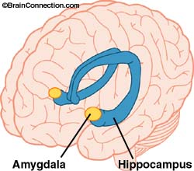
Emotions, Stress Hormones, the Amygdala, and Memory
How does intense emotion cause the brain to form intense memories?
Emotions can trigger a rise in stress hormones.
These hormones trigger activity in the amygdala, located next to the memory-forming hippocampus.
The amygdala increases memory-forming activity and engages the frontal lobes and basal ganglia to “tag” the memories as important.
As a result, the memories are stored with more sensory and emotional details.
These details can trigger a rapid, unintended recall of the memory.
Traumatized people can have intrusive recall that is so vivid that it feels like re-experiencing the event.
Notes:
Click to reveal bullets.
Instructor: students may anticipate that the last bullet point refers to PTSD.
Note that these memories may feel as vivid as if we were re-experiencing the event, but they are not necessarily accurate; in fact, they get altered every time we recall them. This change can make the memory worse, or can be a good thing; trauma therapy depends on this “reconsolidation.”

Slide 26
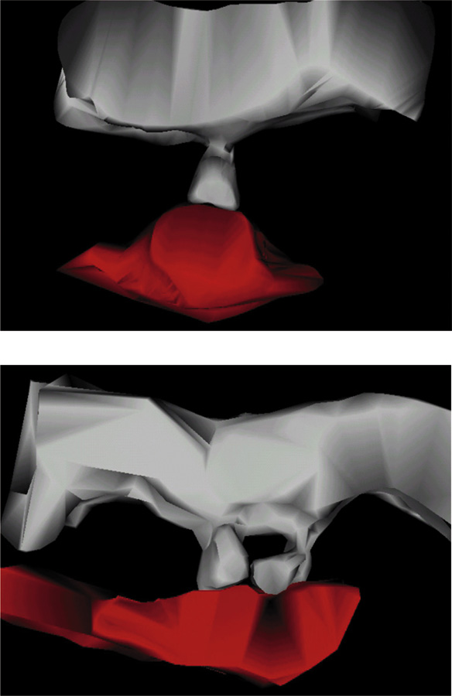
Synaptic Changes
Long-Term Potentiation (LTP) refers to synaptic enhancement after learning (Lynch, 2002).
An increase in neurotransmitter release or receptors on the receiving neuron indicates strengthening of synapses.

Slide 27

Messing with Long-Term Potentiation
Chemicals and shocks that prevent long-term potentiation (LTP) can prevent learning and even erase recent learning.
Preventing LTP keeps new memories from consolidating into long-term memories. For example, mice forget how to run a maze.
Drugs that boost LTP help mice learn a maze more quickly and with fewer mistakes.
Notes:
Click to reveal bullets.
The main method for preventing long-term potentiation (LTP) relies on chemicals such as beta-blocker heart medication and benzodiazepine anti-anxiety medication. Both of these raise levels of GABA, the inhibitory neurotransmitter. You can ask students which neurotransmitter has opposite effect? The answer is glutamate, the excitatory neurotransmitter; raising levels of glutamate boosts LTP and learning.
A newer chemical intervention is to indirectly increase or inhibit the production of CREB, a protein that enhances LTP.
Another new application of LTP manipulation with results continuing to be reported in 2012: messing with the reconsolidation of memories. People who are asked to recall a painful memory, and then are given an LTP-blocking drug such as propranolol (a beta blocker), have effectively erased those memories.

Slide 28
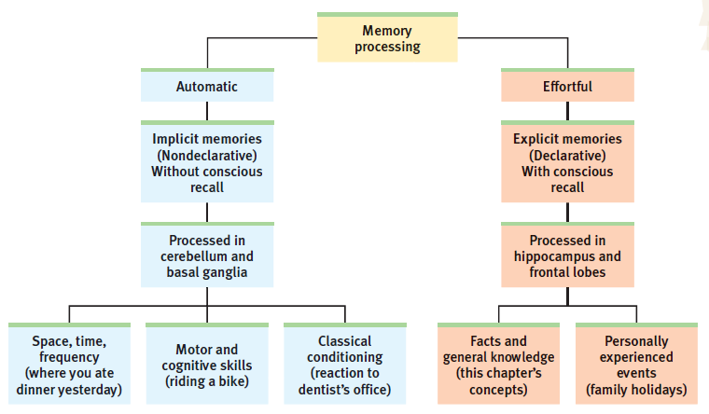
Summary:
Types of Memory Processing
Notes:
No animation.

Slide 29
Memory Retrieval
Recall: some people, through practice, visual strategies, or biological differences, have the ability to store and recall thousands of words or digits, reproducing them years later (“fill-in-the-blank”)
Recognition: the average person can view 2500 new faces and places, and later can notice with 90 percent accuracy which ones they’ve seen before (“multiple choice”)
Relearning: some people are unable to form new memories, especially of episodes; although they would not recall a puzzle-solving lesson, they might still solve the puzzle faster each lesson
Lessons from each of these demonstrations:
our storage and recall capacity is virtually unlimited
our capacity for recognition is greater than our capacity for recall
relearning can highlight that memories are there even if we can’t recall forming them
Notes:
Click to reveal bullets and sidebar.
Another recognition example cited in the text: the elephant that people are more able to recognize in fragments if they had seen the whole picture before…even 17 years before.
Instead of showing that example, they will next get a chopped/partial image of the tree ring picture from the second slide.
Three behaviors show that memory is functioning.
Recall is analogous to “fill-in-the-blank.” You retrieve information previously learned and unconsciously stored.
Recognition is a form of “multiple choice.” You identify which stimuli match your stored information.
Relearning is a measure of how much less work it takes you to learn information you had studied before, even if you don’t recall having seen the information before.

Slide 30
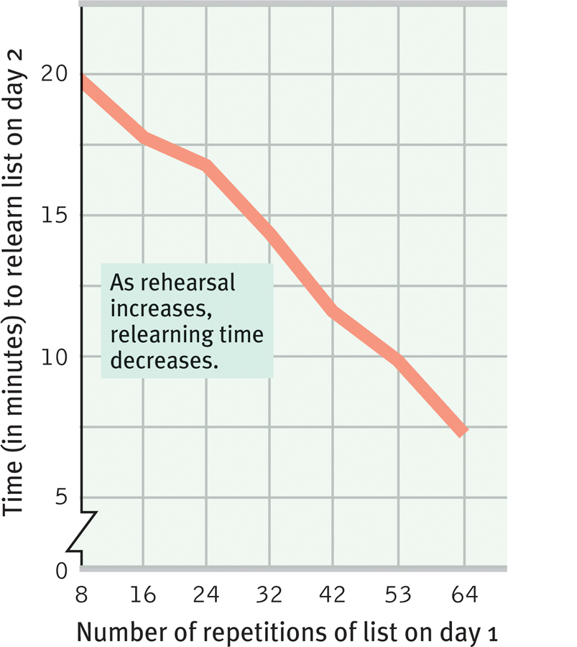
Relearning Time as a Measure of Retention
In the late 1800s, Hermann Ebbinghaus studied another measure of memory functioning: how much time does it take to relearn and regain mastery of material?
He studied the memorization of nonsense syllables (THB YOX KVU EHM) so that depth of processing or prelearning would not be a factor.
The more times he rehearsed out loud on day 1, the less time he needed to relearn/memorize the same letters on day 2.
Notes:
Click to reveal bullets.
Instructor: to introduce the slide (see below for questions you can ask that help rehearse previous concepts), you can say, “We can see in implicit memory, as well as our talent for recognizing faces we don’t consciously recall, that we may not be aware of all that we have in our memory. Another sign of subconscious memory is the demonstrated change in our ability to relearn material. If we can learn the material more easily the second day, we must have preserved some memory of the material, even if it’s nonsense syllables.”
Questions/comments to make after the third bullet:
what type of processing was Hermann Ebbinghaus doing?...effortful processing.
What does this show us about the best way to memorize?...repetition is useful.
However, remind students not to overgeneralize the results. This applies best to rote learning when there is no meaning and no way to do the deep processing.

Slide 31


Priming:
Retrieval is Affected by Activating our Associations
Priming triggers a thread of associations that bring us to a concept, just as a spider feels movement in a web and follows it to find the bug.
Our minds work by having one idea trigger another; this maintains a flow of thought.
Priming Example: Define the word “bark.”
Now what is the definition of “bark”?
Notes:
Click to reveal bullets. Click again to make the tree disappear. Click again to make the dog appear.
Instructor: the point of these images is to demonstrate priming by showing a tree with the texture of the bark clearly visible, and then showing a dog who could bark.

Slide 32



The Power of Priming
Priming has been called “invisible memory” because it affects us unconsciously.
In the case of tree “bark” vs. dog “bark,” the path we follow in our thoughts can be channeled by priming.
We may have biases and associations stored in memory that also influence our choices.
Study: People primed with money-related words were less likely to then help another person.
Study: Priming with an image of Santa Claus led kids to share more candy.
Study: people primed with a missing child poster then misinterpreted ambiguous adult-child interactions as kidnapping.
Notes:
Click to show three study examples.
Another hypothetical example of “invisible memory” priming that you can suggest to students: if a professor’s words, even everyday phrases, echo words that one of your parents said often, you may transfer feelings (good or bad or complex) from that parent to the professor. This may occur even if you don’t consciously recognize that your are being reminded of your parent, or even if you don’t consciously recall your parent’s words.

Slide 33
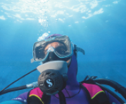
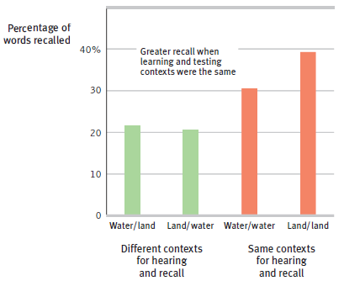
Context-Dependent Memory
Words learned underwater are better retrieved underwater.
Part of the web of associations of a memory is the context. What else was going on at the time we formed the memory?
We retrieve a memory more easily when in the same context as when we formed the memory.
  → Did you forget a psychology concept? Just sitting down and opening your book might bring the memory back.
Notes:
Click to reveal bullets.

Slide 34
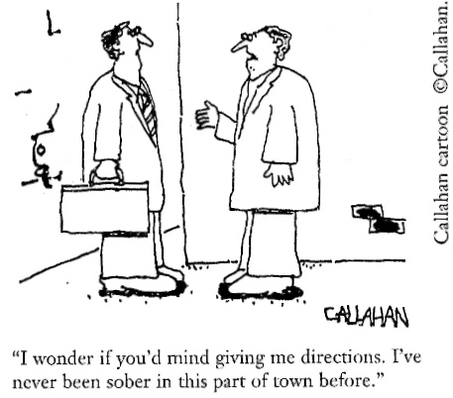
State-Dependent Memory
Memories can even be linked to physiological states:
Our memories are not just linked to the external context in which we learned them.
Memories can also be tied to the emotional state we were in when we formed the memory.
Mood-congruent memory refers to the tendency to selectively recall details that are consistent with one’s current mood.
  → This biased memory then reinforces our current mood!
“I wonder if you’d mind giving me directions. I’ve never been sober in this part of town before.”
Notes:
Click to reveal bullets.
Instructor: the first bullet point links this concept to previous concepts, and could be deleted from the slide.

Slide 35
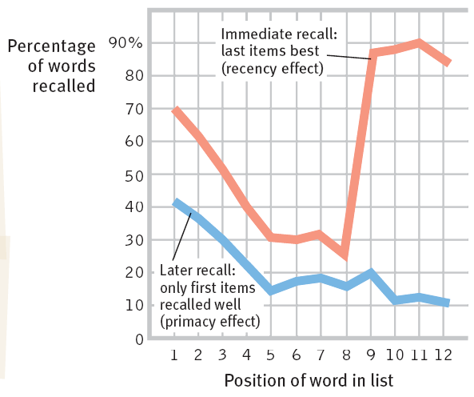
The Serial Position Effect
Priming and context cues are not the only factors which make memory retrieval selective.
The serial position effect refers to the tendency, when learning information in a long list, to more likely recall the first items (primacy effect) and the last items (recency effect).
In what situation is the recency effect strongest?
Which words of your national anthem are easiest to recall?
Notes:
Click to reveal bullets.
Instructor: the first bullet point links this concept to previous concepts, and could be deleted from the slide.
Ask students to analyze the graph to see when the primacy effect is strongest or most noticeable (during delayed, later recall, using long-term memory) and when the recency effect is strongest (during immediate recall, using working memory, as in conversations at a party right after learning the names of many people).
Regarding the national anthem question (which could be moved off the slide): see if you can bring out the serial position effect by asking students in your class room, ideally from more than one country of origin, to state the first four words, the last four words, and then any middle four words of their national anthem.
In this example, it may not just be an issue of how the information is encoded, but about retrieval cues. We can use the beginning or end of a song, or a list, as a context cue to recall the words right around that point. → To test this: ask students for the four words leading up to the highest or longest-sustained note in the song, and suddenly more words will come to mind.

Slide 36

“Forgetfulness is a form of freedom.”
Khalil Gibran
Jill Price (b. 1965) has hyperthymesia; she not only recalls everything, but is unable to forget anything.
For Jill, both the important and the mundane are always accessible, forming a “running movie” of images and information that run simultaneously with current stimuli.
She has said, “I’ll be talking to someone and [also] seeing something else….”
Jill Price, patient “A.J.”
Another possible problem if we were unable to forget: we might not focus well on current stimuli because of intrusive memories.
Notes:
Click to reveal bullets.
Instructor: you could ask students, “what do they think Khalil Gibran’s quotation means?” Perhaps he is implying that the ability to forget traumatic or discouraging memories can free us to choose our current outlook on life.
The discomfort with intrusive memories applies not only to people like Jill Price with this brain condition (known as hyperthymesia), but also to “memory athletes” who memorize huge amounts of data. It also applies to people with memories burned in by trauma or other emotional intensity or obsessive review/rehearsal.

Slide 37
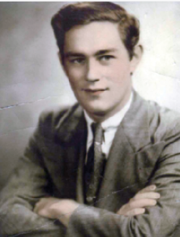

The Brain and the Two-Track Mind: The Case of Henry Molaison (“H.M.”)
In 1953, the removal of H.M.’s hippocampus at age 27 ended his seizures, but also ended his ability to form new explicit memories.
H.M. could learn new skills, procedures, locations of objects, and games, but had no memory of the lessons or the instructors. Why?
H.M. also retained memories from before the surgery. What is his condition called?
H.M., like another such patient, “Jimmy,” could not understand why his face looked older than 27 in the mirror. Why not?
Notes:
Click to reveal bullets.
This is an optional slide explaining some elements of the previous slide, and it also can be used in place of the following slide.
H.M. actually had more parts of the temporal lobe removed, including the amygdala and parahippocampal gyrus.
Regarding the “why” question in the second bullet: these are examples of implicit memories and automatic processing (learning his way around a neighborhood or house), and are processed in other parts of the brain. H.M.’s experience helped confirm where in the brain different kinds of memories are formed.
The name of the condition is anterograde amnesia, covered on the next slide.
H.M. and “Jimmy” could not understand the aging in the mirror because they had no memory of all the days that had passed; age 27 felt like yesterday (or today) to H.M.

Slide 38
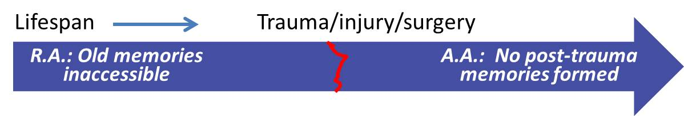
The Two Types of Amnesia
Retrograde amnesia refers to an inability to retrieve memory of the past.
Anterograde amnesia refers to an inability to form new long-term declarative/ explicit memories.
Retrograde amnesia can be caused by head injury or emotional trauma and is often temporary.
It can also be caused by more severe brain damage; in that case, it may include anterograde amnesia.
H.M. and Jimmy lived with no memories of life after surgery.
See also the movie Memento. Most other movie amnesia is retrograde amnesia.
Notes:
ClRetrograde amnesia refers to the inability to retrieve memory of the past.
“H.M.” and “Jimmy” suffered from hippocampus damage and removal causing anterograde amnesia, an inability to form new long-term declarative memories.
They had no sense that time had passed since the brain damage. While they were not forming new declarative memories, encoding was still happening in other processing “tracks.”
Jimmy and H.M. could still learn how to get places (automatic processing), could learn new skills (procedural memory), and acquire conditioned responses
However, they could not remember any experiences which created these implicit memories.
ick to reveal bullets under each definition and the diagram.

Slide 39
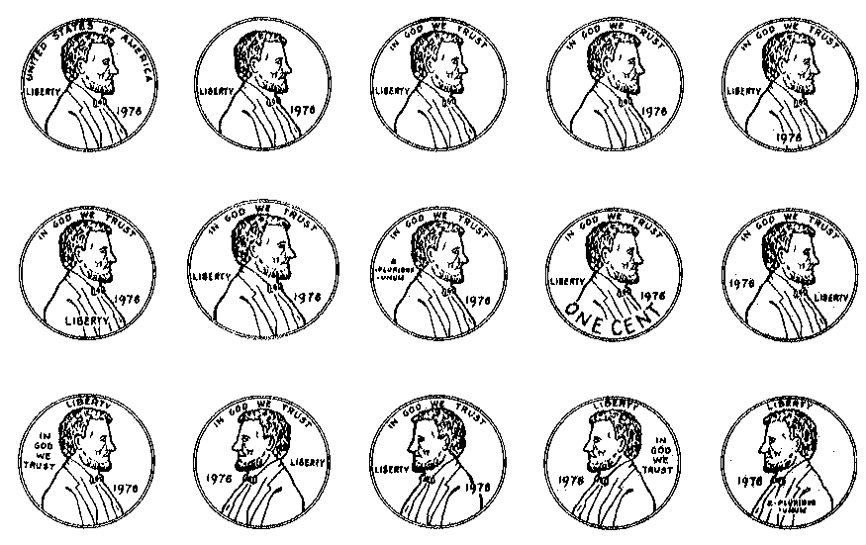
Penny Memory Test
Which of these has the design of an actual U.S. cent?
Retrieval test: what words and numbers, in which locations, are on the front of a U.S. one cent coin? This should be easy because it was in the book.
Recognition test: choose the correct design from among these pictures:
Notes:
Animation:
First line of the title is on the slide at the beginning.
Then the two bullets appear on click.
On another click, the bullets slowly fade as the second line of the title fades in and the pennies slowly come in (credits style?) from the bottom.
The illustration is from Nickerson and Adams, 1979, as cited in the text, although here I have the full set of options, and not just the six in the text.
Answer: the design of an actual U.S. cent is in the second row, second from the left.

Slide 40
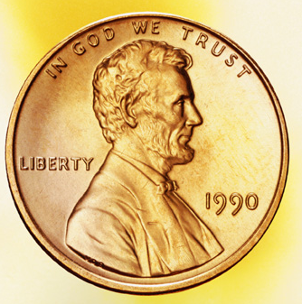
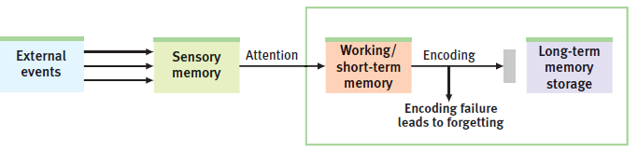
Encoding Failure
If we got the penny image wrong, did we fail to retrieve the information?
It could be that we never paid attention to the penny details and didn’t select them from sensory memory to hold in working memory.
Even if we once looked at the penny and paid attention to it, we still didn’t bother rehearsing it and encoding it into long term memory.
Notes:
Click to reveal bullets.
Instructor: you can add that encoding ability declines with age, as well as working memory in general. For this reason, long term memories may be more reliable, accurate and complete than newly learned memories.

Slide 41
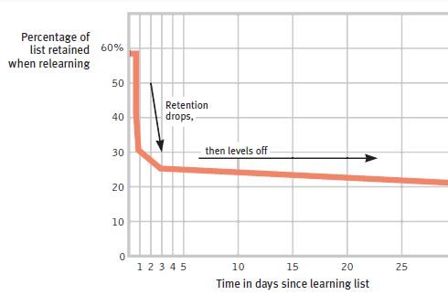
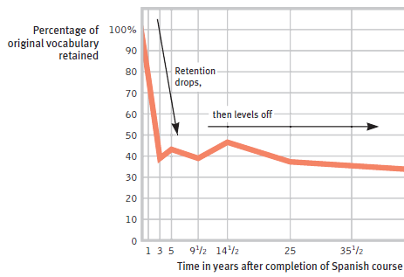
Storage Decay
Material encoded into long term memory will decay if the memory is never used, recalled, and re-stored.
Decay is LTP in reverse (or like pruning). Unused connections and networks wither while well-used memory traces are maintained.
Decay tends to level off. Memory for both nonsense syllables and Spanish lessons decays rapidly.
However, what hasn’t decayed quickly tends to stay intact long-term.
Notes:
Click to reveal bullets.
The first graph of the decay of nonsense syllables memorized by Hermann Ebbinghaus appears with the “decay tends to level off” bullet.
Another click brings the graph showing the decay of Spanish lessons, followed automatically by the last bullet.

Slide 42
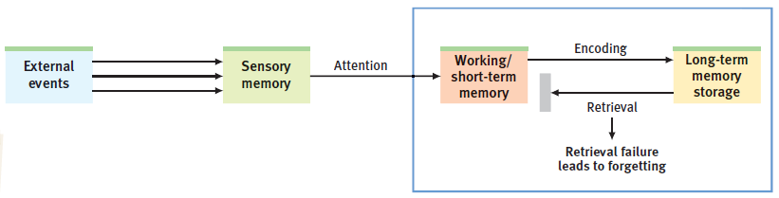
Tip of the Tongue: Retrieval Failure
Sometimes, the memory itself does not decay. Instead, what decays are the associations and links that help us find our way to the stored memory.
As a result, some stored memories seem just below the surface: “I know the name...it starts with a B maybe…”
To prevent retrieval failure when storing and rehearsing memories, you can build multiple associations, linking images, rhymes, categories, lists, and cues.
Notes:
Click to reveal bullets.
This retrieval failure is prominent in dementia, when connections across the brain are breaking down and even everyday words and the names of friends can be hard to retrieve. Psychotherapy can slow the functional impairment by helping develop habits of priming and cuing, and building new pathways and associations to reconsolidate and help retrieve memories.

Slide 43
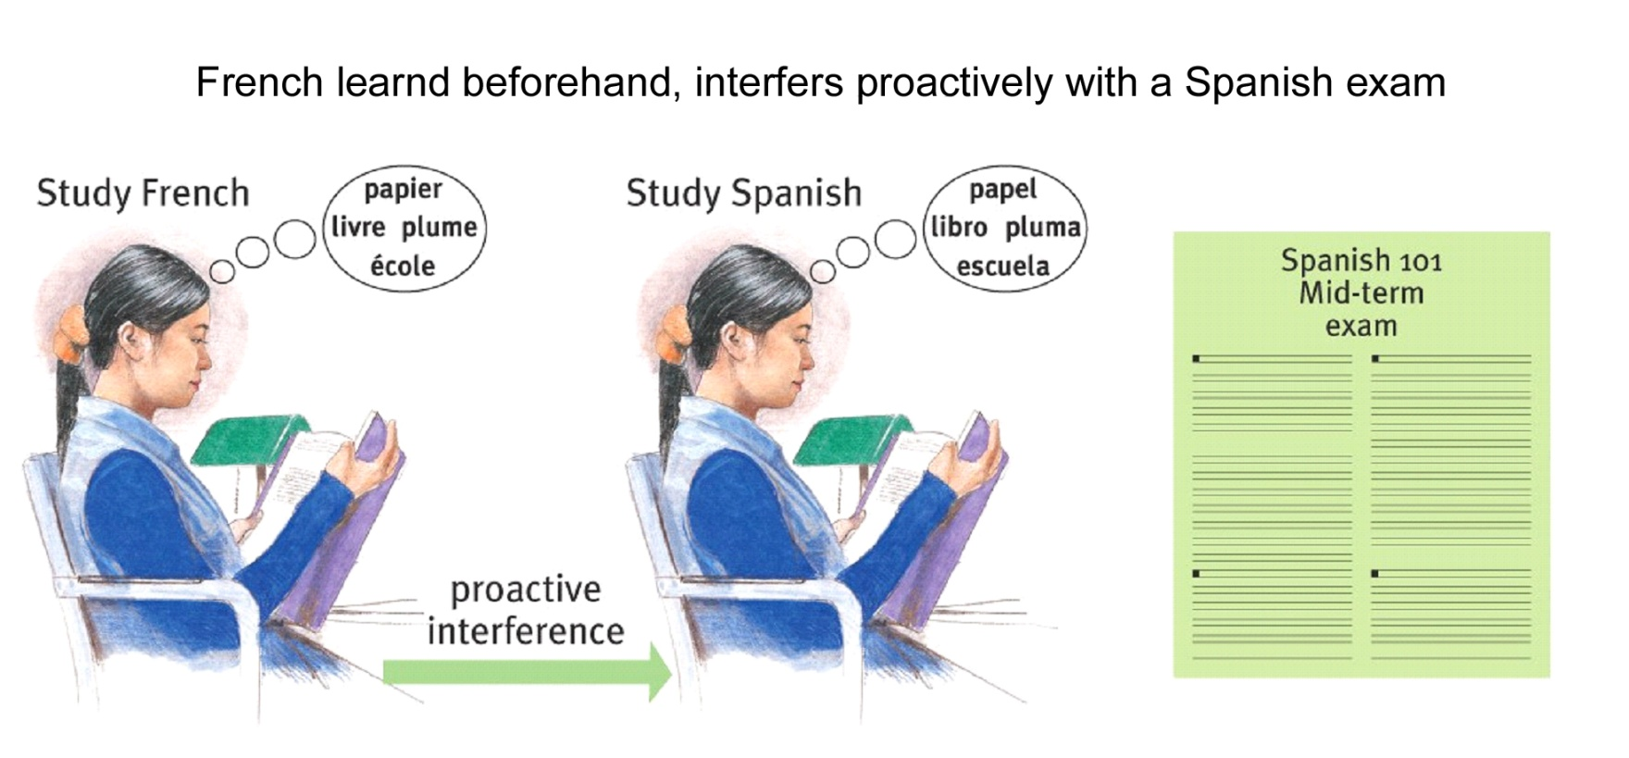
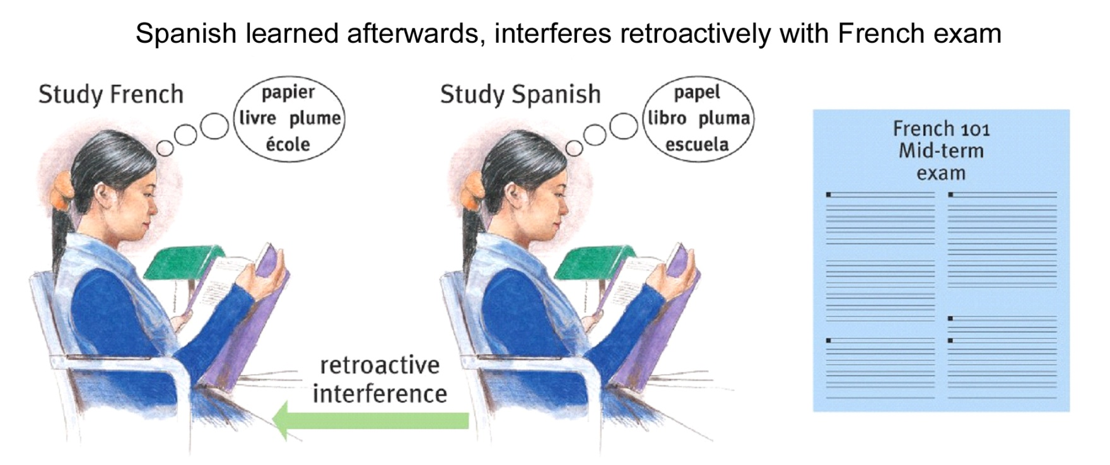
Proactive & Retroactive Interference
Learning some new information may disrupt
retrieval of other information.
Notes:
OBJECTIVE 21| Contrast proactive and retroactive interference, and explain how they can cause retrieval failure.

Slide 44
Interference and Positive Transfer
Another downside of not forgetting is that old and new memories can interfere with each other, making it difficult to store new memories and retrieve old ones.
Occasionally, the opposite happens. In positive transfer, old information (like algebra) makes it easier to learn related new information (like calculus).
Proactive interference occurs when past information interferes (in a forward-acting way) with learning new information.
  You have many strong memories of a previous principal, and this memory makes it difficult to learn the new principal’s name.
  You had to change email passwords, but you keep typing the old one and can’t seem to memorize the new one.
Notes:
Click to reveal bullets.
To introduce this topic, you might say, “although our memory storage never gets full, the fact that memories overlap across the brain means that they can interfere with each other’s storage and retrieval.”

Slide 45
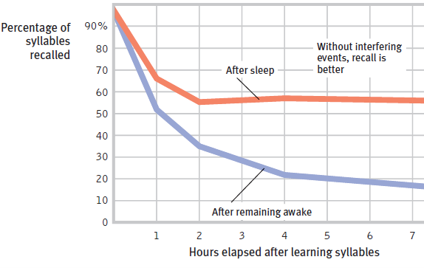
Retroactive Interference and Sleep
Retroactive interference occurs when new stimuli/learning interferes with the storage and retrieval of previously formed memories.
In one study, students who studied right before eight hours of sleep had better recall than those who studied before eight hours of daily activities.
The daily activities retroactively interfered with the morning’s learning.
Notes:
Click to reveal definition and bullets.

Slide 46
Motivated Forgetting
Memory is fallible and changeable, but can we practice motivated forgetting, that is, choosing to forget or to change our memories?
Sigmund Freud believed that we sometimes make an unconscious decision to bury our anxiety-provoking memories and hide them from conscious awareness. He called this repression.
New techniques of psychotherapy and medication interventions may allow us to “erase” (prevent reconsolidation of) recalled memories.
Motivated forgetting is not common. More often:
recall is full of errors.
people try not to think about painful memories. If they fail to rehearse those memories, the memories can fade.
Notes:
Click to reveal bullets.

Slide 47
Why is our memory full of errors?
Memory not only gets forgotten, but it gets constructed (imagined, selected, changed, and rebuilt).
Memories are altered every time we “recall” (actually, reconstruct) them. Then they are altered again when we reconsolidate the memory (using working memory to send them into long term storage).
Later information alters earlier memories.
No matter how accurate and video-like our memory seems, it is full of alterations.
Ways in which our memory ends up being an inaccurate guide to the past:
the misinformation effect
imagination inflation
source amnesia
déjà vu
implanted memories
Notes:
Click to reveal bullets.

Slide 48
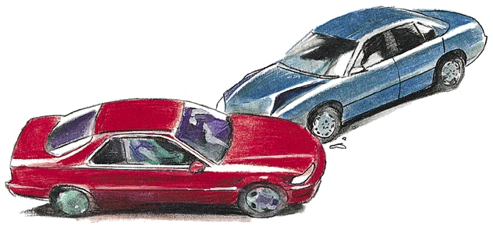
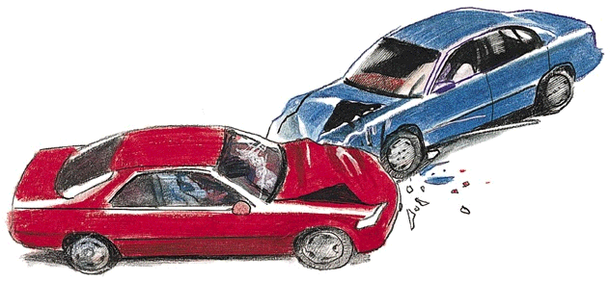
The Misinformation Effect:
The Misinformation Effect:
Incorporating misleading information into one’s memory of an event.
In 1974, Elizabeth Loftus and John Palmer asked people to watch a video of a minor car accident. The participants were then asked, “How fast were cars going when they hit each other?”
Those who were asked, “...when the cars smashed into each other?” reported higher speeds and remembered broken glass that wasn’t there.
Actual accident
Misremembered accident
Notes:
Click through to reveal all text and animation.
Instructor: you can introduce this topic by saying, “a change in the way a question is asked can change the memory that is reported.”

Slide 49
Implanted Memories
Imagination Inflation
Simply picturing an event can make it seem like a real memory.
Once we have an inaccurate memory, we tend to add more imagined details, as perhaps we do for all memories.
Why does this happen? Visualizing and actually seeing an event activate similar brain areas.
In one study, students were told a false story that spoiled egg salad had made them ill in childhood. As a result, many students became [even] less likely to eat egg salad sandwiches in the future.
In a study by Elizabeth Loftus, people were asked to provide details of a incident in childhood when they had been lost in a shopping mall.
Even though there actually had been no such incident, by trying to picture details, most people came to believe that the incident had actually happened.
Lessons:
By trying to help someone recall a memory, you may implant a memory.
You can’t tell how real a memory is by how real it feels.
Notes:
Click to reveal arrows and sidebar.

Slide 50
Source Amnesia/Misattribution
Have you ever discussed a childhood memory with a family member only to find that the memory was:
from a movie you saw, or book you read?
from a story someone told you about your childhood, but they were kidding?
from a dream you used to have?
from a sibling’s experience?
If so, your memory for the event may have been accurate, but you experienced source amnesia: forgetting where the story came from, and attributing the source to your own experience.
Notes:
Click to reveal bullets.

Slide 51
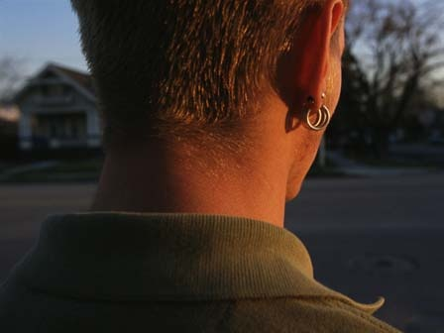
Déjà vu (“Already seen”)
Déjà vu refers to the feeling that you’re in a situation that you’ve seen or have been in before.
In an experiment in the text, students got this feeling, because they actually were shown an image previously.
However, we can feel very certain that we’ve seen a situation before even when we have not. This can be seen as source amnesia: a memory (from current sensory memory) that we misattribute as being from long term memory.
Why does this happen? Sometimes our sense of familiarity and recognition kicks in too soon, and our brain explains this as being caused by prior experience.
Notes:
Click to reveal bullets.
Instructor: you could make a joke about déjà vu by putting this slide on screen twice and see if students notice. However, that wouldn’t really be déjà vu. To possibly trigger an actual mistaken feeling of having seen something before, the title of this slide will flash (on and off quickly) before coming on screen to stay. After the definition appears, you can say, with intentionally ambiguous wording and memory-implanting questioning: “you may be having déjà vu right now. But there’s a trick. How many of you noticed that I briefly flashed these words on screen earlier today?” Technically, you did: the title flashed. See if students get a false memory, a déjà vu feeling of having seen the definition on screen before.

Slide 52

Applying what we’ve learned about memory
Improving Memory to Improve Grades
Ways to save overall studying time, and build more reliable memory.
Learn the material in more than one way, not just by rote, but by creating many retrieval cues.
  Think of examples and connections (meaningful depth).
  Create mnemonics: songs, images, and lists.
Minimize interference with related material or fun activities; study right before sleep or other mindless activity.
Have multiple study sessions, spaced further and further apart after first learning the material.
Spend your study sessions activating your retrieval cues including context (recalling where you were when learning the material).
Test yourself in study sessions: 1) to practice doing retrieval as if taking a test, and 2) to overcome the overconfidence error: the material seems familiar, but can you explain it in your own words?
Notes:
Click to reveal bullets.

