Slide 1
Types of Learning
Classical conditioning: learning to link two stimuli in a way that helps us anticipate an event to which we have a reaction
Operant conditioning: changing behavior choices in response to consequences
Cognitive learning: acquiring new behaviors and information through observation and information, rather than by direct experience
Notes:
Automatic animation.
There are millions of sensory neurons and millions of motor neurons, but BILLIONS of interneurons.

Slide 2
Associative Learning I
Learning to associate one stimulus
with another.

Slide 3
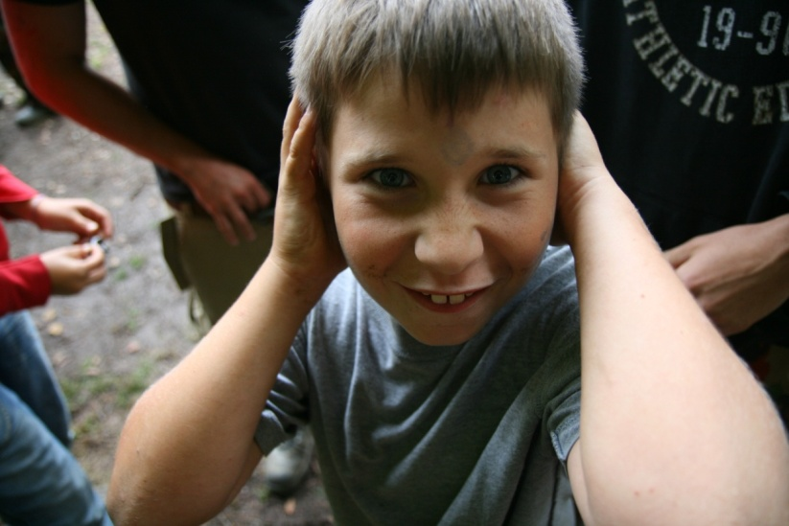
Associative Learning:
Classical Conditioning
Stimulus 1: See lightning
How it works: after repeated exposure to two stimuli occurring in sequence, we associate those stimuli with each other.
Result: our natural response to one stimulus now can be triggered by the new, predictive stimulus.
Stimulus 2: Hear thunder
Here, our response to thunder becomes associated with lightning.
After Repetition
Stimulus: See lightning
Response: Cover ears to avoid sound
Notes:
Click to start animated example (let it play out).
Instructor: another example of classical conditioning in which we learn from experience occurs when conditioning helps us associate “BEEEP” with an approaching car. The BEEP sound soon is as alarming as the car. Without this learning, cars might run us over.
Another example of classical conditioning: military service personnel who hear a mortar launch sound “thoom” followed by a violent explosion nearby may learn to associate those two stimuli. As a result, at fireworks, even when they know there is no danger, the launch of fireworks sometimes still triggers a “duck and cover” reaction.

Slide 4
Associative Learning II
Learning to associate a response
with a consequence.

Slide 5
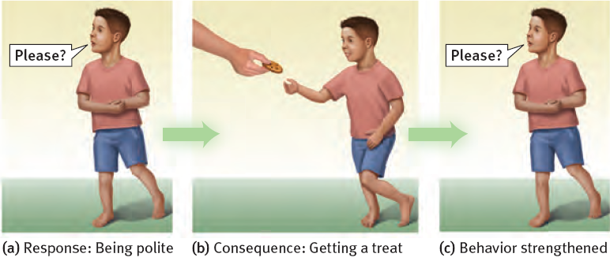
Associative Learning: Operant Conditioning
Child associates his “response” (behavior) with consequences.
Child learns to repeat behaviors (saying “please”) which were followed by desirable results (cookie).
Child learns to avoid behaviors (yelling “gimme!”) which were followed by undesirable results (scolding or loss of dessert).
Notes:
No animation.

Slide 6
Cognitive Learning
Cognitive learning refers to acquiring new behaviors and information mentally, rather than by direct experience.
Cognitive learning occurs:
by observing events and the behavior of others.
by using language to acquire information about events experienced by others.
Notes:
No animation.

Slide 7
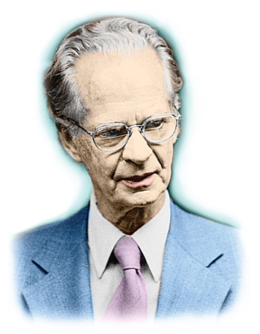
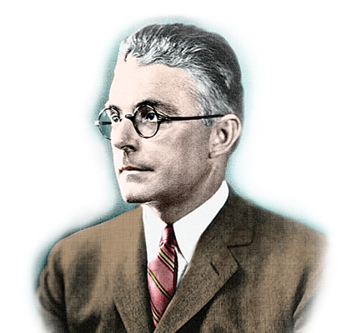
Behaviorism
The term behaviorism was used by John B. Watson (1878-1958), a proponent of classical conditioning, as well as by B.F. Skinner (1904-1990), a leader in research about operant conditioning.
Both scientists believed the mental life was much less important than behavior as a foundation for psychological science.
Both foresaw applications in controlling human behavior:
Skinner conceived of utopian communities.
Watson went into advertising (based on poor decision making).
Notes:
Click to reveal bullets.

Slide 8
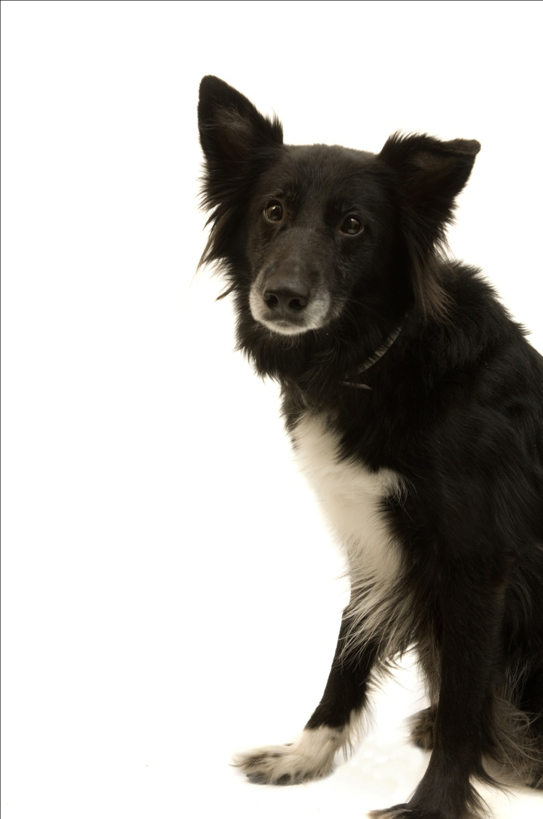
Ivan Pavlov’s Discovery
While studying salivation in dogs, Ivan Pavlov found that salivation from eating food was eventually triggered by what should have been neutral stimuli such as:
just seeing the food.
seeing the dish.
seeing the person who brought the food.
just hearing that person’s footsteps.
Notes:
Click to reveal bullets.
Instructor, you can add verbally:
“The dog had learned that these stimuli predicted the arrival food. These neutral stimuli had become conditioned stimuli.”
Ivan Pavlov then performed controlled experiments yielding much of the knowledge about conditioning still used today.

Slide 9
Before Conditioning
Neutral stimulus:
a stimulus which does not trigger a response
Neutral
stimulus (NS)
No response
Notes:
Click to start animation.

Slide 10
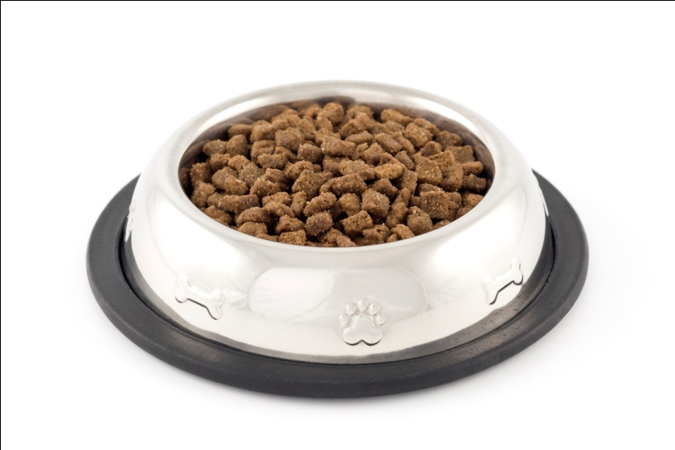
Before Conditioning
Unconditioned stimulus and response:
a stimulus which triggers a response naturally,
before/without any conditioning
Unconditioned response (UR):
dog salivates
Unconditioned
stimulus (US): yummy dog food
Notes:
Click to start animation.
Ivan Pavlov’s dogs exhibited salivation (UR) in response to food (US).

Slide 11
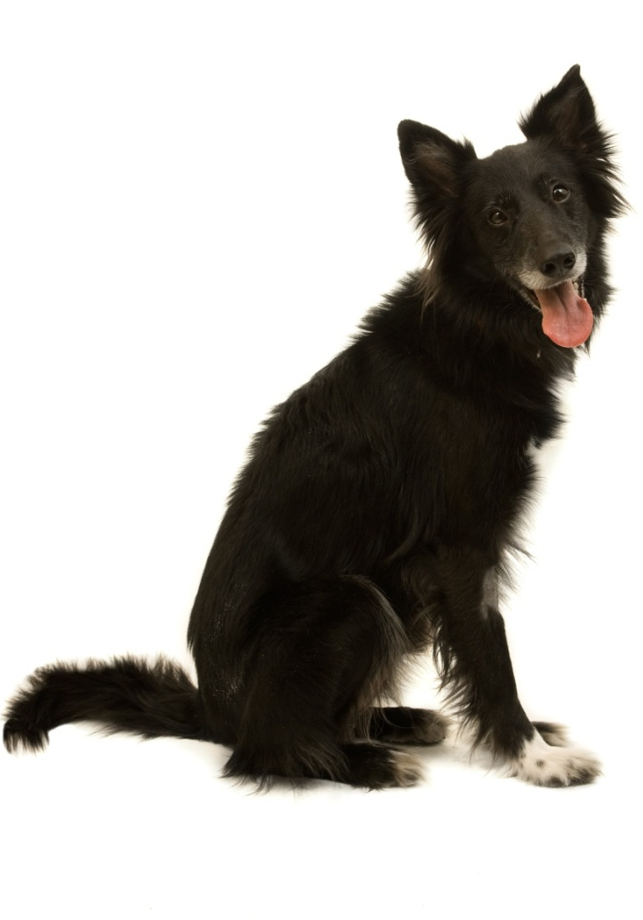
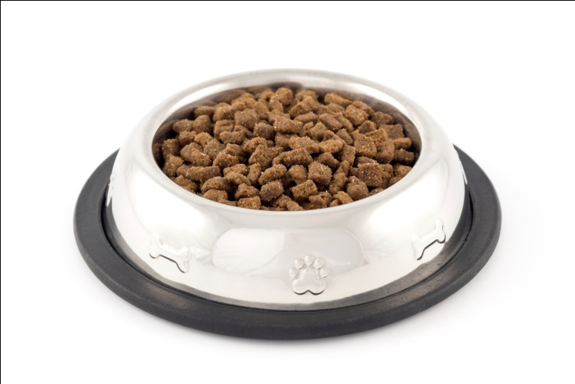
During Conditioning
The bell/tone (N.S.) is repeatedly presented with the food (U.S.).
Neutral
stimulus (NS)
Unconditioned response (UR):
dog salivates
Unconditioned
stimulus (US)
Notes:
Click to start animation.
Ivan Pavlov then presented a tone (NS) just before presenting the food (US).
APA Learning Goal 1: Knowledge Base of Psychology

Slide 12
After Conditioning
The dog begins to salivate upon hearing the tone (neutral stimulus becomes conditioned stimulus).
Did you follow the changes?
The UR and the CR are the same response, triggered by different events.
The difference is whether conditioning was necessary for the response to happen.
The NS and the CS are the same stimulus.
The difference is whether the stimulus triggers the conditioned response.
Conditioned response:
dog salivates
Conditioned (formerly neutral)
stimulus
Notes:
Click to start animation. Click again to show recap.
After a few pairings, the NS (tone) became a CS, and it was able to produce a CR (salivation) by itself.

Slide 13
Pavlov’s Experiments
Before conditioning, food (Unconditioned Stimulus, US) produces salivation (Unconditioned Response, UR). However, the tone (neutral stimulus) does not.
Notes:
Preview Question 3: How does a neutral stimulus become a CS, and what are the processes of acquisition, extinction, spontaneous recovery, generalization, and discrimination in classical conditioning?

Slide 14
Pavlov’s Experiments
During conditioning, the neutral stimulus (tone) and the US (food) are paired, resulting in salivation (UR). After conditioning, the neutral stimulus (now Conditioned Stimulus, CS) elicits salivation (now Conditioned Response, CR)

Slide 15
Find the US, UR, NS, CS, CR in the following:
Your romantic partner always uses the same shampoo. Soon, the smell of that shampoo makes you feel happy.
The door to your house squeaks loudly when you open it. Soon, your dog begins wagging its tail when the door squeaks.
The nurse says, “This won’t hurt a bit,” just before stabbing you with a needle. The next time you hear “This won’t hurt,” you cringe in fear.
You have a meal at a fast food restaurant that causes food poisoning. The next time you see a sign for that restaurant, you feel nauseated.
Notes:
No animation.

Slide 16
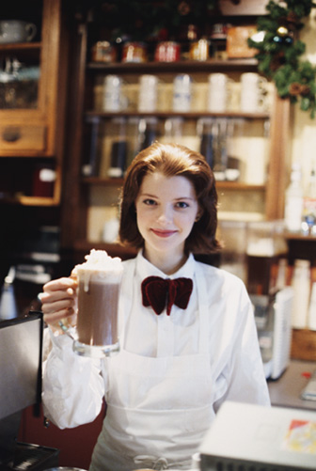
Higher-Order Conditioning
If the dog becomes conditioned to salivate at the sound of a bell, can the dog be conditioned to salivate when a light flashes…by associating it with the BELL instead of with food?
Yes! The conditioned response can be transferred from the US to a CS, then from there to another CS.
This is higher-order conditioning: turning a NS into a CS by associating it with another CS.
→A man who was conditioned to associate joy with coffee, could then learn to associate joy with a restaurant if he was served coffee there every time he walked in to the restaurant.
Notes:
Click to reveal bullets.

Slide 17
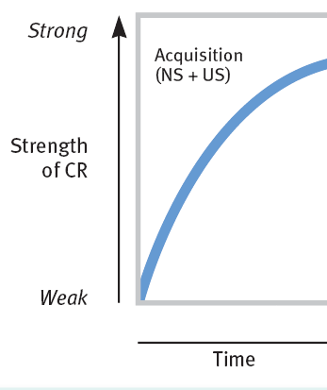
Acquisition
Acquisition refers to the initial stage of learning/conditioning.
What gets “acquired”?
→ The association between a neutral stimulus (NS) and an unconditioned stimulus (US).
How can we tell that acquisition has occurred?
→ The UR now gets triggered by a CS
(drooling now gets triggered by a bell).
Timing
For the association to be acquired,
the neutral stimulus (NS) needs to repeatedly appear before the unconditioned stimulus (US)…about a half-second before, in most cases. The bell must come right before the food.
Notes:
Click to reveal text boxes.
Instructor, some discussion prompts:
“In the “acquisition graph,” what does “strength” mean?” [Answer: it refers to the strength of the association between NS and US, as measured by the likelihood and intensity of the unconditioned response (drooling) now being triggered by the former neutral (now conditioned) stimulus (the bell). More drooling = more strength.
Timing issue: why wouldn’t it work if we rang the bell AFTER presenting the food?...because our bodies/brains are not set up to work that way. Why not?...conditioning allows us to prepare for benefits or threats; a bell after the food wouldn’t predict anything..
An exception to the half-second rule is food aversion, coming up in a later slide.

Slide 18
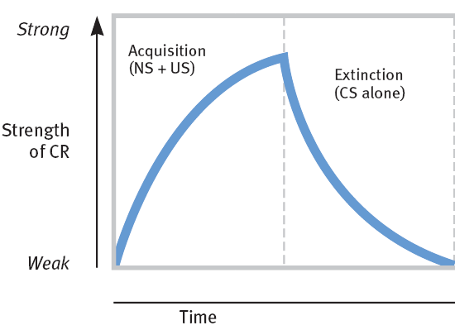
Acquisition and Extinction
The strength of a CR grows with conditioning.
Extinction refers to the diminishing of a conditioned response. If the US (food) stops appearing with the CS (bell), the CR decreases.
Notes:
No animation.

Slide 19
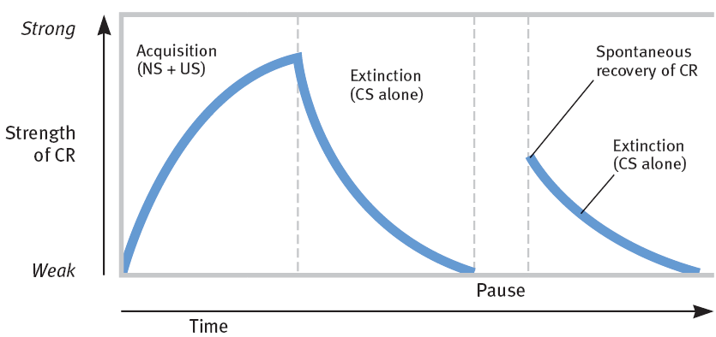
Spontaneous Recovery [Return of the CR]
After a CR (salivation) has been conditioned and then extinguished:
following a rest period, presenting the tone alone might lead to a spontaneous recovery (a return of the conditioned response despite a lack of further conditioning).
if the CS (tone) is again presented repeatedly without the US, the CR becomes extinct again.
Notes:
No animation.
Instructor: one implication of spontaneous recovery is that a behavior therapist may think that a phobic reaction has been extinguished, by repeatedly presenting the phobic stimulus without anything bad happening. However, after a rest from treatment, the phobic reaction can return. One solution is counterconditioning in order to build a new association.

Slide 20
Generalization and Discrimination Please notice the narrow, psychological definition .
Ivan Pavlov conditioned dogs to drool when rubbed; they then also drooled when scratched.
Ivan Pavlov conditioned dogs to drool at bells of a certain pitch; slightly different pitches did not trigger drooling.
Generalization refers to the tendency to have conditioned responses triggered by related stimuli.
Discrimination refers to the learned ability to only respond to a specific stimuli, preventing generalization.
MORE stuff makes you drool.
LESS stuff makes you drool.
Notes:
Click to show generalization and then discrimination sequences.
There are possible evolutionary values for each of these aspects of conditioning.
Generalization: if a leopard roars and then bites you, it might help you survive if you avoid other large cats who roar, and maybe the ones who growl too. → Abused children have been found to generally fear any angry face.
You also can apply your associations to related situations. If you get hurt by a Colt 45, watch out for ALL guns
Discrimination: if hearing your mother’s voice comes right before getting fed, it might help you to survive if you recognize and distinguish your mother’s voice from among a group of people. → Therapy can help anxious people stop having fears triggered by safe stimuli.
You learn to react only when it’s appropriate. For example you fear guns, but not someone pointing a finger at you, and you don’t develop an aversion to ALL food.

Slide 21
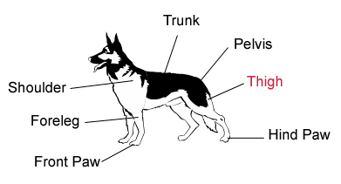
Stimulus Generalization
Tendency to respond to stimuli similar to the CS is called generalization. Pavlov conditioned the dog’s salivation (CR) by using miniature vibrators (CS) on the thigh. When he subsequently stimulated other parts of the dog’s body, salivation dropped.

Slide 22
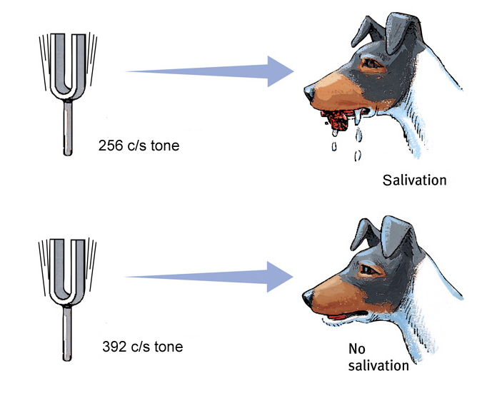
Stimulus Discrimination
Discrimination is the learned ability to distinguish between a conditioned stimulus and other stimuli that do not signal an unconditioned stimulus.

Slide 23
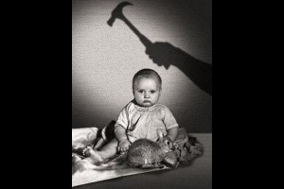
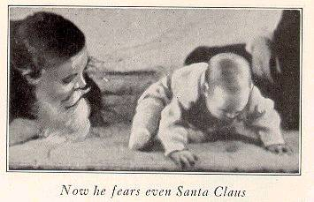
The Little Albert Experiment

Slide 24
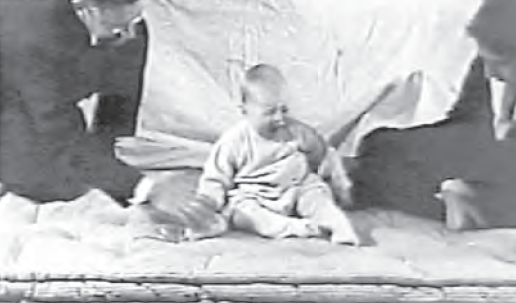
John B. Watson and Classical Conditioning: Playing with Fear
In 1920, 9-month-old Little Albert was not afraid of rats.
John B. Watson and Rosalie Rayner then clanged a steel bar every time a rat was presented to Albert.
Albert acquired a fear of rats, and generalized this fear to other soft and furry things.
Watson prided himself in his ability to shape people’s emotions. He later went into advertising.
Notes:
Click to reveal bullets.
A different application of classical conditioning would include working with phobias; not just creating them, but eliminating them.
Exposure to a conditioned stimulus (such as a store where panic attacks have occurred) without UR (the panic attack) can extinguish phobias, but to prevent spontaneous recovery, counterconditioning must occur (associating the store with a relaxed state).

Slide 25
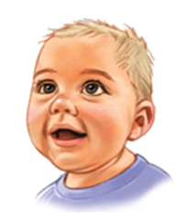
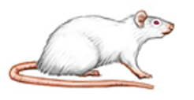
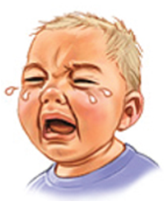
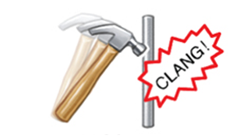
Little Albert Experiment
Before Conditioning
No fear
NS: rat
UCS: steel bar hit with hammer
Natural reflex:
fear
Notes:
Automatic animation (top half sequence).
Click to reveal bottom half sequence.

Slide 26
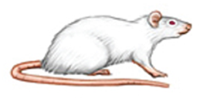
Little Albert Experiment
UCS: steel bar hit with hammer
NS: rat
Natural reflex:
fear
During Conditioning
Notes:
Automatic animation.

Slide 27
Little Albert Experiment
NS: rat
Conditioned reflex:
fear
After Conditioning
Notes:
Automatic animation.

Slide 28
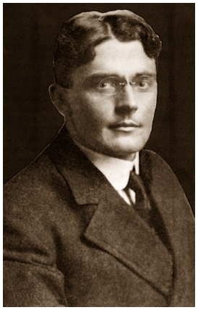
Applications of Classical Conditioning
Watson used classical conditioning procedures to develop advertising campaigns for a number of organizations, including Maxwell House, making the “coffee break” an American custom.
John B. Watson

Slide 29
Extending Pavlov’s Understanding
Pavlov and Watson considered consciousness, or mind, unfit for the scientific study of psychology. However, they underestimated the importance of cognitive processes and biological constraints.
Notes:
Preview Question 5: Do cognitive processes and biological constraints affect classical conditioning?

Slide 30
Cognitive Processes
Early behaviorists believed that learned behaviors of various animals could be reduced to mindless mechanisms.
However, later behaviorists suggested that animals learn the predictability of a stimulus, meaning they learn expectancy or awareness of a stimulus (Rescorla & Wagner, 1972).

Slide 31
Biological Predispositions
Pavlov and Watson believed that laws of learning were similar for all animals. Therefore, a pigeon and a person do not differ in their learning.
However, behaviorists later suggested that learning is constrained by an animal’s biology.

Slide 32
Biological Predispositions
Garcia showed that the duration between the CS and the US may be long (hours), but yet result in conditioning. A biologically adaptive CS (taste) led to conditioning but other stimuli (sight or sound) did not.
Courtesy of John Garcia
John Garcia

Slide 33
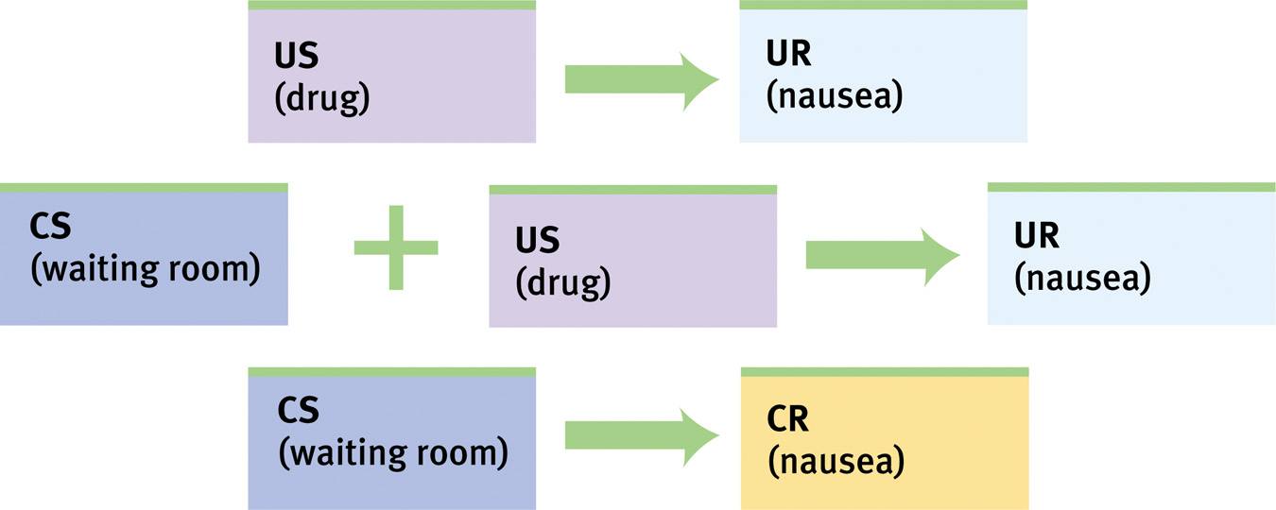
Biological Predispositions
Even humans can develop classically to conditioned nausea.

Slide 34
Ivan Pavlov’s Legacy
Insights about conditioning in general
It occurs in all creatures.
It is related to biological drives and responses.
Insights about science
Learning can be studied objectively, by quantifying actions and isolating elements of behavior.
Insights from specific applications
Substance abuse involves conditioned triggers, and these triggers (certain places, events) can be avoided or associated with new responses.
Notes:
No animation.
A different application of classical conditioning might include working with phobias...not just creating them, but eliminating them.
Exposure to a conditioned stimulus (such as a store where panic attacks have occurred) without the UR (the panic attack) can extinguish phobias. However, to prevent spontaneous recovery, counterconditioning must occur (associating the store with a relaxed state).

Slide 35
Operant Conditioning
Operant conditioning involves adjusting to the consequences of our behaviors, so we can easily learn to do more of what works, and less of what doesn’t work. Examples →
We may smile more at work after this repeatedly gets us bigger tips.
We learn how to ride a bike using the strategies that don’t make us crash.
How it works:
An act of chosen behavior (a “response”) is followed by a reward or punitive feedback from the environment.
Results:
Reinforced behavior is more likely to be tried again.
Punished behavior is less likely to be chosen in the future.
Response: balancing a ball
Consequence: receiving food
Behavior strengthened
Notes:
Click to reveal bullets and example.
Instructor: the word “strengthened” is used here to refer to making the behavior happen more frequently, more intensely, or in the case of the seals, more accurately and reliably.

Slide 36
Classical conditioning:
Operant and Classical Conditioning are Different Forms of Associative Learning
Operant conditioning:
involves respondent behavior, reflexive, automatic reactions such as fear or craving
these reactions to unconditioned stimuli (US) become associated with neutral (then→conditioned) stimuli
involves operant behavior, chosen behaviors which “operate” on the environment
these behaviors become associated with produced consequences which punish (decrease) or reinforce (increase) the operant behavior
There is a contrast in the process of conditioning.
The experimental (neutral) stimulus repeatedly precedes the respondent behavior, and eventually triggers that behavior.
The experimental (consequence) stimulus repeatedly follows the operant behavior, and eventually punishes or reinforces that behavior.
Notes:
Click to reveal all bullets.

Slide 37
Skinner’s Experiments
Skinner’s experiments extend Thorndike’s thinking, especially his Law of Effect. This law states that rewarded behavior is likely to occur again.

Slide 38
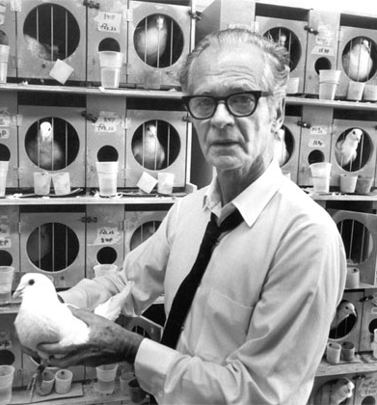
B.F. Skinner: Behavioral Control
B. F. Skinner saw potential for exploring and using Edward Thorndike’s principles much more broadly. He wondered:
how can we more carefully measure the effect of consequences on chosen behavior?
what else can creatures be taught to do by controlling consequences?
what happens when we change the timing of reinforcement?
B.F. Skinner trained pigeons to play ping pong, and guide a video game missile.
Notes:
Click to reveal bullets.
B.F. Skinner, unlike John B. Watson, did not go into advertising to use his ideas. Instead, Skinner envisioned societies where desired behaviors were deliberately shaped with reinforcement. Skinner is well known for his books Walden Two (1948) and Beyond Freedom and Dignity (1971).

Slide 39
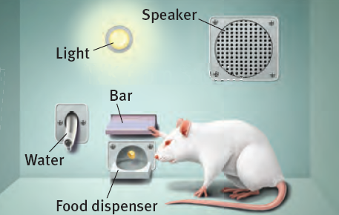
B.F. Skinner: The Operant Chamber
B. F. Skinner, like Ivan Pavlov, pioneered more controlled methods of studying conditioning.
The operant chamber, often called “the Skinner box,” allowed detailed tracking of rates of behavior change in response to different rates of reinforcement.
Recording device
Bar or lever that an animal presses, randomly at first, later for reward
Food/water dispenser to provide the reward
Notes:
Click to reveal bullets.

Slide 40
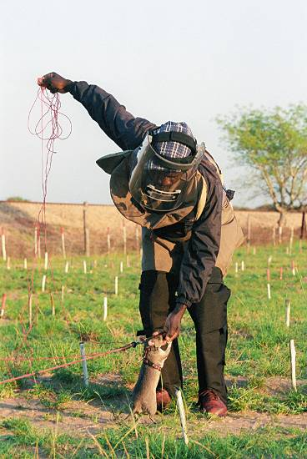
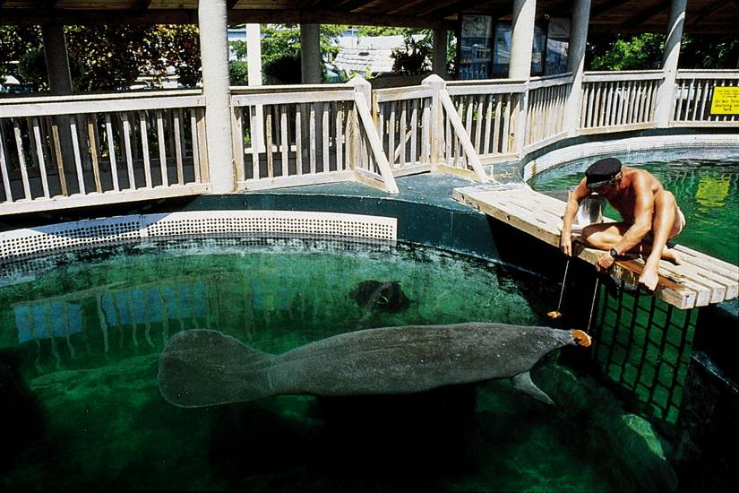
Shaping
Shaping is the operant conditioning procedure in which reinforcers guide behavior towards the desired target behavior through successive approximations.
A rat shaped to sniff mines. A manatee shaped to discriminate
objects of different shapes, colors and sizes.

Slide 41
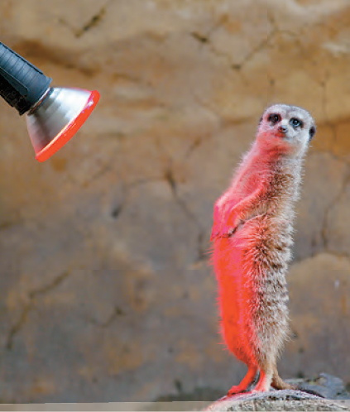
Reinforcement
Reinforcement refers to any feedback from the environment that makes a behavior more likely to recur.
Positive (adding) reinforcement: adding something desirable (e.g., warmth)
Negative (taking away) reinforcement: ending something unpleasant (e.g., the cold)
This meerkat has just completed a task out in the cold
Word up!
For the meerkat, this warm light is desirable.
Notes:
Click to reveal bullets.
You can give students a preview of upcoming concepts by pointing out that taking the warm light away from the meerkat could be used as a punishment (a negative punishment, because it’s taking something away).

Slide 42
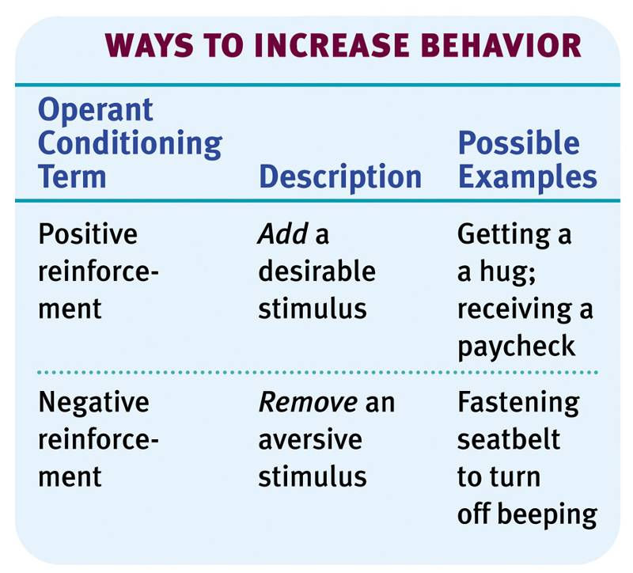
Types of Reinforcers
Notes:
Preview Question 9: What are the basic types of reinforcers?

Slide 43
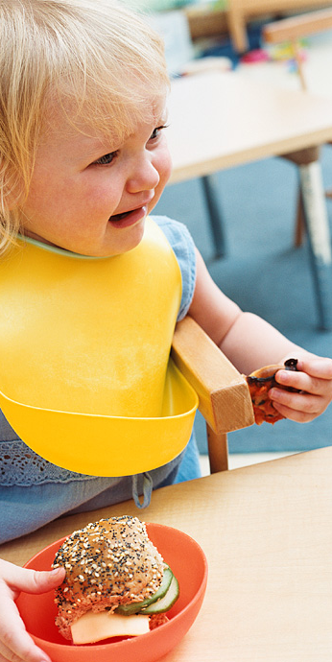
A cycle of mutual reinforcement
Children who have a temper tantrum when they are frustrated may get positively reinforced for this behavior when parents occasionally respond by giving in to a child’s demands.
Result: stronger, more frequent tantrums
Parents who occasionally give in to tantrums may get negatively reinforced when the child responds by ending the tantrum.
Result: parents giving-in behavior is strengthened (giving in sooner and more often)
Notes:
Click to reveal bullets.

Slide 44
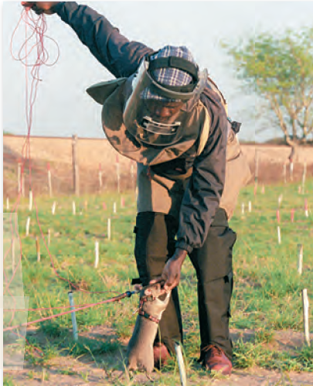
Discrimination
Discrimination refers to the ability to become more and more specific in what situations trigger a response.
Shaping can increase discrimination, if reinforcement only comes for certain discriminative stimuli.
For examples, dogs, rats, and even spiders can be trained to search for very specific smells, from drugs to explosives.
Pigeons, seals, and manatees have been trained to respond to specific shapes, colors, and categories.
Bomb-finding rat
Manatee that selects shapes
Notes:
Click to reveal bullets.

Slide 45
Primary & Secondary Reinforcers
Primary Reinforcer: An innately reinforcing stimulus like food or drink.
Secondary Reinforcer: A learned reinforcer that gets its reinforcing power through association with the primary reinforcer.

Slide 46
Immediate & Delayed Reinforcers
Immediate Reinforcer: A reinforcer that occurs instantly after a behavior. A rat gets a food pellet for a bar press.
Delayed Reinforcer: A reinforcer that is delayed in time for a certain behavior. A paycheck that comes at the end of a week.
We may be inclined to engage in small immediate reinforcers (watching TV) rather than large delayed reinforcers (getting an A in a course) which require consistent study.

Slide 47
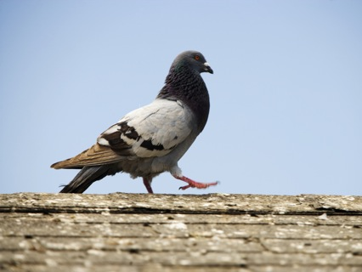
How often should we reinforce?
Do we need to give a reward every single time? Or is that even best?
B.F. Skinner experimented with the effects of giving reinforcements in different patterns or “schedules” to determine what worked best to establish and maintain a target behavior.
In continuous reinforcement (giving a reward after the target every single time), the subject acquires the desired behavior quickly.
In partial/intermittent reinforcement (giving rewards part of the time), the target behavior takes longer to be acquired/established but persists longer without reward.
Notes:
Click to reveal bullets.
A pigeon given a reward sometimes for pecking a key, later pecked 150,000 times without getting a reward. Trying to think like this pigeon: if the reward sometimes comes even after not showing up for a while, maybe the 150,001st time will be the time I get the reward.
Perhaps this is why neglected kids hold out hope of parental love and keep trying for it even after years without a response; maybe on some rare occasion, there was an apparently loving moment.

Slide 48
Different Schedules of Partial/Intermittent Reinforcement
We may plan for a certain ratio of rewards per number of instances of the desired behavior.
Fixed ratio schedule: reward every five targeted behaviors
Variable ratio schedule: reward after a randomly chosen instance of the target behavior
We may schedule our reinforcements based on an interval of time that has gone by.
Fixed interval schedule: reward every hour
Variable interval schedule: reward after a changing/random amount of time passes
Notes:
Click to reveal two text boxes.
Examples of each of the above:
Fixed interval schedule--paid once a week
Variable interval schedule--patted on the back occasionally
Fixed ratio schedule--paid for every 10 units of work completed
Variable ratio schedule--unpredictably getting a “good job” comment about some unit of work you completed

Slide 49
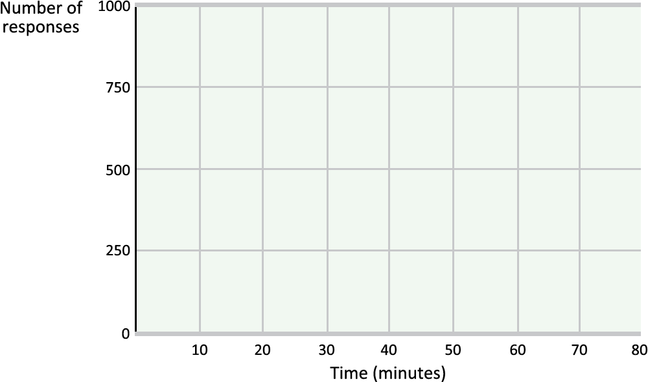
Effectiveness of the ratio schedules of Reinforcement
Fixed ratio
Fixed ratio: high rate of responding
Buy two drinks, get one free? I’ll buy a lot of them!
Variable ratio: high, consistent responding, even if reinforcement stops (resists extinction)
If the slot machine sometimes pays, I’ll pull the lever as many times as possible because it may pay this time!
Reinforcers
Variable ratio
Notes:
Click to reveal bullets.

Slide 50
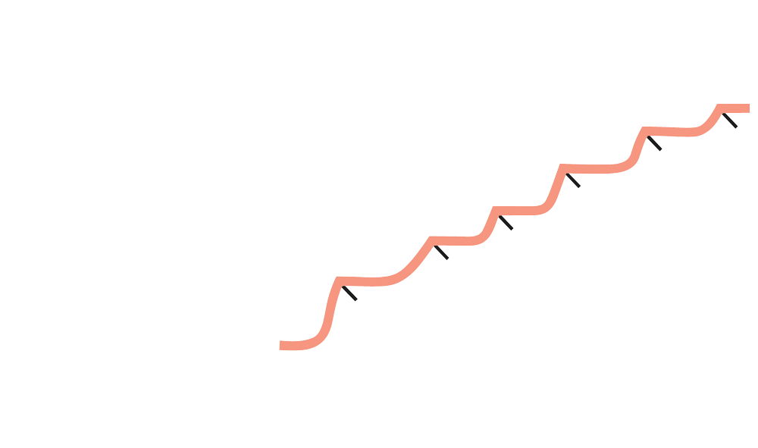
Results of the different schedules of reinforcement Which reinforcements produce more “responding” (more target behavior)?
Fixed interval: slow, unsustained responding
If I’m only paid for my Saturday work, I’m not going to work as hard on the other days.
Variable interval: slow, consistent responding
If I never know which day my lucky lottery number will pay off, I better play it every day.
Rapid responding near time for reinforcement
Fixed interval
Rapid responding near time for reinforcement
Fixed interval
Variable interval
Steady responding
Notes:
Click to reveal bullets.

Slide 51
Operant Effect: Punishment
Punishments have the opposite effects of reinforcement. These consequences make the target behavior less likely to occur in the future.
+ Positive Punishment
You ADD something unpleasant/aversive (ex: spank the child)
- Negative Punishment
You TAKE AWAY something pleasant/ desired (ex: no TV time, no attention)--MINUS is the “negative” here
→Positive does not mean “good” or “desirable” and
negative does not mean “bad” or “undesirable.”
Notes:
Click to reveal bullets.

Slide 52
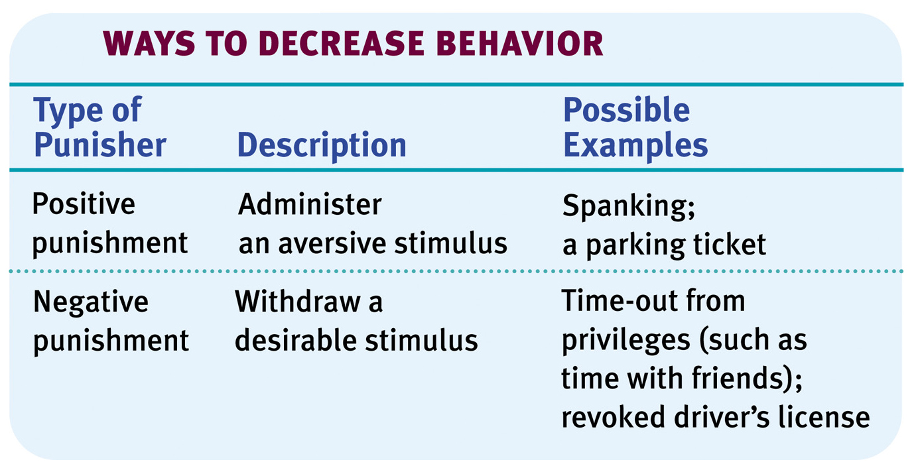
Punishment
An aversive event that decreases the behavior it follows.
Notes:
Preview Question 11: How does punishment affect behavior?

Slide 53
When is punishment effective?
Punishment works best in natural settings when we encounter punishing consequences from actions such as reaching into a fire; in that case, operant conditioning helps us to avoid dangers.
Punishment is effective when we try to artificially create punishing consequences for other’s choices; these work best when consequences happen as they do in nature.
→Severity of punishments is not as helpful as making the punishments immediate and certain.
Notes:
Click to reveal bullets.
Instructor: an overall answer to the question in the slide title might be that punishment works best when it approximates the way we naturally encounter immediate consequences (less well when the only consequence we encounter is a distant, delayed, possible threat).
You can ask students, testing both their reading and their thinking: “Does the final sentence suggest any changes to our criminal justice system?” The text reviews an example of how drunk driving was reduced not by harsh sentencing, but by better patrolling (more certainty of consequences) and by arresting people right away (more immediate consequences). Another study applied this insight to traffic enforcement. Immediate feedback, even signs showing your speed, work better to reduce traffic violations than punishments that were more severe but delayed and inconsistent.

Slide 54
Applying operant conditioning to parenting Problems with Physical Punishment
Punished behaviors may restart when the punishment is over; learning is not lasting.
Instead of learning behaviors, the child may learn to discriminate among situations, and avoid those in which punishment might occur.
Instead of behaviors, the child might learn an attitude of fear or hatred, which can interfere with learning. This can generalize to a fear/hatred of all adults or many settings.
Physical punishment models aggression and control as a method of dealing with problems.
Notes:
Click to reveal bullets.
Instructor: you can point out to students that these points, especially the first three, are not reasons why physical punishment is morally wrong. Instead, they are reasons why physical punishment doesn’t work well as an operant conditioning technique. The fourth/last point is also an example of ineffectiveness if (presumably) the parent is trying to teach prosocial behavior.

Slide 55
Don’t think about the beach
Don’t think about the waves, the sand, the towels and sunscreen, the sailboats and surfboards. Don’t think about the beach.
Are you obeying the instruction? Would you obey this instruction more if you were punished for thinking about the beach?
Notes:
Let the automatic animation play out.

Slide 56
Problem:
Punishing focuses on what NOT to do, which does not guide people to a desired behavior.
Even if undesirable behaviors do stop, another problem behavior may emerge that serves the same purpose, especially if no replacement behaviors are taught and reinforced.
Lesson:
In order to teach desired behavior, reinforce what’s right more often than punishing what’s wrong.
Notes:
Click to reveal lesson.
Instructor: see if students can think of examples of lessons their parents tried to teach them that were in the form of “Don’t…” Then see if the students can restate the lesson in a form of what they SHOULD do. For example, “don’t run across the street without looking” might become “look both ways before you cross the street.”

Slide 57
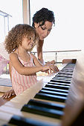
More effective forms of operant conditioning The Power of Rephrasing
Positive punishment: “You’re playing video games instead of practicing the piano, so I am justified in YELLING at you.”
Negative punishment: “You’re avoiding practicing, so I’m turning off your game.”
Negative reinforcement: “I will stop staring at you and bugging you as soon as I see that you are practicing.”
Positive reinforcement: “After you practice, we’ll play a game!”
Notes:
Click to reveal bullets.

Slide 58
Summary: Types of Consequences
Adding stimuli | Subtract stimuli | Outcome
Positive + Reinforcement (You get candy) | Negative –Reinforcement (I stop yelling) | Strengthens target behavior (You do chores)
Positive + Punishment (You get spanked) | Negative –Punishment (No cell phone) | Reduces target behavior (cursing)
= uses desirable stimuli
= uses unpleasant stimuli
Notes:
No animation.

Slide 59
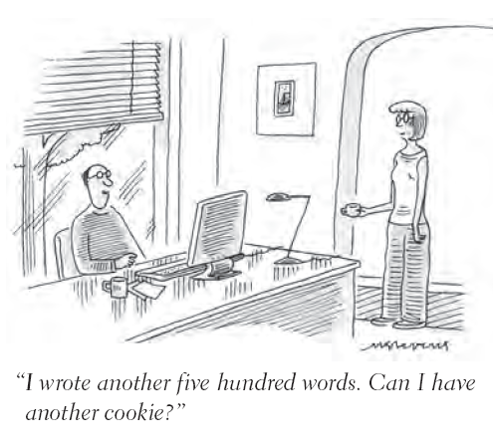
More Operant Conditioning Applications
Parenting
Rewarding small improvements toward desired behaviors works better than expecting complete success, and also works better than punishing problem behaviors.
Giving in to temper tantrums stops them in the short run but increases them in the long run.
Self-Improvement
Reward yourself for steps you take toward your goals. As you establish good habits, then make your rewards more infrequent (intermittent).
Notes:
Click to reveal bullets.
Instructor: there is only one self-improvement strategy rather than the four in the text, because the second one (monitoring) has less to do with operant conditioning, and recent research has shown the first one (announcing your goals to friends) has shown to be incorrect. I combined the third and fourth points.
[Announcing goals apparently creates a false sense of accomplishment that reduces motivation. This is called the substitution effect or the Gollwitzer effect (after psychologist Peter Gollwitzer). I let the author know about this.]

Slide 60
Role of Biology in Conditioning
Classical Conditioning
John Garcia and others found it was easier to learn associations that make sense for survival.
Food aversions can be acquired even if the UR (nausea) does NOT immediately follow the NS. When acquiring food aversions during pregnancy or illness, the body associates nausea with whatever food was eaten.
Males in one study were more likely to see a pictured woman as attractive if the picture had a red border.
Quail can have a sexual response linked to a fake quail more readily and strongly than to a red light.
Notes:
Click to reveal bullets.

Slide 61
In classical conditioning
Cognitive Processes
In operant conditioning
When the dog salivates at the bell, it may be due to cognition (learning to predict, even expect, the food).
Conditioned responses can alter attitudes, even when we know the change is caused by conditioning.
However, knowing that our reactions are caused by conditioning gives us the option of mentally breaking the association, e.g. deciding that nausea associated with a food aversion was actually caused by an illness.
Higher-order conditioning involves some cognition; the name of a food may trigger salivation.
In fixed-interval reinforcement, animals do more target behaviors/responses around the time that the reward is more likely, as if expecting the reward.
Expectation as a cognitive skill is even more evident in the ability of humans to respond to delayed reinforcers such as a paycheck.
Higher-order conditioning can be enabled with cognition; e.g., seeing something such as money as a reward because of its indirect value.
Humans can set behavioral goals for self and others, and plan their own reinforcers.
Notes:
Click to reveal all bullets.
Psychotherapy relies on these cognitive processes. When dealing with panic disorder with agoraphobia, a client may not even agree to exposure therapy until they cognitively accept that a panic attack in a store did not mean that there was an actual danger in the store, even though they now have a conditioned fear of the store. This insight can begin to break the association between the store and danger; exposure therapy then finishes the job.

Slide 62
Operant vs. Classical Conditioning

Slide 63
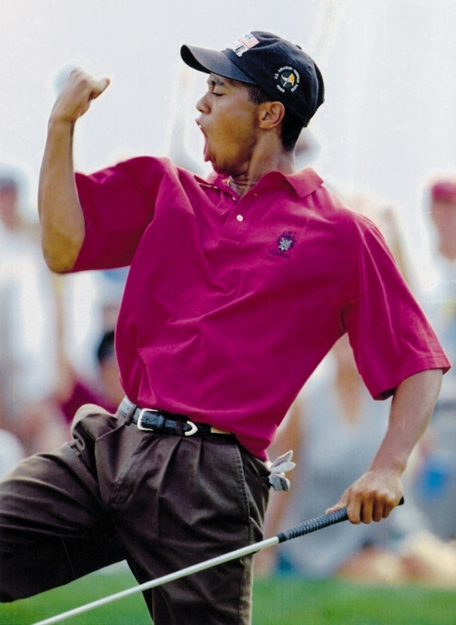
Learning, Rewards, and Motivation
Intrinsic motivation refers to the desire to perform a behavior well for its own sake. The reward is internalized as a feeling of satisfaction.
Extrinsic motivation refers to doing a behavior to receive rewards from others.
Intrinsic motivation can sometimes be reduced by external rewards, and can be prevented by using continuous reinforcement.
One principle for maintaining behavior is to use as few rewards as possible, and fade the rewards over time.
What might happen if we begin to reward a behavior someone was already doing and enjoying?
Notes:
Click to reveal bullets.
Answer to the question on the slide: the person might lose intrinsic motivation, and might not reliably do the behavior well.

Slide 64
Learning by Observation
Can we learn new behaviors and skills without conditioning and reward?
Yes, and one of the ways we do so is by observational learning: watching what happens when other people do a behavior and learning from their experience.
Skills required: mirroring, being able to picture ourselves doing the same action, and cognition, noticing consequences and associations.
Observational Learning Processes
Modeling | The behavior of others serves as a model, an example of how to respond to a situation; we may try this model regardless of reinforcement.
Vicarious Conditioning | Vicarious: experienced indirectly, through others Vicarious reinforcement and punishment means our choices are affected as we see others get consequences for their behaviors.
Notes:
Click to reveal bullets.

Slide 65
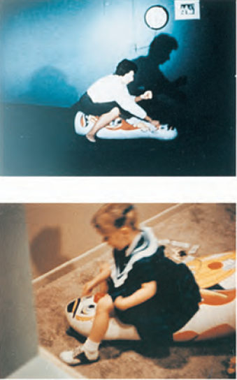
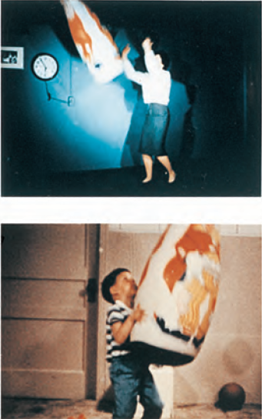
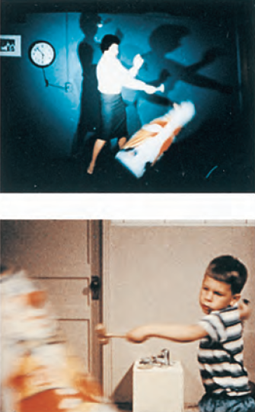
Albert Bandura’s Bobo Doll Experiment (1961)
Kids saw adults punching an inflated doll while narrating their aggressive behaviors such as “kick him.”
These kids were then put in a toy-deprived situation… and acted out the same behaviors they had seen.
Notes:
Click to reveal bullets and start animation of pictures from left to right.
Instructor: point out to students that in each of the three pairs of pictures, the child is doing a behavior shown by the adult above. Maybe that’s selective editing and a coincidence…but the kids echoed the adult’s words also.
Students might consider a critical thinking question that some have asked in recent years: were the children really acting out aggression, or just bored? Actually, it doesn’t matter; the adults were not narrating anger, just narrating their actions. Even if the motivation is boredom, the kids were still imitating the adults’ behaviors.

Slide 66
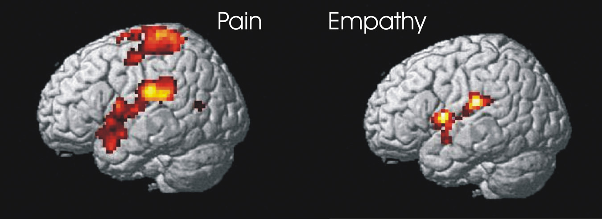
Mirroring in the Brain
When we watch others doing or feeling something, neurons fire in patterns that would fire if we were doing the action or having the feeling ourselves.
These neurons are referred to as mirror neurons, and they fire only to reflect the actions or feelings of others.
Notes:
Click to reveal bullets.
Instructor: in this image, the brain of the person empathizing/mirroring the feelings of another are firing in some of the same areas as the person experiencing pain. Notice that the areas are more closely related to the emotional anguish than the physical sensations (the sensory strip is not firing in the empathizer).
This mirroring can be involuntary, leading to the emotional “contagion” of moods and attitudes spreading from one person to another.

Slide 67
From Mirroring to Imitation
Humans are prone to spontaneous imitation of both behaviors and emotions (“emotional contagion”).
This includes even overimitating, that is, copying adult behaviors that have no function and no reward.
Children with autism are less likely to cognitively “mirror,” and less likely to follow someone else’s gaze as a neurotypical toddler (left) is doing below.
Notes:
Click to reveal bullets.
Instructor: perhaps you can nudge students to speculate why humans are more likely to have such a strong biological tendency to spontaneously have mirror neurons fire, and to have contagious emotions and behaviors.
One clue might be by seeing what is lost for children with autism who do not experience contagious yawning or have mirror neurons fire when seeing others experience actions and feelings. These children miss out on cognitive practice/observational learning of social skills, and have difficulty making social-emotional connections with others. They are able to feel such a connection, typically with family and partners, but have more difficulty establishing such connections without the quick “ESP” of neuronal mirroring.

Slide 68
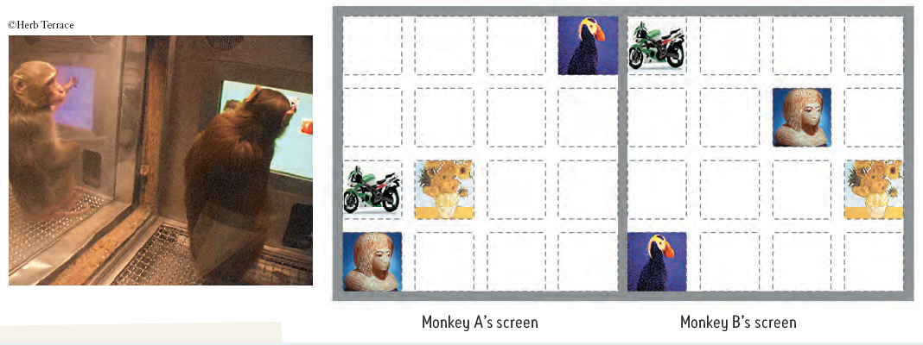
Mirroring Plus Vicarious Reinforcement
Mirroring enables observational learning; we cognitively practice a behavior just by watching it.
If you combine this with vicarious reinforcement, we are even more likely to get imitation.
Monkey A saw Monkey B getting a banana after pressing four symbols. Monkey A then pressed the same four symbols (even though the symbols were in different locations).
Notes:
Click to reveal bullets.

Slide 69
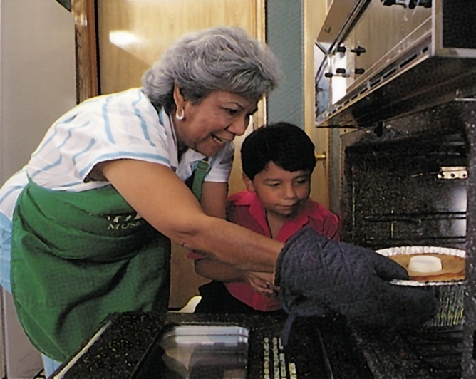
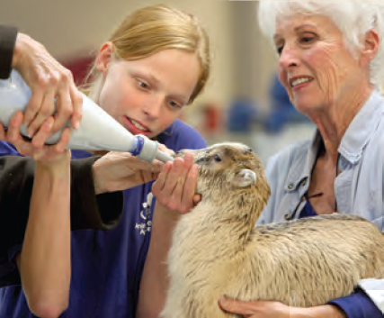
Prosocial Effects of Observational Learning
Prosocial behavior refers to actions which benefit others, contribute value to groups, and follow moral codes and social norms.
Parents try to teach this behavior through lectures, but it may be taught best through modeling… especially if kids can see the benefits of the behavior to oneself or others.
Notes:
Click to reveal bullets.

Slide 70
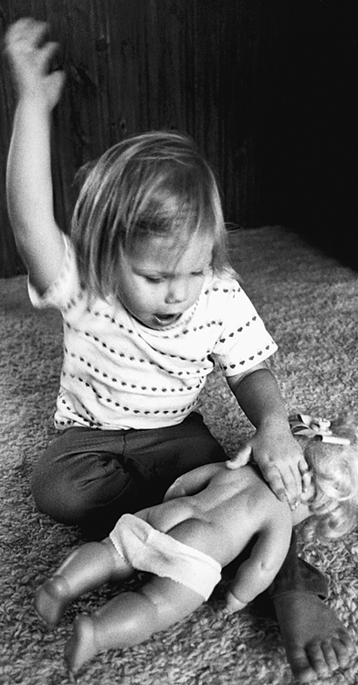
Antisocial Effects of Observational Learning
What happens when we learn from models who demonstrate antisocial behavior, actions that are harmful to individuals and society?
Children who witness violence in their homes, but are not physically harmed themselves, may hate violence but still may become violent more often than the average child.
Perhaps this is a result of “the Bobo doll effect”? Under stress, we do what has been modeled for us.
Notes:
Click to reveal bullets.

Slide 71
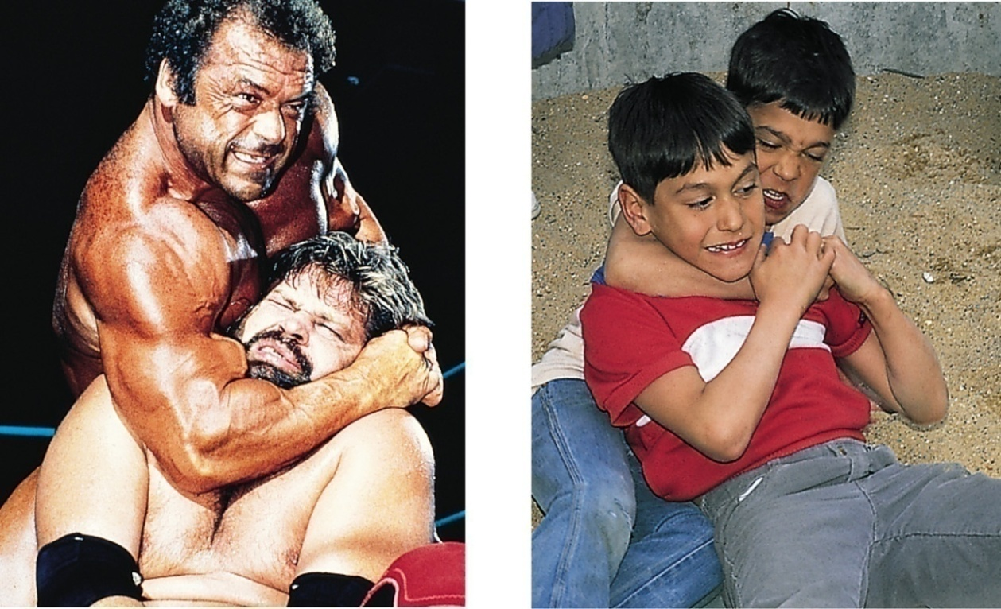
Media Models of Violence
Do we learn antisocial behavior such as violence from indirect observations of others in the media?
Research shows that viewing media violence leads to increased aggression (fights) and reduced prosocial behavior (such as helping an injured person).
This violence-viewing effect might be explained by imitation, and also by desensitization toward pain in others.
Notes:
Click to reveal bottom bar.

