Slide 1
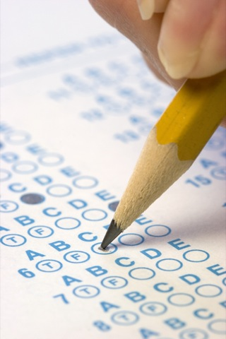
“Definition” of Intelligence
Intelligence tests are a series of questions and other exercises which attempt to assess people’s mental abilities in a way that generates a numerical score, so that one person can be compared to another.
Intelligence is the ability to learn from experience, solve problems, and use our knowledge to adapt to new situations.
Intelligence can also be defined as “whatever intelligence tests measure.” This tends to be “school smarts.”
Your college entrance test measures how good you are at scoring well on that test.
Notes:
Click to reveal bullets.
It is hard to argue with this definition of intelligence other than to point out that it’s pretty much a tautology (a circular reasoning statement that really doesn’t say much). However, the text goes out on a limb and puts a little meaning into the concept (next slide).
Overall question to consider:
does each of us have an inborn level of talent, a general mental capacity or set of abilities, and can that level be measured and represented by a score on a test?
Definitions of intelligence
One ability or many?
The role of creativity and emotional intelligence
How to construct tests to try to assess intelligence
Intelligence stability, change, and extremes
Genetic vs. environmental influences
Group differences in ability
Racial difference or cultural test bias?

Slide 2
Intelligence: Single or Multiple?
Is intelligence one general ability or several specific abilities?
Charles Spearman | general intelligence [g]
Howard Gardner | 8 intelligences
Robert Sternberg | 3 intelligences
Emotional intelligence | 4 components
Notes:
No animation.

Slide 3
General Intelligence, also known as g
Charles Spearman (1863-1945) performed a factor analysis* of different skills and found that people who did well in one area also did well in another. Spearman speculated that these people had a high “g” (general intelligence).
*Factor analysis refers to a statistical technique that determines how different variables relate to each other; for example whether they form clusters that tend to vary together.
Notes:
Click to reveal bullets.
Instructor: see if students can guess what is not clearly stated in the text, that “g” stands for “general.” This may be a good demonstration of hindsight bias; it will seem obvious if told, but not so obvious if you right away ask, “why did he call this ‘g’?”
Factor analysis is a statistical technique to determine how different variables relate to each other, for example whether they form clusters that tend to vary together (correlate).

Slide 4
General Intelligence
Spearman proposed that general intelligence (g) is linked to many clusters specific intelligences (s) that can be analyzed by factor analysis.
For example, people who do well on vocabulary examinations do well on paragraph comprehension examinations, a cluster that helps define verbal intelligence. Other factors include a spatial ability factor, or a reasoning ability factor.

Slide 5
Multiple Intelligences
The “savant syndrome” refers to having isolated “islands” of high ability amidst a sea of below-average cognitive and social functioning.
Howard Gardner’s Multiple Intelligences
Howard Gardner (b. 1943) noted that different people have intelligence/ability in different areas.
Research and factor analysis suggests that there may be a correlation among these intelligences.
Notes:
Stephen Wiltshire (b. 1974) is limited in his social and overall cognitive skills by autism, but has extraordinary visual memory. Wiltshire was able to draw this picture of the Tokyo skyline from memory after a 30-minute helicopter ride and a view from the top of a skyscraper. The existence of the savant syndrome suggests that intelligence can exist in parts.
Click to reveal Howard Gardner’s Multiple Intelligences.
Narrative linking to above: “Howard Gardner feels that even discounting the “savant syndrome,” different people have different strengths.” Acknowledging all of these abilities means honoring strengths and success in areas other than verbal and math ability.

Slide 6
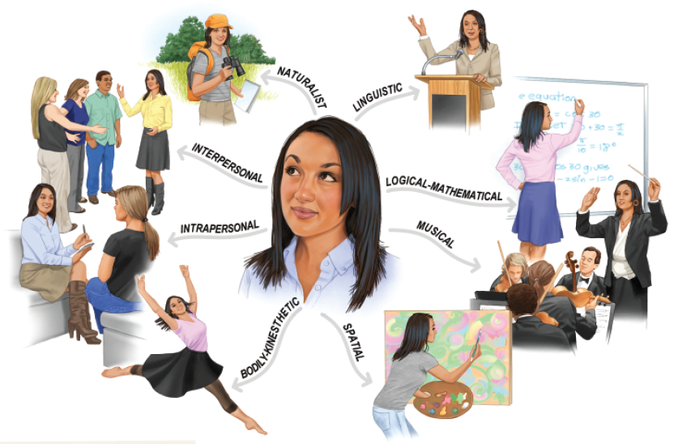
Howard Gardner’s Eight Intelligences
Notes:
No animation.
In case a student asks, Howard Gardner has considered adding “moral” intelligence and “spiritual”/”existential” intelligence to his list, but does not consider them to have adequate empirical support.

Slide 7
Robert Sternberg’s Triarchic Theory
Sternberg (1985, 1999, 2003) also agrees with Gardner, but suggests three intelligences rather than eight.
Componential/Analytical Intelligence: Intelligence that is assessed by intelligence tests.
Experiential/Creative Intelligence: Intelligence that makes us adapt to novel situations, generating novel ideas.
Contextual/Practical Intelligence: Intelligence that is required for everyday tasks (e.g. street smarts).

Slide 8
Sternberg’s Intelligence Triarchy
Robert Sternberg (b. 1949) proposed that “success” in life is related to three types of ability.
Analytical intelligence: solving a well-defined problem with a single answer
Practical intelligence: expertise and talent that help to complete the tasks and manage the complex challenges of everyday life
Creative intelligence: generating new ideas to help adapt to novel situations
Notes:
Click to show three types.
This is referred to as the “triarchic” (three-part) model.
The first type of intelligence is the best fit for the early definition we encountered in this chapter: intelligence is what intelligence tests measure.
The definition of “practical” intelligence, like the example earlier of the rainforest resident who understands plants, is hard to separate from the concept of expertise. This intelligence may include expertise but also include the ability to handle situations that do not draw just upon previous experience. Some people are skilled with fixing machines or managing people, even when it’s a situation they have never seen before.

Slide 9
Components of
Emotional Intelligence
Benefits of
Emotional Intelligence
People with high emotional intelligence often have other beneficial traits, such as the ability to delay gratification while pursuing long-term goals.
The level of emotional intelligence, including the skill of reading the emotions of others, correlates with success in career and other social situations.
Perceiving emotions
Recognizing emotions in facial expressions, stories, and even in music
Understanding emotions
Being able to see blended emotions, and to predict emotional states and changes in self and others
Modulating and expressing emotions in various situations
Managing emotions
Using emotions
Using emotions as fuel and motivation for creative, adaptive thinking
Notes:
Click to reveal more about each component.
Introducing this slide: “emotional intelligence can be defined by four components identified on a test by Mayer, Salovey, and Caruso (2002, 2008):”
In this case, “modulating” means not allowing emotions get out of control; having one’s emotions be a connective rather than a disruptive force in social situations.
Click to reveal sidebar.
The second bullet point relates to the struggles of people on the autism spectrum who have difficulty in this area and sometimes in all areas of emotional intelligence, even if overall intelligence test scores are in the normal range.
Social intelligence refers to the ability to understand and navigate social situations.
Emotional intelligence
involves processing and managing the emotional component of those social situations, including one’s own emotions.

Slide 10
Emotional Intelligence: Criticism
Gardner and others criticize the idea of emotional intelligence as garbage and question whether we stretch this idea of intelligence too far when we apply it to our emotions.
Does it make any more sense, for example, to discuss “intelligent emotions?”

Slide 11
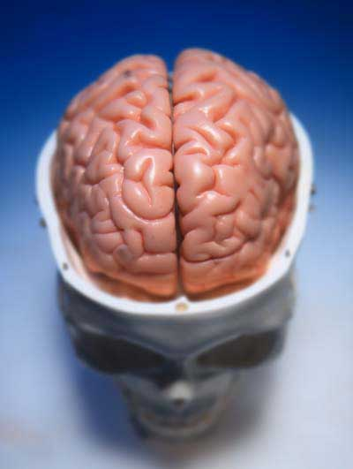
Intelligence and Brain Anatomy
“Genius” seems to correlate with:
overall brain size.
the size of some brain regions such as the parietal lobe.
high brain activity in the frontal and parietal lobes.
extra gray matter (brain cell bodies, seen as more brain surface area/convolutions).
extra white matter (axons) leading to high connectivity among different regions.
Intelligence and Brain Functioning
Intelligence in action seems to involve:
activity of the front part of the frontal lobes to organize and coordinate information
“being in shape”; using less energy to solve problems than the brains of “normal” people.
Notes:
Click to reveal bullets.
Instructor: either before or after the bullets (or both), you could ask students, “would you say that intelligence correlates with the size of the brain, or with the brain’s complexity?

Slide 12
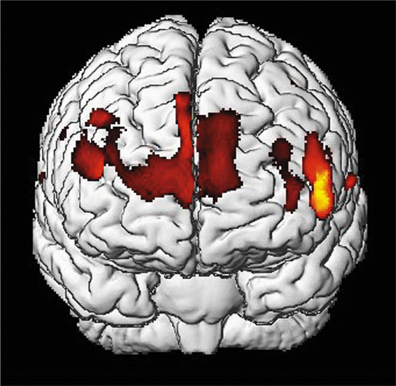
Is Intelligence Neurologically Measurable?
Recent Studies indicate some correlation (about +.40) between brain size and intelligence. As brain size decreases with age, scores on verbal intelligence tests also decrease.
Gray matter concentration in people with high intelligence.
Notes:
OBJECTIVE 6| Describe the relationship between intelligence and brain anatomy.

Slide 13
Assessing Intelligence
Assessment refers to the activity and the instruments used to measure intelligence.
The challenge is to make these instruments valid (measure what they are supposed to measure) and reliable (yielding the same score if administered again, even if administered by someone else).
Why Try to Measure Intelligence?
to study how (and why) people differ in ability
to match strengths and weaknesses to jobs and school programs
to help the “survival of the fittest” process; trying to select the people who have the greatest abilities. This was the position of eugenicist Francis Galton (1822-1911).
Guess who was a big fan of Galton’s hypotheses?
Notes:
Click to reveal bullets.
Left sidebar: This material is optional, with a definition not made clear in the text and a reference to validity and reliability that doesn’t show up at this point in the book. Delete the whole box if you feel it’s unnecessary.
The word eugenics was invented by the Englishman Francis Galton in 1883 to denote the ‘science of the biological improvement of humans. The first half of the 1900s saw governments use laws, and sometimes violence, to interfere in reproductive decisions; these actions ranged from enforced sterilization to mass murder. In the 1920s and 1930s, the United States led the world in eugenic legislation. By 1938, 29 states had passed sterilization laws and doctors had performed more than 30,000 involuntary vasectomies (for males) and salpingectomies (for females). Most Americans saw eugenics as a beneficial and progressive policy. A poll by a national magazine in 1937 reported that 63 percent of Americans supported the compulsory sterilization of habitual criminals while 66 percent endorsed the sterilization of mental defectives.
Remind students that eugenics was supported by many famous American scientists and psychologists who defended involuntary sterilization by claiming it was “socially responsible” scientific activism. They were willing to force a medical procedure on other people, denying them children, in the hope of improving humanity. In Buck v. Bell (1927), the U.S. Supreme Court ruled (8-1) that Virginia could forcibly sterilize the “unfit” for the supposed “protection and health of the state.” The decision is considered one of the worst in the history of the Supreme Court.

Slide 14
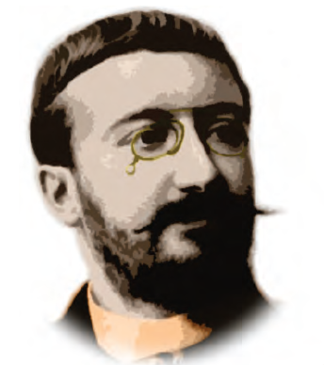
Predicting School Achievement: Alfred Binet
Problem: in the late 1800s, a new law in France required universal education even for those without the ability to succeed with the current instruction.
Solution: Alfred Binet devised tests for children to determine which ones needed help.
Binet hoped to predict a child’s level of success in regular education.
Notes:
Click to reveal bullets.
The plan, and the hope of France’s minister of public education, was to assess children in a systematic way rather than relying on teacher judgment (which might be biased, but was also not “scientific” even if it was more accurate).
Alfred Binet assumed that all children follow the same course of development, some going more quickly, and others more slowly.
Binet’s tests attempted to measure mental age--how far the child had come along on the “normal” developmental pathway.
The implication was that children with lower ability were delayed (with a mental age below their chronological age), and not disabled; with help, they could improve.

Slide 15
Predicting School Achievement: Alfred Binet
Alfred Binet assumed that all children follow the same course of development, some going more quickly, and others more slowly.
Binet’s tests attempted to measure mental age--how far the child had come along on the “normal” developmental pathway.
The implication was that children with lower ability were delayed (with a mental age below their chronological age), and not disabled; with help, they could improve.
Notes:
Click to reveal bullets.
The plan, and the hope of France’s minister of public education, was to assess children in a systematic way rather than relying on teacher judgment (which might be biased, but was also not “scientific” even if it was more accurate).
Alfred Binet assumed that all children follow the same course of development, some going more quickly, and others more slowly.
Binet’s tests attempted to measure mental age--how far the child had come along on the “normal” developmental pathway.
The implication was that children with lower ability were delayed (with a mental age below their chronological age), and not disabled; with help, they could improve.

Slide 16
Lewis Terman
Lewis Terman, of Stanford University, adapted Alfred Binet’s test, adding new test items and extending the age range into adulthood.
Terman also tested many California residents to develop new norms, that is, new information about how people typically performed on the test.
The result was the Stanford-Binet intelligence test.
William Stern’s scoring (1914) of the Stanford-Binet test resulted in the concept of IQ, the Intelligence Quotient.

Slide 17
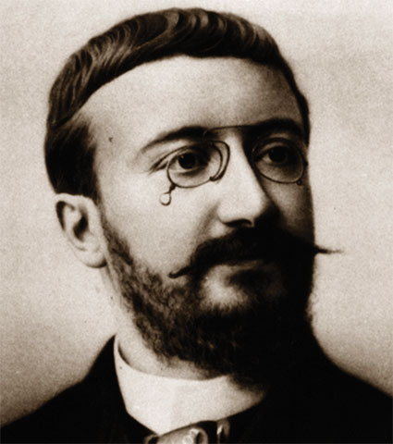
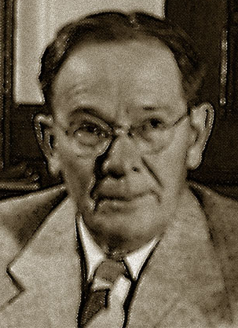
What do scores mean?
What to do if you score low on an IQ test?
Lewis Terman, of Stanford University, began with a different assumption than Binet; Terman felt that intelligence was unchanging and innate (genetic).
Later, Terman saw how scores can be affected by people’s level of education and their familiarity with the language and culture used in the test.
Study, and develop self-discipline and attention span.
Binet
Remove your genes from the population
(eugenics).
Terman
Notes:
Answer to the question on the slide: the 10-year-old is scored as 8/10 x 100 = 80.
You can now ask students: “Is William Stern’s calculation of IQ a better way of presenting a score than “mental age?” Lets test it by seeing if it works with adults, as Terman hoped. What IQ do you get if a 16 year old scores as well as a 20 year old (20/16 = 5/4 = IQ 125). Now try it with a 50 year old scoring as well as a typical 20 year old. Oops…IQ would be 20/50... IQ = 40.
Coming up soon, under the topic of standardization, is a new way of calculating IQ by simply comparing your raw score to the general population of adults who took the test. We will soon see why the book says here, “about 2/3 of people fall between 85 and 115 [in IQ].”
Terman proposed using IQ tests to classify children; he believed IQ was inherited and was the strongest predictor of one's ultimate success in life. Terman was a prominent member of the Human Betterment Foundation, which supported the promotion and enforcement of compulsory and involuntary sterilization laws in California.
Lewis Terman, of Stanford University, adapted Alfred Binet’s test, adding new test items and extending the age range into adulthood.
Terman also tested many California residents to develop new norms, that is, new information about how people typically performed on the test.
The result was the Stanford-Binet intelligence test.
William Stern’s scoring (1914) of the Stanford-Binet test resulted in the concept of IQ, the Intelligence Quotient.
Eugenics is the idea that society can be improved by deliberate selection, that is, keeping people with undesired traits from reproducing. Thus, Terman’s hypothetical comment about removing inferior genes from the population. It is not clear whether Terman’s changing views about influences on test scores changed his views of whether people could be improved or still had “inferior” genes.
Eugenics has been making a comeback in recent years with the development of new reproductive technologies. Once again, it is supported by many researchers and psychologists. Distinguished scientists, including several Nobel Prize-winners, have supported genetic screening bordering on eugenics. James Watson, the American biologist who helped discover DNA in 1953, said in 2003 that he backed genetic manipulation to make people more intelligent and better looking. “If you really are stupid, I would call that a disease,” he said. “The lower 10 percent who really have difficulty, even in elementary school, what's the cause of it? A lot of people would like to say, ‘Well, poverty, things like that.’ It probably isn't. So I'd like to get rid of that, to help the lower 10 percent.”--Richard Ingram, “EUGENICS: Stupidity should be cured—Watson,” DarwinAwards, 19 June 2003, at http://www.darwinawards.com/old/main200306a.html.
Remind students that attitudes like this were prevalent in Germany during World War II.

Slide 18
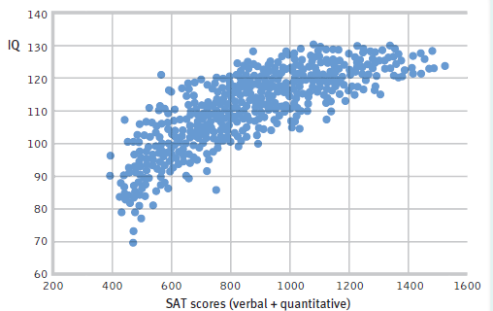
Aptitude vs. Achievement
Achievement tests measure what you already have learned. Examples include a literacy test, a driver’s license exam, and a final exam in a psychology course.
Aptitude tests attempt to predict your ability to learn new skills.
The SAT, ACT, and GRE are supposed to predict your ability to do well in future academic work.
IQ
If the SAT is an aptitude test, should it correlate with IQ?
SAT scores (verbal + quantitative)
Notes:
Click to reveal bullets and graphic.
Why do we say that aptitude should correlate with intelligence? Because according to one definition, intelligence refers to an ability to adapt and handle challenges, and is not a measure of existing knowledge. By this definition, “intelligence” would give one more aptitude, more likelihood of performing well in the future.
Remind students that this is a scatterplot; it’s as if each blue dot is a person positioned by that person’s SAT and IQ scores.
Notice that although there is a strong correlation (+.82) in this sample of 14- to 21- year olds, the SAT separates out some above-average IQ people from others. In other words, IQ scores do not do a good job of distinguishing among people with IQ’s over 120 (presuming the SATs measure anything meaningful at all). You can remind students that men typically do better than women on SATs, yet women have a greater success rate in college; why do they think this is?

Slide 19
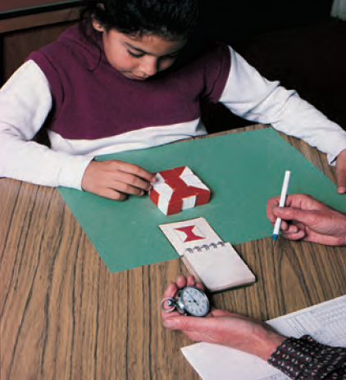
David Wechsler’s Tests: Intelligence PLUS
The Wechsler Adult Intelligence Scale (WAIS) and the Wechsler Intelligence Scale for Children (WISC) measure “g”/IQ and have subscores for:
verbal comprehension.
processing speed.
perceptual organization.
working memory.
Notes:
No animation.
WAIS and WISC Test items include:
describing similarities and differences between objects or between concepts.
doing math problems, presented as story problems, while being timed.
being tested on speed of decoding, translating symbols to numerals.
assembling blocks into prescribed patterns while being timed (pictured in the text and on this slide).
digit span retention and re-ordering (working memory).
vocabulary knowledge and general knowledge.
question and sentence comprehension and expression.
arranging related pictures in chronological/story sequence.
picture completion.

Slide 20
WAIS measures overall intelligence and 11 other aspects related to intelligence that are designed to assess clinical and educational problems.

Slide 21
Standardization
Standardizing a test involves administering the test to a representative sample of future test takers in order to establish a basis (norms) for meaningful comparison.
Notes:
OBJECTIVE 10| Discuss the importance of standardizing psychological tests, and describe the distribution of scores in a normal curve.

Slide 22
Normal Curve
Standardized tests establish a normal distribution of scores on a tested population in a bell-shaped pattern called the normal curve.

Slide 23
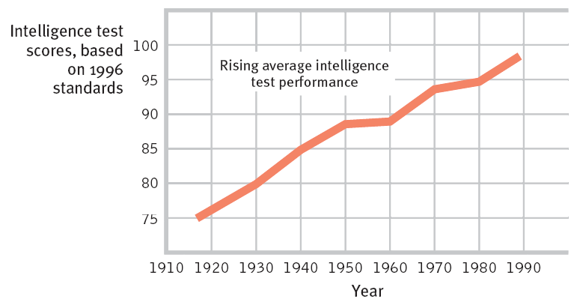
Re-Standardization and the Flynn Effect
Re-Standardization: Re-testing a sample of the general population to make an updated, accurate comparison group, in case people are smarter than they used to be when the test was first made.
The Flynn Effect:
Performance on intelligence tests has improved over the years, worldwide.
Notes:
Click to reveal example.
Explaining the Flynn effect: “hybrid vigor” (increased genetic mixing produces more vigorous offspring than inbreeding), nutrition, education, parental involvement, smaller families, may lead to improved intelligence.
Implication of the Flynn Effect: Test scores need to be adjusted so that “average” means “like the average score of TODAY’s general population.” --[Foley] Question for extension: Why might the average scores in 1920 only rate a 76 IQ compared to a 2010 population? Hint: What happened to the population at least males, in the six years before 1920? Foley’s hypothesis, in addition to the ones suggested in the book pp. 381-2: Maybe WWI killed, wounded, and disrupted the education of a lot of people.
--[Foley] Question for understanding, duplicated on the next slide if you want it on screen: You took an IQ test last week and got an IQ result of 120, and then, after decades of the Flynn effect, the test got restandardized this week. Today, you took the same test and got exactly the same number of items correct. Your new IQ score is most likely to be:
a. 105
b. 120
c. 128
Answer: a.
Help students think this out: the IQ is now standardized so that your raw score is compared to a post-Flynn effect population (SMARTER). Compared to this newer, smarter, group, your number of items correct might not seem so great, it will drop, it might even no longer seem to be above average.

Slide 24
Reliability
A test is reliable when it yields consistent results. To establish reliability researchers establish different procedures:
Split-half Reliability: Dividing the test into two equal halves and assessing how consistent the scores are.
Equivalent Form Reliability : Using different forms of the test to measure consistency between them.
Test-Retest Reliability: Using the same test on two occasions to measure consistency.
Notes:
OBJECTIVE 11| Explain what it means to say that a test is reliable.

Slide 25
Validity
Reliability of a test does not ensure validity. Validity of a test refers to what the test is supposed to measure or predict.
Content Validity: Refers to the extent a test thoroughly measures a particular domain, behavior or trait. (physics test has physics questions, not chemistry)
Criterion-related/Predictive Validity: Refers to the function of a test in predicting a particular behavior or trait. (correlate with another measure of performance)
Construct Validity: Refers to the extent to which a test measures the concept or construct that it is intended to measure. (correlate with other well-established measure of the construct)
Notes:
OBJECTIVE 12| Explain what it means to say that a test is valid, and describe two types of validity.

Slide 26
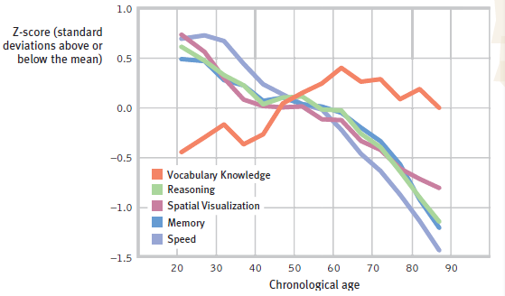
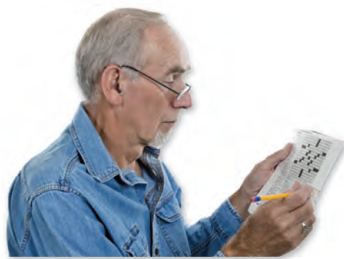
Which type of intelligence?
Stability of Intelligence during Aging:
Based on this chart, at what age might you do best at completing a crossword puzzle quickly?
Notes:
No animation.
Even though younger people have faster processing speed, the better vocabulary of older people allows them to complete crossword puzzles more quickly. It looks like people at about age 63 might do best.
Note that this slide presupposes that there are different kinds of intelligence; does this imply the single-number IQ score is problematic?

Slide 27
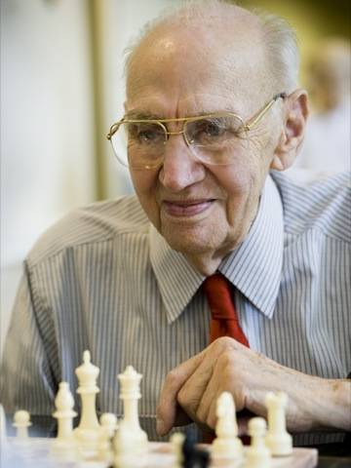
Fluid and Crystallized Intelligence
Fluid intelligence refers to the ability to think quickly and abstractly, integrate information, and acquire skills. It diminishes with age.
Crystallized intelligence refers to accumulated wisdom, knowledge, expertise, and vocabulary. It is relatively robust over the course of the life-span.
Notes:
Click to reveal bullets.
The wisdom that comes with age may include social understanding, humility, and expert knowledge about life in general. Our thinking may become less distorted by emotional factors.
Fluid intelligence allows the young to make great contributions in mathematics; crystallized intelligence allows the old to make great contributions in literature.

Slide 28
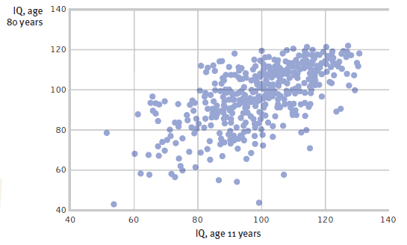
Stability of Intelligence Test Scores Over the Lifespan
Pushing toddlers to learn does not seem to help much. Only by age four is a child’s performance on intelligence tests a predictor of future performance on intelligence tests.
Based on the results of a longitudinal study depicted in this chart, does intelligence test score at age 11 predict intelligence test score at age 80?
Notes:
Click to show chart.
The chart does show a correlation between intelligence test scores at these different ages. Review the problem with a longitudinal study: those who survived to age 80 may not be a representative sample of the original cohort.

Slide 29
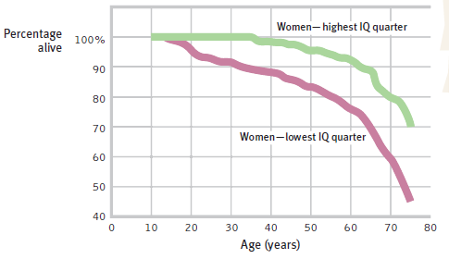
Intelligence and Longevity
In a Scottish longitudinal study, 11-year-olds with higher intelligence test scores lived longer and more independently and were less likely to develop Alzheimer’s Disease.
In a study of nuns , those with lower verbal ability were later more likely to develop Alzheimer’s Disease, which includes a shorter lifespan.
Notes:
Click to reveal chart.
The text does not suggest an explanation for the association between intelligence test score and longevity.

Slide 30
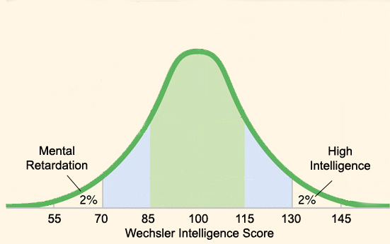
Extremes of Intelligence
The Wechsler Intelligence Scale is set so that about 2 percent of the population is above 130 and about 2 percent of the population is below 70.
Very High Intelligence, Gifted
Intellectual Disability
Notes:
No animation.

Slide 31
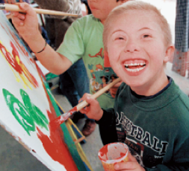
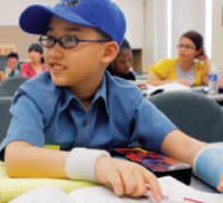
Extremes of Intelligence
“Intellectual disability” refers to people who
have an IQ around 70 or below.
have difficulty with adaptive skills, such as:
conceptual skills (literacy and calculation).
social skills, including making safe social choices.
practical daily living skills such as hygiene, occupational skills, and using transportation.
Although some people with high intelligence test scores can seem socially delayed or withdrawn, most are “successful.”
“Gifted” children, like any children, learn best with an appropriate level of challenge.
Segregated, “tracked” programs, however, often unfairly widen achievement gaps.
Notes:
Click to reveal bullets.
The child in the picture at the top left has Down syndrome. He is shown happily painting in a classroom with children of varying abilities.
The child in the picture at bottom right is in a college statistics class; he is 10 years old. At both ends of the intellectual aptitude spectrum, labeling and tracking children has the danger of becoming a self fulfilling prophecy because of the power of expectations and the availability of educational opportunities. Education of all children in an integrated classroom can prevent these problems, although they require greater individualization to assure appropriate levels of challenge.

Slide 32
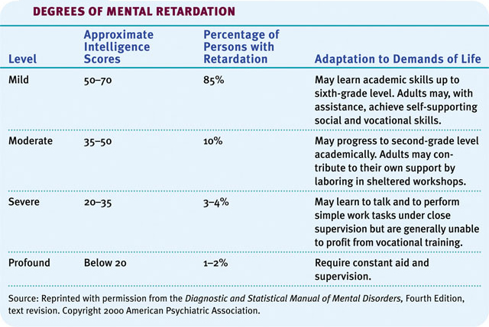
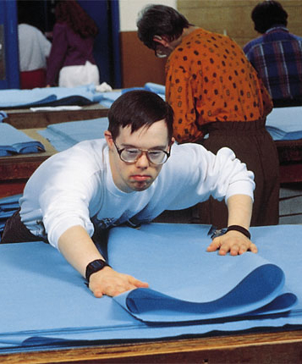
Mental Retardation
Mentally retarded individuals required constant supervision a few decades ago, but with a supportive family environment and special education they can now care for themselves.

Slide 33
Genetic and Environmental Influences on Intelligence
No other topic in psychology is so passionately followed as the one that asks the question, “Is intelligence due to genetics or environment?”

Slide 34
Genetic Influences
Studies of twins, family members, and adopted children together support the idea that there is a significant genetic contribution to intelligence.
Notes:
OBJECTIVE 15| Discuss the evidence for the genetic contribution to individual intelligence, and explain what psychologists mean by the heritability of intelligence.

Slide 35
Adoption Studies
Adopted children show a marginal correlation in verbal ability to their adopted parents.

Slide 36
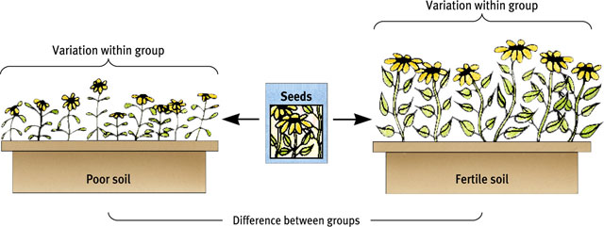
Environmental Effects
Differences in intelligence among these groups are largely environmental, as if one environment is more fertile in developing these abilities than another.

Slide 37
Early Intervention Effects
Early neglect from caregivers leads children to develop a lack of personal control over the environment, and it impoverishes their intelligence.
Romanian orphans with minimal
human interaction are delayed in their development.

Slide 38
Schooling Effects
Schooling is an experience that pays dividends, which is reflected in intelligence scores. Increased schooling correlates with higher intelligence scores.
To increase readiness for schoolwork,
projects like Head Start facilitate leaning.

Slide 39
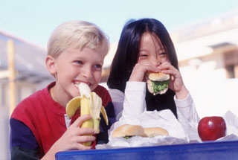
Male-Female Ability Differences
Girls tend to be better at spelling, locating objects, and detecting emotions.
Girls tend to be more verbally fluent, and more sensitive to touch, taste, and color.
Boys tend to be better at handling spatial reasoning and complex math problems.
It is a myth that boys generally do better in math than girls. Girls do at least as well as boys in overall math performance and especially in math computation.
Notes:
Click to reveal bullets.
Question to raise with students: do you think that these differences are caused by genetics and strengths developed through natural selection, or because boys and girls are raised differently?

Slide 40
Gender Similarities and Differences
There are seven ways in which males and females differ in various abilities.
1. Girls are better spellers
2. Girls are verbally fluent and have large vocabularies
3. Girls are better at locating objects
4. Girls are more sensitive to touch, taste, and color
5. Boys outnumber girls in counts of underachievement
6. Boys outperform girls at math problem solving, but under perform at math computation
7. Women detect emotions more easily than men do
Notes:
OBJECTIVE 18| Describe gender differences in abilities.

Slide 41
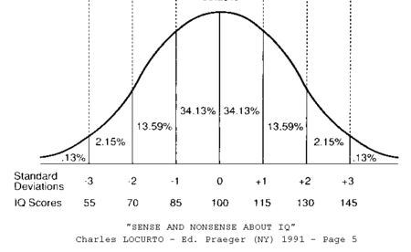
Ethnic/Racial Differences in Intelligence Test Scores
The bell curve for African American intelligence test scores is centered at 85. For non-African Americans, the average is 100.
Whatever the cause of this score difference, it is incorrect to use this information to predict the score of an individual.
The green triangle shows African-Americans scoring higher than the average non-African-Americans.
How can we interpret this group difference in average intelligence test scores?
We will look at the issue of test bias and other factors affecting scores for perceived minorities.
But first…
Notes:
Click to animate graph.
Click to reveal remaining bullets.
The following statement perhaps gives too much away before seeing if students can figure out the concept on the next slide, but I included here as material for explaining the next slide: “But first we must train ourselves to see that differences between groups can be caused by environmental factors (even identical twins can have differences in height, sexuality, and ability).
Remind students that even the term “African American” has little or no meaning; is it self-defined or can someone determine who fits in this category? Do Egyptians and Algerians count? Are Bantu peoples to be lumped in with Khoisan? Is the American “one drop of blood” rule to be used to determine “African American-ness,” or a different standard from Brazil or Trinidad?
Remind students that a future slide notes that racial categories are not distinct genetically.

Slide 42
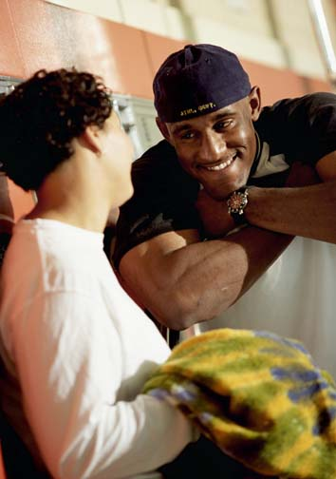
The “Racial” Intelligence Test Score Gap
Racial categories are not distinct genetically and are unscientific.
Both “whites” and “blacks” have higher intelligence test scores than “whites” of the 1930s.
“Whites” may have more access to “fertile soil” for developing their potential, such as:
schools and educational opportunities.
wealth, nutrition, support, and educated mentors.
relative freedom from discrimination.
Notes:
Click to reveal bullets.

