Slide 1
“Think critically” with psychological science… does this mean “criticize”?
Why do I need to work on my thinking? Can’t you just tell me facts about psychology?
The brain is designed for surviving and reproducing, but it is not the best tool for seeing ‘reality’ clearly.
To improve our thinking, we will learn to catch ourselves in some critical thinking errors.
Critical thinking refers to a more careful style of forming and evaluating knowledge than simply using intuition.
In addition to the scientific method, critical thinking will help us develop more effective and accurate ways to figure out what makes people do, think, and feel the things they do.
Notes:
Click to reveal two text boxes.
Instructor: A comment you could make before or after mentioning the scientific method, “Although our personal experiences give us many ideas about the people around us, psychological science will help us evaluate and test those ideas in order to have more accurate knowledge about mind, feelings, and behavior.”
In the magenta sidebar: Optional Material. Could just be part of lecture material instead. Added comments:
“We’ll see more about how our minds are not the most accurate scientific tool when we get to topics such as Memory, Sensation and Perception, and Social Thinking and Influence.”
Instructor: Although the text does not bring up the phenomenon of confirmation bias at this point, I suggest mentioning it here, because it fits well with issues and examples in this chapter.

Slide 2
When our natural thinking style fails:
Hindsight bias:
“I knew it all along.”
Overconfidence error:
“I am sure I am correct.”
The coincidence error, or
mistakenly perceiving order in random events:
“The dice must be fixed because you rolled three sixes in a row.”
Notes:
Click to show three circles.
Instructor: There is a series of slides explaining these concepts, not all of which are necessary.
The middle error on this slide can also be described as “mistakenly thinking that a random sequence of events is a meaningful pattern.”

Slide 3

Hindsight “Bias”
Why call it “bias”?
The mind builds its current wisdom around what we have already been told. We are “biased” in favor of old information.
For example, we may stay in a bad relationship because it has lasted this far and thus was “meant to be.”
Notes:
Optional slide.
Click to reveal second graphic and text box.
Further explaining the bias: We are “biased” in favor of old information; we give old knowledge more weight than new information because we feel as if we have always known it to be correct.
Explaining the target image: Hindsight bias is like watching an arrow land and then drawing a target around it, saying “that was what we were aiming at.”

Slide 4
Overconfidence Error 1:
Performance
Overconfidence Error 2:
Accuracy
We are much too certain in our judgments.
We overestimate our performance, our rate of work, our skills, and our degree of self-control.
We overestimate the accuracy of our knowledge. People are much more certain than they are accurate.
Overconfidence is a problem in eyewitness testimony.
Overconfidence is also a problem on tests. If you feel confident that you know a concept, try explaining it to someone else.
Test for this: “how long do you think it takes you to…” (e.g. “just finish this one thing I’m doing on the computer before I get to work”)?
And your unscrambling speed?
HEGOUN
ERSEGA
Notes:
Optional slide.
Click to reveal all bullets in each column.
Instructor:
Overconfidence Error 1: The example in the text of unscrambling the anagrams is a version of “performance overestimation.”
“Still think you’d unscramble the words faster than it says in the book? And you peeked at the answer for “COSHA”? How about : HEGOUN (Enough) or “ERSEGA” (Grease)…” [I made those up, so I doubt they’ll have seen them]
Overconfidence Error 2:
Familiarity error: You may feel you know a concept from the psychology text because it looks familiar. However, then you might get surprised on the exam when it’s hard to choose between two similar answers. I suggest asking students, “do you understand?” The call on someone who nodded/raised hand to explain the concept.”
Demonstration of misjudging our accuracy: Any trivia quiz in which the answers are numbers (the diameter of the earth, the age of a famous historical figure when they died, etc.) allows you to test overconfidence; give students a chance to create a 90 percent confidence interval (90 percent sure that the correct answer is between x and y), and they may still get a lot wrong, showing overconfidence. Here’s a sample online: http://tim-richardson.net/misc/estimation_quiz.html

Slide 5
Why do we make these errors and overuse our intuition?
From an evolutionary perspective:
Hindsight bias
might be an offshoot of our useful habit of analyzing an event and trying to figure out why it occurred.
Overconfidence error
might help us lead other people; certainty builds confidence in followers more than accuracy does.
Perceiving order helps us make predictions; we just need to test these and not overdo it.
Sometimes our intuition gives the right answer, which makes us trust it even more.
Notes:
This slide follows up from the first slide on these three topics, but this slide also is optional.
Click to show three circles and text.
The three circles explain these “errors” from an evolutionary perspective; however, the text that follows is a behaviorist perspective…that our use of intuition gets positively reinforced.

Slide 6

Making our ideas more accurate by being scientific
What did “Amazing Randi” do about the claim of seeing auras? He developed a testable prediction, which would support the theory if it succeeded.
Which it did not.
The aura-readers were unable to locate the aura around Randi’s body without seeing Randi’s body itself, so their claim was not supported.
Notes:
Click through to demonstrate “seeing and aura” when a face is covered and when a body is covered.
Randi’s prediction: “If you can see my aura, then you should be able to identify my location even if my body is concealed.”
The aura-readers were unable to locate the aura around Randi’s body without seeing Randi’s body itself, so their claim was not supported.
Randi shows here how to apply the scientific method to serve a part of the scientific attitude we’ll refer to in a moment: skepticism.

Slide 7
Look for hidden assumptions and decide if you agree.
Consider if there are other possible explanations for the facts or results.
Look for hidden bias, politics, values, or personal connections.
Critical thinking: analyzing information to decide if it makes sense, rather than simply accepting it. Goal: getting at the truth, even if it means putting aside your own ideas.
See if there was a flaw in how the information was collected.
Put aside your own assumptions and biases, and look at the evidence.
Notes:
Click to reveal five circles.

Slide 8
Getting to the truth:
The Scientific Method
The scientific method is the process of testing our ideas about the world by:
setting up situations that test our ideas.
making careful, organized observations.
analyzing whether the data fits with our ideas.
If the data doesn’t fit our ideas, then we modify our ideas, and test again.
Notes:
Automatic animation.

Slide 9
Some research findings revealed by the scientific method:
Scientific Method: Tools and Goals
The brain can recover from massive early childhood brain damage.
Sleepwalkers are not acting out dreams.
Our brains do not have accurate memories locked inside like video files.
There is no “hidden and unused 90 percent” of our brain.
People often change their opinions to fit their actions.
The basics:
Theory
Hypothesis
Operational Definitions
Replication
Research goals/types:
Description
Correlation
Prediction
Causation
Experiments
Notes:
Click to reveal bullets.
The last bullet on the left refers to cognitive dissonance theory and explains the “foot in the door” phenomenon.
Scientific Method Tools and Goals follow in next clicks.

Slide 10
Theory: the big picture
A theory, in the language of science, is a set of principles, built on observations and other verifiable facts, that explains some phenomenon and predicts its future behavior.
Example of a theory: “All ADHD symptoms are a reaction to eating sugar.”
Notes:
Automatic animation.
Theories are not guesses; they are the result of carefully testing many related guesses.
Learn to say, when making a guess about something: “I have a theory hypothesis…”

Slide 11
Hypotheses: informed predictions
A hypothesis is a testable prediction consistent with our theory.
“Testable” means that the hypothesis is stated in a way that we could make observations to find out if it is true.
What would be a prediction from the “All ADHD is about sugar” theory?
To test the “All” part of the theory: “ADHD symptoms will continue for some kids even after sugar is removed from the diet.”
One hypothesis: “If a kid gets sugar, the kid will act more distracted, impulsive, and hyper.”
Notes:
Click to reveal all text.
If students need elaboration on this term: “Predictions” can simply be that two factors in our theory go together in the way that we suggested.
Below is more detail about the sample predictions that will appear on screen, after you have the students give it a try:
Example from our ADHD-sugar theory, the type of hypothesis generated by our confirmation bias: “If a kid gets sugar, the kid will act more distracted, impulsive, and hyper.” Problem: the theory could still be wrong even if we saw this result; it could be coincidence.
Even better is a disconfirming hypothesis like the Amazing Randi’s test, to test the “All” part of the theory. “All” is an extremely strong word; try to find a case in which this is not true: “ADHD symptoms will continue for some kids even after sugar is removed from the diet.”

Slide 12
Danger when testing hypotheses:
theories can bias our observations
Guide for making useful observations:
How can we measure “ADHD symptoms” in the previous example in observable terms?
  Impulsivity = # of times/hour calling out without raising hand.
  Hyperactivity = # of times/hour out of seat
  Inattention = # minutes continuously on task before becoming distracted
We might select only the data, or the interpretations of the data, that support what we already believe. There are safeguards against this:
Hypotheses designed to disconfirm
Operational definitions
Notes:
Click to reveal all bullets.

Slide 13
The next/final step in the scientific method: replication
Replicating research means trying it again using the same operational definitions of the concepts and procedures.
You could introduce a small change in the study, e.g. trying the ADHD/sugar test on college students instead of elementary students.
Notes:
Automatic animation.
“If we have planned our research well, others will readily be able to confirm the results.”

Slide 14
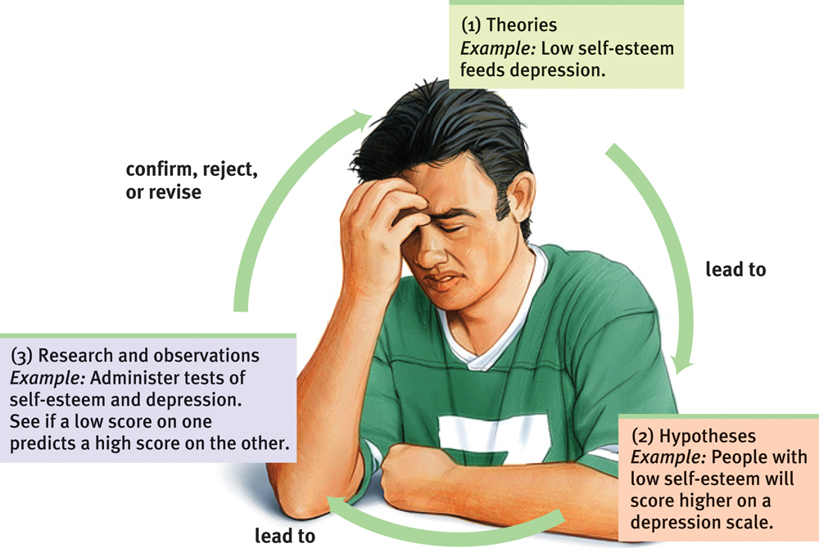
Research Process: the depression example
Notes:
No animation.
Instructor: Optional slide. If you use it, consider critiquing this example from the book as I have done below.
Problem with this example, as we soon will see; the procedure described in part (3) only tells us whether self-esteem and depression vary together, but does not tell us whether low self-esteem “feeds” (implication: causes or worsens) depression. The result might be explained by depression “feeding” low self-esteem!
We would come closer if there was a test of self-esteem in non-depressed people, and then the low self-esteem group later became more depressed, or if interventions that changed self esteem only were found to have an impact on depression.
And of course, this implies that a “depression scale” and a “test of self-esteem’ is a meaningful and accurate (in all cases and at all times) measure of ‘depression’ and ‘self-esteem.’

Slide 15
Scientific Method: Tools and Goals
The basics:
Theory
Hypothesis
Operational Definitions
Replication
Now that we’ve covered this
Research goals/types:
Description
Correlation
Prediction
Causation
Experiments
We can move on to this
Notes:
Automatic animation.

Slide 16
Research goal and strategy: description
Descriptive research is a systematic, objective observation of people.
Strategies for gathering this information:
Case Study: observing and gathering information to compile an in-depth study of one individual
Naturalistic Observation: gathering data about behavior; watching but not intervening
Surveys and Interviews: having other people report on their own attitudes and behavior
The goal is to provide a clear, accurate picture of people’s behaviors, thoughts, and attributes.
Notes:
Click to reveal three strategies for gathering information.
“Attributes” here refers to age, gender, income, and other labels that might sort people into categories in our studies. Note that all categories are culturally determined.

Slide 17
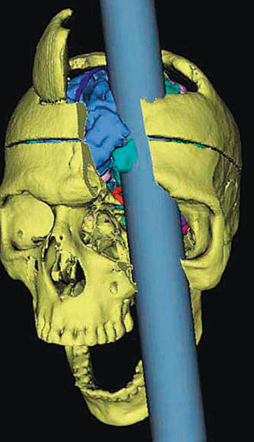
Case Study
Examining one individual in depth
Benefit: can be a source of ideas about human nature in general
Example: cases of brain damage have suggested the function of different parts of the brain (e.g. Phineas Gage)
Danger: overgeneralization from one example; “he got better after tapping his head so tapping must be the key to health!”
Notes:
Click to reveal bullets.
“The plural of anecdote is not evidence” quote in the book has appeared in many versions, including the original quote that the plural of anecdote IS data. The key is whether data is collected and analyzed systematically. That’s where the next two topics take steps in the right direction..

Slide 18
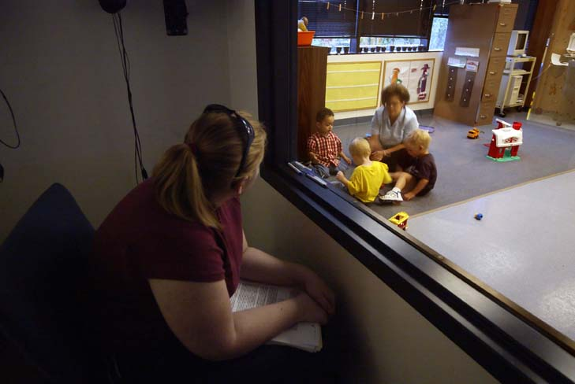
Naturalistic Observation
Observing “natural” behavior means just watching (and taking notes), and not trying to change anything.
This method can be used to study more than one individual, and to find truths that apply to a broader population.
Notes:
Click to reveal bullets.

Slide 19
The Survey
Wording effects
the results you get from a survey can be changed by your word selection.
Example:
Q: Do you have motivation to study hard for this course?
Q: Do you feel a desire to study hard for this course?
Definition: A method of gathering information about many people’s thoughts or behaviors through self-report rather than observation.
Keys to getting useful information:
  Be careful about the wording of questions
  Only question randomly sampled people
Notes:
Click to reveal all bullets on right.
Something to say before clicking-in the second bullet: “A survey generally covers more people than naturalistic observation, so it may find truths that apply to an even broader population, IF you do it right.”
The next slides are about doing it right.
Click to reveal sidebar.
“The wording effect can be manipulated: use your critical thinking to catch this. Someone wanting to make students look ambitious would choose the first question, while someone wanting to make students look lazy could choose the second.”

Slide 20
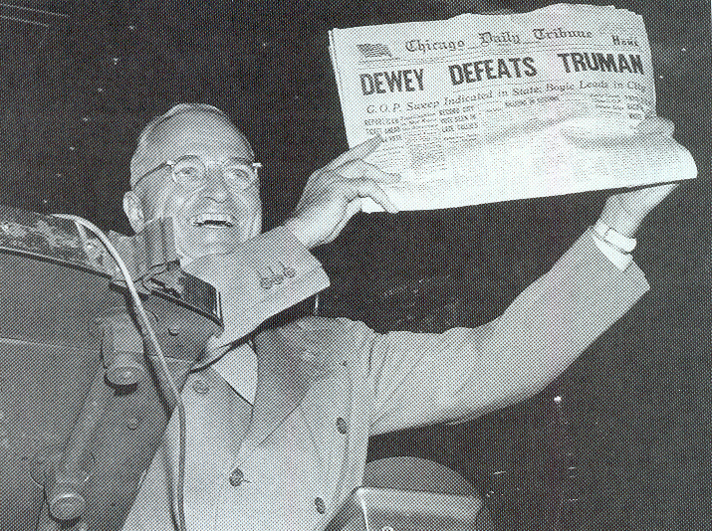
What psychology science mistake was made here?
Hint #2: The Chicago Tribune interviewed people about whom they would vote for.
Hint #3:
in 1948.
Hint #4: by phone.
Hint #1: Harry Truman won.
Notes:
Optional Slide, to introduce the topic of the need for RANDOM sampling.
Automatic animation.
Answer to the title question: People wealthy and urban enough to have a phone in 1948 were more likely to report having voted for Thomas Dewey.
This example shows how you need to make a plan for a random sample that represents a population. If your results are supposed to describe all Americans who are likely and able to vote, you should try not leave out ones with no phones (or ones that don’t answer the phone, or ones only on one party’s mailing list, etc.).

Slide 21
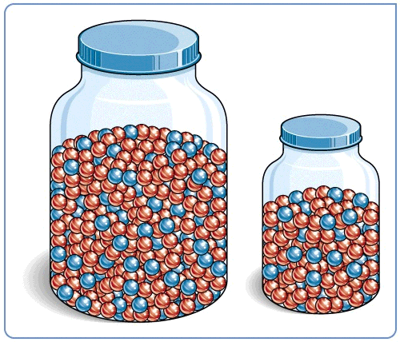
Why take a sample?
If you want to find out something about men, you can’t interview every single man on earth.
Sampling saves time. You can find the ratio of colors in this jar by making sure they are well mixed (randomized) and then taking a sample.
population
sample
Random sampling is a technique for making sure that every individual in a population has an equal chance of being in your sample.
“Random” means that your selection of participants is driven only by chance, not by any characteristic.
Notes:
Click to reveal bullets and example.
If this is done right, a few thousand people, randomly selected, can be an adequate predictor of the population of a country of 350 million people.
Click to reveal definition of random sampling. (two parts)
You can add: “If the red balls were larger than the other colors, it would be harder to get a random sample by shaking the jar (counterintuitively, the larger ones would rise to the top….)”

Slide 22
A possible result of many descriptive studies: discovering a correlation
In a case study: The fewer hours the boy was allowed to sleep, the more episodes of aggression he displayed.
Correlation
General Definition: an observation that two traits or attributes are related to each other (thus, they are “co”-related)
Scientific definition: a measure of how closely two factors vary together, or how well you can predict a change in one from observing a change in the other
In a naturalistic observation: Children in a classroom who were dressed in heavier clothes were more likely to fall asleep than those wearing lighter clothes.
In a survey: The greater the number of Facebook friends, the less time was spent studying.
Notes:
Optional: Click for 3 fictional examples.

Slide 23
Correlation
When one trait or behavior accompanies another, we say the two correlate.
ABSOLUTE VALUE of number:
Indicates strength of relationship
(0.00 to 1.00)
Correlation
coefficient
r =
+
0.37
Correlation Coefficient is a statistical measure of the relationship between two variables.
The SIGN:
Indicates direction
of relationship
(positive or negative)
Notes:
OBJECTIVE 8| Describe positive and negative correlations and explain how correlational measures can aid the process of prediction.

Slide 24
Finding Correlations: Scatterplots
Place a dot on the graph for each person, corresponding to the numbers for their height and shoe size.
In this imaginary example, height correlates with shoe size; as height goes up, shoe size goes up.
Height
Shoe size
Notes:
Click to reveal second bullet.
Instructor note: “when you’ve established a correlation like this, then for any given shoe size of a new person, you could predict the height, and vice versa.”

Slide 25
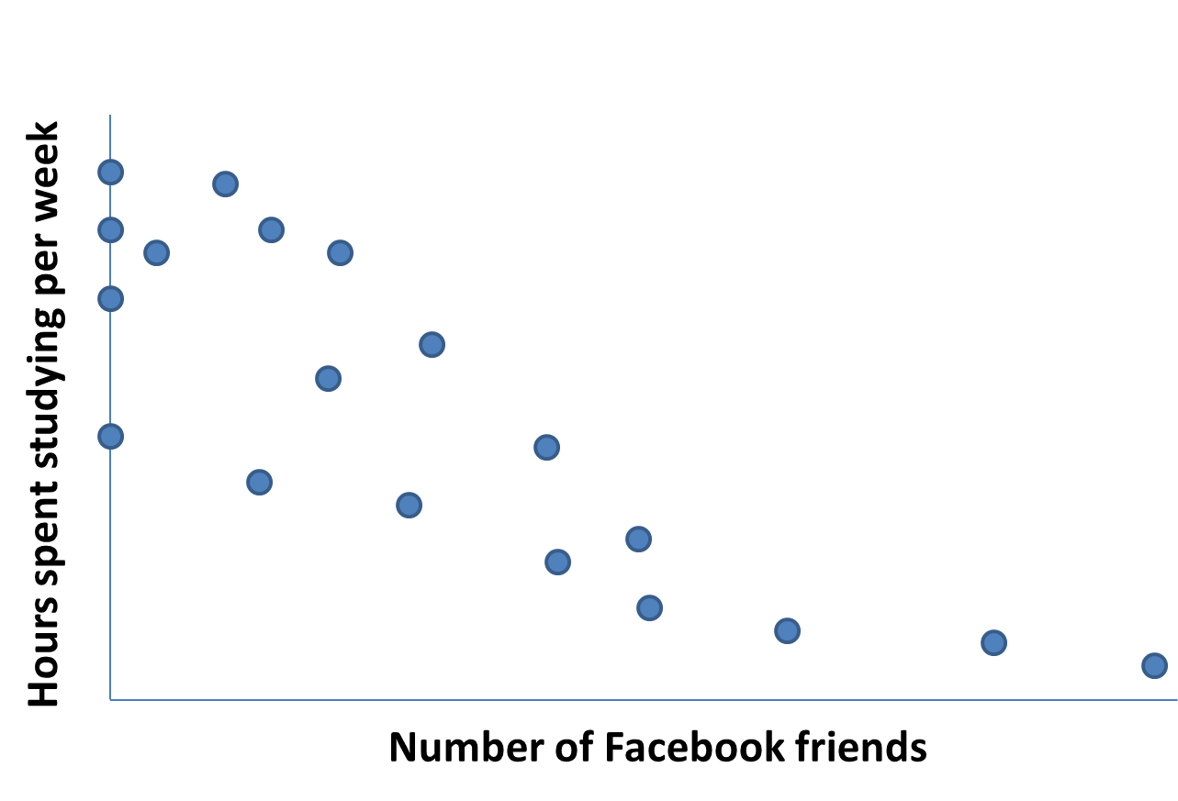
Negative Correlation:
Facebook and Studying
These are two factors which correlate; they vary together.
This is a negative correlation; as one number goes up, the other number goes down.
Notes:
Optional Slide, illustrating the concept.
Click to reveal bullets and example.

Slide 26
Correlation Coefficient
The correlation coefficient is a number representing the strength and direction of correlation.
The strength of the relationship refers to how close the dots are to a straight line, which means one variable changes exactly as the other one does; this number varies from 0.00 to +/- 1.00.
The direction of the correlation can be positive (both variables increase together) or negative (as one goes up, the other goes down).
Guess the Correlation Coefficients
Perfect positive correlation
Perfect negative correlation
No relationship,
no correlation
+ 1.00 - 1.00 0.00
Notes:
Click to reveal bullets and example. Click again to reveal answers.

Slide 27
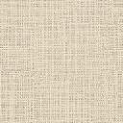
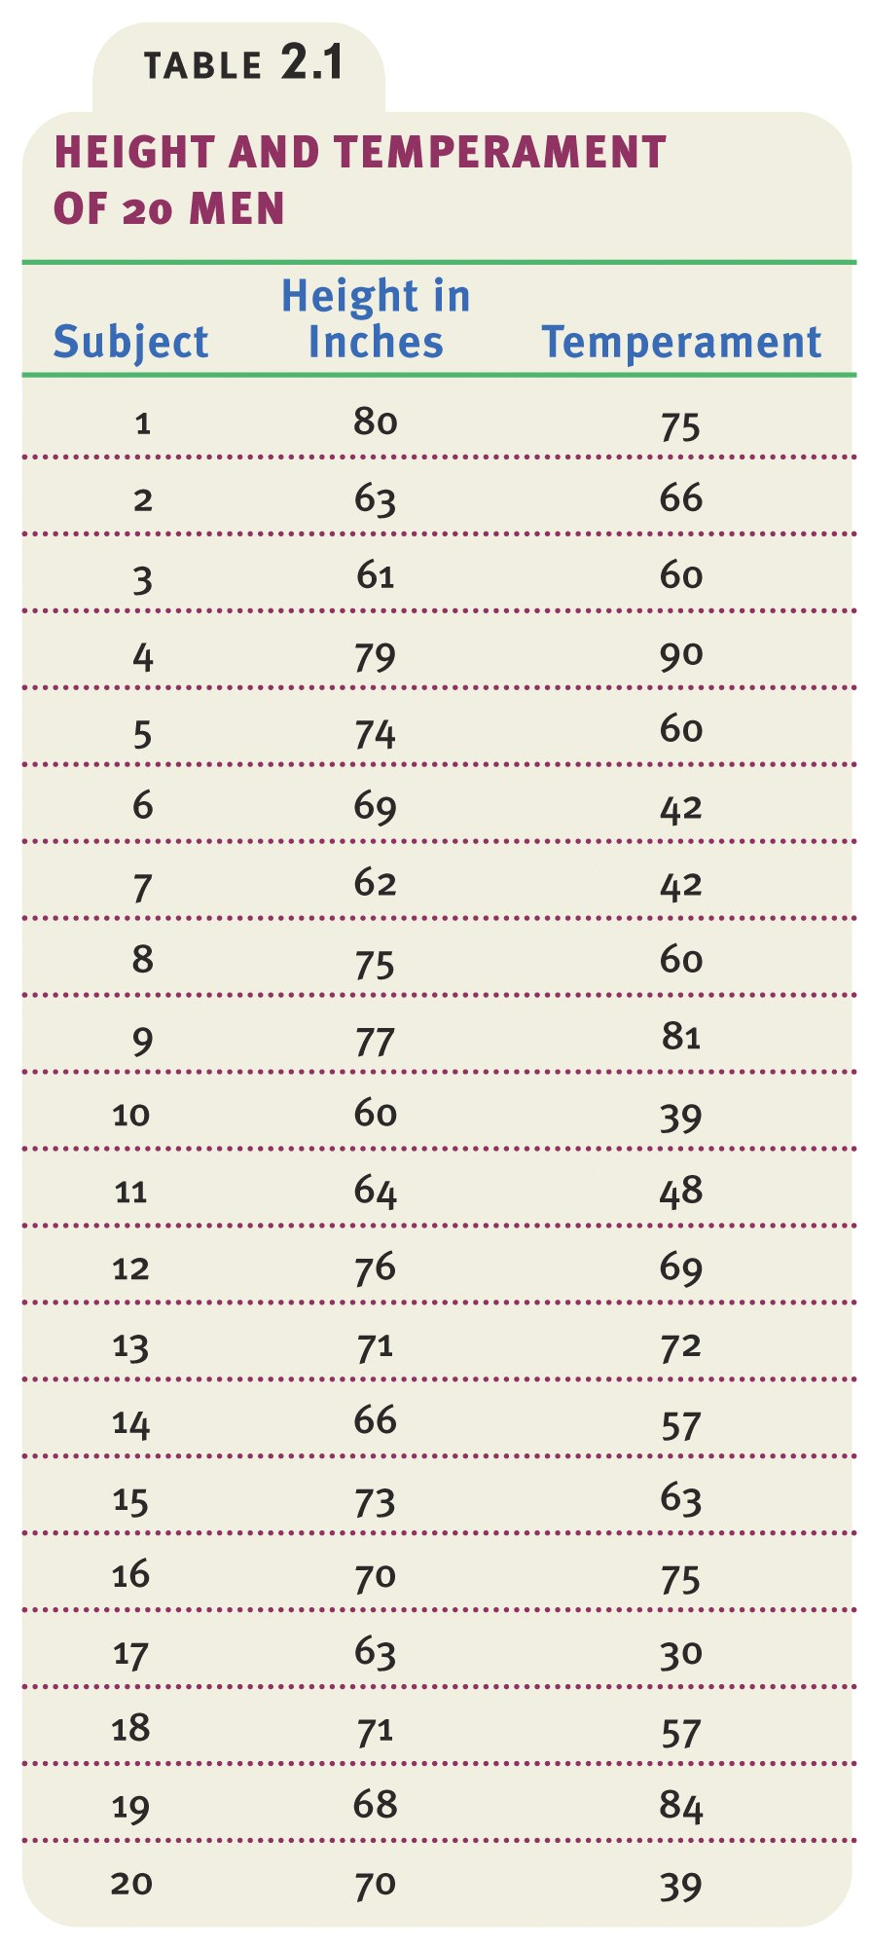
Data
Data showing height and temperament in people.

Slide 28
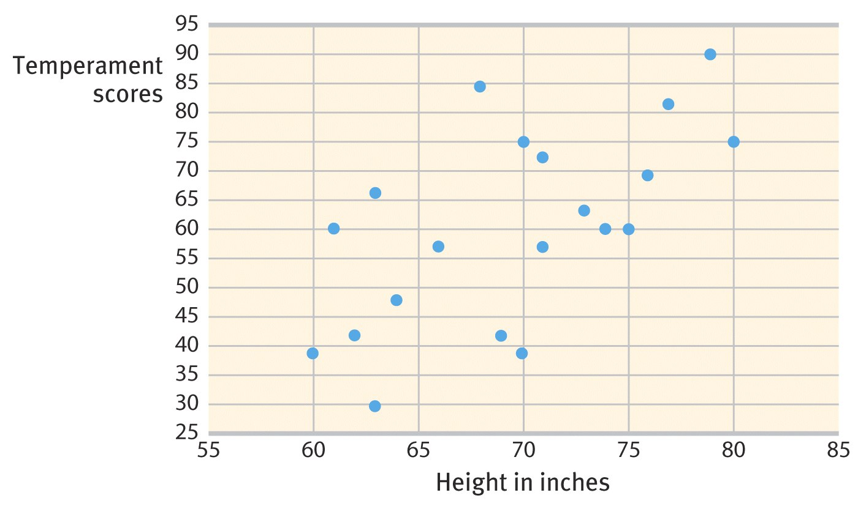
When scatterplots reveal correlations:
Height relates to shoe size, but does it also correlate to “temperamental reactivity score”? A table doesn’t show this, but the scatterplot does.
Notes:
Click to show example of scatterplot with line that shows correlation.

Slide 29

If we find a correlation, what conclusions can we draw from it?
Let’s say we find the following result:
there is a positive correlation between two variables,
ice cream sales, and
rates of violent crime
How do we explain this?
Notes:
Optional Slide, introducing the concept on the next slide, “correlation does not mean causation.”
Click to reveal bullets.
Possible explanations for this correlation:
“Does ice cream cause crime?
Does violence give people ice cream cravings?
Is it because daggers and cones look similar?
Perhaps both are increased by a third variable: hot weather.”

Slide 30
Correlation is not Causation!
“People who floss more regularly have less risk of heart disease.”
If this data is from a survey, can we conclude that flossing might prevent heart disease? Or that people with heart-healthy habits also floss regularly?
“People with bigger feet tend to be taller.”
Does that mean having bigger feet causes height?
Notes:
Click to reveal two examples and questions.
Not even if one event or change in a variable precedes another can we assume that one event or variation caused the other; the correlation between the two variables could still be caused by a third factor.
If the data is from a survey, we are presuming that the respondents answered accurately and/or truthfully.

Slide 31
Thinking critically about the text:
If a low self-esteem test score “predicts” a high depression score, what have we confirmed?
that low self-esteem causes or worsens depression?
that depression is bad for self-esteem?
that low self-esteem may be part of the definition of depression, and that we’re not really connecting two different variables at all?
Notes:
Optional Slide, illustrating the concept, getting students thinking before it’s diagrammed on the next slide.
Click to reveal bullets.

Slide 32
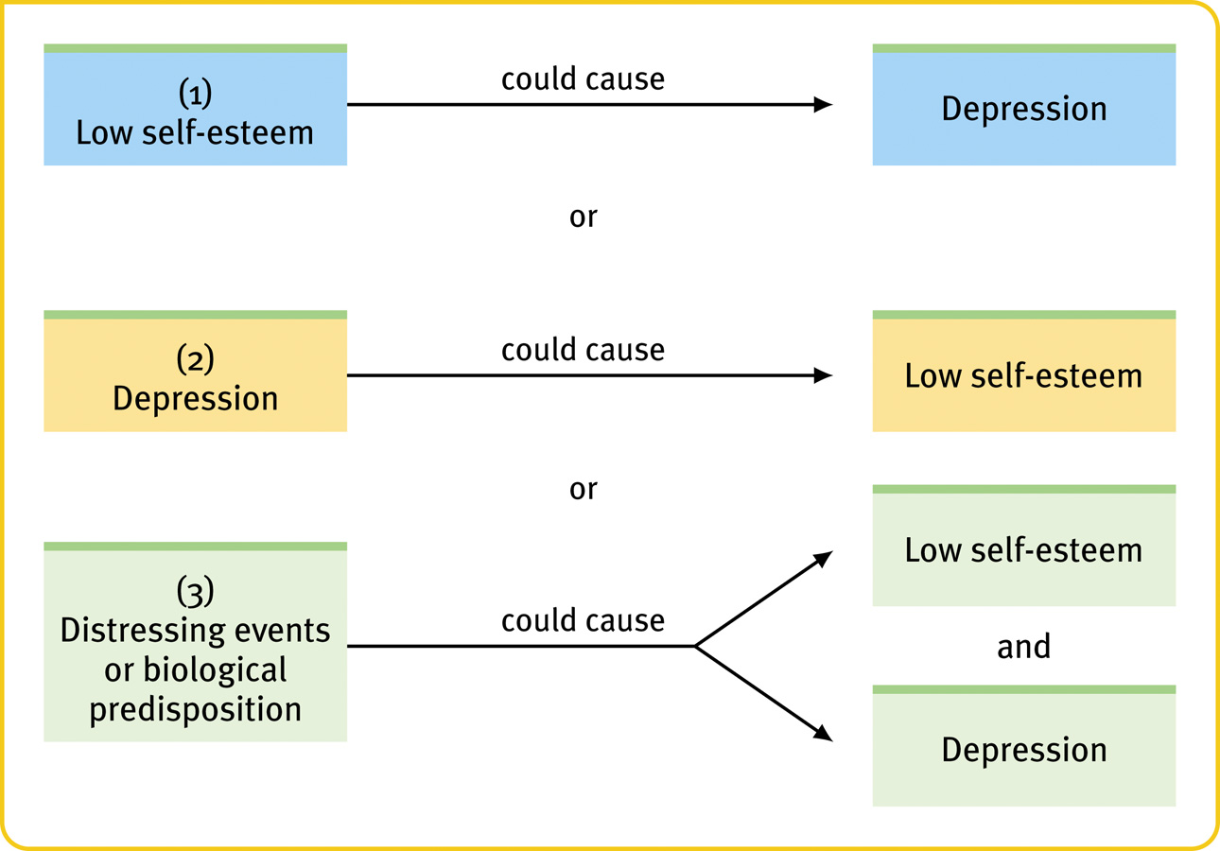
If self-esteem correlates with depression, there are still numerous possible causal links:
Notes:
No animation.

Slide 33
So how do we determine causation? By experimentation.
Experimentation: manipulating one factor in a situation to determine its effect
Example: removing sugar from the diet of children with ADHD to see if it makes a difference
In the depression/self-esteem example: trying interventions that improve self-esteem to see if they cause a reduction in depression
Notes:
Click to reveal bullets.
About the definition: sometimes you might manipulate more than one variable, but always a limited number of variables, manipulated in a controlled way.

Slide 34
Just to clarify two similar-sounding terms…
Random sampling is how you get a pool of research participants that represents the population you’re trying to learn about.
Random assignment of participants to control or experimental groups is how you control all variables except the one you’re manipulating.
First you sample, then you sort (assign).
Notes:
Automatic animation.

Slide 35
Double-blind Procedure
In evaluating drug therapies, patients and experimenter’s assistants should remain unaware of which patients had the real treatment and which patients had the placebo treatment.
WHY IS THIS IMPORTANT???
Notes:
OBJECTIVE 13| Explain why random assignment and double-blind procedure build confidence in research findings.

Slide 36
Placebo effect
Working with the placebo effect:
Control groups may be given a placebo – an inactive substance or other fake treatment in place of the experimental treatment.
The control group is ideally “blind” to whether they are getting real or fake treatment.
Many studies are double-blind – neither participants nor research staff knows which participants are in the experimental or control groups.
How do we make sure that the experimental group doesn’t experience an effect because they expect to experience it?
Example: An experimental group gets a new drug while the control group gets nothing, yet both groups improve.
    Guess why.
Placebo effect: experimental effects that are caused by expectations about the intervention
Notes:
Click to reveal bullets, bubble and sidebar.
Note: the placebo effect even occurs for non-psychotropic medications and interventions.
In cases of psychotherapy, the control group can get chatty conversation or education instead of treatment.
The function of double-blind research (see if they can guess): to control for the effect of research expectations on the participants. Obviously, this works better for pills than psychotherapy.

Slide 37
The Control Group
If we manipulate a variable in an experimental group of people, and then we see an effect, how do we know the change wouldn’t have happened anyway?
We solve this problem by comparing this group to a control group, a group that is the same in every way except the one variable we are changing.
    Example: two groups of children have ADHD, but only one group stops eating refined sugar.
By using random assignment: randomly selecting some study participants to be assigned to the control group or the experimental group.
How do make sure the control group is really identical in every way to the experimental group?
Notes:
Click to reveal bullets.
You could add/explain: “It’s called a “control” group rather than just a “comparison” group because using such a group is like being able to control the factors in the situation except the one you are manipulating.
If the experimental group showed a reduction in ADHD symptoms, but the control group did also, we don’t have evidence that eliminating sugar made a difference (maybe they all got better because they were being watched, got other help, got older, etc).
Click to reveal two text boxes about random assignment.
Example: “If you let the participants choose which group they will be in-=-such as the mothers who decided to use breast milk vs. those who chose to use formula---then there may be some difference between the two groups.”
It is important here to review the difference between random assignment and random sampling, because by test time this gets confused. You can use the next slide, but it would be better continuity to delete it and just remind them, below:
“Random sampling, from the population you’re trying to learn about, refers to how you get your pool of research participants; random assignment of people to control or experimental groups is how you control all variables except the one you’re manipulating.”

Slide 38
Naming the variables
The variable we are able to manipulate independently of what the other variables are doing is called the independent variable (IV).
The variable we expect to experience a change which depends on the manipulation we’re doing is called the dependent variable (DV).
  If we test the ADHD/sugar hypothesis:
    Sugar = Cause = Independent Variable
    ADHD = Effect = Dependent Variable
The other variables that might have an effect on the dependent variable are confounding variables.
  Did ice cream sales cause a rise in violence, or vice versa? There might be a confounding variable: temperature.
Notes:
Click to reveal three types.
Principle: try not to let the confounding variables vary!
How to prevent the confounding variables from varying in the ice cream example: you could do all your data collection only on days in which the high temperature is 70 degrees (but why 70 degrees? why not 60 or 80 degrees? Or make the temperature a third variable? But then what about humidity?).

Slide 39
Filling in our definition of experimentation
An experiment is a type of research in which the researcher carefully manipulates a limited number of factors (IVs) and measures the impact on other factors (DVs).
*in psychology, you would be looking at the effect of the experimental change (IV) on a behavior or mental process (DV).
Notes:
Click to reveal second bubble.

Slide 40
Correlation vs. Causation: the breastfeeding/intelligence question
Studies have found that children who were breastfed score higher on intelligence tests, on average, than those who were bottle-fed.
Can we conclude that breast feeding CAUSES higher intelligence?
Not necessarily. There are at least two confounding variables: genes and education. The intelligence test scores of the mothers might be higher in those who choose breastfeeding, and the quality of the schools the children attend could be different.
So how do we deal with this confounding variable? Hint: experiment.
Notes:
Click to reveal bullets.
These questions set up the next slide about bottle vs. breast feeding experiments.
These slides contrast the difference in what we can conclude from descriptive research vs. experimental research.

Slide 41
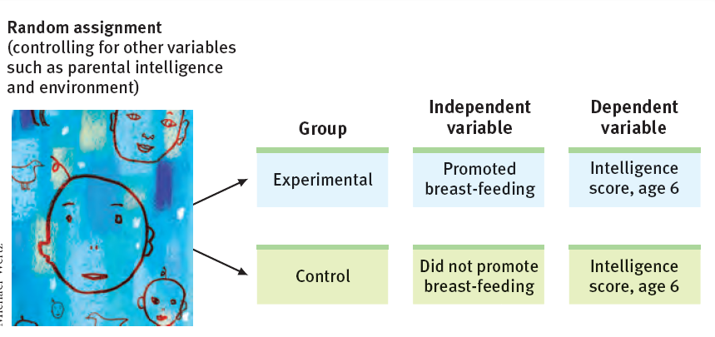
Ruling out confounding variables: experiment with random assignment
An actual study: women were randomly selected to be in a group in which breastfeeding was promoted
+6 points
Notes:
No animation.
Note: for ethical and practical reasons, it is problematic to have researchers actually make the choice of nutrition for the babies, as the graphic seems to indicate. Thus I’ve added a note about how the study in the book was conducted. In that study, intelligence tests were administered at age 6, not age 8; the diagram here refers to a different study, by Lucas in 1992.
Result of the study: 43 percent of women in the breastfeeding promotion group chose breastfeeding, but only 6 percent in the control group (regular pediatric care) chose breastfeeding (this was in Belarus, perhaps a part of the world influenced more than the United States by advertisements for buying formula).
Result: The kids in the group breastfeeding promotion group had intelligence scores 6 percentage points higher on average (not clear from the book if this figure included those who still chose not to breastfeed; it appears so).

Slide 42
Critical Thinking
Watch out: descriptive, naturalistic, retrospective research results are often presented as if they show causation.
Analyze this fictional result:
“People who attend psychotherapy tend to be more depressed than the average person.”
Does this mean psychotherapy worsens depression?
Notes:
Click to reveal additional text.
Hopefully, students will see that people who choose to use psychotherapy are possibly going to be more symptomatic (depressed, anxious, irritable, confused) than the general population.

Slide 43
Summary of the types of Research
Comparing Research Methods
Research Method | Basic Purpose | How Conducted | What is Manipulated | Weaknesses
Descriptive | To observe and record behavior | Perform case studies, surveys, or naturalistic observations | Nothing | No control of variables; single cases may be misleading
Correlational | To detect naturally occurring relationships; to assess how well one variable predicts another | Compute statistical association, sometimes among survey responses | Nothing | Does not specify cause-effect; one variable predicts another but this does not mean one causes the other
Experimental | To explore cause-effect | Manipulate one or more factors; randomly assign some to control group | The independent variable(s) | Sometimes not possible for practical or ethical reasons; results may not generalize to other contexts
Notes:
Click to reveal row for each research method.

Slide 44
From data to insight: statistics
The Need for Statistical Reasoning
A first glance at our observations might give a misleading picture.
  Example: Many people have a misleading picture of what income distribution in America is ideal, actual, or even possible.
Value of statistics:
  to present a more accurate picture of our data (e.g. the scatterplot) than we would see otherwise.
  to help us reach valid conclusions from our data; statistics are a crucial critical thinking tool.
We’ve done our research and gathered data.
Now what?
We can use statistics, which are tools for organizing, presenting, analyzing, and interpreting data.
Notes:
Click to reveal bullets, then sidebar bullets.
A statistical tool we’ve already seen: the scatterplot.

Slide 45
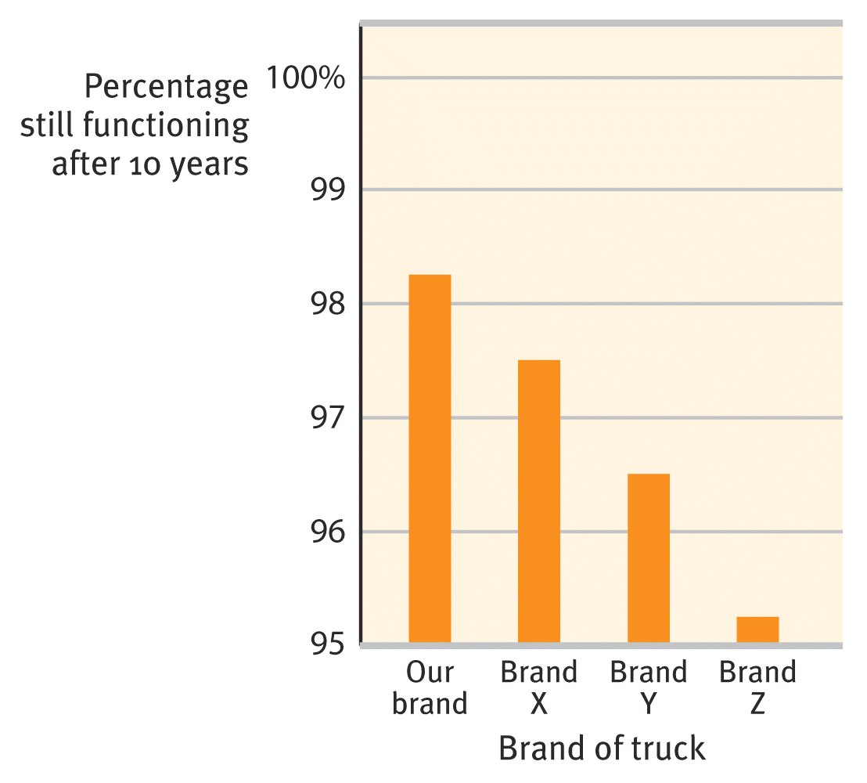
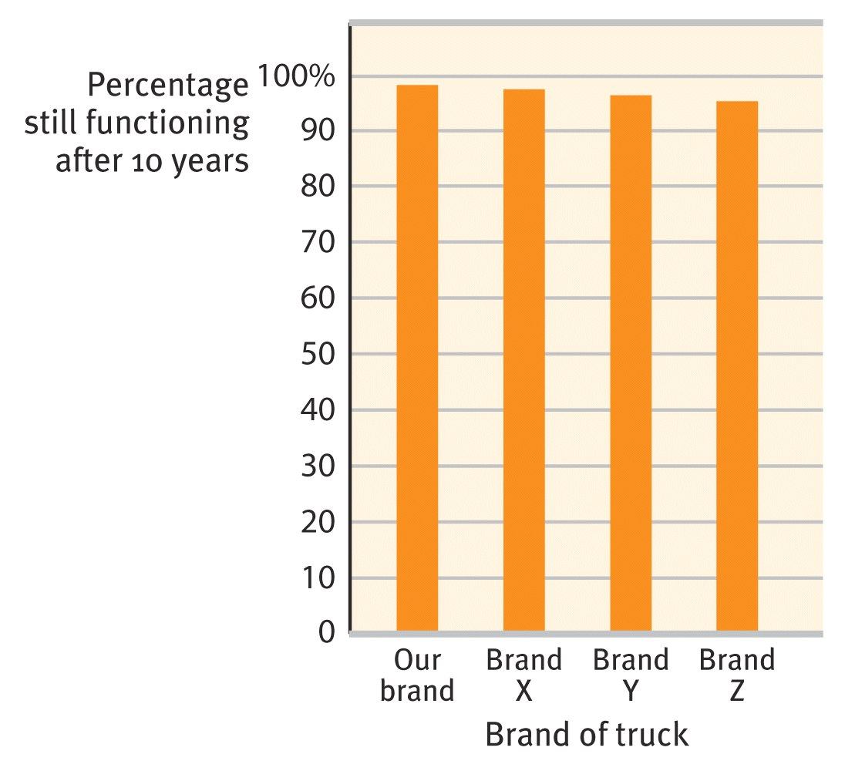
Tools for Describing Data
The bar graph is one simple display method but even this tool can be manipulated.
Our brand of truck is better!
Our brand of truck is not so different…
Why is there a difference in the apparent result?
Notes:
Automatic animation.

Slide 46
Measures of central tendency
Are you looking for just ONE NUMBER to describe a population’s income, height, or age?
Options:
Mode
Mean
(arithmetic “average”)
Median
(middle person’s score, or 50th percentile)
  the most common level/number/
  score
  the sum of the scores, divided by the number of scores
  the number/level that half of people scored above and half of them below
Notes:
Click to reveal the three options.

Slide 47
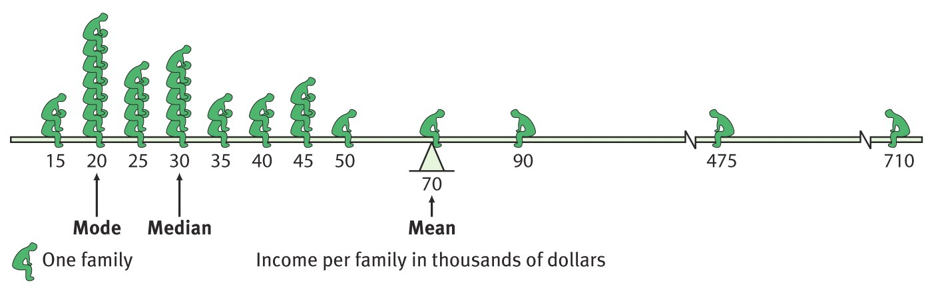
Measures of central tendency
Here is the mode, median, and mean of a family income distribution. Note that this is a skewed distribution; a few families greatly raise the mean score.
Why does this seesaw balance? Notice these gaps?
Notes:
In this type of distribution, no one’s family income can be below zero, but the other end of the scale is unlimited.
Click to reveal example.

Slide 48
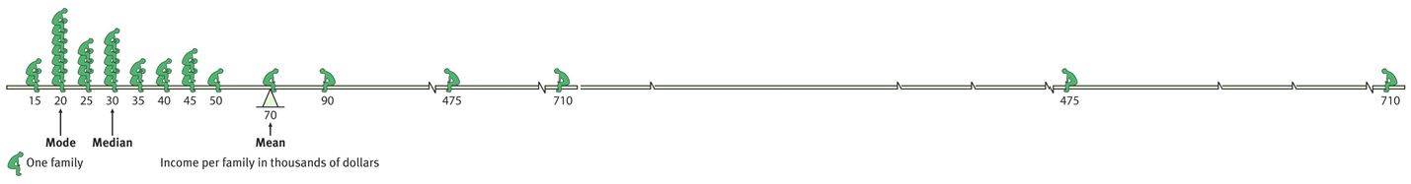
A different view, showing why the seesaw balances:
The income is so high for some families on the right that just a few families can balance the income of all the families to the left of the mean.
Notes:
Click to reveal explanation.
See if students understand the concepts well enough to understand that changing the income of the highest family changes the mean income, but does not change the mode or even the median. What would change the mode?...(changing which stack of people is the biggest). What would change the median?...(moving some families from one side of the current mean to the other).

Slide 49
Measures of variation:
how spread out are the scores?
Range: the difference between the highest and lowest scores in a distribution
Standard deviation: a calculation of the average distance of scores from the mean
Small standard deviation
Large standard deviation
Mean
Notes:
No animation.

Slide 50
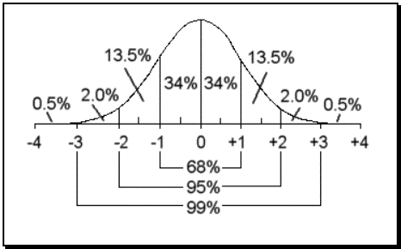
100

Slide 51
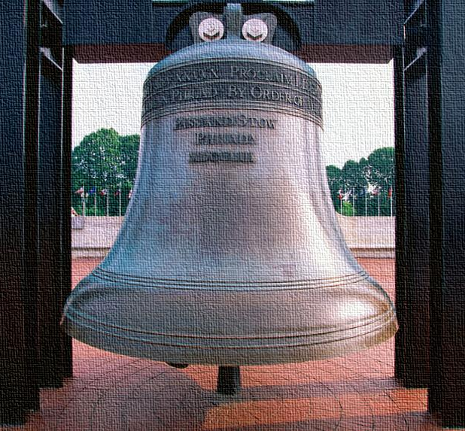
Skewed vs. Normal Distribution
Income distribution is skewed by the very rich.
Intelligence test distribution tends to form a symmetric “bell” shape that is so typical that it is called the normal curve.
Skewed distribution
Normal curve
Notes:
Automatic animation.

Slide 52
Applying the concepts
Try, with the help of this rough drawing below, to describe intelligence test scores at a high school and at a college using the concepts of range and standard deviation.
Intelligence test scores at a high school
Intelligence test scores at a college
100
Notes:
No animation.
Notice that in this fictional example, the range is the same, but the mean is different. More importantly, the standard deviation is smaller at a college. Possible explanation: there is likely to be a narrower range of intelligence test scores at a college than at a high school, because at a given college, people with lower intelligence test scores might not have the SAT/ACT scores and grades to be accepted, and people with higher intelligence test scores might have the SAT/ACT scores to apply to a college with a higher median student ability level.

Slide 53
Drawing conclusions from data: are the results useful?
After finding a pattern in our data that shows a difference between one group and another, we can ask more questions.
Is the difference reliable: can we use this result to generalize or to predict the future behavior of the broader population?
Is the difference significant: could the result have been caused by random/ chance variation between the groups?
How to achieve reliability:
Nonbiased sampling: Make sure the sample that you studied is a good representation of the population you are trying to learn about.
Consistency: Check that the data (responses, observations) is not too widely varied to show a clear pattern.
Many data points: Don’t try to generalize from just a few cases, instances, or responses.
When have you found statistically significant difference (e.g. between experimental and control groups)?
When your data is reliable AND
When the difference between the groups is large (e.g. the data’s distribution curves do not overlap too much).
Notes:
Click to reveal bullets, then click to reveal an additional text box about reliability and one about significant.
Remember: a result can have STATISTICAL significance (clearly not a difference caused by chance), but still not signify much.

Slide 54
The Need for Ethical Principles
Psychologists must ask and answer questions such as:
  Are we putting our participants at risk?
  Is our experimental treatment harmful?
  Is the information we will gather from our experiment worth the potential risk and harm to participants that is involved?

Slide 55
The Need for Ethical Principles
Four instances that created major concern regarding research ethics are:
  The medical atrocities of World War II
  The Tuskegee syphilis project
  The Willowbrook hepatitis project
  Stanley Milgram’s obedience studies of the 1960’s

Slide 56
The Need for Ethical Principles
Many Nazis who committed medical research atrocities during World War II were prosecuted at the Nuremburg War Tribunal. The Nuremburg Code stressed consideration of the following ethical principles of research:
  Participants should consent to participate in research.
  Participants should be fully informed of the nature of the research project.
  Risks should be avoided whenever possible.
  Participants should be conducted by scientifically qualified personnel.
  Participants have the right to discontinue participation at any time.

Slide 57
APA Principles in the Conduct of Research with Humans
Experiments such as the Tuskegee syphilis project and Milgram’s study have led to the development of ethical guidelines by the APA.
The APA adopted and published the original code of ethics in 1973; it was revised in 1982, and again in 2002.

Slide 58
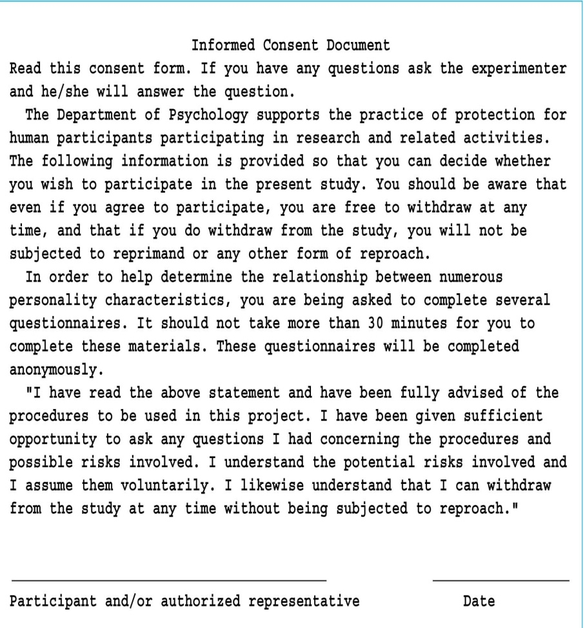
APA Principles in the Conduct of Research with Humans
Informed Consent
  The informed consent form should:
    Give a general description of the project in which they are going to participate.
    Inform the participants that no penalties will be invoked if they choose not to participate.
    Clearly state that participants have the right to withdraw their participation at any time they desire.

Slide 59
APA Principles in the Conduct of Research with Humans
Participants at Risk and Participants at Minimal Risk
  Participants at risk: are participants who, by virtue of their participation in the research project, are placed under some emotional or physical risk.
  Securing informed consent from participants at risk is a mandatory condition.
    What about those participants at risk who are participating in a study involving deception?
    How do we satisfy the ethical guidelines in such as case?

Slide 60
APA Principles in the Conduct of Research with Humans
Participants at Risk and Participants at Minimal Risk
  Participants at minimal risk: are participants who will experience no harmful effects through taking part in the research project.

Slide 61
APA Principles in the Conduct of Research with Humans
The Debriefing Session:
  Is usually the final step in conducting the research project
  Involves explaining to the participants the nature and purpose(s) of the project.

Slide 62
The Institutional Review Board
The Institutional Review Board (IRB) is a campus review panel for the use of human participants in research projects.
  At some institutions the IRB also reviews research projects that utilize animals.
  Many institutions have an Animal Care and Use Committee that reviews research projects that utilize animals.
    A veterinarian must be a member of any panel that reviews animal research proposals.
  The typical IRB is composed of a cross-section of individuals.
    IRB’s might contain faculty members from history, biology, education, psychology, and economics, as well as one or two members from the community who are not associated with the institution.
    The IRB serves to ensure that the experimenter treats research participants, whether they are humans or animals, according to the established ethical guidelines.

