Slide 1
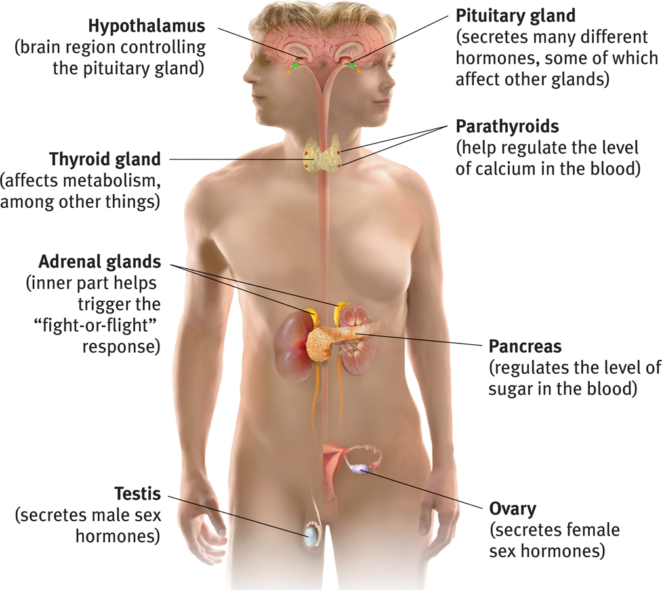
The Body’s “Slow but Sure” Endocrine Message System
The endocrine system sends molecules as messages, just like the nervous system, but it sends them through the bloodstream instead of across synapses.
These molecules, called hormones, are produced in various glands around the body.
The messages go to the brain and other tissues.
Hormones hang out for a bit, so the effect of the message lasts longer.
The endocrine system refers to a set of glands that produce chemical messengers called hormones.
Notes:
Click to reveal bullets.
“Slow but sure” endocrine system messages take longer to get to their location, but then the molecules hang around for a bit, so the effect of the “message” lasts longer. In neural communication, reuptake of the neurotransmitters sometimes prevents effective communication. (This is the real “chemical imbalance” treated by some medication: slowing reuptake.)

Slide 2
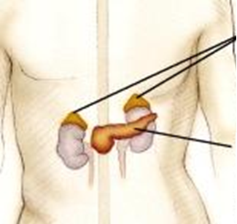
Adrenal Glands
produce hormones such as adrenaline/epinephrine, noradrenaline/norepinephrine, and cortisol.
Adrenal Glands
The sympathetic “fight or flight” nervous system responds to stress by sending a message to adrenal glands to release the hormones listed above.
Effect: increased heart rate, blood pressure, and blood sugar. These provide ENERGY for the fight or flight!
Pancreas
Notes:
Click to reveal bullets.
The adrenal glands also produce cortisol; more about this when we talk about stress and health.

Slide 3
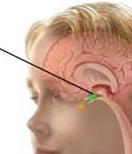
The Pituitary Gland
The pituitary gland is the “master gland” of the endocrine system.
It is controlled through the nervous system by the nearby brain area--the hypothalamus.
The pituitary gland produces hormones that regulate other glands such as the thyroid.
It also produces growth hormone (especially during sleep) and oxytocin, the “bonding” hormone.
Pituitary gland
Notes:
Click to reveal bullets.

Slide 4
Areas of the brain and their functions
The brainstem and cerebellum:
coordinates the body
The limbic (border) system:
manages emotions, and connects thought to body
The cortex (the outer covering):
integrates information
ensure basic survival
Notes:
No animation.

Slide 5
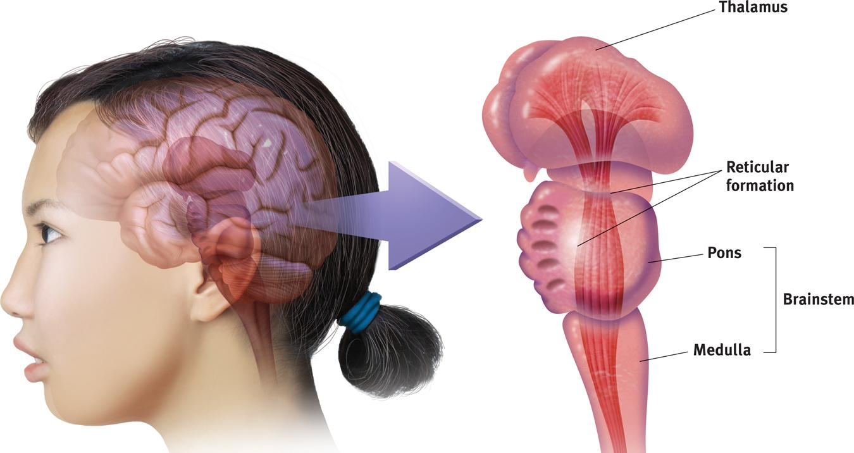
The Brainstem: Pons and Medulla
The medulla controls the most basic functions such as heartbeat and respiration.
The pons (“bridge”) helps coordinate automatic and unconscious movements. It relays signals from the forebrain to the cerebellum, along with nuclei that deal primarily with sleep, respiration, swallowing, bladder control, hearing, equilibrium, taste, eye movement, facial expressions, facial sensation, and posture. The pons is implicated in sleep paralysis, and also plays a role in generating dreams
Notes:
Click to reveal second bullet.
The brain’s innermost region begins where the spinal cord enters the skull. Christopher Reeve (1952-2004; an image of him here might work well), an actor in Superman movies and Smallville, couldn’t breathe on his own after a horse riding accident broke his spine at the level of the medulla.

Slide 6
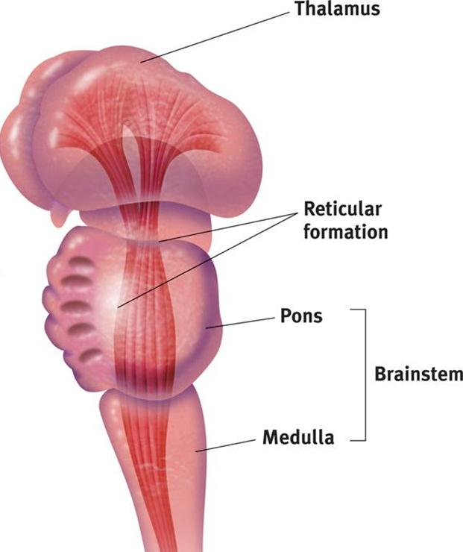
Reticular (“Netlike”) Formation
The reticular formation is a nerve network in the brainstem.
It enables alertness, (arousal) from deep sleep to wide awake when stimulated and produces permanent coma when lesioned (as demonstrated in the cat experiments).
It also filters incoming sensory information and controls selective awareness.
Notes:
Click to reveal bullets.
Additional information/lecture material:
The structure of the reticular formation: this network of neurons branches from the spinal cord up into the thalamus. I have added two lines to the picture to indicate this.
How do we know about arousal? In the cat experiments, researchers stimulated the reticular formation in order to make a sleeping cat pop awake. Similarly, cutting the reticular formation made a cat lapse into a permanent coma.
About the filtering: it could be said that the reticular formation controls selective awareness; it ‘selects’ which incoming information to send to other brain areas. This enables us to follow a conversation in a crowd, i.e. to select a “signal” out of sensory “noise.”

Slide 7
The Thalamus (“Inner Chamber”)
The thalamus is the “sensory switchboard” or “router.”
All sensory messages, except smell, are routed through the thalamus on the way to the cortex (higher, outer brain).
The thalamus also sends messages from the cortex to the medulla and cerebellum.
Damage to the thalamus can cause blindness and other loss of the senses, even if the sensory organ is fine.
Notes:
Click to reveal bullets.
The book says “switchboard,” but perhaps it’s time to upgrade the term to “router.”
Damage to the thalamus can cause blindness and other loss of the senses, even if the sensory organ is fine.
However, damage to the thalamus could not hurt your sense of smell, which bypasses the thalamus and goes straight to the olfactory bulb in the brain.

Slide 8
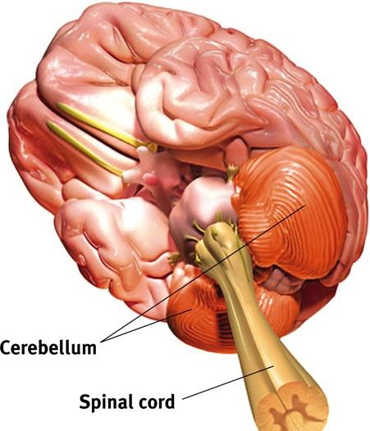
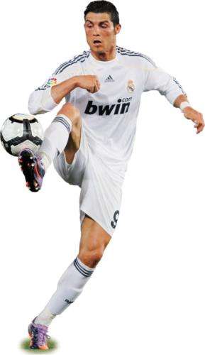
Cerebellum (“little brain”)
The cerebellum helps coordinate voluntary movement and balance, such as playing a sport.
The cerebellum also is the area where implicit memories and conditioning are stored. It also helps us judge time, modulate emotions, and integrate multiple sources of sensory input.
Notes:
Click to reveal bullets.
The cerebellum is located in two parts, behind the pons and below the back of the brain.
The cerebellum also is the area where implicit memories and conditioning are stored. It also helps us judge time, modulate emotions, and integrate multiple sources of sensory input.

Slide 9
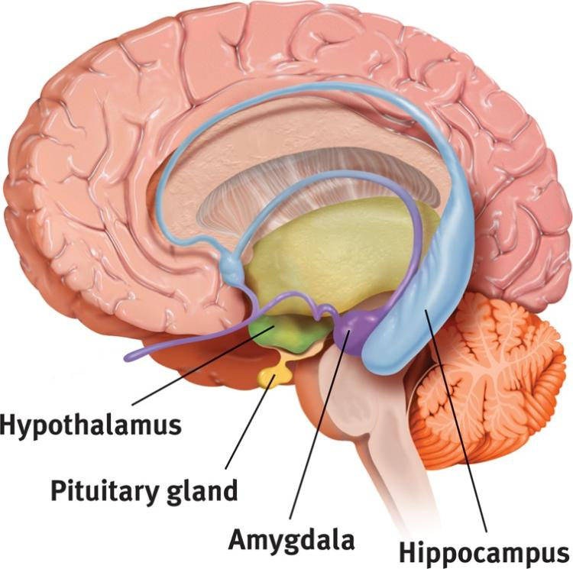
The Limbic (“Border”) System
The limbic system coordinates:
emotions such as fear and aggression.
basic drives such as hunger and sex.
the formation of episodic memories.
The hippocampus (“seahorse”)
processes conscious, episodic memories.
works with the amygdala to form emotionally charged memories.
one of the few places in the brain in which neurogenesis is known to take place.
The Amygdala (“almond”)
consists of two lima bean- sized neural clusters.
helps process emotions, especially fear and aggression.
Notes:
Click to reveal bullets.
The limbic system is located on the “border”/limbus between the brainstem and cortex; it is between the least complex and most advanced brain structures and between the cerebral hemispheres.
The hippocampus is one of the few places in the brain in which neurogenesis is known to take place.
Stimulating different parts of the amygdala triggers different versions of the defensive, self-protective emotions; one part increases aggressive reactions, while another increases fearful withdrawal. Destruction of part of the amygdala can apparently eliminate both emotions.
Note: aggression and fear reactions involve networks across the brain, and these reactions can be stimulated elsewhere.
The pituitary gland is in the text image, but I faded and shrank the label because it is not really part of the limbic system; I’ll restore it when talking about the hypothalamus.

Slide 10
The Amygdala
Electrical stimulation of a cat’s amygdala provokes aggressive reactions.
If you move the electrode very slightly and cage the cat with a mouse, the cat will cower in terror.
Destruction of part of the amygdala can apparently eliminate both emotions.
Notes:
Click to reveal bullets.

Slide 11
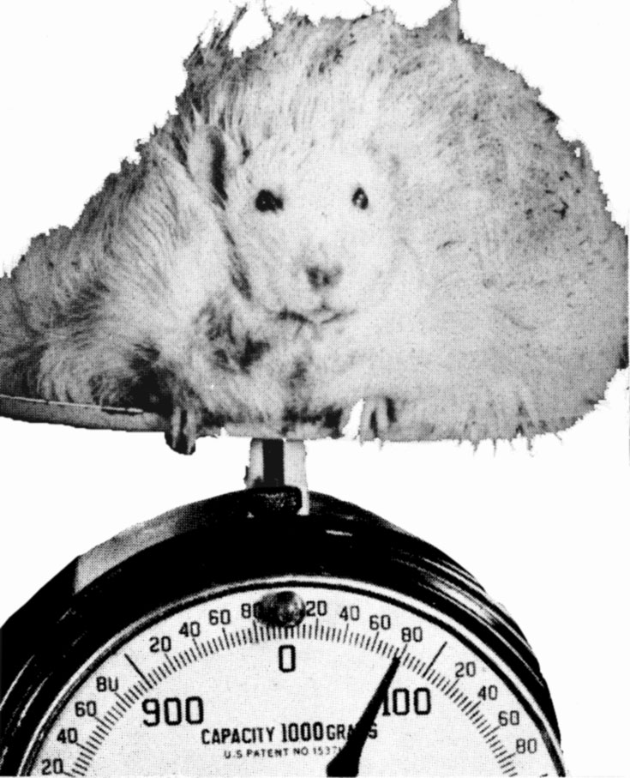
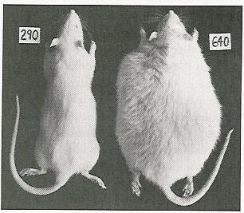
Hypothalamus
DUDE!!! WHAT HAPPENED???

Slide 12
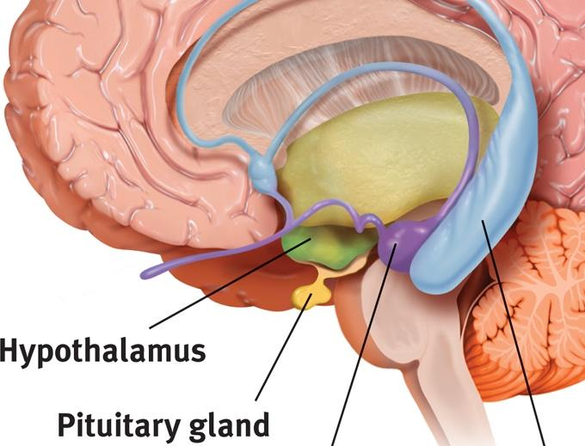
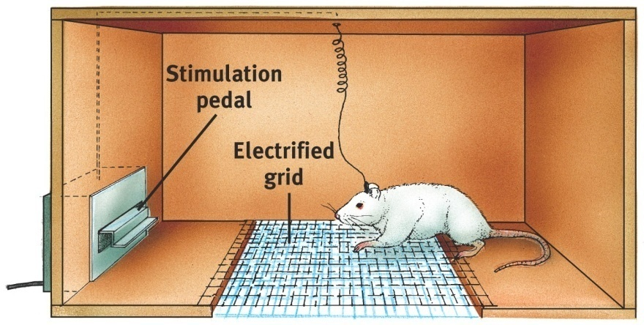
The Hypothalamus:
lies below (“hypo”) the thalamus.
regulates body temperature and ensures adequate food and water intake (homeostasis), and is involved in sex drive.
directs the endocrine system via messages to the pituitary gland.
Thalamus
The Hypothalamus as a Reward Center
Riddle: Why did the rat cross the grid?
Why did the rat want to get to the other side?
Pushing the pedal that stimulated the electrode placed in the hypothalamus was much more rewarding than food pellets.
Notes:
Click to reveal bullets.
If you lesion one part of the hypothalamus of a rat, it stops eating; lesion another part and it hardly stops eating.
Click to reveal ‘Hypothalamus Reward Center’ riddle. Click again for answer.
Instructor: After addressing the riddle on the slide, but before adding the additional lecture material below, consider throwing out a question, “So where on this screen is the reward center?. Is it here, (point to the cage), the place to go to get rewards? Oh, it’s up here? (point to the hypothalamus).” [This is where you could note, as below, that there are other reward centers…]
Additional lecture material:
There are other reward centers, including an area near the hypothalamus, the nucleus accumbens.
Many of these areas rely on dopamine, which may be why people with low dopamine (ADHD) don’t learn well from rewards, and why people who crave dopamine (ADHD, addicts, young teens, and those with reward deficiency syndrome) are reckless in their search for it, maybe even crossing an electrified grid like the rat in the illustration.

Slide 13
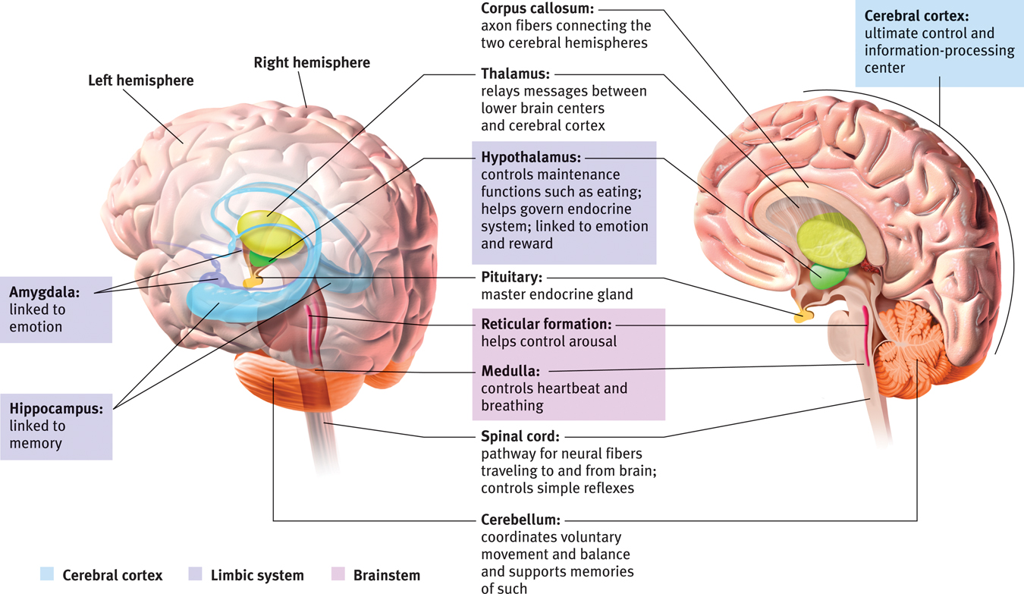
Review of Brain Structures
Notes:
No animation.

Slide 14
The Cerebral Cortex The lobes consist of:
outer grey “bark” structure that is wrinkled in order to create more surface area for 20+ billion neurons.
inner white stuff—axons linking parts of the brain.
180+ billion glial cells, which feed and protect neurons and assist neural transmission.
300 billion synaptic connections
The brain has left and right hemispheres
Notes:
Click to reveal bullets.
The orange area is the cerebellum.

Slide 15
The Lobes of the Cerebral Cortex: Preview
involved in speaking and muscle movements and in making plans and judgments
Frontal Lobes
Parietal Lobes
Occipital Lobes
Temporal Lobes
include the sensory cortex
include the visual areas; they receive visual information from the opposite visual field
include the auditory processing areas
Notes:
Click to reveal bullets.

Slide 16
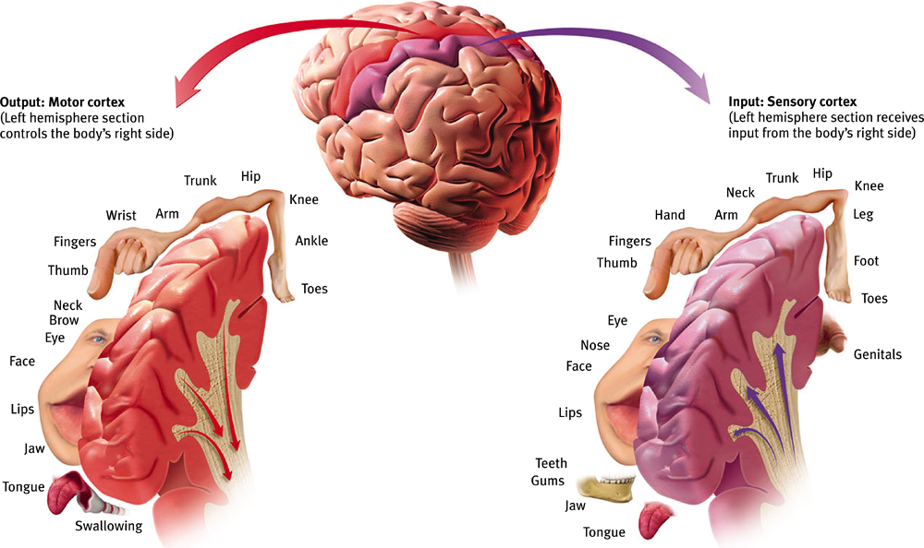
Functions of the Brain: The Motor and Sensory Strips
Output: Motor cortex (Left hemisphere section controls the body’s right side)
Input: Sensory cortex (Left hemisphere section receives input from the body’s right side)
← Axons receiving motor signals FROM the cortex
←Axons sending sensory information TO the cortex
Notes:
No animation.
The body parts along each strip represent the amount of neural space devoted to movement or sensation of that body part. Parts needing more precise sensation or control take up more cortical space.
These “strips” are located at the border of the frontal lobe and the parietal lobe.

Slide 17
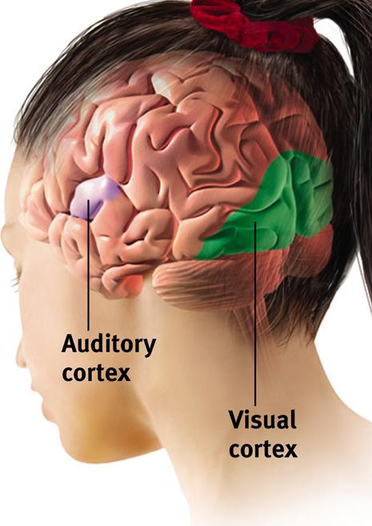
Sensory Functions of the Cortex
The sensory strip deals with information from touch stimuli.
The occipital lobe deals with visual information.
Auditory information is sent to the temporal lobe.
Auditory areas are also active when someone in a psychotic state is experiencing “voices” or auditory hallucinations
Notes:
Click to reveal bullets.
Auditory areas are also active when someone in a psychotic state is experiencing “voices”/auditory hallucinations

Slide 18
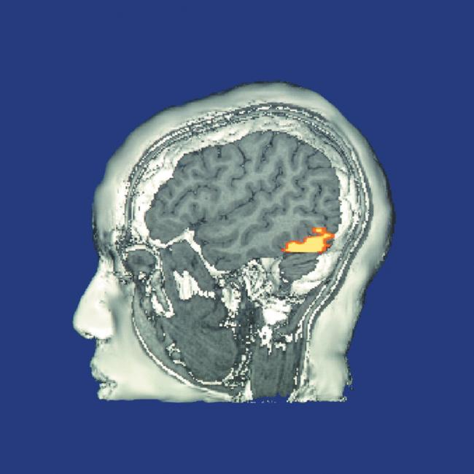
The Visual Cortex
This fMRI scan shows increased activity in the visual cortex when a person looks at a photograph.
Notes:
No animation.

Slide 19
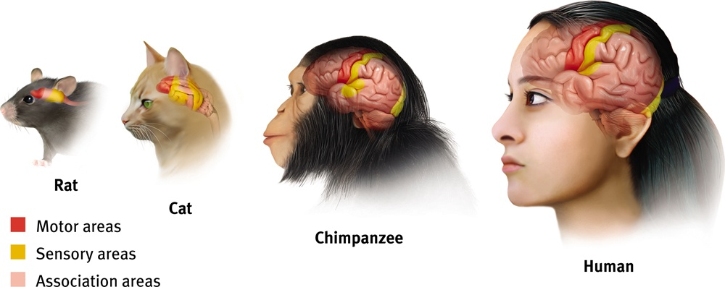
Association function of the cortex
More intelligent/complex animals have more cortical space devoted to integrating and associating information, hence: association areas
Notes:
No animation.
The relative proportion of the cortex devoted to taking in sensory information and sending out motor commands is smaller as the association areas are larger (a negative correlation).

Slide 20
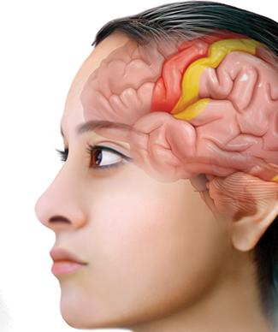
Association Areas: Frontal Lobes
The frontal lobes are active in “executive functions” such as judgment, planning, and inhibition of impulses.
The frontal lobes are also active in the use of working memory and the processing of new memories.
They contribute largely to making us uniquely “human.”
Notes:
Click to reveal bullets.
There is a large set of association areas in front of the motor strip and behind the forehead.

Slide 21
Phineas Gage (1823-1860)
Case study: In a work accident, a metal rod shot up through Phineas Gage’s skull, destroying his eye and part of his frontal lobes.
After healing, he was able to function in many ways, but his personality changed; he was rude, odd, irritable, and unpredictable.
Possible explanation:
Damage to the frontal lobes could result in loss of the ability to suppress impulses and to modulate emotions.
Notes:
The possible explanation appears with a click.
See if students can guess at an explanation for Gage’s symptoms based on the area of brain damage.

Slide 22
Parietal Lobe Association Areas
This part of the brain has many functions in the association areas behind the sensory strip:
managing input from multiple senses
performing spatial and mathematical reasoning
monitoring the sensation of movement
Notes:
Click to reveal bullets.

Slide 23
Temporal Lobe Association Areas
Some abilities managed by association areas in this “by the temples” lobe:
recognizing specific faces
managing sensory input related to sound, which helps the understanding of spoken words
Notes:
Click to reveal bullets.

Slide 24
Whole-brain Association Activity
Whole-brain association activity involves complex activities which require communication among association areas across the brain such as:
memory
language
attention
meditation and spirituality
consciousness
Notes:
Click to reveal list.

Slide 25
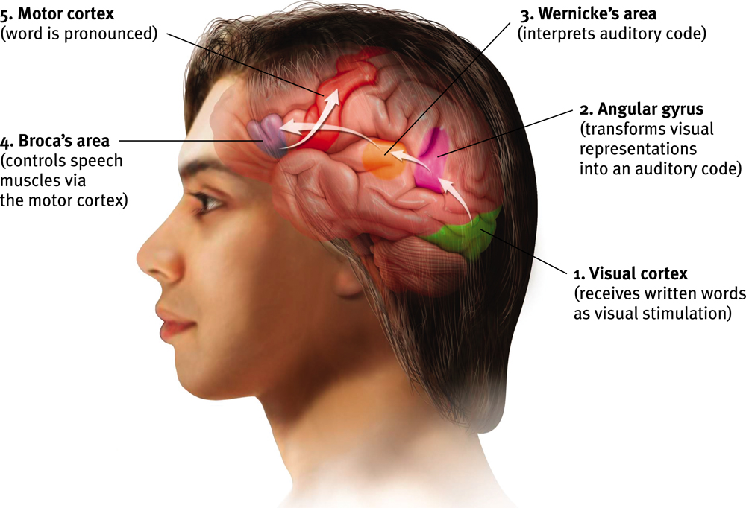
Specialization and Integration Five steps in reading a word aloud:
Notes:
No animation.
This slide should be considered optional here, or presented as such to the students, because this chapter no longer includes this image or this level of detail.
If any of these processes are not working properly (e.g because of damage to one of these brain areas in the left hemisphere), aphasia can result. Aphasia refers to the impairment of language, usually caused by left hemisphere damage either to Broca’s area (speech impairment) or to Wernicke’s area (impairing understanding or causing the inability to produce meaningful words).

Slide 26
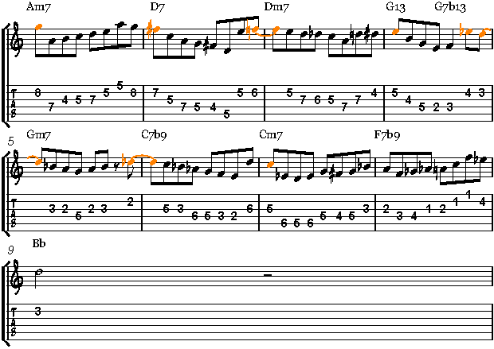
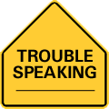
Language – A Lateralized Function
Broca’s Area
an area of the left frontal lobe that directs the muscle movements involved in speech
Expressive Aphasia
difficulty initiating and executing voluntary movement patterns necessary to produce speech when there is no paralysis or weakness of speech muscles.
Signs:
Producing the desired speech sound.
Using the correct rhythm and rate of speaking.

Slide 27
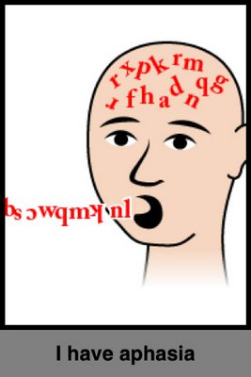
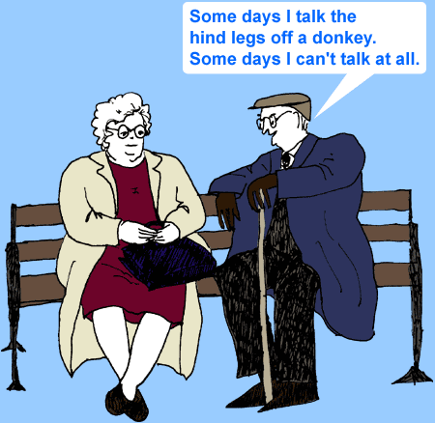
Language – A Lateralized Function
Wernicke’s Area
an area of the left temporal lobe involved in language comprehension and expression
Receptive Aphasia
impairment in the ability to use or comprehend words
Signs:
Understanding words.
Finding the word to express a thought
Understanding grammatical sentences.
Reading or writing words or sentences.

Slide 28
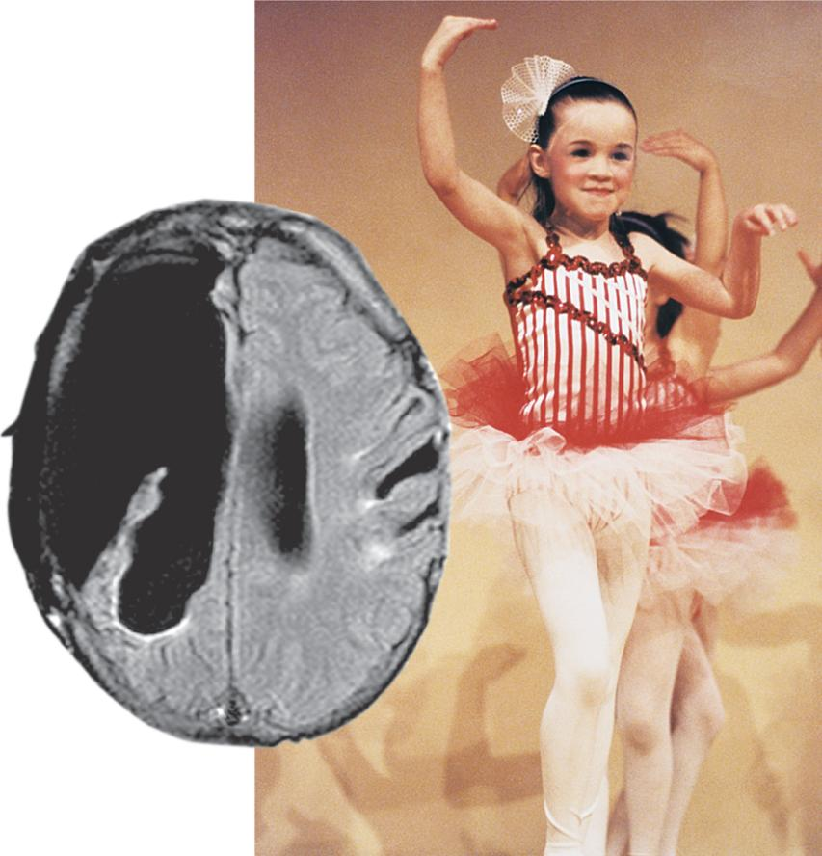
Plasticity: The Brain is Flexible
If the brain is damaged, especially in the general association areas of the cortex:
the brain does not repair damaged neurons, BUT it can restore some functions
it can form new connections, reassign existing networks, and insert new neurons, some grown from stem cells
This 6-year-old had a hemispherectomy to end life-threatening seizures; her remaining hemisphere compensated for the damage.
Notes:
Click to reveal bullets and example.
Despite lists of lateralized functions, there are many areas of overlap and duplication in the hemispheres. This is part of the reason that the girl with only one hemisphere was able to adapt.

Slide 29
Cerebral Cortex – Neural Organization Experiment
Some rats are housed alone in empty cages
Their littermate twins are group-housed in cages with toys, which are changed frequently
Richer environments led to heavier, thicker brains, more synapses, and better learning

Slide 30
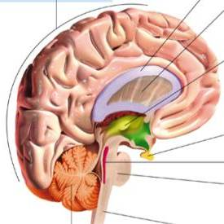
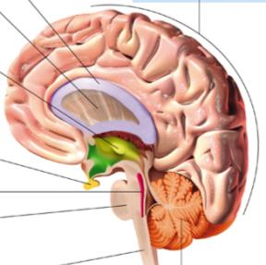
Our Two Hemispheres
Lateralization (“going to one side”)
The two hemispheres serve some different functions.
How do we know about these differences?
Brain damage studies revealed many functions of the left hemisphere.
Brain scans and split brain studies show more about the functions of the two hemispheres, and how they coordinate with each other.
Notes:
Click to reveal bullets.
Brain scan studies show normal individuals engage their right brain when completing a perceptual task and their left brain when carrying out a linguistic task. However, many functions of the two hemispheres overlap.

Slide 31
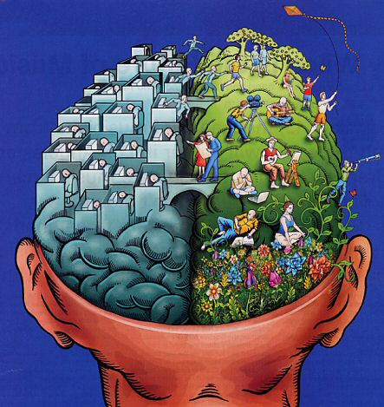
Our Divided Brain – The Two Hemispheres
Left Hemisphere
Verbal
Math
Analytic
Boring
Right Hemisphere
Spatial
Holistic
Nonverbal
Fun Party

Slide 32
The intact but lateralized brain Right-Left Hemisphere Differences
Left Hemisphere
Right Hemisphere
Thoughts and logic
Details such as “trees”
Language: words and definitions
Linear and literal
Calculation
Pieces and details
Feelings and intuition
Big picture such as “forest”
Language: tone, inflection, context
Inferences and associations
Perception
Wholes, including the self
Notes:
No animation.
I’ve included this here rather than later because it helps with understanding the split brain studies.
Note (from the “Handedness” close-up box in the text): about 3 percent of people, mostly lefties, do not follow this pattern as clearly, e.g. they process language in the right, or both, hemispheres.

Slide 33
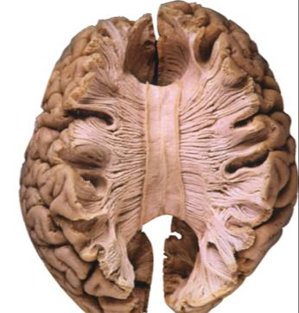
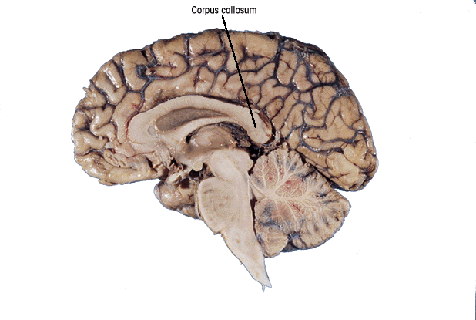
Brain Studies
Split-
To end severe whole-brain seizures, some people have had surgery to cut the corpus callosum,
a band of axons connecting the hemispheres.
Researchers have studied the impact of this surgery on patients’ functioning.
Notes:
Click to reveal two sentences.

Slide 34
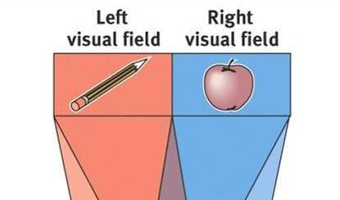
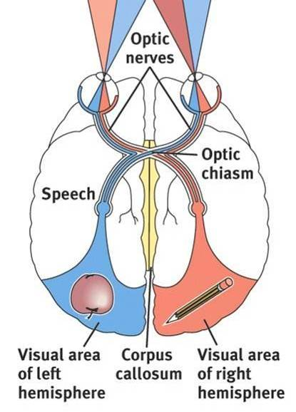
Split visual field
Each hemisphere does not perceive what each EYE sees. Instead, it perceives the half of the view in front of you that goes with the half of the body that is controlled by that hemisphere.
Notes:
No animation.
Notice that the optic chiasm is not cut when the corpus callosum is cut.
Instructor: you may want to switch the text, move the slide’s bullet point to the notes and the note to the slide.

Slide 35
Divided Awareness in the Split Brain Try to explain the following result:
Notes:
No animation.
See if the students can piece it together: the left hemisphere is the one that does verbal language, and that hemisphere is processing the right visual field, so what it can verbally report is “Art.”

Slide 36
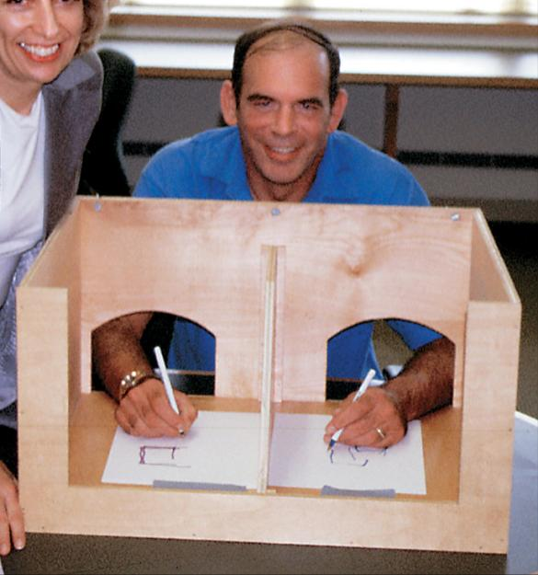
The divided brain in action
Talent: people are able to follow two instructions and draw two different shapes simultaneously
Drawback: people can be frustrated that the right and left sides do different things
Notes:
Click to reveal second bullet.
People with ‘divided brains’ may be more likely to report frustration with what the LEFT hand is doing; see if students can figure out why that is (the left hemisphere is the one talking to you and doesn’t know what input or purposes the right hemisphere is acting on).
The Future of Brain Research: Can these questions be answered? Is every part of the mind’s functioning going to be found someday on some brain scan? If so, have we found the mind, or is that still something separate from the brain?

