Slide 1
Unit 1:Neuroscience
Daily Objectives: Module 9
1. Explain why psychologists are concerned with human biology
2. Describe the parts of a neuron, and explain how its impulses are generated
3. Describe how nerve cells communicate with other nerve cells
4. Describe how neurotransmitters influence behavior, and explain how drugs and other chemicals affect neurotransmission

Slide 2
Surveying the Chapter: Overview What We Have in Mind
Building blocks of the mind: neurons and how they communicate (neurotransmitters)
Systems that build the mind: functions of the parts of the nervous system
Supporting player: the slower-communicating endocrine system (hormones)
Star of the show: the brain and its structures
Notes:
Is our identity in the heart? In the brain? In the whole body? The brain is not a computer, or a mind, or identity which is separate from the rest of the body; it is all interconnected.

Slide 3
History of Mind
Ancient Conceptions About Mind
Plato correctly placed mind in the brain. However, his student Aristotle believed that mind was in the heart.
Today we believe mind and brain are faces of the same coin. Everything that is psychological is simultaneously biological.
Notes:
OBJECTIVE 1| Explain why psychologists are concerned with human biology, and describe the ill-fated phrenology theory.

Slide 4
Searching for the self by studying the body Phrenology
Phrenology
(developed by Franz Gall in the early 1800’s):
the study of bumps on the skull and their relationship to mental abilities and character traits
Phrenology, though diabolically flawed, yielded one big idea--that the brain might have different areas that do different things (localization of function).
Notes:
Click to reveal additional text.

Slide 5
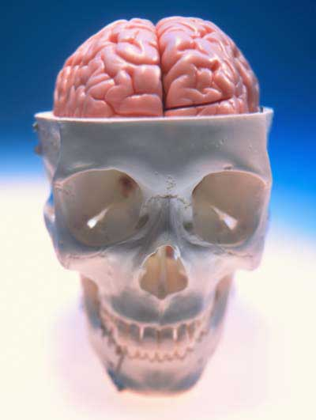
Today’s search for the biology of the self: biological psychology
Biological psychology includes neuroscience, behavior genetics, neuropsychology, and evolutionary psychology.
All of these subspecialties explore different aspects of: how the nature of mind and behavior is rooted in our biological heritage.
Our study of the biology of the mind begins with the “atoms” of the mind: neurons.
Notes:
Click to reveal bullets.

Slide 6
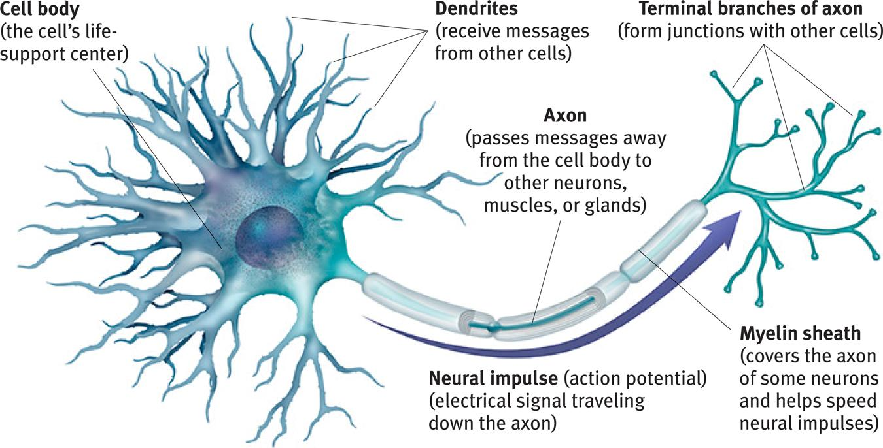
Neurons and Neuronal Communication: The Structure of a Neuron
There are billions of neurons
(nerve cells) throughout the body.
Notes:
No animation.
Most of the neurons are in the brain but there are motor and sensory neurons throughout the body. The message does not travel down the axon in the same way an electrical signal does down a wire; in fact electricity in a wire travels 3 million times faster. In the body, neural signals travel about 2 to 180 miles per hour. However, the chemical signal has an advantage; it does not decrease in intensity as it travels down the axon. No signal is lost.
You could demonstrate speed of signal transmission by having it travel across all the students hand to brain to hand across the room (or hand to shoulder to possibly bypass the brain).
Note the myelin sheath. Multiple sclerosis involves the degeneration of this layer, thus interfering with neural communication with muscles and other areas.

Slide 7
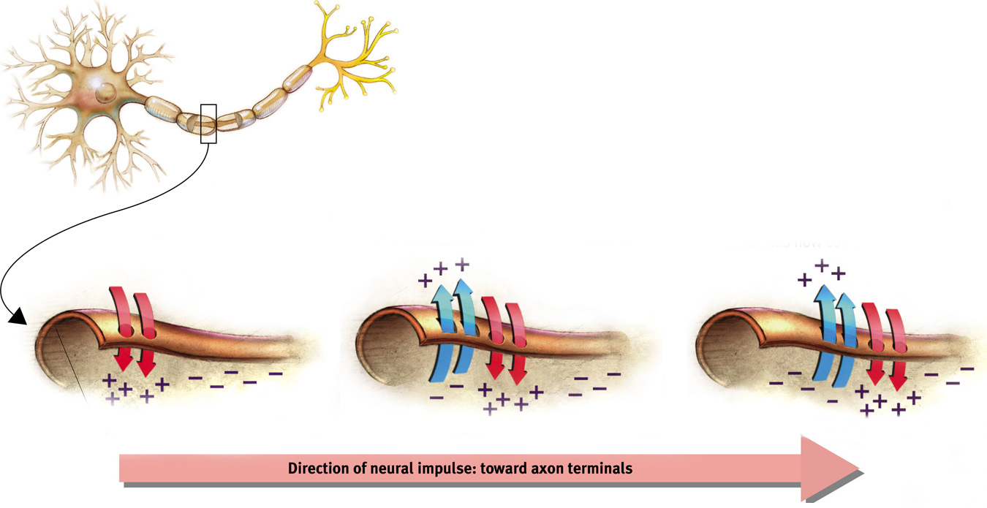
Action potential: a neural impulse that travels down an axon like a wave
Just as “the wave” can flow to the right in a stadium even though the people only move up and down, a wave moves down an axon although it is only made up of ion exchanges moving in and out.
Notes:
Automatic animation.
Note: with both the stadium example and the action potential example, no physical object actually flows in any direction when the wave flows.
The action potential is the area that is briefly charged by the net intake of positive ions; this is the traveling “electrical charge” created when channels in the cell membrane quickly allow positive ions in, and then more slowly pump the ions out again as the wave moves on.
The fans in the stadium create the wave by standing up briefly; the cell membrane creates a wave by pumping positive ions in briefly. This could be the subject of a demonstration in class.

Slide 8
Depolarization & Hyperpolarization
Depolarization occurs when positive ions enter the neuron, making it more prone to firing an action potential.
Hyperpolarization occurs when negative ions enter the neuron, making it less prone to firing an action potential.

Slide 9
When does the cell send the action potential?... when it reaches a threshold
How neurons communicate (with each other):
The neuron receives signals from other neurons; some are telling it to fire and some are telling it not to fire.
When the threshold is reached, the action potential starts moving.
Like a gun, it either fires or it doesn’t; more stimulation does nothing.
This is known as the “all-or-none” response.
The action potential travels down the axon from the cell body to the terminal branches.
The signal is transmitted to another cell. However, the message must find a way to cross a gap between cells. This gap is also called the synapse.
The threshold is reached when excitatory (“Fire!”) signals outweigh the inhibitory (“Don’t fire!”) signals by a certain amount.
Notes:
Click to show each stage in the path.
If signals only have one level of intensity, then why does a punch hurt more than a tap? Because in the case of the punch, more neurons are firing.

Slide 10
Refractory Period & Pumps
Refractory Period: After a neuron fires an action potential it pauses for a short period to recharge itself to fire again.
Sodium-Potassium Pumps: Sodium-potassium pumps pump positive ions out from the inside of the neuron, making them ready for another action potential.

Slide 11
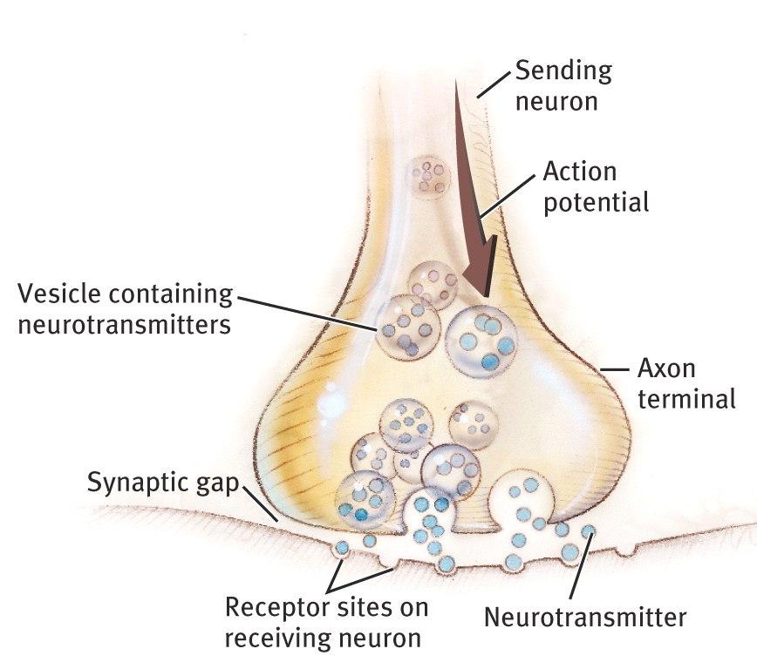
The Synapse
The synapse is a junction between the axon tip of the sending neuron (presynaptic) and the dendrite or cell body of the receiving neuron (postsynaptic).
The synapse is also known as the “synaptic junction” or “synaptic gap.”
Notes:
No animation.

Slide 12
Neurotransmitters
Neurotransmitters (chemicals) released from the sending neuron travel across the synapse and bind to receptor sites on the receiving neuron, thereby influencing it to generate an action potential.
Notes:
No animation.
Neurotransmitters are released from the sending neuron and stimulate receptor sites on the receiving neuron. These are the signals telling the receiving cell whether or not to fire the next action potential.

Slide 13
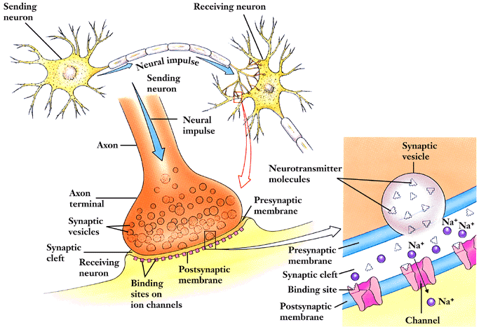
Neural Communication – Between Neurons

Slide 14
Lock & Key Mechanism
Neurotransmitters bind to the receptors of the receiving neuron in a key-lock mechanism.
Notes:
OBJECTIVE 6| Explain how drugs and other chemicals affect neurotransmission, and describe the contrasting effects of agonists and antagonists.

Slide 15
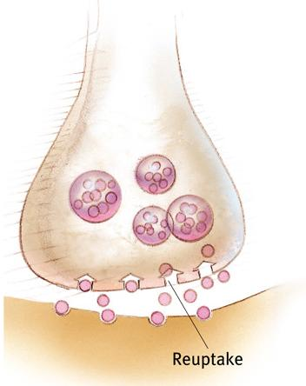
Reuptake: Recycling Neurotransmitters
Reuptake:
After the neurotransmitters stimulate the receptors on the receiving neuron, the chemicals are taken back up into the sending neuron to be used again.
Notes:
No animation.
Reuptake ends the transmission of the signal.
Medications which inhibit this reuptake process help ensure that the signal gets transmitted. SSRIs help reduce depression by increasing serotonin levels at the synapse this way, and most ADHD medications such as Ritalin work by blocking the transport of dopamine back into the sending neuron.

Slide 16
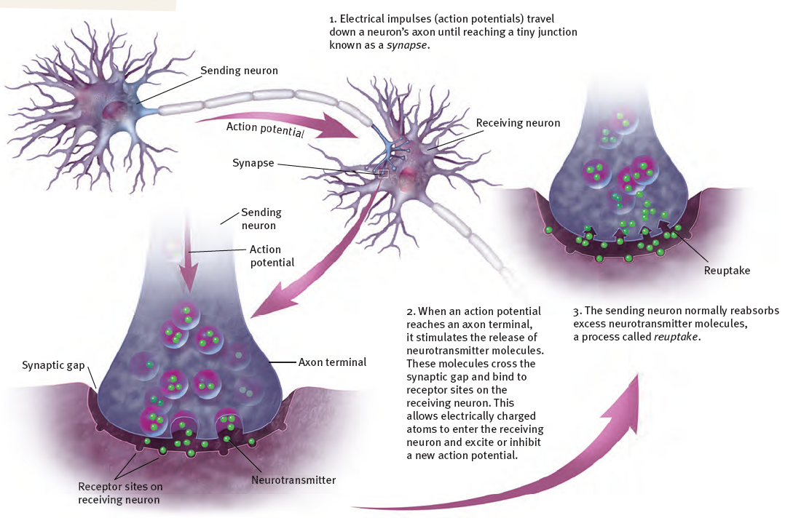
Seeing all the Steps Together
Neural Communication:
Notes:
No animation.

Slide 17
Roles of Different Neurotransmitters
Some Neurotransmitters and Their Functions
Neurotransmitter | Function | Problems Caused by Imbalances
Serotonin | Affects mood, hunger, sleep, and arousal | Undersupply linked to depression; some antidepressant drugs raise serotonin levels
Dopamine | Influences movement, learning, attention, and emotion | Oversupply linked to schizophrenia; undersupply linked to tremors and decreased mobility in Parkinson’s disease and ADHD
Acetylcholine (ACh) | Enables muscle action, learning, and memory | ACh-producing neurons deteriorate as Alzheimer’s disease progresses
Norepinephrine | Helps control alertness and arousal | Undersupply can depress mood and cause ADHD-like attention problems
GABA (gamma-aminobutyric acid | A major inhibitory neurotransmitter | Undersupply linked to seizures, tremors, and insomnia
Glutamate | A major excitatory neurotransmitter; involved in memory | Oversupply can overstimulate the brain, producing migraines or seizures; this is why some people avoid MSG (monosodium glutamate) in food
Notes:
Click to reveal row.
There are some uses/functions that are not mentioned, such as the role of inadequate norepinephrine and dopamine in ADHD.
Note: Some antidepressants, by blocking reuptake of serotonin, raise serotonin levels at the synapse; they don’t add more serotonin to the body.
The problem in schizophrenia may actually be an overabundance of dopamine receptors, not just an oversupply of dopamine itself.

Slide 18
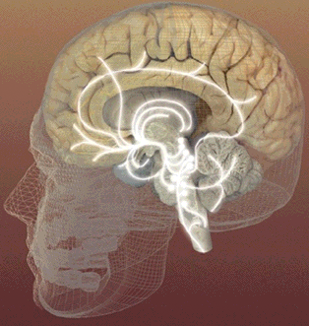
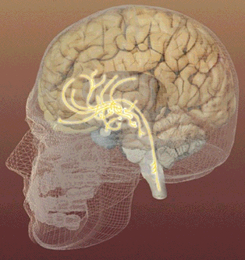
Serotonin pathways
Dopamine pathways
Networks of neurons that communicate with serotonin help regulate mood.
Networks of neurons that communicate with dopamine are involved in focusing attention and controlling movement.
Notes:
No animation.

Slide 19
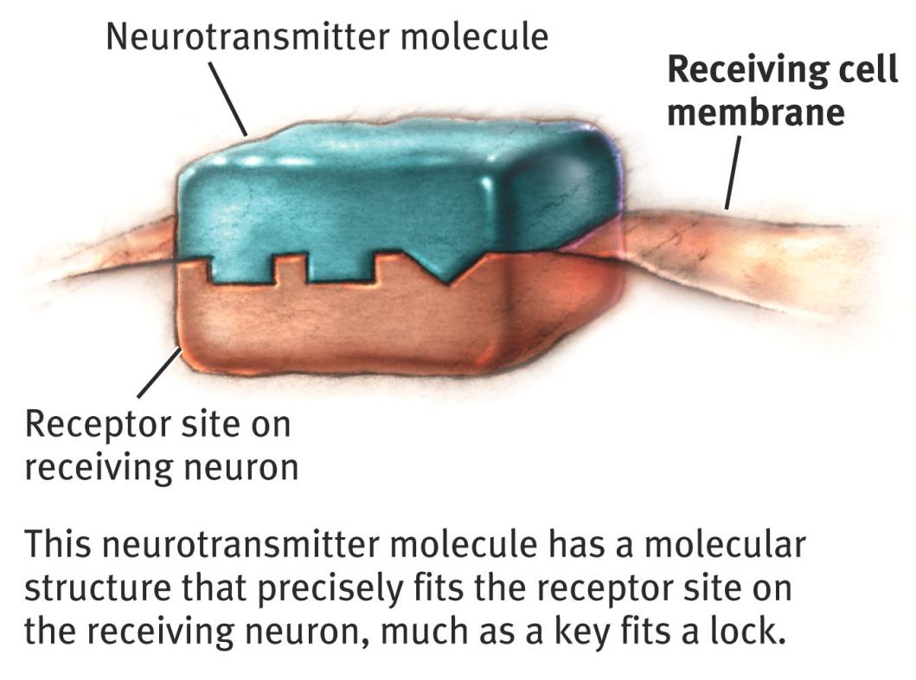
Hearing the message How Neurotransmitters Activate Receptors
When the key fits, the site is opened.
Notes:
No animation.

Slide 20
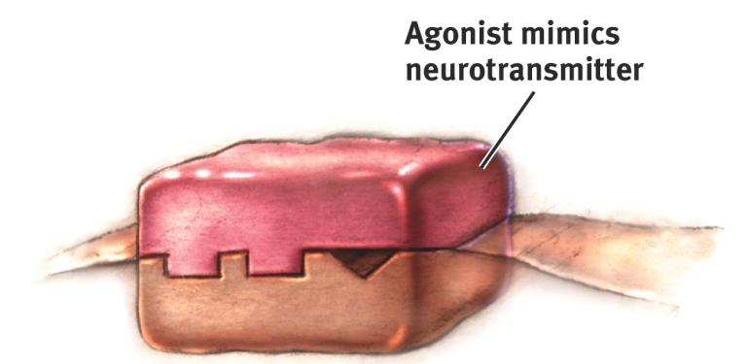
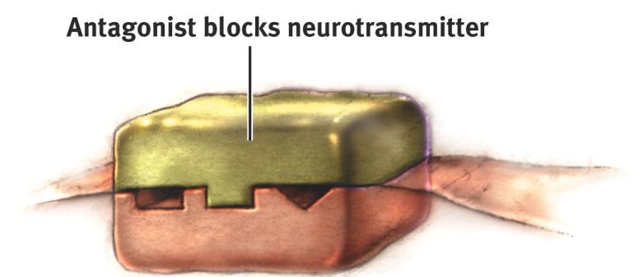
Keys that almost fit: Agonist and Antagonist Molecules
An antagonist molecule fills the lock so that the neurotransmitter cannot get in and activate the receptor site. Snake venom causes paralysis by blocking the acetlycholine (ACh) receptors on motor neurons.
An agonist molecule fills the receptor site and activates it, acting like the neurotransmitter. Morphine, for instance, mimics the action of endorphins by stimulating receptors in brain areas involved in mood and pain perception.
Notes:
No animation.
Examples you can use to test your students: pausing for the blanks below so students can fill in the correct term:
Opiate drugs stimulate the opiate receptors that are otherwise stimulated by endorphins to reduce pain. These drugs are opiate ______ (agonists).
Curare causes paralysis by blocking the acetlycholine (ACh) receptors on motor neurons; curare is an ACh _______ (antagonist).

Slide 21
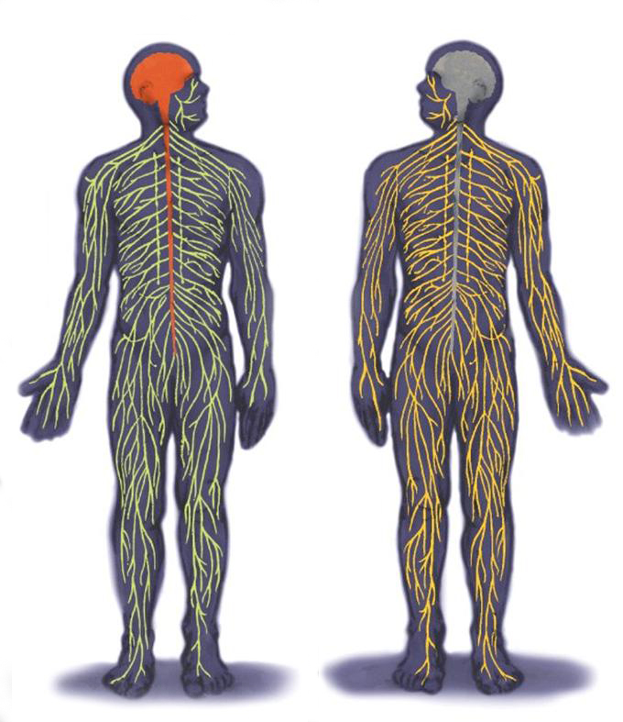
The Inner and Outer Parts of the Nervous System
The peripheral nervous system [PNS] consists of ‘the rest’ of the nervous system.
The PNS gathers and sends information to and from the rest of the body.
The central nervous system [CNS] consists of the brain and spinal cord.
The CNS makes decisions for the body.
Notes:
No animation.
The descriptive text is color-coded to go with the part of the nervous system referred to in the diagram.
The image is from a previous version of the text.

Slide 22
More Parts of the Nervous System
Notes:
No animation.
Note that the autonomic, somatic, sympathetic, and parasympathetic branches of the nervous system are all part of the PNS. Nerves consist of neural “cables” containing many axons. Nerves consist of neural “cables” containing many axons. Nerves are part of the peripheral nervous system and connect muscles, glands, and sense organs to the central nervous system.

Slide 23
Peripheral Nervous System
Somatic Nervous System: The division of the peripheral nervous system that controls the body’s skeletal muscles.
Autonomic Nervous System: Part of the PNS that controls the glands and other muscles.
Notes:
OBJECTIVE 8| Identify the subdivisions of the peripheral nervous system, and describe their functions.

Slide 24
Autonomic Nervous System (ANS)
Sympathetic Nervous System: Division of the ANS that arouses the body, mobilizing its energy in stressful situations.
Parasympathetic Nervous System: Division of the ANS that calms the body, conserving its energy.

Slide 25
The Autonomic Nervous System:
The sympathetic NS arouses (fight-or-flight) The parasympathetic NS calms (rest and digest)
Notes:
No animation. 1. Question to ask students: Why not just stay aroused all the time?...to allow the body to repair itself and regain energy from food.
2. Comment to students: note the sympathetic nervous system’s effect on the stomach and bladder., This helps us understand why “I was so upset that I wet my pants” or “I was so upset I threw up.” Now you can take these reports as a sign of strong activation of the sympathetic part of the autonomic nervous system.

Slide 26
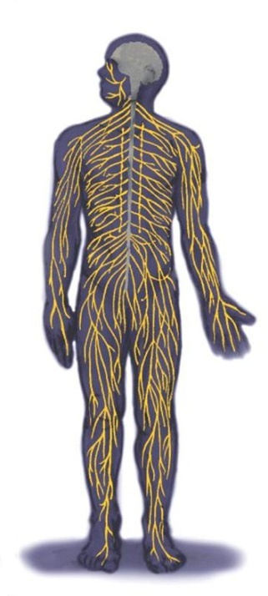
The Nerves
Nerves consist of neural “cables” containing many axons. They are part of the peripheral nervous system and connect muscles, glands, and sense organs to the central nervous system.

Slide 27
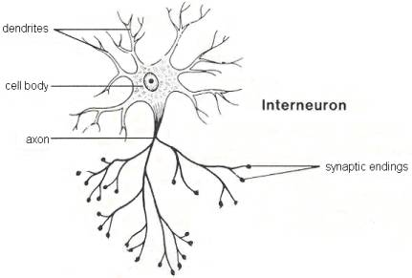
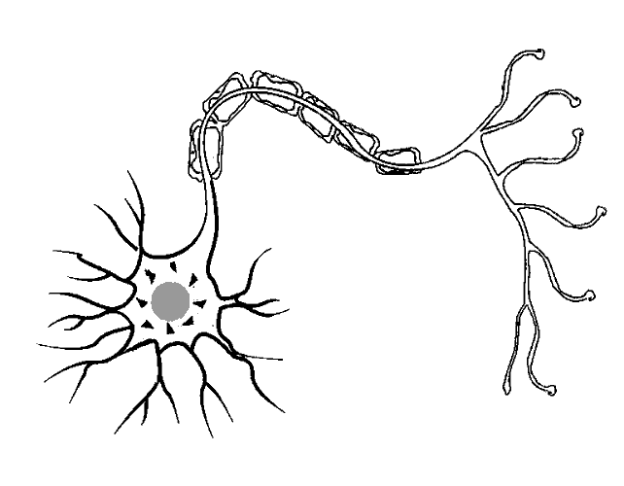
Kinds of Neurons
Sensory Neurons (afferent) carry incoming information from the sense receptors to the CNS. Motor Neurons (efferent) carry outgoing information from the CNS to muscles and glands. Interneurons connect the two neurons.
Sensory Neuron
Motor Neuron
Motor Neuron

Slide 28
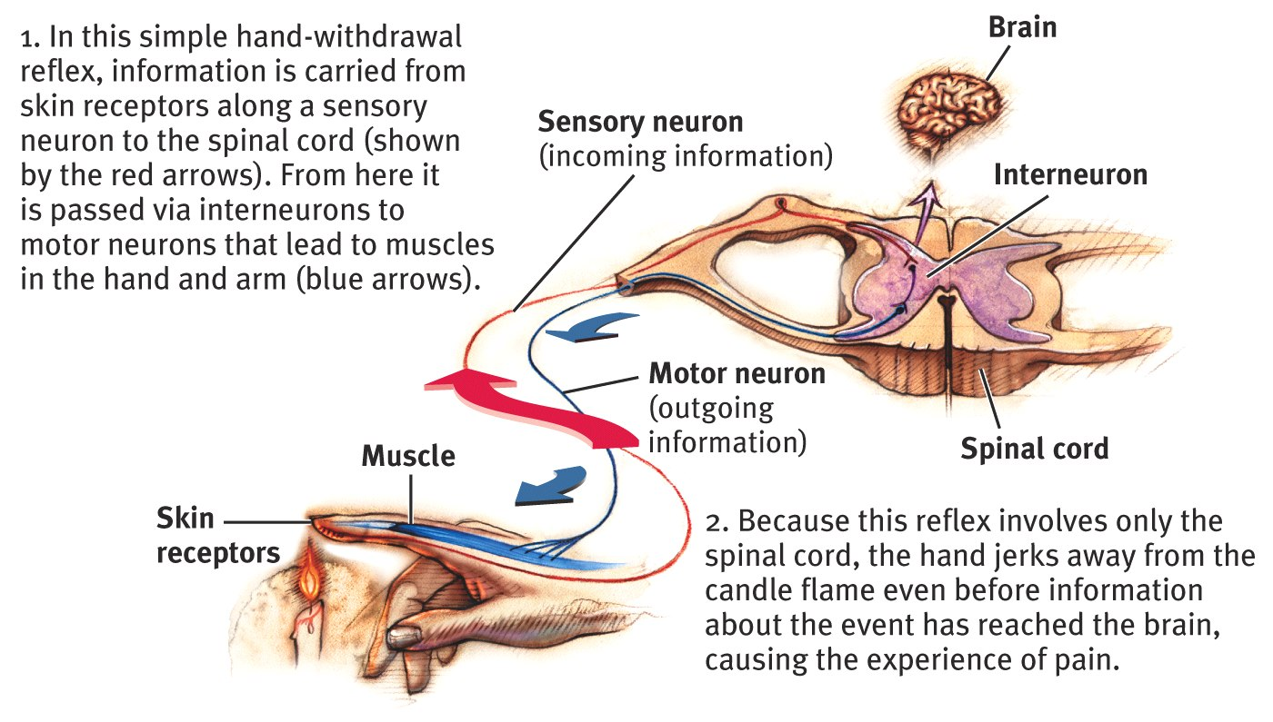
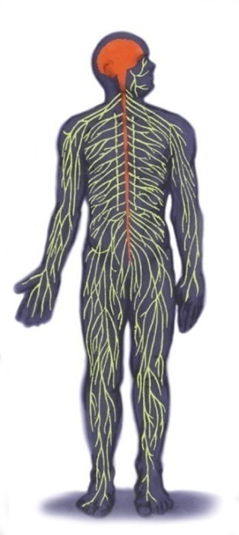
Central Nervous System
The Spinal Cord and Reflexes
Simple Reflex
Notes:
OBJECTIVE 9| Contrast the simplicity of the reflex pathways with the complexity of neural networks.

Slide 29
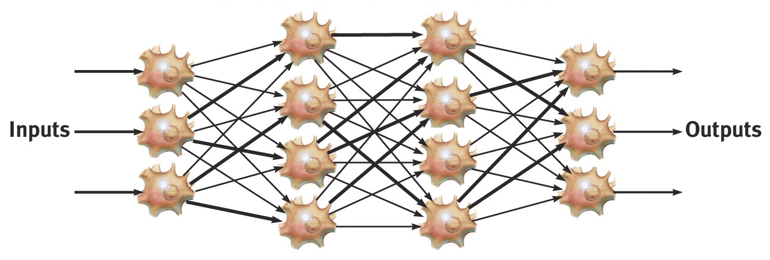
Central Nervous System
The Brain and Neural Networks
Interconnected neurons form networks in the brain. Theses networks are complex and modify with growth and experience.
Complex Neural Network

Slide 30
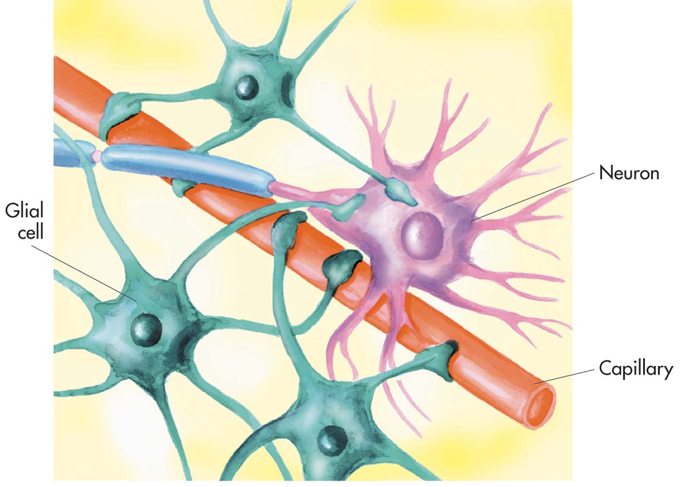
Kinds of Glial Cells
Glial (“glue”) cells provide various types of support for neurons. Glia are much smaller than neurons, but they outnumber neurons by 10 to 1, thus accounting for over 50% of the brain’s volume. Astrocytes provide nutrition to neurons. Oligodendrocytes and Schwann cells insulate neurons as myelin.
Astrocytes

Slide 31
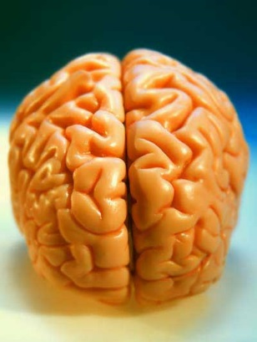
Investigating the Brain and Mind:
Strategies for finding out what is different about the mind when part of the brain isn’t working normally:
case studies of accidents (e.g. Phineas Gage)
case studies of split-brain patients (corpus callosum cut to stop seizures)
lesioning brain parts in animals to find out what happens
chemically numbing, magnetically deactivating, or electrically stimulating parts of the brain
How did we move beyond phrenology and get inside the skull and under the “bumps”?
by finding what happens when part of the brain is damaged or otherwise unable to work properly
by looking at the structure and activity of the brain: CAT, MRI, fMRI, and PET scans
Notes:
Questions about parts of the brain:
Do you think that the brain is the sum of its parts, or is the brain actually about the way they are connected?
What do you think might happen if a particular area of the brain was stimulated?
What do you think might happen if a particular area of the brain was damaged or not working well?

Slide 32
Studying cases of brain damage
When a stroke or injury damages part of the brain, we have a chance to see the impact on the mind.
Notes:
No animation.
Instructor: Some examples of brain areas we learned about thanks to patients with brain damage: the frontal lobes (as with Phineas Gage, pictured here), Broca’s area, and Wernicke’s area. Broca’s area is named after French physician Pierre Paul Broca (1824-1880) . Wernicke’s area was named after German physician Carl Wernicke (1848-1905).

Slide 33
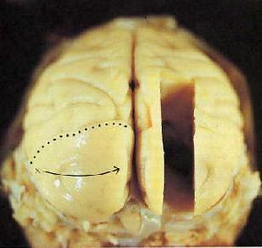
Intentional brain damage:
Lesions (surgical destruction of brain tissue)
performed on animals
has yielded some insights, especially about less complex brain structures
no longer necessary, as we now can chemically or magnetically deactivate brain areas to get similar information
Notes:
Click to reveal bullets.

Slide 34
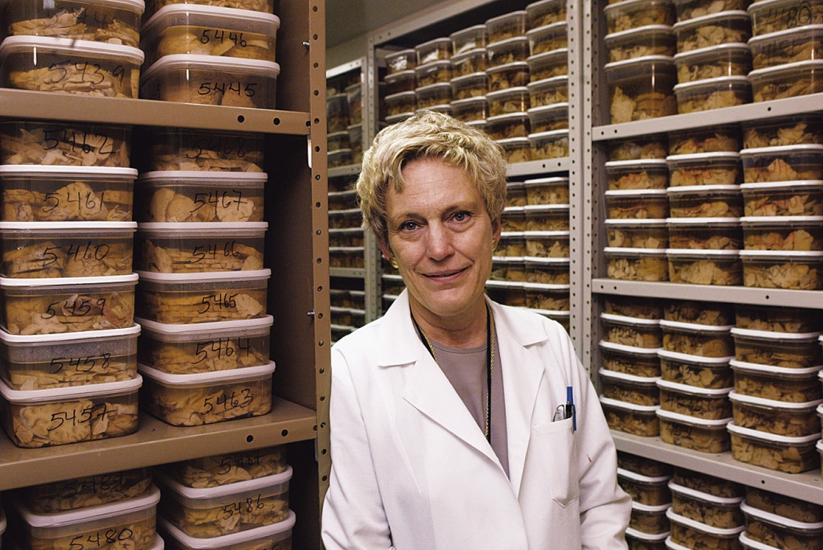
Clinical Observation
Clinical observations have shed light on a number of brain disorders. Alterations in brain morphology due to neurological and psychiatric diseases are now being catalogued.

Slide 35
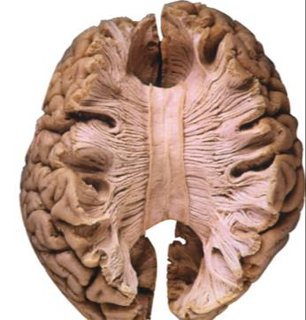
Split-Brain Patients
“Split” = surgery in which the connection between the brain hemispheres is cut in order to end severe full-brain seizures
Study of split-brain patients has yielded insights discussed at the end of the chapter
Notes:
Click to reveal bullets.

Slide 36
We can stimulate parts of the brain to see what happens
Parts of the brain, and even neurons, can be stimulated electrically, chemically, or magnetically.
This can result in behaviors such as giggling, head turning, or simulated vivid recall.
Researchers can see which neurons or neural networks fire in conjunction with certain mental experiences, and even specific concepts.
Notes:
Click to reveal bullets.
Hopefully students will understand that brain stimulation is less dramatic than the use of a bolt of lighting; it involves only small electrodes. Although people feel like the stimulation of certain brain locations produces vivid memories, research has proven that this impression is false; the memories feel vivid, but are inaccurate.

Slide 37
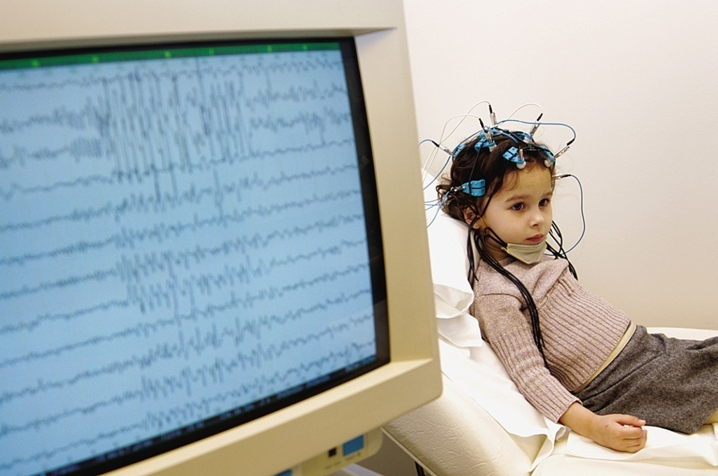
Electroencephalogram (EEG)
An amplified recording of the electrical waves sweeping across the brain’s surface, measured by electrodes placed on the scalp.
AJ Photo/ Photo Researchers, Inc.

Slide 38
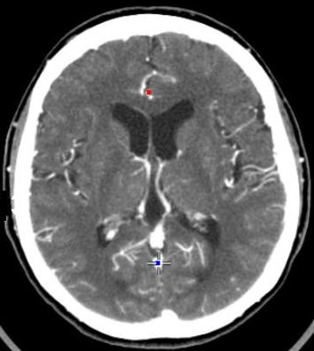
CAT Scan
A computerized axial tomography scan is an x-ray procedure that combines many x-ray images with the aid of a computer to generate cross-sectional views and, if needed, three-dimensional images of the internal organs and structures of the body. Computerized axial tomography is more commonly known by its abbreviated names, CT scan or CAT scan. A CT scan is used to define normal and abnormal structures in the body and/or assist in procedures by helping to accurately guide the placement of instruments or treatments.

Slide 39
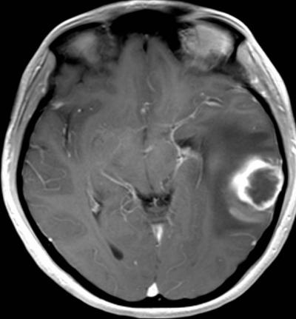
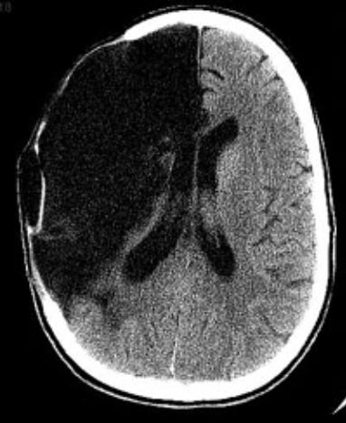
Abnormal CAT Scans

Slide 40
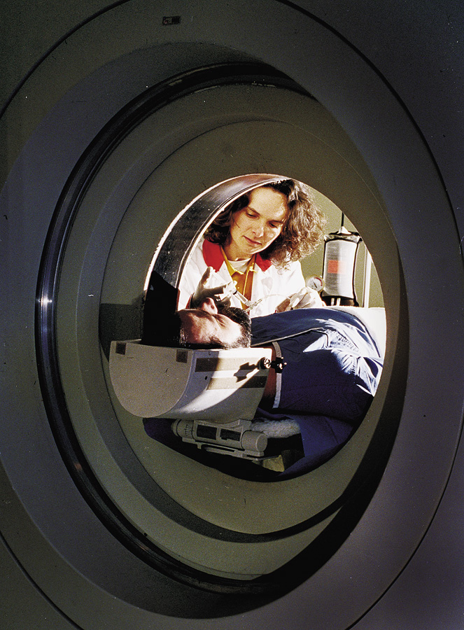
PET Scan
PET (positron emission tomography) Scan is a visual display of brain activity that detects a radioactive form of glucose while the brain performs a given task.
Courtesy of National Brookhaven National Laboratories

Slide 41
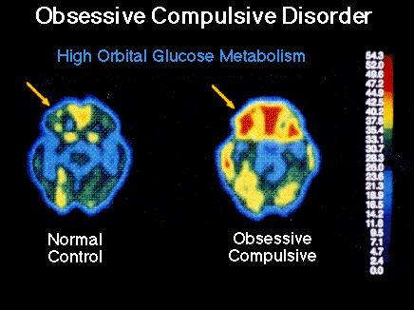
PET Scan

Slide 42
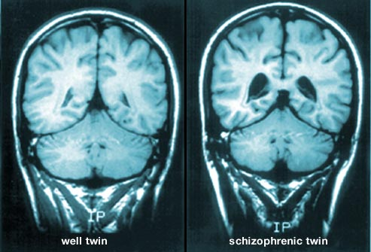
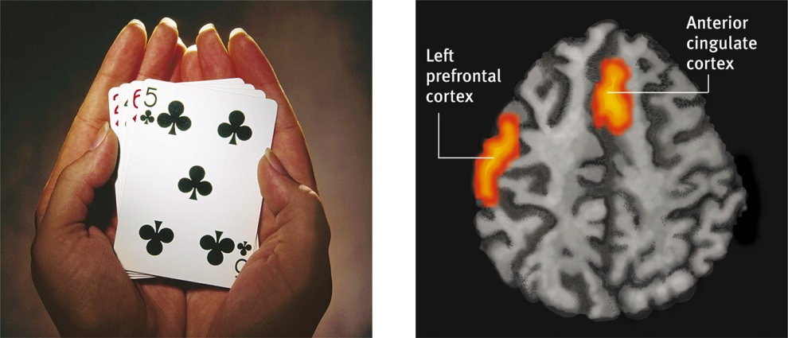
MRI Scan
MRI (magnetic resonance imaging) and fMRI use magnetic fields and radio waves to produce computer-generated images that distinguish among different types of brain tissue. Top images show ventricular enlargement in a schizophrenic patient. Bottom image shows brain regions when a participants lies.

Slide 43
MRI Scan

