Slide 1
Social Psychology
Topics we can analyze interactively
How we think in relation to other people
How other people influence not only our thinking but our actions:
How we treat each other, relate to each other
Conformity
Obedience
Group Behavior
Prejudice
Attraction
Aggression
Altruism
Conflict and Peacemaking
Notes:
Click to reveal all bullets.

Slide 2
Social Psychology
Sample social psychology question: Why might students speak up in class, or hesitate to speak?
To answer this, we can study emotions, cognitions, motivations, reinforcers, and more:
Personality Psychologists could study the traits that might make one person more likely than another to speak, and
Social Psychologists might examine aspects of the classroom situation that would influence any student’s decision about speaking.
Notes:
Click to reveal bullets.

Slide 3
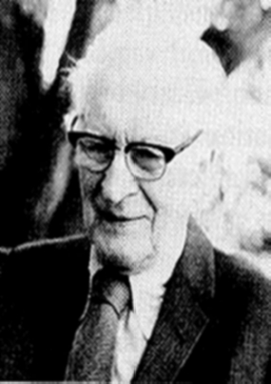
Attributing Behavior to Persons or to Situations
Attribution Theory: Fritz Heider (1958) suggested that we have a tendency to give causal explanations for someone’s behavior, often by crediting either the situation or the person’s disposition.
Fritz Heider
Notes:
OBJECTIVE 2| Contrast dispositional and situational attributions, and explain how the fundamental attribution error can affect our analysis of behavior.

Slide 4
Social Thinking
Attribution: Identifying causes
With all that we have learned about people so far in this course, you should make pretty good guesses about the nature of other people’s behavior, right?
We, especially those raised in Western, Individualist cultures, tend to make Fundamental Attribution Error
Attribution: a conclusion about the cause of an observed behavior/event.
Attribution Theory: We explain others’ behavior with two types of attributions:
Situational Attribution (factors outside the person doing the action, such as peer pressure), or
Dispositional Attribution (the person’s stable, enduring traits, personality, ability, emotions)
Notes:
Click to reveal bullets and sidebar.

Slide 5
Fundamental Attribution Error
Social Thinking:
See if you can find the error in the following comment:
“I noticed the new guy tripping and stumbling as he walked in. How clumsy can you be? Does he never watch where he’s going?”
The Fundamental Attribution Error: When we go too far in assuming that a person’s behavior is caused by their personality.
What’s the error?
Hint: Next day…
“Hey, they need to fix this rug! I tripped on it on the way in!
Not everyone tripped? Well, not everyone had a test that day and their cell phone was buzzing.”
We think a behavior demonstrates a trait.
We tend to overemphasize __________ attribution and underemphasize __________ attribution.
Notes:
Instructor: Before you click to make the hint appear, see if students can come up with other explanations for “the clumsy behavior.” See if they can come up with aspects of the situation, such as a rug having a folded up edge, or the “new” person (new student or employee) being unfamiliar with the environment, or the person being distracted or nervous because of [the situation of] entering a new social environment, having people watching.
After you make the hint appear, students may point out “hypocrisy”, but that’s not the fundamental error, so click and make the hint go away), and help them figure out: When viewing the new person, the observer was attributing the clumsy behavior to a TRAIT of clumsiness or not being observant.
Another click brings up the title and definition. Click to reveal two more boxes.
In the last sentence, hopefully any randomly picked student will be able to fill in the blanks even if they didn’t do the reading: dispositional, and situational.
This error may not seem so “fundamental” to students; it’s also know as actor-observer bias or correspondence bias. It would be nice if it were known as something that helped identify it, the “trait over situation” error.

Slide 6
Fundamental Attribution Error
Social Thinking:
We make this error even when we are given the correct facts:
Williams College study: A woman was paid and told to act friendly to some students, unfriendly to others. The students felt that her behavior was part of a her disposition, even when they were told that she was just obeying instructions.
Notes:
Optional slide
No animation.
In this 1979 study, they used the term “correspondence bias.”
If we are told a person is homeless due to medical bills, we may still see them and wonder: “why don’t they look for work?”

Slide 7
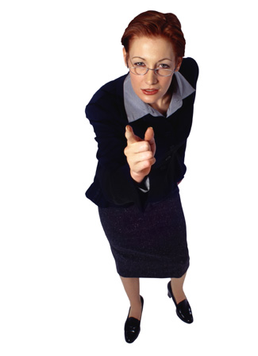
Social Thinking:
Self vs. Other/Actors and Observers
When we explain our OWN behavior, we partly reverse the fundamental attribution error: we tend to blame the situation for our failures (although we take personal credit for successes). This is called the self-serving bias.
This happens not just out of selfishness: it happens whenever we take the perspective of the actor in a situation, which is easiest to do for ourselves and people we know well.
Notes:
Optional slide
Click to reveal bullets.
Instructor: The social thinking habits described in this slide are typically called self-serving bias or the actor-observer effect. The text author uses these terms, but doesn’t include this as a formal term students need to know. I have blended those concepts here.
The text tells of an experiment that this effect, this flipping of the F.A.E. and by seeing the actor’s point of view, even happens when we can view an event in a video when the action is displayed on screen from the actor’s perspective.

Slide 8
Social Thinking:
Cultural differences
People in collectivist cultures (those which emphasize group unity, allegiance, and purpose over the wishes of the individual), do not make the same kinds of attributions:
  The behavior of others is attributed more to the situation; also,
  Credit for successes is given more to others,
  Blame for failures is taken on oneself.
Notes:
Optional slide
Click to reveal bullets.
Instructor: See if students can explain why this might generally be true, why one’s experience in collectivist cultures might encourage different attributions: is there pressure to interpret things differently, to take blame for failures, or in the collectivist experience, is this more likely to be an accurate view, that successes and behavior are guided by the group and failures are caused by individuals?
Does this cultural difference make this less fundamental? Fundamental doesn’t mean universal, it means most important; to judge someone as having a certain trait just because you see them do a behavior (is a soldier a murderer?) is considered here to be the most basic error you can make in viewing another person.

Slide 9
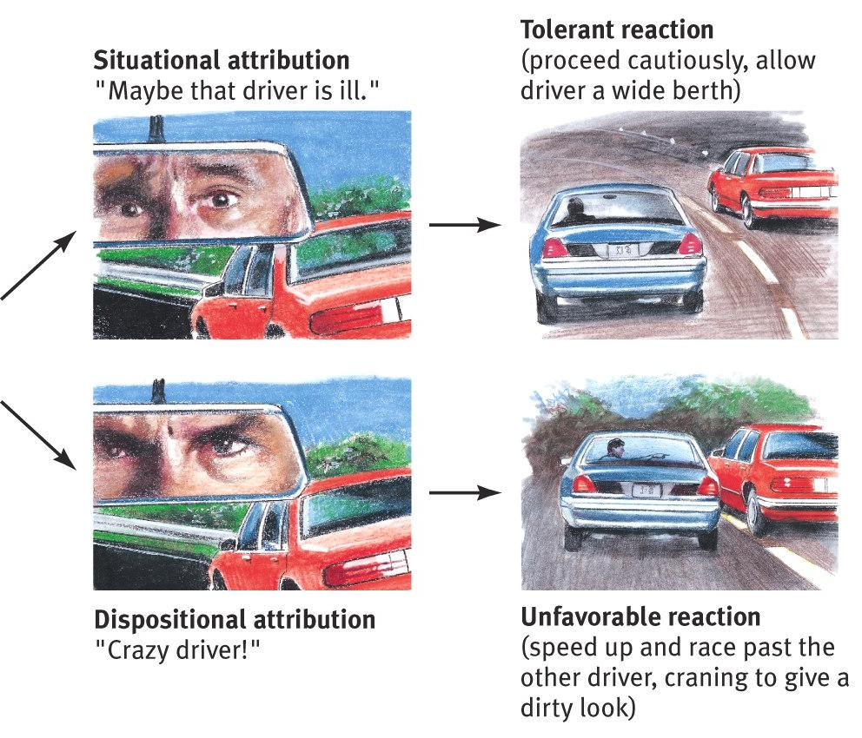
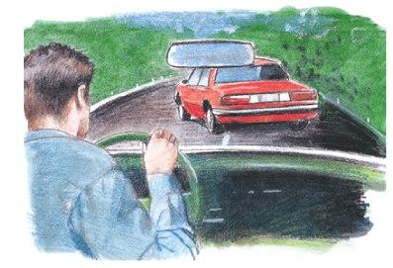
Emotional Effects of Attribution
Social Thinking
Problematic behavior: someone cuts in front of us.
How we explain someone’s behavior affects how we react to it.
Notes:
Optional slide
Click to reveal sequence of graphics.
This effect is somewhat tangential to the social psych concept, but connects to the topic of attitude coming up.

Slide 10
Social Thinking:
Attitudes and Actions
Attitude:
Feelings, ideas, and beliefs that affect how we approach and react to other people, objects, and events.
Attitudes, by definition, affect our actions;
We shall see later that our actions can also influence our attitudes.
Notes:
Automatic animation.
To link this definition of “Attitude” to the more popular usage: A “bad attitude” toward a situation or a group of people isn’t just a bad mood, it is a mindset that makes us likely to react negatively to that situation or group.

Slide 11
Social Thinking:
Persuasion
Two cognitive pathways to affect attitudes
Central Route Persuasion
Going directly through the rational mind, influencing attitudes with evidence and logic.
Peripheral Route Persuasion
Changing attitudes by going around the rational mind and appealing to fears, desires, associations.
  “My product has been proven more effective.”
  “People who buy my product are happy, attractive!”
Notes:
Click to reveal two circles.
Instructor: Students may see “Persuasion” as a social influence topic; but here, the influence on behavior is mediated by cognition (attitudes).

Slide 12
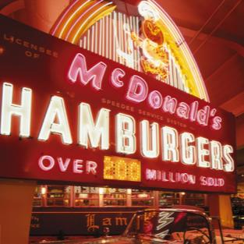
Social Thinking
Attitudes affect our actions when:
External influences are minimal
The attitude is stable
The attitude is specific to the behavior
The attitude is easily recalled.
Example:
“I feel like [attitude] eating at McD’s, and I will [action];”
There are no nutritionists here telling me not to,
I’ve enjoyed their food for quite a while,
It’s so easy to get the food when I have a craving,
It’s easy to remember how good it is when I drive by that big sign every day.”
Notes:
Click to start the animation of an example of how attitudes can affect actions: When we not only have a desire for McDonald’s food, but actually go ahead and act on our desire. Then click to reveal a quote illustrating each of four factors that makes attitudes more likely to affect our actions.

Slide 13
If attitudes direct our actions, can it work the other way around? How can it happen that we can take an action which in turn shifts our attitude about that action?
Social Thinking:
Actions affect attitudes:
Through three social-cognitive mechanisms:
The Foot in the Door Phenomenon
The Effects of Playing a Role, and
Cognitive Dissonance
Notes:
Click to reveal three social-cognitive mechanisms.
The Foot in the Door Phenomenon
The Effects of Playing a Role, and
Cognitive Dissonance

Slide 14

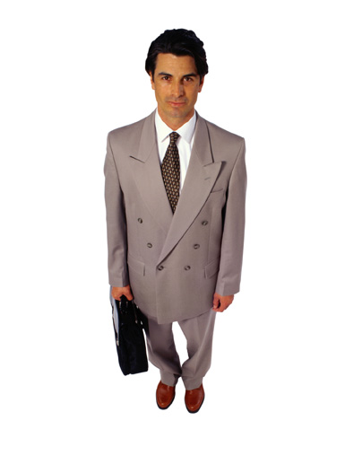
Social Thinking:
Small Compliance Large Compliance
A political campaigner asks if you would open the door just enough to pass a clipboard through. [Or a foot]
      You agree to this.
Then you agree to sign a petition.
  Then you agree to make a small contribution. By check.
What happened here?
Notes:
Automatic animation.
Instructor: The answer to the question is on the next slide.

Slide 15
Social Thinking:
Small Compliance Large Compliance
The Foot-in-the-Door Phenomenon: the tendency to be more likely to agree to a large request after agreeing to a small one.
Affect on attitudes: People adjust their attitudes along with their actions, liking the people they agreed to help, disliking the people they agreed to harm.
Notes:
Automatic animation.
Instructor: For the second bullet point you can cite the example of prisoners helping and later identifying with captors; look up the case of Patty Hearst and the SLA, there is a classic photo going along with this story of the captured heiress holding a gun for this militia.
The atrocities at Abu Ghraib, used as an example of role playing in the book, may also be an example of the foot in the door phenomenon, if: as prisoners were harmed, attitudes about the prisoners became more dehumanizing, allowing harm to escalate.
You might want to postpone discussion of why this phenomenon happens until you talk about cognitive dissonance (or teach that concept first).
I recommend starting class asking for help setting up your classroom, then help getting something from your car or going to make a request of someone elsewhere in the building…

Slide 16
Social Thinking:
Role Playing Affects Attitudes
In arranged marriages, people often come to have a deep love for the person they marry.
Actors say they “lose themselves” in roles.
Participants in the Stanford Prison Study ended up adopting the attitudes of whatever roles they were randomly assigned to;
  “guards” had demeaning views of “prisoners,”
  “prisoners” had rebellious dislike of the “guards.”
“No man, for any considerable period, can wear one face to himself, and another to the multitude, without finally getting bewildered as to which may be the true [face].”
-- Nathaniel Hawthorne
“Fake it till you make it.”
--Alcoholics Anonymous slogan
When we play a role, even if we know it is just pretending, we eventually tend to adopt the attitudes that go with the role, and become the role.
Notes:
Click to reveal bullets and sidebar bullets.
A tragic story which may relate to the second bullet is the possible suicide of Heath Ledger who complained before his death that he was becoming disturbed by the attitudes he adopted while immersing himself in the role of the Joker in a Batman movie.
Instructor: if you play excerpts from the Stanford prison study video, I strongly recommend featuring the interviews at the end which show how the attitudes remained after the role playing was done.

Slide 17
Social Thinking:
Cognitive Dissonance
Cognitive Dissonance: When our actions are not in harmony with our attitudes.
Cognitive Dissonance Theory: the observation that we tend to resolve this dissonance by changing our attitudes to fit our actions.
Origin of Cognitive Dissonance Theory
Festinger’s Study (1957): Students were paid either large or small amounts to express enjoyment of a boring activity. Then many of the students changed their attitudes about the activity. Which amount shifted attitudes?
Getting paid more: “I was paid to say that.”
Getting paid less: “Why would I say it was fun? Just for a dollar? Weird. Maybe it wasn’t so bad, now that I think of it.”
Notes:
Optional slide
Click to reveal all text.
Dissonance: in music, this is when two notes played together do not sound pleasant; usually it is followed by one of the notes changing to produce harmony.
How might cognitive dissonance explain the foot in the door phenomenon? Or the way role playing affects attitudes?
Answer: we shift our attitudes to be in line with the actions we are doing.
Maybe Heath Ledger was disturbed not by adopting the attitudes of the role he was playing, but by the strain of cognitive dissonance from trying to maintain his own humanistic attitudes while acting sadistic all day.
Click to reveal origin of cognitive dissonance theory.
The way I’ve phrased this, most students may guess wrong: being paid more shifts must shift attitudes more!

Slide 18
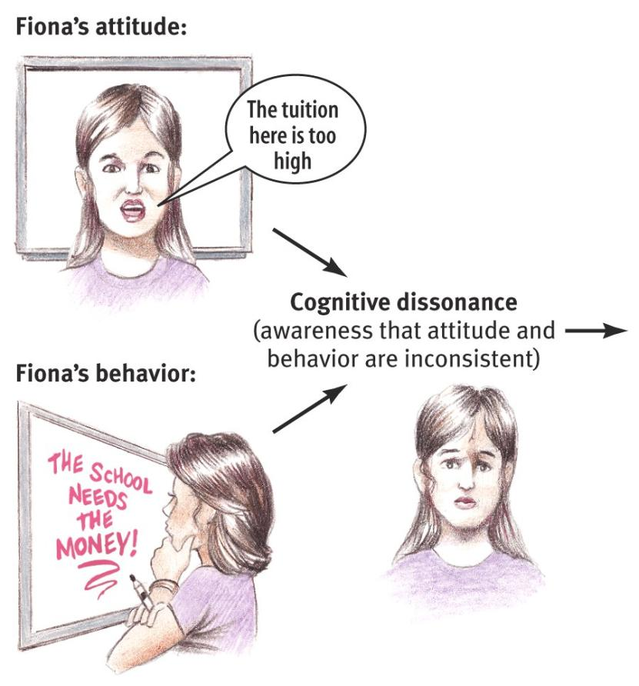
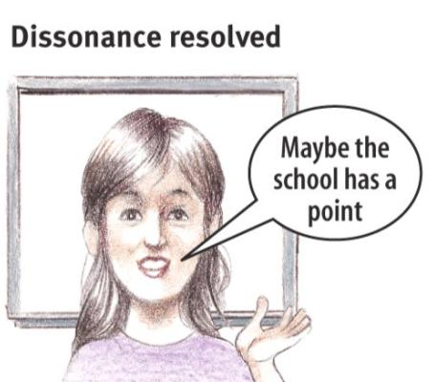
Cognitive Dissonance
If Fiona agrees to do some fundraising for her college, her attitudes about school finances might shift to resolve her cognitive dissonance.
Notes:
No animation.
A question to ask along with this slide:
How much would you expect her attitudes to change if she was paid well to do the fundraising?
How about if she did it as a volunteer activity?
(Answer: her attitudes would shift more if she did it as a volunteer: “If I offered for free to say that the school needs more money, I must sort of agree...” vs. “I was just saying that because I was paid a lot to say it.”)

Slide 19
Social Influence
Social situations have many ways of influencing our behavior, attitudes, beliefs, and decisions. This social influence can take many forms, including:
  Conformity
  Obedience
  Group situations and group behavior, which leads to
    social facilitation
    social loafing
    polarization
    deindividuation
    groupthink
Notes:
Click to reveal three strategies for gathering information.
“Attributes” here refers to age, gender, income, other labels that might sort people into categories in our studies.

Slide 20
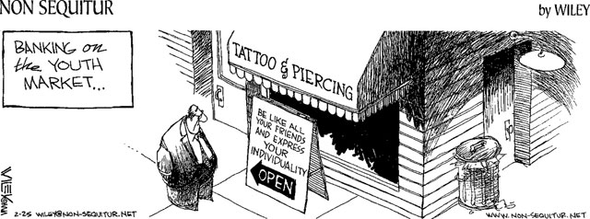
Conformity
What form of social influence is the subject of this cartoon?
Notes:
Click to reveal title after students have had a chance to answer the question on the slide.

Slide 21
Social Influence
Conformity: Mimicry and more
Conformity refers to adjusting our behavior or thinking to fit in with a group standard.
Automatic Mimicry affecting behavior
The power of Conformity has many components and forms, including
Social Norms affecting our thinking
Normative and Informational Social Influence
Notes:
Click to reveal three components.
The example of conformity that may come most easily to students is choice of clothing. If they mention this, ask which type of conformity might that be? First of all, it would be an adjustment in behavior. Beyond that, there can be more than one right answer.
When stating the definition, you may want to insert “to fit in with or align ourselves with what we perceive to be a group standard.”

Slide 22
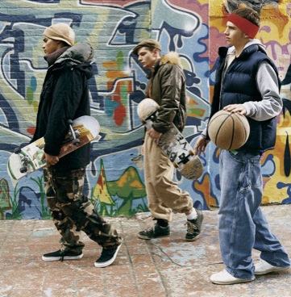
Mimicry
It is not only true that birds of a feather flock together: it is also true that if we flock together, we might choose to wear the same feathers.
Notes:
No animation.
“Same feathers” refers to the same habits, behaviors, or of course the same clothes.

Slide 23
Social Influence
Automatic Mimicry
Some of our mimicry of other people is not by choice, but automatic:
Contagious Yawning, as well as contagious arm folding, hand wringing, face rubbing…
Adopting regional accents, grammar, and vocabulary
Empathetic shifts in mood that fit the mood of the people around us
Adopting coping styles of parents or peers, including violence, yelling, withdrawal.
Notes:
Click to reveal bullets.
The fourth example may help explain not only copycat violence and suicide but also why people can plan on having a different parenting style than their parents but end up under stress doing just what was modeled for them.

Slide 24
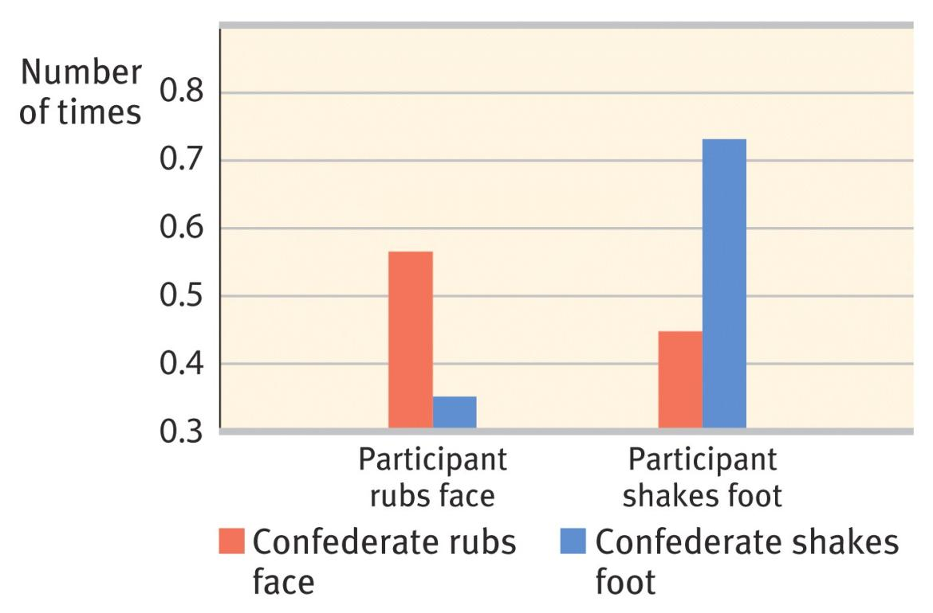
The Chameleon Effect:
Unconscious Mimicry
In an experiment, a confederate/collaborator of the experimenter intentionally rubbed his/her face or shook a foot; this seemed to lead to a greater likelihood of the study participant doing the same behavior.
Notes:
An optional slide if you wanted to suggest this as an experiment.
No animation.
Narrating the chart: Let’s first compare the two bars on the right to the ones on the left: apparently people are more likely to shake a foot than rub their faces, at least in this experiment. The chameleon affect is that that the amount of face rubbing is much greater when the confederate, the person secretly working for the experimenter, is doing face rubbing also. The impact on foot shaking is about the same size (if you look at the numbers, not the chopped-off bars): in both cases, about a 50% increase in the behavior.
(Hypothesis: Yawning would increase the yawning of others more than face rubbing increases the face rubbing of others)…

Slide 25
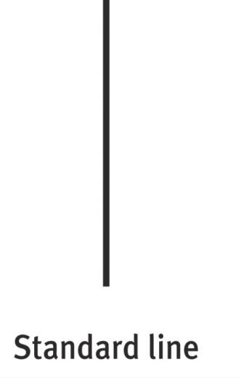
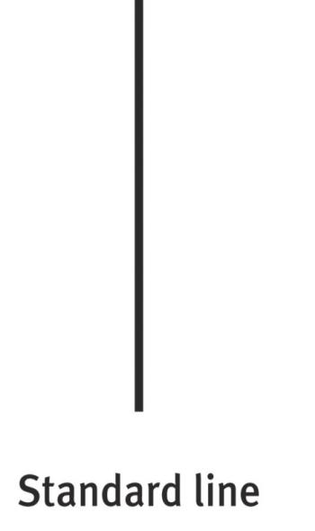
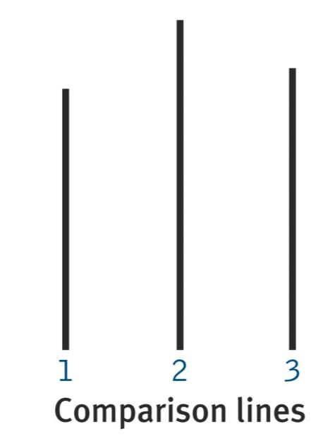
Conforming to Norms
Which comparison line looks the same as the standard line?
Take turns answering, see if a consensus develops.
Notes:
Upon a click, the “standard line” will subtly change so that the standard line changes, starting off closer to the size of the third line, ending up closer to the size of the second line. You could make these change halfway through polling the class one at a time, or make the change anytime five people a row say “line # 2” or answer without looking at the screen.

Slide 26
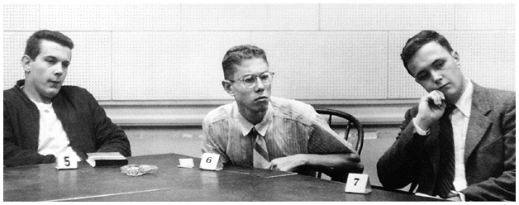
Social Influence: Conformity
Responding to Social Norms
When we are with other people and perceive a social norm (a “correct” or “normal” way to behave or think in this group), our behavior may follow the norm rather than following our own judgment.
Asch Conformity studies: About one third of people will agree with obvious mistruths to go along with the group.
      Think this guy will conform?
B
B
What??
Notes:
Click to reveal bullet and example.
You may want to change “WT???” to “What??” or “WTF??” depending on your judgment of what seems appropriate in your setting.

Slide 27
Social Influence: Conformity
What makes you more likely to conform?
When…
You are not firmly committed to one set of beliefs or style of behavior.
The group is medium sized and unanimous.
You admire or are attracted to the group.
The group tries to make you feel incompetent, insecure, and closely watched.
Your culture encourages respect for norms.
Notes:
Click to reveal bullets.
I say “medium sized” where the text reads “at least three people;” Beyond a certain size group, conformity decreases, perhaps because there is a possibility of subgroups that support non conformity (although they in turn will be an environment in which conformity occurs).

Slide 28
Two types of social influence
Normative Social Influence:
Informational Social Influence:
Example: Going along with others in pursuit of social approval or belonging (and to avoid disapproval/rejection)
The Asch conformity studies; clothing choices.
Example: Going along with others because their ideas and behavior make sense, the evidence in our social environment changes our minds.
Deciding which side of the road to drive on.
Notes:
Click to reveal second circle.
This slide is here because this is where it’s located in the text, but it could be moved all the way to the beginning of the social influence section. In either case, it may seem like a follow up on the persuasion topic, but in this case, no one is trying to persuade us, we are influenced by what we see in our social surroundings.

Slide 29
Obedience: Response to Commands
Milgram wanted to study the influence of direct commands on behavior.
  The question: Under what social conditions are people more likely to obey commands?
  The experiment: An authority figure tells participants to administer shocks to a “learner” (who was actually a confederate of the researcher) when the learner gives wrong answers.
Voltages increased; how high would people go?
Notes:
Click to reveal bullets.

Slide 30
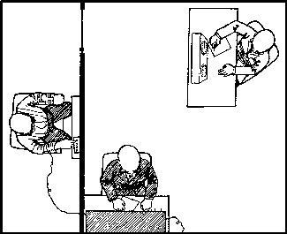


The Design of Milgram’s Obedience Study
One layout of the study
Ow!
Please continue. (Give the shock.)
The “Learner” (working with researchers)
But… …okay.
Shock levels in volts that participants thought they were giving
Slight (15-60) | Moderate (75-120) | Strong (135-180) | Very strong (195-240) | Intense (250-300) | Extreme intensity (315-360) | Danger: severe (375-420) | XXX (435-450)
Notes:
No animation.

Slide 31
Compliance in Milgram’s Study
In surveys, most people predict that in such a situation they would stop administering shocks when the “learner” expressed pain.
But in reality, even when the learner complained of a heart condition, most people complied with the experimenter’s directions:
  “Please continue.”
  “You must continue.”
  “The experiment requires that you continue”…
Notes:
Click to reveal bullets.

Slide 32
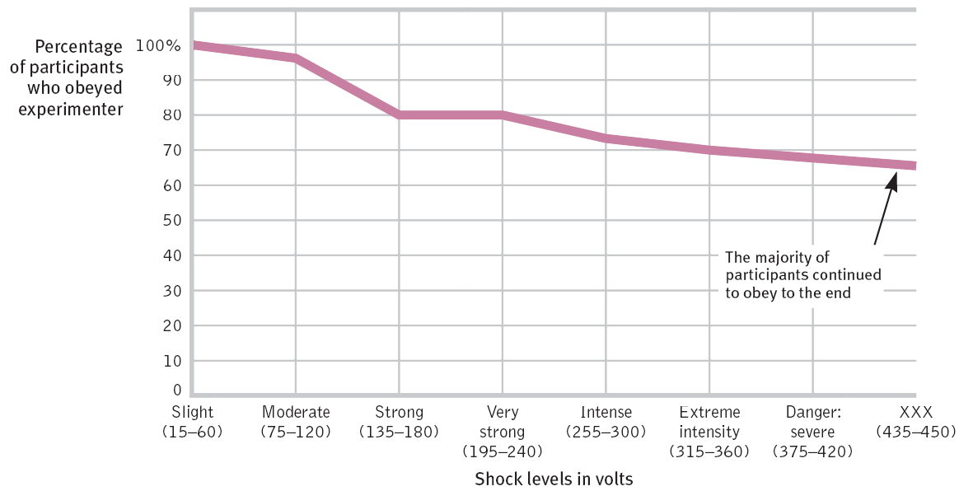
How far did compliance go?
Notes:
No animation.

Slide 33
What Factors Increase Obedience?
The bad news: In war, some people at the beginning choose not to fight and kill, but after that, obedience escalates, even in killing innocent people.
The good news: Obedience can also strengthen heroism; soldiers and others risk or even sacrifice themselves, moreso when under orders
When orders were given by:
  Someone with legitimate authority
  Someone associated with a prestigious institution
  Someone standing close by.
When the “learner”/victim is in another room.
When other participants obey and/or no one disobeys (no role model for defiance)
Other Evidence of the Power of Obedience
Notes:
Click to reveal bullets and sidebar.
There are more versions of this experiment, revealing more patterns:
Compliance is higher when the participant only has to read the questions and announce when wrong answers happen, but someone else administers the shock;
Compliance is much higher when the level of shock is predetermined and enforced by the authority figure (lower if the participant chooses if and when to raise the voltage).

Slide 34
Lessons from the Conformity and Obedience Studies
When under pressure to conform or obey, ordinary, principled people will say and do things they never would have believed they would do.
To look a person committing harmful acts and assume that the person is cruel/evil would be to make the fundamental attribution error.
The real evil may be in the situation.
Notes:
Automatic animation.

Slide 35
Social Influence:
Group Behavior
Besides conformity and obedience, there are other ways that our behavior changes in the presence of others, or within a group:
Social Facilitation
Groupthink
Deindividuation
Social Loafing
Group Polarization
Notes:
Click to show five bubbles: social facilitation, social loafing, polarization, deindividuation, and groupthink.

Slide 36
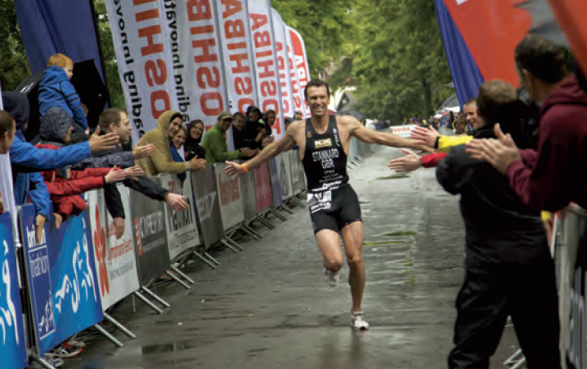
Social Facilitation
Individual performance is intensified when you are observed by others.
Experts excel, people doing simple activities show more speed and endurance in front of an audience… but novices, trying complex skills, do worse.
Notes:
Click to reveal bullets
Novices = people newly trying difficult, complex, skilled activities.
“Facilitation” refers to the improvement, the excellent performance facilitated by the physiological arousal caused by being watched.

Slide 37
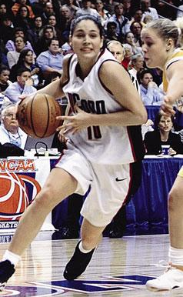
Social Facilitation
Why would the presence of an audience “facilitate” better performance for everyone but newcomers?
Being watched, and simply being in crowded conditions, increases one’s autonomic arousal, along with increasing motivation for those who are confident, and anxiety for those who are not confident.
Notes:
Click to reveal answer.
Why does the presence of an audience “facilitate” an improved performance for most people but a worse performance for novices/newcomers? “Facilitation” refers to the improvement, the excellent performance facilitated by the physiological arousal caused by being watched.

Slide 38
Social Loafing
Ever had a group project, with a group grade, and had someone in the group slack off?
If so, you have experienced Social Loafing: the tendency of people in a group to show less effort when not held individually accountable.
Why does social loafing happen?
When your contribution isn’t rewarded or punished, you might not care what people think.
People may not feel their contributions are needed, that the group will be fine.
People may feel free to “cheat” when they get an equal share of the rewards anyway.
Note: People in collectivist cultures don’t slack off as much in groups even when they could. Why?
Who will know if I’m not pulling as hard as I can? No one can tell how hard each of us is pulling on the rope.
Notes:
Click to reveal bullets, question and answer.
Click for pop-up box: Regarding the first bullet point: when you don’t care what people think, when your individual performance doesn’t seem to matter as much, then what process is not happening? Social facilitation.
Possible answer to the question about collectivist cultures: Perhaps they are raised to feel enough responsibility to the group that they don’t need individual accountability and individual reward (such as individual vs. a group grade on a project). Maybe you are taught that your contribution does matter to the group, to the society, even if there is no reward.

Slide 39
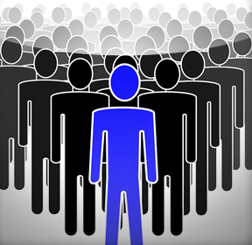
Loss of self-awareness and self-restraint.
  Examples: Riots, KKK rallies, concerts, identity-concealed online bullying.
Happens when people are in group situations involving: 1) Anonymity and 2) Arousal.
Deindividuation
Notes:
Automatic animation.

Slide 40
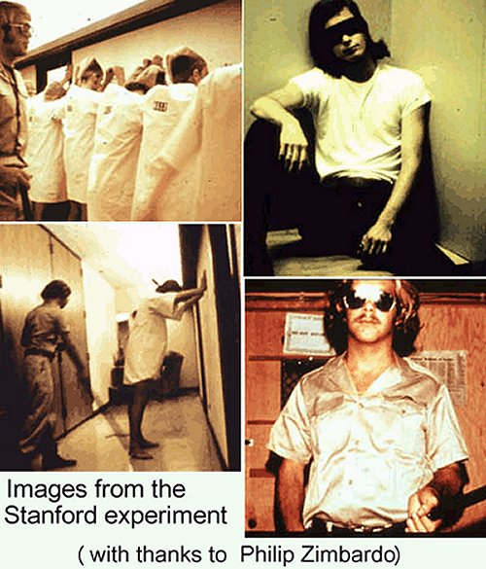
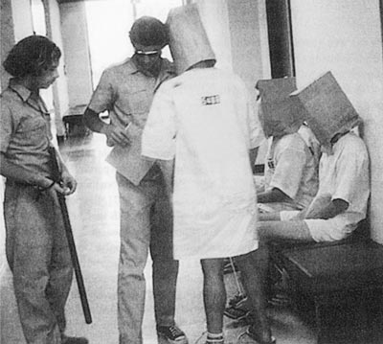
Social Roles & Deindividuation
The loss of self-awareness and self-restraint in group situations that foster arousal and anonymity. Zimbardo’s Stanford Prison Experiment is an excellent examples of these phenomena.

Slide 41
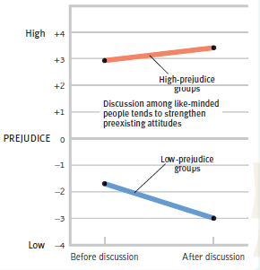
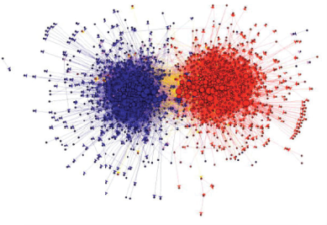
Group Polarization
When people of similar views form a group together, discussion within the group makes their views more extreme.
Thus, different groups become MORE different, more polarized, in their views.
People in these groups may have only encountered ideas reinforcing the views they already held.
Liberal Blogs (blue) and conservative blogs (red) link mostly to other like-minded blogs, generating this portrait of the polarized Blogosphere.
Notes:
Click to reveal bullets and two examples.
Instructor: Does discussion help increase open-mindedness to more views? Not necessarily. If people are grouping themselves with people having similar views, then Group Polarization happens: discussion makes their views stronger, more extreme; this makes two groups with different viewpoints become MORE different in their views.
See if this calls to mind the style of political discussion, and the polarizing result of that discussion, when people only encounter discussions and news coming from people who already agree with them.
Before you click on example of political blogs: Introducing this slide with a question: Does discussion help increase open-mindedness to more views? Not necessarily. If people are grouping themselves with people having similar views, then Group Polarization happens: discussion makes their views stronger, more extreme; this makes two groups with different viewpoints become MORE different in their views.

Slide 42

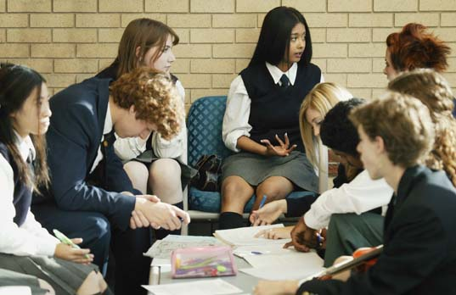
Groupthink
In pursuit of social harmony (and avoidance of open disagreement), groups will make decisions without an open exchange of ideas.
Irony: Group “think” prevents thinking, prevents a realistic assessment of options.
Notes:
Automatic animation.

Slide 43

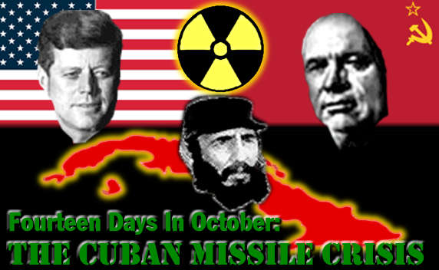
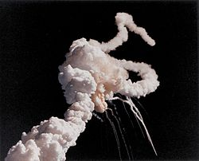
Groupthink
A mode of thinking that occurs when the desire for harmony in a decision-making group overrides the realistic appraisal of alternatives.
Attack on Pearl Harbor
Kennedy and the Cuban Missile Crisis
Space Shuttle Challenger Disaster

Slide 44
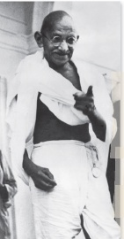
Social Influence
The Power of Individuals
Despite all of these forces of social influence, individuals still have power:
Some people resist obeying and conforming.
Individuals can start social movements and social forces, not just get caught up in them.
Groupthink can be prevented if individuals speak up when a group decision seems wrong.
Notes:
Click to reveal bullets.
Resisting obedience: Remember that although we’d like people to refuse to carry out genocidal orders, this can be a good or a bad thing; disobedience can seem to have bad results if you believe in the mission of any organization that relies on obedience, an army, or even a sports team.
Starting social movements: This is where Ghandi comes in, as mentioned in the text, although his political strategy relied on another concept, civil disobedience, that he picked up from reading Thoreau.
Classic example of individuals overriding Groupthink: the play and movie 12 Angry Men (performed sometimes as 12 Angry Jurors).

Slide 45
Social Relations
Social Psychologists also study the psychological components of how people relate to each other. Examples:
Prejudice: When we prejudge others
Attraction and Love Relationships
Aggression: When we hurt others
Altruism: When we help others
Social Conflict: When and how we make peace
Notes:
Click to reveal examples.
Instructor: As the text on screen reads “When we…[prejudge, help, hurt, etc.] ” You could verbally substitute or add: “Under what conditions and in what ways are we likely to…[prejudge, etc).”

Slide 46
Social Relations
Prejudice
Components of Prejudice
Prejudice: An unjustified (usually negative) attitude toward a group (and its members).
Discrimination: Unjustified behavior selectively applied to members of a group.
Stereotype: A generalized belief about a group, applied to every member of a group.
Beliefs (stereotypes)
Emotions (hostility, envy, fear)
Predisposition to act (to discriminate)
Notes:
Click to reveal bullets.
Instructor: you can ask students to flesh out the word “attitude” here: this is not just a feeling, it is also a predisposition to act in a certain way.

Slide 47
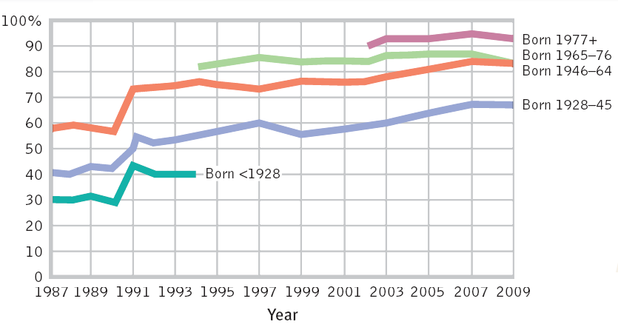
Levels of Prejudice can Change
Generation X
Generation Y
Baby Boomers
The Silent Generation
Support for interracial dating
The Greatest Generation
Notes:
No animation.
Notice that attitudes about interracial dating change not just over time (longitudinally) but even more by generation (cohort).

Slide 48
Social Relations
Prejudice Remains
Attitudes about gay marriage have not come as far as attitudes about interracial marriage.
Increased prejudice toward all Muslims and Arabs after 9/11 has still not subsided much.
Women are still judged and treated unfairly and paid less than men for performing the same jobs.
Automatic, subtle, and institutional prejudice still occurs even when people state that they have no prejudice in principle (but may have unconscious prejudiced reactions).
Notes:
Click to reveal bullets.

Slide 49
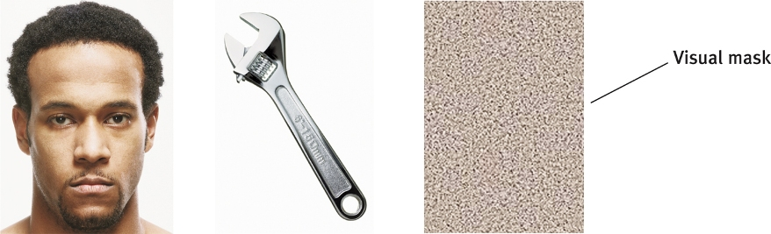
Automatic Prejudice
Study: People were more likely to misperceive a tool as a gun when preceded by an African-American face, when both were presented quickly followed by blank screen or “visual mask.”
Not a gun
Notes:
Click to show the face and wrench again.
Instructor: You may want to have students try, at home or on screen, an “Implicit Association Test” such as this one: https://implicit.harvard.edu/implicit/

Slide 50
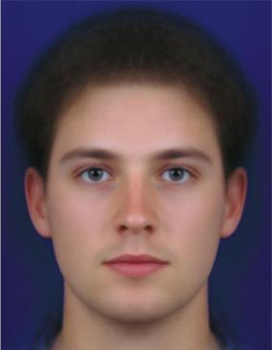
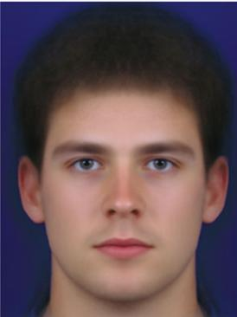
Prejudice based on Gender
People may prefer a feminine face
But this preference doesn’t counteract gender prejudice:
Preference for male babies, even abortion or infanticide of females
Blaming women for adultery
Seeing assertiveness or ambition as attractive in men, abrasive in women
Notes:
Click to reveal bullets after face pictures show up.
Although people, including most women, expressed a preference for a face with feminine features, this preferential feeling doesn’t translate into preferential treatment or respect for girls and women.

Slide 51
Social Relations
Social Roots of Prejudice
Social Inequality, when some groups have fewer resources and opportunities than others:
May result from prejudice, but can also make it worse…
May be used to justify people as deserving their current position:
  it breeds contempt for the people better off, disrespect for people less well off.
“Those doing well must have done something right, so: those suffering must have done something wrong.”
Notes:
Click to reveal bullets.
The “Just World Fallacy” concept is presented twice, here and under cognitive factors; this presentation will cover the concept just once, under cognitive factors.

Slide 52
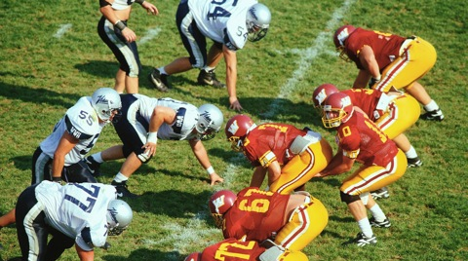
Us vs. Them: Ingroups vs. Outgroups
Even if people are randomly assigned to groups:
Part of our natural drive to belong to a group leads to ingroup bias (favoring one’s own group), misjudging other groups, and quickly categorizing strangers: “with me or against me.”
Notes:
Click to reveal text.
This bias can lead people to magnify all cognitive errors in relation to that group: selectively remembering, or even misremembering/confabulating, negative information about the other group (the Democrat vs. Republican example in the book).

Slide 53
Social Relations
Emotional Roots of Prejudice
Scapegoat Theory: The observation that, when bad things happen, prejudice offers an outlet for anger by finding someone to blame.
Experiments show a link: Prejudice increases during temporary frustration (and decreases when experiencing loving support)
Link to fear: Prejudice seems absent in people with inactive fear responses in the amygdala.
Notes:
Click to reveal bullets.
Natural disasters have been blamed on gays, liberals, atheists, etc., but this may be politically motivated as much as emotionally motivated.

Slide 54
Social Relations
Cognitive Roots of Prejudice
Forming Categories:
The Other-Race Effect
The Power of Vivid Cases:
Availability heuristic ignores statistics
“Just World” Belief:
People must deserve what they get
Fed by hindsight bias, cognitive dissonance
Notes:
Automatic animation.

Slide 55

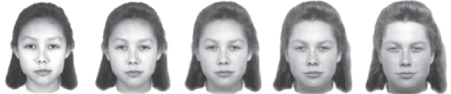
Social Relations: Cognitive Roots of Prejudice
The Other-Race Effect
We also are hypersensitive to difference, seeing mixed-race faces as belonging to the other group:
Which faces are
Caucasians said:
Reality:
Other-race effect: We tend to see uniformity in the appearance of other groups, and may assume other similarities such as traits;
These presumed similarities form stereotypes.
Notes:
Click through to show all stages of animated example.
This tendency to see other ethnic groups as all looking alike (and then presumably all having other traits in common) is due in part to lack of experience in seeing differences among faces of other ethnic groups.
This is the own-race bias, or other-race effect.

Slide 56
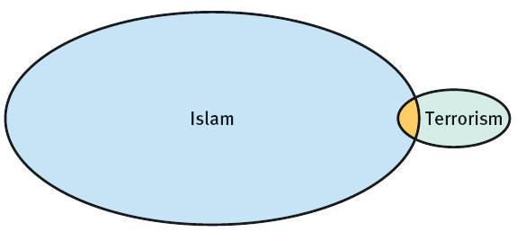
Judging Based on Vivid Cases
If we see dramatic examples of terrorism carried out by people who are Muslim, we may form a false association, when in fact:
9/11 hijackers
The stereotype “Muslim = terrorist” sticks in some people’s minds even though the vast majority of Muslims do not fit this stereotype.
Notes:
Automatic animation.
Since it’s getting close to the final exam, see if students can recall:
1) What is it called when vivid cases overrule statistics in our thinking?
--The Availability Heuristic.
2) What process makes us not likely to look for counterexamples to our stereotypes?
--Confirmation Bias.

Slide 57
Social Relations: Cognitive Roots of Prejudice
Belief that the World is Just
The Just-World Fallacy: Believing that Justice generally happens, that people get the benefits and punishments they deserve.
Implication: If people are rich, privileged, they must have earned it;
So, if people are poor, outcast, they must not deserve better.
  Believing that justice happens… leads to blaming the victim.
Notes:
Click to reveal bullets.

Slide 58
The Availability Heuristic: Stereotypes are built on vivid cases rather than statistics
Thinking Habits Reinforcing Prejudice
Cognitive dissonance: “My culture and family treats minorities this way, can we be wrong?”
Confirmation Bias: we are not likely to look for counterexamples to our stereotypes.
Hindsight Bias: “they should have known better,” blames victims for misfortunes.
Notes:
Click to reveal four bubbles.

Slide 59
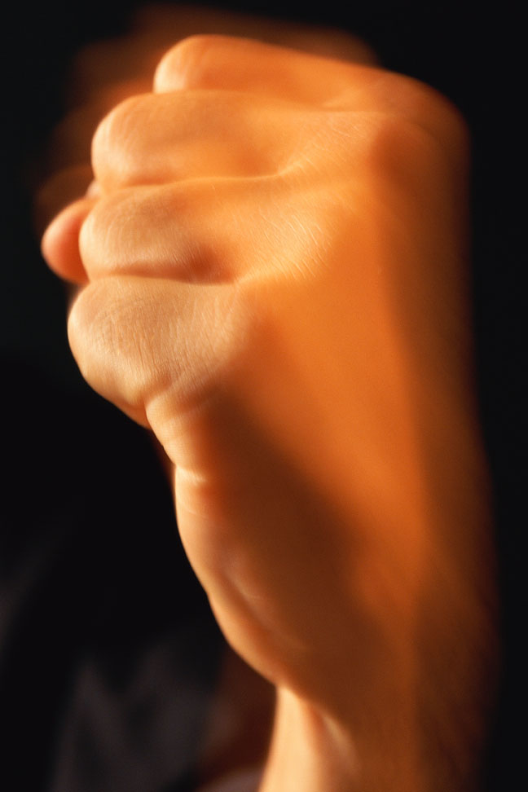
Social Relations
Aggression
Definition: Behavior with the intent of harming another person.
Aggression can have many forms and purposes:
Aggression can be physical, verbal, relational: e.g. punching, insulting, shooting, betraying.
Aggression can be planned or reactive.
Aggression can be driven by hostile rage or can be a coldly calculated means to an end.
Notes:
Click to reveal bullets.
The “other” that I have inserted into the definition: Social/Relational aggression, not fitting neatly into “physical” or simply “verbal” behavior: Examples include gossip, exclusion, scapegoating, deceiving, manipulating, betraying.

Slide 60
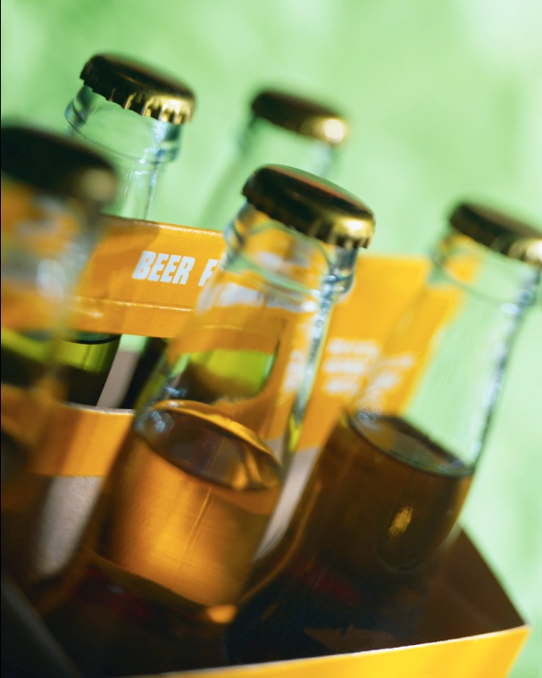
Social Relations
The Biology of Aggression
There is not one genetically universal style or amount of aggressiveness in human behavior
But there are biological factors which may explain variation in levels of aggression:
Genetic factors (including Heredity)
Neural factors, esp. Brain Activity
Biochemistry, esp. hormones and alcohol
Notes:
Click to reveal bullets.

Slide 61
Social Relations
Genetic Influences on Aggression
There is evidence that aggression is tied to genes, even if we’re not sure which ones:
Aggression can be selectively bred in animals and then passed on to the next generation
Identical twins are more similar in their levels of aggression than fraternal twins or siblings
Males are more prone to aggression, and differ by a chromosome (female XX vs. male XY)
Notes:
Click to reveal bullets.

Slide 62
Social Relations
Neural Influences
Brain Activity and Aggression
Evidence of brain links to aggression:
One monkey learned to subdue the aggression of another, by turning on an electrode implanted in an aggression-inhibiting brain area
A woman became rude and violent after painless stimulation of her amygdala
Underactive frontal lobes (which inhibit impulses) are linked to aggression, violence
Notes:
Click to reveal bullets.

Slide 63
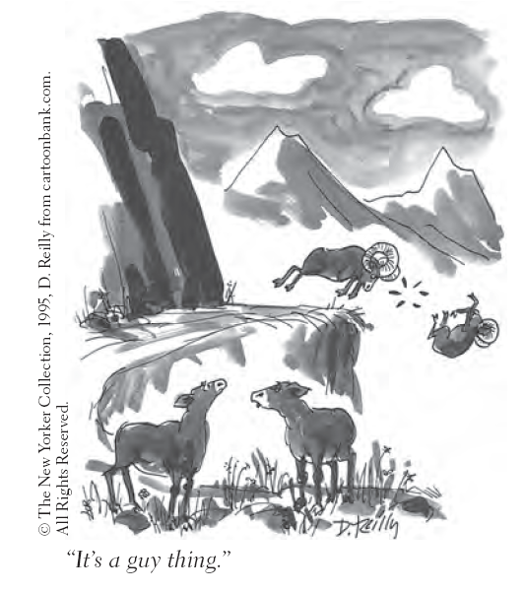
Social Relations
Biochemistry of Aggression
The Male hormone
Testosterone levels are correlated with irritability, assertiveness, impulsiveness, and low tolerance for frustration.
Traits linked to testosterone levels, such as facial width, also are linked to aggressiveness.
Violent criminal males have high testosterone levels along with low serotonin levels
Reducing testosterone reduces aggression, in both humans and animals
Notes:
Click to reveal bullets.
Low serotonin levels are linked to depression and irritability.
Many men report reduction in anger problems when taking antidepressants, which raise serotonin levels.

Slide 64
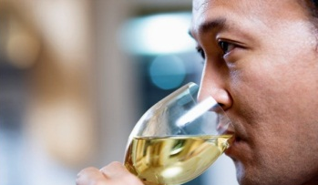
Social Relations
Biochemistry of Aggression
Alcohol
Alcohol may chemically or psychologically make the following more likely:
Disinhibited aggressive behavior
Aggressive responses to frustration
Violent crimes, especially spousal abuse
Lack of attention to peacemaking options
Interpreting neutral acts as provocations
Notes:
Click to reveal bullets.

Slide 65
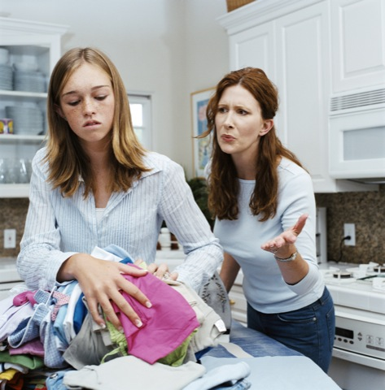
Social Relations
Psychosocial Factors and Aggression
Levels of aggression are influenced by:
Aversive conditions and feeling frustrated;
Getting reinforced for aggressive behavior;
Having aggression modeled at home or in the media
Adopting social scripts for aggression from culture and the media.
Notes:
Click to reveal bullets.
This slide can serve as a summary of the section or, if you want more detail, as a table of contents slide for the upcoming five slides.

Slide 66
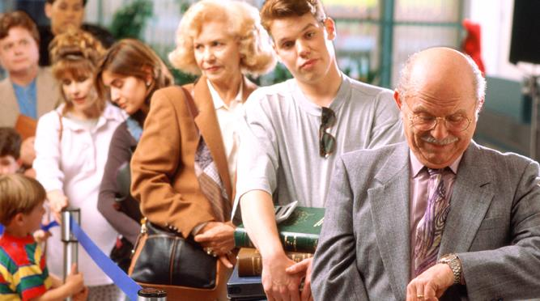
Aversive/Unpleasant Conditions
Aggression is often a response to frustration and other aversive conditions and events.
Violence increases during hot years, hot days.
Also aversive: pain, heat, crowding, foul odors.
Frustration-Aggression Principle:
After repeated frustrating events,
Anger can build, and find a target, and then:
Aggression can erupt, possibly against someone who was not the initial cause of the frustration.
Notes:
Click to reveal bullets and Frustration-Aggression Principle bubble.
Frustrations: Events in which one is surprisingly blocked from achieving a goal.

Slide 67
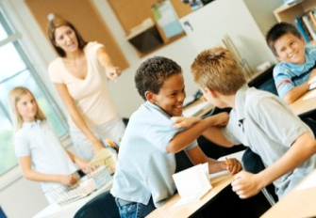
Reinforced/Rewarded Aggression
Sometimes aggression works! Bullies win control and obedience, Robbers gain wealth, tacklers who injure receivers get bonuses.
    Aggression, like any behavior, increases in frequency and intensity after it is reinforced.
Parents and Aggression-Replacement Training can guide youth by rewarding other, prosocial behaviors that still meet personal needs.
Notes:
Click to reveal bullets.
Aggression Replacement Training was developed by Arnold Goldstein of Syracuse University in the early 1980s.

Slide 68
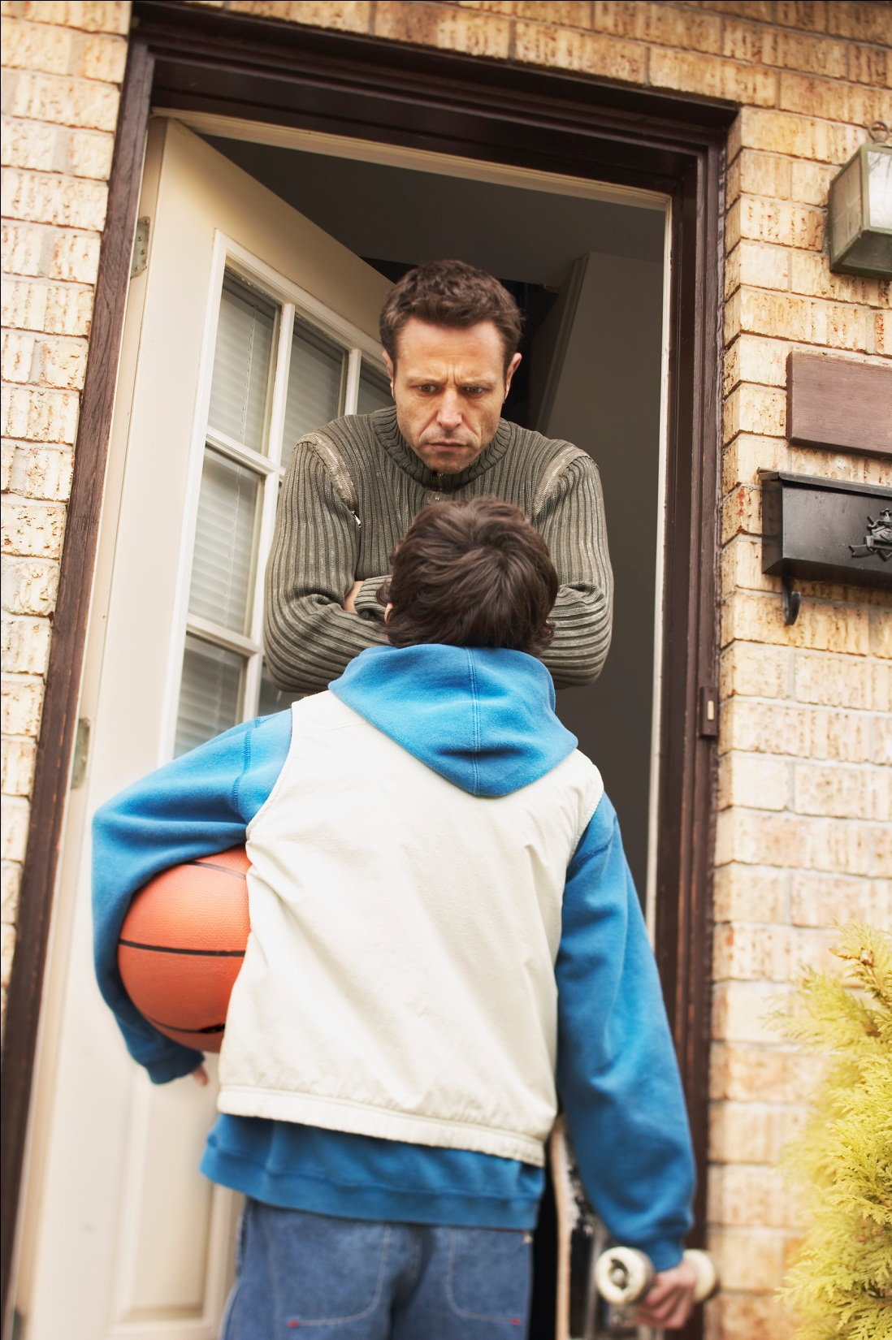
Family, Cultural Models for Aggression
Parents dislike aggressive behavior in their children, but unfortunately: They may have modeled that behavior, such as yelling, as their kids watched them handle frustration.
Some cultures model aggression and violence as a solution to personal and societal injustice.
Models for aggression are also conveyed through media, in the form of social scripts.
Notes:
Click to reveal bullets.
A comment on the first bullet and a preview of conflict reduction/peacemaking: Parents can stop modeling aggression, and start modeling prosocial/assertive coping, at any time. This means refusing to yell and spank even when you feel your child “deserves” it, because doing so will not work in the long run to get respectful behavior from the children. It means ending the aggression even when the other person continues.

Slide 69
Aggression in Media: Social Scripts
Aggression portrayed in video, music, books, and other media, follows and teaches a script.
When confronted with new situations, we may rely on social scripts to guide our responses. Many scripts proscribe aggression.
Social Scripts: Culturally constructed directions on how to act, downloaded from media as a “file” or “program” in the mind.
Effects of Social Scripts
Watchers of TV crime see the world as more threatening (needing a aggressive defense?)
Randomly assigned to watch explicit pornography, study participants suggested shorter sentences for rapists and accepted the myth that victims may have enjoyed the rape.
Studies: Exposure to one aggressive story increases other forms of aggressive behavior.
Notes:
Click to reveal bullets.

Slide 70
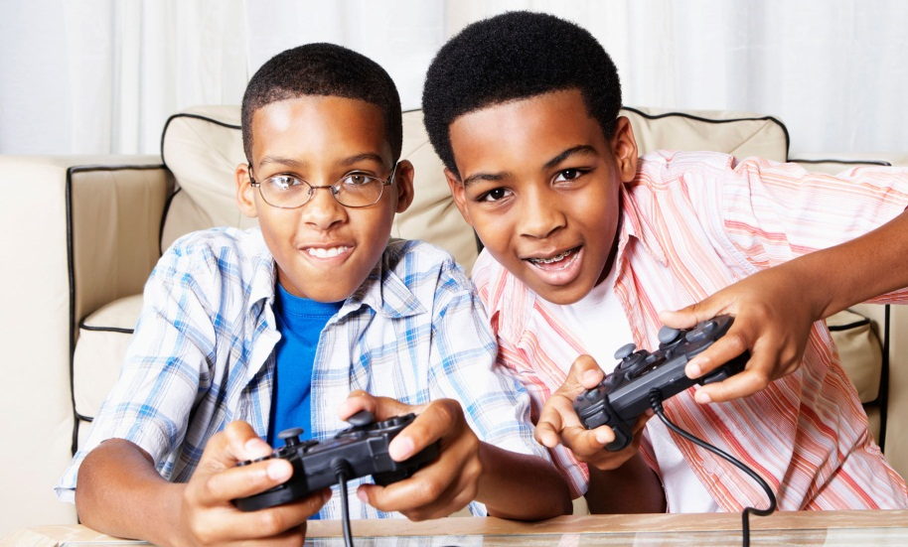
More Media Effects on Aggression
Video Games and Aggression
Exposure to violence in media, especially in pornography, seems to increase, rather than release, male aggressive impulses.
Media can portray minorities, women, the poor, and others with less power as being weak, stupid, submissive, and less human, and thus deserving their victimhood.
People randomly assigned to play ultraviolent video games showed increases in hostility
People playing a game helping characters, showed increased real-life helping
People have acted out violent acts from video games; People playing the most violent games tended to be the most aggressive; but what came first, aggressiveness or games?
Notes:
Click to reveal bullets.

Slide 71
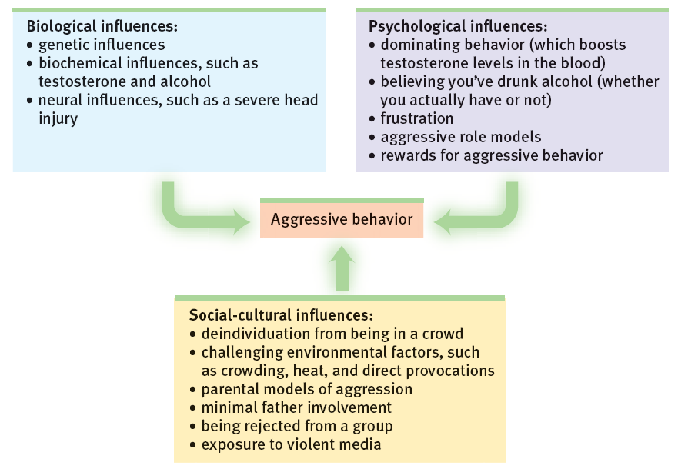
The Many Origins of Aggression
Notes:
No animation.

Slide 72
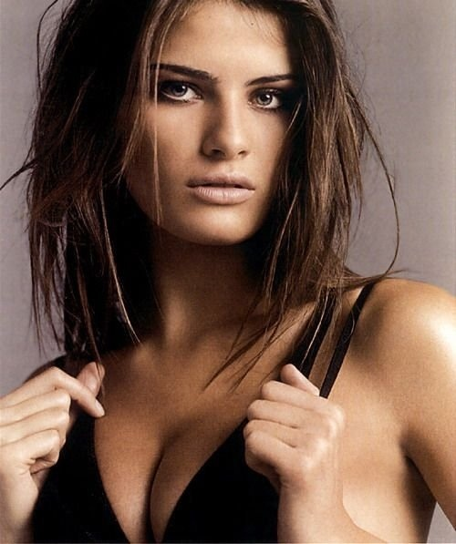

Slide 73
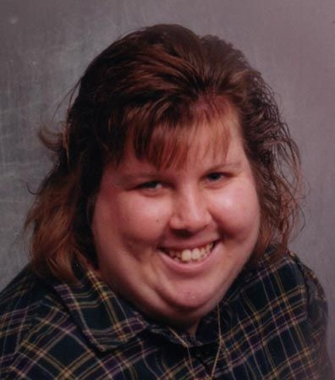

Slide 74
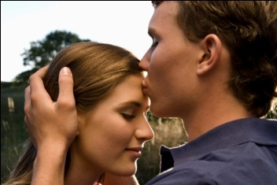
Social Relations
Understanding Attraction
What factors make two people feel attraction, wanting to be together?
Psychological factors bringing people together: Proximity, Exposure/Familiarity, Attractiveness
What can develop next: Romantic Love, with: Passion, Compassion, Self-Disclosure, Positive Interactions, and Support
Notes:
Click to reveal bullets.
This slide can serve as a summary of the section or, if you want more detail, as a table of contents slide for the upcoming six slides.

Slide 75
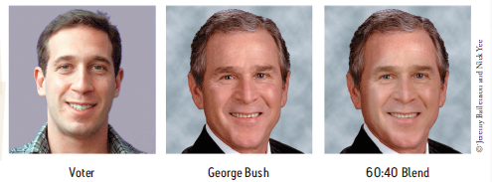
Proximity/Exposure and Attraction
Encounters once depended on proximity, working or living near the other person, but the key factor here is exposure.
The Mere Exposure Effect: Merely seeing someone’s face and name makes them more likeable. Your are more likely to develop attraction to someone you’ve seen a lot.
        This effect probably helped our ancestors survive: What was familiar was more trustworthy, safe.
        In the modern age, thanks to mirrors and photos, the face we are most familiar with is our own; so we are now attracted to people that look like us.
Implications
Study: Voters preferred a candidate whose picture incorporated the voter’s features.
Notes:
Click to reveal bullets.
About the relationship between proximity and exposure: The growth of online methods of starting and maintaining relationships depends on the idea that physical proximity is not necessary, at least at first, but repeated exposure to the person’s face and thoughts is still crucial.
The Mere Exposure Effect might explain the value of lawn signs in political campaigns.
It also predicts that although a new student may be approached by friendly greeters on the first day or two, people are going to be more interested in initiating friendships (and more) after a month.

Slide 76
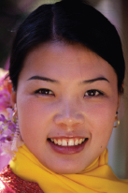


Physical Attractiveness
Who is rated as physically attractive?
People who are rated as physically attractive:
Become the objects of emotional attraction.
Are seen as healthy, happy, successfully, and socially skilled, though not necessarily caring.
Are not any happier than the average person,
Do not have higher self-esteem, in fact mistrust praise as being about their looks.
Standards differ from culture to culture about what facial and body features are desirable.
Across cultures (suggesting evolutionary influence):
  Men seek apparent youth and fertility
  Women seek maturity, masculinity, affluence
  Both like facial symmetry and averageness
Also attractive: Nice people, and loved ones.
Notes:
Click to reveal bullets. The picture in the upper right corner will change automatically once the magenta box is showing on screen.
“Averageness” refers to the preference for average-sized features, and refers to the preference for a computer-generated face that is the average of many faces.

Slide 77

Similarity and Attraction
Opposites Attract? Not usually.
We already have seen: We like those who share our features.
We also enjoy being around people who have similar attitudes, beliefs, humor, interests, intelligence, age, education, and income.
We like those who have similar feelings, especially if they like us back.
Notes:
Click to reveal bullets.

Slide 78
Romantic Love
Held together by positive interaction, support
Grows into Compassionate Love
Then often has a phase of Passionate Love
Made closer by Equity and Self-Disclosure
Often starts with attraction, or friendship
Notes:
Click to reveal all boxes.

Slide 79


Compassionate Love
Deep, caring, affectionate attachment/commitment
Passionate Love
A state of strong attraction, interest, excitement, felt so strongly that people are absorbed in each other
Components of Passionate Love
Physiological Arousal (sweating, heart pounding)
Flattering appraisal of the other
Intense desire for the others’ presence
Commitment: a plan to stay together even when not feeling passionate attraction
Attachment is now more than just desire to be together: a feeling that lives are intertwined.
Notes:
Click to reveal more text about passionate love, then more about compassionate love.
The definition of passionate love in the text sounds a lot like infatuation. To differentiate the concepts, maybe the absorption is not just about attraction, but also about interest and desire for shared experience, but more importantly, the feelings are not just one person’s experience, it’s two people having a shared experience.

Slide 80

Keys to a Lasting Love Relationship
Equity: Both giving and receiving, sharing responsibilities, with a sense of partnership
Self-Disclosure: Sharing self in conversation increases intimacy
Positive Interactions and Support: Offering sympathy, concern, laughs, hugs
Notes:
Click to reveal bullets.
I would hope that the partnership in a relationship actually gets beyond the text’s definition of equity, “receiving in proportion to what is given,” and gets to the point of just wanting to give, not worrying about whether one is receiving an equal proportion.

Slide 81

Altruism
Unselfish regard for the welfare of other people;
Helping and protecting others without need for personal gain, doing it because it is the right thing to do, often despite personal risk or sacrifice.
The Psychology of Altruism
Under what conditions do people help others?
How do bystanders make a decision about helping?
What cultural norms reinforce the motive to help others?
Notes:
Click to reveal another text box.
When mentioning bystanders, you could verbally insert a definition, “people in the vicinity or observing when there is someone in need.”

Slide 82


Social Relations: Altruism/Helping
Bystander Intervention
When there is someone apparently suffering or otherwise in need of help, how do people make a decision to help?
Attention:
Appraisal:
Social Role:
Taking Action:
Notes:
No animation.
With each of these steps, see if students can speculate how the presence of others might affect whether a problem is noticed, how the problem is appraised, and whether the individual decides to be a helper.

Slide 83

Social Relations: Altruism/Helping
Bystander Action: Social factors
Why are there sometimes crowds of people near a suffering person and no one is helping?
Because of the [Multiple] Bystander Effect: Fewer people help when others are available.
Why does the presence of others reduce the likelihood that any one person will help?
Because of diffusion of responsibility: The role of helper does not fall just on one person.
People in a crowd follow the example of others; which means everyone waiting for someone else to help first.
After a while, people rationalize inaction: “if no one is helping, they must know he’s dangerous or faking it.”
Notes:
Click to reveal bullets.
The chart is related to an experiment in which people heard a call for help from someone apparently having a seizure, but sometimes got the impression that 1-4 other people heard the call for help too.

Slide 84
Social Relations: Altruism/Helping
Other Factors promoting helping
Bystanders are most likely to help when:
The person we might help:
  appears to be in need, deserving of assistance.
  is a woman, and/or is similar to us in some way.
  is in a small town or rural area.
Meanwhile, upon encountering this person:
  We are feeling some guilt, and/or just saw someone else trying to help.
  We are not in a hurry, and/or not preoccupied.
  Strongest predictor: We are in a good mood.
Notes:
Click to reveal bullets.
About the last bullet point: Being happy makes us more likely to help, and helping makes us happy. Students may recall that this is called the “feel-good, do-good phenomenon.

