Slide 1
2: Racial and Ethnic Relations
Patterns of Assimilation
Notes:
Instructors Note:
An excellent video for supplementary use is In the White Man’s Image. See the website below for more information.
http://www.iath.virginia.edu/seminar/unit7/assim.html

Slide 2
Assimilation
Assimilation is a process in which formerly distinct and separate groups come to share a common culture and merge together socially.
As a society undergoes assimilation, differences among groups begin to decrease.
© Pine Forge Press, an imprint of Sage Publications, 2003
Notes:
Instructors Note:
Arguably the best example of assimilated groups for discussion are European ethnic groups.

Slide 3
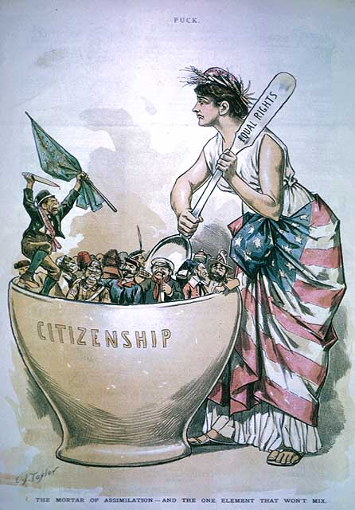
Assimilation
Melting pot—a process in which different groups come together and contribute in roughly equal amounts to create a common culture and a new, unique society.

Slide 4
Assimilation in the U.S.
Anglo conformity is the most common pattern of assimilation
WASP – White Anglo-Saxon Protestants
Which ethic groups have assimilated most successfully with WASPS?

Slide 5
Cultural Pluralism
Pluralism, on the other hand, exists when groups maintain their individual identities.
In a pluralistic society, groups remain separate, and their cultural and social differences persist over time.
Notes:
Instructors Note:
The Amish are a great example of a pluralistic group.

Slide 6
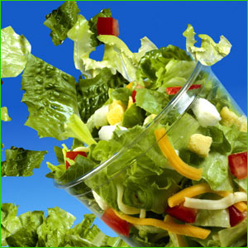
Pluralism – A Salad rather than Melting Pot
Interest in pluralism has increased due to
Increasing U.S. diversity
Global conflicts rooted in ethnic differences
What are examples of groups that have maintained their ethnic identities in the United States?
Notes:
Instructors Note:
Pluralism exists when groups maintain their individual identities.
In a pluralistic society, groups remain separate, and their cultural and social differences persist over time.
The Amish are a great example of a pluralistic group.
Multiculturalism, a general term for a variety of programs and ideas that stress mutual respect for all groups and for the multiple heritages that shaped the United States.

Slide 7
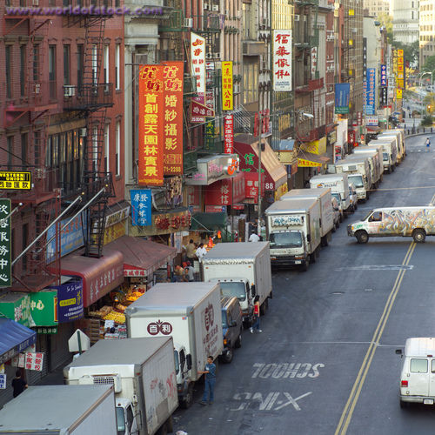
Pluralism
US example: China Town, Little Italy, etc…
China Town, NYC
© Pine Forge Press, an imprint of Sage Publications, 2003
Notes:
Instructors Note:
Many Native Americans are culturally pluralistic, maintaining their traditional languages and cultures and living on isolated reservations.
An example of structural pluralism can be found on any Sunday morning in the Christian churches of the United States. Not only are local parishes separated by denomination, they are also often identified with specific ethnic groups or races.
An enclave minority establishes its own neighborhood and relies on a set of interconnected businesses, each of which is usually small in scope, for its economic survival—Miami’s ‘Little Havana’.
Middleman minority also relies on small shops and retail firms, but the businesses are more dispersed throughout a large area rather than concentrated in a specific locale—Korean American groceries.

Slide 8
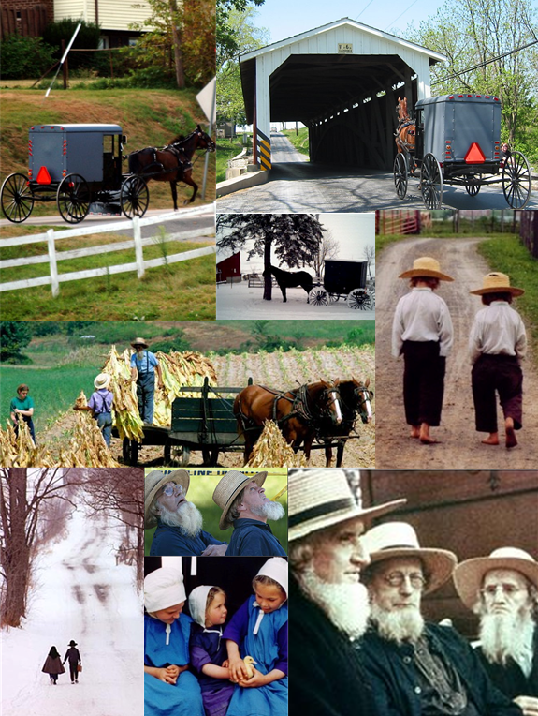
Accommodation
Extreme form of cultural pluralism
Ex. Amish

Slide 9
Assimilation vs. Pluralism
Horace Kallen (1915) rejected the notion of Anglo conformity/assimilation. She said it was inconsistent with democracy and other core American values.
Why do you think she would say that?
Do you agree?
© Pine Forge Press, an imprint of Sage Publications, 2003

Slide 10
Assimilation and Pluralism
In some ways, assimilation and pluralism are contrary processes, but they are not mutually exclusive.
They may occur together in a variety of combinations within a particular society or group.
Some segments of a society may be assimilating, while others are maintaining (or even increasing) their differences.
© Pine Forge Press, an imprint of Sage Publications, 2003
Notes:
Instructors Note:
Latinos have varying levels of assimilation between and within particular ethnic groups.

Slide 11
2: Racial and Ethnic Relations
Patterns of Conflict
Notes:
Instructors Note:
An excellent video for supplementary use is In the White Man’s Image. See the website below for more information.
http://www.iath.virginia.edu/seminar/unit7/assim.html

Slide 12
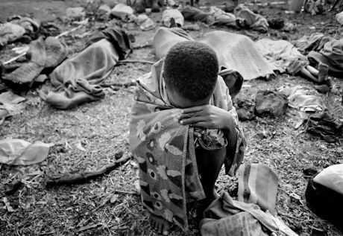
Genocide
Systematic attempt to destroy an entire ethnic group.
Examples?

Slide 13
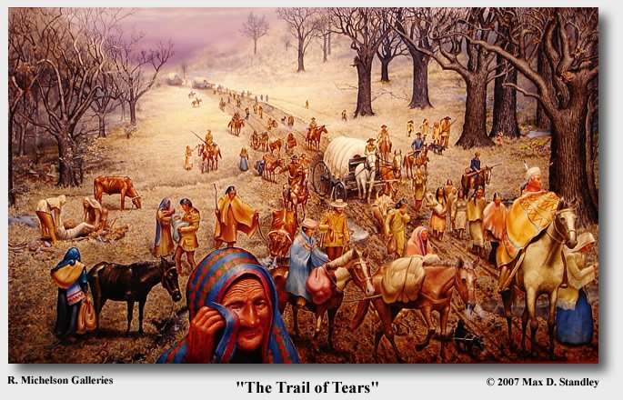
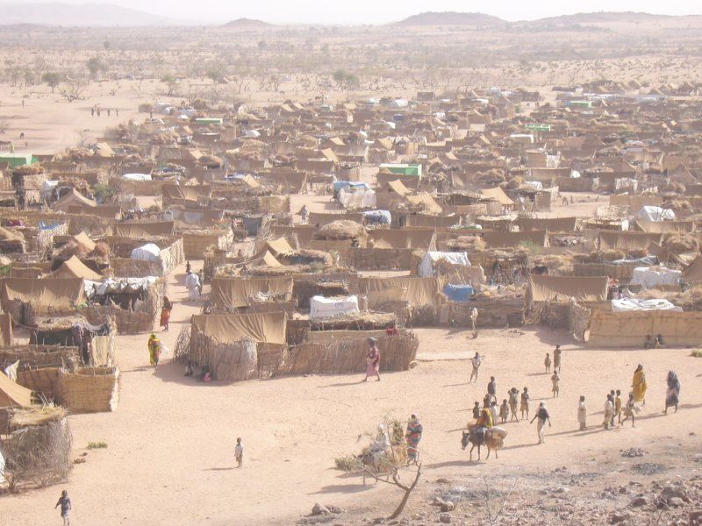
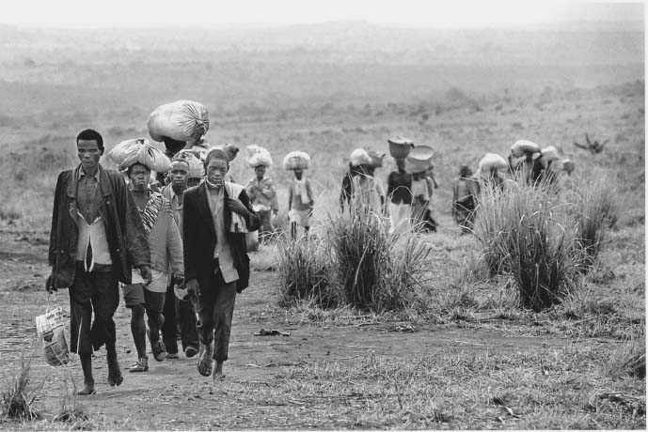
Population Transfer / Exile
A minority is forced to move to a remote location or to leave entirely
Refugee is a person being exiled
A refugee camp is a temporary living area in a remote location

Slide 14
Subjugation
Minority is denied equal access to cultural and lifestyle of dominant class
This occurs most often and in two ways:
1) de jure segregation: legal segregation
2) de facto segregation: not legal, but practiced anyway

Slide 15
Rank the following by degree of control or hostility at minority
Subjugation
Assimilation
De jure segregation
De facto segregation
Genocide
Accommodation
Population transfer

