Slide 1
CH. 15 – Sociology of Sport
1 – the nature of sport

Slide 2
Intro
In pairs or groups, discuss some problems society has faced with race, gender, and age in sports.
Site specific examples

Slide 3
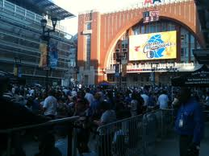
The Nature of Sport
In your notebook answer the question, “what do sports mean to me?”
Remember: some students who don’t participate in mainstream sports still can be considered athletic
Why did 200,000 people go to the Maverick victory parade?
Individuals identify with the team and city
The Mavs are a reflection of Dallas, and sport is a reflection of society

Slide 4
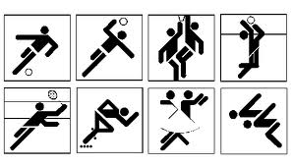
Definition of Sport
Sport –
competitive activity in which the winner and loser are determined is determined by physical performance within a set of established rules.
What’s the difference between a sport and game?
Notes:
Do you agree that in order for an activity to be a sport it has to have a clearly defined set of rules? Why or why not?

Slide 5
Activity
Create a new sport in pairs or groups according to the definition given by sociologists.

Slide 6
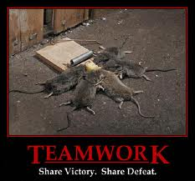
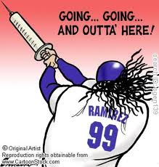
Sport as Social Institution
Sport teaches basic values, attachment to the society, and connects the self to the society.
What are some basic values American sports try to teach?
What are taboos in American sports?
Notes:
The Greek statues are for cheaters

Slide 7
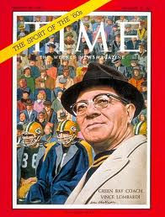
Sport, Culture, and Society
“People who visit the United States from other countries are often amazed at the extent to which competition [in sport] is used to distribute rewards and evaluate the work of human beings” (Coakley, 1998:82)
How important is winning in the US? Any ideas why it is so important to win?
Vince Lombardi
Notes:
Activity – make a grid a sport played by students outside of school. Was it a positive experience or a negative one? What made them feel that way? What did they learn about other than sport’s skills? Would you recommend this experience to others, why or why not?
Across the left side list the sports.
Across the top list the different experiences.
Keep track of gender.

Slide 8
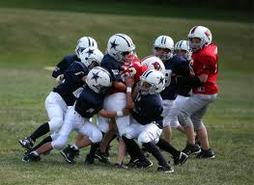
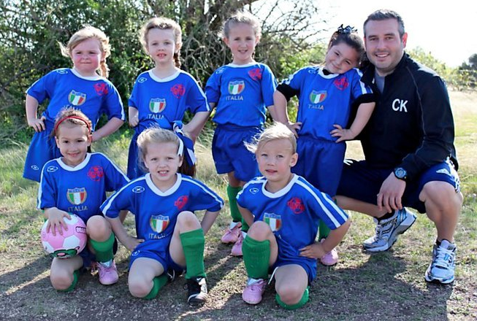
Sport, Culture, and Society
Do you believe we put too much emphasis on winning?
Does the maxim “It’s not whether you win or lose, but how you play the game” really a social norm, or is this a case of ideal vs. real culture?
In this school, how is the cultural value of achievement reflected in the behavior of athletes, peers, teachers, and parents? Give examples.
My brother and niece

Slide 9
Sport as Secondary Institution
Name the last 5 Super Bowl champions.
Name the 5 most important people in your life.
What’s the lesson?

Slide 10
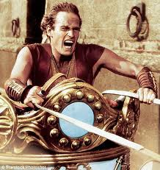
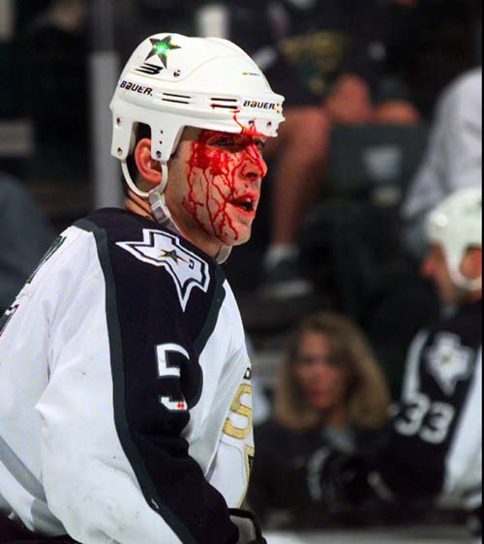
Sport, Culture, and Society
Violence in sports – read page 499 and answer questions at the bottom
Should someone who commits sports violence be subject to the same consequences as someone on the street?
Should the governing body alone decide the punishment? If not, who should decide?
Roman chariot races as seen in Ben Hur
Is hockey becoming a blood-sport?
Notes:
Watch the Ben Hur chariot race and Mad Max Thunderdome game. Are we more or less violent than these examples? Give examples
Read the left column on page 500
Is hockey becoming a bloodsport? Click on picture for article

Slide 11
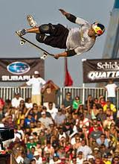
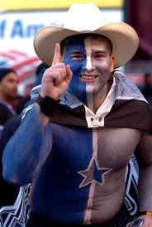
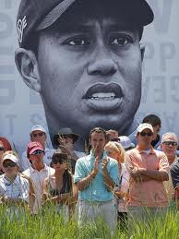
Sport Subcultures
Sport Subcultures – a group with distinct norms values, norms, and beliefs organized around a sporting activity.
Examples?
“there are several differences between a football game and a revolution. For one thing, a football game usually last longer and the participants wear uniforms. Also, there are more injuries at a football game.” - Alfred Hitchcock
Notes:
Group activity on page 500

Slide 12
Group Activity
Steps you need to take to solve the problem:
Identify the problem
Gather information; research
Make a list of options for pros and cons
Choose a solution
Implement the solution
Validate the solution by giving specific reasons for the decision
The scenario:
Jared confides in you that he desperately want to win a power lifting competition for his weight class. Lately, you have noticed him bulking up nicely; he’s lifting more than ever before.
However, he seems really tense, which maybe due to his failing grade in pre-cal. You warned him not to enroll, but he didn’t listen.
You also notice that his face is acne-ridden now, and his skin has a yellow pallor. You suspect he is taking steroids, and as his best friend you are concerned.
Notes:
Have students decide what to do and determine the best, most justifiable option. Write letters to Jared explaining their decision. How does Jared’s situation relate to what we have talked about in section one?

