Slide 1
Chapter 14 - Religion
1 Religion and Society

Slide 2
Intro Activity
Answer the following questions:
How do you define religion?
What does religion mean to you?
Do you believe in the supernatural?
If you do believe in the supernatural, how do you imagine it to be?
Notes:
Discuss, but cut it off when the discussion gets heated

Slide 3
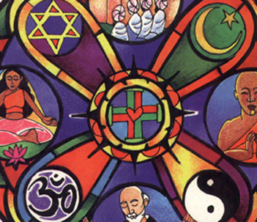
Sociology and Religion
Each individual is free to define religion as they choose (what amendment?), but there are general characteristics that hold true for all religions – and this is what we will study.
Religion deals with values, sociology deals with evidence

Slide 4
Sociology and Religion
Examples of how sociologists study religion.
If someone belongs to a cult, is he or she more likely to be unstable?
Why do people go to church, and what are the factors in them leaving or changing churches?
Are questions like these objective or subjective?

Slide 5
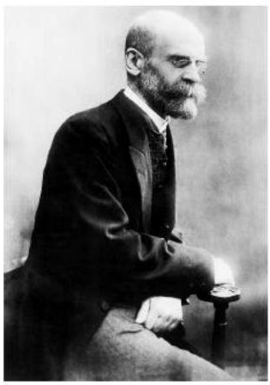
The Sociological View of Religion
Emile Durkheim
Religion is socially constructed.
Humans create religions and assign religious meaning to objects.

Slide 6
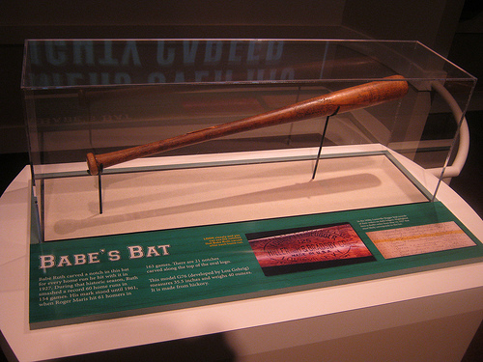
The Sociological View of Religion
Religion –
a system of beliefs and practices that are concerned with sacred things.
Sacred –
holy; set apart or given a special meaning that goes beyond, or transcends, immediate existence
Profane –
everything else
By definition, is Babe Ruth’s baseball bat in the hall of fame sacred or profane? Why or why not?

Slide 7
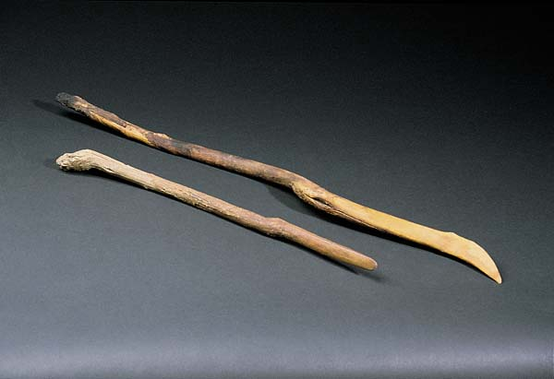
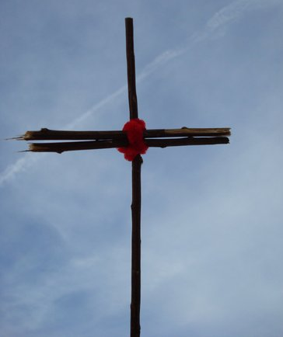
The Sociological View of Religion
Do these two sticks have a special significance to you?
How about if they were made to look like this?
Did you initially think it is used as a sword, or something to hang tomatoes from?
How did two sticks go from being profane to sacred?
Through religious belief, we attach sacred meanings to otherwise profane objects.
Incidentally, the two sticks at the top are digging sticks used by the Navaho, and quite possibly sacred to them.

Slide 8
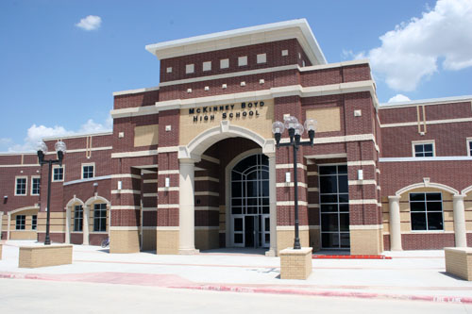
Activity
Get with a partner and make a list of some sacred objects in this school or in America in general.
Do you agree that these are sacred symbols? Why or why not?

Slide 9
The Sociologist Study of Religion
These are the difficult questions to answer:
How do we study things that can’t be seen?
How can wee remain objective given our own beliefs and values?
Is science the proper tool to evaluate religion?

Slide 10
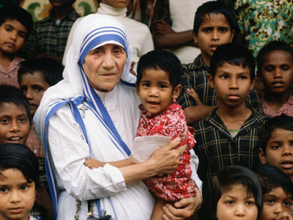
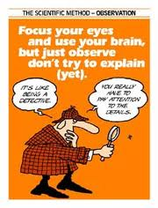
The Sociologist Study of Religion
Sociologists can’t study the spiritual side, but they can study the social side.
i.e. The amount of charitable work performed by different religious groups.
Sociologists must keep their own faith and beliefs personal to effectively study the social dimensions of religion.
To have credibility, they cannot look to validate their own beliefs – they have to report what they observe.

