Slide 1
Chapter 10: INEQUALITIES OF GENDER AND AGE
Introduction

Slide 2
Solve the following riddle quietly by yourself:
A young man was in a serious car accident and taken to the hospital for an emergency brain operation. The brain surgeon looked at the boy and said, “I can’t operate on him. He’s my son.” But the surgeon was not the boy’s father. Explain how this could be.

Slide 3
Answer
The surgeon is the boy’s mother.
Why is it assumed (by some) that the surgeon is a man?

Slide 4
Discussion - True or false?
Women in the United States lead the world in efforts to achieve job equality with men.
A: False. Among industrialized nations, the USA is third from the bottom in male/female income equality.

Slide 5
1 - Sex and gender identity
Chapter 10: INEQUALITIES OF GENDER AND AGE

Slide 6
Defining male and female
Read and discuss this sentence: You inherit your sex but you learn your gender.
How much of your sexual identity is socialized?
Answer: A lot!

Slide 7
Defining male and female
What are little girls made of?
Sugar and spice
And everything nice.
That’s what little girls are made of.
What are little boys made of?
Snips and snails
And puppy dog tails.
That’s what little boys are made of.

Slide 8
Defining male and female
Read and compare the two fairy tales.
What differences can you see?
How does this relate to gender identity?

Slide 9
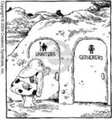
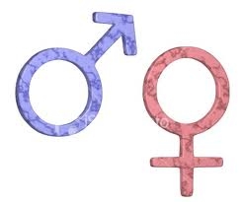
Defining male and female
SEX – based on biological differences
Are men naturally more aggressive?
Are women naturally more emotional?
BIOLOGICAL DETERMINISM – behavior is determined by the inherited physical traits. This theory has never been proven.
GENDER IDENTITY – behavior is based on learned cultural values.

Slide 10
Defining male and female
Get in small groups and discuss whether the following are true or false.
Women talk more that men.
Women are more likely to touch each other than men.
Women use more space than men.

Slide 11
Defining male and female
Answers:
False: Men talk more than women (average in study 10 minutes)
False: Personality determines touchiness more than gender.
False: Men tend to take up more space than women

Slide 12
Defining male and female
http://www.youtube.com/watch?v=VwT1kp0C3Ss
It’s time for androgyny, here comes Pat!

Slide 13
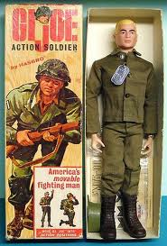
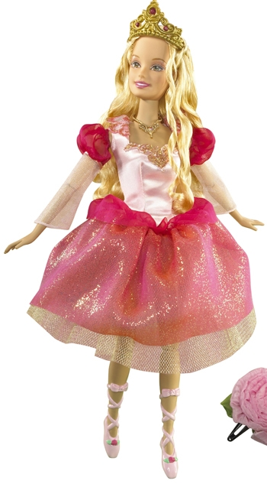
Defining male and female
CONCLUSIONS:
Sex = biological
Gender = passed from culture
Barbie and G.I. Joe toys are examples of gender roles of a culture being passed on. Can you think of other examples?

Slide 14
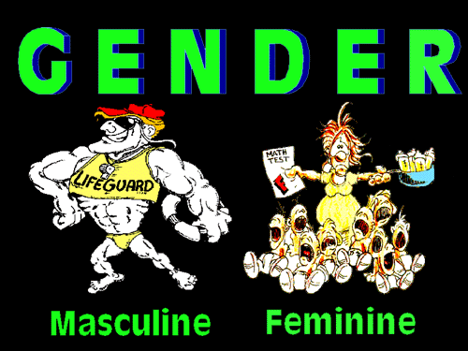
Biology, culture, and behavior
Males and females have some slight differences in their brain structure, but not much
Males have more activity in aggressive regions
Females can use both hemispheres at the same time when performing a task
Females also have more activity in the newer, more highly developed areas that are linked to emotion
NEVERTHELESS, NO EVIDENCE CAN LINK BEHAVIOR TO THESE BIOLOGICAL DIFFERENCES

Slide 15
Biology, culture, and behavior
Sociologists look cultural expectations and how they play into behavior.
Among the Arapesh, both men and women were conditioned to be cooperative, unaggressive, and empathetic.
Among the Mundugumor, the men and women are both conditioned to be aggressive, ruthless, and unresponsive to the needs of others.
Among the Tchambuli, the roles were the opposite as they are here: women were dominant, impersonal, and aggressive. Men were dependant and submissive.

Slide 16
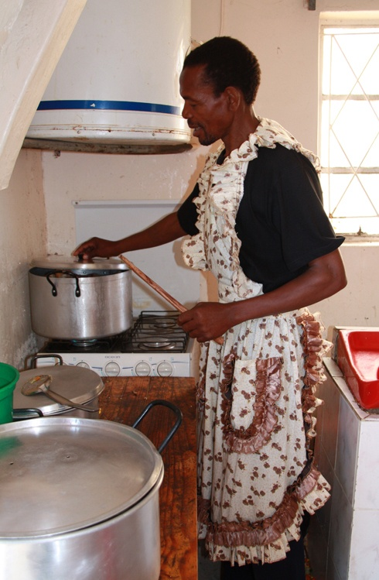
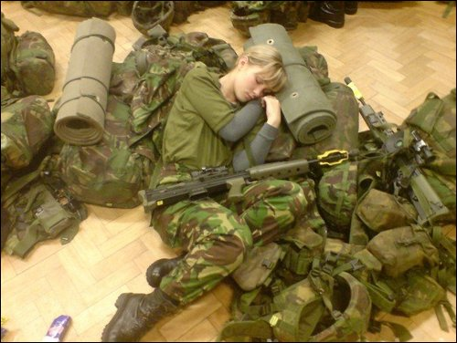
Biology, culture, and behavior
What can be concluded about the way men and women behave?
Read the passage on page 342-343 and answer the questions that follow.

