Slide 1
Minority, Race, and Ethnicity

Slide 2
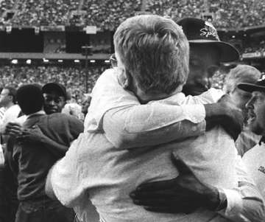
“Color makes a difference. Gender makes a difference. Ethnicity makes a difference. Acting as if they don’t will create more problems than it will solve.”
James Jones (1990)

Slide 3
Minority Groups
Minority --
a group in a lower position in society
may be larger in numbers than the dominant group (e.g., South Africa)
may be a minority in one society & dominant in another
Characteristics:
Distinct physical or cultural characteristic
Minority traits viewed as inferior
Common sense of identity/loyalty
Majority ascribes status
Dominated by majority

Slide 4
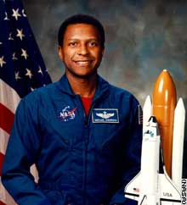
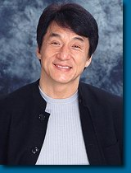
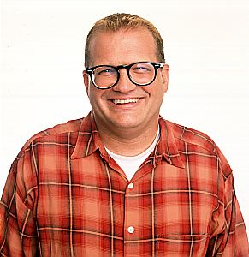
Race --
category of people who share certain combinations of inherited physical traits
Sociologists see race as more of a social category than a biological one
Racial Groups
outward characteristics that divide humans
How do we separate races? How do we know people are different?
A: e.g. race, head form, hair texture, etc.
Is there a such thing as a pure race? A: –no.
How do we assume someone is something that they are not?
Three main groups:
a. Negroid (Black)
b. Mongoloid (Brownish-yellow)
c. Caucasoid (White)

Slide 5
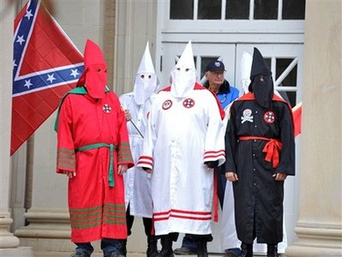
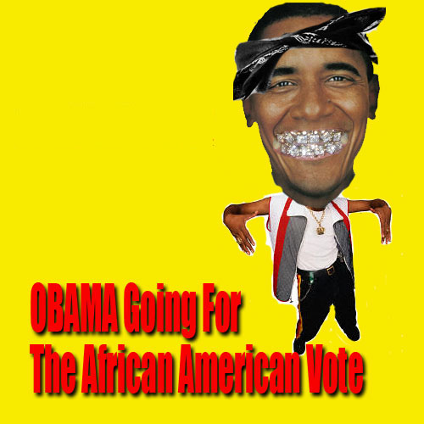
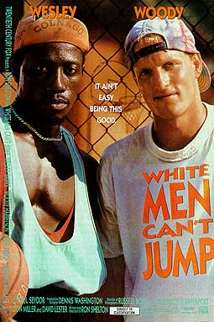
Inter-group Hostility
every nation has a mixture of peoples & culture
homogenous societies (where everyone is the same) are very rare
heterogeneous societies (a mixture of peoples, cultures, etc.) are the norm
Why are ethnic minorities seen as inferior?
Ethnocentrism
becomes “we” vs. “they”
a superior attitude develops

Slide 6
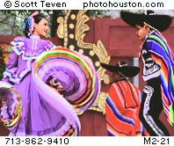
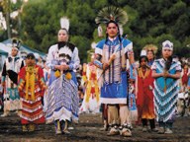
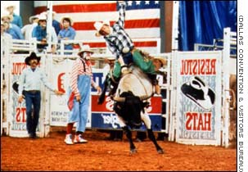
Ethnicity & Ethnocentrism
ethnicity --
the degree to which ethnic identity is held to be important by persons, groups, or societies
it reflects the extent of belongingness to a particular group
ethnic pride is in minority & dominant groups
Examples? Personal Examples?

